Slide 1
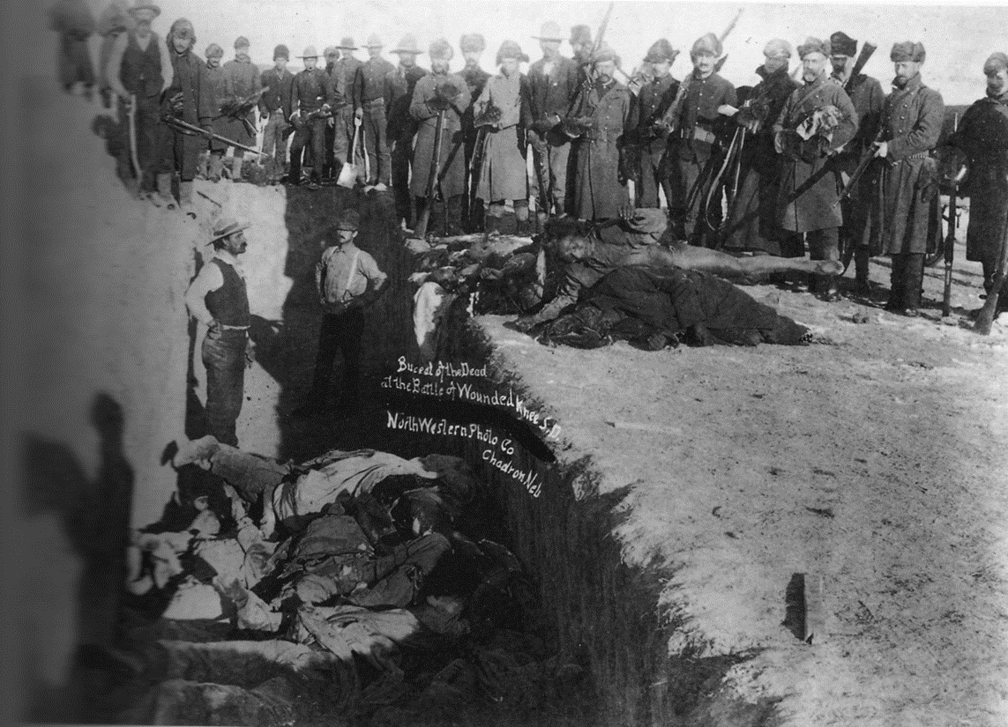
Introduction: Wounded Knee Massacre
In 1890, the 7th Cavalry of United States Army murdered in cold blood 300 Lakota men, women, and children at Wounded Knee in modern-day South Dakota. The Wounded Knee Massacre is often viewed as the climax in a centuries-long genocide by the United States against indigenous populations who had rightfully and lawfully lived on their land for thousands of years.
Fueled by notions of racial superiority, economic exploitation, and "manifest destiny," the United States forced Native American peoples into concentration camps, abducted their children into state-run boarding schools, and ushered in an all-out attack on Native American culture through the 19th century.
The victory over General Custer at Little Big Horn and the rise of the millenarian movement among Native American communities known as the "Ghost Dance" fueled white fears of an Indian Uprising and compelled US Soldiers to murder 300 innocent victims at Wounded Knee.

Slide 2
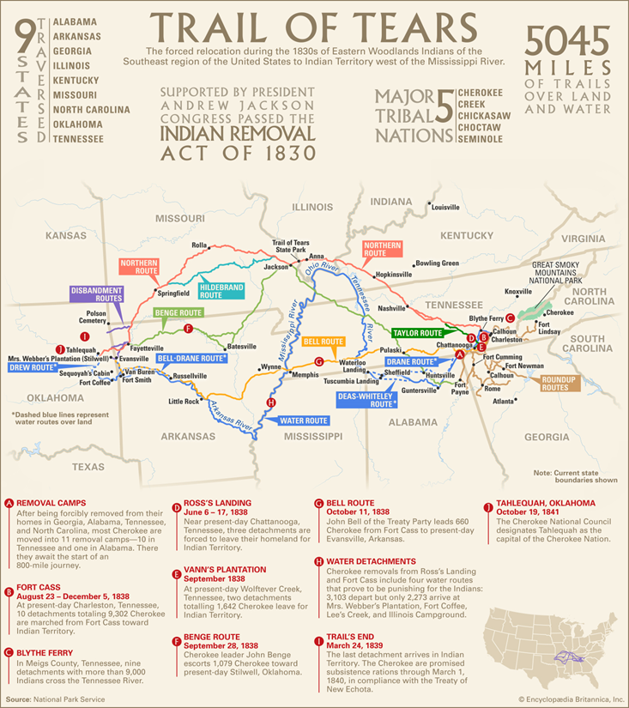
Summary
1850 – 1871
1804-1806: The purchase of the Louisiana Territory and the Lewis and Clark Expedition opens the Great Plains and the Western United States to settlement and economic development.
1830: US Congress under Andrew Jackson signs the Indian Removal Act, which relocates all Native Americans west of the Mississippi River.
1831: Trail of Tears begins, killing thousands of Native Americans on the forced march west, lasting into 1850.
1851: First Treaty of Fort Laramie between US Government and Northern Plains Tribe.
1864: Sand Creek Massacre, during which the US Cavalry kills 200 Cheyanne and Apraho men.
1866: Red Cloud's War begins.
1868: Second Fort Laramie Treaty begins, creating the Great Sioux Reservation.

Slide 3
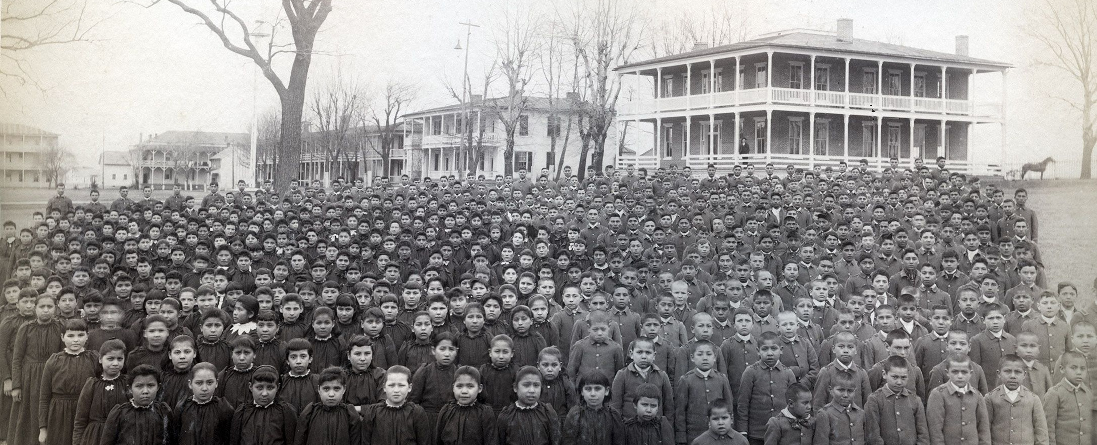
Summary, Continued
1870 – 1906
1874: Blacks Hills Gold Rush begins.
1876: Lakota and allied tribes under Crazy Horse defeat US Cavalary at the Battle of the Rosebud and Little Big Horn.
1877: Death of Crazy Horse
1879: First Indian Boarding School opened
1889: The Paiute medicine man named Wovoka has visions starting the Ghost Dance Movement.
1890: The 7th US Cavalry under the command of James Forsyth kills upwards of 300 innocent Lakota men, women, and children in the Pine Ridge Reservation in what becomes known as the Wounded Knee Massacre.
1891: 20 US Cavalry members at Wounded Knee receive Medal of Honor for the Wounded Knee Massacre
1906: Burke Act passes which allows the US Government to break up reservation land.

Slide 4
Ten Stages of Genocide
The Stages Represented By Wounded Knee:
Classification: Strong Delineation between the 'White Man' and the 'Indians,' which is demonstrated through the reservation system.
Symbolization: ‘Indians’ are seen as savages, resulting in reeducation programs for the youth. The Native Americans refer to the US as 'White men' and as the 'Great Father.’
Discrimination: Continuing acts and laws restricted Native land, in many cases taking advantage of many not knowing how to read English.
Dehumanization: There are numerous references stating that 'half-breeds' or those of both white and Native heritage are seen as weaker than the 'normal' (white) man.
Organization: Rising tension surrounding the Black Hills demonstrates a growing organized effort to justify military action.
Polarization: Throughout the conflict, it is common to see Native tribes disarmed and having their horses taken away, which was seen as a method of disabling them.
Preparation: Each agreement is used as a method to further restrict and divide reservations and agencies.
Persecution: Tribes speak of not being permitted to hunt and are restricted to their agencies or reservations where food and hunting is scarce, forcing them to rely on government rations. Additionally, reeducation programs are established, removing children from their cultures and teaching them to view their own culture as lesser.
Extermination: The majority of attacks against the US are directed towards military groups, while the major US victories are conducted against villages and reference the killing of children and women in addition to the warrior men who were actively fighting.
Denial: Many of the conflicts are referenced as 'fights' or 'battles' such as Wounded Knee, where some of the US soldiers received medals of valor, whereas now there is little debate as to the true nature of Wounded Knee as a massacre. While there have been clarifications as to the nature of these conflicts, the true nature of the Native American genocide has yet to be recognized as a genocide by the United States. Notably, the Black Hills, which are now famed for Mount Rushmore, are still debated to be the property of the Lakota Sioux due to the 1868 Treaty of Fort Laramie and subsequent treaties not being legally valid.

Slide 5
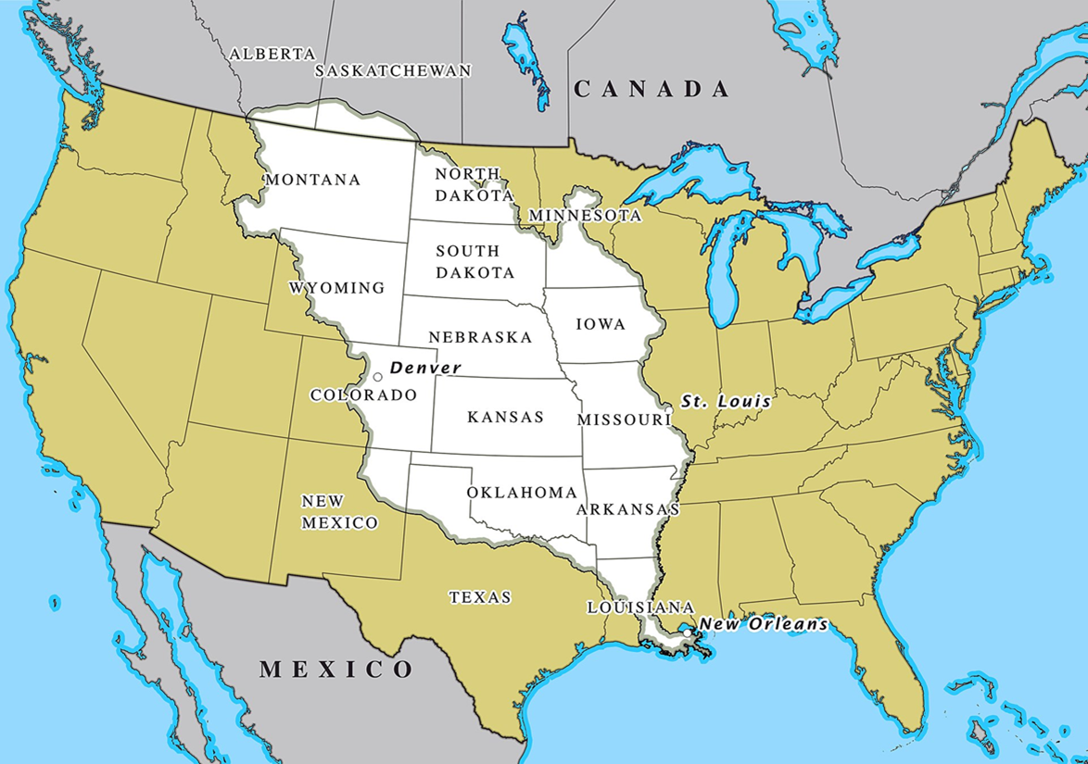
Louisiana Purchase
July 3, 1803
France sold its 828,000 sq mile Louisiana Territory to the United States for fifteen million dollars. This set the stage for United States' expansion westward and conflict with the Plains Indians.

Slide 6
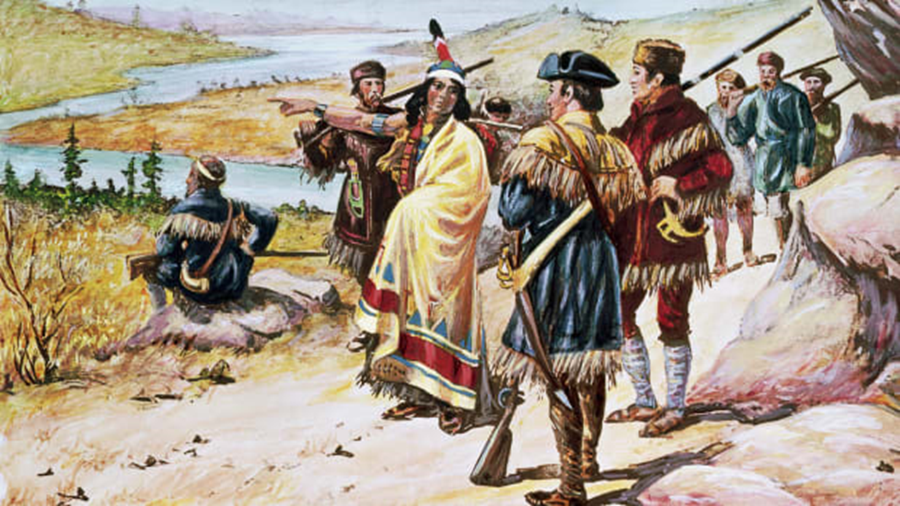
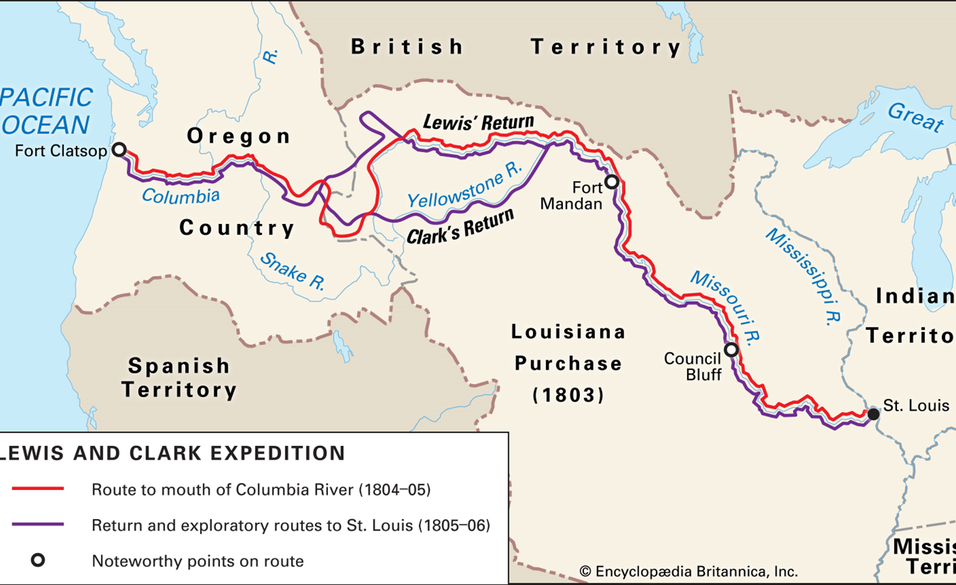
Lewis and Clark Expedition
Aug 31, 1803 – Sep 25, 1806
Under the command of Captain Meriwether Lewis and Second Lieutenant William Clark, a group of explorers charted the vast Louisiana territory in a two-year-long expedition, establishing forts along the way and making contact with Native American tribes in the west. This set the stage for the increased westward expansion of the United States.

Slide 7
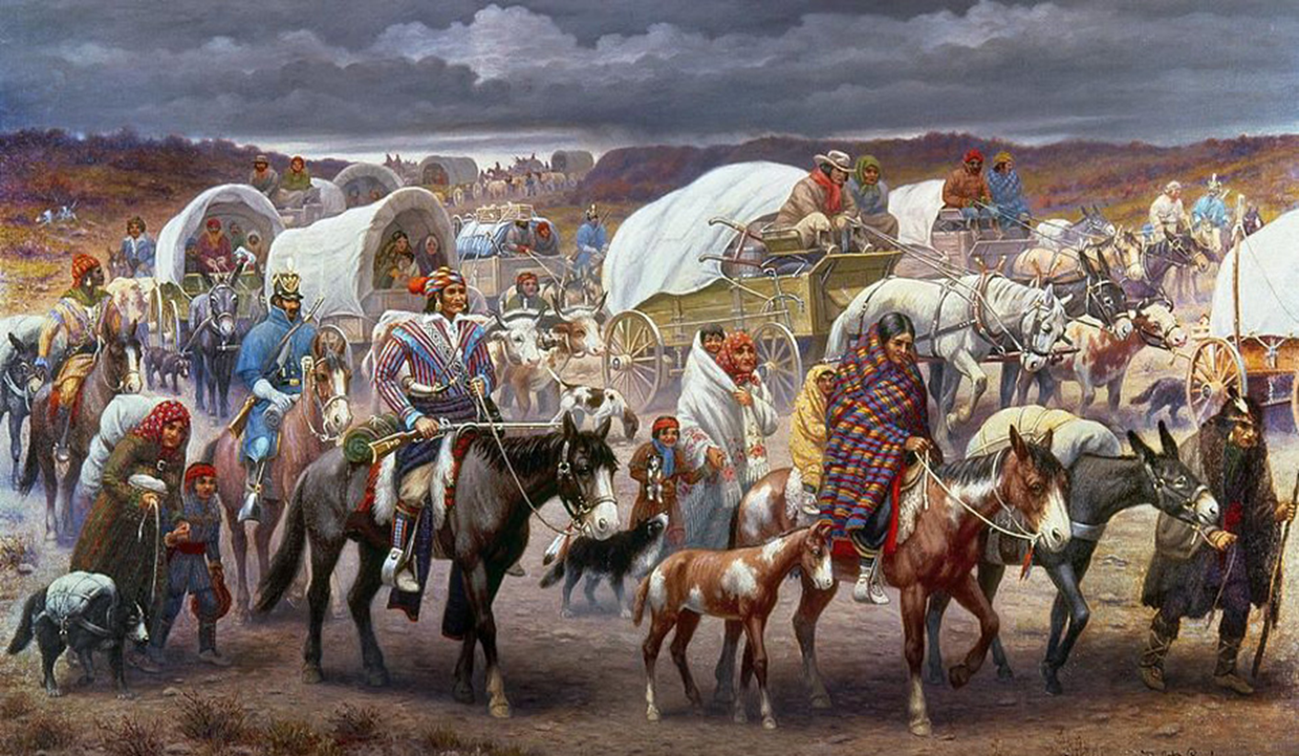
Trail of Tears
1829 – 1850
Around 60,000 Native Americans from the Cherokee, Muscogee (Creek), Seminole, Chickasaw, and Choctaw nations (among others) were forcibly removed from their ancestral lands in Southern states and pushed to the Oklahoma territory.
This occurred partially in response to the Georgia Gold Rush and anti-Indian sentiment. Thousands of Native Americans died of starvation, disease, and exposure during the long march east. The Trail of Tears set a precedent for putting Native Americans on reservations.

Slide 8
Indian Removal Act
May 27, 1830
Andrew Jackson signed the Indian Removal Act, which allowed the United States government to forcibly evict tribes from the Southern United States and move them west of the Mississippi River.

Slide 9
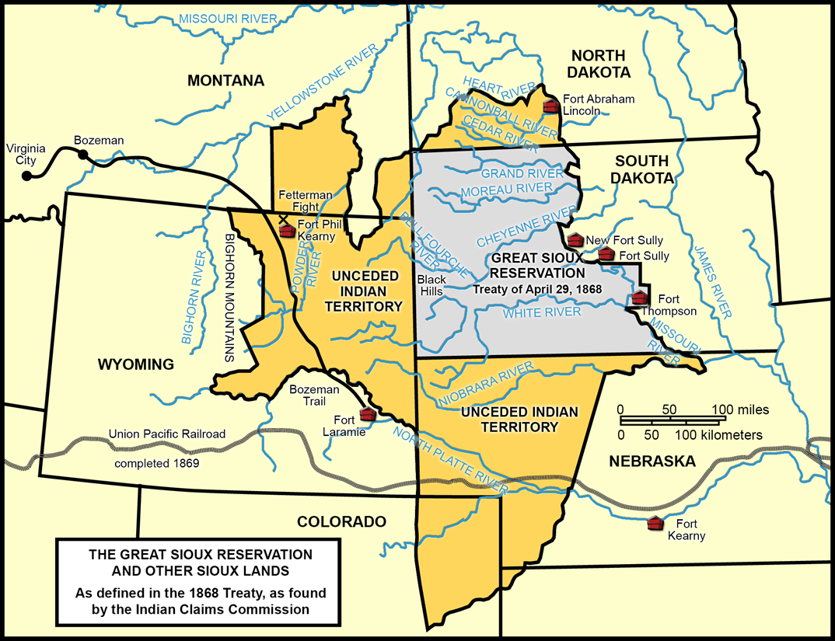
1868 Treaty of Fort Laramie
April 29, 1868
The 1868 Treaty of Fort Laramie was a peace settlement between the United States Government and the Red Cloud Native American Nation. It assured the "Great Sioux Reservation," which included the Black Hills, as Native American land.

Slide 10
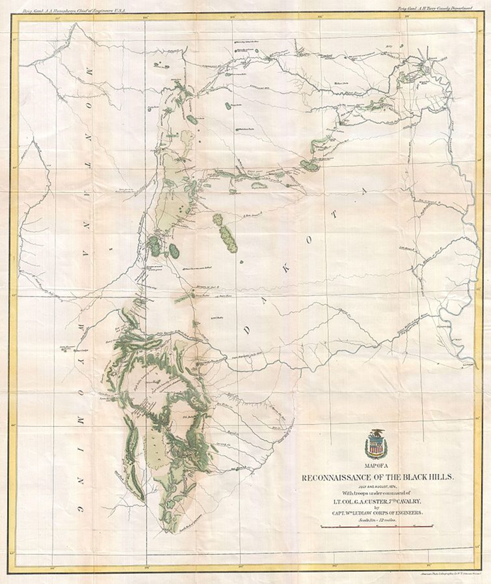
Rising Tension in the Black Hills
1873 – 1876
White miners were present in the Black Hills starting in 1873.
Jul 2, 1874 – Aug 30, 1874: General Custer leads an expedition into the Black Hills to confirm reports of valuable ore.
Sep 20-29, 1875: Commission arranged in the US to purchase the Black Hills. Ultimately, the tribes refuse to sell the Black Hills.
Nov 9, 1875: Commissioners report that 'Plains Indians' posed a threat.
Dec 3, 1875: ‘Indians’ living off of agency lands are ordered to report to reservations by January 31, 1876, under threat of military action. Due to winter weather, the runners took longer than expected to reach the tribes, and the reservations were already struggling to feed those living on the land on current rations.

Slide 11
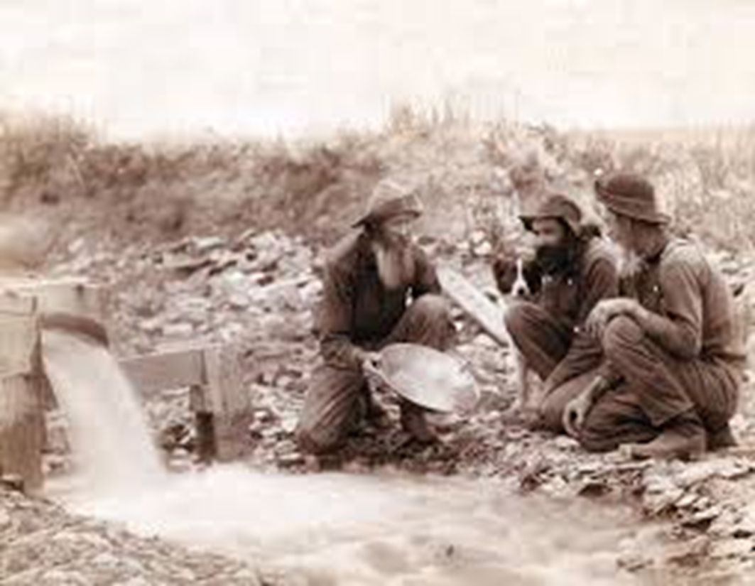
Black Hills Gold Rush Begins
1874 – 1877
Gold was discovered in the remote Black Hills following George Armstrong Custer's 1874 Expedition into the Dakota Territory. Thousands of miners and fortune-seekers flocked to the Hills and the town of Deadwood.
Despite the fact that the 1868 Treaty of Fort Laramie forbade white settlement in the Black Hills, the United States government encouraged settlement. Eventually, it granted Dakota's statehood in 1889 as a result of the gold rush.
The violation of the treaty prompted the Sioux to wage war against the settlers and the US cavalry. This eventually led to the Battle of the Little Big Horn and the massacre at Wounded Knee.

Slide 12
Custer's Black Hills Expedition
July 2, 1874 – Aug 31, 1874
The U.S. ordered reconnaissance into the Black Hills, due to reports of valuable minerals. General Custer later reported that gold was present "from the grassroots down." No consent was obtained from the Native American tribes.
General Custer conducted an expedition of the Black Hills, accompanied by over 1,000 men and a woman. Among these were a geologist (Professor N. H. Winchell), a paleontologist (George Bird Grinnell), an assistant geologist (A. B. Donaldson), and two miners. There were also members of the press present.
Legal documents also stated that an additional goal of the expedition was to establish a military outpost for the U.S.

Slide 13
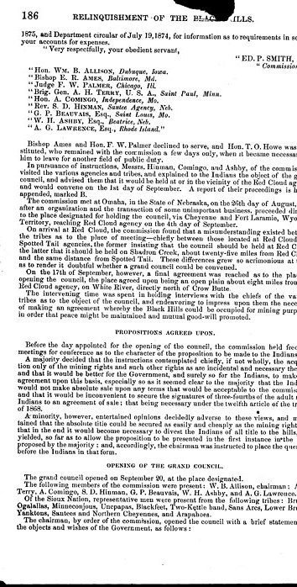
Commission Assembly for Purchase of Black Hills
September 20-30, 1875
U.S. Commission initially requested permission from tribal leaders present to have the Black Hills lent to the U.S. until no gold was present. Spotted Tail refused to lend the land.
On September 23, Red Cloud and an envoy from Crazy Horse, known as Little Big Man, arrived. Little Big Man threatened to kill any chief who spoke of selling the Black Hills and was subsequently removed from the commission. Negotiations were postponed.
Several days after the September 23, Red Cloud left, leaving the response to Spotted Tail. The U.S. offered 400,000 dollars a year for mineral rights in the Black Hills or to purchase the Black Hills outright for six million. Spotted Tail ended negotiations, stating that the Black Hills were not for sale nor lease. The commission recommended to Washington to "force" the sale of the Black Hills and present the sale as a "finality."

Slide 14
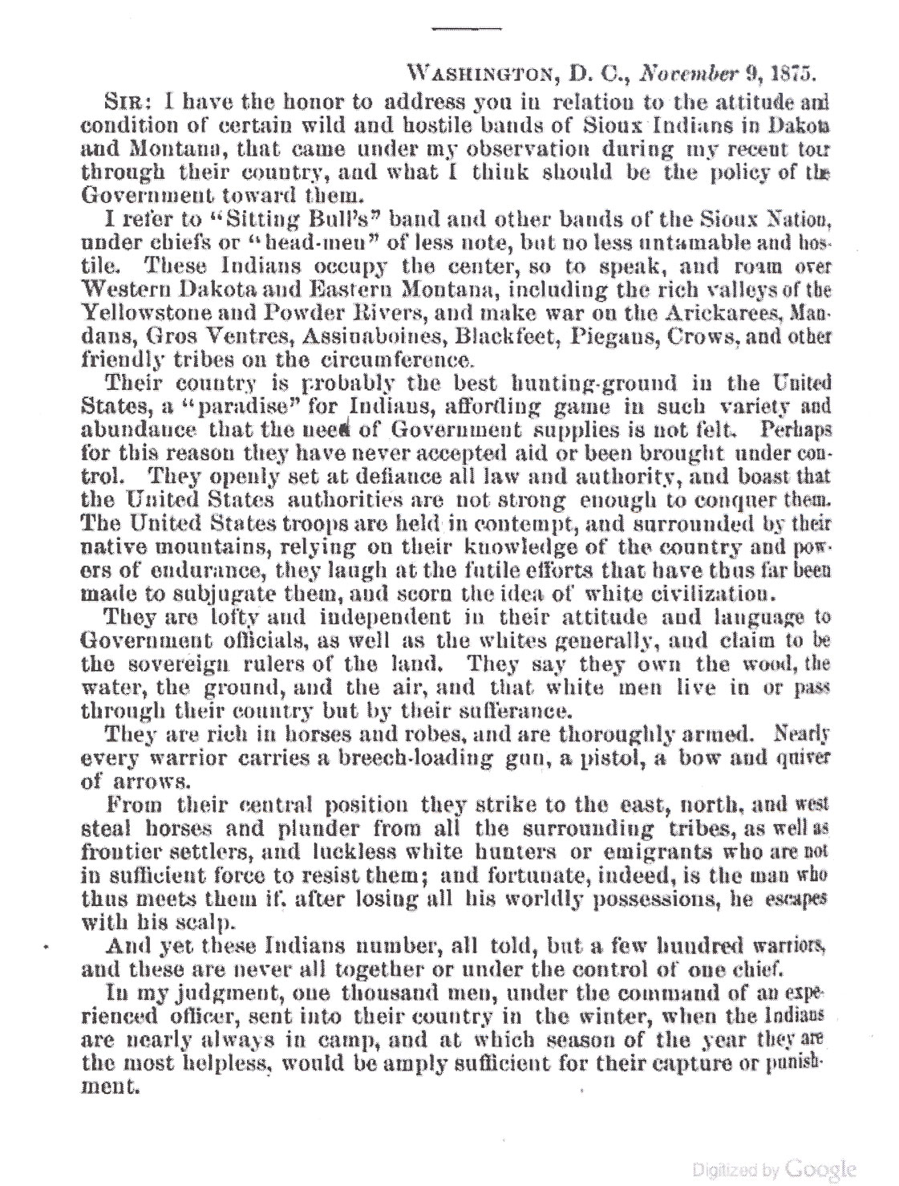
Report that 'Plains Indians' Pose a Threat
November 9, 1875
A report to the Commissioner of Indian Affairs stated that the 'Plains Indians' who resided outside of the reservations were well-fed and well-armed. Additionally, it stated that these Native Americans presented an independent attitude and represented a threat to the reservation system. The report recommended that troops be sent in the winter to subjugate them.

Slide 15
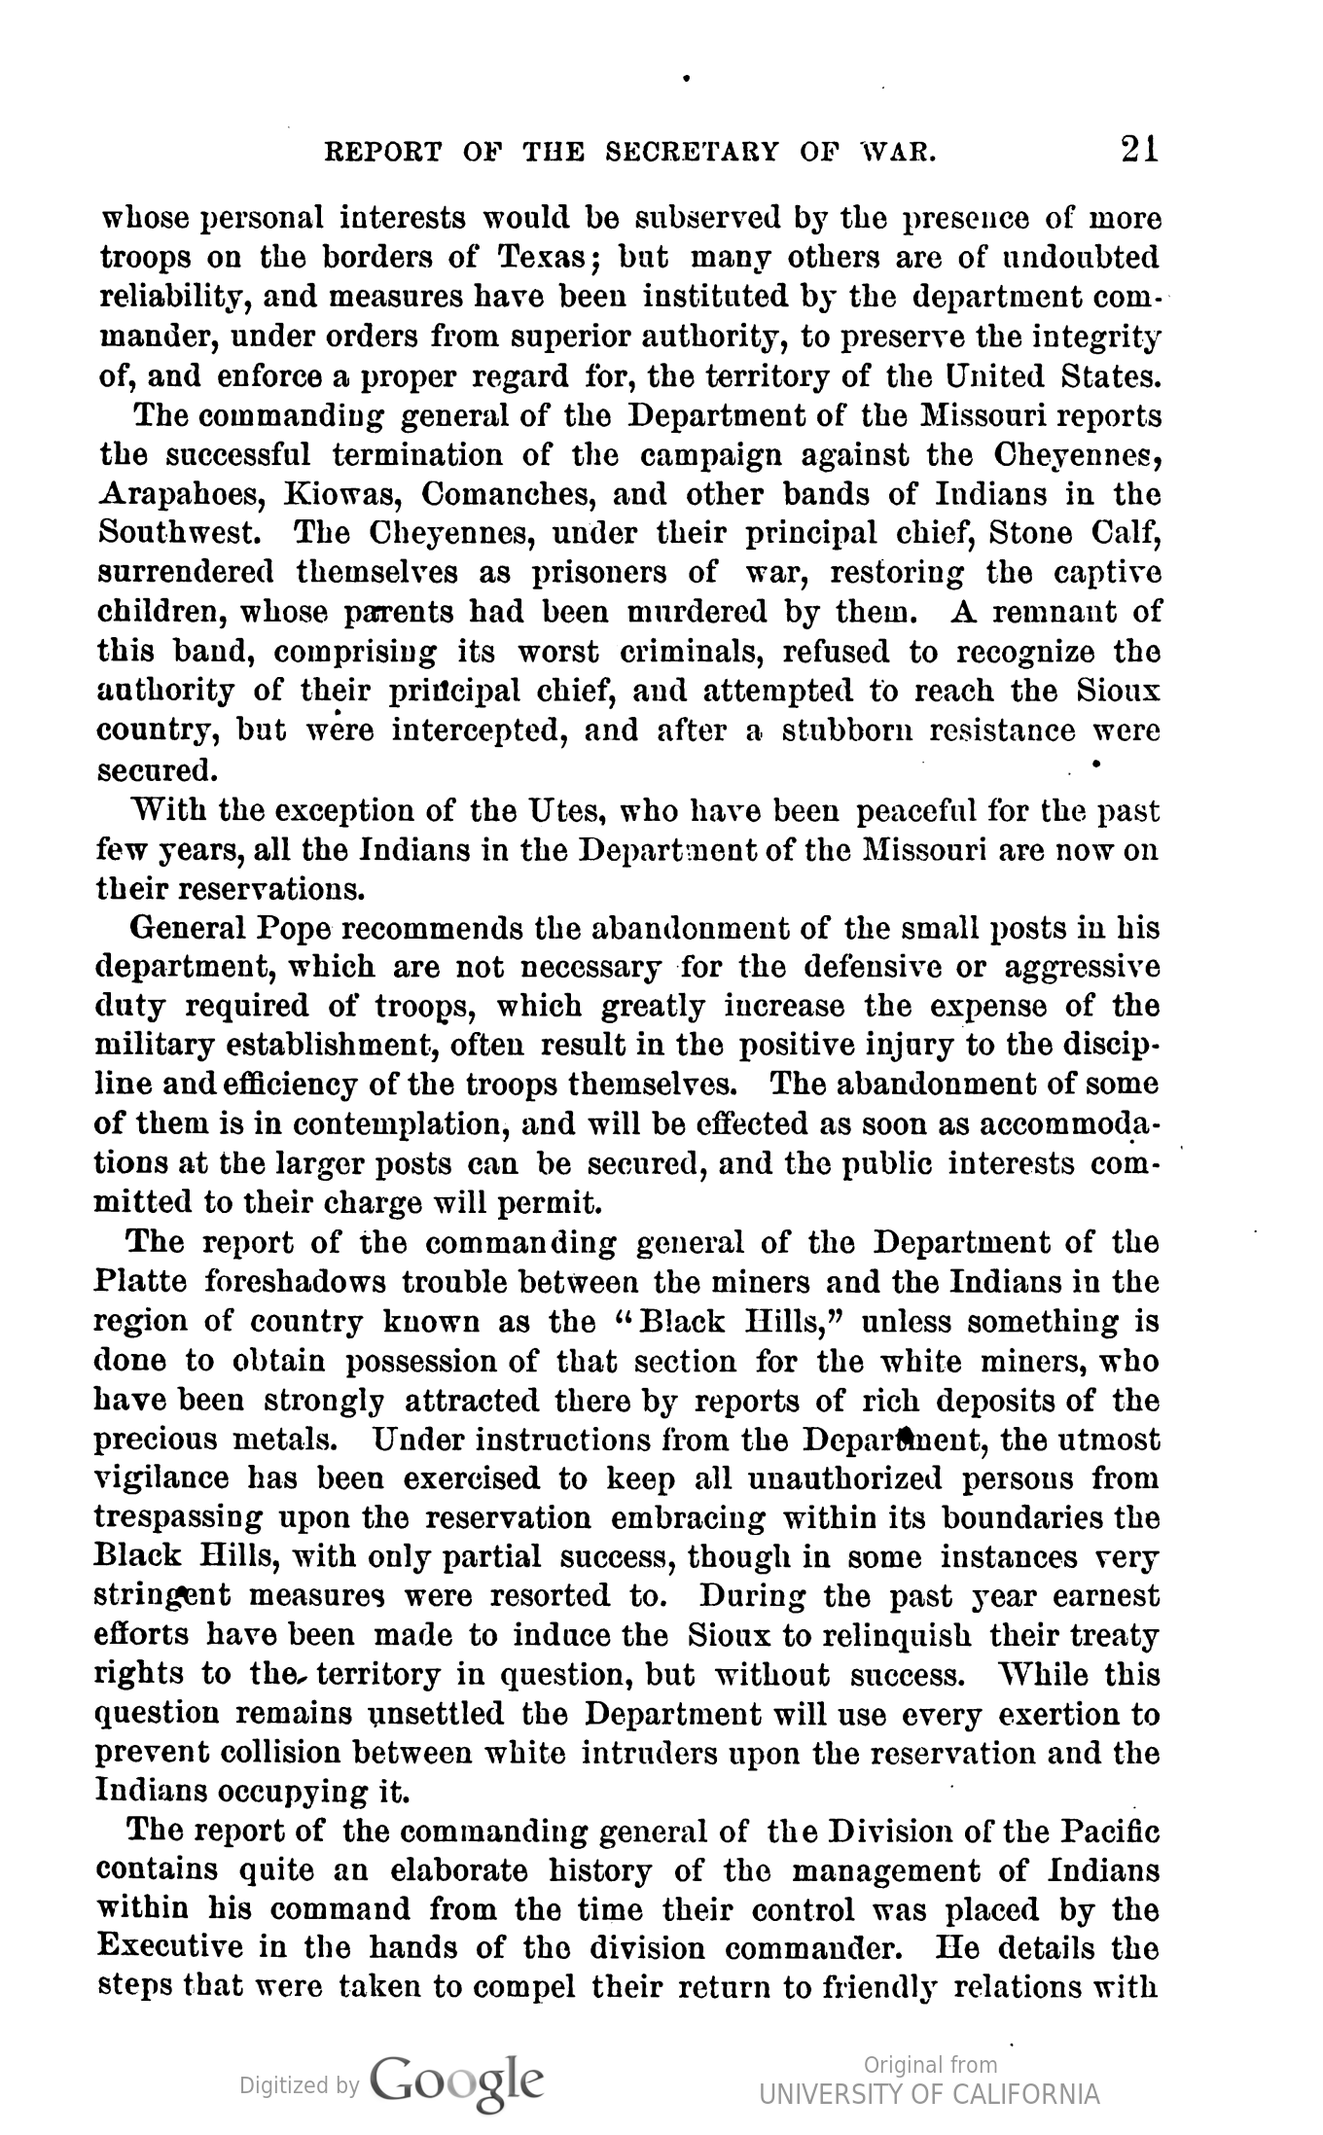
Secretary of War Warns of Trouble
November 22, 1875
The U.S. Secretary of War, W.W. Belknap, warned that there would be trouble if the Black Hills were not in U.S. possession for white miners. His report claimed that the rich deposits were attracting miners and had to be obtained to protect the miners.

Slide 16
‘Indians’ Ordered to Report to Agencies
December 3, 1875 – February 1, 1876
Edward P. Smith, the Commissioner of Indian Affairs, ordered agents from the Sioux and Cheyenne tribes to inform Native Americans living outside of reservations to report to their agencies by January 31, or military force would be implemented.
Those living outside the reservations were still within the territory of the 1868 Treaty and were legally allowed to reside there.

Slide 17
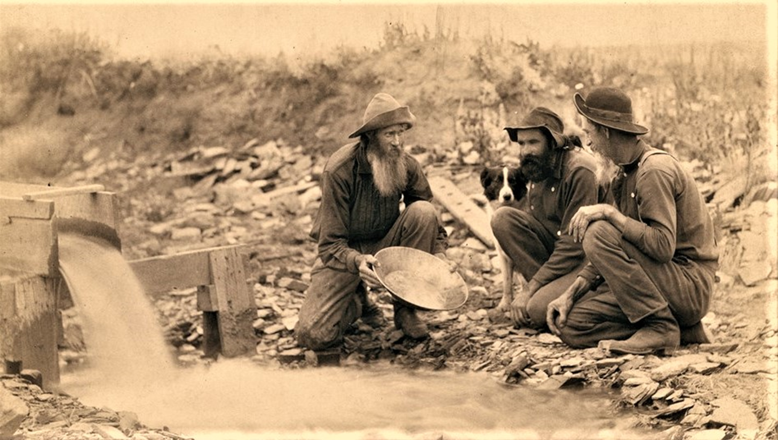
Miners Present in Black Hills
1876
Hundreds of miners were reported to be present in the Black Hills. The U.S. Army was sent to stop or stem the flow of miners, but few were removed only temporarily, and the government took no legal action. Native American tribes members protest the mining and call on Washington to enforce the Treaty.
Notably, on April 9th of 1876, two brothers, Fred and Moses Manuel, and their partner, Hank Harney, claimed the Homestake Goldmine, which would become the United States' longest-running and most profitable goldmine.

Slide 18
Secretary of War Given Leave to Deal with Tribes outside Reservations
February 1, 1876
The Secretary of the Interior informed the Secretary of War that the time for the "hostile" Native Americans had expired, and the matter was being turned over to the military to handle.

Slide 19
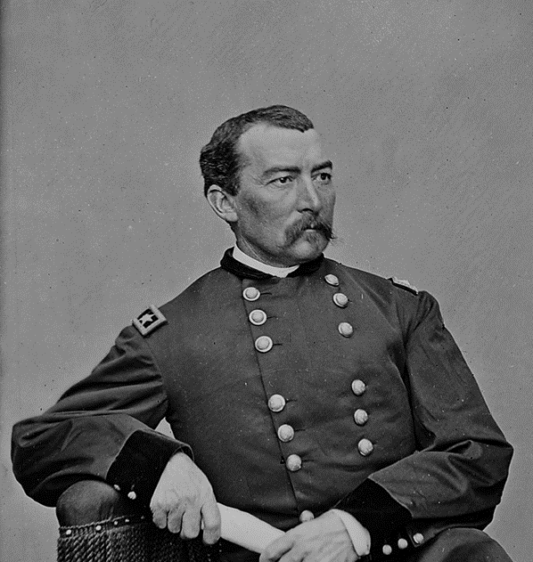
General Sheridan Authorized Military Efforts
February 7, 1876
The War Department authorized General Sheridan to begin operations against the Sioux, specifically the bands under Sitting Bull and Crazy Horse, which the government described as hostile.

Slide 20
General Sheridan Orders Crook and Terry
February 8, 1876
General Sheridan ordered Generals Crook and Terry to prepare for military actions directed at the headwaters of the Powder, Tongue, Rosebud, and Bighorn rivers. Crazy Horse and his allies were known to frequent these locations.

Slide 21
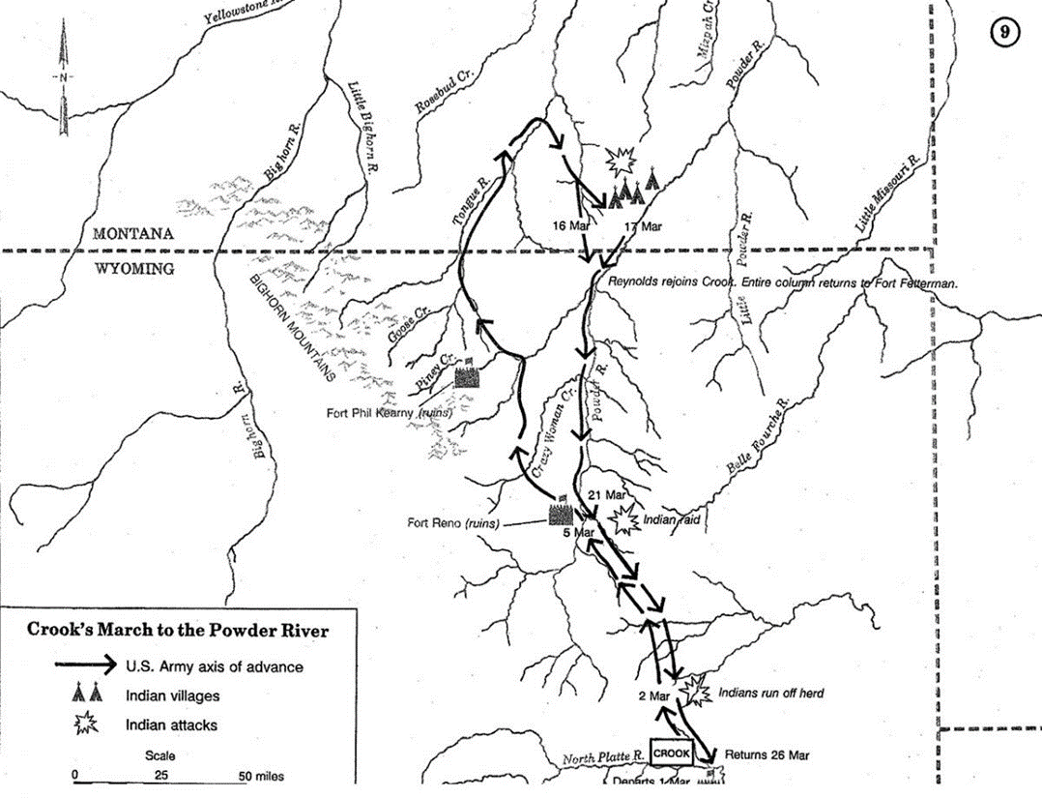
"The Attack on Crazy Horse's Village"
March 17, 1876
Oglala Sioux and Northern Cheyenne tribal members were camped in Powder River country, where they traveled in hopes of hunting buffalo and antelope. The group was led by Two Moon, Little Wolf, Old Bear, Maple Tree, and White Bull, as well as by the Cheyenne leaders and the Oglala Chief, Low Dog. There were also some warriors from Crazy Horse's village; however, this was not closely associated with Crazy Horse.
On the morning of March 17th, Colonel Reynolds was leading six companies of the 2nd and 3rd US Cavalry under the command of General Crook who wasn't present. When this force attacked, children, women, and the elderly fled, while others protected them until they could get to safety.
Colonel Reynolds, Captain Moore, and Captain Noyes were allegedly later court-martialed for their failure in allowing the women and children to escape and failing to successfully subjugate the Native Americans in the area as General Crook hoped.

Slide 22
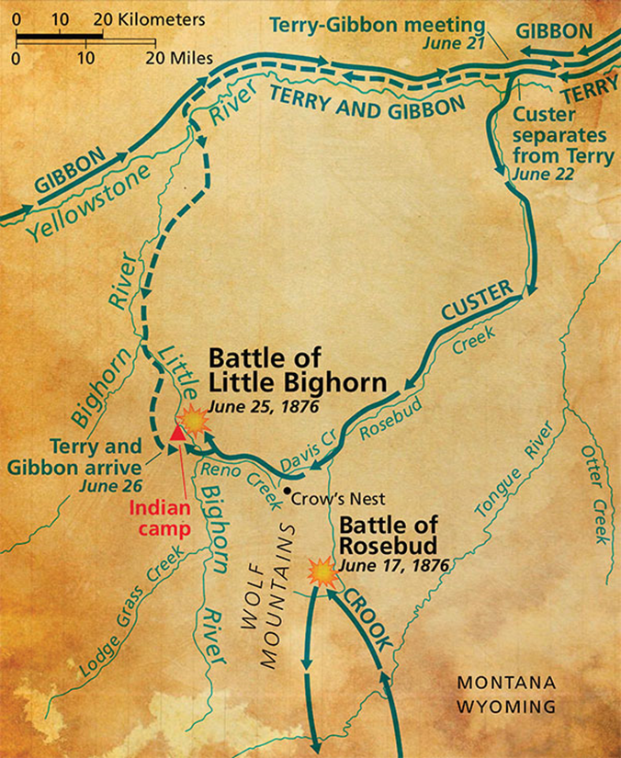
Battle of the Rosebud
June 16, 1876
Lakota Sioux and Northern Cheyenne, under the command of Crazy Horse, won a decisive victory against the United States Cavalry under General George R. Crook and his native Crow and Shoshoni allies at Rosebud Creek in the Montana Territory.
This large-scale and long-term engagement differed from Sioux's typical hit-and-run style of attack. The pitched battle foreshadowed the most decisive Native American victory at the Battle of the Little Big Horn and helped amplify white paranoia of collective and united Native military force.

Slide 23
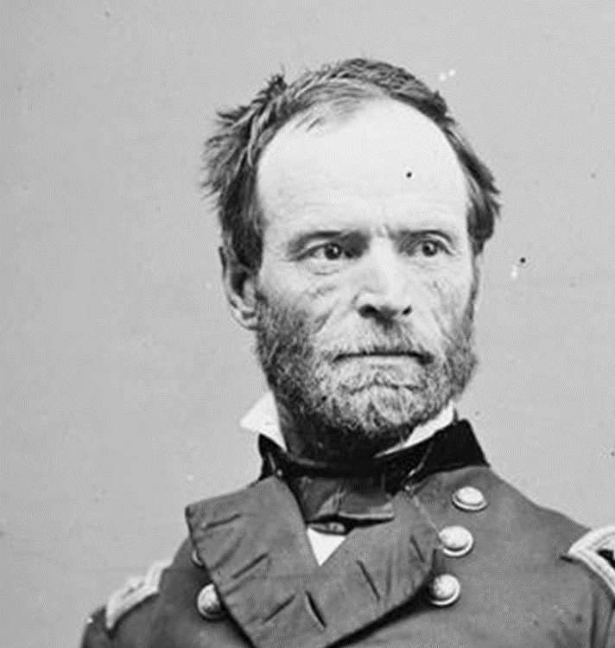
General Sherman Assumes Military Control of Reservations
June 22, 1876
General Sherman was given the authority to assume military control of the reservations on the Sioux country, i.e., the land provided by the 1868 Treaty of Fort Laramie.

Slide 24
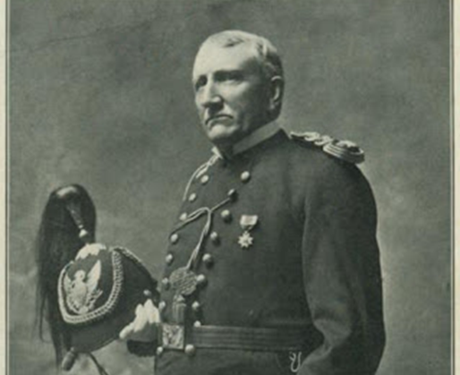
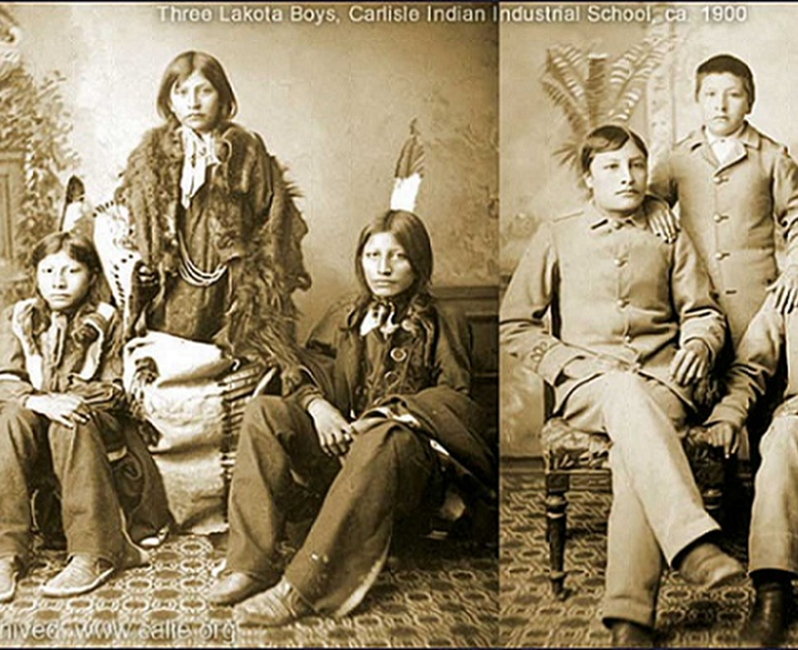
Richard Henry Pratt Opens the First 'Indian' Boarding school
August 1876
Richard Pratt founded the first 'Indian' boarding school in Carlisle, Pennsylvania. The U.S. government funded the school, which attempted to assimilate Native Americans into white culture forcibly.
Pratt coined the phrase "kill the Indian, save the man" as the ethos of his boarding school. Native Americans were forbidden to speak their language, and children were purposefully separated to break up a tribe's sense of community. Pratt's boarding school became a model for hundreds of others around the United States and Canada. The 'Indian' schools succeeded in breaking up dozens of tribes, destroyed many Native American languages, and remain an intensely controversial topic to this day.

Slide 25
Indian Appropriations Act
August 14, 1876
Known to the Sioux as the "Sell or Starve" rider, the Indian Appropriations Act allowed the United States government to withhold food rations from the Sioux and other tribes if they refused to sell their land to settlers or the government.

Slide 26
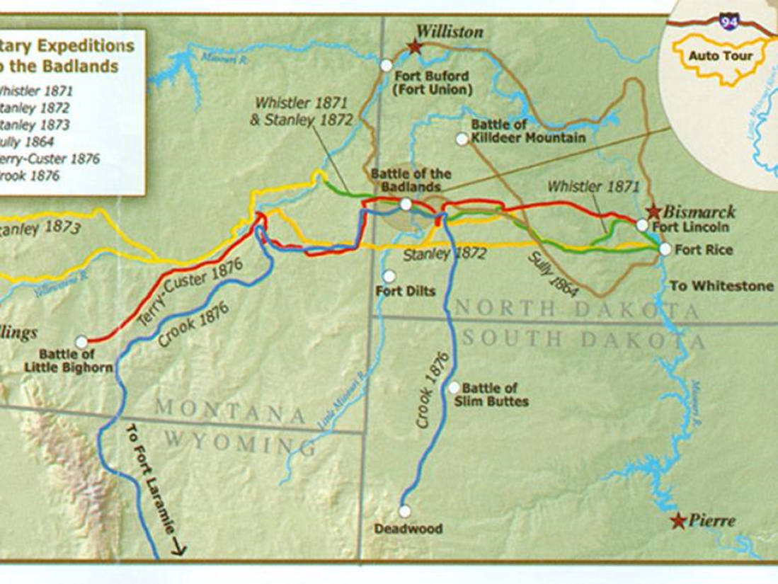
Battle of Slim Buttes
September 9-11, 1876
After months of searching for Native American warrior bands, General Crooke, running low on supplies, commenced the "horsemeat march" in which his men were forced to eat their horses for food. While returning to Fort Robinson to resupply, his forces came across a village of Sioux.
On the morning of September 9th, his forces surrounded the village and attacked, killing men, women, and children as families attempted to flee.
The U.S. forces resupplied by looting the village and then burned it to the ground and continued their campaign.

Slide 27
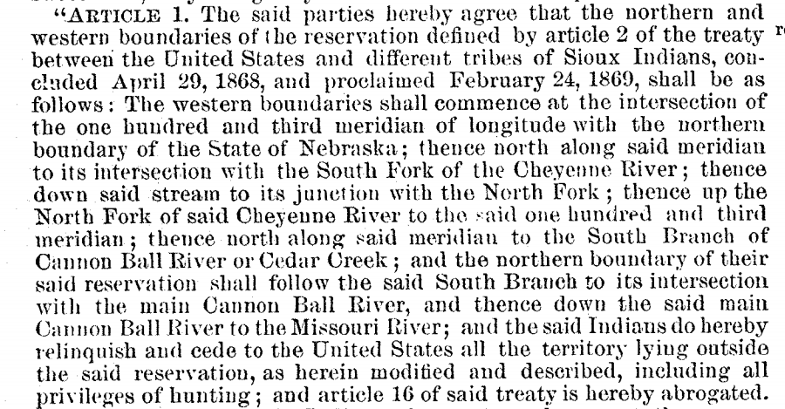
Agreement of 1876
Sept 26, 1876
This act altered some of the terms reported in the 1868 Treaty of Fort Laramie and is considered in more contemporary legal documents to effectively negate the Treaty. If the chiefs present (Red Cloud, Red Dog, Spotted Tail, among others) did not sign the treaty, the US government would refuse any rations, disarm them, take their horses, and forcibly move them much further south.
This treaty was signed by approximately 10% of the adult Sioux in the territory. One report (Grange Jr., 1958) states that, of the 2,267 signatures required, only 40 were collected at the Red Cloud Agency. By the requirements of the 1868 Treaty of Fort Laramie, land could only be ceded from the Sioux with the signatures of 3/4's of the adult Sioux men in the territory, as over half the warriors of the tribes were North with Sitting Bull and Crazy Horse.
By receiving some of the signatures to claim much of the land, the United States effectively ended the conflicts by holding power over those who remained on the reservations and agencies.

Slide 28
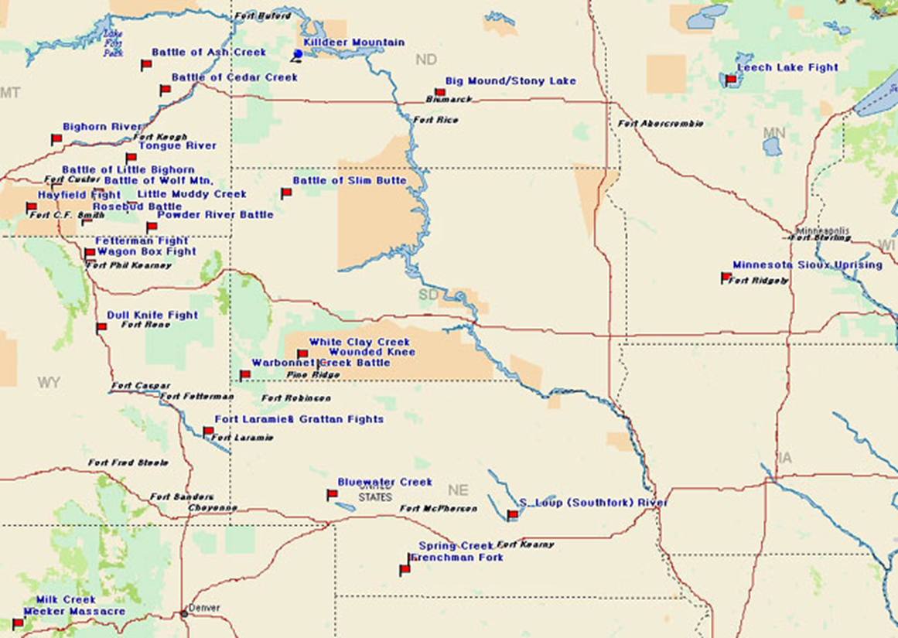
Dull Knife Fight
Nov 25, 1876
Mackenzie's force attempted to surround the village thought to be associated with Dull Knife, although its primary leader at the time was Little Wolf. However, the Cheyenne identified his forces, so the families sleeping in their lodges began to escape, leading Mackenzie to launch his attack. The Cheyenne present fought back to allow the families time to escape, with many fleeing into the mountains with no additional clothing or supplies.
On the US side, McKinney and six men were killed, with 22 wounded. The Cheyenne lost approximately 40, with twice as many wounded. However, they would have to travel through the mountains for almost a week through freezing cold and a blizzard before reaching Crazy Horse's village in Montana. Eleven babies froze to death the first night after the attack.

Slide 29
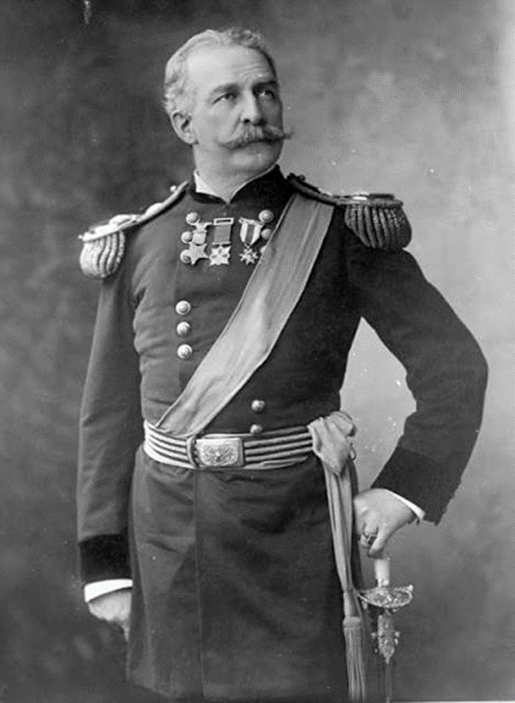
Crows Kill Crazy Horse's Truce Envoy
December 16, 1876
Under a flag of truce, an envoy of eight chiefs and warriors who volunteered to travel to Col. Nelson A. Miles' fort to discuss surrender were subsequently killed by the Crows (mercenaries under Miles) due to tribal history.
Three of the eight envoys escaped and warned Crazy Horse that Miles knew the Sioux were nearby and they must flee.

Slide 30
Decoy Band Strike Against Miles
December 18-29, 1876
A decoy band of nearly 100 warriors was sent from the Sioux to attack various weak points of Miles and draw targets to ambush points. This involved attacking and looting a mail carrier shipment on December 18 and attacking and stealing 250 head of cattle from Miles' post's beef contractor. Ultimately this decoy group hoped to draw Miles to an ambush location where he would meet Crazy Horse.
Despite this, the majority of Miles' force amassed and moved through the Tongue River Valley on the trail of Crazy Horse.

Slide 31
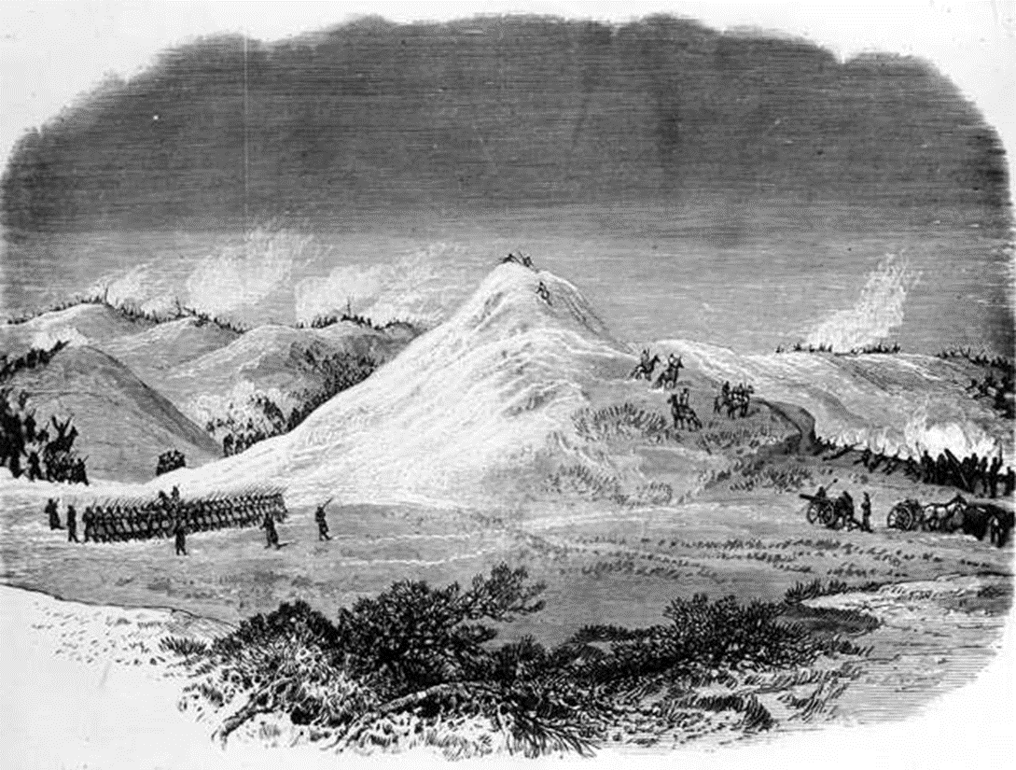
Battle Butte
January 8, 1877
AKA: Battle of Wolf Mountain(s), Battle of the Butte, Battle of Belly Butte, Where Big Crow Walked Back and Forth, Miles's Battle on the Tongue River.
The night before (January 7th), Miles captured a women's camp of the Sioux. This capture drew out the decoy party, who thought that the women would be killed. The Sioux held the U.S. troops for four hours, allowing the majority of the Native Americans to escape through the Wolf Mountains. Miles' force would eventually fall back to Fort Keogh.

Slide 32
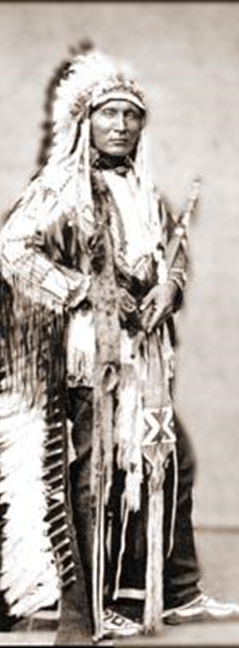
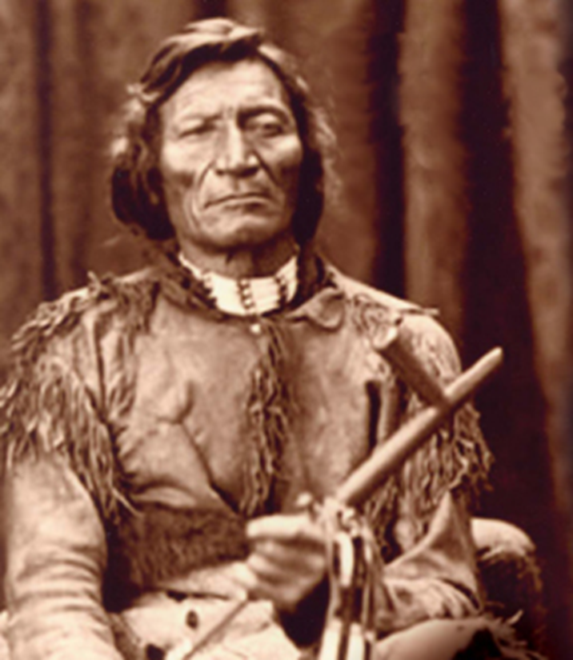
Touch the Clouds and Dull Knife Surrender
April 1, 1877 – May 1, 1877
In April, Touch the Clouds surrendered at the Spotted Tail agency. Dull Knife and his Cheyenne surrendered at Camp Robinson.

Slide 33
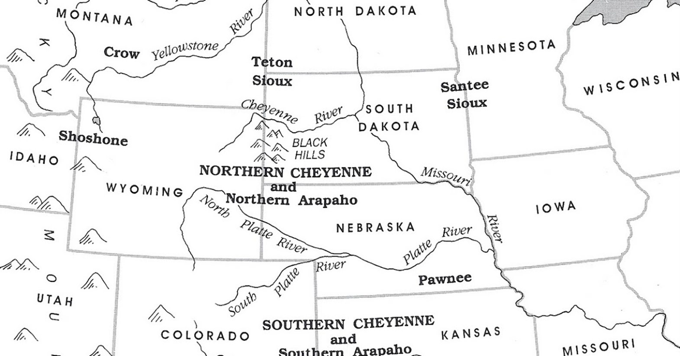
Great Cheyenne Exodus Begins
April 30, 1877 – August 6, 1877
The U.S. ordered a total of one thousand Northern Cheyenne, among them chiefs Little Wolf, Dull Knife, Standing Elk, and Wild Hog, who surrendered at Fort Robinson and expected to live alongside the Sioux to relocate to the southern Cheyenne reservations.

Slide 34
Sitting Bull Escapes to Canada
May 5, 1877
After fighting and fleeing the U.S. forces, Sitting Bull took his forces north to Canada, where he would remain for four years.

Slide 35
Crazy Horse and Followers Surrender
May 6, 1877
Crazy Horse and his followers, amounting to 889 men, women, and children surrender at Camp Robinson.

Slide 36
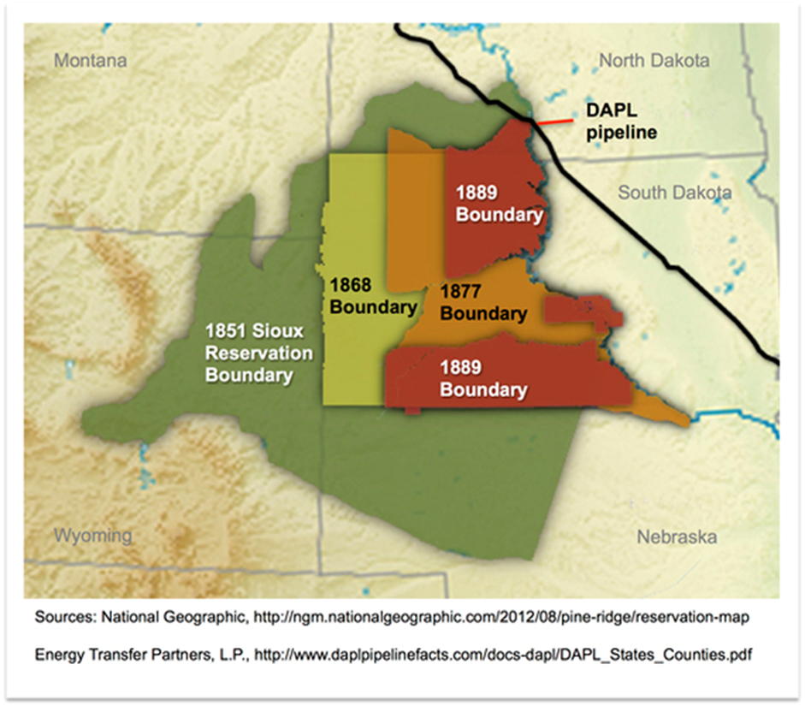
Act of 1877 (Sell or Starve)
Aug 15, 1877
This act formalized and implemented the 1876 agreement and negated the 1868 Treaty of Fort Laramie (UNITED STATES, Petitioner, v. SIOUX NATION OF INDIANS et al.).
This is also referred to as the "Sell or Starve" act by many Native American tribes. The act officially established the Native American reservations.

Slide 37
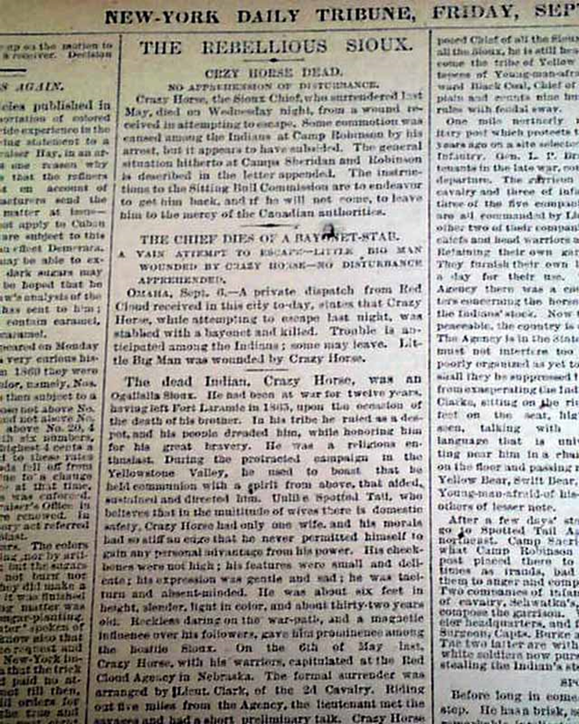
Death of Crazy Horse
September 5, 1877
While in the custody of Little Big Man, Crazy Horse became an agency policeman and accompanied U.S. soldiers. Upon seeing those chained where he was to be placed, Crazy Horse resisted and was stabbed in the abdomen by a bayonet.

Slide 38
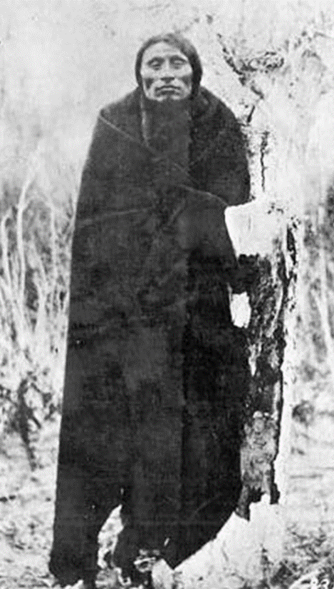
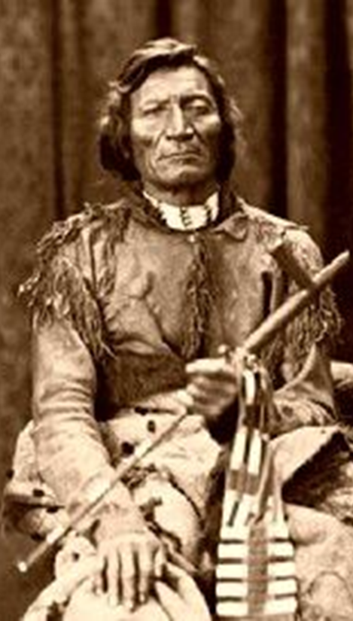
Little Wolf and Dull Knife Lead Cheyenne North
September 10, 1878
During the night of September 9th, Little Wolf and Dull Knife told the remaining Cheyenne, some 297 men, women, and children, that they were leaving the area near Fort Reno and going back North. After years of disease, little food, and poor rations, they wished to return to their homes in the North.

Slide 39
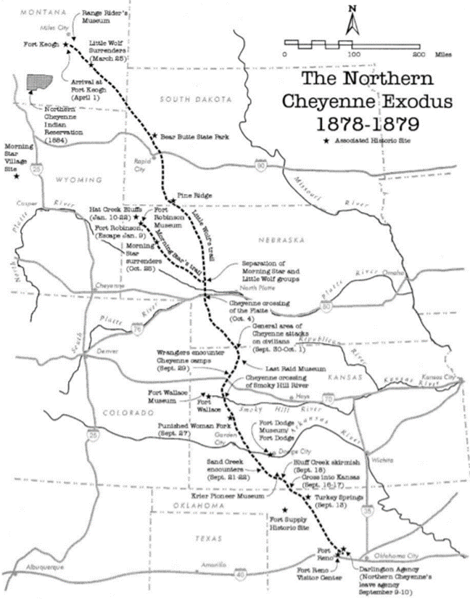
Cheyenne Fight Their Way North
September 13, 1878 – October 21, 1878
Dull Knife and Little Wolf set up a defensive position while crossing the Cimarron (150 miles north of Fort Reno). Miles sent soldiers after them, despite Little Wolf stating they didn't want violence and just wanted to move their people north, who caught up with the group on September 13th.
After a short parley, in which Little Wolf stressed that they wanted to travel north peacefully, the soldiers attacked the Cheyenne within the canyons where the tribes' warriors were hiding. The warriors held the soldiers while the majority of the group slipped away to the north.
The Cheyenne group fought their way as they traveled across Kansas and into Nebraska. Soldiers attacked from nearby forts and ranchers, cowboys, settlers, and tradesmen, along with 3,000 "white men," attacked them repeatedly the entire way. The traveling and attacks continued for approximately six weeks.

Slide 40
Dull Knife and Little Wolf Split
October 20-24, 1878
After weeks of fighting, the bands decided to split. Dull Knife wished to travel to Red Cloud's agency to ask for shelter and food. Little Wolf wished to continue to the Tongue River Valley, where he hoped to live "like Cheyennes again."
53 men, 43 women, and 38 children continue straight North with Little Wolf. About 150 others went Northwestward with Dull Knife.

Slide 41
Dull Knife's Group Surrounded
October 23, 1878
Dull Knife's group was halted by a blizzard while a couple of days away from Fort Robinson and found that a group of cavalry had them surrounded. They surrendered and disassembled their good weapons, hiding the parts and keeping their broken ones in case the soldiers disarmed them.

Slide 42
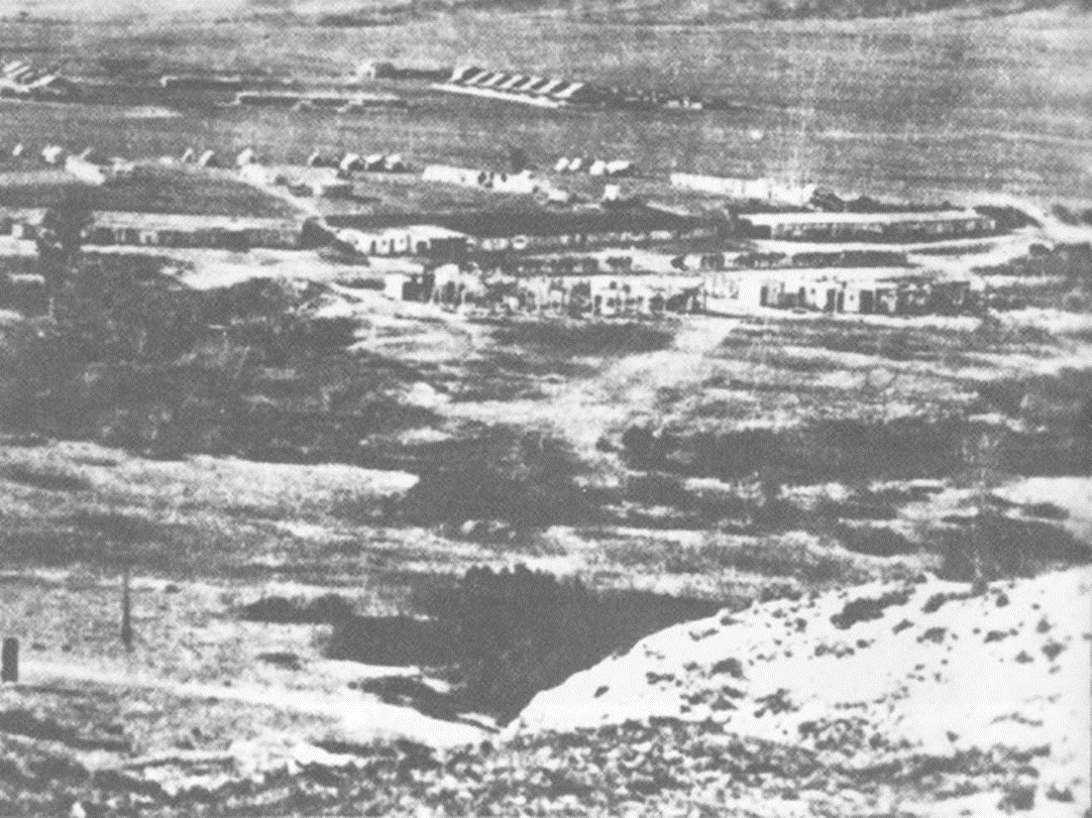
Dull Knife Arrives at Fort Robinson
October 25, 1878
Dull Knife and his group were taken to Fort Robinson after being disarmed and placed in a log barracks. They were initially treated well and given blankets, shelter, food, and medicine.

Slide 43
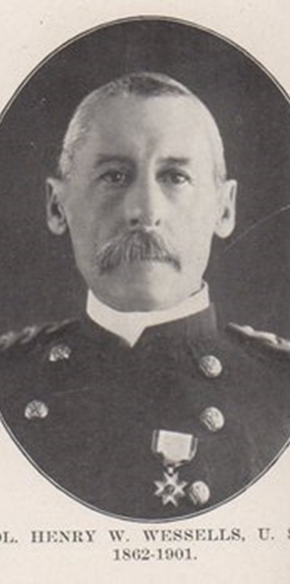
Captain Wessell's Ordered to Send Cheyenne South
January 3, 1879
The U.S. War Department sent orders to Captain Wessells stating that, unless the Cheyenne were sent south, they would endanger the entire reservation system. This order required immediate action, despite the frigid winter weather.
Dull Knife refused to obey the order, and Wessells told them they had 5 days to change their minds.

Slide 44
Wessells Stops Providing For the Barracks
January 8, 1879
Wessels ordered the Cheyenne to be confined to the barracks and stopped providing food and wood to heat the stove. This caused the Cheyenne to have to huddle together for warmth and scrape the snow and frost off the windows for water.

Slide 45
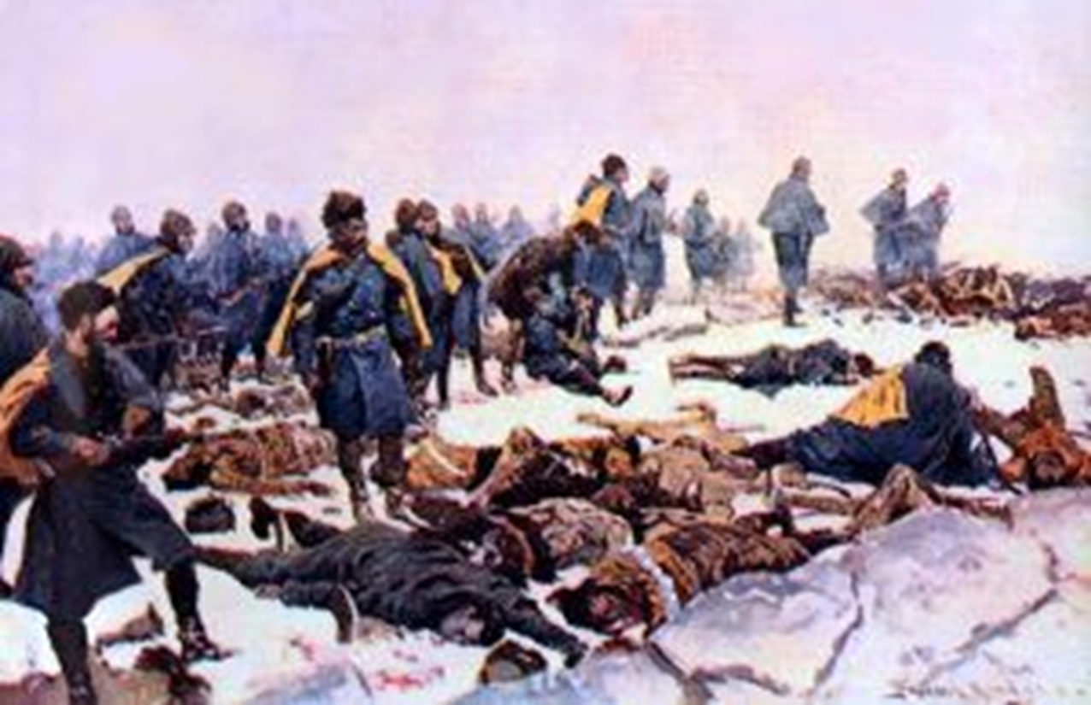
Cheyenne Attempt to Escape Fort Robinson
Jan 9, 1879
Capt. Wessells summoned the chiefs held at Fort Robinson to his quarters. When Wild Hog informed Wessells that they would not go south, Wessells attempted to arrest him and the others. Wild Hog managed to get outside to warn those in the barracks before being brought down by soldiers.
That night, those in the barracks assembled the parts of the guns that they had hidden and fired on the soldiers guarding the barracks. All of those inside attempted to escape.
By the following morning, soldiers had captured 65 of those that escaped, 23 of them wounded. 38 escaped alive; 32 were together, while 6 (Dull Knife, his wife, his surviving son, daughter-in-law, grandchild, and a boy named Red Bird) hid miles from the fort.
In the following days, the soldiers from Fort Robinson hunted down the group of 32, trapping them at Hat Creek Bluffs, and killed all but 9.
Dull Knife and his small group would eventually make their way north to Pine Ridge and were imprisoned on Red Cloud's reservation.

Slide 46
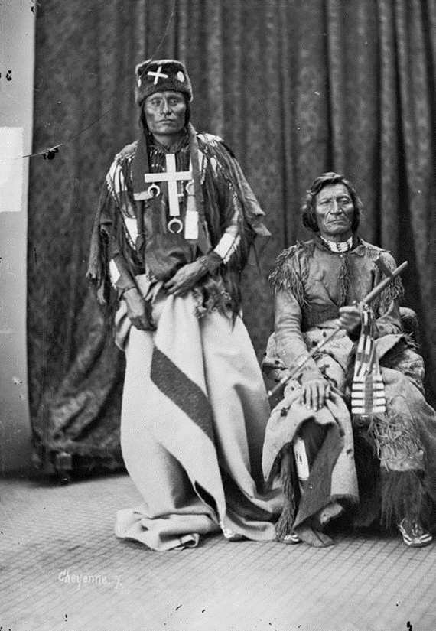
Little Wolf Surrenders
March 25, 1879
Little Wolf managed to bring his group to near Fort Keogh, where he encountered Two Moon. Two Moon informed him that Lt. Clark was looking for him. Little Wolf agrees to meet with Lt. Clark.
Due to a previous friendship, Clark disarmed himself for the meeting. Clark assured a peaceful transition upon the conditions of disarmament and taking the horses.
Little Wolf agreed, and the group surrendered to Fort Keogh. The majority of the men, including Little Wolf, were later employed as scouts.

Slide 47
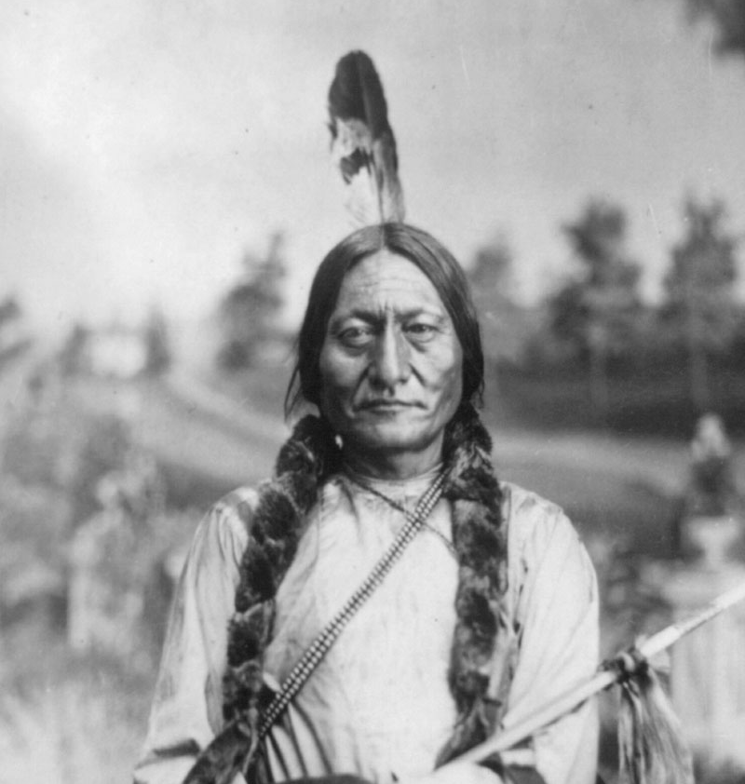
Sitting Bull Surrenders
July 19, 1881
Sitting Bull returned from Canada with 186 of his followers. Despite having assurances in a council in October 1877 that, if he surrendered his weapons, he would receive a full pardon, he was arrested upon reaching Fort Buford.
Sitting Bull and his followers would have stayed in Canada, but the government refused to provide them any food, shelter, or assistance besides what hunting they could get for themselves. Additionally, they received no land.

Slide 48
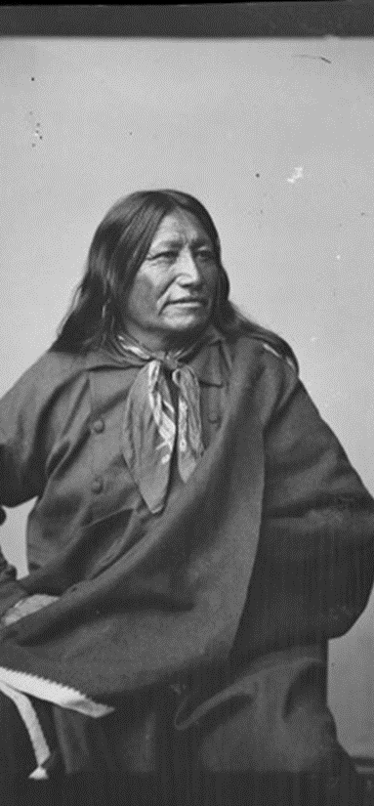
Death of Spotted Tail
August 5, 1881
While riding horseback on a trail in the Rosebud reservation, Crow Dog shot and killed Spotted Tail. Rumors stated that their dispute was due to a quarrel over a woman, however, others claimed that the shooting was at the behest of the Indian Bureau agents.
After Spotted Tail's death, the Sioux on the wider reservations turned their attention toward Sitting Bull at Fort Randall.

Slide 49
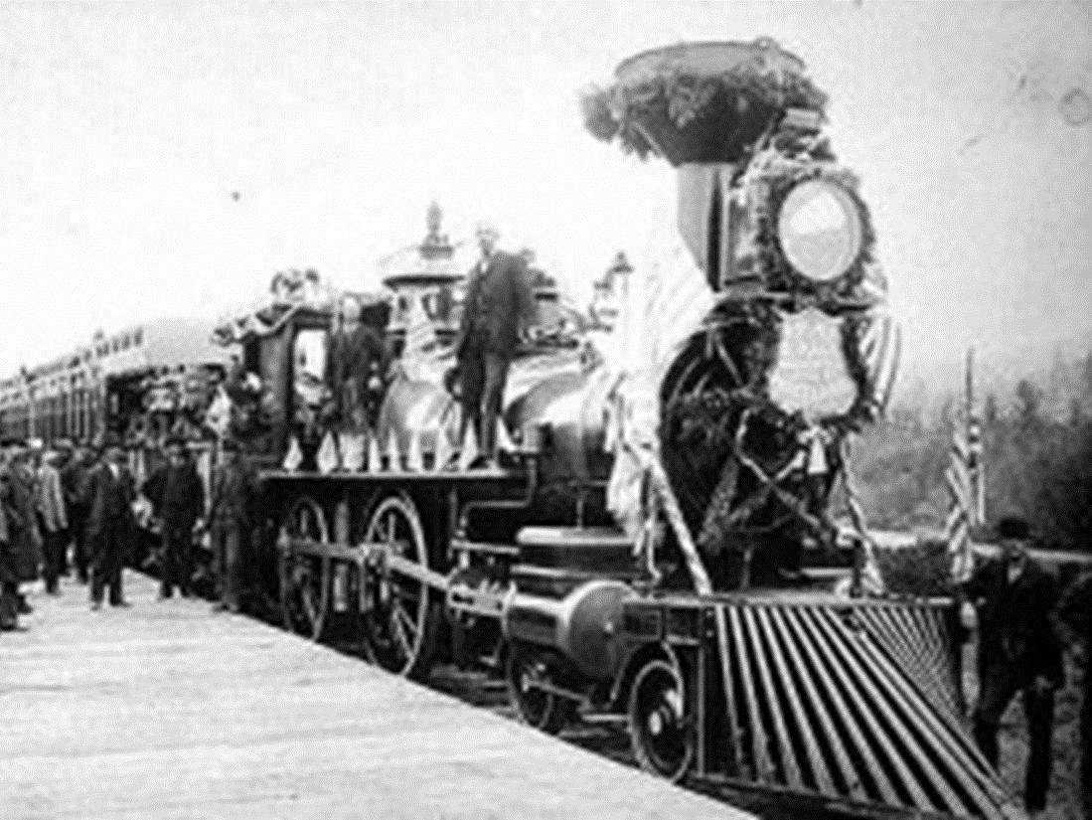
Sitting Bull Speaks in Bismarck, ND
Sept 8, 1883
Upon the completion of the Northern Pacific Railroad, Sitting Bull was invited to the ceremony to deliver a scripted statement in his native tongue, which an officer would translate into English.
Instead of following the script, he said, "I hate all the white people. You are thieves and liars. You have taken away our land and made us outcasts." Only the translator understood what he had said; the officer claimed Sitting Bull was happy to be there, which was met with a standing ovation from the audience. Later, due to the audience's reception, Sitting Bull would go to St. Paul, Minnesota, for another ceremony.

Slide 50
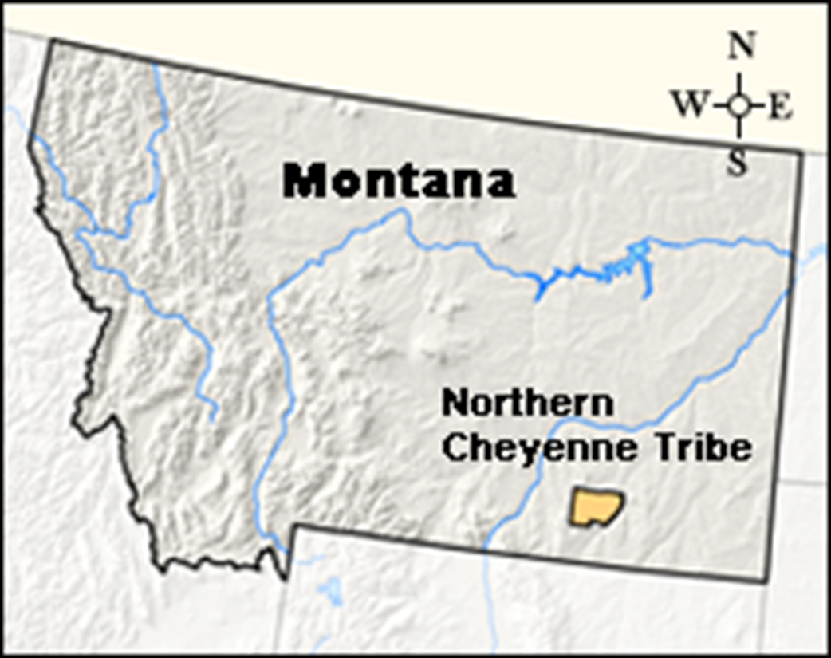
Tongue River Reservation Established
1884
The Tongue River reservation, also known as the Northern Cheyenne reservation, was established. The remaining Cheyenne warriors at Fort Robinson, Dull Knife, and those few now at Pine Ridge were permitted to join their people on the reservation.

Slide 51
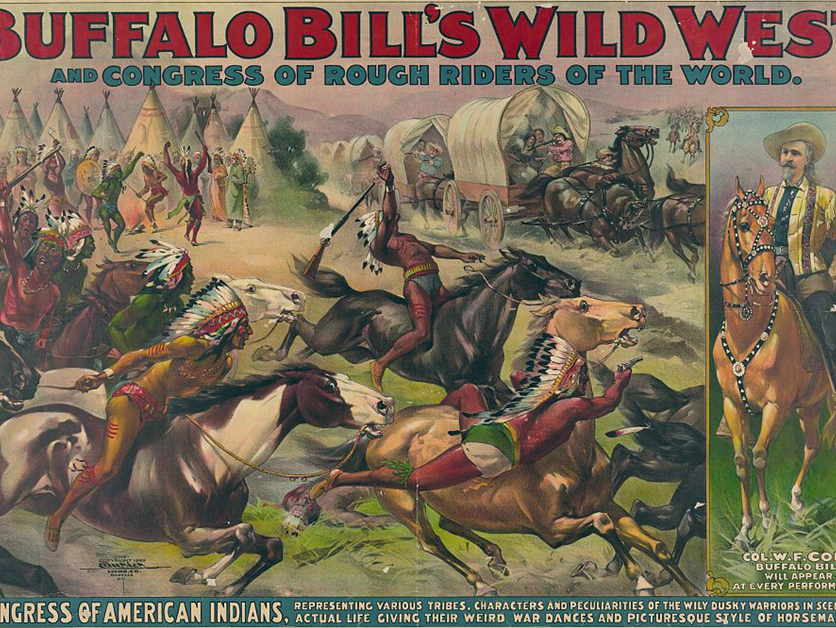
Sitting Bull joins Buffalo Bill's Wild West Show
1885
During the summer of 1885, Sitting Bull was a part of Buffalo Bill's Wild West Show, which traveled across the US and Canada. During the shows, he was booed and called "The Killer of Custer," but was paid to provide autographs. Buffalo Bill gave him two gifts – a white sombrero and a performing horse – when he returned to Standing Rock at the end of the season.

Slide 52
Sitting Bull Refuses to Travel to Europe with Buffalo Bill
1887
Buffalo Bill asked Sitting Bull to rejoin the traveling show for their tour in Europe. Sitting Bull refused, saying "I am needed here. There is more talk of taking our lands."

Slide 53
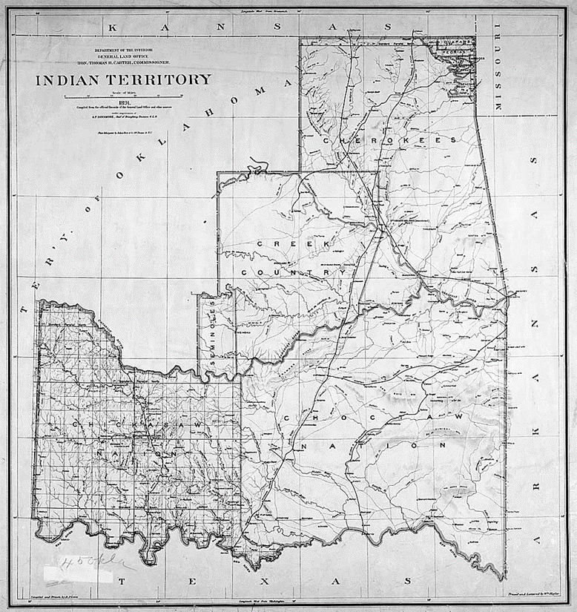
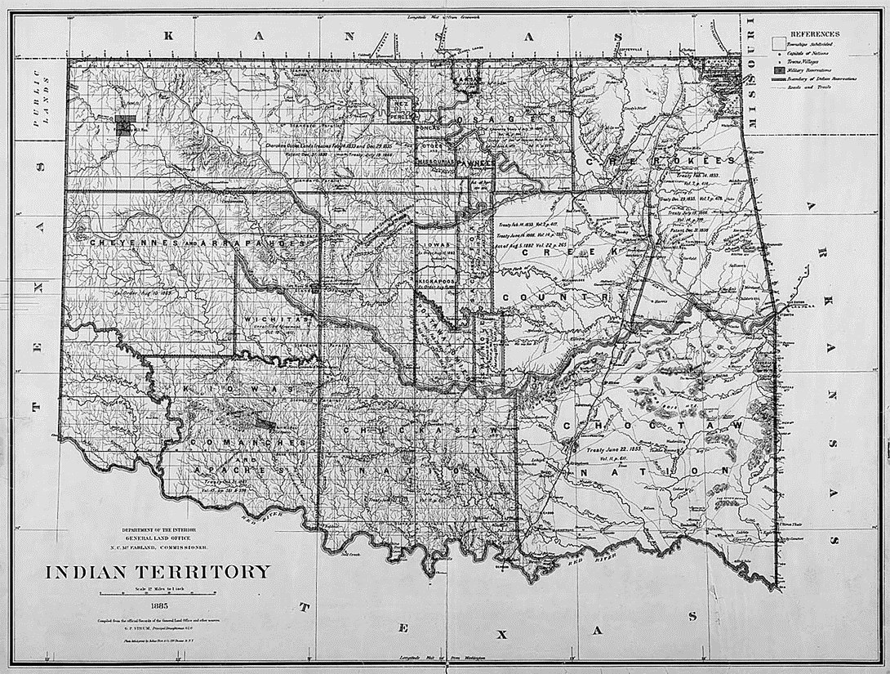
Congress Passes the Dawes Act
February 7, 1887
Also known as the Dawes Severalty Act or General Allotment Act, this law allowed the United States government to break up land designated for a tribal reservation. The goal of this was to get Native Americans to stop living as communal pastoralists and to become sedentary farmers. Those who agreed to the breakup of native land would be given US citizenship. The United States government eventually stripped over 90 million acres of Native American land through the Dawes Act.

Slide 54
Wovoka Receives his Vision
January 1, 1989
Jack Wilson, a medicine man from the Northern Paiute tribe, received a vision during a solar eclipse that prophesied the removal of whites and a return to the traditional pre-contact lives of Native Americans.
Taking the name Wovoka, meaning "woodcutter," at the core of his teachings was the performance of the 'Ghost' dance. The circle dance was practiced to hasten the prophecy and bring upon Wovoka's new world.
The dance also led to the creation of 'ghost' shirts, which were articles of clothing thought to have magical properties, including the power to stop bullets.

Slide 55
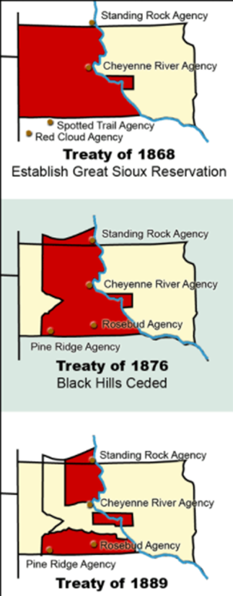
The Sioux Agreement of 1889
March 2, 1889
Beginning in May 1889, Washington sent General Crook to negotiate the signing of a treaty that would force the tribes to sell their land or else have it taken from them entirely.
Crook began at the Rosebud agency due to the death of Spotted Tail leaving the agency divided. Crook informed those present that many Americans were eyeing the land that the Native Americans weren't using. Crow Dog, the man who killed Spotted Tail, was the first to sign the agreement.
He acquired signatures at other reservations until he reached Standing Rock on July 27. Crook described that many at Standing Rock followed closely by Sitting Bull's example, where he sat quietly. Crook managed to secure the signatures of the chiefs present by arranging a secret council away from Sitting Bull and lying to the chiefs present that Sitting Bull knew of the council.

Slide 56
Lakota Leaders Send Delegation
August 1890
Lakota leaders sent a delegation to Nevada in order to investigate Wovoka and his new religion.
The delegate from the Miniconjou Tribe assessed the new religion when he returned to South Dakota, "My brothers, I bring you the promise of a day in which there will be no white man to lay his hand on the bridle of the Indian’s horse, when the red men of the prairie will rule the world and not be turned from the hunting- grounds by any man.”
While some Sioux leaders, including Sitting Bull, were skeptical about the new religion and chose not to adopt it, other leaders saw it as a way to boost morale among the starving and diseased living in the reservation. Following the Ghost Dance movement was open defiance of the reservation's ban on native dancing.

Slide 57
Kicking Bear Visits Sitting Bull
October 9, 1890
Kicking Bear and his brother-in-law Short Bull visited Sitting Bull after taking a pilgrimage to see Wovoka. Sitting Bull asked them to learn more about the Ghost Dance.
Sitting Bull didn't believe that the dead would come back to life, but didn't prevent those dancing the Ghost Dance, although he feared for the safety of those who did. Kicking Bear assured him that the Ghost Shirts were painted with magic symbols that would prevent any harm and stop bullets.
Sitting Bull invited Kicking Bear to stay with his group at Standing Rock to teach them the Ghost Dance.

Slide 58
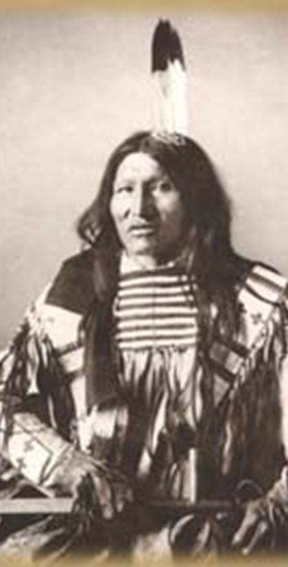
Kicking Bear is Escorted off Standing Rock
October 16, 1890
McLaughlin sent a large force of Indian Police onto the reservation after a previous failed attempt. The police escorted Kicking Bear off the reservation.
The following day, McLaughlin notified Washington that the main power behind the Ghost Dance religion was actually Sitting Bull and recommended his arrest. The commission in Washington decided against arresting Sitting Bull, as they thought it would cause greater trouble.

Slide 59
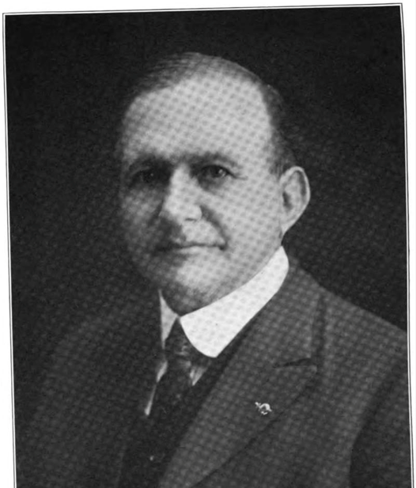
Agent Daniel F. Royer calls for help
October 1890
Daniel F. Royer, an inexperienced and paranoid Bureau of Indian Affairs agent in charge of the Pine Ridge Reservation, wrote to his superiors that "Indians are dancing in the snow are wild and crazy...we need protection and we need it now."

Slide 60
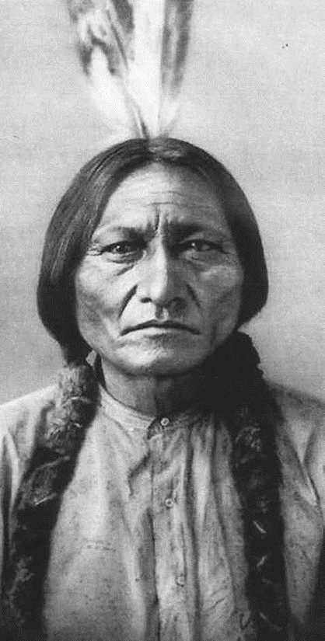
Death of Sitting Bull
December 15, 1890
Sitting Bull, the legendary Lakota Chief who united the Sioux and defeated Custer at the Little Big Horn, was killed by Indian Affairs Agents in the Standing Rock Reservation during his attempted arrest.
The U.S. government was frightened by the popularity of the Ghost Dance movement and feared Sitting Bull would use it as a tool to rebel.

Slide 61
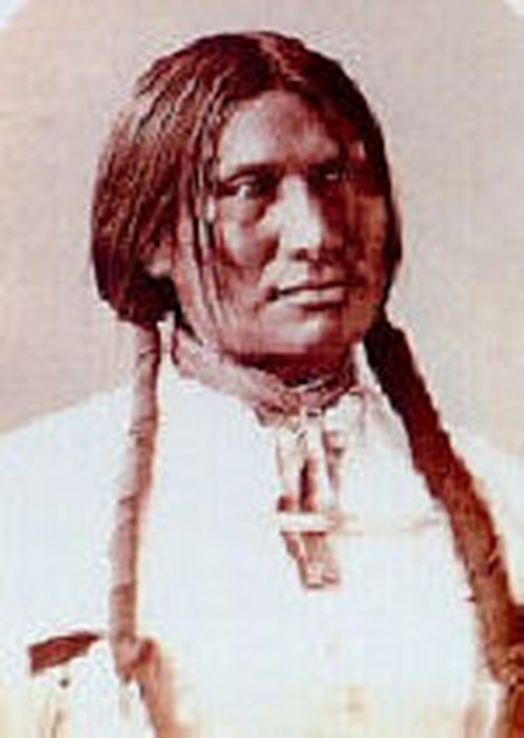
Big Foot Captured by 7th Cavalry
December 28, 1890
Big Foot (AKA Spotted Elk) was leading a group to Standing Rock, but upon hearing of Sitting Bull's death, he turned his group towards the Pine Ridge reservation in hopes that they would be protected by Red Cloud.
The 7th Cavalry came across the group, and at this point, Big Foot was extremely ill. The commander of the 7th Cavalry, Whitside, informed Big Foot that he had orders to take the group to the Wounded Knee Camp nearby.

Slide 62
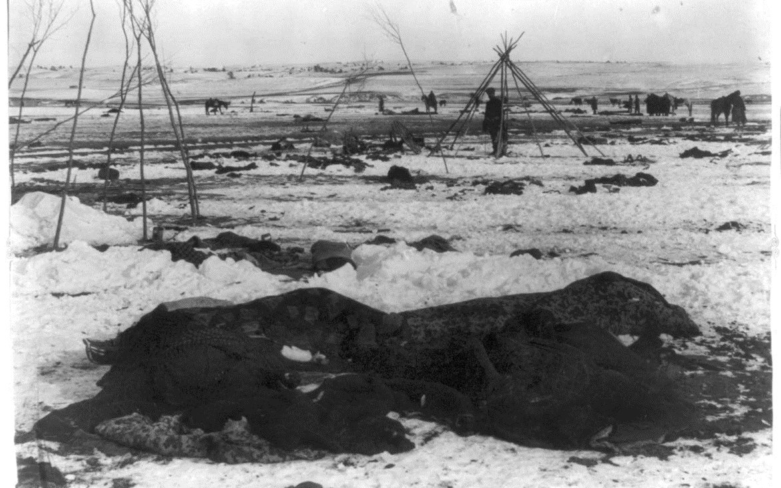
Wounded Knee Massacre
December 29, 1890
The band under Big Foot amounted to 120 men and 230 women and children of Lakota.
After camping the night, Major Whitside begins to disarm the group. There were very few guns, and during this process, some members of the tribe began to perform the Ghost Dance. At the same time, the soldiers were attempting to disarm a young man named Black Coyote, who announced that he had paid good money for his gun. Reports indicate that Black Coyote was also deaf. The soldiers struggled to disarm Black Coyote, and a shot was fired.
Upon this, the entire 7th cavalry began to open fire on the Native Americans present. 153 were known to have been killed initially, but many were wounded and died later. Estimates place the total number of deaths at just under 300 of the original 350 men, women, and children. The soldiers lost 25 and 29 were wounded, with accounts that the majority of these were due to their own bullets and shrapnel. Many of the dead Native Americans were left in the snow and ice.

Slide 63
20 Medals of Honor awarded to the 7th Cavalry
1891
The United States government awarded 20 members of the 7th Cavalry who massacred the Sioux at Wounded Knee the highest military honor for bravery.

Slide 64
Crager Gives items to Kelvingrove Museum
1892
A reporter who was present in the aftermath of the Wounded Knee Massacre gave a number of items to the Kelvingrove Museum in Glasgow, Scotland after traveling with Buffalo Bill's Wild West Show in Europe. Included among these items was a ceremonial Ghost Dance Shirt thought to originate from the Wounded Knee Massacre.

Slide 65
Death of Wovoka
Sep 20, 1932
Wovoka dies of prostate cancer at the age of 75. In the end, his prophecy did not come true. Most Native Americans gave up the Ghost Dance movement after the Wounded Knee Massacre.
Wovoka himself became disheartened by the movement saying, "Today, I call upon you to travel a new trail...the only trail now open–the white man's road.”
However, even after his death, Wovoka was still revered for his mystical powers and held an important place in establishing a collective Native American identity.

Slide 66
Occupation of Wounded Knee
Feb 27, 1973 – May 8, 1973
In protest over the failed impeachment of Pine Ridge Reservation Chairman Dick Wilson, over 200 Oglala Sioux occupied the town of Wounded Knee and held out in a 71-day siege from the FBI and the local law enforcement.
Under the flag of the American Indian Movement (AIM), a pan-Indian civil rights organization, the occupation attracted widespread media and law enforcement coverage.
The siege ended with the death of a supporting Cherokee tribesman and the execution of civil rights activist Ray Robinson at the hands of Dick Wilson's private militia.

Slide 67
Visitor Identifies the Ghost Dance Shirt
1992
An American lawyer of Cherokee descent John R. Earl recognized the Ghost Dance shirt on display while visiting the Kelvingrove Museum in Glasgow and informed the Lakota Sioux in the United States. Shortly thereafter, there was a written request for the items in the collection to be returned.

Slide 68
Ghost Dance Shirt Repatriated
November 1998
The Kelvingrove Museum agreed to return the Ghost Dance Shirt to the Lakota Sioux, with the initial display taking place at the South Dakota Cultural Heritage Center until the Lakota Sioux could display it themselves. A handmade replica was provided to the Kelvingrove by the tribe to provide an educational benefit and connection between the two entities.

Slide 69
Conclusion
The Wounded Knee Massacre had a devasting impact on the Ghost Dance Movement and Native American hopes for returning to life before the arrival of Europeans. For decades, the United States government and media presented the Wounded Knee, as a "battle" and even reenacted the events for years to come. Wounded Knee has had a huge effect on the collective memory of modern Native Americans and their relationship with the United States government.

