Slide 1
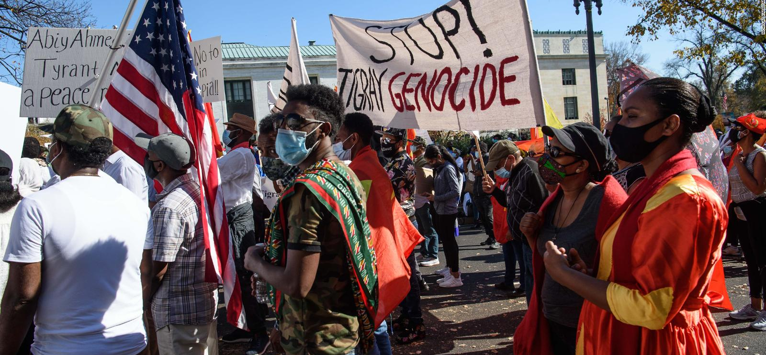
Ethiopia’s Genocides
Authors: Nat Hill, Faith Marie Stahl, Deanna Wilken (Genocide Watch)
Ethiopia has experienced several conflicts and genocides since the first Italian occupation in 1895. This Timestream provides a brief history of Ethiopia beginning with the First Italo-Ethiopian War, and focuses on the atrocities committed during the Red Terror under Mengistu Haile Mariam, the executions by the transitional government under Meles Zenawi, and the current genocide in Tigray. As of May 2021, Genocide Watch considers Ethiopia to be in Stage 9 of the 10 Stages of Genocide: Extermination.

Slide 2
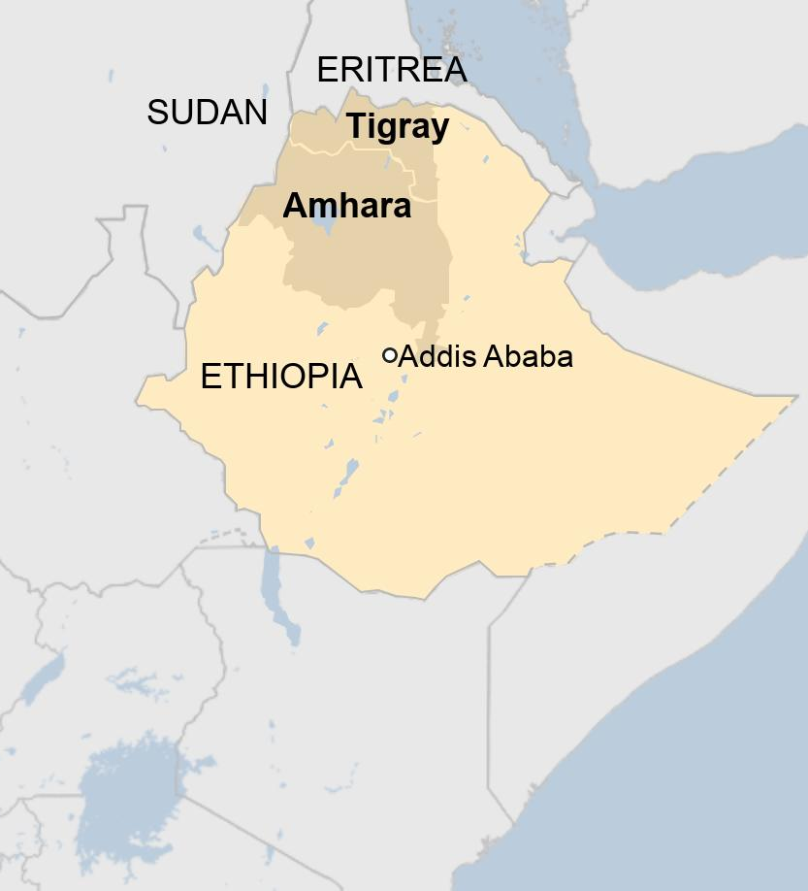
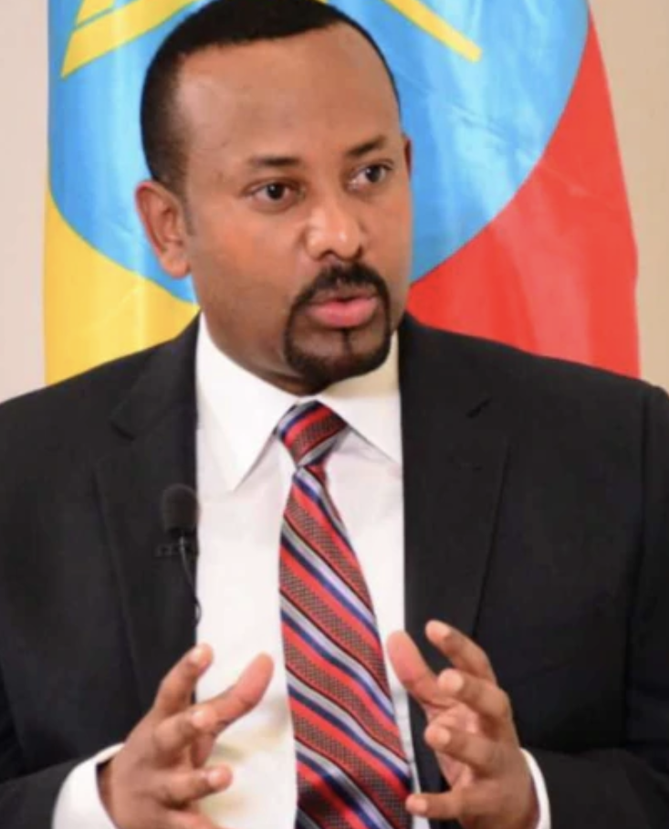
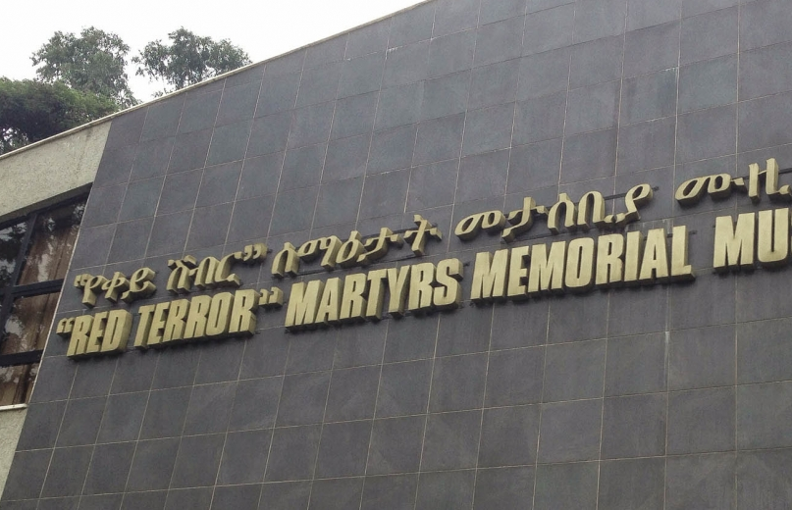
Key Findings
May 2021
Ethiopia has experienced continual conflict since 1895, most notably the Red Terror of the 1970s and today's genocide in Tigray.
Several periods of famine weakened the country during periods of war and internal strife.
Despite peace-making efforts with Eritrea, Ethiopia's Prime Minister Abiy Ahmed's term has been consistently impacted by protests and ethnic violence.
War crimes and genocide in Tigray are still occurring, despite claims that Eritrean troops and Ethiopian federal troops would begin to withdraw from the conflict zone.

Slide 3
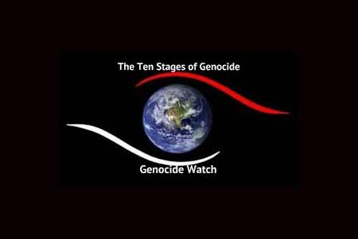
The Ten Stages of Genocide
November 2020
The Ten Stages of Genocide were developed by Dr. Gregory Stanton, Founder of Genocide Watch. Genocide is a process that develops in ten stages that are predictable but not inexorable. At each stage, preventive measures can stop it. The process is not linear. Stages may occur simultaneously. With the continual mass killings of Amharas, Tigrayans, Oromos, and Gedeo peoples, Ethiopia is in Stage 9: Extermination.

Slide 4
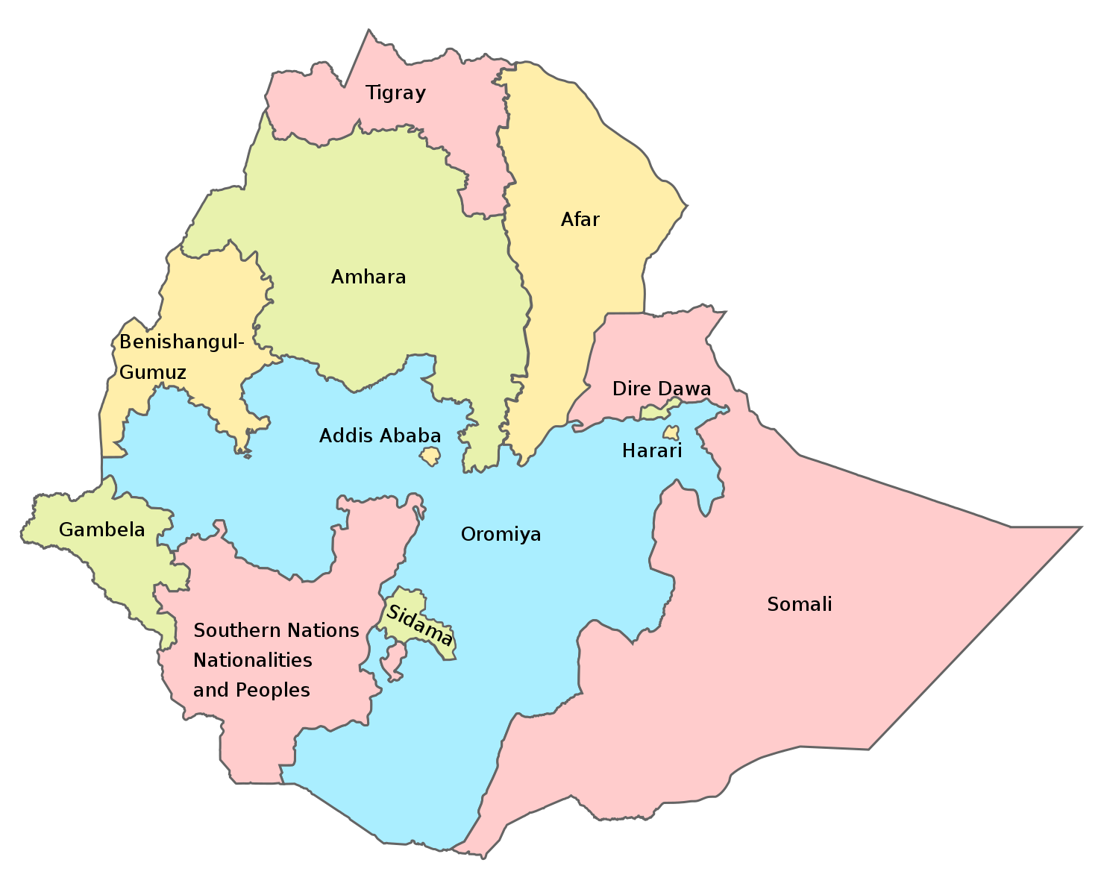
Ethiopia: Country Profile
Ethiopia is the oldest independent country in Africa and has never been colonized.
The country faced Italian aggression in the late 1800s and was occupied by Italy from 1936-1941.
Emperor Haile Selassie ruled Ethiopia from 1930 until he was overthrown in 1974.
With the assistance of the Derg, a socialist military junta, Mengistu Haile Mairam seized power in 1977.
Mengistu led a brutal genocidal campaign through 1991 when the Ethiopian People’s Revolutionary Democratic Front (EPPDF) ousted him.
In 1993, Eritrea became independent following a referendum.
The 1994 constitution divided Ethiopia into ethnically-based regions.
Meles Zenawi became Prime Minister of Ethiopia in 1995.
A border war between Ethiopia and Eritrea began in 1999 until reaching resolution in 2018.
Abiy Ahmed became new Prime Minister of Ethiopia in 2018, and immediately launched political reforms.
In November 2020, tensions erupted in the Tigray region after a state election was deemed unconstitutional.

Slide 5
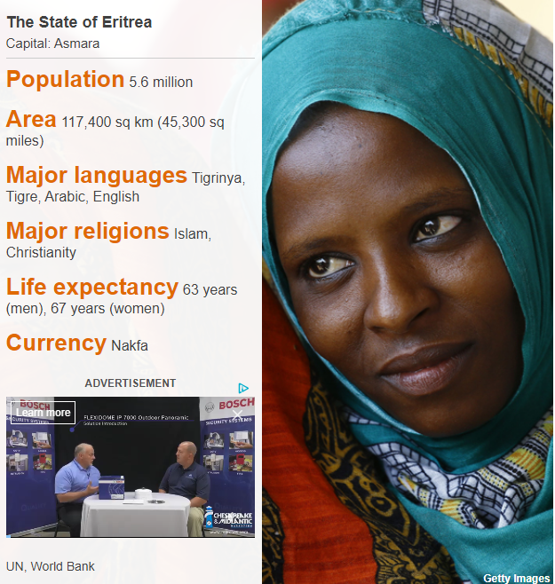
Eritrea: Country Profile
Eritrea was a province of the Ottoman Empire during the 16th century but came under Italy’s control in the late 1800s.
The British army conquered Eritrea in 1941, but Italian control was not relinquished until 1947.
Ethiopia annexed Eritrea in 1952.
Eritrea gained independence from Ethiopia in 1993.
Eritrean-Ethiopian border clashes between 1998-2001 turned into a full-scale war, killing roughly 70,000 people.
The UN sanctioned Eritrea in December 2009 for "its alleged support" for Islamist insurgents in Somalia.
In 2014, the UNHRC issued a report that estimated about six percent of Eritrea's population fled the country over repression and poverty.
Two years later, the UNHRC asked the African Union "to investigate Eritrean leaders for alleged crimes against humanity."
July 2018, Ethiopia and Eritrea finally end their war.
Considered a militarized one-party state run by the People’s Front for Democracy and Justice (PFDJ) president Isaias Afewerki.

Slide 6
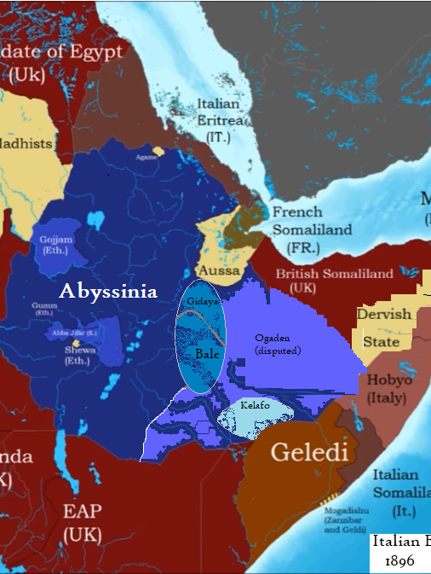
Italian Eritrea
January 1, 1882 to December 31, 1936
Eritrea was Italy's first and longest-held colonial territory. During the 1870s and 1880s, Italians were campaigning for a colonial empire of their own. After Italian companies purchased the Red Sea port of Assab, the Kingdom of Italy began expanding from the coast and came into increasing conflict with Abbisyina. Abbisyina had managed to remain independent during the Scramble for Africa. Italy and Ethiopia fought a war from 1887-1889 over control of Eritrea. The Italians won and annexed what is the modern-day borders of Eritrea. Like every other colonial government in Africa, Italian rule in Eritrea was oppressive, exploitative, and violent. Italian settlers were given the best land, which was forcibly taken from local Eritreans. Eritrean women were taken as "madams" for colonial officers into sexual slavery. During fascist rule, the Eritrean landscape was rebuilt in Mussolini's utopian vision, with hundreds of Italian buildings still standing today.

Slide 7
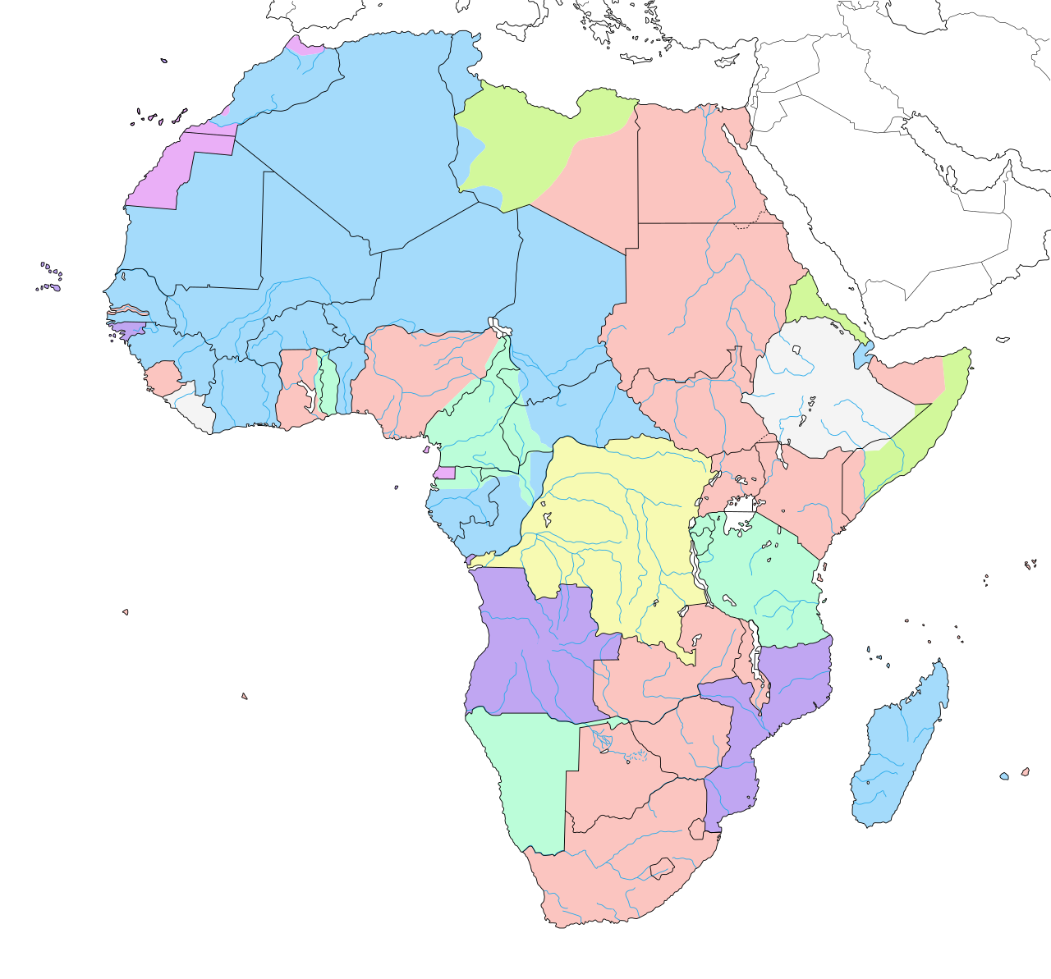
Scramble for Africa
January 1884
Also known as the Berlin Conference, the European powers carved up Africa into various colonial entities. Only Liberia and Ethiopia remained independent from colonialism after the conference.

Slide 8
The Great Famine of 1888-1892
1888 to 1893
Sometimes called the "Evil Days," the 1888 Ethiopian Famine is possibly the worst in Ethiopian history. Coinciding with the Italian invasion, a large-scale rinderpest epidemic killed cattle and crops. This combination killed thousands of Ethiopians by starvation.

Slide 9
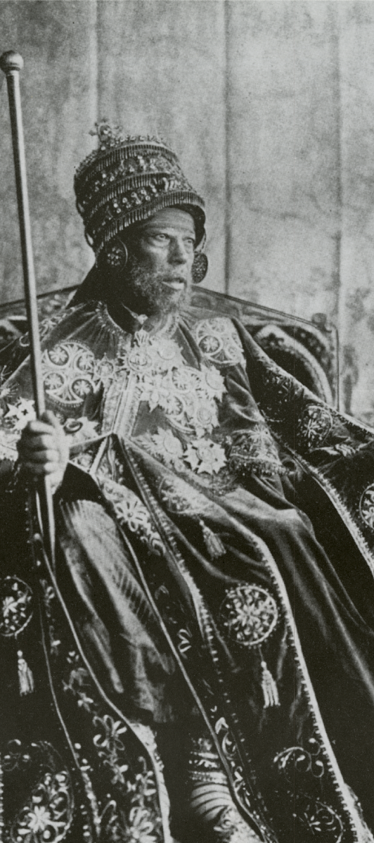
Reign of Menelik II
1889 to 1913
Born Sahle Maryam and coronated in 1889, King Menelik II took the Ethiopian throne after his predecessor, King Yohannes II, was killed in battle by Sudanese Forces. Menelik can be considered as the first modern ruler of what is now called Ethiopia. Menelik began a large-scale modernization campaign to unite the disparate Ethiopian ethnic, tribal, religious, and political groups. Menelik abolished the slave trade, modernized the army, introduced railways, roads, and other modern infrastructure, and invited foreign diplomats and consultants. Menelik is probably best known for his victory over the Italian Army at the Battle of Adwa, which allowed the Ethiopians to remain free from colonization for the next 30 years.

Slide 10
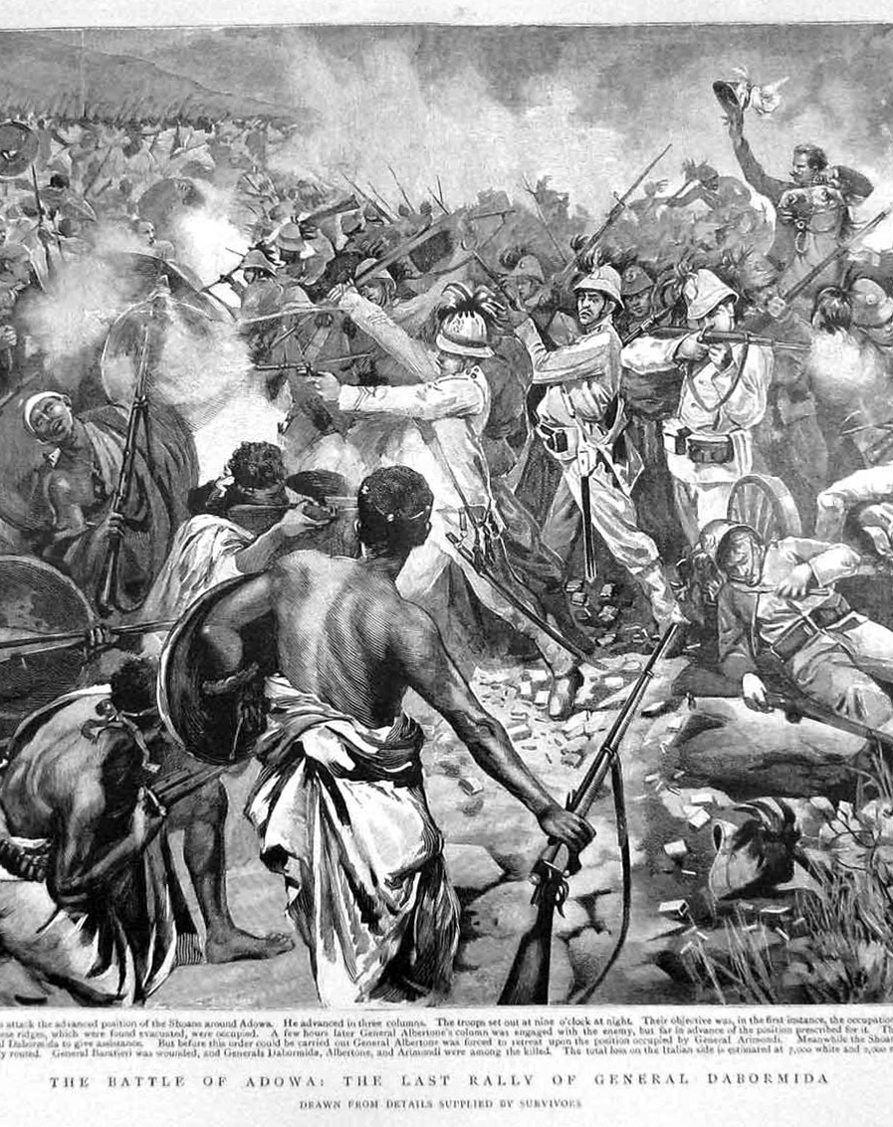
Battle of Adwa
March 1, 1896
In 1896, the Italians broke the Wuchale, which demarcated the border between Italian Eritrea and independent Ethiopia. The Italian Army and their recruited Eritrean Ascaris invaded Ethiopia, attempting to take control over the capital at Addis Abba. 15,000 Italians, under Oreste Baratieri, met 100,000 Ethiopians at the town of Adwa. The Ethiopians crushed the Italians, killing nearly 4,000. Italy's defeat was a shock to the world and one of the few times an invading colonizing army was defeated in battle. Italy withdrew from the Ethiopian territory and signed the Treaty of Addis Ababa that guaranteed Ethiopia its independence. The Battle of Adwa is a landmark moment in Ethiopian history and is a national holiday. For the Italians, it was a huge disgrace. Revenge contributed to fascist Italy's invasion 40 years later.

Slide 11
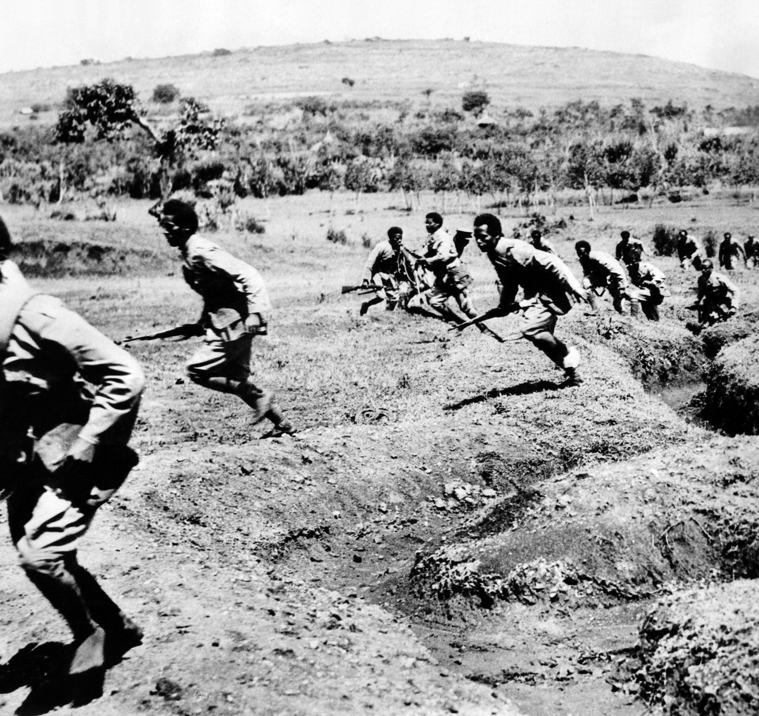
Italian War Crimes
1935 to 1945
The Second Italian invasion of Ethiopia was marked by horrific crimes committed by the Italian fascists against Ethiopian troops and civilians. The Italians allegedly used mustard gas and other chemical weapons on the Ethiopians around 300 times. The Italian air force indiscriminately bombed cities, villages, and fleeing refugees. The international community only really took notice when the Italians began targeting Red Cross camps and hospitals with poison gas and high explosives.

Slide 12
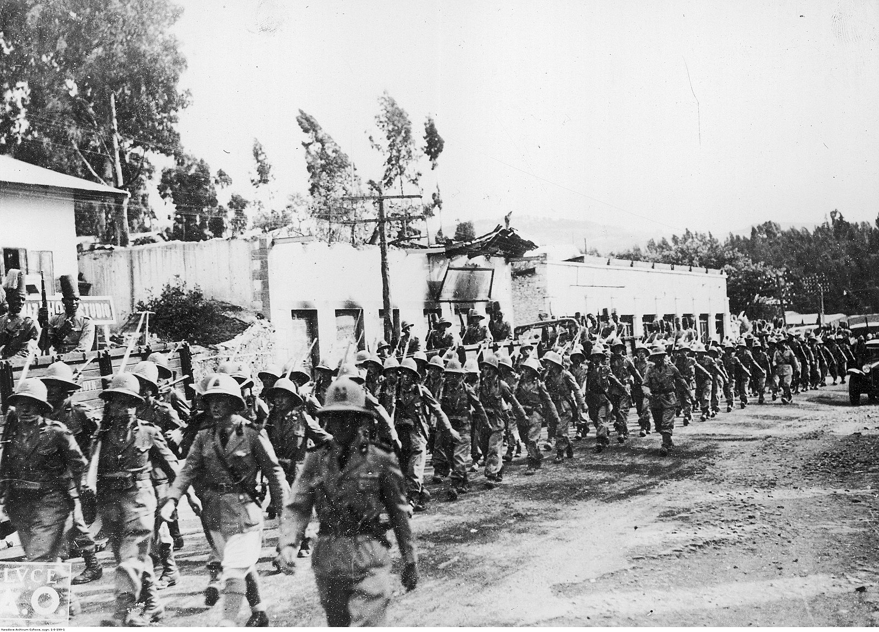
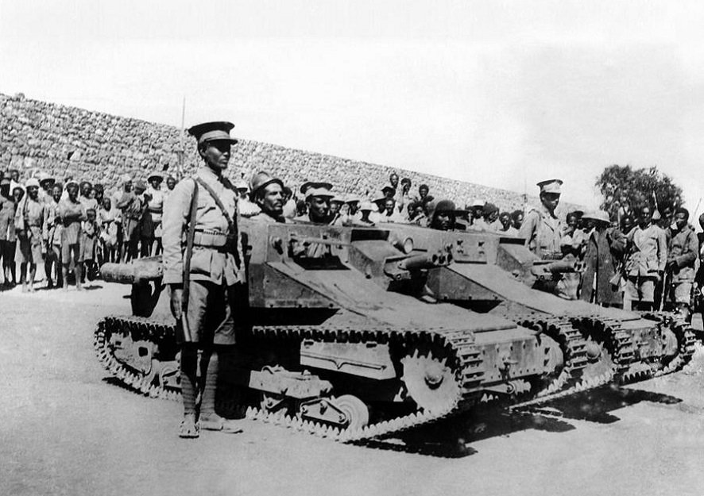
Second Italo-Ethiopian War
October 3, 1935 to February 19, 1937
Under Benito Mussolini, Italy attempted once again to conquer Ethiopia at whatever cost. In 1935, the Italian Army under the command of Emilio De Bono invaded Abyssinia from Italian-controlled Somalia and Eritrea. Despite a spirited and brave defense by the Ethiopians in the face of invasion, the Italians managed to capture Addis Abba in 1936, and King Haile Selassie fled to exile in London. The Italian Army used chemical weapons, tanks, and aerial attacks against Ethiopian soldiers and civilians alike in violation of the Laws of War.

Slide 13
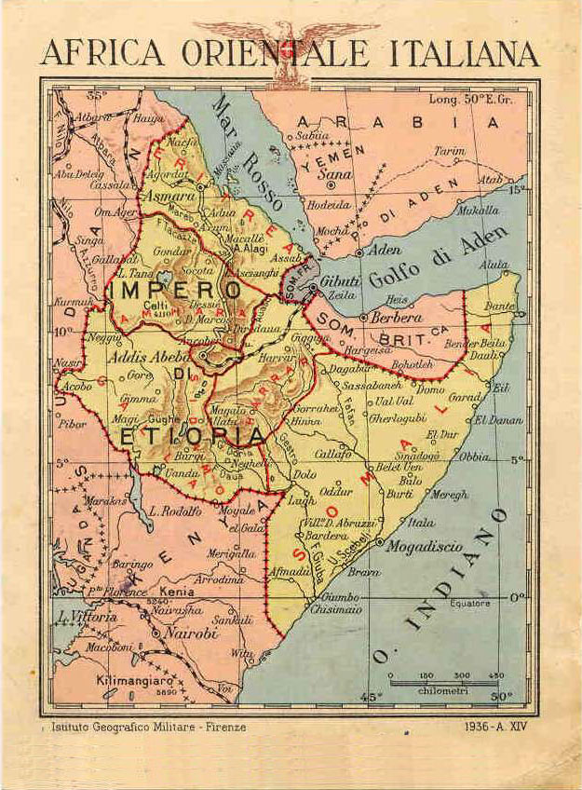
Italian East Africa
1936 to 1945
Africa Orientale Italiana comprised of Italian Eritrea, Somalia, and Ethiopia. It was Benito Mussolini's attempt at creating his dream of a fascist Roman Empire. Italian rule in East Africa was oppressive and exploitative to the local populations. The best farming and grazing land was given to Italian settlers. Italians committed brutal reprisals against native resistance and oppressed native culture.

Slide 14
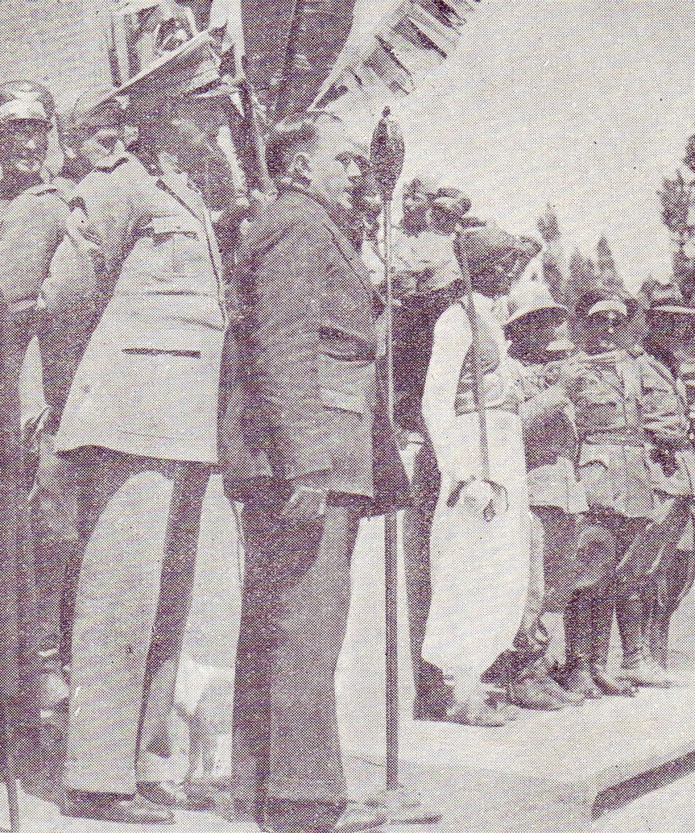
Yekatit 12
February 19-21, 1937
Ethiopian agents attempted to assassinate the Italian Marshal Rodolfo Graziani, the Marquis of Negele and the Viceroy of Italian East Africa. In reprisal, the Italians embarked on a massive campaign of extermination and imprisonment. An estimated 30,000 Ethiopians were murdered by Italian soldiers and civilians. Victims were beheaded and their corpses mutilated. The event is remembered in Ethiopia as Yekatit "February" 12th.

Slide 15
Reign of Haile Selassie
April 2, 1930 to September 12, 1974
After the death of Queen Regent Zewditu in 1930, Ras Tafari Makonnen, more known by his royal title, Haile Selassie, became the emperor of Ethiopia. A landmark figure in Ethiopia's history, Selassie came to the world stage when he addressed the League of Nations in protest over the Italian invasion of Ethiopia. After helping defeat the Axis powers during World War II, Selassie began a widespread modernization campaign of Ethiopia, including abolishing slavery and introducing Ethiopia's first written constitution. Selassie also had a major role in establishing the groundwork for the African Union and is even revered as a god incarnate by the Rastafari Movement. Despite his accomplishments in defeating fascism and introducing reforms into Ethiopian society, one could view his rule as autocratic, authoritarian, and oppressive. His favoritism of the Ethiopian Orthodox Church, enforcement of Amharic culture and language, and forceful annexation of Eritrea contributed to his deposal and alleged assassination by the Derg in 1975.

Slide 16
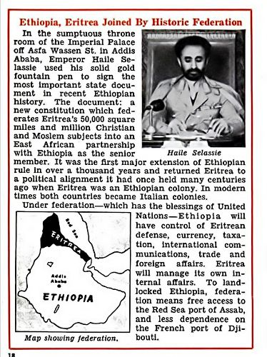
Federation of Ethiopia and Eritrea
1952 to 1962
Under the United Nations, what was former Italian Eritrea formally joined the Kingdom of Ethiopia, with Eritrea being given nominal autonomy. Under the federation, the Tigray language was repressed, and Eritrean Muslims were alienated. Ethiopia would later annex Ethiopia in violation of the treaty.

Slide 17
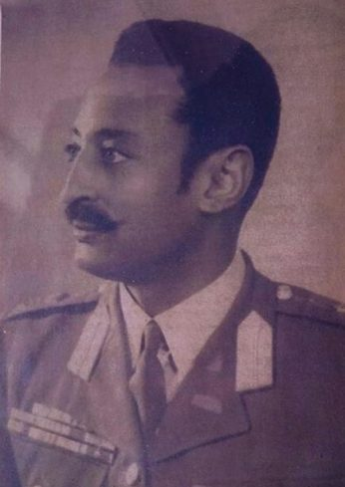
1960 Ethiopian Coup Attempt
December 13-17 1960
Four conspirators, known as the Council of the Revolution, led by commanders from the Ethiopian Imperial Guard, attempted to overthrow Haile Selassie while he was away on a state visit. After securing the imperial palace in Addis Ababa and issuing an 11-point proclamation for a new government, several members of the king's staff were murdered. The rebels attempted to sway public opinion in their favor, yet the population, the army, and the imperial guard remained loyal to the king. In the end, the coup failed and all conspirators were executed or committed suicide.

Slide 18
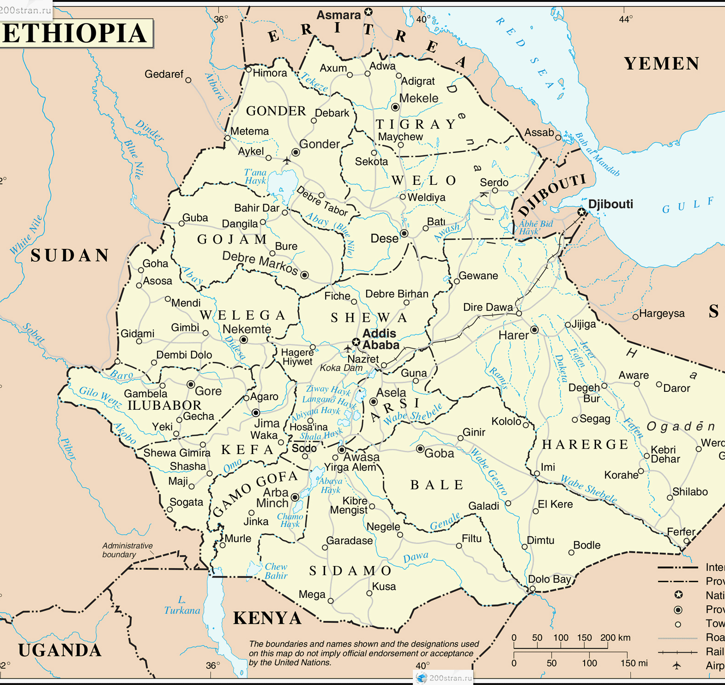
Annexation of Eritrea
1962
Ethiopia, under Haile Selassie, illegally annexed Eritrea in violation of UN Resolution 390(A). Eritrea became part of the Kingdom of Ethiopia.

Slide 19
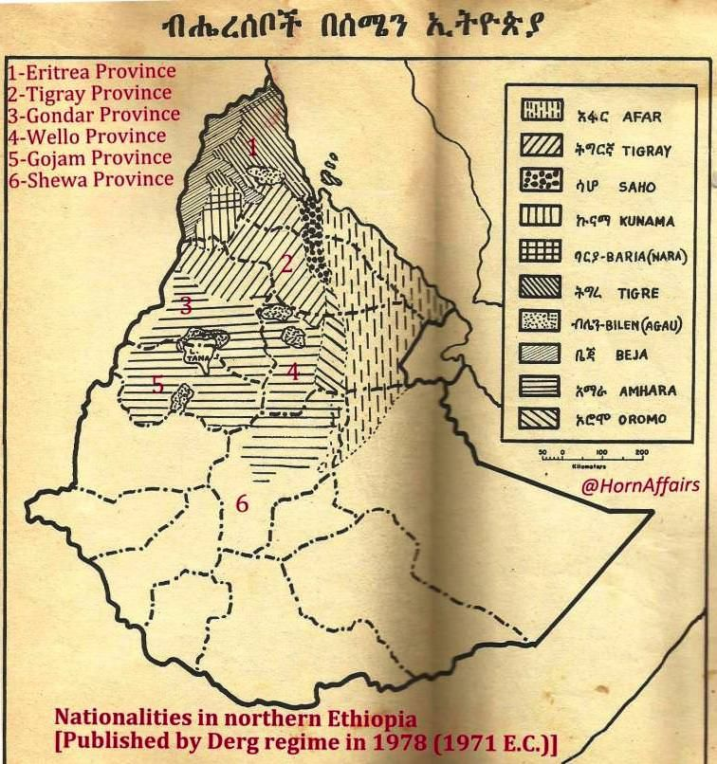
1967 Ethiopian Offensives
The Ethiopian military enacted three large-scale offensives against the Eritreans rebels. The Ethiopian Army burned 62 villages and killed over 400 civilians and thousands of cattle. 25,000 Eritreans fled as a result.

Slide 20
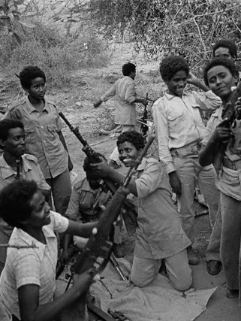
Eritrean People's Liberation Front
1970 to 1994
In the 1970s, several disaffected groups split off from the Eritrea Liberation Front and formed the Eritrean People's Liberation Front under the leadership of Isaias Afwerki. The EPLF then became the dominant party in the fight for Eritrean Independence and later became the People's Front for Democracy and Justice, the only political party legally allowed in Eritrea.

Slide 21
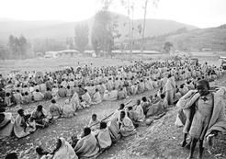
The Wollo Famine
1972 to 1973
Between 40,000 and 80,000 people died during the famine in Wollo. The famine was blamed on drought, a backward and impoverished social system, and the cover-up attempted by the imperial government.

Slide 22
Eritrean Civil Wars
February 1972 to October 13, 1974
The two liberation movements fighting for Eritrean Independence, the ELN and the EPLF break out into civil war in the 1970s and 1980s over ideological and political differences. The EPLF eventually wins in 1980 totally defeating and dissolving the ELN.

Slide 23
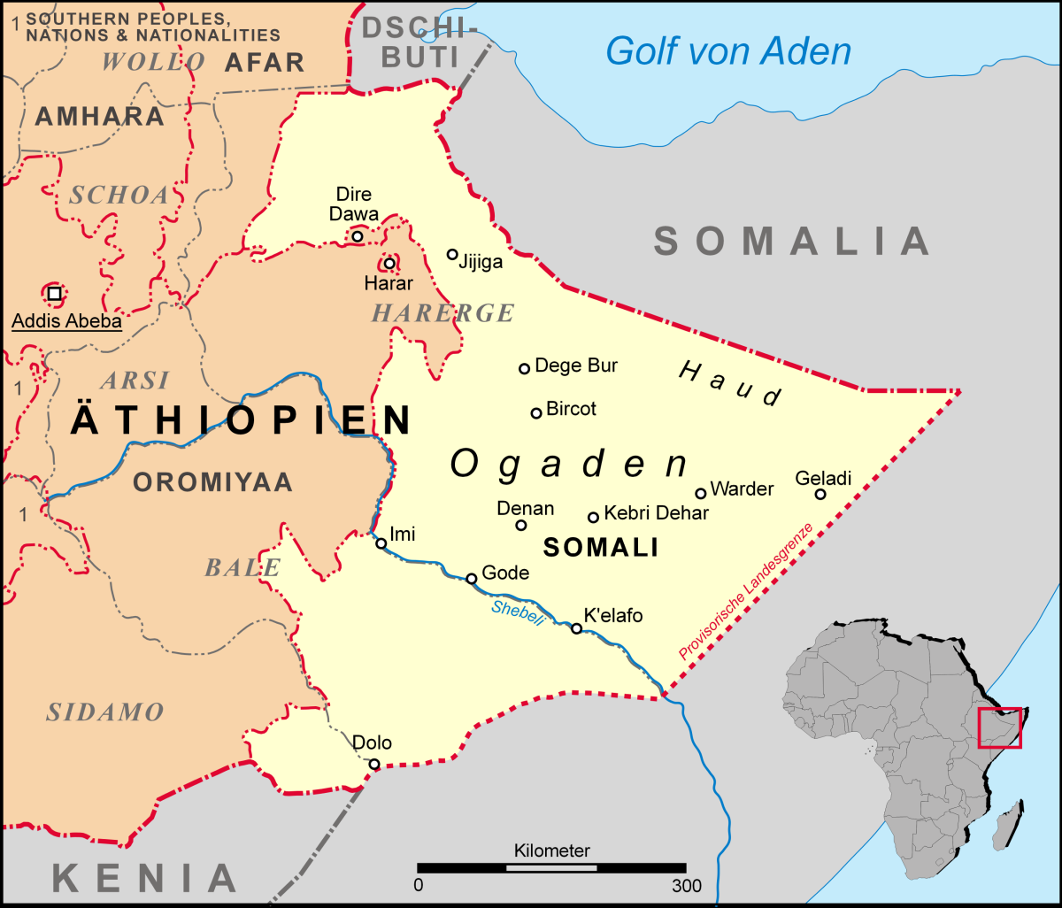
The Ogaden Famine
1974 to 1975
In 1974, Ogaden was struck by famine following a severe drought. The loss of pastures to immigrant farmers, restrictions on movement, and continued armed clashes all contributed to the famine. An estimated 55,000 people in this region died from famine.

Slide 24
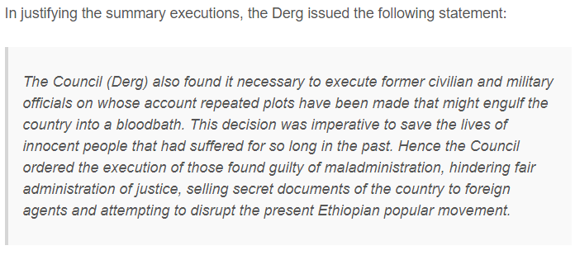
"Bloody Saturday"
November 23, 1974
In a bloody coup, Mengistu and the Derg party overthrew then Emperor Haile Selassie. An estimated 60 officials who had served under Selassie were executed.

Slide 25
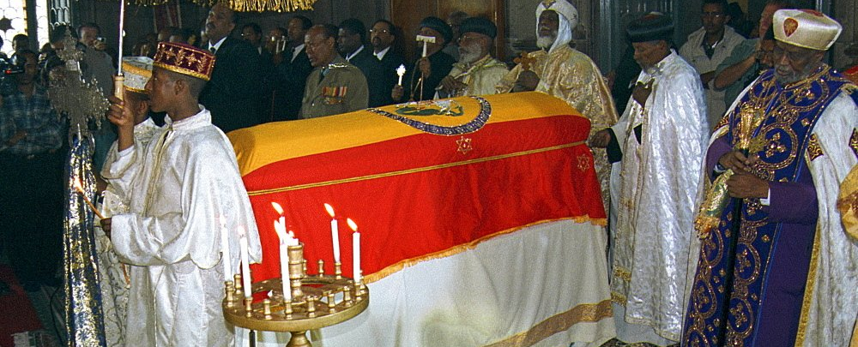
Death of Haile Selassie
August 27, 1975
After the Derg seized power in 1975 and imprisoned the 82-year-old king, the state media claimed that Selassie died of complications from a prostate operation. However, several internal Derg documents and eyewitnesses in the 1994 trial claim that Selassie was strangled by Derg officers and his remains buried under a latrine. His remains were eventually found and reburied by the Ethiopian Church. Some of his followers in the Rastafari movement still debate whether he actually died in 1975.

Slide 26
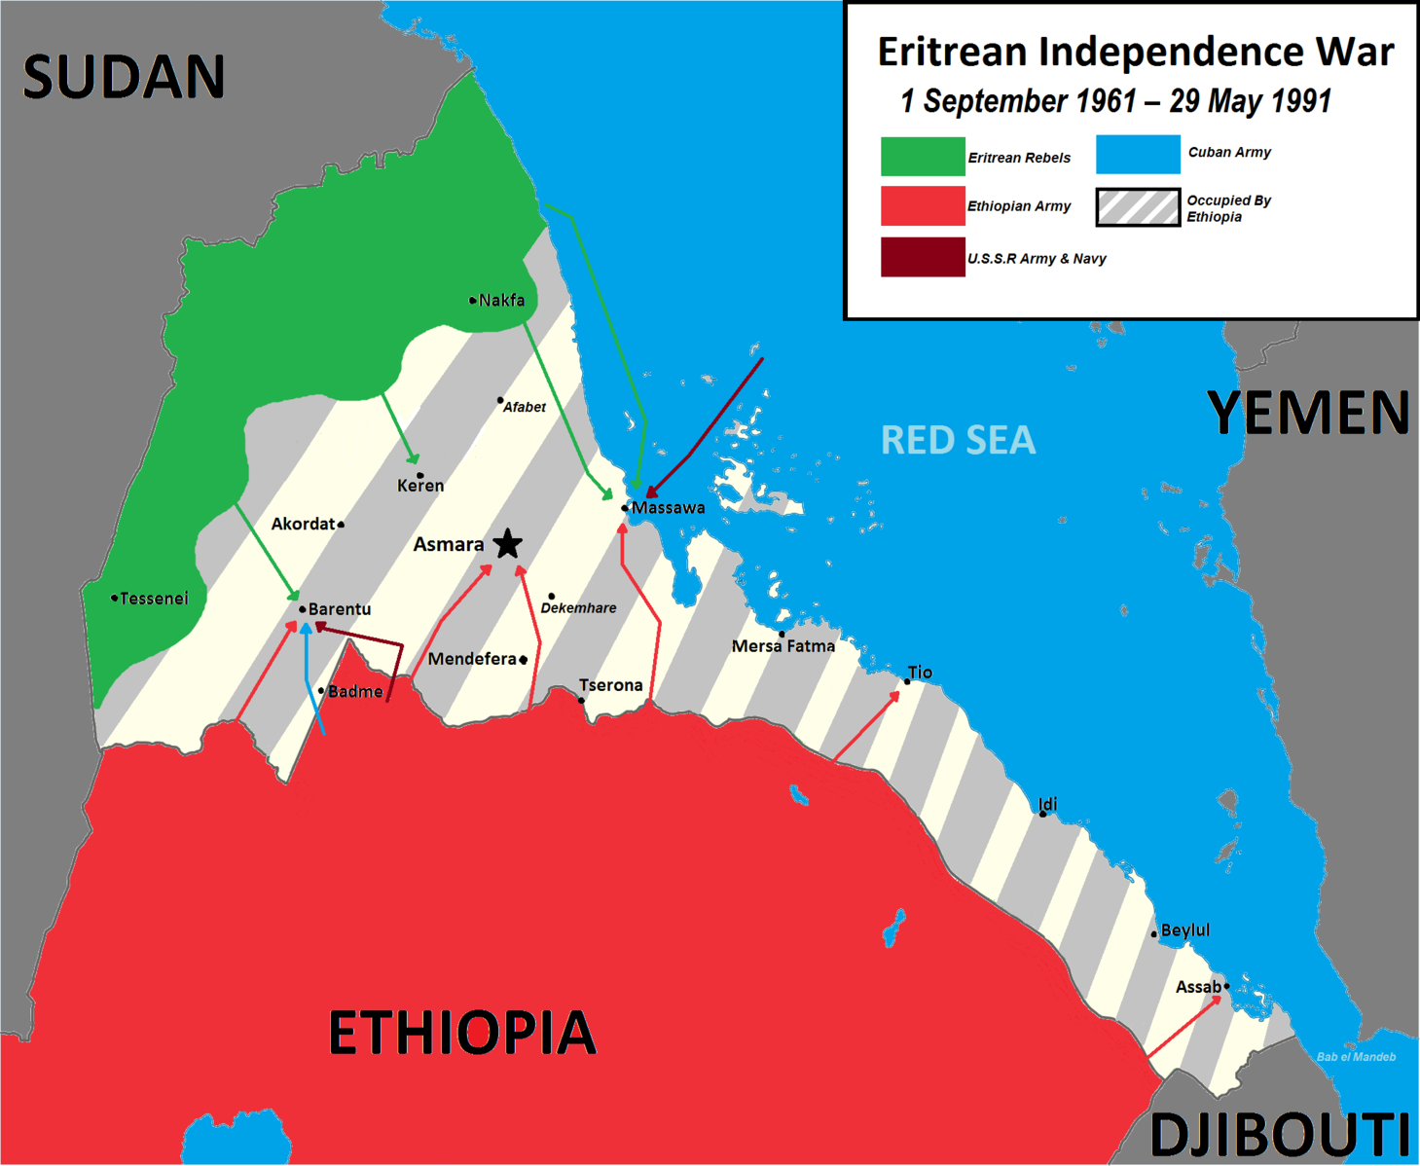
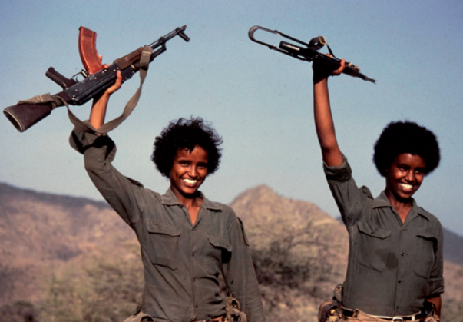
Eritrean War of Independence
September 1, 1961 to May 28, 1991
After being annexed by Ethiopia, several Eritrean dissidents formed the Eritrean Liberation Front to fight for their independence. During a brutal 30-year war, hundreds of thousands of people were killed, starved, displaced, and maimed. Eritrea formally gained its independence in 1991. The Eritrean Liberation Front eventually lost power after it was defeated in a long civil war with the Eritrean People's Liberation Front, lead by Isaias Afewerki.

Slide 27
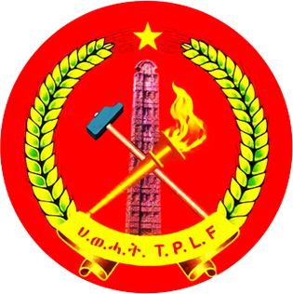
180 People Executed
June 1976
Following a battle between the Derg and TPLF, the Derg rounded up 180 civilians in the market square and executed them using machine guns.

Slide 28
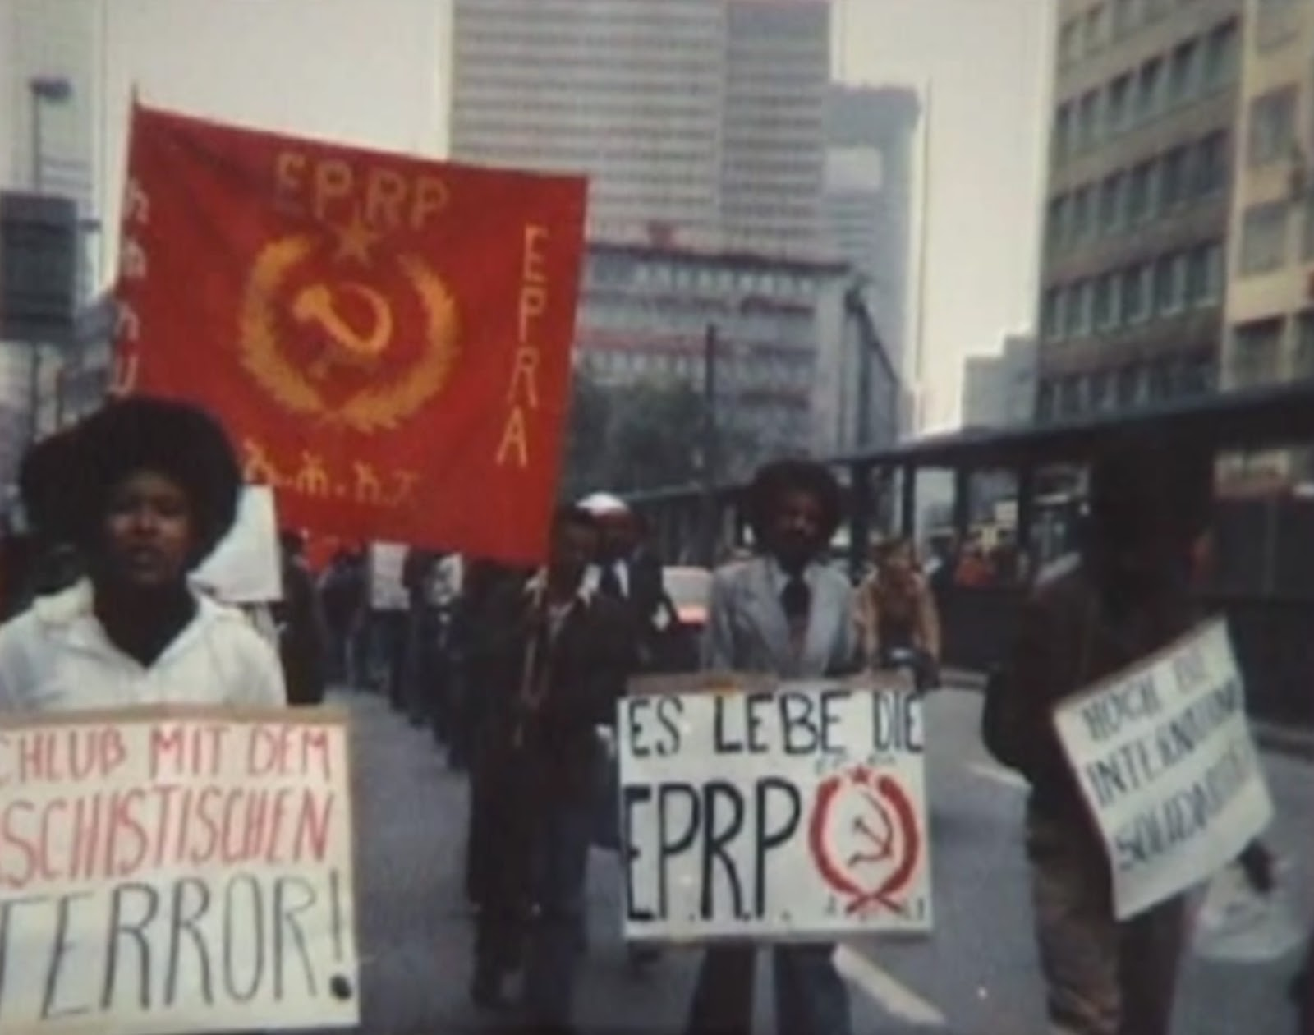
21 EPRP Members Executed
October 21, 1976
Beginning in September 1976, people suspected of being members of EPRP were killed, but exact numbers weren't reported until October.

Slide 29
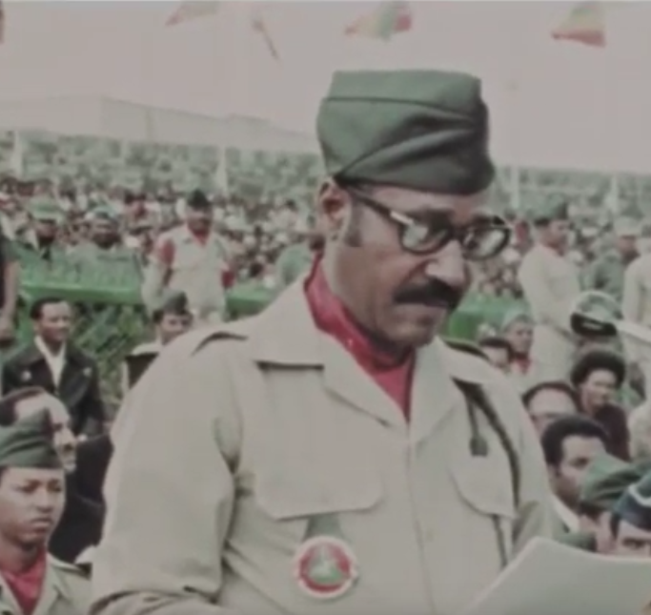
EPRP General Teferi Bante Killed
February 1977
The murder of General Teferi Bante by Mengistu was said to be the official start of the Red Terror in Ethiopia.

Slide 30
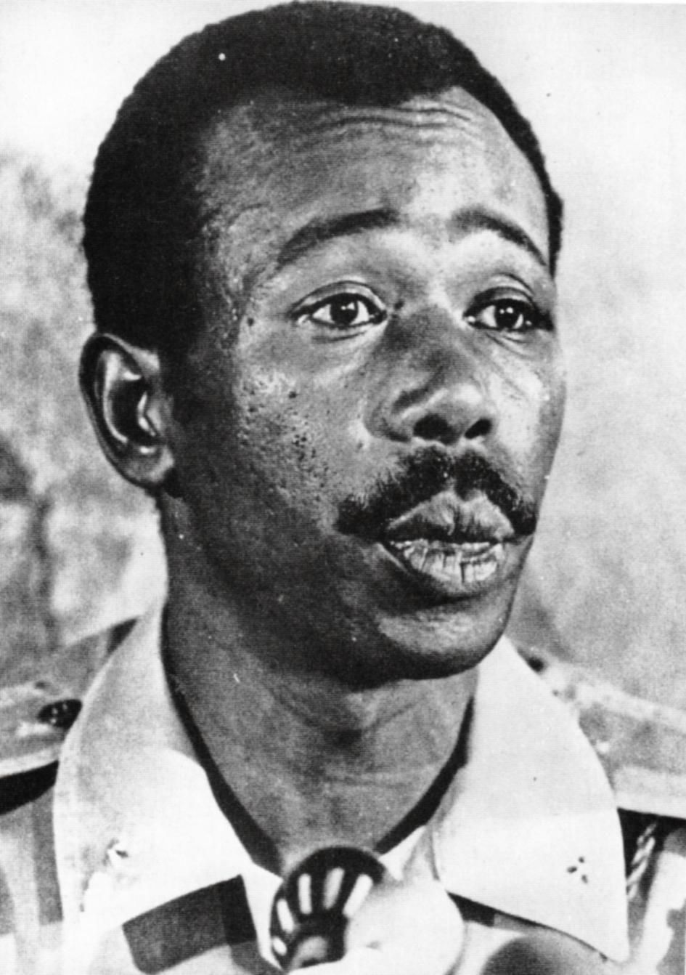
Mengistu Takes Power
February 3, 1977
Despite participating in the bloody coup in 1974, it wasn't until 1977 that Mengistu took power. Mengistu killed all potential opposition in the regime until he was the uncontested leader of the country and the Derg.

Slide 31
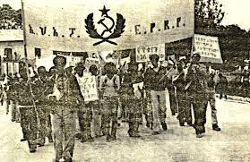
44 EPRP Members Executed
February 26, 1977
44 EPRP prisoners were taken to a place outside of the capital and executed.

Slide 32
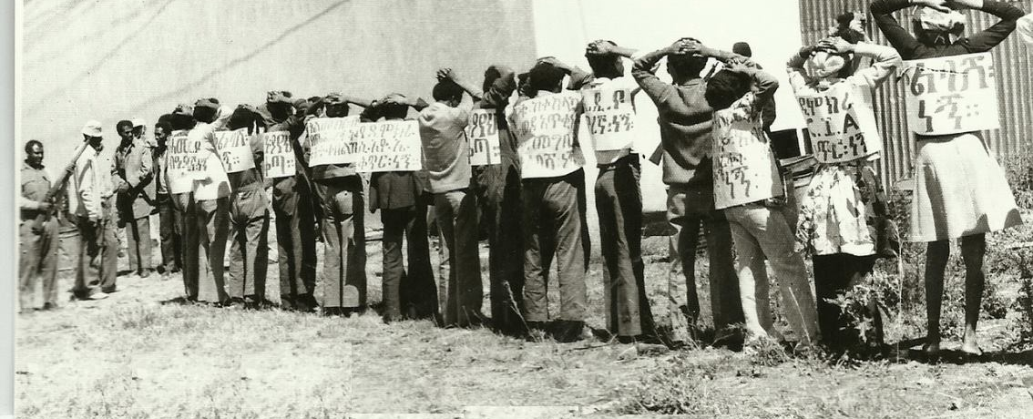
Protestors Shot and Killed
March 2, 1977
Several civilian protestors were killed for distributing EPRP propaganda during a pro-government demonstration.

Slide 33
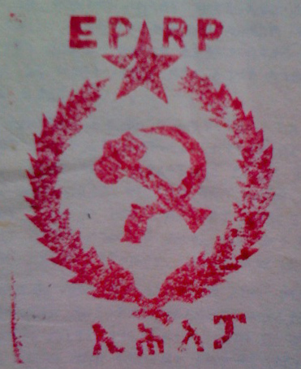
Over 1,000 People Detained
March 23-26 1977
Mengistu and the Derg conducted sweeps of every household in Addis Ababa, detaining over 1,000 civilians with alleged ties to the EPRP.

Slide 34
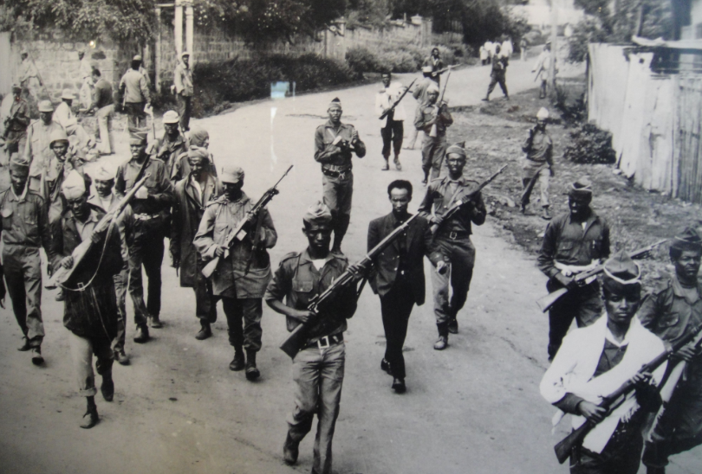
"May Day" Massacres (The Red Terror First Wave)
April 29-June 1977
Beginning April 29, 1977, a series of violent attacks and mass murders started in Ethiopia. This period of intense violence is now known as "May Day." It is estimated that at least 1,000 civilians were killed in the first few days.

Slide 35
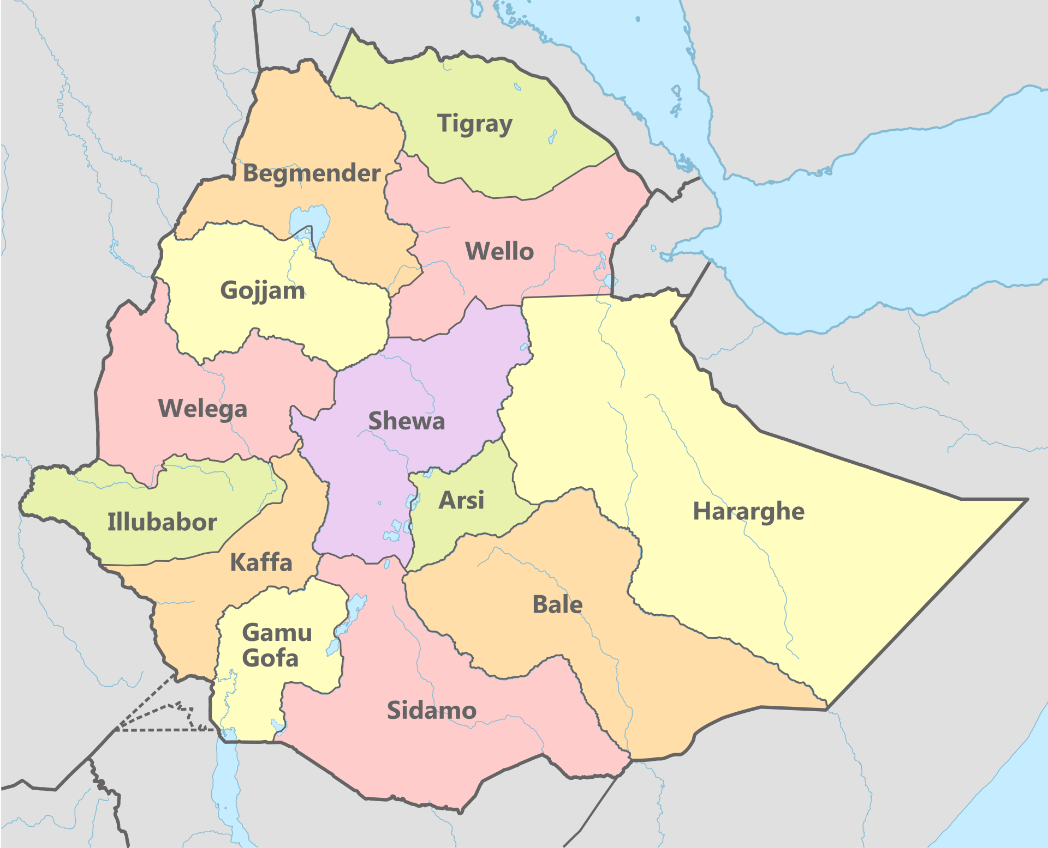
Over 1,700 People Executed
May 1-May 15, 1977
1,713 people were executed in the country towns of Gonder, Harerghe, Sidamo, and Bale during the first wave of the Red Terror.

Slide 36
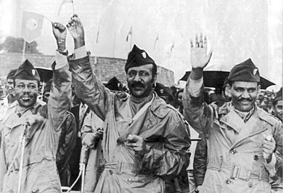
Curfew and Arrests Issued
May 7-8, 1977
Beginning May 7, 1977, Mengistu mandated a daytime curfew and directed Derg officers to conduct house-to-house searches. Thousands were detained during the sweep.

Slide 37
Reports of Over 1,000 Children Massacred
May 17, 1977
On May 17, 1977, the Save the Children Fund reported that "one thousand children have been massacred in Addis Ababa and their bodies, lying in the streets, are ravaged by roving hyenas." Save the Children estimated that 100-150 youth were killed every night.

Slide 38
400 Students Killed
June 5-6, 1977
Mengistu's Defense Forces executed an estimated 400 students.

Slide 39
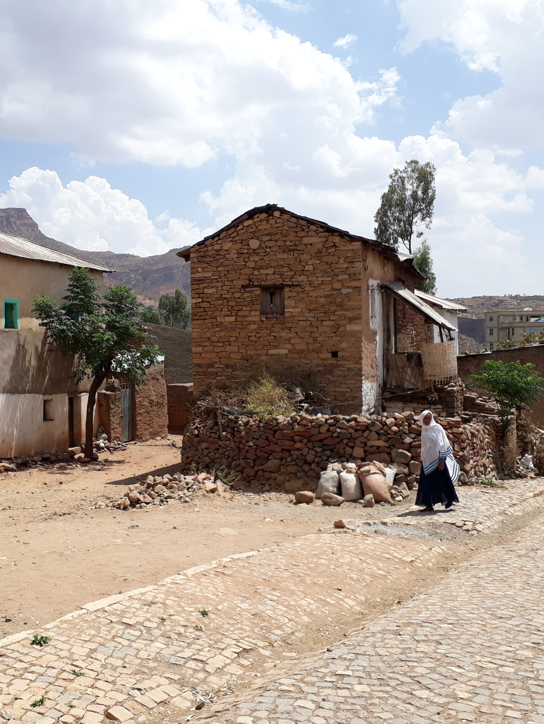
178 Peasants Killed
July 1977
178 peasants were killed by Derg officials and Mengistu's Defense Force in July 1977 due to the village's alleged support of the TPLF.

Slide 40
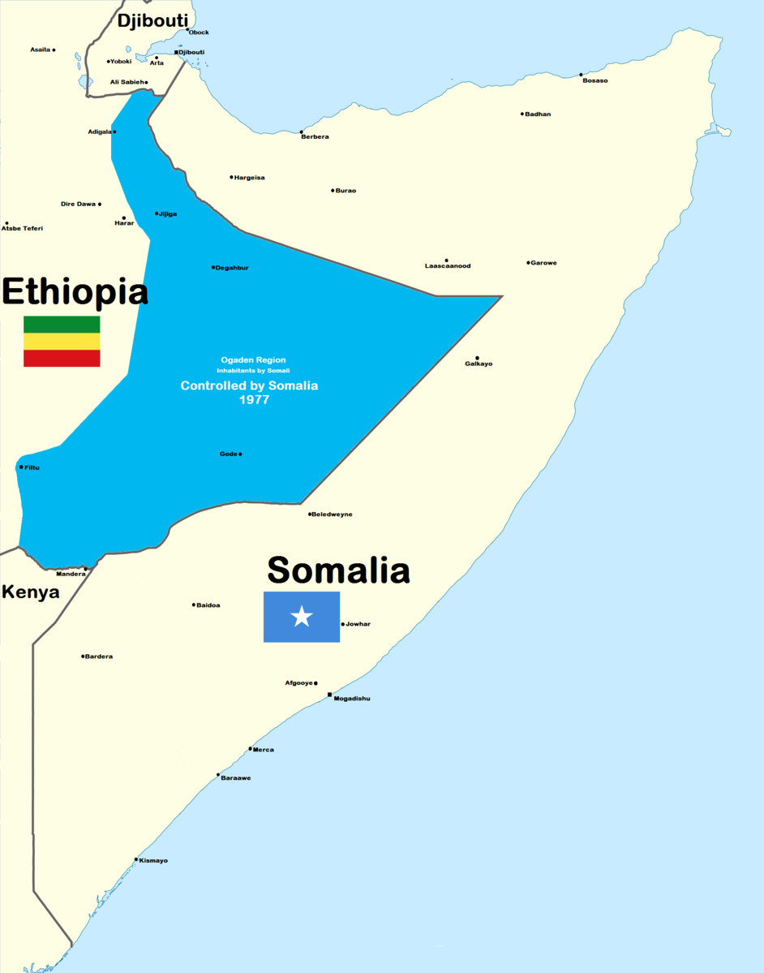
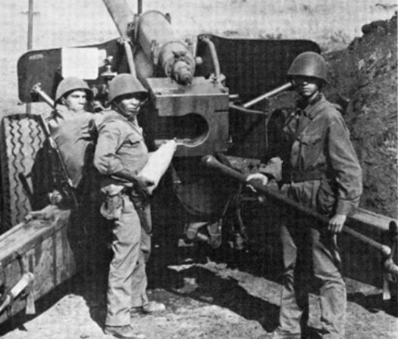
Ogaden War
July 13, 1977 to March 23, 1978
Somalia, under the authoritarian rule of Siad Barre, invaded the Somali region of Ethiopia with the intention of creating a greater Somalia. Assisted by the Western Somali Liberation Front, the Somali national army initially made deep advances into Ethiopian territory. However, the Soviet Union and Cubans sided with the Ethiopian Derg government and provided the Ethiopians with troops and weapons that allowed them to push the Somalis all the way back. The war killed and displaced hundreds of thousands in the Somali region. The Ogaden War had a drastic effect on Siad Barre's regime and was a contributing factor to the collapse of the Somali state in 1991 and the subsequent civil war.

Slide 41
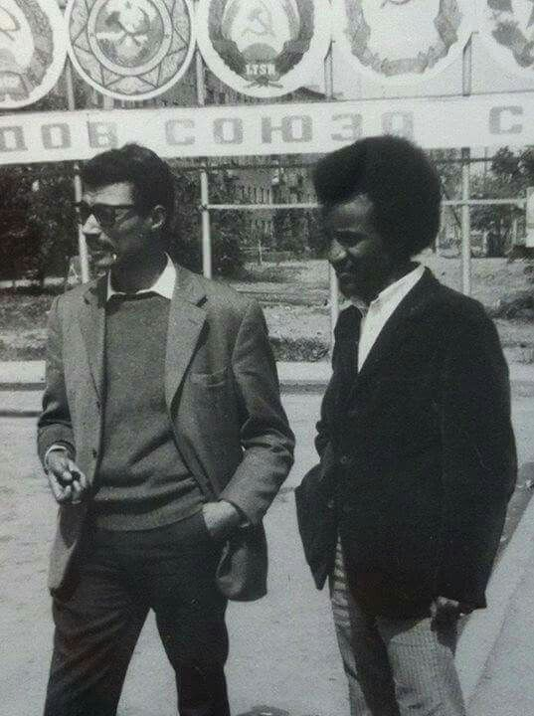
Haile Fida of MEISON Detained
August 1977
Haile Fida, leader of the All-Ethiopia Socialist Movement (MEISON), was detained by the Derg for alleged counter-revolutionary ties. After several months in prison, he disappeared. Many other MEISON cadres were arrested shortly afterward.

Slide 42
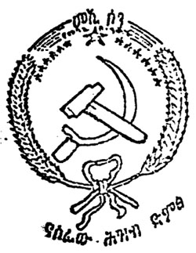
The Red Terror Second Wave Begins
October 1977
Much of the killing in October 1977 occurred during a civil war between MEISON and the remaining members of the EPRP. Both groups had been infiltrated by security agents who were able to assassinate cadres of the opposing organization while blaming the government for not acting. The continued killings by members of the EPRP also created a justification for the Derg's continuing repression. An estimated 3,000-4,000 people were killed in the month of October.

Slide 43
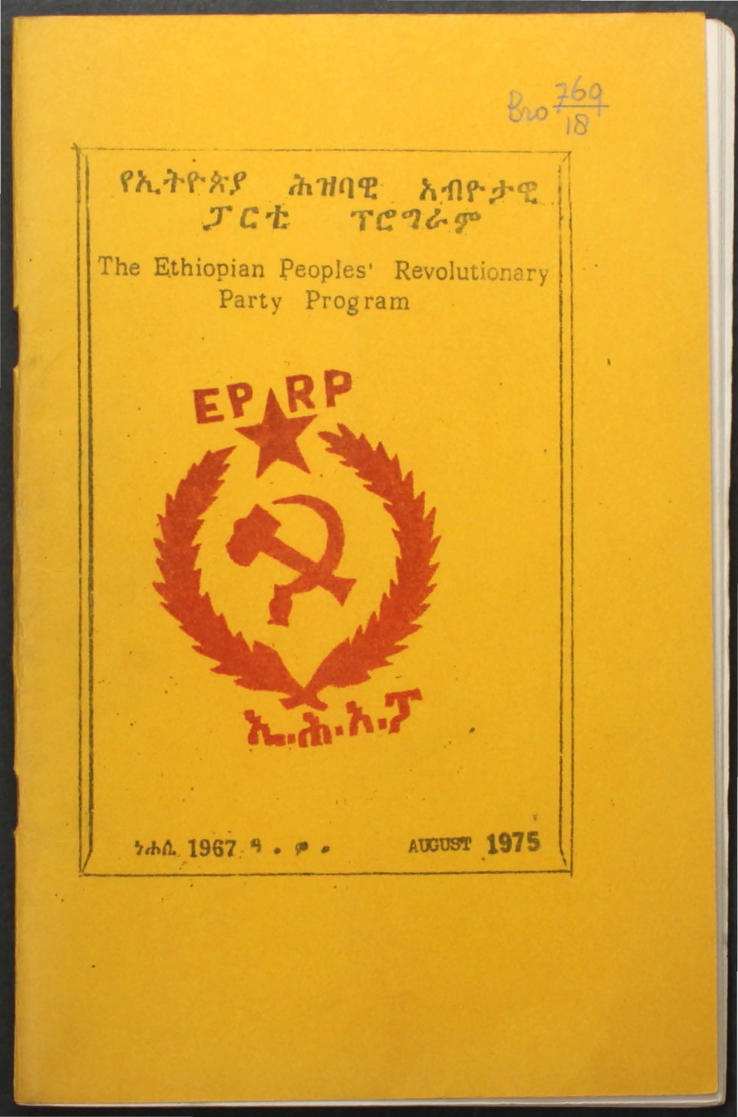
54 People Executed
November 1977
54 killed when security forces opened fire on an EPRP demonstration.

Slide 44
Over 200 Executed in Countrywide Campaign
December 1977
A recorded 56 prisoners were killed in Tigray, 74 in Wollo, 32 in Chebo and Gurage (Shewa), and 56 in Gonder.

Slide 45
The Red Terror Third Wave Begins
December 16, 1977
According to Human Rights Watch interviews and reports, the third wave of the Red Terror took place between December 1977 and February 1978. An estimated 300 people were executed on December 16th alone.

Slide 46
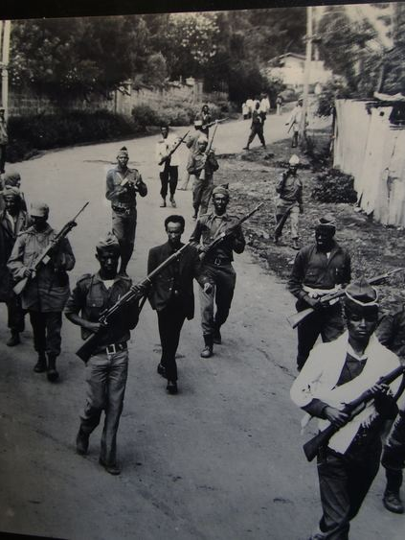
Seven People Murdered While Sleeping
On January 29, 1978, the Derg killed seven people in their homes with no explanation. The bodies were left outside the houses as a warning. Anyone caught mourning those killed was put in prison.

Slide 47
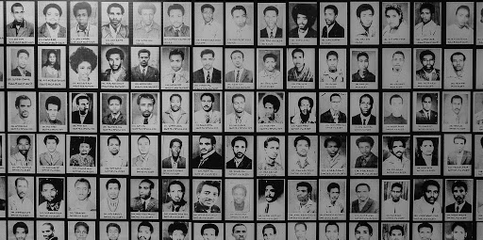
The Red Terror Campaign Concludes
March 1978
According to most accounts, the Red Terror concluded in Addis Ababa by March 1978. However, some lower levels of violence and detentions continued through the year. An estimated 10,000-20,000 people were killed during this campaign.

Slide 48
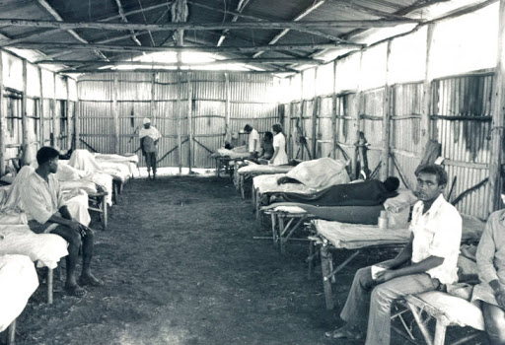
Melka Oda Refugee Resettlement Opened
1979
The first of two resettlement camps opened in the Bale region for those affected by the drought and famine.

Slide 49
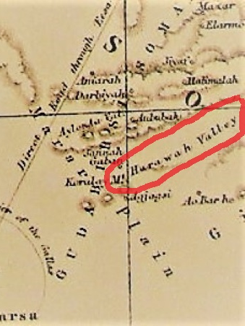
Harawa Refugee Resettlement Opened
1979
The second of two resettlement camps opened in the Bale region for those affected by the drought and famine. The Harawa settlement hosted over 7,000 families.

Slide 50
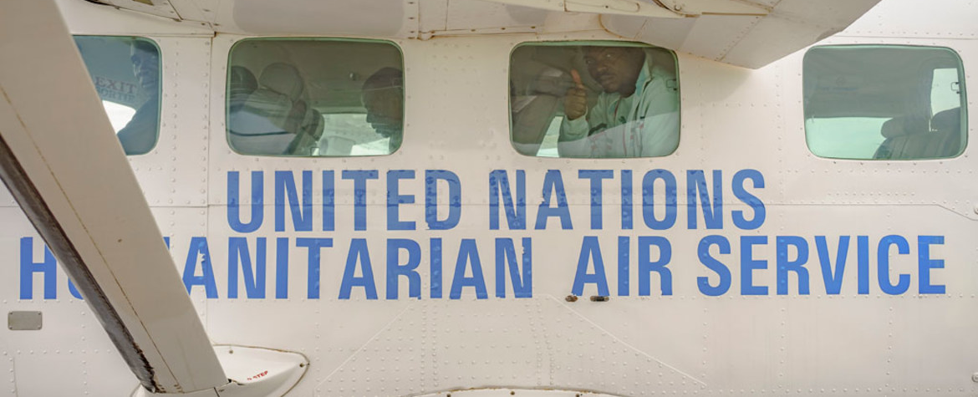
UN Recommends Humanitarian Aid
May-June 1980
A UN team visited Ethiopia to record the impact of the drought and urgent requests for aid. The team recommended "the government's resettlement [i.e. villagization] should be given all possible support."
The team also recommended the delivery of 158,000 metric tonnes of food and $8.1 million from UNHCR.

Slide 51
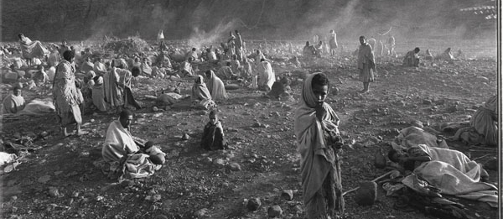
The Great Famine
1983 to 1985
The Great Famine began in 1983 and lasted for two years. The most affected region was northern Ethiopia, where over 400,000 people were killed. Over half of the 400,000 deaths were attributed to human rights abuses that caused the famine to come earlier and hit harder.

Slide 52
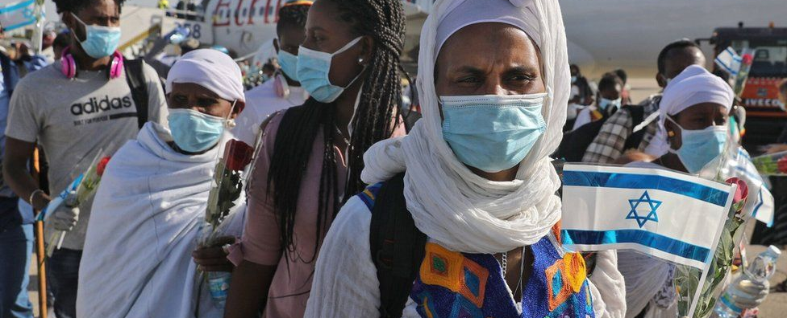
Operation Moses, Solomon, Joshua, and Dove Wing
1984 to 2010
Ethiopian Jews, also known as Beta Israel, had long been a marginalized community in Ethiopian society. During the civil war, the majority of the Ethiopian Jewish community fled to Sudan and was left starving in refugee camps. After a long debate, the Israeli government allowed the Ethiopian Jews to immigrate to Israel. With the United States, European and Sudanese assistance, Israeli Mossad agents flew thousands of Ethiopian Jews to Israel. Large bribes were paid to the Derg government to allow the Jews to leave. Another community, now known as Falash Mura, who are Ethiopian Jews who converted to Christianity, was allowed to immigrate to Israel in 2010 under Operation Dove Wing. A debate in the Israeli government as to whether this community is actually "Jewish" is still ongoing.

Slide 53
Over 100,000 Recorded Deaths in One Year
Between August 1984 and August 1985, between 100,000-150,000 people died for the whole famine zone for the whole period.

Slide 54
Famine Resettlement
1985
Mengistu and the Derg responded to the famine by forcing the resettlement of civilians. This involved numerous abuses of human rights, including the violent and arbitrary manner in which resettlers were taken, appalling conditions in transit and on arrival, the displacement of indigenous people in the resettlement areas, and violence against resettlers who attempted to escape. The resettlement program is estimated to have killed at least 50,000 people.

Slide 55
Kelbessa Negewo Flees to U.S.
August 3, 1987
Kelbessa Negewo, a former Derg official under Mengistu's regime, allegedly oversaw massacres and the torture of hundreds of political opponents. Negewo allegedly recruited people to execute and torture university students involved in anti-government protests. A few years before the fall of Mengistu's regime, Negewo fled Ethiopia to the United States. He received asylum under false pretenses.

Slide 56
Carter Led Peace Talks
1989 to 1991
Former President Jimmy Carter formally open peace talks between the Eritrean Rebels and the Ethiopian Government after a stalemate had been reached in the fighting.

Slide 57
Arrest by Transitional Government 1991-1995
1991 to 1995
After the fall Derg Regime, the transitional government under the Ethiopian People's Revolutionary Democratic Front, chaired by Meles Zenawi, drastically improved the human rights situation in Ethiopia, yet still committed its own atrocities against rival political groups. An estimated 100,000 members of the old Derg regime and rival parties of Zenawi were imprisoned without cause or trial. Several prisoners were summarily executed in prison

Slide 58
Transitional Charter of Zenawi Government
1991
The Transitional Charter set up Ethiopia's system of government set up by Zenawi and the EPRDF that still exist today. The charter lays out the transition of Ethiopia's government from a military dictatorship to a multi-federal democracy. This document established the current legislative body, the Council of Representatives. It also established the current form of ethnic federalism that exists today.

Slide 59
Ethnic Federalism in Ethiopia
1991
Under Mele Zenawi's Transitional Government, Ethiopia was divided up into distinct ethnic regions with some degree of autonomy. In theory, each region had the right to succeed from the federation if it desired. The system was an attempt to prevent the traditional domination of the Amhara ethnic group and reduce conflict, yet some argue that it has only done more to divide Ethiopians. The Ethnic Regions are:
1. Addis Ababa 2. Afar 3. Amhara 4. Benishangul-Gumuz 5. Dire Dawa 6. Gambela 7. Harari 8. Oromia 9. Somali 10. Tigray 11. Southern Nations Nationalities and People (SNNPR)

Slide 60
Mengistu Resigns and Flees Ethiopia
May 22, 1991
After 14 years of his brutal dictatorship in Ethiopia, Mengistu resigned and fled to Zimbabwe. Mengistu fled just two days after rebel troops captured two strategic towns in the country, cutting off any supplies from reaching the capital where Mengistu presided.

Slide 61
The Derg Collapse
June 1991
Shortly after the fall of Mengistu in May 1991, the Ethiopian People’s Revolutionary Democratic Front seized power from the Derg. The EPRDF wanted to bring members of the Mengistu regime to justice. A Special Prosecutor's Office was created with the support of several Western countries in order to investigate and prosecute former Derg officials.

Slide 62
1993 Eritrean independence referendum
April 23-25, 1993
A vote was held in Eritrea on whether or not to be independent of Ethiopia. 99.83% voted in favor, with a 98.5% turnout.

Slide 63
Isaias Afwerki Becomes President of Eritrea
May 19, 1993 to Present
The leader of the Eritrean People's Liberation Front Isais Afwerki becomes president of the new republic of Eritrea. Isais continues to rule the country as a one-party totalitarian state to this day.

Slide 64
Eritrea Admitted to the United Nations
July 16, 1993
Eritrea was formally admitted into the United Nations after 30 years of war for independence.

Slide 65
Flooding in Central Ethiopia
June 21-September 20, 1996
50,000 Ethiopians were forced to flee their homes after the Awash river overflowed and flooded their villages.

Slide 66
200 Students Arrested
March 1997
Over 200 university students were detained after a peaceful demonstration which the government declared illegal. The protestors were supporting peasant farmers "whose land had been confiscated because of their association with the former government."

Slide 67
Floods Displace over 2,500 People
November 1997
Thousands of Ethiopians in Afar were displaced after three rivers overflowed.

Slide 68
Eritrean–Ethiopian War
May 6, 1998 to June 18, 2000
After the fall of the Derg Regime, Eritrea under Isaias Afewerki and Ethiopia under Meles Zenawi began to skirmish over several disputed areas along the Eritrea and Ethiopia Border. Both sides attempted large-scale military offensives to gain territory. Eventually, the war bogged down into brutal trench warfare in which an estimated 100,000 people were killed. The fighting ended with the 2000 Algiers agreement and the presence of a UN monitoring force. In the end, very minor changes to the border occurred, and a formal peace between Ethiopia and Eritrea was only established in 2018.

Slide 69
Eritrean–Ethiopian Border Conflict
May 6, 1998 to July 9, 2018
After the independence of Eritrea, Ethiopia and Eritrea embarked on a 20 year-long border war, in which both sides disputed the territorial borders between the two countries. During this time, Eritrea blocked Ethiopia's access to the sea. In 2018, the two sides signed a peace agreement and reopened the border between the two countries.

Slide 70
Algiers Agreement
December 12, 2000
The Algiers Agreement provided for the exchange of prisoners and the return of displaced persons, established a Boundary Commission to demarcate the border, and formed a Claims Commission to assess damages caused by the conflict.
The purpose of the agreement was to:
End hostilities permanently and agree to refrain from the threat or use of force.
Respect and implement fully the provisions of an agreement on cessation of hostilities signed on June 18, 2000.
Release and repatriate all prisoners of war and all other persons detained.
Provide humane treatment to each other's nationals and persons of each other's national origin within their respective territories.

Slide 71
41 Students Killed in Protests
April 18-20, 2001
Security forces opened fire into crowds of students who were protesting for political rights and academic freedom. 41 were reported killed and another 51 injured.

Slide 72
EPRDF Wins Election
May 16, 2005
Despite claims of intimidation and election-rigging from the opposing party, the Coalition for Unity and Democracy (CUD), the EPRDF party, claimed victory in the 2005 elections. The EPRDF immediately banned all demonstrations and public gatherings for a month.

Slide 73
22 Die in Election Protests
June 9, 2005
Ethiopian security forces opened fire into a crowd of protesters following growing unrest from the election results. Police and troops opened fire on crowds who were throwing stones, "looting shops, robbing banks, attacking the police and trying to free detainees." 22 people were killed and roughly 100 wounded.

Slide 74
Over 30,000 People Arrested
November 10, 2005
Following the May 16th election results, the EPRDF arrested over 30,000 people were arrested for their support of the opposition parties. Of those, only 2,417 were released on November 10th.

Slide 75
Kelbessa Negewo Extradited to Ethiopia
January 2006
In Ethiopia, Negewo was tried in absentia and sentenced to life imprisonment. 16 years after his sentencing in Ethiopia, Negewo was extradited from the U.S. to serve his term in prison.

Slide 76
Ethiopia Government Finds Mengistu Guilty of Genocide
December 13, 2006
Mengistu was found guilty of genocide by an Ethiopian court on December 13, 2006. Mengistu "killed thousands of political opponents and ignored a famine which killed one million people." Mengistu's Red Terror not only killed thousands of Ethiopians but displaced even more. Further, his lack of action during the 1984 famine resulted in the deaths of over one million people.

Slide 77
ICC: Mengistu Found Guilty
January 20, 2007
The ICC found Mengistu guilty of genocide in absentia. The trial took 12 years. The genocide verdict carried a maximum of a death sentence and was passed by two votes to one on the three-judge panel. According to the court ruling, "Mengistu’s government directly killed more than 2,000 people, including 60 top officials, ministers and royal family members executed by firing squad. About 2,400 people were tortured, the court said."

Slide 78
Anti-Terrorism Proclamation
June 29, 2009
The Anti-Terrorism Proclamation grants the Ethiopian government a broad interpretation of what counts as terroristic. In the name of preventing armed dissent, it allows for the prevention of peaceful protests and public criticism. "Criminals" can be convicted for life-long imprisonments or death penalties.

Slide 79
Arrests of Over 200 Ethnic Oromos
March-April 2011
Between 200 and 300 ethnic Oromos were arrested in widespread sweeps in the Oromia region and Addis Ababa. 89 members of the Oromo Federalist Democratic Movement (OFDM) and Oromo People’s Congress (OPC) were arrested. Several of the members were part of the national parliament or the Oromia regional assembly but were not re-elected in 2010.

Slide 80
Opposition Tortured in Detention Center
March-November 2011
During the period of government sweeps, 116 journalists and opposition members allegedly associated with terrorist organizations were arrested and sent to the Maekelawi detention center. According to Amnesty International, a significant number of the detainees were tortured during interrogation, which "included beatings; kicking and punching; beating with objects, such as with a chair, and pieces of wire and metal; being tied and suspended by the wrists from the wall or ceiling; sleep deprivation; forced physical activity over a long period; being held in isolation; and being held in complete darkness for prolonged periods."

Slide 81
Oromo Liberation Front Designated Terrorist Group
June 2011
The Ethiopian Parliament designated the Oromo Liberation Front (OLF) as an armed insurgent group in June 2011. It later accused the Oromo Federalist Democratic Movement (OFDM) and Oromo People’s Congress (OPC) members of being associated with the terrorist organization.

Slide 82
20 Arrested in Second Government Sweeps
August-September 2011
At least 20 ethnic Oromo were arrested. Nine of the 20 arrested were Oromo Federalist Democratic Movement (OFDM) and Oromo People's Congress (OPC) members. All the OPC and OFDM members were arrested on suspicion that they were members of the Oromo Liberation Front (OLF).

Slide 83
116 Journalists and Opposition Members Charged
November 2011
The Ethiopian Parliament's continued roundup of journalists and opposition supporters resulted in 116 arrests. All were charged with alleged association with known terrorist groups.

Slide 84
Conviction of Eskinder Nega
January 22, 2012
Eskinder Nega is a vocal rights activist in Ethiopia. Previously arrested in 2005 for participating in protests, he authored an article criticizing the government's anti-terrorism legislation. In 2011, he was arrested for this criticism and convicted under the same anti-terrorism legislation. Nega was sentenced to 18 years in prison.

Slide 85
Death of Prime Minister Meles Zenawi
August 20, 2012
Prime Minister Meles Zenawi died from health complications while in office. Zenawi's death invoked fear of instability.

Slide 86
Hailemariam Desalegn takes office
August 21, 2012
Following the death of Meles Zenawi, his deputy Hailemariam Desalegn inherited the role of Prime Minister until the 2015 elections. The government reassured its citizens and the international community that the transition would be calm.

Slide 87
El Niño Drought
2013 to 2017
A 2014-2016 El Nińo event (periodic alteration of global weather patterns) caused significant flooding, drought, and food insecurity through 2017. Various charities worked to provide the country with clean drinking water and new wells. Some regions reported a 90% loss of crops in 2015. Malnutrition resulted in a rise in maternal mortality rates and the spread of infectious diseases such as scabies.

Slide 88
Hailemariam Desalegn elected Prime Minister
In May 2015, Desalegn was officially elected for the first time. Desalegn and his party - the Ethiopian People’s Revolutionary Democratic Front (EPRDF) - continued to hold the majority in the government.

Slide 89
Oromo Protests
October 2015 to December 2017
In 2015, a series of protests began in response to news of a proposed expansion of Addis Ababa into surrounding Oromo villages. The Addis Ababa Integrated Development Master Plan had the potential to displace already struggling Oromo farmers. The Oromo protesters not only resisted this proposal but also called for an end to systemic racism against the Oromo people. The protests mainly occurred in the Amhara and Oromia ethnic regions. Many protestors died in the violent response to their demands. They were arrested under the anti-terrorism legislation. The government shut down internet access across the country during days of protest on multiple occurrences. Although the Oromo form the largest ethnic group in Ethiopia, their marginalization found them relatively voiceless in the federal government. The protests undermined the authority of the long-standing EPRDF and elite Tigrayans.

Slide 91
Human Rights Watch report on the Oromo Protests
June 14, 2016
Activist group Human Rights Watch issued a report detailing the violence against Oromo protesters. The report included recommendations for Ethiopia and the international community. Ethiopia denied the number of deaths and arrests listed in the report.

Slide 92
Ethiopia rejects UN request for international investigation
Following reports of over 100 deaths during protests in early August 2016, the UN requested that a formal investigation be conducted into possible crimes against humanity. The UN statement highlighted Ethiopia's lack of effort in stopping police violence and recognized protesters' freedom of speech and right to peacefully protest. Ethiopia resisted this proposal. It determined that its government - not outside peacekeepers - was responsible for the safety of its citizens and interpretation of domestic terrorism.

Slide 93
Police action and stampede kills protestors
October 2016
During a protest in the city of Bishoftu, police used tear gas and rubber bullets on the crowd. Protesters fled the scene, resulting in a stampede that caused the deaths of at least 52 individuals. Human Rights Watch called for an independent investigation into the incident, although it was not conducted.

Slide 94
Eshetu Alemu Trial Begins
October 30, 2017
Eshetu Alemu, 63, was accused of ordering the execution of 75 people during Ethiopia's "Red Terror" in the late 1970s. The former aide to Mengistu was also accused of torture but denied all accusations. More than 300 victims came forward. In a statement, prosecutors said that Alemu "allegedly ordered the killing of 75 young prisoners" in a church. The bodies were then dumped in a mass grave, they said. Alemu was also accused of "arbitrary detention and cruel and inhuman treatment of civilians and fighters who had laid down their arms."

Slide 95
Eshetu Alemu Found Guilty
December 15, 2017
Alemu was found guilty of all war crimes accusations, including the execution of 75 people. Ethiopia sentenced him to death in absentia.

Slide 96
Closure of Maekelawi Detention Center
On January 3, 2018, Prime Minister Hailemariam Desalegn announced the mass release of political prisoners and the closure of the Maekelawi detention center in Addis Ababa. Maekelawi was known for its oppressive treatment of inmates who represented a number of political dissenters and ethnic groups such as the Amhara and Oromo people. Desalegn's announcement was not accompanied by a timeline for the release of prisoners or Maekelawi's closure.

Slide 97
Prime Minister Hailemariam Desalegn resigns
February 14, 2018 19:00
Hailemariam Desalegn served as Prime Minister from 2012 to 2018 and acted as chairman of the ruling Ethiopian People’s Revolutionary Democratic Front (EPRDF). His term was filled with significant political unrest in the Amhara and Oromia regions. Desalegn stated that his resignation was "vital in the bid to carry out reforms that would lead to sustainable peace and democracy."

Slide 98
Abiy Ahmed becomes Prime Minister
April 1, 2018
The 2015-2018 protests in Oromia contributed to efforts to remove the ERDPF and TPLF from power. Abiy Ahmed is Ethiopia's first prime minister of Oromo descent. Abiy Ahmed participated in the fight against Mengistu's communist government. In 2010, he was elected to parliament. In 2017, he received a doctorate degree in peace and conflict research from Addis Ababa University. His term as prime minister appeared to signal a change to Ethiopia's charged ethnic politics.

Slide 99
Liyu police target Oromo families
April-August 2018
At the end of May 2018, the Liyu counter-terrorism police in the Somali Region began to target Oromo families in the area. Oromia homes were burned, and their residents were forced to flee to villages in the Oromia region. Several farmers were killed in the Liyu raids. Raids and murders continued into August 2018. Targets were chosen for both ethnic and religious reasons. Human rights groups such as Amnesty International and Human Rights Watch asked the Ethiopian government to reform the Liyu peace force.

Slide 100
Continued release of political prisoners
May 2018
Abiy Ahmed continued to follow Hailemariam Desalegn's intent to release political prisoners. The federal government removed three ethnic national groups from Ethiopia's terrorist list. These groups were: the Oromo Liberation Front (OLF), the Ogaden National Liberation Front (ONLF), and Ginbot 7.

Slide 101
War with Eritrea is concluded
In June 2018, Abiy Ahmed Ali announced that he was willing to recognize the 2000 Algiers Peace Agreement with Eritrea. Ahmed Ali and Eritrean President Isaias Afwerki met to discuss further terms of a peace deal. On September 16, 2018, the Jeddah Peace Agreement was officially recognized by both leaders. The agreement opened the border between Ethiopia and Eritrea, and commerce between the nations resumed. The United Nations lifted sanctions against Eritrea.

Slide 102
2018 Eritrea–Ethiopia peace summit
July 8-9, 2018
Under Isaias Afewki and Abiy Ahmed, Eritrea and Ethiopia sign a landmark peace deal in Saudi Arabia that both ends the conflict between the two countries and opens the borders to trade and migration.

Slide 103
Closure of Jail Ogaden
August 2018
On July 4, 2018, Human Rights Watch reported on human rights abuses occurring in Jail Ogaden or Jijiga Central Prison in the Somali region. The jail was packed with the region's government's political and ethnic enemies. Former inmates revealed conditions of rape and torture. In September 2018, the Somali regional government announced the closure of Jail Ogaden. After its closure, Ogaden would be transformed into a memory museum similar to the transformation at Maekelawi Detention Center.

Slide 104
Arrest of Hassan Ismail Ibrahim
On May 26, 2019, the chief of Jail Ogaden, Hassan Ismail Ibrahim, was arrested. His arrest was part of a series initiated by the Somali region's prime minister, Mustafa Omer. In April 2019, Omer announced his intent to apprehend those responsible for the abuse at Jail Ogaden.

Slide 105
Abiy Ahmed wins Nobel Peace Prize
September 2019
Abiy Ahmed Ali was awarded the 2019 Nobel Peace Prize "for his efforts to achieve peace and international cooperation, and in particular for his decisive initiative to resolve the border conflict with neighboring Eritrea," as well as his reforms to Ethiopian politics. His Nobel Peace Prize profile was accompanied by curiosity over whether the reforms would continue: "At the time Abiy Ahmed received the Nobel Peace Prize, there was considerable suspense as to whether he would succeed in fulfilling his promise of free and fair elections in 2020."

Slide 106
Protests in Addis Ababa and surrounding Oromia Region
October 22-24, 2019
Jawar Mohammed is an activist and media entrepreneur who was involved in the Oromo protests in 2016. On October 22, 2019, Abiy Ahmed Ali warned against using social media to express or encourage dissent. Jawar Mohammed's home was surrounded by police that night who try to remove his security detail. On October 23rd, young protestors gathered in front of the home and police and expressed their support for Jawar and against Abiy Ahmed. Demonstrations grew violent and police used tear gas, force, and bullets to subdue the protests. On October 24th, Jawar asked the protestors to go home, saying, "Calm yourself but sleep with one eye open."

Slide 107
Unrest at universities
October 2019 to March 2020
In Oromia, unrest between Amhara and Oromo students led to protests that ran until the SARS-COVID19 pandemic forced the closure of schools. The unrest occurred on over 22 campuses, and at least 35,000 students quit classes. Several students were killed in the clashes, and a number of kidnapping cases were reported and remain unsolved.

Slide 108
Asylum policy changes
December 2019
Human Rights Watch reported on unofficial changes to categories for refugees arriving in Ethiopia from Eritrea. Unaccompanied children were amongst those no longer officially recognized.

Slide 109
SARS-COVID19 Pandemic
February 2020 to May 2021
Ethiopia reported its first case of COVID-19 on March 13, 2020. As of April 29, 2021, the country had reported about 250,000 cases and about 3,600 deaths. At the end of April 2021, over 1 million vaccine doses had been administered. Children particularly suffered during the pandemic. 26 million children were unable to attend school, and many of these children relied on the security of regular school meals.

Slide 110
Law against hate speech
March 22, 2020
Under the pandemic's state of emergency, the federal government enacted a new "Hate Speech and Disinformation Prevention and Suppression Proclamation." The proclamation curbs freedom of speech and targets journalists, activists, and social media users.

Slide 111
August Elections Postponed
March 30, 2020
Following the global outbreak of SARS-COVID19, Abiy Ahmed Ali announced that the August parliamentary and presidential elections would be postponed until the end of the pandemic.

Slide 112
Killings in Benishangul Gumuz
In March 2020, Benishangul-Gumuz was the center of a number of ethnic divisions and retaliatory killings. On April 9th, 8 civilians were killed by armed men. Reports mentioned that government forces were witnesses to the skirmish but did nothing to stop it. The attack was possibly linked to the Oromo Liberation Front (OLF).

Slide 113
Food Insecurity
April 2020 to May 2021
Invasion of desert locusts and increased rainfall caused damage to farmland across Ethiopia but particularity in Oromia and Somali.

Slide 114
Hachalu Hundessa's Death
On the evening of June 29, 2020, Hundessa was shot and died from his wounds. Earlier in the week, he had given an interview where he mentioned he had received death threats. Several suspects were arrested, but the case was a dead end. Hachalu Hundessa was a popular Ethiopian musician who used his music to tackle the nation's politics. He was Oromo and was seen by many as a representative and voice for the group.

Slide 115
Hachalu Hundessa Riots
June 29-July 22, 2020
Hundessa's death was the catalyst for riots throughout the Oromia region. Police gassed protestors and also opened fire. The government briefly disabled the internet. The Ethiopian Human Rights Commission reported in July that protestors were committing crimes against humanity. Minority Rights Group International also released a statement finding that the increasingly violent riots targeted minority groups in Oromia, including Amharas and Gurages.

Slide 116
Sodo city protests
August 9, 2020
In the summer of 2020, the Ethiopian government began to discuss the reorganization of the Southern Nations, Nationalities, and People’s Region into four further regional states. In the Wolaita zone, officials grew frustrated at the government's lack of acknowledgment of their separate appeal for statehood. In Wolaita's Sodo city, protestors gathered to raise awareness of the arrests of a number of Wolaita's leading officials. Police injured or killed at least 18 protestors. Others were detained without cause.

Slide 117
Tigray holds regional election
August 2020
Despite the decree that the 2020 elections would be postponed until the following summer, Tigray continued to hold a 2020 regional election, with voting occurring in mid-September 2020. Tigray People’s Liberation Front (TPLF) won the majority. Abiy Ahmed Ali calls the election unconstitutional and illegal.

Slide 118
Protests agains ethnic violence are banned
October 26, 2020
The National Movement of Amhara (NaMA) planned to stage protests throughout the Amhara region on October 28, 2020, in order to bring attention to the ethnic persecution that the Amhara minority faces in Benishangul, Oromia, and the Southern Nations, Nationalities, and Peoples regional states. The Ethiopian and Amhara Regional governments issued a statement banning the planned protests and branding them illegal.

Slide 119
Oromo Liberation Army targets Amhara minorities
In late October and early November 2020, Amhara living in the Oromia region remained the targets of attacks from the Oromo Liberation Army. On November 1, 2020, three villages were targeted. Estimates of 30-60 Amhara people were massacred at a school compound before the villages were looted. The attacks followed the withdrawal of federal troops from the region, leaving the area unprotected against potential ethnic violence.

Slide 120
Government troops enter Tigray
November 3, 2020
Responding to state repression following what was deemed an illegal September election, the TPLF attacked a federal army camp. Abiy Ahmed Ali swiftly declared a six-month state of emergency in the Tigray region, and federal troops mobilized against the TPLF. Despite making peace with Eritrea, Abiy Ahmed Ali's term had been marked by a lack of peace in Ethiopia. International news outlets reported on the state of emergency with curiosity. Abiy Ahmed Ali's social media addressed his move, stating that “Our defense forces … have been ordered to carry out their mission to save the country. The final point of the red line has been crossed. Force is being used as the last measure to save the people and the country."

Slide 121
Attack on passenger bus in Benishangul-Gumuz
On November 15, 2020, dozens were massacred in an attack on a bus in the Benishangul-Geumuz region traveling from Wonbera to Chagni. The perpetrators were not identified to be from a specific group, but the attack followed patterns of violence by ethnic Gumuz militias against ethnic Amhara and Agew minorities. Information on ethnic tension in Benishangul-Gumuz was sparsely provided to international news outlets, although similar attacks were acknowledged to have happened in September and October of 2020.

Slide 122
TPLF Targets Eritrea
November 14, 2020
War broke out in Tigray after the deployment of Ethiopian federal troops against the TPLF. TPLF leaders began to not only target its Ethiopian enemy but also neighboring Eritrea. Tigray's president, Debretsion Gebremichael, alluded to the presence of Eritrean troops in Ethiopia in the early days of the conflict. Eritrea's capital city of Asmara was targeted by TPLF missiles. Sites of importance to the Eritrean military and government were attacked.

Slide 123
Troops take control of Axum
By November 19, 2020, the combined forces of Ethiopian and Eritrean troops occupied the city of Axum. The occupation was followed by severe, systematic crimes against humanity.

Slide 124
Massacre at Axum
November 27-29, 2020
While victory was claimed in Mekele, troops occupying Axum began a systematic massacre of the Tigrayan town. Reports of the massacre did not break until months after the conflict. The majority of the killings were executed on November 28-29th. Civilians were targeted and shot indiscriminately. Homes and businesses were looted. On November 30th, survivors buried the dead in mass graves near two churches. Although survivors stated that the massacre was committed by the Eritrean troops, they noted that federal Ethiopian troops did nothing to stop the violence.

Slide 125
Government troops claim Mekele
November 27, 2020
Following deadly artillery strikes on Mekele, Abiy Ahmed Ali claimed an end to the conflict in Tigray and victory for the Ethiopian government. Although the government claimed its goodwill, over 40,000 refugees were displaced during the first few weeks of conflict. Tigray remains almost inaccessible to aid groups. Despite losing Mekele, the TPLF stated that the conflict was far from over.

Slide 126
Famine in Tigray
November 29, 2020 to May 2021
Continued pillaging and war in Tigray resulted in food insecurity and famine, contributing to the humanitarian crisis.

Slide 127
Abiy Ahmed Ali denies the presence of Eritrean troops in Tigray
November 2020
Fighting in Tigray continued despite the federal government's victory at Mekele. Although multiple news outlets reported the presence of Eritrean troops in Tigray, Abiy Ahmed Ali consistently denied any involvement from Eritrea. His denials followed intense scrutiny from Ethiopian groups and international powers who decried his use of foreign power to quell the internal conflict.

Slide 128
Aid in Tigray
November 2020 to May 2021
Throughout the conflict in Tigray, the region has been kept inaccessible to humanitarian groups and aid workers. In December 2020, it was reported that several aid workers were killed in an Eritrean refugee camp. In May 2021, reports concluded that almost the entirety of Tigray has remained inaccessible to aid.

Slide 129
Ethnic Violence in Benishangul-Gumuz
December 22, 2020
Ahead of the June elections, further ethnic violence occurred in Benishangul-Gumuz. Armed groups killed 100 people from various ethnic minorities in the region - groups included Oromo, Amhara, and Shinasha.

Slide 130
June parliamentary vote announced
December 24, 2020
Ethiopia's National Electoral Board announced that the postponed 2020 elections would be held on June 5, 2021. Unrest continued in all of Ethiopia's regions.

Slide 131
Reports of genocidal processes in Tigray
January-April 2021
As violence in Tigray continued, multiple news outlets and humanitarian groups released reports of human rights violations in Tigray. These included the use of identification cards for Tigrayan minorities, mass rape, restricting humanitarian aid, and systematic killing.

Slide 132
Ethiopia and United Nations joint inquiry agreement
March 16, 2021
Upon a request from the Ethiopian Human Rights Commission (EHRC), the United Nations human rights chief Michelle Bachelet agreed to a joint inquiry into possible war crimes in Tigray.

Slide 133
Abiy Ahmed admits to the presence of Eritrean troops in Tigray
March 22, 2021
After months of denial, Abiy Ahmed admitted to the presence of Eritrean troops in Tigray.

Slide 134
Eritrean troops recalled
March 25, 2021
Following his acknowledgment of Eritrean troops in Tigray, Abiy Ahmed held talks with President Isaias Afwerki. He announced that Afwerki agreed to withdraw Eritrea's troops.

Slide 135
G7 Leaders issue statement
April 1, 2021
Foreign ministers from Canada, France, Germany, Italy, Japan, the UK, and the USA and the High Representative of the EU officially recognized human rights abuses in Tigray. They called for a transparent UN inquiry, immediate humanitarian access to Tigray, and democratic elections throughout Ethiopia.

Slide 136
Civilian casualties in the Afar and Somali regions
April 6, 2021
On the border of the Afar and Somali regions, clashes between ethnic groups caused over 100 civilian casualties. The regions' border was moved in 2014, and the regions have been in conflict over three towns that were transferred from Afar to Somali.

Slide 137
Eritrea confirms its presence in Tigray
April 16, 2021
Six months after the war in Tigray broke out, Eritrea admitted to the presence of its troops in Tigray.

Slide 138
State of Emergency declared in Amhara
April 18, 2021
Although the Amhara region is comprised of a majority of the Amhara ethnic minority, special zones for the Oromia people experienced the violence of Oromia forces against the Amhara. Following the armed conflict, the Ethiopian government deployed military forces to the region and declared a state of emergency. The situation in Amhara further contributed to tense relationships between Oromo and Amhara representatives in Abiy Ahmed Ali's Prosperity Party.

Slide 139
Sedal Woreda Seized
April 21, 2021
An unidentified armed group seized the Sedal Woreda county in the Benishangul-Gumuz region. About 25,000 people live in the Sedal Woreda area. Refugees told the Ethiopian Human Rights Commission of the burning and looting of property. The attack followed violence leading up to the June elections.

Slide 140
June elections delayed
May 1, 2021
Elections scheduled for June 5th were delayed until June 21st. The government cited logistics and continued states of emergency in regions including Tigray and Amhara. This second delay has the potential to further ethnic divides and undermine Abiy Ahmed's consolidation of power.

Slide 141
Summary
May 1, 2021
Ethiopia's history of conflict and humanitarian disasters resulted in the loss of countless lives.
Mengistu's reign dramatically increased the death toll of innocent Ethiopians and exacerbated the effects of one of the world's worst famines in history.
The fall of Mengistu and the Derg sparked hope for Ethiopians, but the transitional government led to even more genocidal massacres.
Minority groups in Ethiopia remain targeted by ethnic militias and the federal government. Genocidal processes continue to unfold throughout the country's regions - particularly against the Tigrayan, Amhara, and Oromo groups.
Abiy Ahmed postponed elections, a tactic considered to benefit his chances in reelection.

