Slide 1
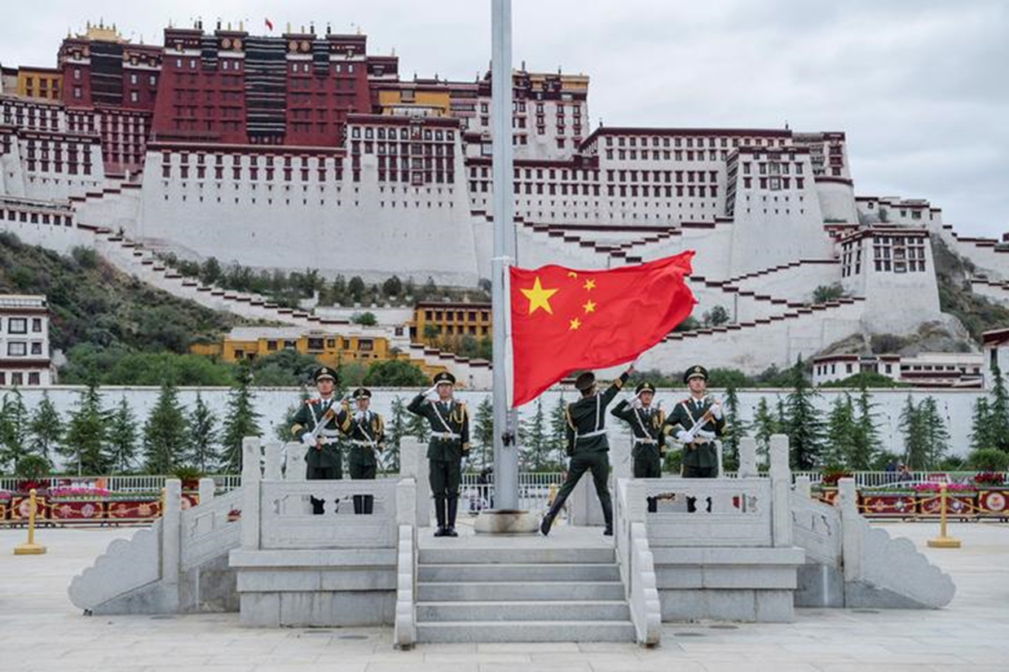
Key Findings
The Chinese Communist Party is employing genocidal tactics to erode any semblance of Tibetan sovereignty. China seeks to fully incorporate Tibet into its territory to secure its access to the mineral-rich region. Destruction of monasteries, the expulsion of monks and nuns, and restrictions on the use of the Tibetan language are the means by which China seeks to undermine Tibetan identity. Militarization and mass arrests are employed to eliminate any resistance to Chinese authority.

Slide 2
Ten Stages of Genocide
Dr. Gregory Stanton, Founding President of Genocide Watch, uses the Ten Stages of Genocide to describe and explain the genocidal process. The stages are:
Classification
Symbolization
Discrimination
Dehumanization
Organization
Polarization
Preparation
Persecution
Extermination
Denial
Genocide Watch considers China's actions in Tibet to be at:
Stage 3: Discrimination, due to their policies and actions towards Tibetan Buddhists.
Stage 8: Persecution, due to China's continued militarization of Tibet coupled with its enforcement measures meant to undermine Tibetan cultural sovereignty.
Stage 10: Denial, due to its restrictions on journalists operating in Tibet and exploitation of monasteries as tourist attractions.

Slide 3
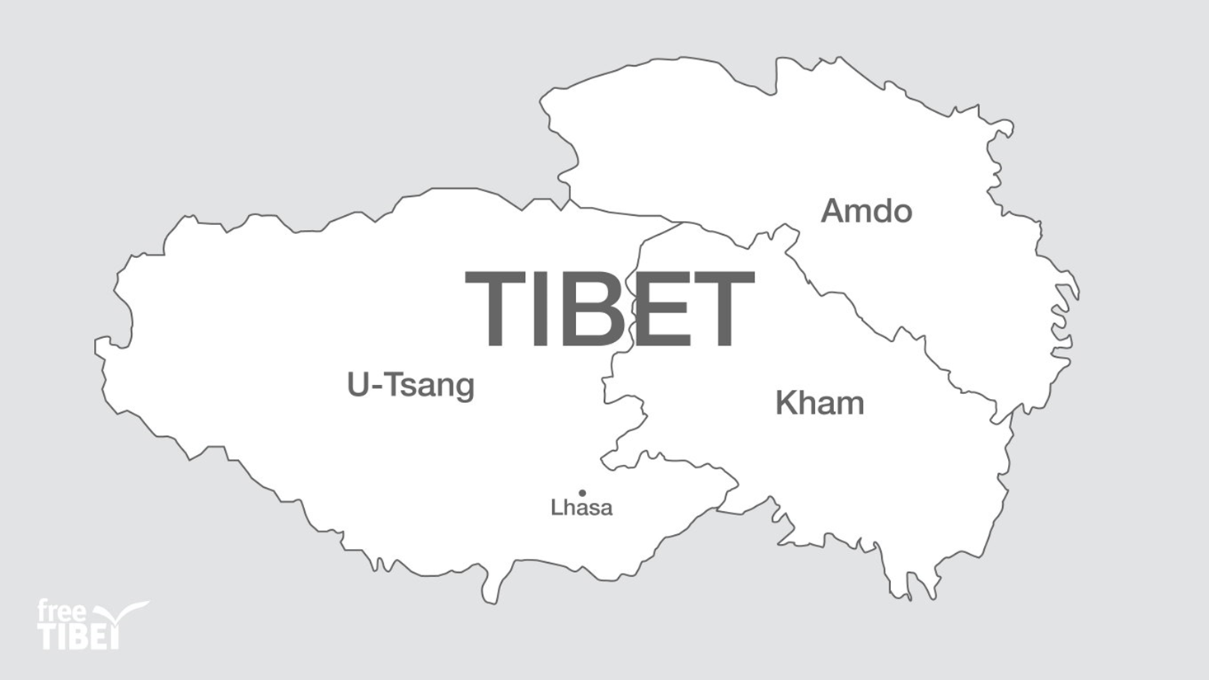
Tibet Profile
Spanning 474,300 miles, Tibet sits at the southwest of China. The region is characterized by its mountainous terrain and frigid climate.
Most Tibetans practice a specific form of Buddhism called Tibetan Buddhism. The most prominent language is Tibetan.
Despite its distinct cultural heritage and isolated geography, Tibet does not have independence and remains a part of the People’s Republic of China. Since the Chinese invasion in 1949, some 1.2 million Tibetans have been killed and over 6,000 monasteries destroyed.

Slide 4
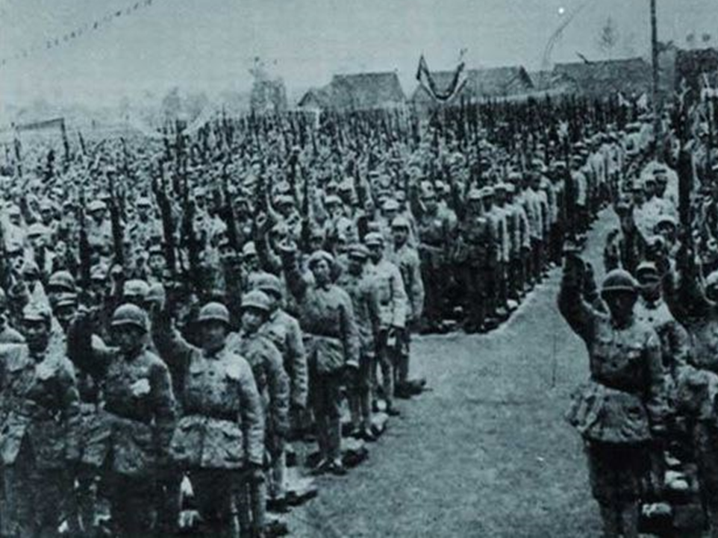
Battle of Chamdo
Oct 6, 1950 to Oct 24, 1950
From 1912 to 1950, Tibet functioned as a "de facto independent country" led both spiritually and politically by the Dalai Lama. However, when Mao Zedong and the Chinese Communist Party came to power in 1949, Mao saw Tibet as a threat to his rule and declared that the annexation of Tibet was the main goal of the People's Liberation Army in 1950.
After months of failed negotiations with Tibetan leadership, the People's Liberation Army captured the Tibetan army and usurped the de facto government in Lhasa. By eliminating the Tibetan army and government, China was able to pressure Tibetan authorities into recognizing China's claim over the region.

Slide 5
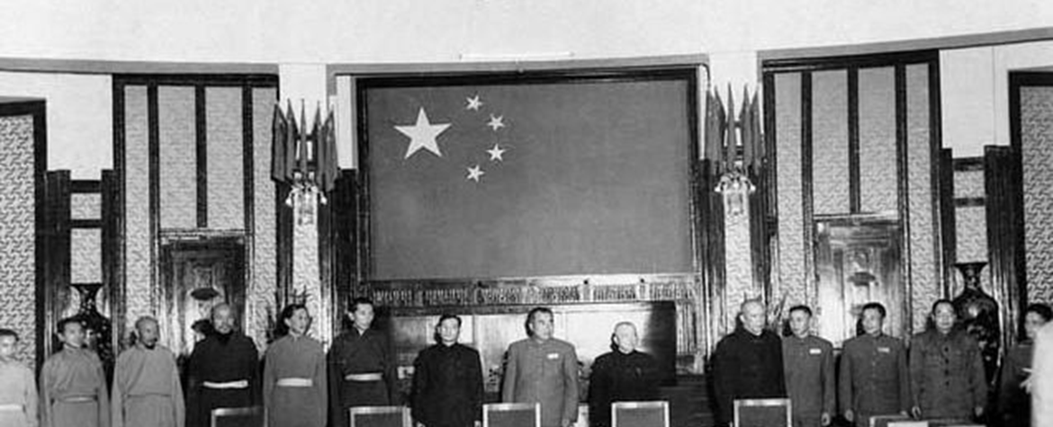
Seventeen Point Agreement
1951
The Seventeen Point Agreement, formally known as the "Seventeen Point Agreement of the Central People’s Government and the Local Government of Tibet on Measures for the Peaceful Liberation of Tibet,” formalized the People's Republic of China's claim to Tibet. It established Tibet as a part of the People's Republic of China (PRC) but allowed it to self-govern. The Dalai Lama was left as the head of government in Tibet. However, the PRC did not hold up its end of the agreement. The Seventeen Point Agreement marks the beginning of China's long journey of oppressive policies in Tibet designed to incorporate the region into one China with one culture.

Slide 6
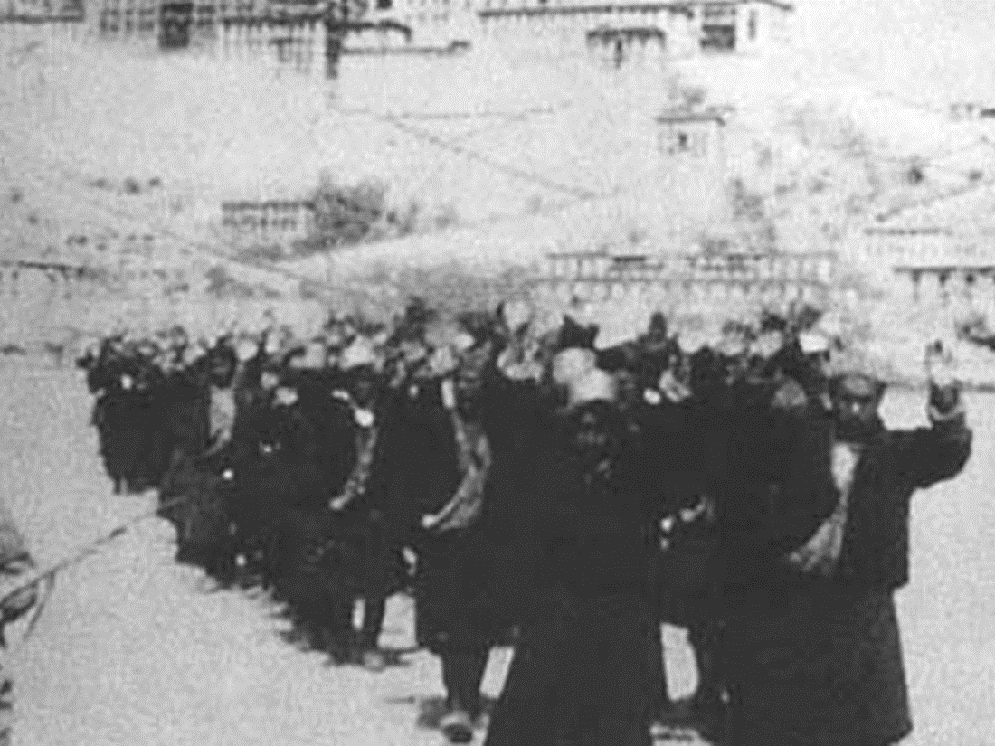
1959 Tibetan uprising
Mar 10, 1959 to Mar 23, 1959
Tension in Tibet remained high after the Seventeen Point Agreement. People's Liberation Army soldiers remained in Tibet and seized large amounts of grain produced by Tibetan farmers, causing famine. In response to the CCP's continued presence, 80,000 Tibetans joined armed resistance groups.
These groups sprang into action on March 10, 1959, when rumors that the People's Liberation Army planned to kidnap the Dalai Lama, who was both the political and spiritual leader of Tibet. Over 300,000 Tibetans surrounded the Dalai Lama's summer palace to protect him. The demonstration grew into an even large protest calling for the eviction of China from Tibet altogether. The situation quickly deteriorated into a firefight, but the Tibetans were no match for the Chinese forces. By the end of the fighting, the People's Liberation Army killed 87,000 Tibetans, and another 80,000 fled to neighboring countries as refugees.

Slide 7
Dalai Lama Exile Begins
March 31, 1959
The Dalai Lama fled Tibet in a self-imposed exile in the wake of the 1959 Tibetan Uprising. He crossed the border into India, where he was granted political asylum, and established a shadow Tibetan government. The Dalai Lama continued to lead the Tibetan people in exile both spiritually and politically and became an advocate for peace in Tibet.

Slide 8
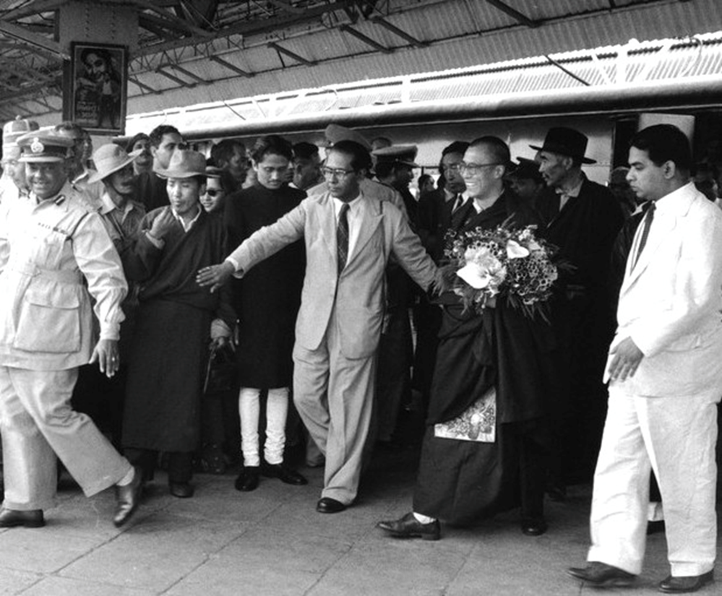
Dalai Lama Repudiates 17 Point Agreement
April 1959
Once the Dalai Lama reached India, he immediately repudiated the 17 Point Agreement. The Dalai Lama stated that the Agreement was forced upon the Tibetan people and that China did not maintain its commitments.

Slide 9
Tibetan Flag and National Anthem Banned
1959
After the Tibetan uprising, the Chinese Communist Party banned the playing of the Tibetan national anthem and the display of the Tibetan flag. This policy aimed to decrease Tibetan nationalism and increase Tibet's cohesion with the rest of China. As a result, the Tibetan flag and national anthem have become commonplace in Tibetan protests.

Slide 10
UN Resolution 1353 XIV
Oct 21, 1959
U.N. Resolution 1353 XIV called for respect for the fundamental rights of the Tibetan people and for their distinctive cultural and religious life.

Slide 11
UN Resolution 1723 XVI
Dec 20, 1961
Resolution 1723 XVI established that the "principle of self-determination of peoples and nations" applies to the people of Tibet.

Slide 12
UN Resolution 2079 (XX)
Dec 18, 1965
UN Resolution 2079 (XX) articulated concern surrounding "The continued violation of the fundamental rights and freedoms of the people of Tibet and the continued suppression of their distinctive cultural and religious life, as evidenced by the exodus of refugees to the neighboring countries."

Slide 13
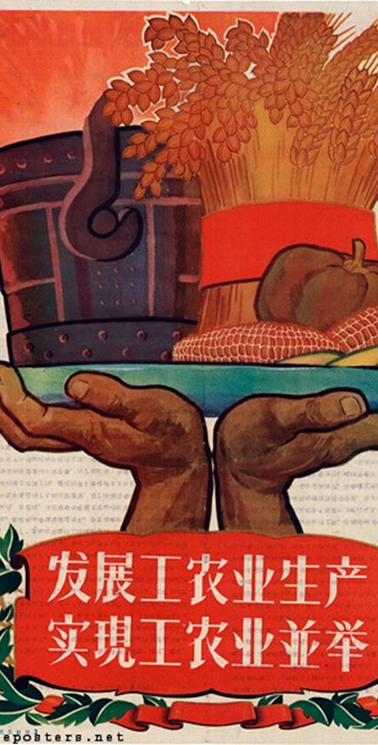
The Great Leap Forward: Tibet famine
1961
The Great Leap Forward was series of policies meant to rapidly industrialize China by establishing large rural communes implemented starting in 1958. While trying to create industries in China, these policies neglected agriculture, leading to food shortages across the country.
In Tibet, Chairman Mao instituted policies that forced Tibetan farmers to grow corn as opposed to the traditional crop of barley. The failure of the maize crop resulted in the starvation of thousands of Tibetans. The Tibetan famine is an example of how China's disregard for Tibetan tradition destroys lives.

Slide 14
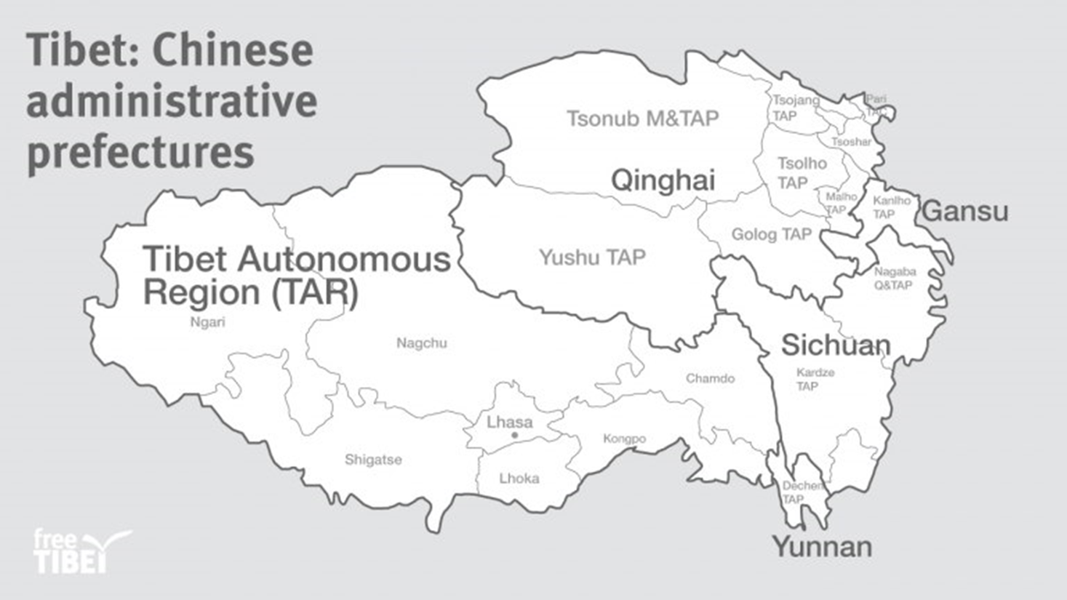
TAR Established
1965
The Chinese Communist Party (CCP) established the Tibet Autonomous Region (TAR) in 1965. The TAR, however, does not include all the land that Tibet historically occupied. Parts of Tibet were incorporated into the Chinese provinces of Sichuan, Qinghai, Gansu, and Yunnan. By incorporating parts of Tibet into other Chinese provinces, the CCP continued its efforts to erase Tibetan culture. This also made it more difficult for Tibetans to visit important religious sites that are within the TAR.

Slide 15
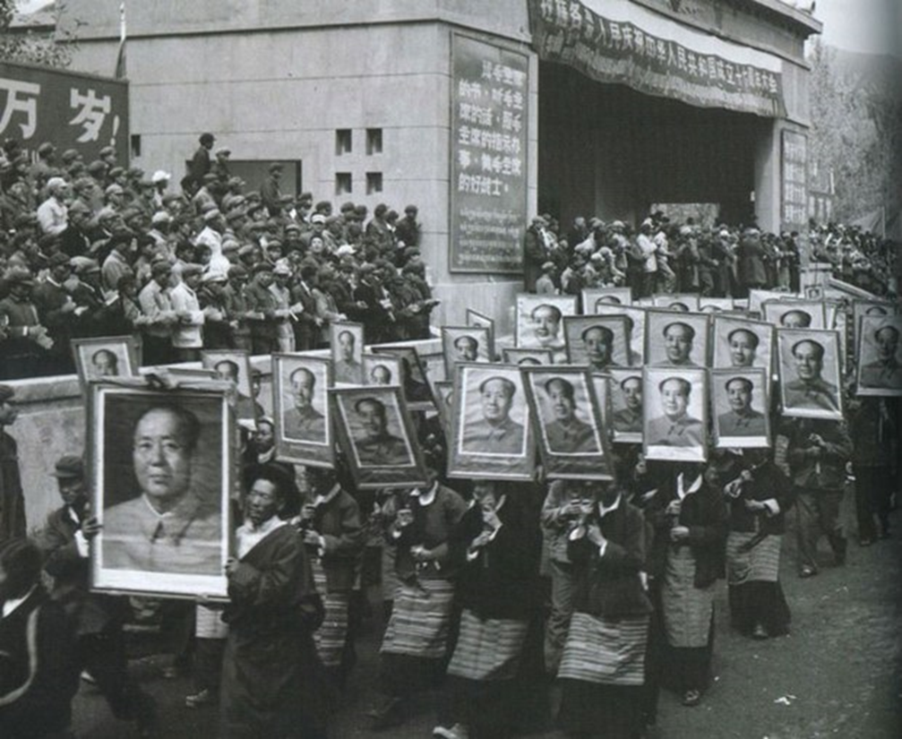
Monastery Destructions in the 1960s
1960 to 1969
In the 1960s, Chinese forces destroyed many Tibetan monasteries. During the Cultural Revolution, Mao called for the destruction of anything representing traditional values or "bourgeois." For Tibet, this meant an attack on anything that was a symbol of Tibetan Buddhism, including monasteries, religious art, prayer flags, images of the Dalai Lama, and incense burners.

Slide 16
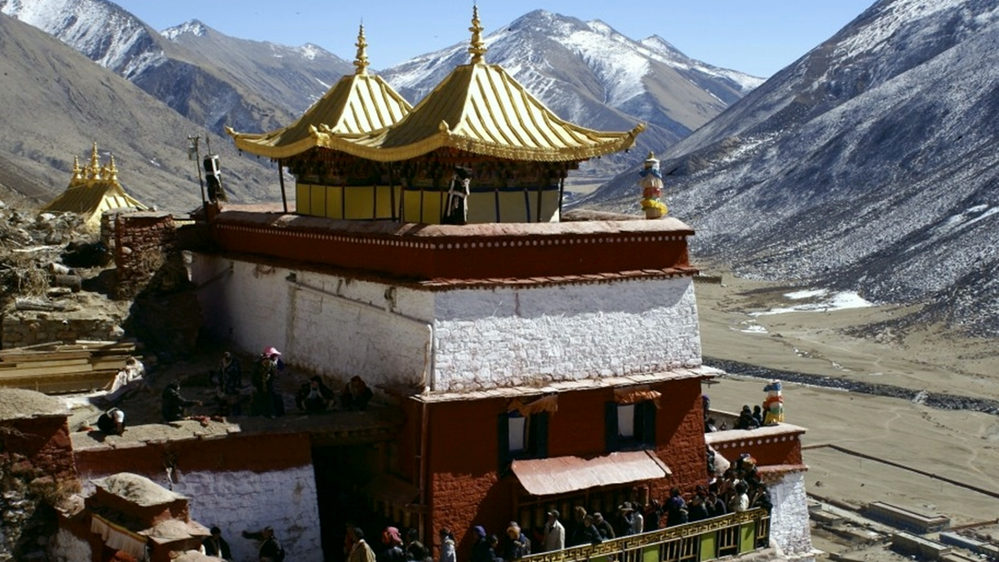
Destruction of the Drigung Monastery
1959
Dating to the 12th century, the Drigung monastery served as a key spiritual center in Tibet renowned for the meditation techniques developed within its walls. It was damaged during the cultural revolution, and key cultural relics (manuscripts and statues) were destroyed.

Slide 17
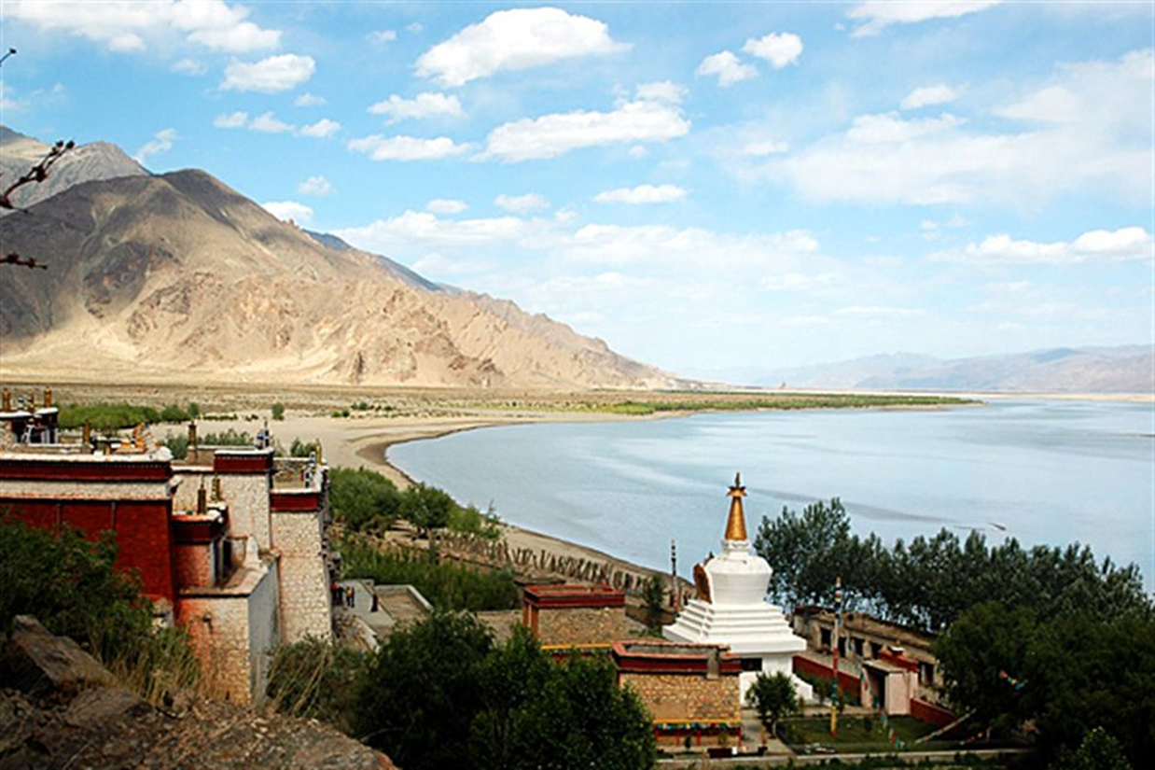
Destruction of the Dorje Drak Monestary
1959
Dorje Drak Monastery was a hub for early Tibetan study of medicine. Chinese authorities destroyed it in 1959. A second demolition occurred in 1985 though it is now under reconstruction.

Slide 18
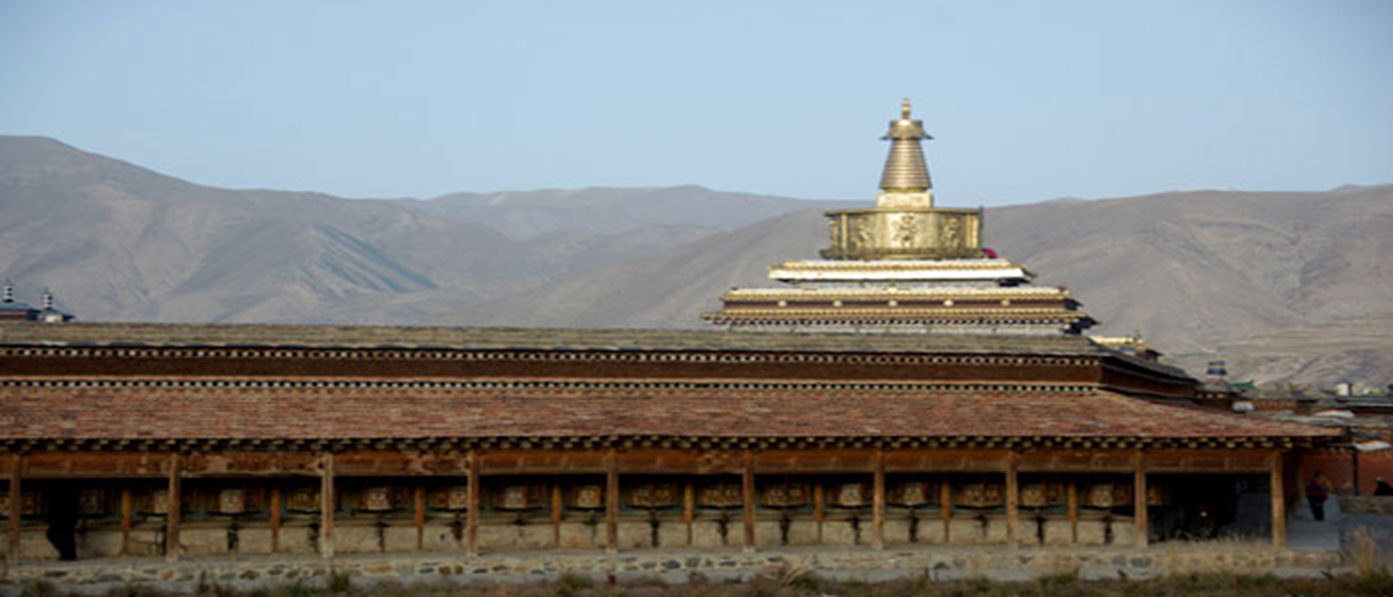
Closing of the Labrang Tashikyil Monastery
1966
The Labrang Tashikyil Monastery has played an essential role in Tibetan society since its founding in 1709. The Monastery served as a major university and hub for economic activity. During the cultural revolution, the monastery was forcefully closed by Chinese authorities. Upon reopening in 1980, Chinese authorities exploited the structure as a tourist attraction. Tibetan presence has been suppressed, and mass arrests of monks occurred.

Slide 19
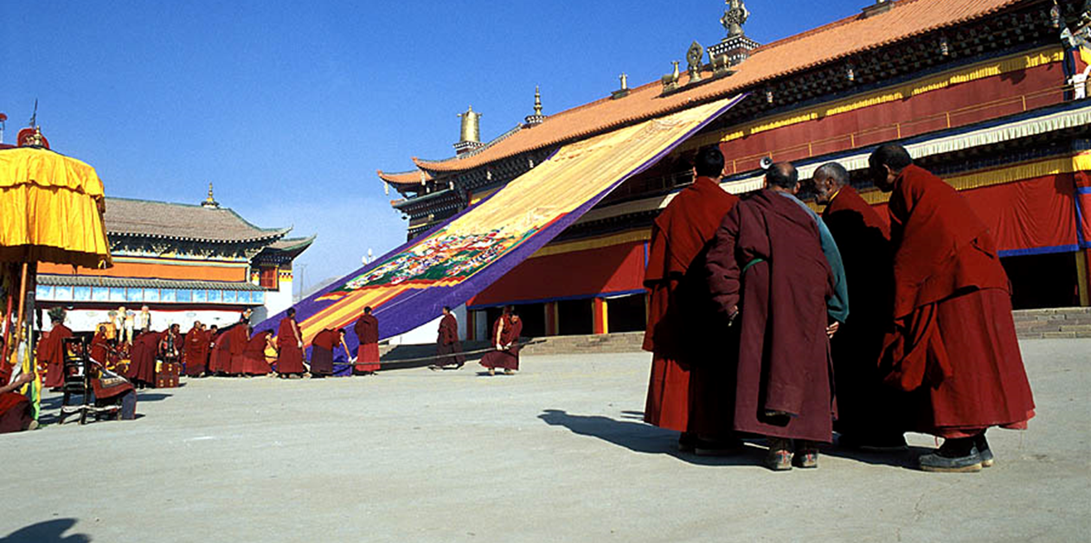
Destruction of the Kirti Monastery
1966
Founded in 1472, the Kirti monastery has long been a symbol of Tibetan political identity. During the cultural revolution, Chinese authorities obliterated the monastery. Though the monastery was rebuilt in 1991 and its role as a hub for Tibetan political identity was revived, it remains subject to intense scrutiny by Communist Party officials. Following a demonstration at the monastery in 2008, Chinese authorities opened fire on demonstrators, killing 23 people. Today, Kirti remains a symbol of Tibetan resistance.

Slide 20
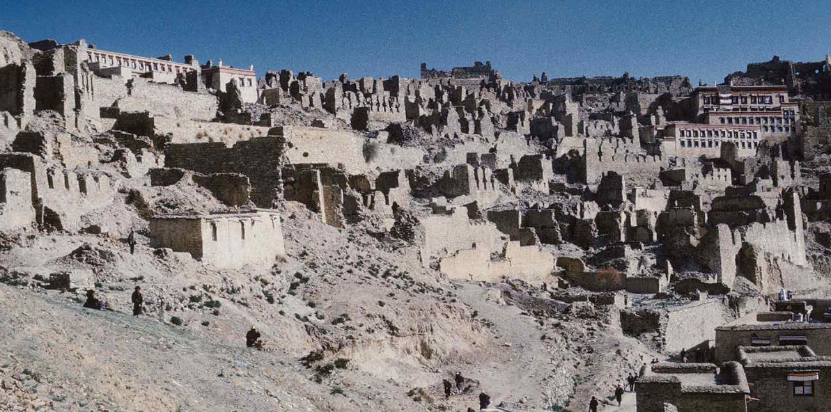
Destruction of the Ganden Monastery
1966
Established in 1409, the Ganden Monastery played an essential role in Tibetan religious and political authority. It was obliterated in 1959 during a Chinese bombing campaign.

Slide 21
Cultural Revolution
1966 to 1976
The Cultural Revolution was devastating for all of China. Tibet was hit particularly hard, as 90% of the remaining monasteries in Tibet were destroyed, and the CCP outlawed many Tibetan cultural customs and religious practices.
At the end of the Cultural Revolution in 1976, the CCP stated that the "mistakes" in Tibet were the fault of the ultra-leftist Gang of Four. It wasn't until 1980 that most religious practices were allowed to resume in Tibet.

Slide 22
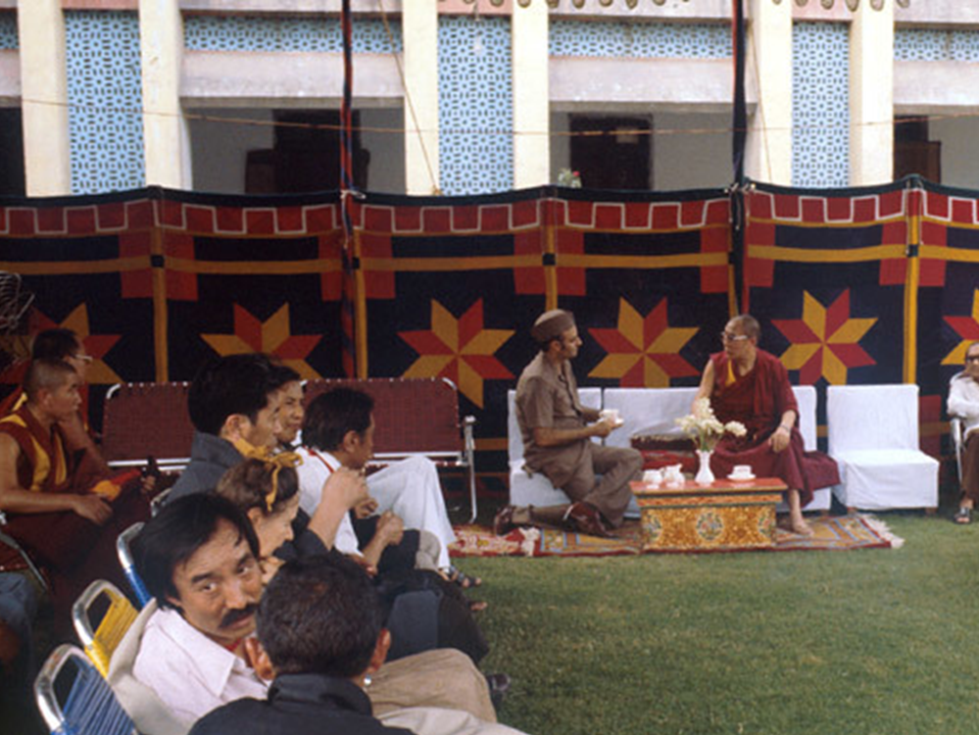
Contact with CCP Reestablished
1979
The Dalai Lama and the Chinese Communist Party's (CCP) government in Beijing had their first contact since the Dalai Lama fled to India, marking the beginning of possible negotiations. Deng Xiaoping, the leader of the CCP, invited the Dalai Lama to return to China on the condition that he stay in Beijing. The Dalai Lama turned down this offer and chose to remain in India, where he continued to advocate for a free Tibet.

Slide 23
Cadre Transfers
1981 to 1987
During the 1980s, the CCP transferred over 10,000 cadres into Tibet to serve in technical and political positions. These cadre transfers were a precursor to large population transfers the CCP would encourage over the next four decades.
Since 1959, more than 111,000 cadres have been transferred into Tibet. The movement of cadres into Tibet shows that the CCP did not honor the 17 Point Agreement, which would have allowed Tibet self-government. Instead, the CCP increased the political pressure on Tibetans to conform to CCP rule.

Slide 24
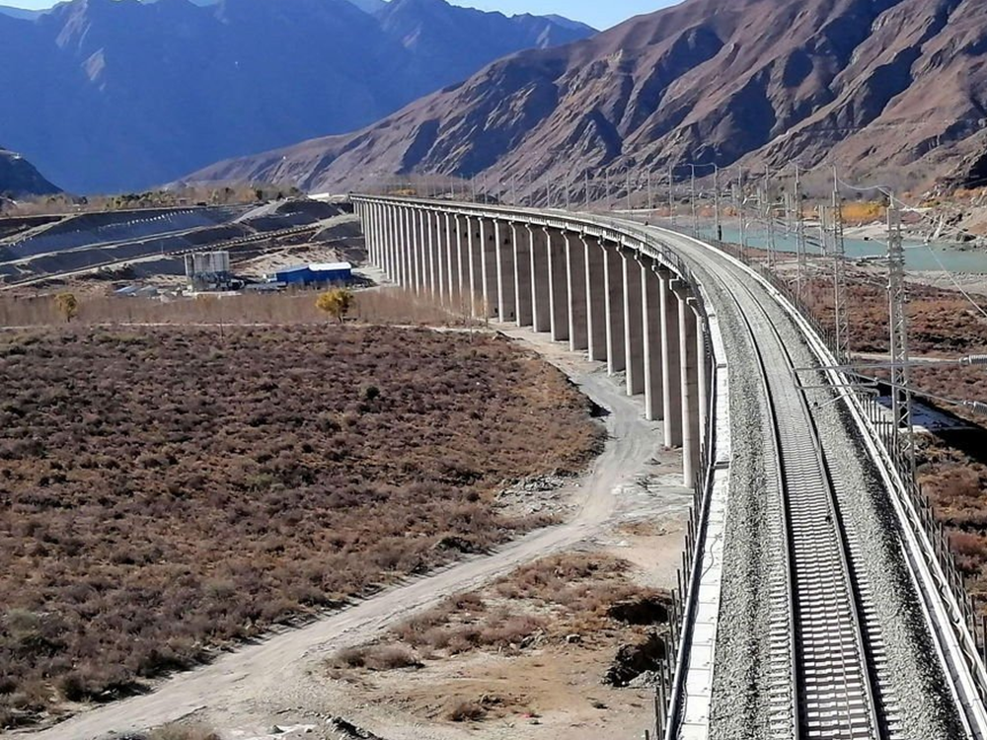
Infrastructure Development Project & Nomadic Herders
1984
In conjunction with the cadre transfers during the 1980s, the CCP also began a massive infrastructure development project in 1984. Large teams of workers were sent to the TAR to build railways, roads, and other forms of infrastructure in order to "modernize" the region. However, these developments did not respect the cultural traditions of Tibetan nomads and herders, destroying pastoral lands. Furthermore, these infrastructure projects made it easier for the CCP to encourage the migration of Han Chinese into Tibet.
Nomadic herders were further impacted by new policies that required them to sell a certain amount of their goat, yak, or sheep wool to the government before they could sell it elsewhere. The government would underpay for the product they bought, then sell it, making a 30-50% profit. These policies were intentionally designed to keep Tibetan herders in poverty and make their traditional lifestyle harder to sustain.

Slide 25
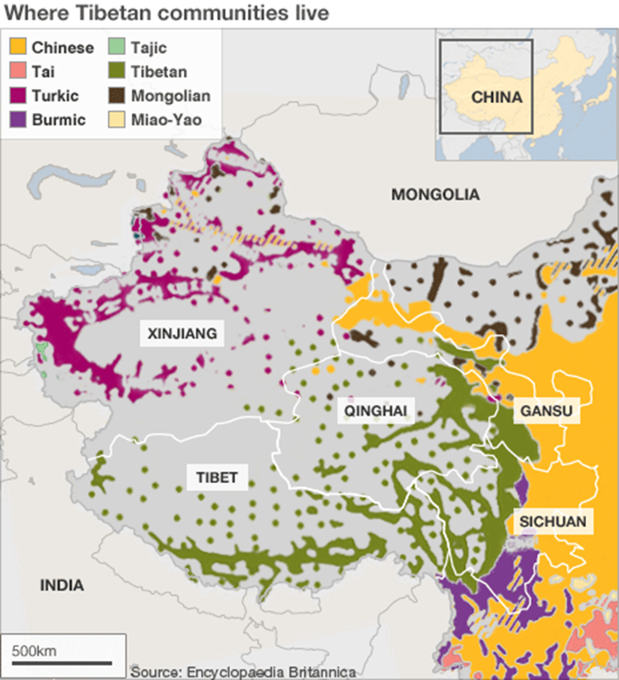
Sinicization of Tibet
1986 to 2021
Sinicization is the term used to describe the ways that the CCP pushes cultural unity onto Tibet. One of the CCP's main strategies is the movement of non-Tibetans into Tibet. Since the 1980s and China's open-door policy towards Tibet, the CCP has encouraged swaths of ethnically Han Chinese to move to Tibet. This push has drastically shifted the ethnic make-up of Tibet to the point where Tibetans are nearing the minority in their own region.

Slide 26
Five Point Peace Plan
Sept 21, 1987
In 1987, while still leading the Tibet government from exile, the Dalai Lama addressed the US Congressional Human Rights Caucus in Washington D.C. and presented his Five Point Peace Plan for Tibet. The five points of the plan were:
“Transformation of the whole of Tibet into a zone of peace;”
“Abandonment of China's population transfer policy which threatens the very existence of the Tibetans as a people;”
“Respect for the Tibetan people's fundamental human rights and democratic freedoms;”
“Restoration and protection of Tibet's natural environment and the abandonment of China's use of Tibet for the production of nuclear weapons and dumping of nuclear waste;”
“Commencement of earnest negotiations on the future status of Tibet and of relations between the Tibetan and Chinese peoples."

Slide 27
Drepung Monastery and Sera Monastery Protests
Sept 27, 1987 to Oct 1, 1987
In September 1987, 21 monks from the Drepung Monastery in Lhasa took to the streets to voice support for the Dalai Lama and Tibetan independence. The police arrested all 21 in addition to 5 other people.
Four days later, monks from the Sera Monastery again protested for Tibetan independence. However, this protest turned violent. Protestors attacked a police station, and 6 Tibetans were killed. Hundreds of Tibetans were arrested following this incident, and foreign journalists were expelled from Tibet.
While protests for Tibetan independence were common in Tibet, these two instances sparked a crackdown by the CCP on Tibetan independence movements, which led to increased arrests and persecutions.

Slide 28
Strasbourg Proposal
June 15, 1988
The Dalai Lama presented the Strasbourg Proposal to the European Parliament in 1988. During his address, he reiterated the Five Point Peace Plan and called for European countries to lend their support to Tibet. This event increased the international pressure on the CCP to negotiate with the Dalai Lama and institute reforms in Tibet. However, the CCP did not adapt its policies as a result of the proposal.

Slide 29
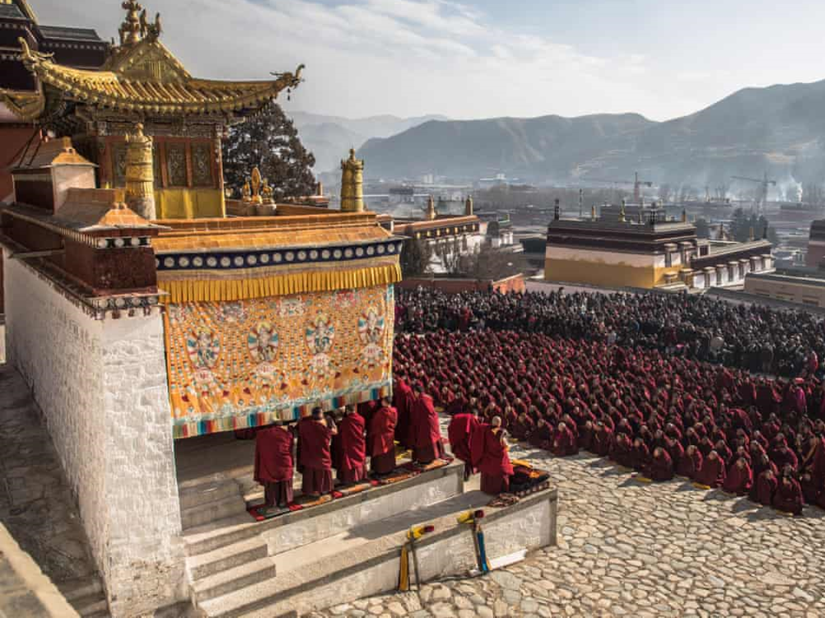
Monlam Demonstrations
1988
On the last day of the Monlam Festival, which is the most important prayer festival for Tibetan Buddhists, protests for Tibetan independence escalated to the point of violence in Tibet's capital, Lhasa. Protestors, who saw the CCP-run organization as a symbol of the oppression they faced, attacked the Tibetan branch of the Buddhist Association of China. Hundreds of Tibetans were arrested, and several died, in addition to several Chinese police officers.

Slide 30
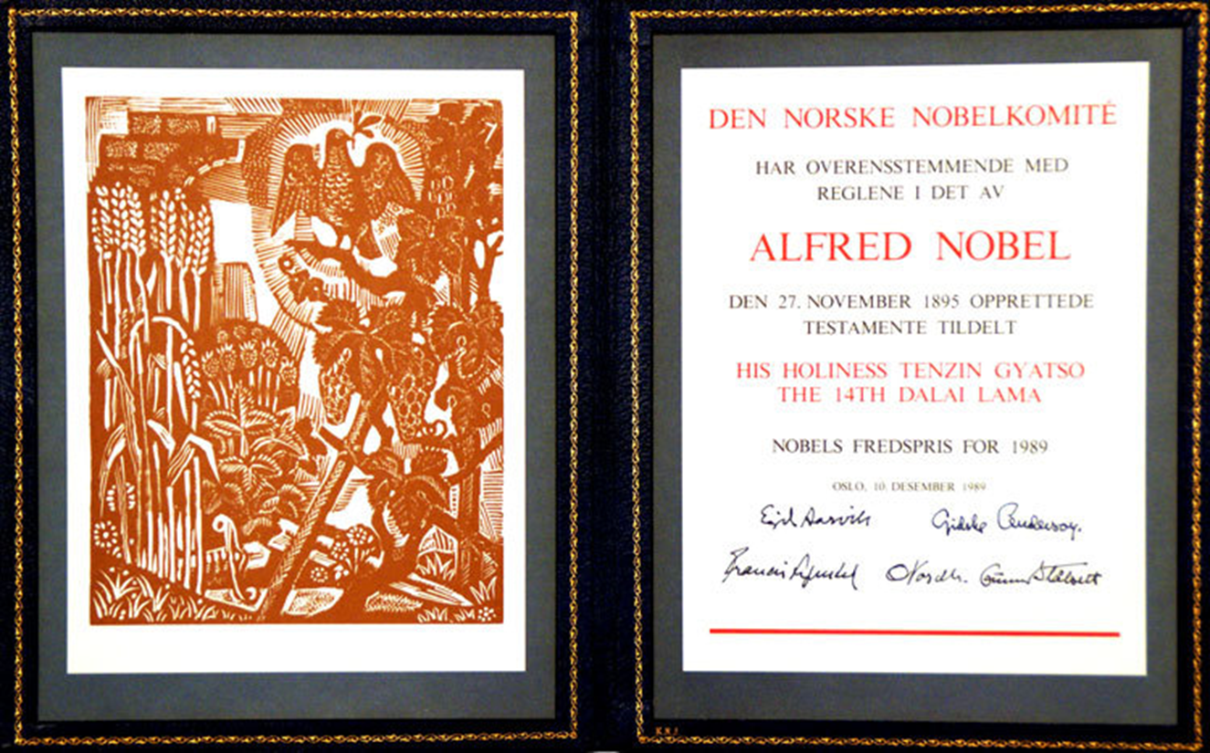
Dalai Lama Awarded Nobel Peace Prize
1989
The Dalai Lama was awarded the Nobel Peace Prize in 1989 for his work toward peace in Tibet to preserve the cultural and historical heritage of the Tibetan people. The Dalai Lama's consistent opposition to violence and a commitment to tolerance and mutual respect were key to the community's decision.

Slide 31
Lhasa Protests - Martial Law Declared
March 1989
Police opened fire on a small group of protestors who were demonstrating after the death of the 10th Panchen Lama, a key figure in Tibetan Buddhism. The demonstrations then grew in size, involving upwards of 10,000 people. In the two days following the initial incident, it is believed that security forces killed 200 people before martial law was declared. The People's Liberation Army took control of Lhasa and expelled foreign tourists, journalists, and diplomats.
The expulsion of foreigners from Tibet allowed the Army free reign over Tibet with no witnesses. Reportedly, 1,000 Tibetans were arrested before the expulsion, with countless more arrests likely following. The true number of arrests and deaths, as well as the extent of China's crackdown, is unknown as attention was quickly drawn away from Tibet and to Beijing due to the Tiananmen Square massacre the following month.

Slide 32
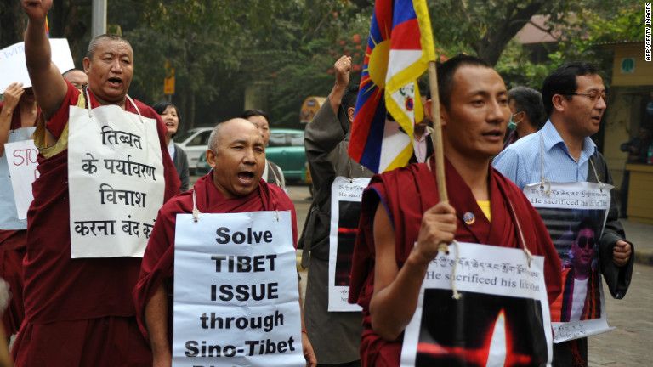
Price Gouging Protests
1993
Protests about pricing in Tibet evolved into pro-independence protests. Police used tear gas to disperse the crowd of nearly 1,000 Tibetans. This was the largest incident of unrest since the 1989 protests.

Slide 33
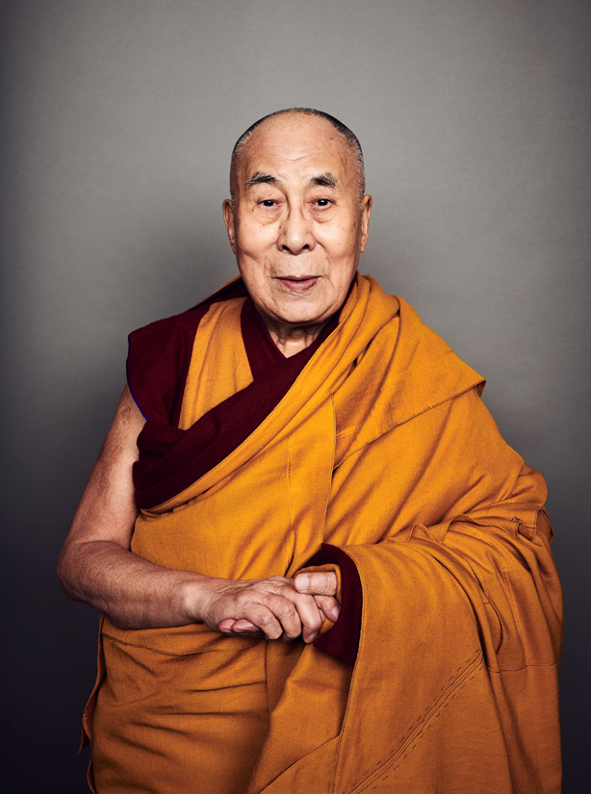
Third Party Forum on Tibet
1994
The Third Forum on Tibet identified the Dalai Lama as an enemy of the Chinese state. This served the CCP's goal of vilifying the Dalai Lama in hopes of getting the Tibetan people to stop their support of his government in exile. It also put the hope of any form of negotiation between Beijing and the Dalai Lama to rest.

Slide 34
Arrest of Panchen Lama
1995
Gendun Choeki Nyima, a six-year-old boy, was identified as the reincarnation of the Panchen Lama by a team of Tibetan Monks. The CCP disagreed with this and arrested the boy and his parents. Gendun has not been seen since.
The CCP forced a different group of Monks to name the five-year-old boy Gyaltsen Norbu as the Panchen Lama. Since then, Norbu has been paraded throughout Tibet each year and lives under house arrest.
China has continually interfered with the ability of Tibetans to practice their religion. The arrest of the Panchen Lama and the forced appointment of a different Panchen Lama emphasizes the lengths that China is willing to go to remain in control of Tibet.

Slide 35
Dalai Lama Accuses Beijing of Cultural Genocide
Dec 1999
In a statement made in December 1999, the Dalai Lama stated that Tibetans would accept self-rule in Tibet if full independence was not possible, once again showing his willingness to negotiate with the CCP to bring peace to Tibet. However, the Dalai Lama reiterated his statements that the CCP was committing cultural genocide due to the sinicization of Tibet.

Slide 36
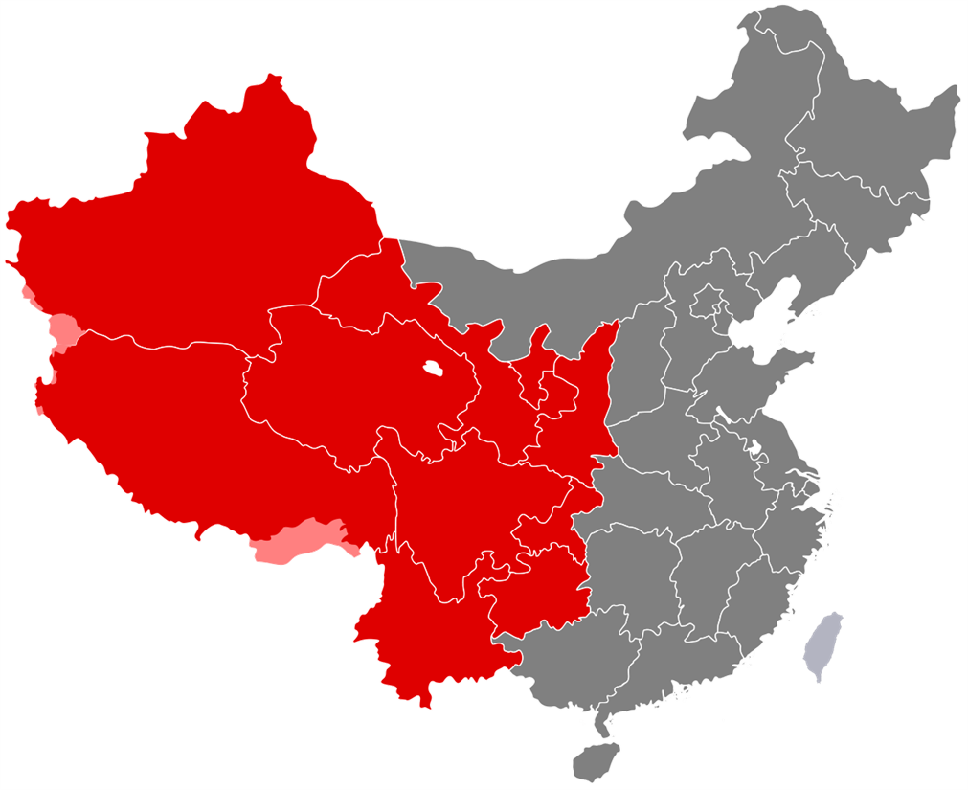
"Go West" Campaign
2000
The CCP initiated the "Go West" Campaign in 2000 to increase income and ease social tensions in China's west. However, the campaign has had limited success in Tibet. Many of the projects focus on establishing industry and trade in the region. This is significantly hampered by the mountainous landscape of Tibet, which caters to the more traditional elements of Tibetan life, such as herding. The "Go West" Campaign suppresses traditional ways of life in Tibet in favor of more industrial careers.

Slide 37
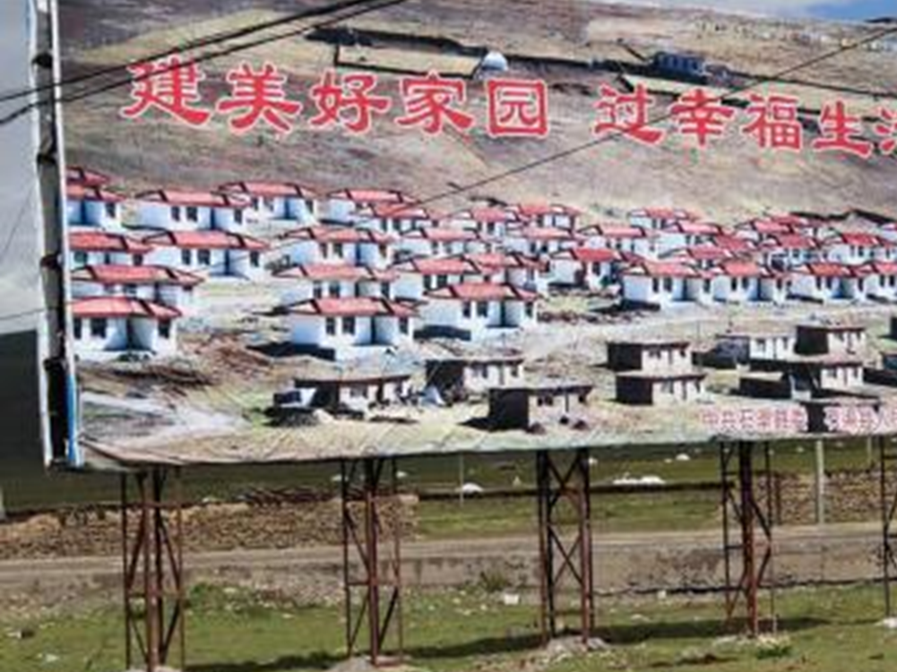
"Comfortable Housing Initiative"
2006 to 2012
The CCP forcibly resettled 2 million rural Tibetans into "socialist villages" in the Tibetan countryside. These new houses cost $6,000, which the Tibetans had to pay for themselves, despite rural Tibetan families having an average annual income of $320.
Not only are these homes unaffordable for rural Tibetans, but they also do not have the ability to sustain traditional rural Tibetan life, as they don't have space to keep their livestock. This move forces Tibetans out of traditional ways of life and poses a threat to Tibetan culture.

Slide 38
“Measures on the Management of the Reincarnation of Living Buddhas”
2007
China's State Administration for Religious Affairs ruled that all reincarnations must be government-approved. In order to be approved, Buddhist temples must submit reincarnations to the government. Reincarnations must be viewed as preserving national unity and cannot be influenced by parties outside of China. Notably, this means that no reincarnation that the Dalai Lama has contributed to can be officially approved.
Reincarnation is an essential part of Tibetan Buddhism. By interfering in the reincarnation process, the CCP is preventing Tibetan Buddhists from practicing their religion and further cementing their control of Tibet.

Slide 39
49th Anniversary of Tibetan Uprising Protests
March 2008
On the 49th anniversary of the Tibetan Uprising, hundreds of monks came together to protest in Lhasa. They called for the release of fellow monks who the CCP had detained. Violence escalated throughout the week, with reports of indiscriminate shooting and beatings by Chinese security forces. More than 140 people died.
TAR government officials accused the Dalai Lama of orchestrating the riots and closed Tibet to foreign tourists and reporters. Since the 2008 incident, there have been repeated reports of Chinese security forces using excessive force and violence in Tibet.

Slide 40
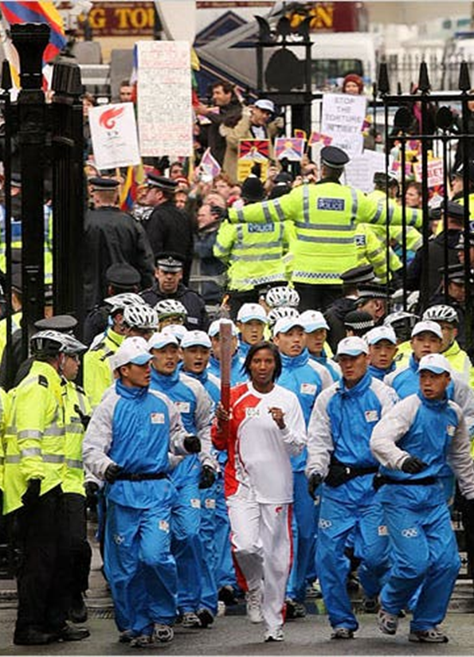
Beijing Olympic Protests
April 2008
The Global Olympic torch rally leading up to the 2008 Olympics in Beijing was a flashpoint for Tibetan independence protests. In both San Francisco and London, major protests occurred while the flame was present. As a result, there was an influx of attention paid to Tibet by the international community.

Slide 41
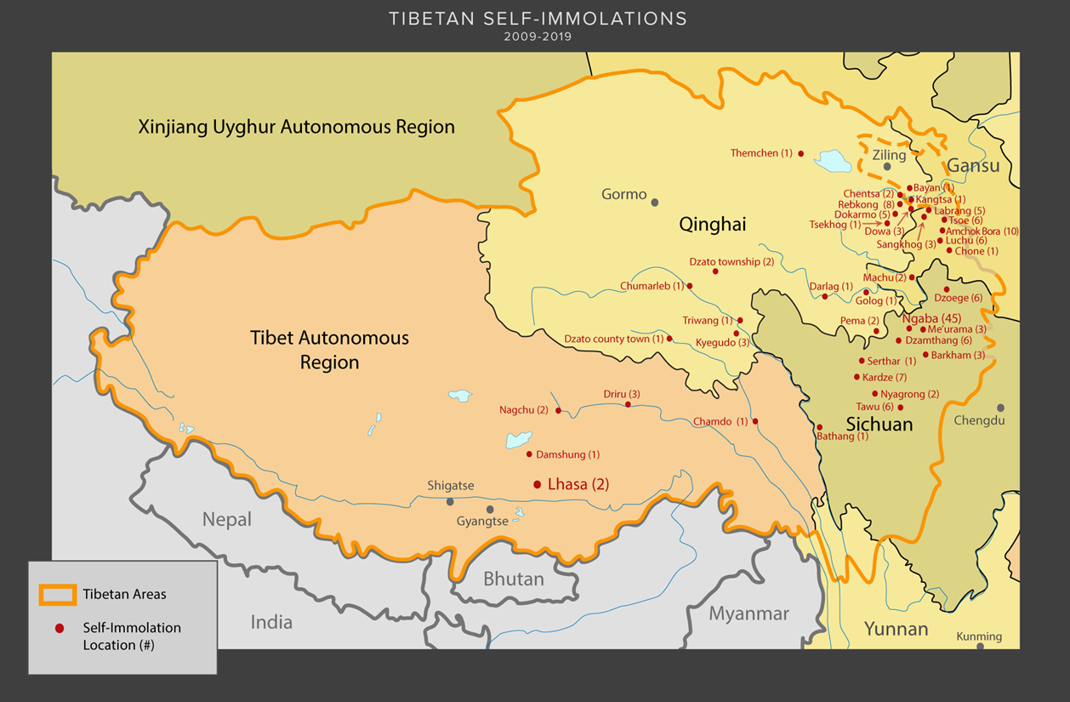
Self-immolations
2009 to 2019
Tibetan monks and devout Tibetan Buddhists have set themselves on fire in protest of Chinese rule in Tibet. The first to do so was Tapey, a monk who self-immolated after prayer ceremonies in his monastery were canceled in 2009. The most recent incident of self-immolation was in 2019, which led to the death of a former monk. Since 2009, 157 Tibetans have self-immolated.
The Dalai Lama has stated that the CCP's cultural genocide is responsible for self-immolations. In a statement after a wave of self-immolations in 2011, the Dalai Lama stated that Tibetans are being pushed to desperate measures by the CCP's oppressive policies.

Slide 42
Last Known Talks with Beijing
2010
The last time there was any form of negotiations between representatives of the Dalai Lama and China was in 2010. Notably, current Chinese President Xi Jinping, who came to power in 2013, has never initiated talks with the Dalai Lama or his representatives. The lack of negotiations between the Tibetan government in exile and China leaves very little hope for an independent or even self-governing Tibet in the future.

Slide 43
Panchen Lama Elected to Chinese People’s Consultative Conference
2010
Beijing elected their pick for Panchen Lama to the Chinese People's Consultative Conference, a key part of the CCP's governing process. However, many see this simply as a ploy to gain more support behind the Panchen Lama and pull Tibetans away from the Dalai Lama. This reignited calls for the original Panchen Lama to be released and reinstated and for the CCP to stop interfering in the practice of Tibetan Buddhism.

Slide 44
Closure of the Shak Rongpo Ganden Dargyeling Monastery
2010
Built in the mid-1700s, the Shak Rongpo Ganden Dargyeling Monastery has been an important center of Tibetan monastic heritage. In April 2010, Chinese authorities accused members of the monastery of collaborating with the exiled Dalai Lama, hence initiating a 150-man strong campaign to shut down the monastery. During this campaign, the Grand Abbot was arrested. Monks were ordered to decry the Dalai Lama and Grand Abbot.
Today, religious activities are prohibited from occurring in the monastery, and all monks have been expelled. The People’s Liberation Army maintains a significant presence of approximately 2,400 near the deserted monastery.

Slide 45
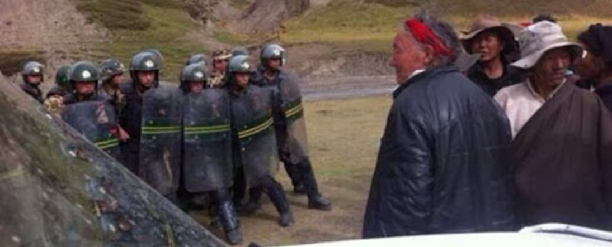
Closing of the Driru County Monasteries
2010
Driru County has been an epicenter of Tibetan resistance. In 2010, Driru erupted in demonstrations condemning environmental exploitation by Chinese companies. In later years, Chinese authorities responded to protests with mass arrests and by firing on protestors. Eventually, Chinese authorities closed down the county's Drongna, Tarmoe, and Rabten monasteries.

Slide 46
Commodification of Buddhist Temples
2011 to 2021
When not actively destroying or closing Tibetan Buddhist temples and monasteries, the CCP has used them to increase tourism and profits in Tibet. One strategy employed by the CCP is deeming temples to be of "national importance" and charging admissions or enclosing the temple within a scenic park that has an admission fee. This makes it more challenging for worshipers to receive religious services, violates the Buddhist tenant of free will, and undermines the authority of temple monks.

Slide 47
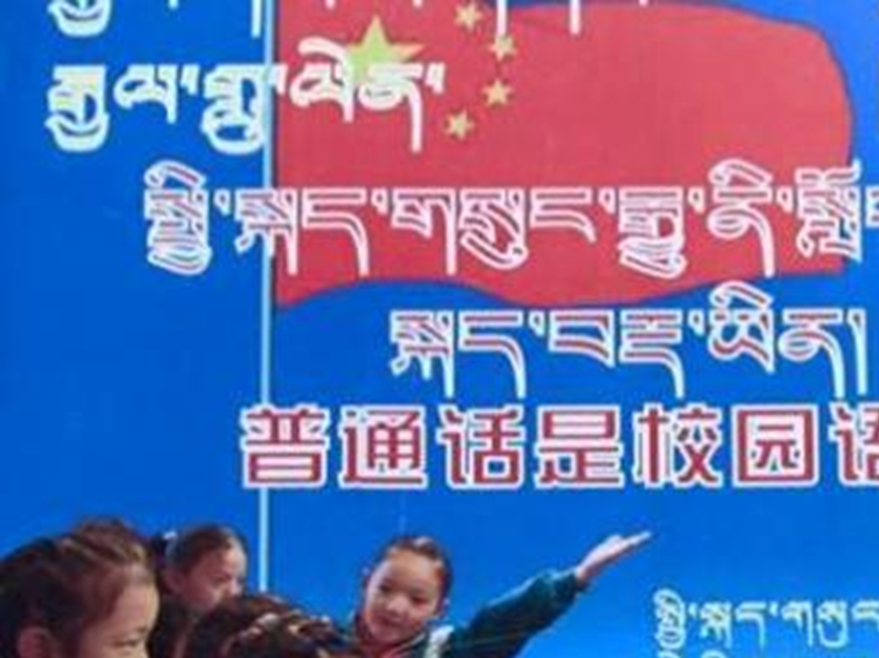
Bilingual Education Policy
2010
The CCP implemented the Bilingual Education Policy, which mandated that all courses taught in Tibetan schools that were not explicitly Tibetan language classes be taught in Mandarin. In addition to banning the formal instruction of Tibetan in schools, the CCP has banned informal schools run by nuns and monks from teaching laypeople Tibetan. The estimated literacy rate of Tibetans in Tibetan has fallen below 20%. By stopping students from learning and being taught in Tibetan, the CCP has made it even more challenging for the Tibetan culture to survive. The implementation of the Bilingual Education Policy also resulted in many Tibetan teachers with low Mandarin skills losing their jobs.

Slide 48
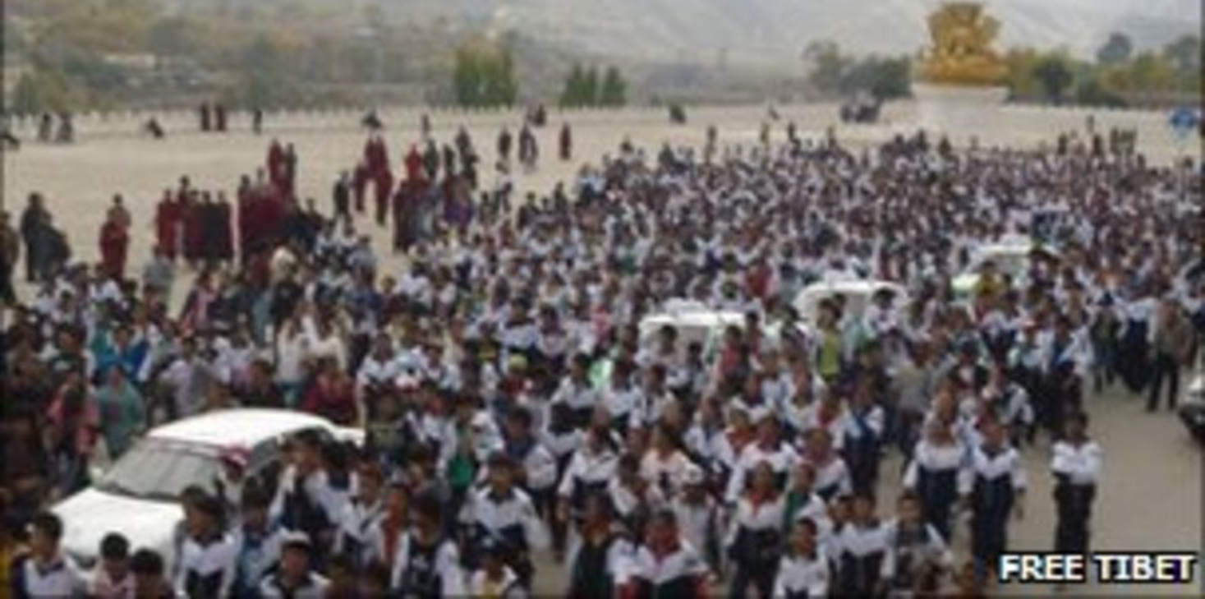
Student Protests
2010
Between 1,000 to 7,000 students took to the streets of Tibet to protest the implementation of the Bilingual Education Policy. Protestors stated that the new rule was an erasure of their culture. While police did not interfere with the protests, students identified as "ringleaders" were threatened with expulsion if the protests continued.

Slide 49
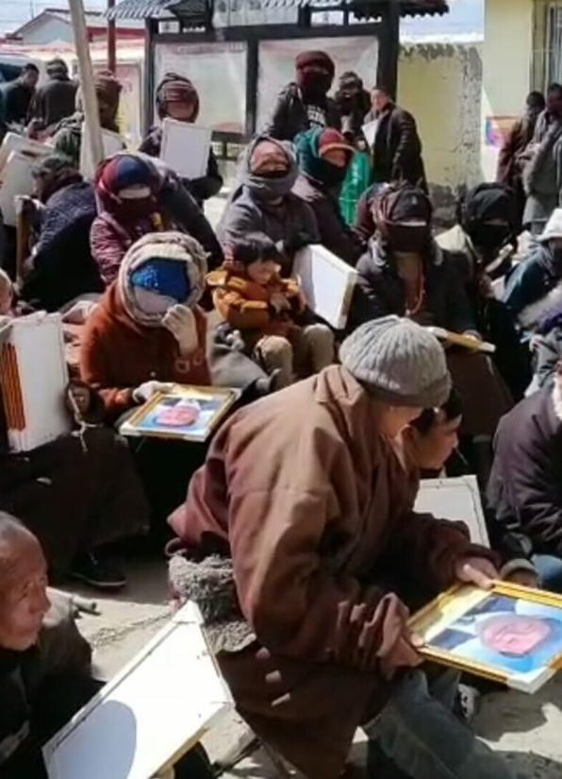
Patriotic Reeducation Campaign
2011 to 2017
In 2011, the CCP sent 21,000 cadres into the Tibetan countryside. In addition to their political monitoring, these cadres also held "patriotic reeducation" at religious sites. These educational sessions were focused on CCP propaganda, including denunciation of the Dalai Lama and recognition of the CCP-elected Panchen Lama. While these types of campaigns have been happening in Tibet since the 1990s, they previously focused on monks and devout practitioners. Instead, this campaign targeted laypeople and the general Tibetan population.

Slide 50
Dalai Lama Retires from Politics
2011
The Dalai Lama formally retired from politics after leading the government from exile starting in 1959. While he stepped away from his political duties and activities, he reiterated that he would continue to serve as a spiritual leader for the Tibetan people. The current President of Tibet is Penpa Tsering.

Slide 51
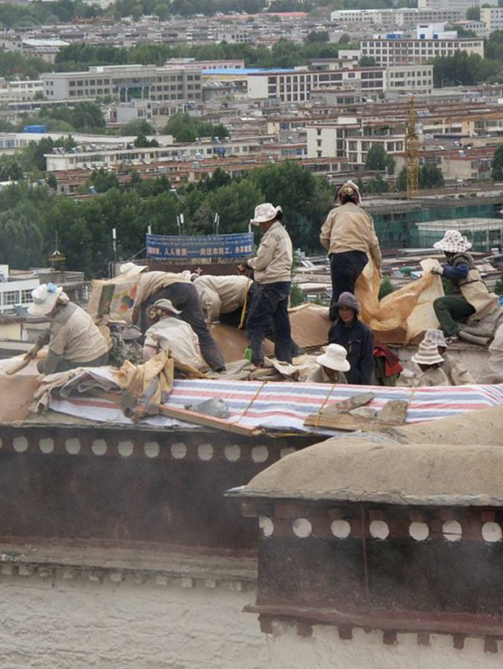
New Urbanization Plan
2014
The CCP's New Urbanization Plan was designed to increase the number of Chinese citizens living in urban areas compared to rural areas. This policy impacted Tibetans in the countryside who had already been moved into socialist villages under the Comfortable Housing Initiative. Rural Tibetans were pushed to sell their pastoral lands to developers and move into urban areas, which are dominated by Han Chinese. Tibetans who move to urban areas are often in poorly paid positions despite having a new, higher cost of living. This is another way that the CCP has been able to suppress Tibetans and their ways of life.

Slide 52
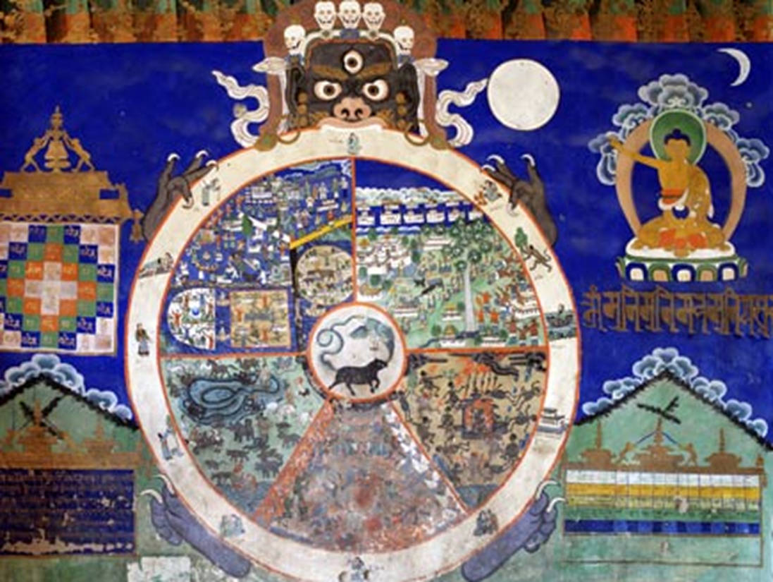
Reincarnation Database
2016
The Buddhist Association of China revealed a digital database of 870 approved reincarnations. The purpose of the database is to prevent "fake reincarnations" from influencing Tibetan Buddhists. However, this is another instance of the CCP's power struggle with the Dalai Lama's leadership in exile.

Slide 53
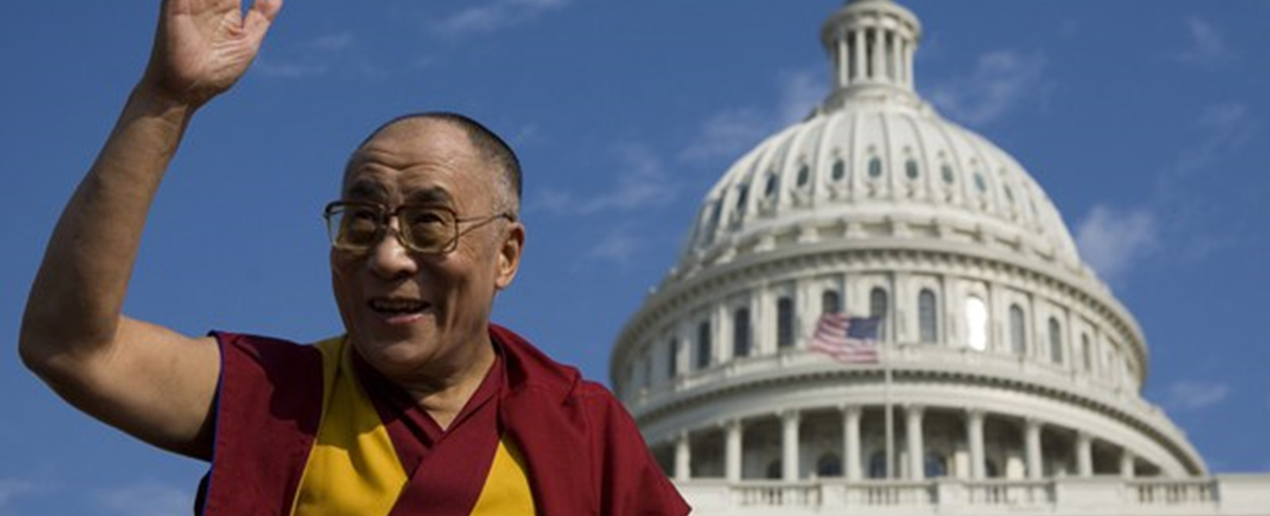
Tibet Policy and Support Act
2020
The Tibetan Policy and Support Act established as U.S. policy that the succession and appointment of all Tibetan Buddhist leaders would be the sole right of Tibetan Buddhists. This effectively codified support for Tibetan cultural sovereignty into U.S. law.

Slide 54
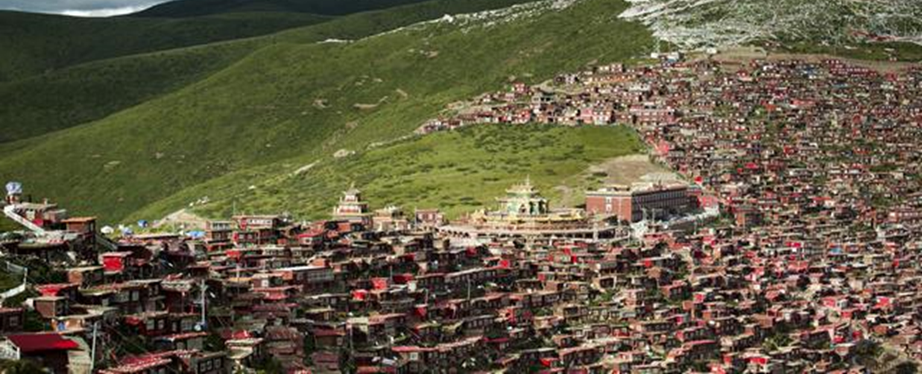
Monk and Nun Evictions
2016 to 2019
While the CCP had been steadily limiting the number of Tibetan monasteries allowed to practice, between 2016 and 2019, six to seventeen thousand monks and nuns were evicted from their monasteries and prevented from practicing elsewhere. Satellite imagery shows that thousands of buildings at the Larung Gar and Yachen Gar Tibetan Buddhist Institutes have been destroyed.

Slide 55
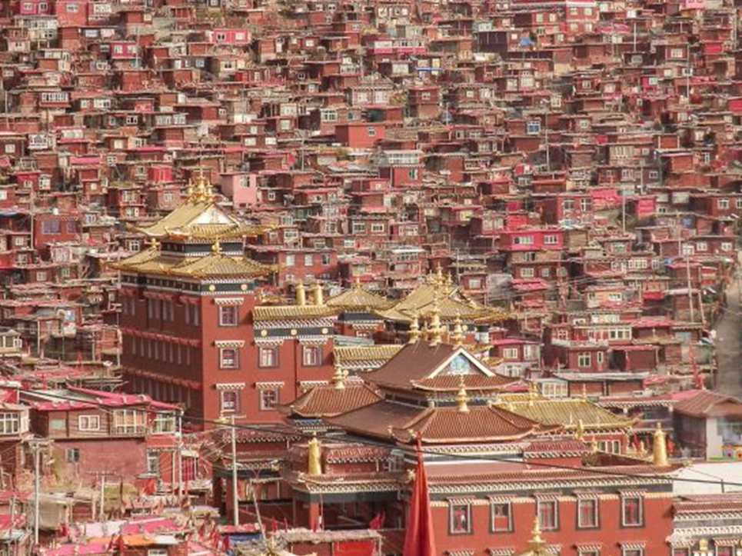
Take Over of Larung Gar
2018
Beijing released a decree stating that Larung Gar, home to approximately 40,000, the largest Tibetan Buddhist institute in the world, and a symbol of what it means to be Tibetan, was over-crowded. The decree mandated reducing the population to 5,000. Beijing proceeded to engage in a campaign of home demolition and forced relocation, which resulted in the destruction of 1,500 residence structures and the deportation of 3,730 people.
Though the Chinese rationale for the project was population management, an independent investigation concluded that China sought to turn the area into a source of revenue and make the area more attractive for tourists. The takeover of Larung Gar represents what the goal of the CCP is for Tibet: to strip Tibetans of their culture while simultaneously profiting off of it.

Slide 56
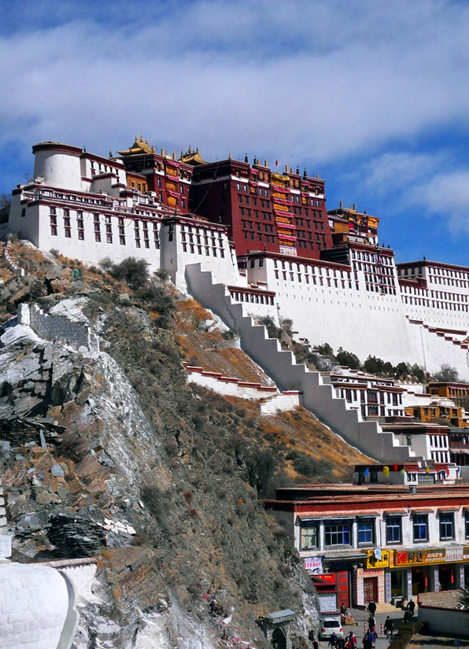
Conclusion
China maintains its posture of religious discrimination and persecution against Tibetans through its discriminatory economic and religious-based policies. Genocide Watch recommends:
The development and passage of a United Nations resolution whose provisions are akin to the Tibetan Policy and Support Act. This would grant Tibet internationally recognized cultural sovereignty.
The repeal of the re-incarnation act.
The relinquishment of Tibetan monasteries as tourist attractions followed by a return of authority to Tibetan monks.
Reopen lines of communication between Beijing and the Tibet Government in Exile.

