Slide 1
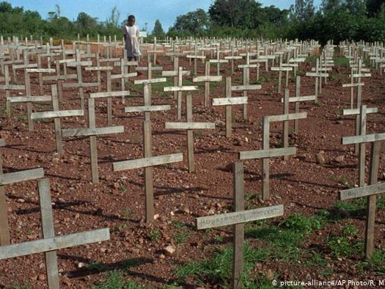
1994 Genocide in Rwanda
By Anna Killen, Şehnaz Güven, and Holly Scala

Slide 2
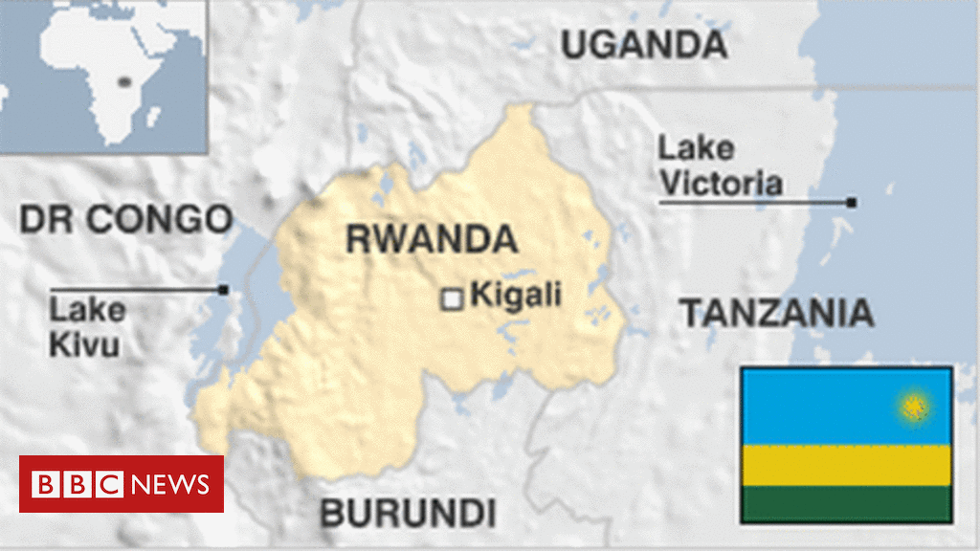
Rwanda: Country Profile
Main ethnic groups: Hutu (84-5%), Tutsi (14-5%), Twa/Batwa (1%). All groups are derived from the same cultural and linguistic group, the Banyarwanda.
Main Religious Groups: Roman Catholic (43.7%), Protestant (37.7%), Seventh Day Adventist (11.8%), Muslim (2.0%).
1884-1885: Following the Berlin Conference, Ruanda-Urundi (Rwanda and Burundi) became a German colony.
1924: Belgian forces occupied the region during World War I. By 1924 a League of Nations mandate awarded the territory to Belgium.
1962: Rwanda (and Burundi) gain formal independence.
1990-1994: Rwandan Civil War breaks out between the rebel RPF and government forces.
April-July 1994: An estimated 800,000 people are murdered in one of the most rapidly mobilized and executed genocides in history.
2015: International Criminal Tribunal hearings for the Rwandan genocide are finalized. Established in 1995, 94 people were convicted over 10 years.

Slide 3
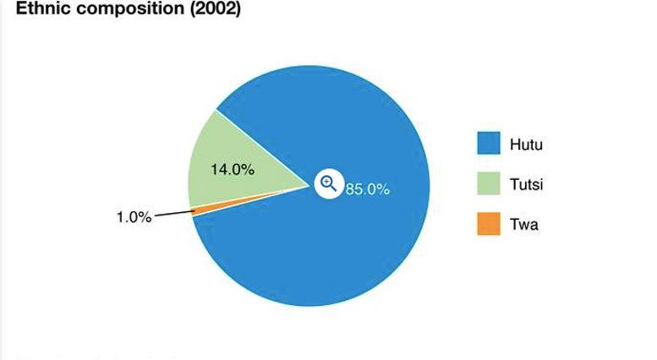
Ethnicity in Rwanda
Differences between Rwandan ethnic groups existed before European colonization. However, it was possible to move between groups through financial changes and/or intermarriage. Ethnicity was not a fixed identity assigned at birth but rather a tool that could be manipulated.
While the Tutsi minority made up the dominant administrative classes and were predominantly herders, the Hutu majority were the farming classes. The small percentage of Twa lived as hunter-gatherers. Generally, the Tutsi minority dominated the Hutus through a system of patron-client ties known as "cattle contracts".

Slide 4
Demography & Ethnicity
Home to over 12 million people, Rwanda is a small landlocked country located in East-Central Africa with one of the region's highest population densities.
There are three main social groupings, all derived from the same cultural and linguistic group, the Banyarwanda. The Hutu make up the majority (84-5%) and the Tutsi (14-5%) are the minority. There also exists a small percentage of Twa (1%).
Between 1948 and 1994, Rwanda's population grew from 1.8 million to around 7 million. Leading up to the 1994 genocide, this rapid demographic change caused land and food scarcity. Socio-economic tensions rose and exacerbated inter-ethnic grievances between the country’s two largest ethnic groups.
While ethnic differences and tensions predated colonization, by 1994 land shortages, resource competition, and colonial rule had cemented and worsened inter-ethnic relations.

Slide 5
Berlin Conference
Nov. 15, 1884 - Feb. 27, 1885
The Berlin Conference, also known as the "West Africa Conference" or the "Congo Conference," was part of the colonial "scramble for Africa." It involved 14 countries, mainly European, who sent representatives to Berlin to distribute African territories amongst themselves.
Colonial partitioning of African land totally excluded indigenous peoples and was solely focused on the expansion of empire and resource extraction. Arbitrarily drawn borders that cut across ethnic, linguistic, and cultural groupings still exist to this day.
Rwanda, then known as Ruanda-Urundi, was "awarded" to the Germans on Nov. 15th, 1884. Formal German occupation did not occur for around a decade.

Slide 6
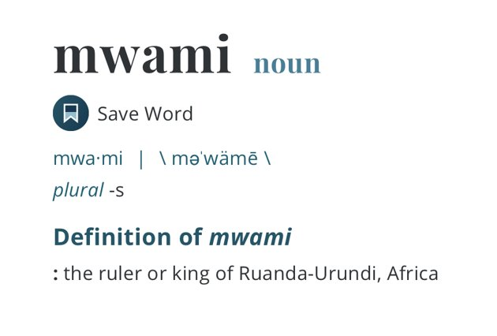
German Colonialism
1894 - 1917
Upon their arrival in Rwanda, German colonists employed brutal subjugation tactics against the Rwandan population.
"Divide and Conquer": The Germans ruled indirectly through the existing political structures created by the Mwami. They utilized existing systems of control, choosing to ally with the Tutsi chiefs who dominated the majority Hutu lower classes. This favoritism fostered and exacerbated enmity towards Tutsis amongst the Hutu.
The Germans also conducted military operations against Hutu chiefs in the North that had not come under the Mwami's control. Resentment between the North and South continued to fester over the coming decades and was a key political factor in Habyarimana's coup.

Slide 7
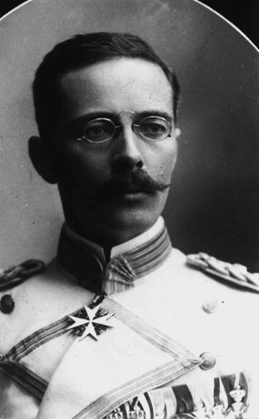
German colonists arrive in Rwanda
1894
In 1894, Count von Götzen (who later became the Governor of German East Africa) arrived on Rwandan soil.
Rwanda and neighboring Burundi (known as Ruanda-Urundi at the time) were caught between the British, German, and Belgian empires; possession of the territory was highly sought after. By 1910, Ruanda-Urundi was under German control but shifted to Belgian control after World War I before gaining independence in 1962.

Slide 8
The 'Hamitic Thesis'
1894
The 'Hamitic Thesis' derives from a Biblical tale that describes a racial myth with very real impacts. It was brought to Rwanda by Belgian missionaries.
The Belgians applied this pseudo-scientific race theory in Rwanda. The Tutsi were perceived as racially superior due to their supposed proximity to Europeans; the myth claimed they originated from lands closer to the European continent.
This led to the development of the idea that the only "true Rwandans" are the Hutu and that the Tutsi are external invaders. This concept was then used to establish the "internal enemy" complex, facilitating the genocide of the Tutsi.

Slide 9
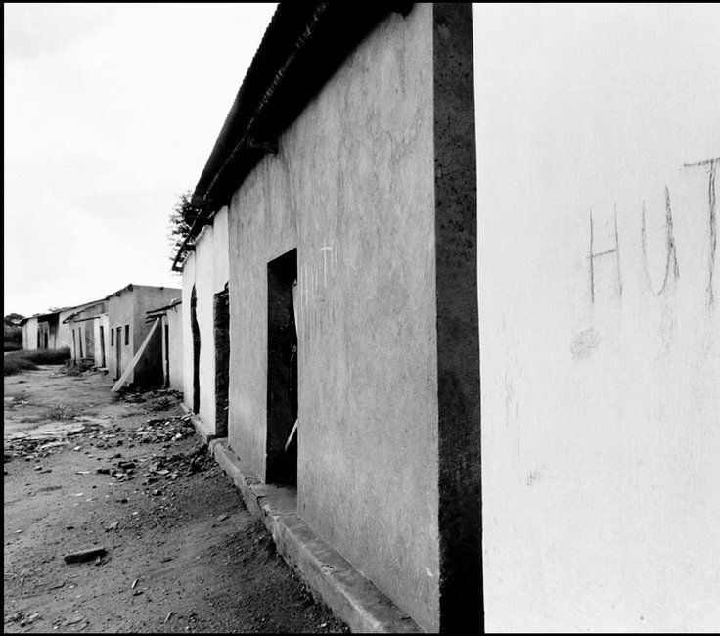
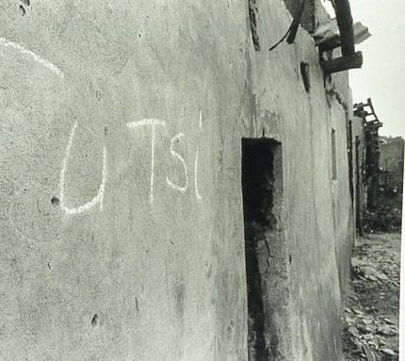
Stage One: Classification
1894
Classification of Tutsis and Hutus was staunchly in place in the lead-up to the Rwandan Genocide from the colonial times of Rwanda.
With the Hamitic Thesis, Belgian colonialism officially concluded that the taller, lighter-skinned Tutsis were ‘superior’ to the Hutus.
The myth of the Hamitic Thesis claimed that Tutsis originated from lands closer to the European continent; hence their rather similar appearance to the Europeans.
This led to the development of the idea that the only "true Rwandans" are the Hutu and that the Tutsi are external invaders. This concept was then used to establish the "internal enemy" complex, facilitating the genocide of the Tutsi.
Tutsis were framed as infiltrators of Central Africa, Ethiopids, or Nilotics. At schools, kids were taught that Hutus and Tutsis are different by nature.

Slide 10
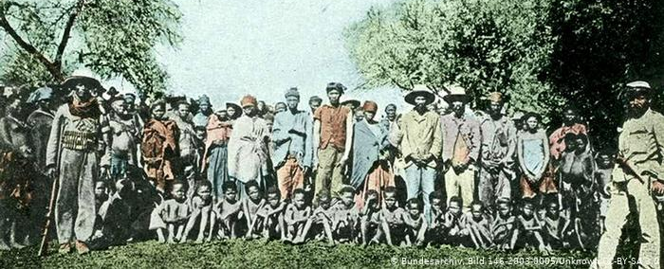
Germany commits Herero and Nama Genocide
1904 - 1909
Whilst occupying Rwanda, the German Empire perpetrated a brutal genocide against the Herero, Omaherero, Nama, and San people of German southwest Africa, a region now known as Namibia.
Commonly viewed as the first genocide of the 20th century, the Herero Nama Genocide was carried out using concentration camps, death marches, and massacres.

Slide 11
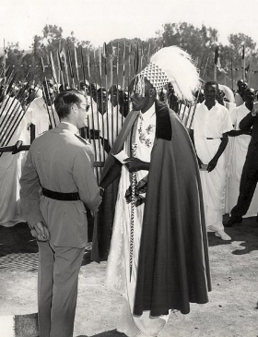
Pre-1945 Belgian Colonial Practice
1916 - 1946
The Belgian colonial authorities continued the German policy of cementing Hutu and Tutsi identities into permanent and "biologically" determined racial categories.
In the first few decades of Belgian occupation, pro-Tutsi policy prevailed. Hutus were continually discriminated against through a patronage system, which deepened socio-economic divisions and strengthened resentment.
While the Germans had ruled largely indirectly, the Belgians took on a more active role, operating directly in their governed regions.

Slide 12
Catholic Church takes control of schools
1916
Belgian colonists brought the Catholic church to Rwanda. The clergy took control of the education system in the country; however, it was highly discriminatory.
The education system differed depending on whether you were Hutu or Tutsi. While Hutu education was strictly focused on preparation for manual labor, Tutsis received a wide range of schooling. This further reinforced the concept of Tutsi 'superiority' and Hutu resentment of their subjugation.
The unequal education system created an imbalance in employment sectors, income, and political participation, further fostering enmity between the two groups.
By 1991, 90% of Rwandans identified as members of Catholic, Protestant, or Seventh-day Adventist Churches. Alongside contributing to the racialization of ethnicity in Rwanda, the Church has been accused of both passive and active harm in the massacres of 1994.
In 2017, after meeting with Rwanda's President Paul Kagame, Pope Francis stated that, in Rwanda, the “sins and failings of the Church and its members had ultimately disfigured the face of Catholicism.”

Slide 13
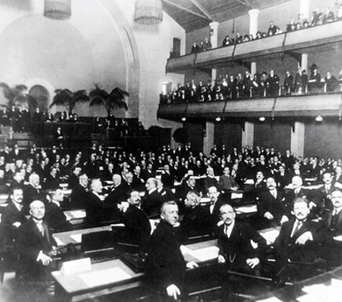
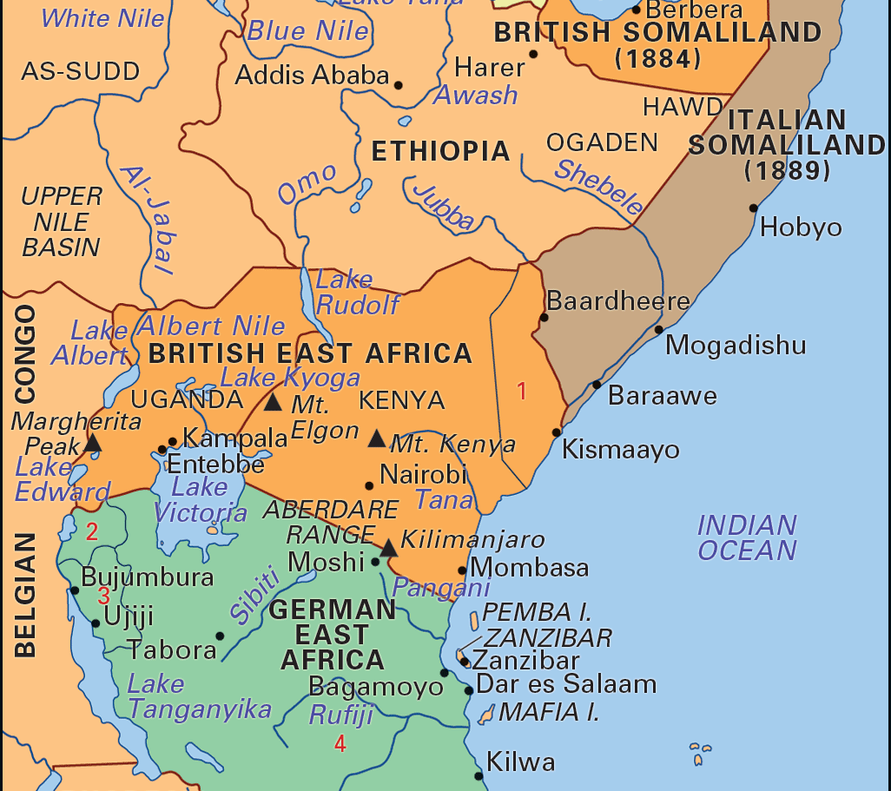
Rwanda turned over to the Belgians
1916
Belgian forces occupied Rwanda during World War I. Following the end of the war, the allies stripped Germany of all its overseas colonies.
By Oct. 20, 1924, a League of Nations mandate formally turned 'supervision' of Rwanda over to the Belgians, who ran a notoriously brutal occupation of the Congo Free State in Central Africa from 1885-1908 that saw the genocide of millions of Congolese people.

Slide 14
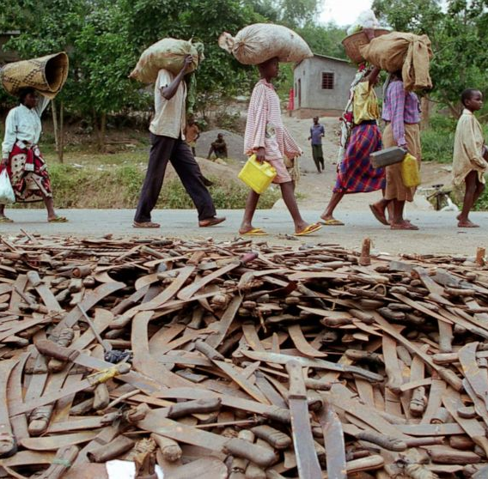
Stage Two: Symbolization
1932
Hutus used machetes and multicolored Hutu flags to demarcate themselves. Machetes were the most common weapon used during the genocide in 1994, as most Hutus already possessed one for farming purposes.
In the 1930s, government officials made it mandatory that everyone carried an identification card with their ethnicity listed.

Slide 15
Identity cards introduced
1932
In the early 1930s, the Belgians introduced identity cards to all Rwandan citizens. Recorded dates range from 1931-1933. The cards marked an individual's ethnicity in rigid racial terms. After Rwandan independence in 1962, the identity cards remained.
This introduction is considered a key point in Rwanda's colonial history. Prior to colonial occupation, Rwanda's ethnicity was linked to fluid socio-economic status rather than a fixed racial identity.
During the 1994 genocide, the identity cards were a key factor in marking Tutsis for death. Rwandans could be forced to show their cards at roadblocks, making them vulnerable to whoever operated the checkpoints.

Slide 16
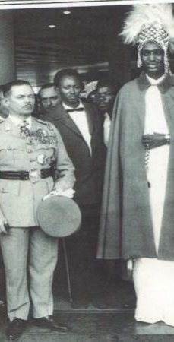
Post-1945 Belgian Colonial Practice
1945 - 1963
By the end of World War II, the Tutsi began to fall out of longstanding favor with the Belgian colonists. This shift in colonial practice saw the Belgians increasingly supporting the Hutus, giving their claims against the Tutsi legitimacy.
The Hutu majority became the dominant power, enjoying new access to education and the political sphere in far greater numbers.
The Tutsi feared this new balance of power, and many suffered "retributive" violence for their previous hegemonic status.

Slide 17
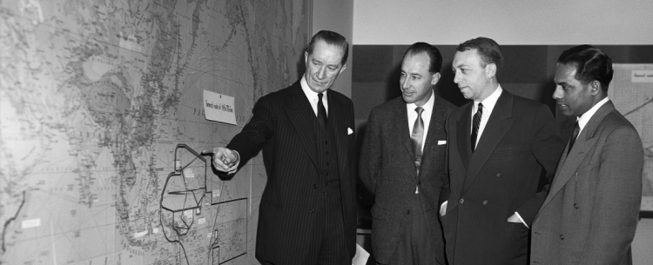
Ruanda-Urundi becomes UN Trust governed by Belgium
Dec. 13, 1946
The League of Nations ceased to be operative during WW2, and by 1946 most of its mandates were refashioned into UN trust territories. The Trusteeship Council was a system of international 'supervision' with broader powers and ended in 1994 when its last territory became independent.
The region of Ruanda-Urundi became a UN trust territory governed by Belgium. Belgians had been present in Rwanda for decades before this formal alteration.

Slide 18
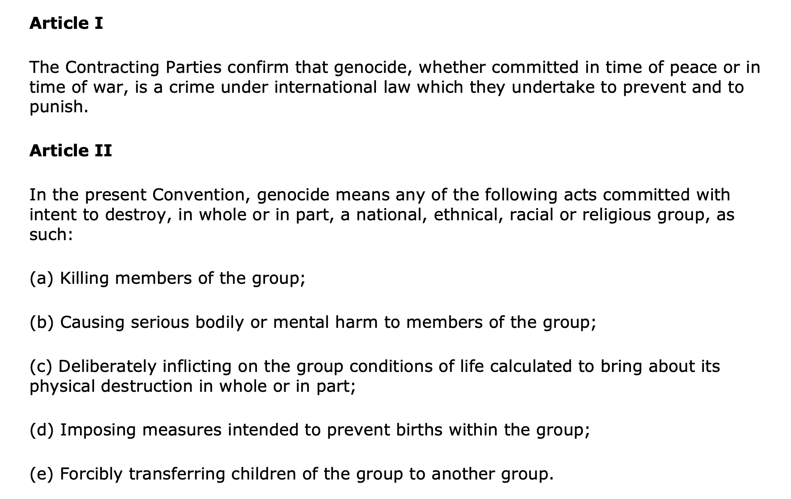
UN Convention on Genocide
Dec. 9, 1948
Following the Jewish Holocaust and World War II, the United Nations General Assembly adopted the Convention on the Prevention and Punishment of the Crime of Genocide. The convention lays out the criteria for what acts are considered genocide and the international community's responsibility to prevent and punish the crime.
In the case of the Rwandan genocide, the UN came under heavy criticism for their failure to act early enough or decisively enough on the many apparent signs of the impending genocide.
On September 18, 1962, the UN General Assembly admitted the Republic of Rwanda to membership in the United Nations. It then became a party to the Genocide Convention and was guilty of breaking that agreement in 1994.

Slide 19
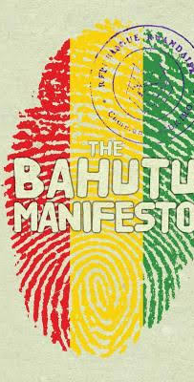
Publication of the Bahutu Manifesto
Mar. 24, 1957
In 1957, nine Hutu intellectuals submitted a 10-page document to the government denouncing perceived Hutu exploitation by the Tutsi.
The publication demanded liberation for Hutus from both the European colonists and the Tutsis, who were represented as Hamitic oppressors using the pseudo-scientific Hamitic thesis.
The manifesto set the tone for much of the subsequent Hutu nationalist movement. Its full title, 'Note on the social aspect of the native racial problem in Rwanda,' indicates the hardening and racializing of ethnic lines that were becoming mainstream in Rwanda.

Slide 20
Hutu Uprising
Nov. 1959 – Feb. 1961
In 1959, after decades of subjugation under colonial power, which favored the Tutsi minority, oppressed Hutus rebelled against the colonial powers and the Tutsi elite.
Over 150,000 Tutsis fled the violence to neighboring Burundi. It is estimated that thousands of Tutsis died during the months of turmoil. While many Hutu view the period as a revolution, Tutsis largely understand it as a massacre.
In January 1961, the Hutu seized power in Rwanda. The Tutsi King, residing outside Rwanda after having fled the violence in the 1960s, was deposed and the Tutsi monarchy abolished. Revolutionaries declared Rwanda a republic, and an all-Hutu provisional national government came into being.
The proclamation of a republic over a year before the declaration of Rwandan independence demonstrates the approval Belgian authorities granted the Hutu forces.

Slide 21
Stage Three: Discrimination
1962
No Tutsis were allowed in the army. Strategic positions such as politics, administration, economics, education, military, and security were restricted to Hutus.
Hutus started to ban Tutsis from going to work and school. Lists were hung up on the doors of public spaces with the names of people who were banned from the entrance, usually with a parenthesis following the name to explain the reason for the ban such as (Tutsi), (Tutsi wife), etc.

Slide 22
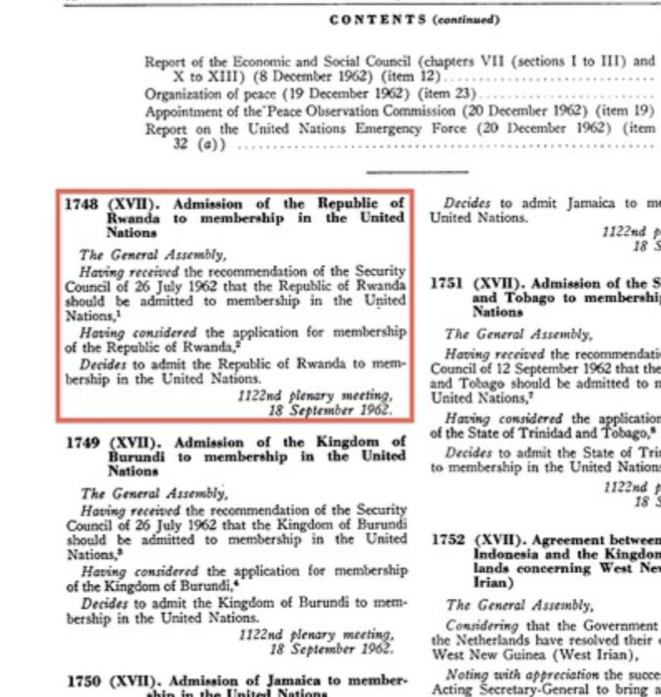
Rwandan Independence
July 1962
In the summer of 1962, following the Hutu coup, Rwanda formally announced independence. With the monarchy abolished and a republic declared, the Belgians withdrew.
Rwanda and Burundi became two separate countries. Gregoire Kayibanda, a Hutu, became Rwanda's first President. Many Tutsis fled to Burundi, where they felt they would hold more power and be less vulnerable.
Rwanda became a member state of the United Nations on Sep. 18, 1962.

Slide 23
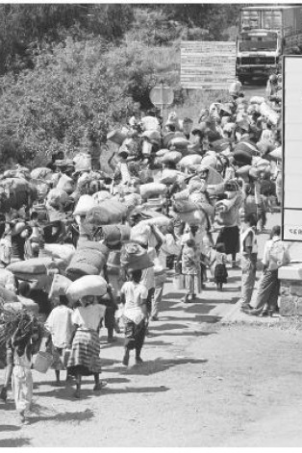
1963 Tutsi Massacre
Dec. 1963
Approximately 20,000 Tutsi were massacred in Rwanda in response to a military attack led by Tutsi-exiles on Dec. 20, 1963, in Burundi. The exiles hoped to return to their country after being forced out in 1959.
During the 1960s, around half of the Tutsi population of Rwanda was living outside the country in fear of violence. Many more fled after this atrocity.

Slide 24
Land shortages
1969
Historians like Gerard Prunier have attributed the genocide, in part, to Rwanda's high population density and the strain this placed on society.
While ethnic differences and tensions predated colonization, by 1994 land shortages, resource competition, and colonial rule had cemented and worsened inter-ethnic relations.
Increasing imbalances in land and food led to malnutrition, periodic famine, and fierce competition for farming land.
Burundi, Uganda, and Eastern Zaire (DRC) also suffered the same situation. While refugees attempted to flee their circumstances, the widespread nature of the issue across the entire region meant the migration did nothing to alleviate the pressure.

Slide 25
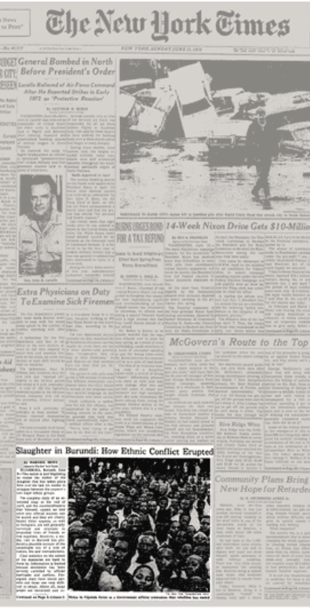
Hutus flee to Rwanda from Burundi
1972 - 1989
Burundi 1972: 150,000 Hutus were massacred by government forces and their supporters in the wake of a Hutu-led uprising in the South. The massacres are known as the Ikiza.
In 1988, anti-Hutu massacres in Burundi once again pushed around 50,000 Hutu refugees into Rwanda.
This refugee crisis deepened tensions between Hutu and Tutsi.

Slide 26
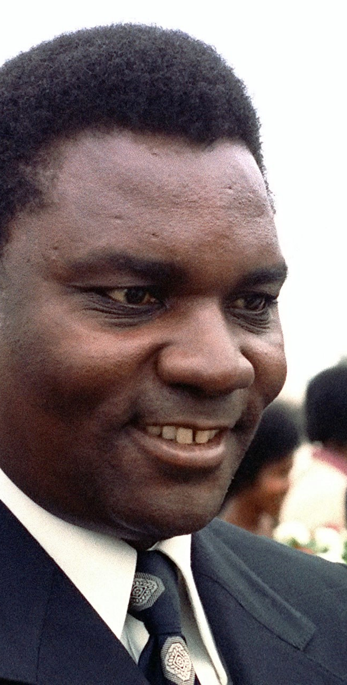
Juvénal Habyarimana's Coup
July 5, 1973
In 1973, Juvénal Habyarimana, the army chief of staff, staged a bloodless coup, overtook the government of President Kayibanda, and established a military dictatorship.
Habyarimana was a Hutu from the North and capitalized on the predominantly northern nature of the army. The absence of Tutsi political power exacerbated tensions between Northern and Southern Hutus.

Slide 27
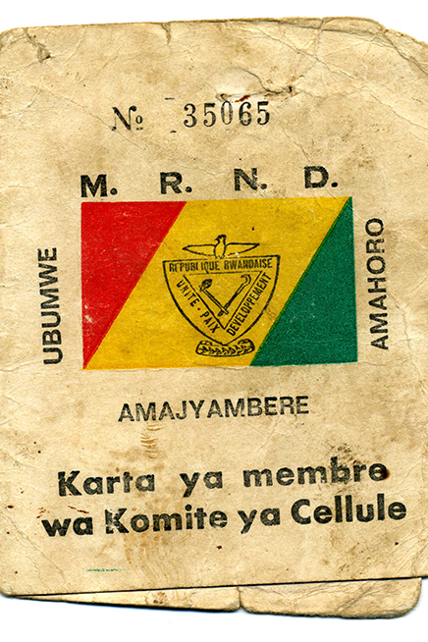
MRND Established
July 5, 1975
President Habyarimana established the National Republican Movement for Democracy and Development (MRND) and turned Rwanda into a one-party state, outlawing all political opposition.
The far-right MRND planned and carried out the 1994 genocide following Habyarimana's assassination. The party set up a youth wing called the Interahamwe, who acted as major belligerents against the Tutsi.

Slide 28
RPF Formed
1987
The 1959-1961 Hutu revolution and accompanying ethnic violence forced more than 336,000 Tutsi to flee to neighboring countries. These refugees remained in contact with the Tutsi in Rwanda but were denied repatriation for three decades.
In the late 1980s, Tutsi exiles in Uganda founded the Rwandan Patriotic Front and began to plan their return to Rwanda by forceful means. They joined Museveni's National Resistance Army (NRA) to fight against Ugandan leader Milton Obote.
Under the leadership of Fred Rwigyema and Paul Kagame, they had an operational army. The exiles were resentful of the oppression of Tutsi back home and their own refugee status.

Slide 29
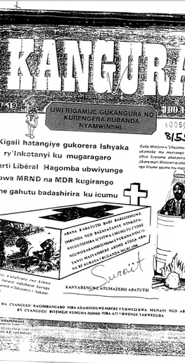
Stage Five: Organization
1990
In 1990, the Interahamwe was formed. This Hutu paramilitary organization was also the youth wing of the MRND party, and many young men involved orchestrated multiple massacres against Tutsis.
Both the Kangura newspaper and the RTLM also assisted in the organization of the genocide by calling for violence against Tutsis, naming people to attack, and identifying Tutsi-dominated locations to target massacres.

Slide 30
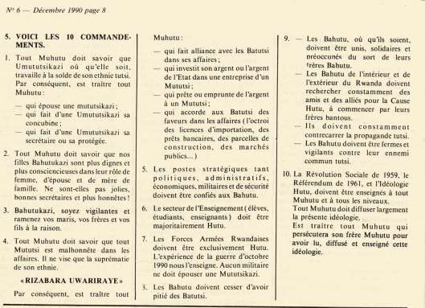
Stage Six: Polarization
1990
Government officials and media pundits propagated "us versus them" rhetoric by framing the RPF, and therefore Tutsis as a whole group, as the enemy. If a Rwandan didn't stand against Tutsis, they stood against Hutus and Rwanda itself.
The 10 Hutu Commandments by the Kangura Newspaper polarized the two sides even more. The Commandments also emphasized the superiority of Hutus and Hutu ideology, and that Hutus should stand tall against their enemy: Tutsis.

Slide 31
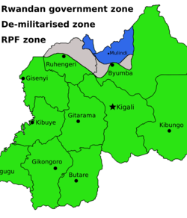
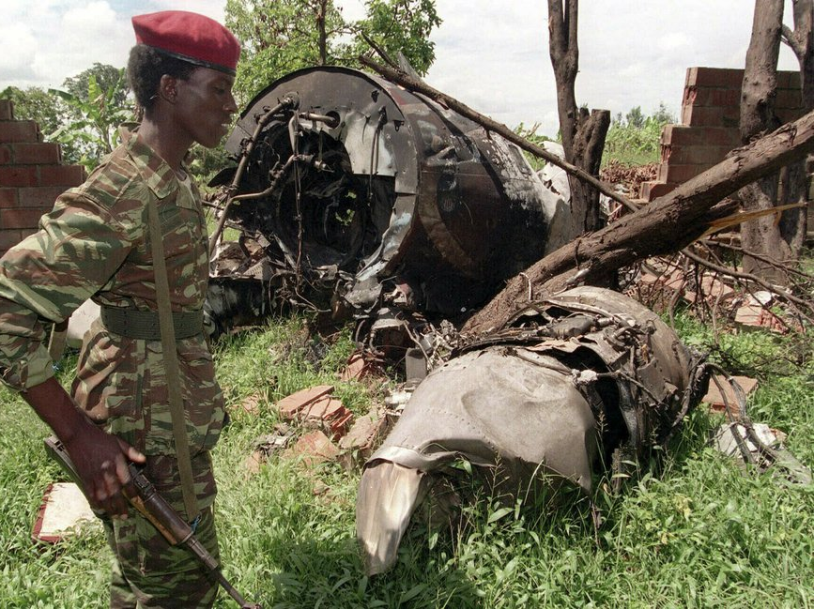
Rwandan Civil War
Oct. 1, 1990 – July 18, 1994
In 1990, a civil war erupted in Rwanda. The Tutsi-led rebel forces of the Rwandan Patriotic Front (RPF) invaded the northeast and came into conflict with the Hutu government's Rwandan Armed Forces (FAR).

Slide 32
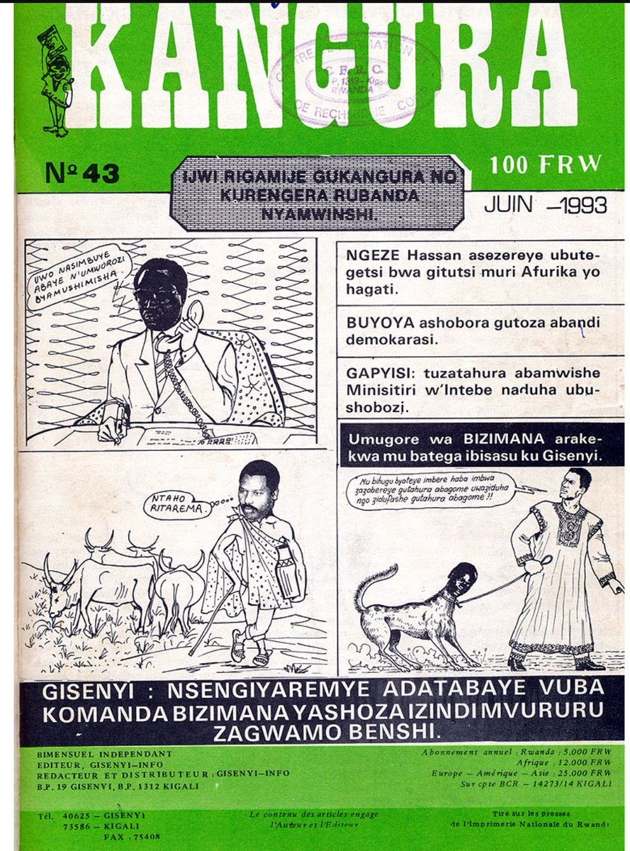
Founding of "Kangura" Newspaper
October 1990
"Kangura", which means "wake others up", was started by Hassan Ngeze, an anti-Tutsi propagandist, after the RPF invaded Rwanda from Uganda in October 1990.
The newspaper was sponsored by the MRND party, the only legal party in Rwanda from 1975-1991 under President Habyarimana.

Slide 33
Kangura's Messages
October 1990
Kangura charged that Tutsis had prepared a war that would leave no survivors, even saying that Tutsis had prepared mass graves for them.
Kangura also famously published its "Hutu 10 Commandments":
1. Every Hutu must know that the Tutsi woman, wherever she may be, is working for the Tutsi ethnic cause. Consequently, any Hutu is a traitor who: Acquires a Tutsi wife; Acquires a Tutsi concubine; Acquires a Tutsi secretary or protégée.
2.Every Hutu must know that our Hutu daughters are more worthy and more conscientious as women, as wives, and as mothers. Aren’t they lovely, excellent secretaries, and more honest!
3. Hutu women, be vigilant and make sure that your husbands, brothers, and sons see reason.
4. All Hutus must know that all Tutsis are dishonest in business. Their only goal is ethnic superiority. We have learned this by experience from experience. In consequence, any Hutu is a traitor who: Forms a business alliance with a Tutsi; Invests his own funds or public funds in a Tutsi enterprise; Borrows money from or loans money to a Tutsi; Grants favors to Tutsis (import licenses, bank loans, land for construction, public markets...)
5. Strategic positions such as politics, administration, economics, the military, and security must be restricted to the Hutu. 6. A Hutu majority must prevail throughout the educational system (pupils, scholars, teachers). 7. The Rwandan Army must be exclusively Hutu. The war of October 1990 has taught us that. No soldier may marry a Tutsi woman. 8. Hutu must stop taking pity on the Tutsi. 9. Hutu, wherever they are, must stand united, in solidarity, and concerned with their Hutu brothers' fate. Hutu within and without Rwanda must constantly search for friends and allies to the Hutu Cause, beginning with their Bantu brothers. Hutu must constantly counter Tutsi propaganda. Hutu must stand firm and vigilant against their common enemy: the Tutsi. 10. The Social Revolution of 1959, the Referendum of 1961, and the Hutu Ideology must be taught to Hutu of every age. Every Hutu must spread the word wherever he goes. Any Hutu who persecutes his brother Hutu for spreading and teaching this ideology is a traitor.

Slide 34
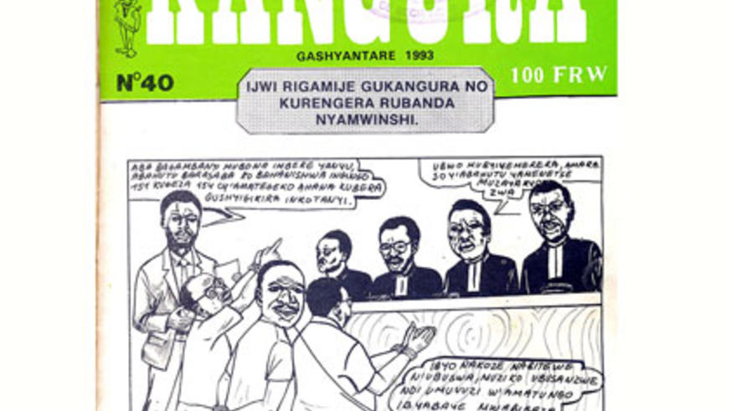
Stage Four: Dehumanization
1993
Rhetoric espoused on the RTLM and in Kangura played a significant role in dehumanizing targets of genocide. The media served several purposes for perpetrators of the genocide.
These purposes include:
Winning over the uncommitted participants and causing divisions among supporters of the other point of view.
Convincing the public that their enemies stand for war, death, slavery, repression, injustice, and cruelty.
“Creating” made-up events that lend credence to the propaganda to bolster up the enemy's views as evil and cruel.
Using “Tutsi” and “RPF” interchangeably to create a homogenous enemy.

Slide 35
Founding of Radio Télévision Libre des Mille Collines (RTLM)
July 8, 1993
Prior to the founding of the RTLM, the only radio station in Rwanda was the national station, Radio Rwanda. Radio Rwanda was the voice of Habyarimana and his government.
Following the founding of a coalition government in April 1992, Radio Rwanda tried to mirror the coalition and diversify its voice.
When the war started, the RPF started its own station, Radio Muhabura, which glorified the RPF but did not emphasize ethnic divisions.
This, along with the diversification of voices on Radio Rwanda, spurred Hutu hardliners to start Radio RTLM, which came about in April 1993 and began broadcasting in August 1993.

Slide 36
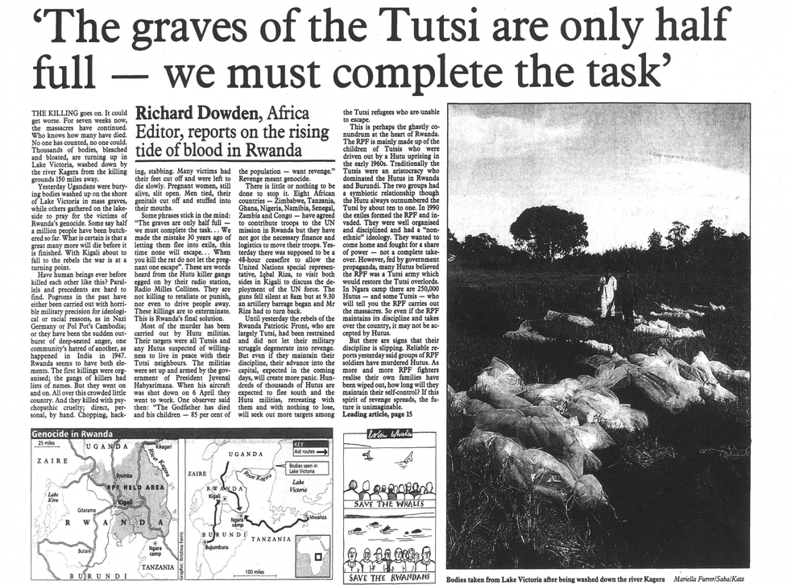
RTLM's Messages
Aug. 1993
The propaganda espoused on RTLM built on lessons Rwandans had learned in school: that Hutus and Tutsis were different by nature.
Broadcasters painted Tutsis as “infiltrators” of Central Africa because they were "Ethiopids" or "Nilotics."
Broadcasters also blamed Tutsis for joblessness and for taking too many spaces in schools and universities.
RTLM warned that Tutsis would “Restore the Old Regime.” Broadcasters claimed the RPF had come to re-establish their total Tutsi control over the Hutu, saying that an RPF victory would return Rwanda to feudalism and Hutus working for Tutsi masters.

Slide 37
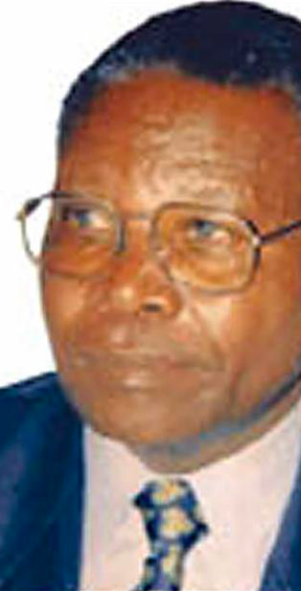
The "Who" of RTLM
Aug. 1993
The apparent break-up between the newly party-agnostic Radio Rwanda and openly partisan RTLM was not as clean as it appeared. Many broadcasters on the RTLM merely joined from their previous posts at Radio Rwanda, including the editor-in-chief, Gaspard Gahigi.
The majority of RTLM founders and hosts were intimately involved with the MRND party, Habyarimana’s northern Hutu-dominated party, and the CDR, a staunchly anti-Tutsi party.
Personal connections to Habyarimana were also common. The daughter of one of the RTLM's main financiers, Félicien Kabuga, was married to Habyarimana’s son.
RTLM was private in name, but demonstrated clear links to Radio Rwanda, the MRND, and other state agencies.

Slide 38
Why Was RTLM So Popular?
Aug. 1993 – Aug. 1994
Radio had always been widespread in Rwanda, both among elites and ordinary people. Radio delivered messages directly and simultaneously to a wide audience, 66% of whom were illiterate, making radio an accessible, though singular, source of information.
RTLM was especially popular because of its lively music and informal style. Broadcasts did not include fact-checking and instead felt like conversing with friends. People could call in and request a song or share a piece of news or gossip that the announcers would share without checking.
During the genocide, when communications were difficult, the radio became the sole source of news and authority for people.

Slide 39
Arusha Accords
Aug. 4, 1993 - Oct. 5, 1993
In August 1993, the Arusha Accords were signed by the Republic of Rwanda (RAF) and the Rwandan Patriotic Front (RPF), officially ending the civil war.
However, not everyone was in support of the decision. Angered by the prospect of a power-sharing agreement, radicals plotted ways to disturb the peace process.
With Resolution 872, the United Nations Security Council (UNSC) agreed to form the United Nations Assistance Mission in Rwanda (UNAMIR) to monitor the ceasefire that was established with the Arusha Accords.

Slide 40
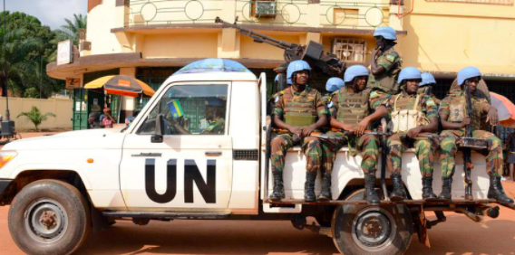
UN establishes UNAMIR
Oct. 5, 1993
With Resolution 872, the United Nations Security Council (UNSC) agreed to form the United Nations Assistance Mission in Rwanda (UNAMIR) to monitor the ceasefire that was established with the Arusha Accords.

Slide 41
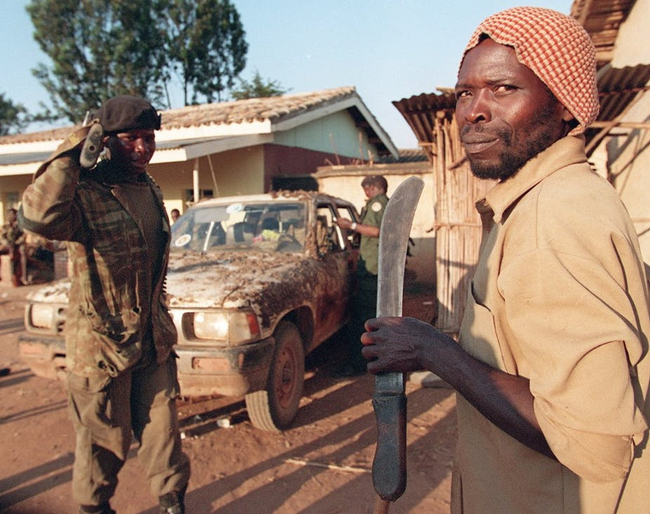
Stage Seven: Preparation
1994
Thousands of machetes were imported into Rwanda in the months preceding the genocide.
French aircrafts landed several times to Hutu-dominated areas to provide weaponry and ammunition before the genocide in April 1994 began.
Kangura newspaper also incited violence. The newspaper gave open orders to carry out killings, areas to be attacked, roads to block, etc.

Slide 42
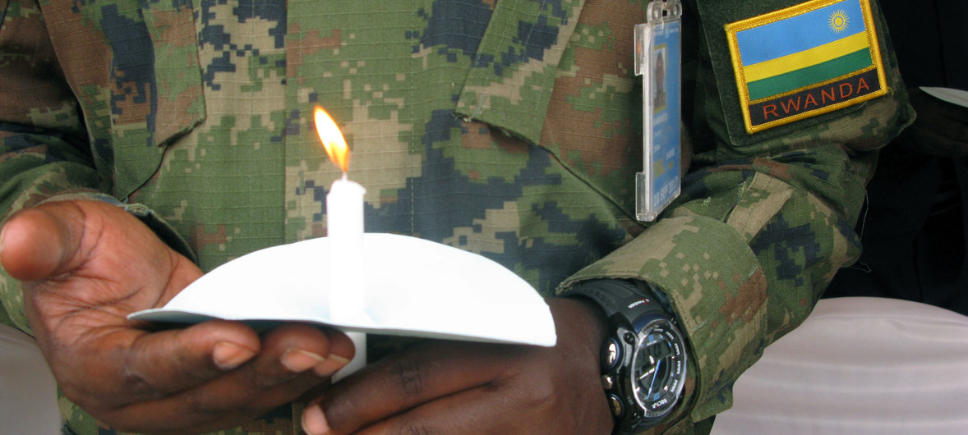
UN's failure to stop genocide & inaction in Rwanda
1994
UNAMIR's failure has become one of the greatest failures of the UN in its entire history of peacekeeping operations.
Many scholars in the field of genocide studies and political science have condemned the inaction of the UN DPKO in early 1994 Rwanda, when UNAMIR was present in the region before the genocide erupted on April 7th.
The UNSC and UNDPKO showed inaction by not reacting accurately or timely.
UNAMIR’s impracticality was seen as a result of the genocide in the region, until 2003.
The UNAMIR commander, Roméo Dallaire published the truth about UNAMIR in his book Shake Hands with the Devil: The Failure of Humanity in Rwanda, in 2003.
In the book, he confesses that he let the UN DPKO know about the genocide before it happened through the Genocide Fax and reported that the staff and equipment were insufficient to conduct the mission upon his arrival.

Slide 43
Stage Eight: Persecution
1994
Tutsis were suppressed to a level where they were not allowed to go out in public, and if they did, they would not be able to go back home.
Moderate politicians were assassinated beginning on Apr. 7, 1994.
Hutus started to carry out massacres against Tutsis once they were seen ‘violating’ the rules that were imposed by Hutus.

Slide 44
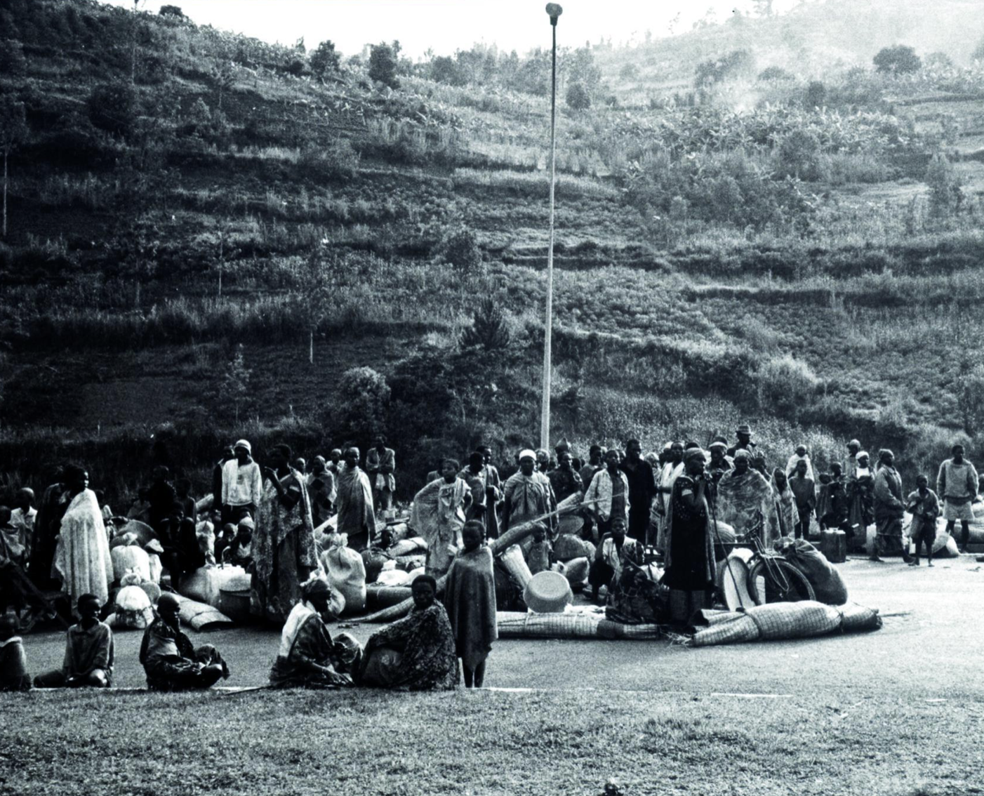
Burundi
1994
When President Habyarimana was killed on April 6, 1994, Burundi's President Cyprien Ntaryamira who traveled in the plane with him was also killed.
Ntaryamira's death and the events in Rwanda deepened ethnic divisions and bolstered fear in Burundi. Hutu and Tutsi watched in shock as the genocide unfolded.
Remarkably, ethnic violence in Burundi has practically ceased in recent years but has been replaced by a high degree of political violence involving extrajudicial executions, rapes, abductions, beatings, and other intimidation tactics targeting political opponents.

Slide 45
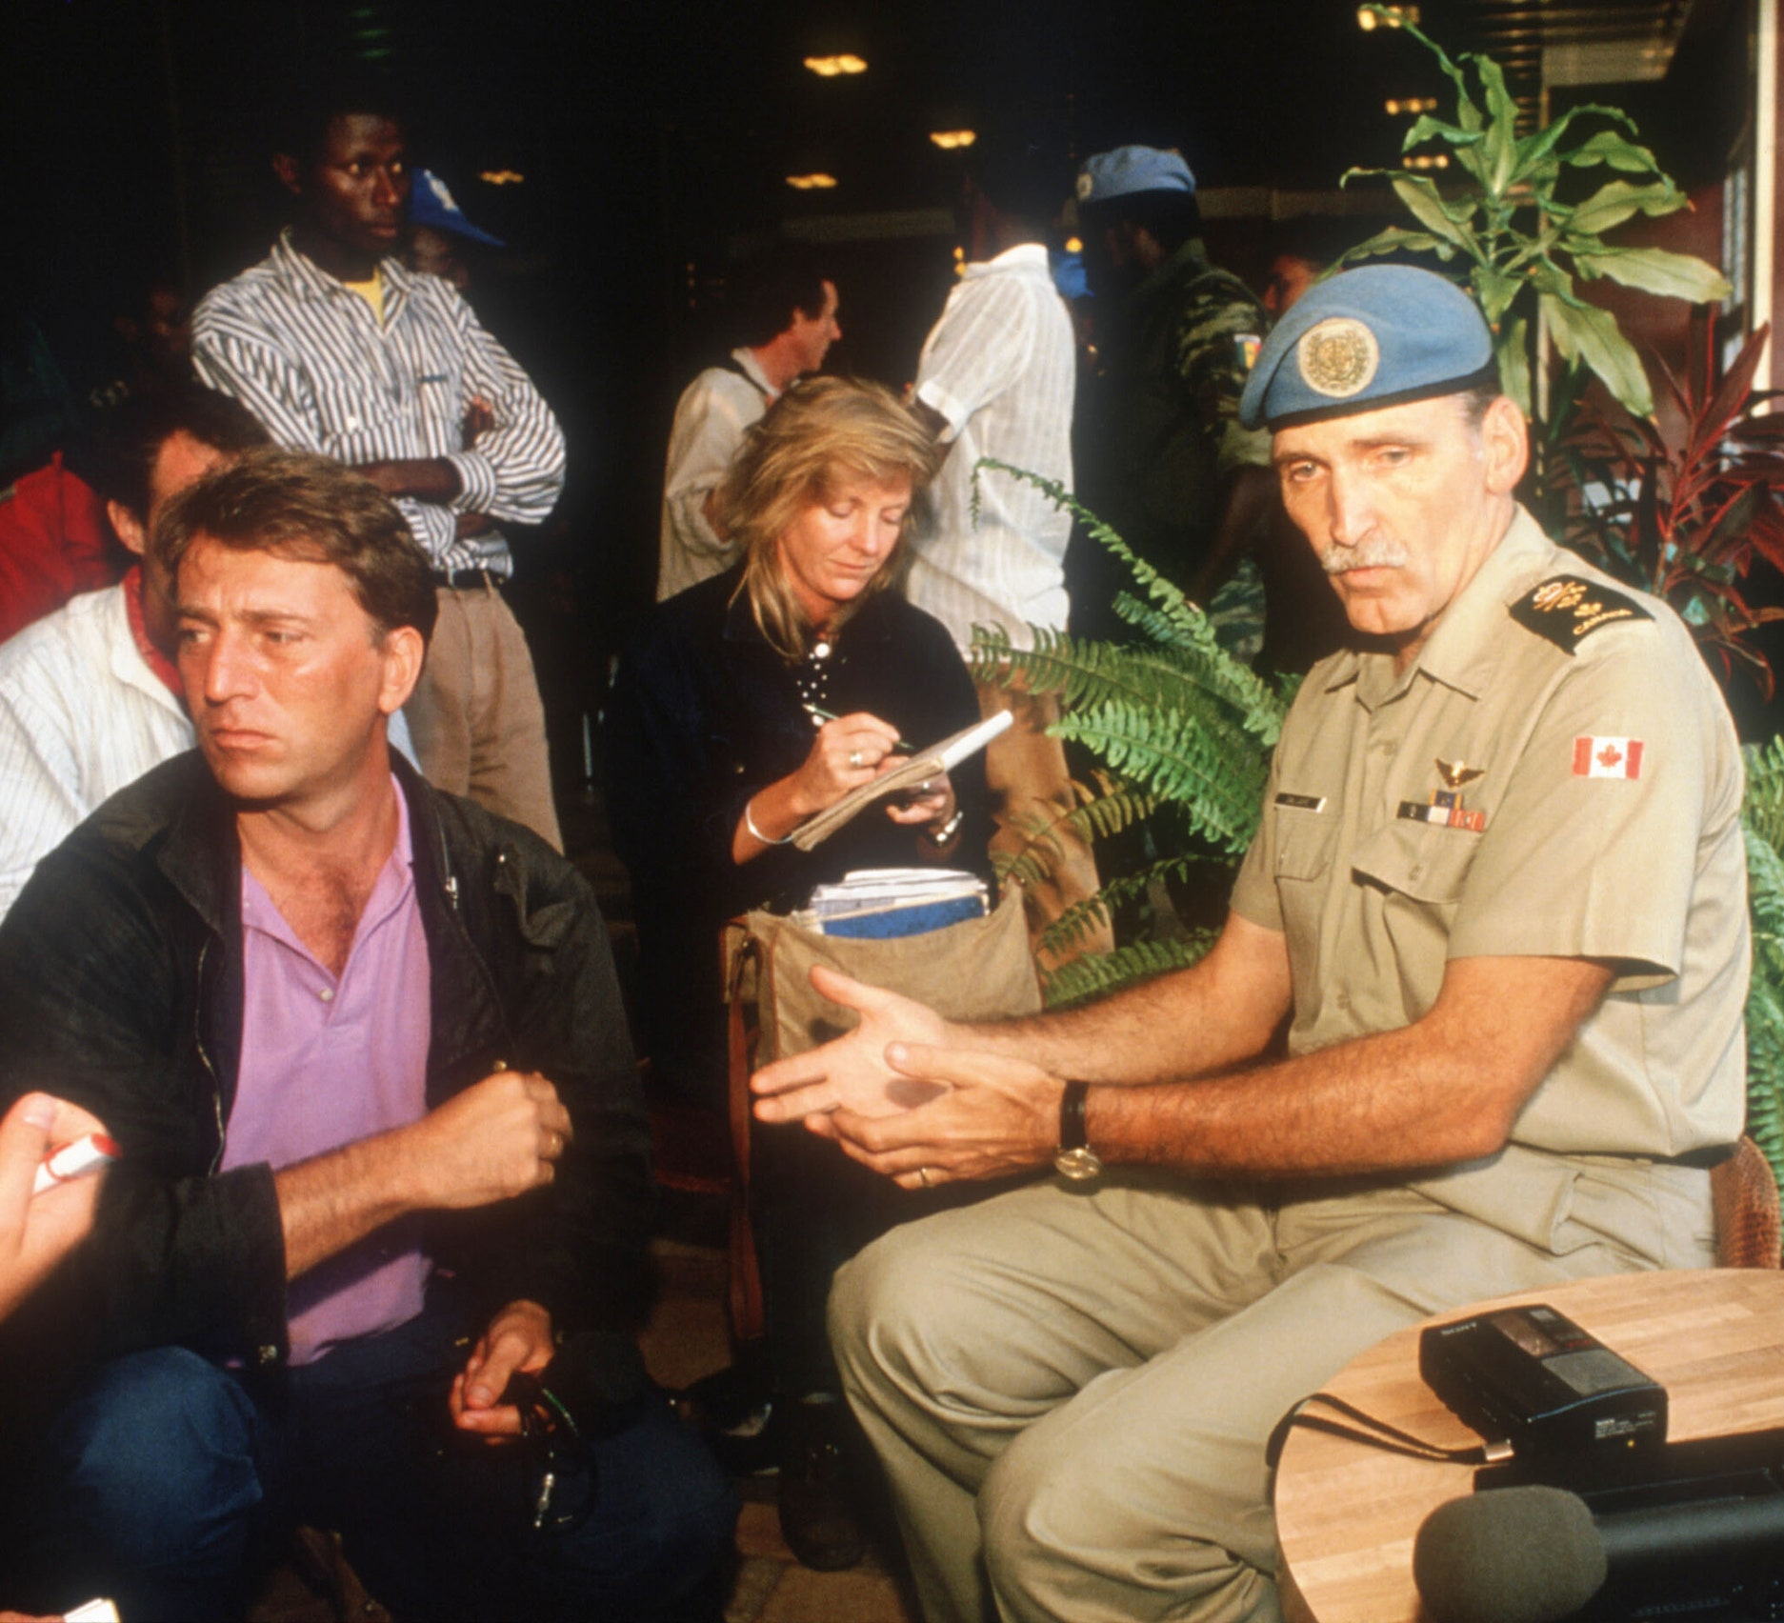
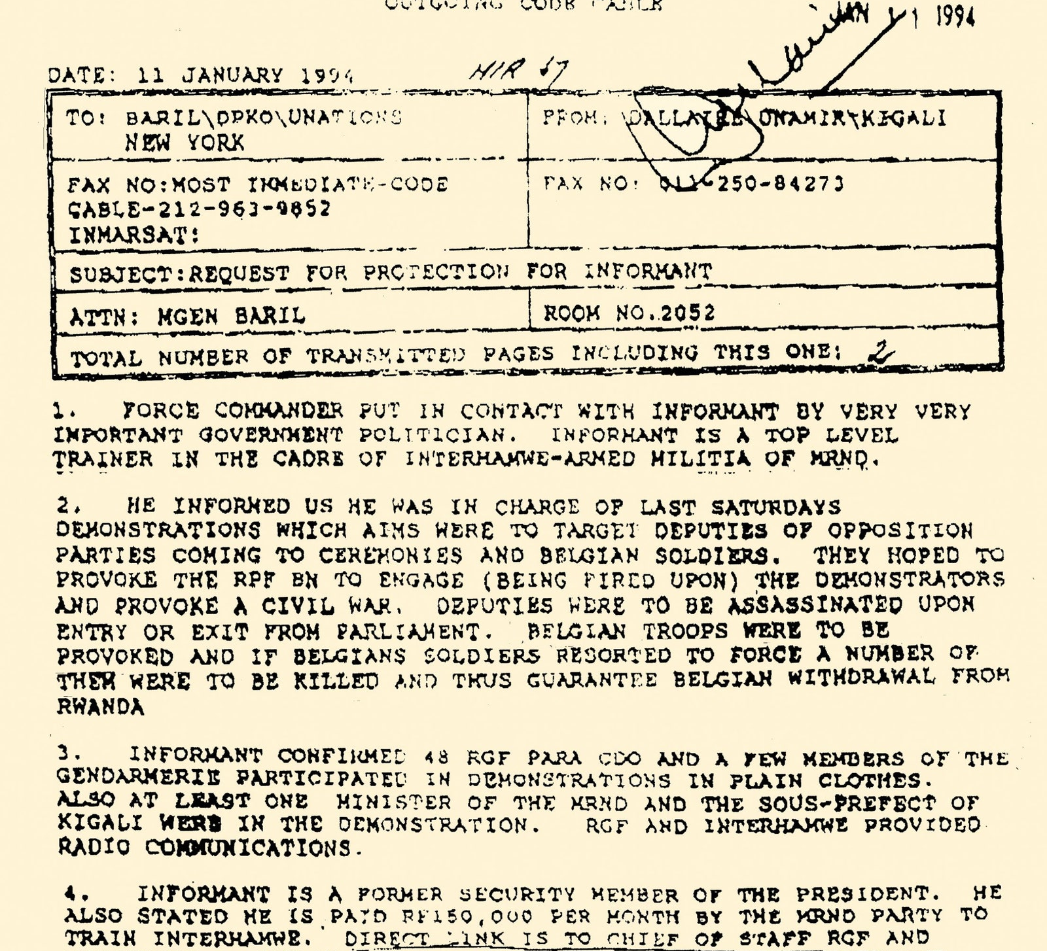
UN's Response to the Genocide Fax
Jan. 11, 1994
Upon receiving information from a high-level Hutu militia, Gen. Dallaire sent a ‘Genocide Fax’ to the UN Department of Peacekeeping Operations (DPKO), stating that genocide against Tutsis is being planned,’ three months before the genocide began.
Gen. Dallaire asked the UN to prevent the planned attack through raiding suspected arms caches, but the UN DPKO rejected the request, stating that it ‘exceeds UNAMIR’s mandate’ and commanded Dallaire to inform the Hutu-dominated government of Rwanda about the genocide which it was planning itself.
Furthermore, UN Secretary-General Boutros-Ghali approved the refusal of authority, leaving Gen. Dallaire with his hands tied.

Slide 46
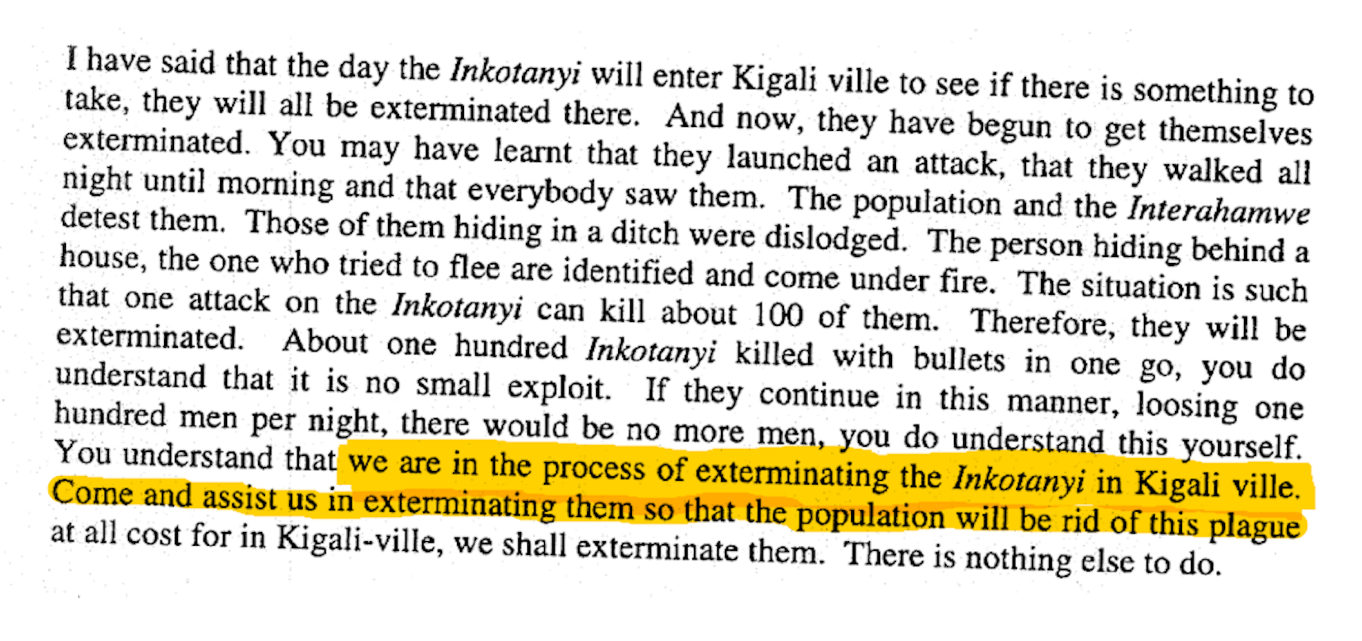
Instructions to Kill
Apr. 1994
Famously, the RTLM communicated orders for carrying out killings and even named people to be targeted for killing.
Broadcasters pointed out areas that should be attacked) and told people to erect barriers or roadblocks, and to carry out searches.
Kangura also directly incited violence. In one publication, written over a picture of a machete was: “What weapons can we use to defeat the Inyenzi once and for all? What if someone brought back the Hutu Revolution of 1959 to finish off these Tutsi cockroaches?”

Slide 47
Torture and Psychological Brutality
Apr. 1994 – Aug. 1994
Perpetrators of the genocide used psychological and physical torture as well.
Many genocidaires dismembered their victims and left them to bleed to death, forcing them naked before killing them to humiliate them so that perpetrators could keep their clothes without bloody stains. Perpetrators refused to allow burials to take place, leaving bodies to rot in the open.
Tutsi were forced to kill their own children, and Hutus were forced to kill their Tutsi spouses.
Many people paid to die by just being shot.
Pictured left is Consolee Nishimwe, a genocide survivor who is now a gender activist.

Slide 48
Sexual violence during the genocide
Apr. 1994 – Aug. 1994
Sexual violence often accompanies war and genocide. Perpetrators commit sexual violence as a way to assert power and control over a target. Perpetrators also use mutilation as a tool of power and control, which often preceded sexual violence.
During the genocide, perpetrators raped tens of thousands of women and girls.
Female Tutsis were depicted as devious. Often, if genocidaires refrained from killing a woman or girl, they would keep them as future sexual servants either for themselves or for subordinates who had “performed” well by killing many people.
At the Kabgai nursing school, soldiers demanded the young women as “contributions to the war effort,” or “umusanzu.” The directress, Dorothée Mukandanga, refused to send her girls to this fate, and she was murdered.
Pictured right is Emilienne Mukansoro, a therapist who works with survivors of rape in Rwanda. She has been doing so for 18 years.

Slide 49
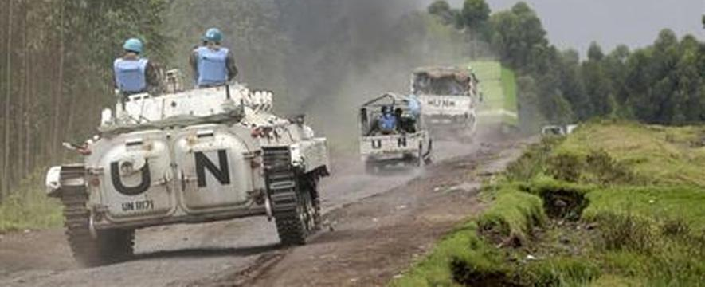
UNAMIR's mandate extended
Apr. 5, 1994
In April 1994, the UNSC extended the mandate of UNAMIR with Resolution 909, believing that the lack of transitional institutions obstructed the implementation of the Arusha Peace Agreement, which subsequently affected the success of UNAMIR in the region.

Slide 50
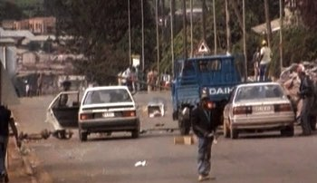
Roadblocks and Assassinations Begin
Apr. 6, 1994
9:18 p.m.
Habyarimana’s elite troops, the Presidential Guard, began erecting roadblocks in Kigali.
The Presidential Guard and other troops, led by Colonel Bagosora, assassinated moderate Hutu government officials and political opposition leaders.

Slide 51
Catalyzing Catastrophe
Apr. 6, 199
8:30 p.m.
President Habyarimana and the President of Burundi, Cyprien Ntaryamira, were flying back from a regional summit in Tanzania when their plane was shot down close to their landing in Kigali.
Although there is debate about who shot down the plane, most believe extremists did not want Habyarimana to implement the Arusha Accords, which prescribed free elections and power-sharing with Tutsis.

Slide 52
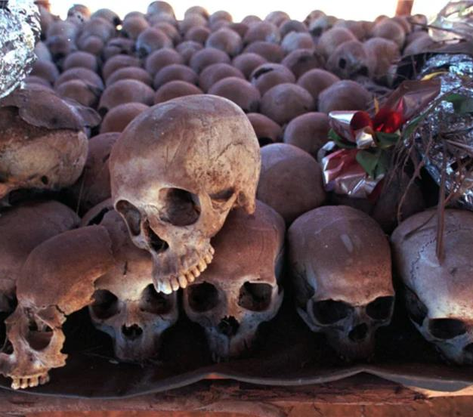
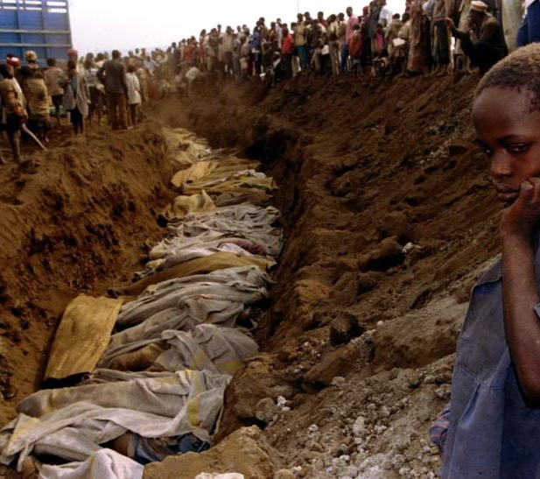
Stage Nine: Extermination
Apr. 6, 1994
Militant Hutus seized power in the immediate aftermath of their president’s Juvenal Habyarimana assassination in April 1994 and started to attack both ethnic Tutsis, Twas, and moderate Hutus.
At the end of April 1994, around 200,000 people were massacred by the Hutu militants and extremists. In addition to the number of casualties, around half a million Rwandans had fled.
Rape has been used as a weapon by the Hutu paramilitary organization Interahamwe.

Slide 53
UN's Failure to stop the genocide
Apr. 7, 1994 – July 15, 1994
UNAMIR was present in the region when the genocide erupted on April 7th, 1994.
The UNSC has shown inaction by not reacting accurately and timely, as their response was merely limited to passing Resolution 912, which condemned the attacks and called for a mediation between the RPF and the Government of Rwanda.
UNAMIR’s impracticality was seen as a result of the genocide in the region, until 2003 when the UNAMIR commander, Roméo Dallaire had written the truth about UNAMIR in his book Shake Hands with the Devil: The Failure of Humanity in Rwanda.

Slide 54
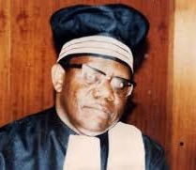
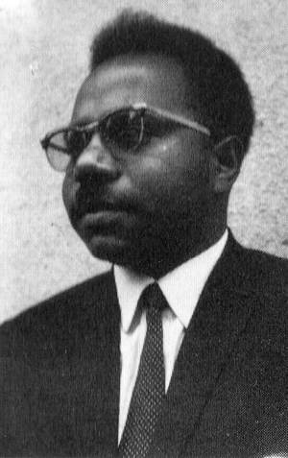
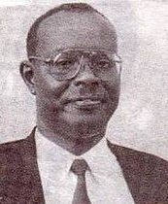
Early Assassinations
Apr. 7, 1994
Early Morning:
Two candidates for the presidency and transitional assembly were executed. These victims were Félicien Ngango and Landoald Ndasingwa, members of the PSD and PL respectively.
The President of the Constitutional Court, Joseph Kavaruganda, was also executed.

Slide 55
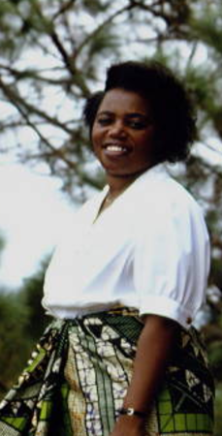
Assassination of Prime Minister Agathe Uwilingiyimana and Belgian Soldiers
Apr. 7, 1994
Noon
Knowing that she would be in danger following the breach in the Rwandan government and becoming aware of Rwandan soldiers disabling the protecting Belgian UNAMIR soldiers’ jeeps outside of her residence, Prime Minister Agathe Uwilingiyimana fled from her home to escape execution.
The Belgian UNAMIR soldiers were captured and taken to a military camp, where, several hours later, they were murdered and mutilated.
Shortly before noon, Rwandan soldiers found Prime Minister Uwilingiyimana in her hiding place and executed her and her husband. Her children escaped this atrocity and were brought to safety by a Senegalese U.N. officer.

Slide 56
Hunting Down Victims
Apr. 7, 1994
The Rwandan Armed Forces (FAR) and the Interahamwe set up more roadblocks. They also began going house to house to kill Tutsis, most of the time with machetes.
With detailed lists of victims to refer to, perpetrators killed thousands of Tutsis on the first day.

Slide 57
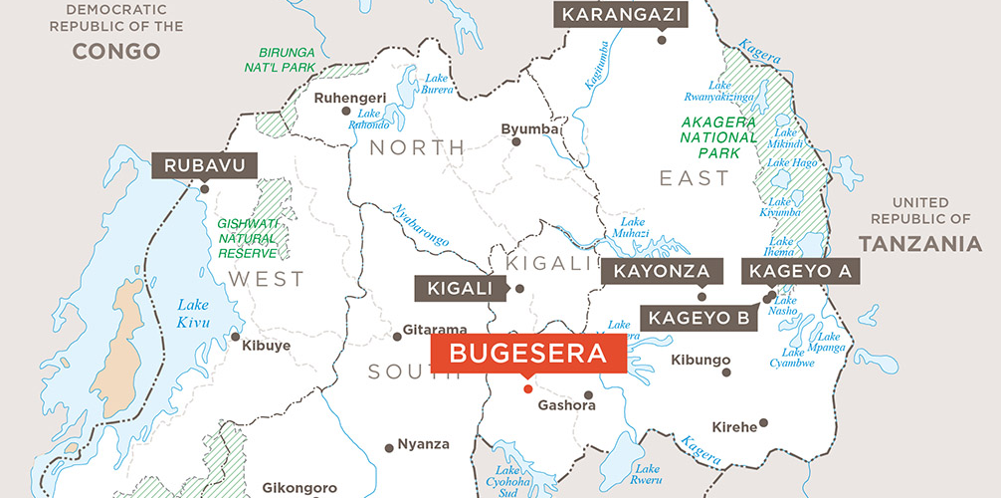
Killing spreads to Bugesera
Apr. 7, 1994
Massacres of Tutsis began to spread toward the Bugesera region of Rwanda.
A group of 60 Interahamwe killed about 100 refugees in an attack on a Catholic mission in Kigali’s Gikondo neighborhood.

Slide 58
Hell on Earth: Church Massacres in the Western Province
Apr. 7, 1994
Starting on Apr. 7, 1994, Tutsis were targeted in various churches, where they often sought protection and refuge. Colonel Anatole Nsengiyumva was the leader of these atrocities in préfecture of Gisenyi.
Below is a list of some of these massacres:
Nyundo Seminary Massacre left 50 people dead
Busogo Church Massacre left 43 dead
Massacre at Busasamana left 150 dead
Massacre at Seventh Day Adventist University campus at Mudende left hundreds dead

Slide 59
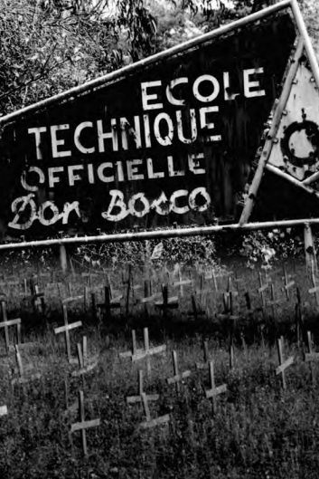
A "New Strategy"
Apr. 11, 1994
2,000 people sheltering inside a UNAMIR-protected school (Ecole Technique Officielle) in Kigali were slaughtered when the UNAMIR soldiers departed briefly to assist in an evacuation of Westerners in Rwanda.
Augustin Ndindiliyimana, who was Chief of the Rwandan National Gendarmerie, sent the National Police to protect those hiding at the school, but the troops joined in the slaughter instead.
This spurred the genocidaires' strategy of driving Tutsis into public spaces like schools, churches, and stadiums and subsequently massacring them at large.
By this day, an estimated 20,000 Rwandans had been murdered, mostly Tutsi.

Slide 60
The Deadliest Weeks
Apr. 11, 1994 – May 2, 1994
These few weeks were some of the deadliest of the genocide. There were massacres of up to thousands of people over a couple days at times. Some of these atrocities occurred at:
ETO school in the city of Kigali
Kiziguro in Byumba
Musambira, Mugina, and Byimana in Gitarama
Rukara church, Rukira commune, and the St. Joseph center in Kibungo
the church and stadium in Kibuye town
Mubuga church, Birambo and Mugonero church and hospital in Kibuye prefecture
Shangi, Nyamasheke, and Mibirizi churches in Cyangugu
Kibeho, Cyanika, and Kaduha churches in Gikongoro
Cyahinda, Kansi and Nyumba churches, Butare hospital and the university in Butare
Nyundo Cathedral in Gisenyi

Slide 61
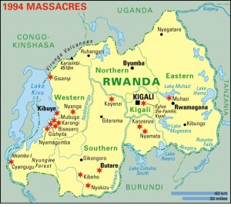
No Escape
Apr. 13, 1994
Emigration to neighboring countries was strictly controlled, per army general officer instructions.
Tutsi attempting to cross the river to Burundi were slaughtered at Nyakizu.

Slide 62
Assassination of Boniface Ngulinzira
Apr. 14, 1994
Rwandan military assassinates former foreign minister of Rwanda, Boniface Ngulinzira, who was also a representative at the signing of the Arusha Accords, which perpetrators deemed maliciously favorable to the RPF.

Slide 63
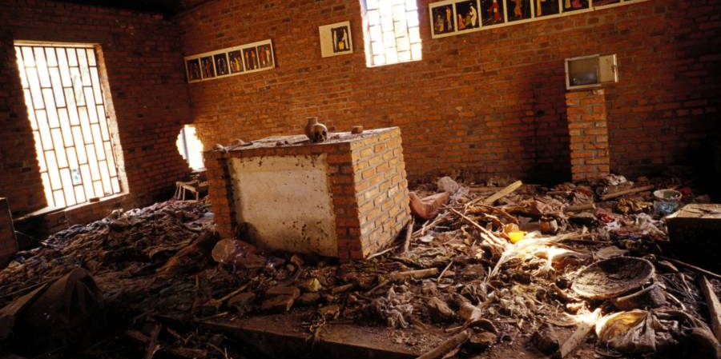
Hell on Earth: Church Massacres in Kibungo
Apr. 15, 1994
Massacre at Ntarama church of about 5,000 people.
Another massacre at a Catholic Church in Nyarubuye left 2,000 dead.

Slide 64
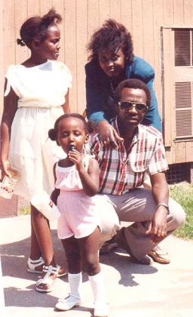
Assassination of Jean-Baptiste Habyalimana
Apr. 17, 1994
Rwanda’s only Tutsi prefect, Jean-Baptiste Habyalimana, and his family were executed. Habyalimana was removed from his post as the prefect for Butare the evening of his assassination. He had been successfully opposing the killings.

Slide 65
Amahoro Massacre
Apr. 19, 1994
The Amahoro Stadium in Kigali became another genocidal site when the Rwandan army shelled it and killed 25, bringing the 13-day death toll up to about 100,000.

Slide 66
UN adopts resolution to take action
Apr. 21, 1994
In April 1994, the UNSC adopted Resolution 912 aiming to adjust the mandate of UNAMIR due to the ''current situation'' in Rwanda and the settlement of the Rwandan conflict.
After the adoption of Resolution 912, the UNSG had called for the UNSC to take further action to cease the massacres in the region.

Slide 67
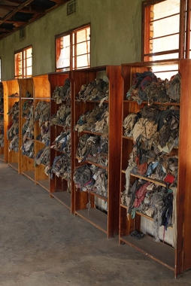
Massacre at Murambi
Apr. 21, 1994
About 50,000 people perished during a massacre at the site of a technical school. Most believe that only 34 people survived the atrocities that took place at Murambi.
Today, Murambi is one of six National Genocide Memorial Sites. The memorial houses the remains of the victims.

Slide 68
Hospital Attack
Apr. 23, 1994
A hospital in Butare came under attack and almost 200 wounded Tutsis were assassinated.

Slide 69
Half a Million Lives
Apr. 28, 1994
Oxfam estimates that 500,000 Tutsis had been slaughtered in under one month.

Slide 70
Carnage on both sides
May 1, 1994
The RPF killed 12 people at the Holy Family Church in Kigali when it shelled it.
Hutus then assassinated 218 people at the Nyundo Cathedral near Kigali, and then 13 Red Cross volunteers in Butare.

Slide 71
UN extends mandate of UNAMIR: UNAMIR II
May 17, 1994
In May, the UNSC extended the mandate of UNAMIR with 5,500 additional troops and equipment with Resolution 918, establishing UNAMIR II.
However, most troops didn't arrive until June 1994 since Western powers were not willing to send troops to a warring country, especially after the US's disastrous intervention in Somalia.

Slide 72
Deadly Retaliation
May 19, 1994
The RPF shelled the hospital in Kigali, and in response to the Rwandan army shelled United Nations headquarters in Kigali.

Slide 73
RPF assassinates Vincent Nsengiyumva
June 3, 1994
The RPF assassinated the Catholic archbishop of Kigali, Vincent Nsengiyumva, along with three bishops and ten priests near Kabgayi.

Slide 74
U.S. and the use of the term 'genocide'
June 10, 1994
While the United Nations had already described the mass killings in Rwanda as genocide, the Clinton Administration tiptoed around the term.
This stance was explained as ''to avoid the rise of moral pressure to stop the killings,'' since the use of such term could put pressure on the US Administration to take action that they were unwilling to take.

Slide 75
The Turquoise Zone
June 22, 1994
The French-led Operation created a safe zone called the Turquoise Zone in a short time.
However, this zone later helped the (French-backed) Hutus, who were behind the planning of the genocide, to escape to neighboring states and avoid legal reparations.

Slide 76
Operation Turquoise
June 22, 1994
UNAMIR required additional troops to start its second and extended mission. Therefore, the UNSC had provoked Chapter VII, and the French-led Operation Turquoise was given ‘’the use of all necessary means to achieve humanitarian objectives’’ with Resolution 929.

Slide 77
Génocidaires rush to finish the job
July 3, 1994
The RPF advanced on Gikongoro, and genocidaires hurried to finish their job and slaughter any survivors who may be able to testify against their actions.

Slide 78
The End of Genocide
July 15, 1994
When the UN finally gathered forces, Ghananian and Bangladeshi troops were sent, but they were not well-equipped or well-trained, and they were outnumbered.
The genocide lasted a hundred days and resulted in the mass slaughter of almost a million Rwandans.
The end of the genocide was marked by the RPF’s victory, which declared a ceasefire in July 1994.
Later, the RPF-led government ceased diplomatic relations with France, whose forces in Rwanda trained the Hutu military and enabled Hutu leaders behind the orchestration and planning of the genocide to flee.

Slide 79
Mass migrations and refugees
1994
The Rwandan genocide and the proto-genocidal massacres that preceded it had huge demographic implications for Eastern and Central Africa.
Around 2 million people fled Rwanda, amongst them many Hutu perpetrators of the genocide. One million more people were displaced within Rwanda. Families were decimated, and homes and communities were destroyed. An estimated 75,000-95,000 surviving children lost one or both parents, according to WorldVision and Unicef, respectively.
This had a destabilizing impact, disrupting cultural, economic, and social ties.

Slide 80
Democratic Republic of the Congo
1994
The consequences of the Rwandan genocide on the Democratic Republic of the Congo (DRC) have been devastating.
Since 1996, many Rwandans fleeing violence settled in the refugee camps in the east of (then) Zaire. The French army present in Rwanda during the 1994 genocide failed to prevent perpetrators from retreating with their weapons and extremist beliefs to neighboring regions.
Massacres and attacks by armed groups in the eastern Congo are frequent and brutal, but media attention for the killings remains limited.
The Zairian government and the UN have done little to demilitarize the camps which Hutu extremists used as bases for preparing attacks on Rwanda and pursuing anti-Tutsi propaganda campaigns.

Slide 81
International Criminal Tribunal for Rwanda
1995-2012
In 1994, the UN Security Council created the International Criminal Tribunal for Rwanda (ICTR) with Resolutions 955 and 978, drafted by Genocide Watch's Founding President Gregory Stanton.
ICTR opened in 1995, after the approval of a UNSC Resolution aiming ''to prosecute persons responsible for genocide and other serious violations of international humanitarian law committed in the territory of Rwanda and neighboring States, between 1 January 1994 and 31 December 1994."
''The ICTR is the first-ever international tribunal to deliver verdicts in relation to genocide and the first to interpret the definition of genocide set forth in the 1948 Geneva Convention.''

Slide 82
Interahamwe remains post-genocide
1995
Interahamwe, translated from Kinyarwanda to English, means “those who work/ fight together”. As a paramilitary organization that most African and Western nations now classify as a terrorist group, the Interahamwe are made up of mainly young Hutu men.
Formed as the youth section of the Hutu MRND party, the Interahamwe were major antagonists against the Tutsi in Rwanda.
The Interahamwe led massacres of Tutsi civilians, Hutu political opposition, and Hutu moderates during the 1994 genocide.
Fleeing Rwanda after the genocide, the Interahamwe have remained a formidable and violent force. Currently based in the Democratic Republic of the Congo and Uganda, the Interahamwe and other Hutu extremist groups such as the FDLR continue to target Tutsis.

Slide 83
Ntarama Church
Apr. 14, 1995
Before 1994, the Ntarama Church was considered sacred and safe. No one would even attempt to attack the Ntarama Church.
Nevertheless, as many Tutsis took refuge in the church located nearby Kigali, the Ntarama Church became the place where many children, babies, and women were brutally murdered.
The victims’ bones and skulls are still exhibited as the church became one of six commemoration sites for the victims of the 1994 genocide.

Slide 84
Stage Ten: Denial
1996
Hutu and the French governments continue to refuse to use the word genocide for the atrocities committed in 1994 against Tutsis. President Kagame also continues to deny that the RPF committed any atrocities.
There is a growing movement among Hutus abroad to deny the genocide by claiming it was a "double genocide" by Hutus against Tutsis and Tutsis against Hutus. Such denialism ignores the disproportionate, targeted, intentional murders of 800,000 more Tutsis than Hutus.
In cases of two-sided ethnic violence, such as in Rwanda, genocide is justified as double-genocide theory, self-defense, civil war, or euphemisms like ethnic cleansing.
Most recently, a French prosecutor announced that there is no evidence that can hold France accountable for aiding the genocide in 1994.

Slide 85
Problems of post-genocide legal reparations within Rwanda
1996
In 1996, Rwanda adopted a new law regarding the prosecution of genocide-related crimes. The following December, genocide trials began.
However, the number of cases to be tackled was unmanageable with the low number of legal staff and lawyers.
Numerous defendants were judged unfairly, without having the chance to stand for trial, as many lawyers were afraid of defending genocide suspects.
The international NGO, Lawyers without Borders, provided great assistance, but the needs far outweighed their capacity.
Prisons were overcrowded and many prisoners died due to unhealthy living conditions in the prisons before facing trial.

Slide 86
Gacaca Courts
1998
By the end of the 1990s, the cases to be tackled regarding the 1994 genocide in Rwanda would take years to complete. The Rwandan government came up with the idea of re-establishing an old community-based way of bringing the perpetrators to justice as well as strengthening the reconciliation process within the community.
However, the preparation process for the Gacaca Courts took so much time that the conventional domestic Rwandan court ceased tackling its own cases for some time to help train the Gacacas judges, who were elected by the population.
In the aftermath, Gacaca courts tackled over 2 million cases. However, while the Courts helped the reparation process in many ways, they also led to many unfair trials. Human Rights Watch has published an article about the mixed legacy of the Gacaca Courts linked below.

Slide 87
The Planning of the Gacaca Courts
Judges for the Gacaca court were elected by the local population. They had no prior legal training or experience.
The development of the Gacaca courts was very time-consuming for the post-genocide Rwandan government and population. This process led other domestic conventional courts to halt their work for almost two years until the Gacaca courts could fully function by themselves.
Gacaca courts were first tried in 2002 but began to fully function in 2005.

Slide 88
Death Penalty: Public Executions
1998-2007
In 1998, 22 people charged with crimes related to the Rwandan genocide were publicly executed.
These executions remained as the only formal executions for crimes related to the 1994 genocide.
Other defendants were also given the death penalty, but with the international community's support in bringing justice to post-genocide Rwanda, the death penalty was abolished in 2007.

Slide 89
An Independent Inquiry finds the UN guilty of inaction in Rwanda
Dec. 16, 1999
As a result of the investigation of an independent inquiry, the UN has been blamed for failing in Rwanda.
UNAMIR's failure has become one of the greatest failures of the UN in its entire history of peacekeeping operations.
Many scholars in the field of genocide studies and political science have condemned the inaction of the UN DPKO in early 1994 Rwanda.

Slide 90
Trial of Jean Kambanda
Oct. 19, 2000
Former President of Rwanda, Jean Kambanda, became the first person ever to plead guilty to the crime of genocide at an international court. He is serving life imprisonment.

Slide 91
First ever prosecution of rape as genocide
2001
ICTR is the first international tribunal to define rape in international criminal law and to recognize rape as a means of perpetrating genocide.
The prosecution of Jean-Paul Akayesu, a former mayor, is marked as the first-ever case of rape as genocide.
This case has paved the way for the prosecution of many more cases in which rape as genocide was present.

Slide 92
Rwanda creates a new national flag
Dec. 31, 2001
In 1999, the Rwandan government inaugurated a genocide memorial and announced plans to change the country's flag design, which was associated with Hutu extremism. A new national flag was hoisted on Dec. 31, 2001, with the aim of promoting national unity.

Slide 93
Bringing Perpetrators to Justice
2004-2012
Rwanda has used all types of courts -international, conventional domestic courts, and community-based Gacaca courts to bring the perpetrators of one of the worst mass killings in the history of humanity to justice.
However, in post-genocide Rwanda, many people were arbitrarily arrested. Since the country has suffered from the deaths of many people of bureaucratic and legal professions as well, the judicial system has been working unfairly; therefore, many people were charged without evidence.

Slide 94
Kigali Genocide Memorial
2004
''The Kigali Genocide Memorial is the final resting place for more than 250,000 victims of the Genocide against the Tutsi.''
The Memorial honors the victims of the 1994 genocide and aims to educate visitors on the causes and consequences of not only the Rwandan genocide but other genocides in history.
The Kigali Memorial is an important center of documentation and exhibition of evidence, which provided relief for the Rwandan nation and survivors, and helped to bring justice in the aftermath of the 1994 genocide.
It is an important center for people from every age to visit to learn more about genocide and to contribute to the support the memorial gathers for the survivors and orphans of the genocide.

Slide 95
Mixed Legacy of the Gacaca Courts
2005-2012
A total of 2 million cases were completed by the Gacaca courts until their closure in 2012.
But the Gacaca Courts left a mixed legacy according to the Human Rights Watch's report published in 2011:
''its' positive achievements included the courts’ swift work in processing a huge number of cases; the participation of local communities; and the opportunity for some genocide survivors to learn what had happened to their relatives...
However, many Gacaca hearings resulted in unfair trials. There were limitations on the ability of the accused to effectively defend themselves; numerous instances of intimidation and corruption of defense witnesses, judges, and other parties; and flawed decision-making due to inadequate training for lay judges who were expected to handle complex cases.''

Slide 96
Post-genocide regime
1994
Rwanda's post-genocide government is the subject of substantial controversy. President Paul Kagame, the founder of the RPF, is hailed by many as the liberator of Rwanda; his forces retook Kigali from the genocidaires in July 1994. Kagame's critics claim he is a tyrant while his supporters argue the challenges of post-genocide politics are complex.
Kagame became Rwanda's President in 2000 and has not lost an election since. In the most recent 2017 election, Kagame reportedly won 98.79% of the vote. NGOs like Human Rights Watch and others question the legitimacy of Kagame's regime, accusing him of authoritarianism, electoral fraud, and human rights violations.
Independent media is tightly constrained, and free speech limited. Those who speak out against the government risk arrest, forced disappearance, and even murder.

Slide 97
''Media Case''
Nov. 28, 2007
ICTR is also the first international tribunal to hold media members, the Kangura Newspaper and the RTLM, responsible for broadcasts intended to provoke the public to commit acts of genocide.
Jean-Bosco Barayagwiza was sentenced to 32 years of imprisonment.
Ferdinand Nahimana was sentenced to 30 years of imprisonment.
Hassan Ngeze was sentenced to 35 years of imprisonment.

Slide 98
Shake Hands with the Devil
2007
Gen. Romeo Dallaire's famous book inspired many and was made into a movie in 2007.
In his book revealing the truth about UNAMIR and the Rwandan Genocide, Dallaire states that upon his arrival in Rwanda, he had already urged the UN authorities that his staff and equipment were insufficient to conduct the mission.
He also unveils several signs of a planned attack, such as the French aircraft loaded with weaponry to support the RAF, which landed in Kigali, the capital, in early 1994.
Also in January 1994, a high-level official from a Hutu militia had informed Dallaire that a wide-scale systematic attack on Tutsis had been planned.

Slide 99
"The Ten Stages of Genocide"
The Ten Stages of Genocide is a model that helps to predict, prevent, and halt genocide. It is created by the founding chairman of Genocide Watch, Dr. Gregory Stanton.
Genocide is a process that develops in ten stages that are predictable but not inexorable. At each stage, preventive measures can stop it.
The stages are not linear. Stages may occur simultaneously. Each stage is itself a process. Logically, later stages are preceded by earlier stages. But all stages continue to operate throughout the process.
The Ten Stages of Genocide Chart for the Rwandan Genocide is linked below as well as our website.

Slide 100
Failures of the ICTR
The main critique against ICTR has been that it had been unwilling to prosecute crimes committed by the RPF.
Although the trial of the RPF soldiers was under the clear mandate of the ICTR, no RPF case was brought before the ICTR for trial.
In 2008, ICTR Prosecutor Hassan Jallow transferred the case of four RPF officers to the Rwandan national court system. Human Rights Watch monitored the trial and concluded that it was a political whitewash, all four RPF soldiers were released- the link for their letter for the UK Justice Secretary is linked below.

Slide 101
Political tensions with neighbors
The Rwandan Genocide impacted not only Rwanda but also neighboring Burundi, Uganda, and the DRC.
Tensions between the Rwandan President Paul Kagame and leaders in Burundi and the DRC remain high. Accusations of support for armed rebel groups are flung between the politicians, regularly creating unstable international relations.

Slide 102
The Fugitives
90 persons have been indicted by the ICTR, six of them remain at large.
Unlike national systems, the Mechanism has no police force and no powers of arrest.
Therefore, the court relies on the cooperation of national governments to arrest fugitives.

Slide 103
Rwandan Genocide in Movies
100 Days is the first movie made about the 1994 Rwandan genocide.
The movie focuses on a young refugee Tutsi girl's life and her attempts to find safety while the genocide was taking place in 1994.
A Sunday in Kigali is a movie based on the same-named book about a documentary filmmaker traveling to Rwanda to make a documentary about AIDS when he finds himself in the middle of an ethnic turmoil which resulted in the 1994 genocide.
Hotel Rwanda is a movie that focuses on Paul Rusesabagina, a Kigali hotelier, and the events around the Hôtel des Mille Collines, a sanctuary for Tutsis and moderate Hutus after its owner shut his doors against the genocide. The film was nominated for multiple Academy Awards.

Slide 104
Notable Documentaries
There are several documentaries worth mentioning for people who are interested in learning more about the events*: - Journey into Darkness (1994) - A Culture of Murder (1994) - Rwanda, how history can lead to genocide (1995) - When Good Men Do Nothing (1997) - Shake Hands With the Devil: The Journey of Romeo Dallaire (2004) - Ghosts of Rwanda (2005) - Exploring Rwanda and Darfur (2006) - Screamers (2006) - about the patterns of genocide from the Armenian Genocide to the Holocaust, from Darfur to Rwanda (full documentary linked below) - Gacaca Film Series (2002-2009) - A Generation After Genocide (2010) -Sometimes in April (2005) - The 600: A Soldiers' Story (2019) -God Sleeps in Rwanda (2004) *Genocide Watch has provided a non-comprehensive list of documentaries related to the Rwandan Genocide, though does not necessarily endorse the views or depictions in each film.

Slide 105
Black Earth Rising
2018
Black Earth Rising is a 2018 television series about the prosecution of the perpetrators of the 1994 Rwandan Genocide.
The series can be accessed through Netflix.

Slide 106
Key Findings
The 1994 genocide in Rwanda was one of the most horrendous genocides in history.
The legacy of colonial governance led to the classification, discrimination, and polarization of an ethnically diverse African country.
UNAMIR failed to stop the genocide and the mission became one of the most infamous UN failures, following Somalia in 1993.
The genocide and the consequent mass migration to neighboring countries led to further instability in the region, which persists today.
The Media Case and the prosecution of rape as genocide paved the way for future cases to be taken into consideration by the courts.
Stage 10 (Denial), is still rampant in Rwanda, but there are many documentaries, movies, series, memorials, and resources that promote education and awareness about the genocide and the consequences thereof.

