Slide 1
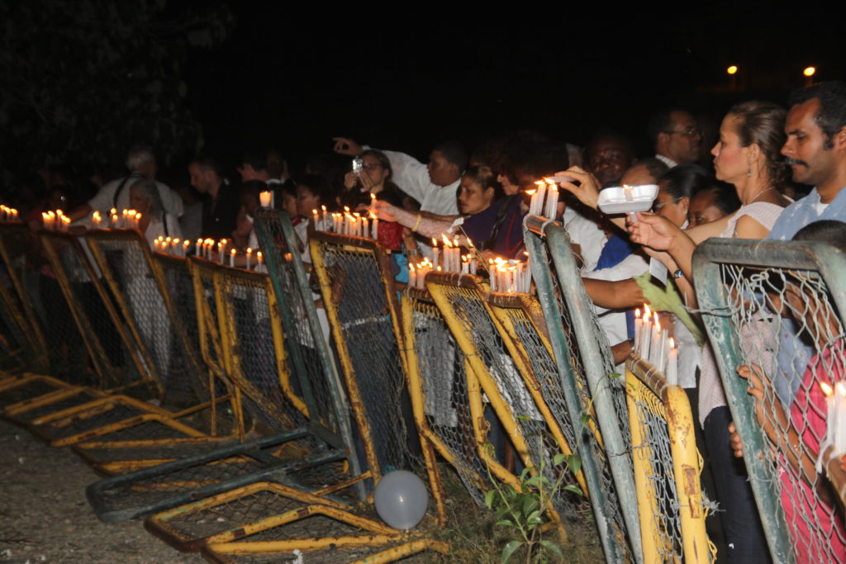
Key Summary
While tensions between the Dominican Republic and Haiti arose from Haiti's occupation of the Dominican Republic in the 1800s, Rafael Trujillo transformed these tensions into a state-doctrine of anti-Haitianism. In what many see as an attempt to solidify his power, Trujillo ordered the Dominican military to massacre Haitians near the Dominican-Haitian border in October 1937. As many as 30,000 people were killed in just ten days.
While the Dominican government never claimed responsibility for the massacre, Trujillo adopted an anti-Haitian state doctrine to justify violence against and exclusion of Haitians. The legacy of the massacre is still seen today in the Dominican Republic's current citizenship laws and racial discrimination.

Slide 2
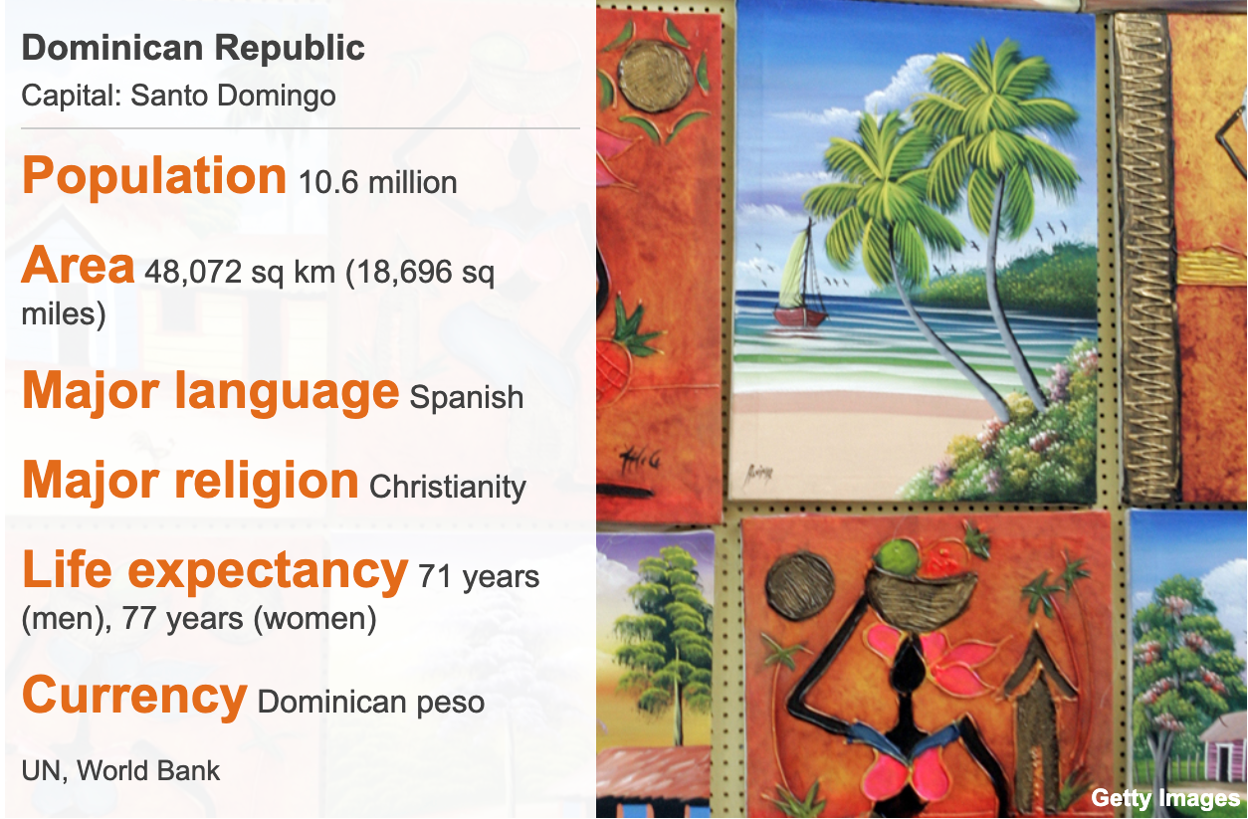
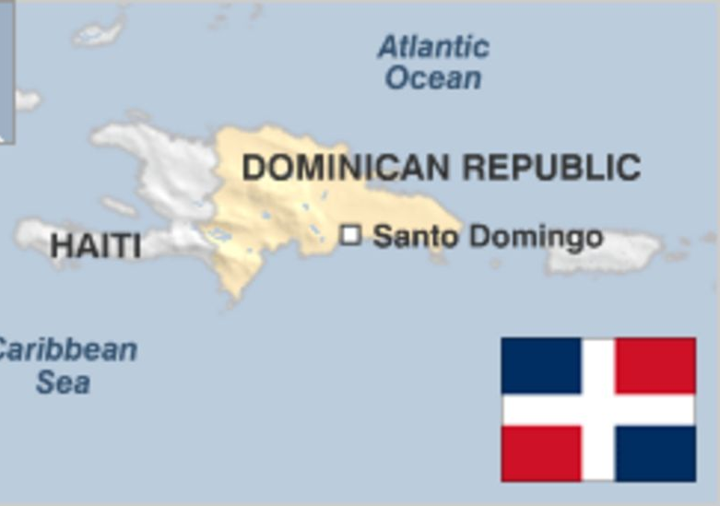
Dominican Republic Country Profile
1496 - Spaniards set up first Spanish colony in Western hemisphere at Santo Domingo, which subsequently serves as capital of all Spanish colonies in America.
1697 - Treaty of Ryswick gives western part of Hispaniola island (Haiti) to France and eastern part (Santo Domingo - the present Dominican Republic) to Spain.
1821 - Uprising against Spanish rules is followed by brief period of independence.
1822 - Haitian President Jean-Pierre Boyer marches his troops into Santo Domingo and annexes it.
1844 - Boyer overthrown; Santo Domingo declares its independence and becomes the Dominican Republic.
1861-64 - President Pedro Santana returns the Dominican Republic to Spanish rule. Spain withdraws from, and annuls its annexation of, the Dominican Republic following a popular revolt.
1916-24 - US forces occupy the Dominican Republic following internal disorder.
1924 - Constitutional government assumes control; US forces withdraw.
1930 - General Rafael Leonidas Trujillo Molina establishes personal dictatorship following the overthrow of President Horacio Vazquez.
1937 - Army massacres 19,000-20,000 Haitians living in areas of the Dominican Republic adjacent to Haiti.
1961 - Trujillo assassinated.

Slide 3
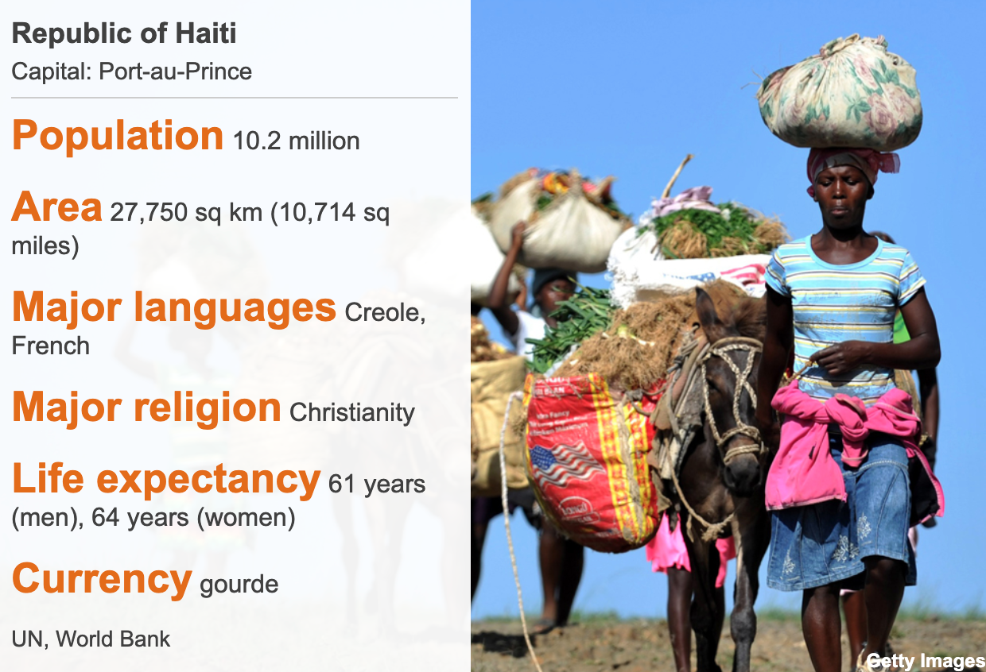
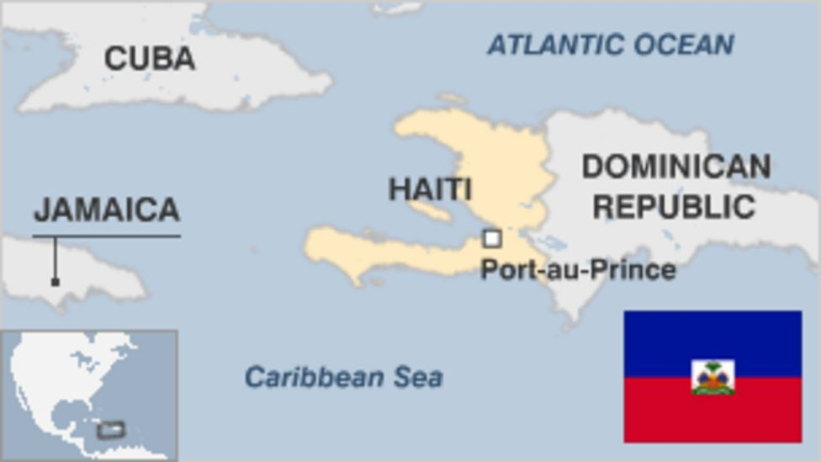
Haiti Country Profile
1804 - General Jean Jacques Dessalines proclaims the independent black republic of Haiti after rebel slaves defeat French troops dispatched by Napoleon Bonaparte.
1915 - US invades following black-mulatto friction, which it thought endangered its property and investments in the country.
1934 - US withdraws troops from Haiti, but maintains fiscal control until 1947.
1957 - Francois "Papa Doc" Duvalier wins elections. He eventually turned his administration into a brutal dictatorship.

Slide 4
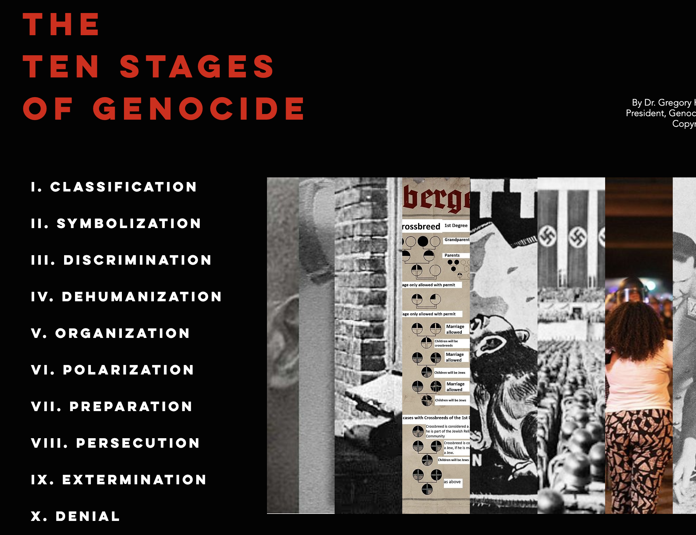
Ten Stages of Genocide
Dr. Gregory Stanton, Founding President of Genocide Watch, uses the Ten Stages of Genocide to describe and explain the genocidal process. The stages are:
1. Classification
2. Symbolization
3. Discrimination
4. Dehumanization
5. Organization
6. Polarization
7. Preparation
8: Persecution
9. Extermination
10. Denial
This process is not linear. The 1937 Haitian Massacre is an example in which Stages 7-9 preceded a campaign of dehumanization (Stage 4). The 1937 Haitian Massacre was an act of genocide; victims were targeted for their nationality and skin color. Trujillo intended to erase Haitians from within Dominican borders.

Slide 5
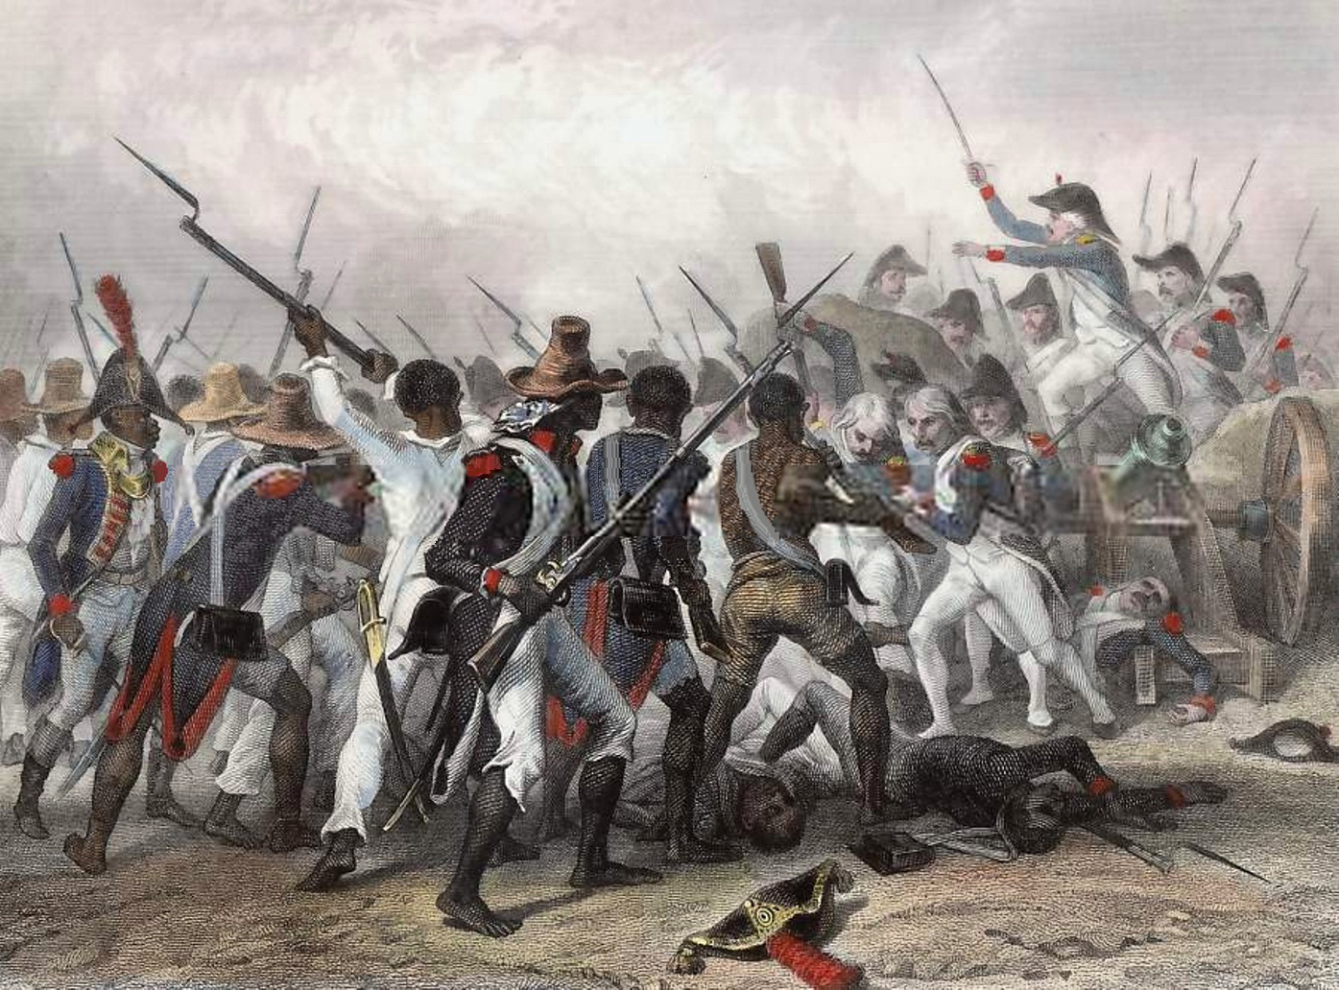
Haitian Revolution
Aug 21, 1791 – 1804
French and Spanish colonial rule on Hispaniola was brutal. Having previously killed nearly all the indigenous Taino people due to disease or back-breaking work in gold mines, both colonial powers relied on slave labor for their profitable plantation systems. The French and Spanish also imposed a strict racial hierarchy that was used to justify slavery.
The French Revolution and Declaration of the Rights of the Man and of the Citizen in 1789, which states that "in the eyes of the law all citizens are equal," inspired oppressed groups to seek equality and bring an end to slavery. In one of the most successful slave revolts in history, Haitians fought for their independence from the French. This revolution not only gave Haiti its independence but also contributed to ending the transatlantic slave trade.
France refused to recognize Haiti's independence until 1825, at which point it saddled the new country with 100 million francs in colonial debt. Other western countries deliberately shut Haiti out of the world economy.

Slide 6
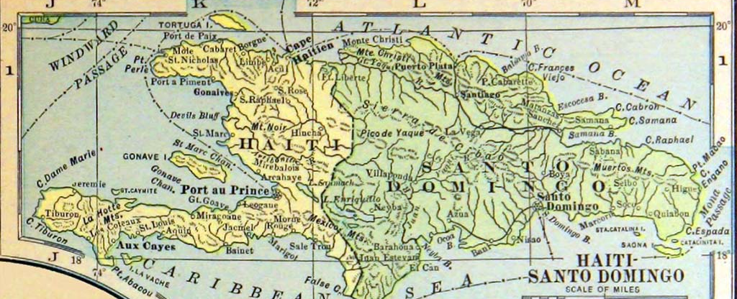
Haitian occupation of the Dominican Republic
Feb 9, 1822 – Feb 27, 1844
Following Santo Domingo's declaration of independence from Spain in 1821, Haitian President Jean-Pierre Boyer's forces quickly overtook the territory. This 22-year occupation fostered resentment among Dominicans towards Haitians due to the repression of their culture, domination in political power, and ethnic tensions. As the economy declined, the local population saw the Haitians more and more as occupiers instead of liberators from Spanish rule.
La Trinitaria, an underground movement led in part by John Pablo Duarte, worked towards independence for over a decade. The group ultimately declared independence once again as the Dominican Republic on February 27, 1844.

Slide 7
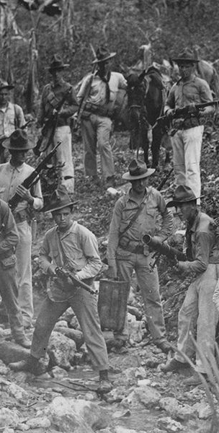
U.S. Occupation of Haiti
1915 – 1934
The U.S. invaded and occupied Haiti from 1915-1934 after seven years of political turmoil. U.S. fear of a German invasion of Haiti was also a primary motivation. However, the main catalyst for U.S. action was when a mob killed pro-U.S. Haitian President Jean Vilbrun Guillaume Sam after he demanded that his political prisoners be murdered.
Though infrastructure improved and the economy stabilized during this time, the U.S. occupation was brutal and racist. It imposed a new constitution, which revoked a ban on foreigners purchasing land. This allowed U.S.-owned businesses to purchase land for plantations in Haiti, thus re-establishing an economy that resembled that of pre-independence Haiti.
The Great Depression made the occupation of Haiti unfeasible. The U.S. agreed to withdraw after elections were held in 1930. The U.S. officially ended its occupation in 1934, though it maintained a presence in Haiti until 1941.

Slide 8
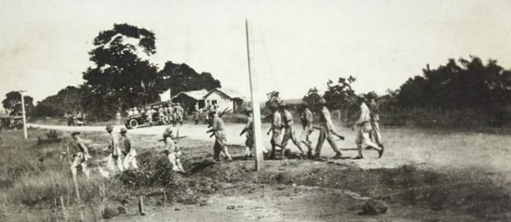
U.S. Occupation of the Dominican Republic
1916 – 1924
The U.S. invaded and occupied the Dominican Republic from 1916-1924 to protect political and economic interests during and after WWI. The Dominican Republic had an enormous national debt and was in the midst of a civil war, thus leaving it vulnerable to invasion.
Due to significant resistance by Dominicans, the U.S. installed its own military government and replaced the Dominican army with the Guardia Nacional Dominica, trained by U.S. Marines.
The U.S. occupation of the Dominican Republic was much shorter than that of Haiti as a result of the difficulty posed by strong resistance and domestic unpopularity of the occupation. The U.S. began to withdraw in 1922, with the last U.S. Marines leaving on September 18, 1924.

Slide 9
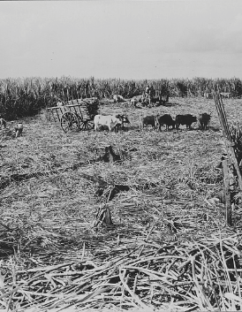
Economic Migrants
1920 – 1937
Beginning under the U.S. occupation of Haiti and the Dominican Republic, travel and migration restrictions across the border eased to allow Haitians to work on sugar plantations. Haiti's lagging economy, low wages, poor working conditions, and lack of arable land led to mass migration, largely to the borderlands of the Dominican Republic.
Though this migration was originally intended to be temporary, many eventually settled in the bateyes (company-owned towns). In 1920, just under 28,000 Haitian nationals were living in the Dominican Republic. By 1935, that number was more than 50,000. This contributed to the already present mix of cultures in communities around the border.

Slide 10
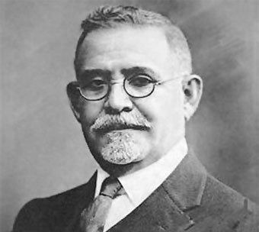
Trujillo Overthrows Vásquez
Feb 23 – Aug 16, 1930
Rafael Trujillo, an army chief in the Guardia Nacional Dominica, and Rafael Estrella Ureña overthrew Horacio Vásquez in 1930. Trujillo took the presidency, while Ureña became Vice President. Trujillo established a brutal dictatorship that would last until his assassination in 1961.

Slide 11
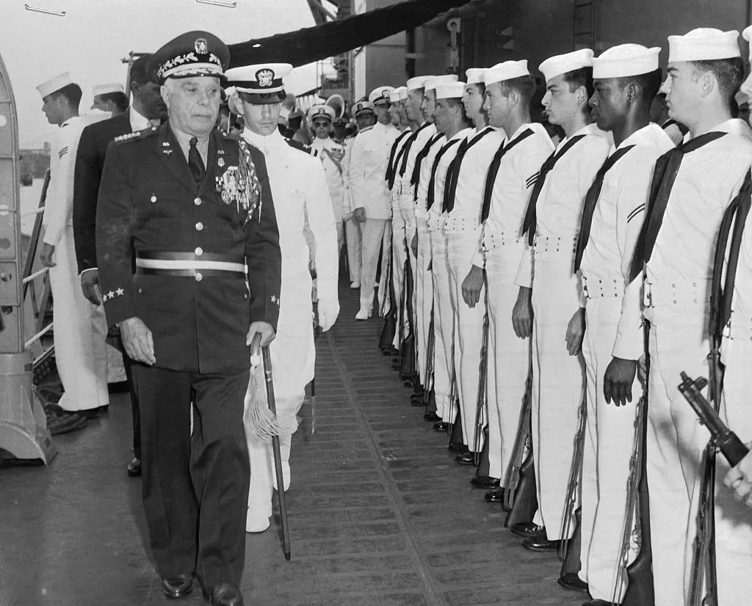
Trujillo's Dictatorship
Aug 16, 1930 – May 30, 1961
Rafael Trujillo applied the counterinsurgency tactics he learned from U.S. Marines during his time in the Guardia Nacional Dominica. Immediately upon becoming head of state, he began ordering the murder of his political opponents to reduce resistance and maintain absolute power. Civilians saw their civil liberties curtailed. Propaganda demanded Trujillo be idolized and seen as the "savior" of the Dominican Republic.
His administration was corrupt; not only did he regularly appoint family members to political positions, but he also instituted economic policies that benefitted his businesses. By the time of his assassination, he controlled 80% of industrial production and employed 60% of the active labor force, including those working for the state.

Slide 12
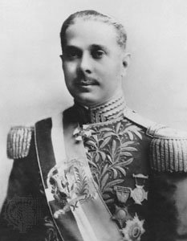
Trujillo's Ideology and Anti-Haitianism
1930
Trujillo represents a common thread of anti-Haitianism in the Dominican Republic originating in colonialism. Despite connected cultures and histories, an ideology of racial superiority and inferiority based on ancestry persists to this day. This discrimination was not only common among citizens but was also institutionalized and manipulated by politicians like Trujillo. Though Trujillo had Haitian ancestry, he viewed the multiculturalism at the Haitian-Dominican border as a threat to his political power.

Slide 13
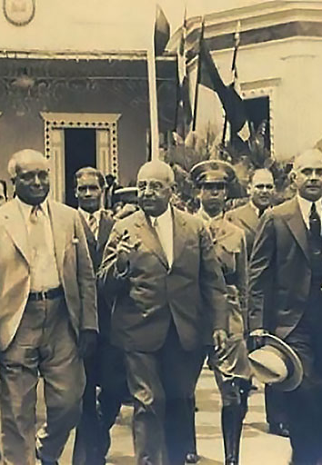
Haiti-Dominican Republic Relations Before Massacre
1933 – 1937
Haiti and the Dominican Republic established peaceful relations following the end of the U.S. occupation of Haiti. Trujillo and President Sténio Vincent signed a border treaty in 1936 after a two-year-long negotiation period. Though this left some Haitians on the "wrong" side of the border, very few moved as the border meant more on paper than on the ground at this time.
This positive diplomatic relationship continued through 1937, indicating that the massacre did not have roots in any ongoing tensions or violent conflict between Haiti and the Dominican Republic.

Slide 14
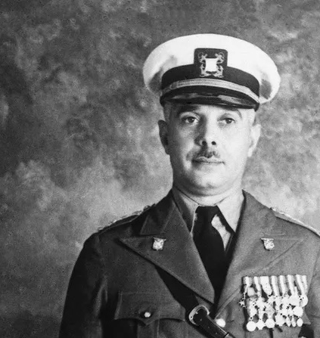
Trujillo's Speech
Oct 2, 1937
Trujillo made a speech claiming that Dominican farmers living near the border were complaining about "depredations by Haitians living among them." In order to solve their problems, he announced the murder of 300 Haitians in Bánica and promised such massacres would continue.
This speech marked the beginning of the genocide.

Slide 15
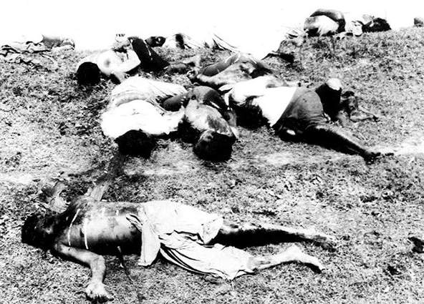
Massacres
Oct 2–12, 1937
Under Trujillo's orders, the Dominican army targeted Black Haitian men, women, and children near the border, moved them to secluded areas, and massacred them using machetes. In some cases, civilians were forced to murder or be murdered. Soldiers burned the bodies of the victims, dumped them into the Dajabòn River, or buried them in mass graves. An estimated 9,000-30,000 individuals were killed in a span of ten days.
Cables to the US described the violence as a "systematic campaign of extermination" approved by Trujillo. U.S. ambassador R. Henry Norweb reported that "the entire northwest of the frontier on the Dajabòn side is absolutely devoid of Haitians. Those not slain either fled across the frontier or are still hiding in the bush."
Records indicate that some Dominicans tried to help Haitians escape, while others helped the soldiers identify Haitian immigrants.

Slide 16

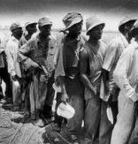
Shibboleth Test
Oct 1937
Because those who lived near the border had higher rates of mixed ancestry and biculturalism, Dominican soldiers faced difficulty in distinguishing between Haitians and Dominicans. One method soldiers used was showing people a sprig of parsley and asking them to name it. Those who correctly pronounced the Spanish word "perejil" were safe. Those who spoke French or Kréyo, the official languages of Haiti, often couldn't pronounce the 'r' correctly.
This was not a perfect test, as many living on the border were bilingual. Thus, it was only used occasionally. Nevertheless, some refer to this massacre as the "Parsley Massacre."

Slide 17
Possible Explanations
Oct 1937
Though there is no way of knowing the true intentions behind Trujillo's orders to massacre Haitians, scholar Edward Paulino proposed four possible explanations:
1. Trujillo may have been implementing blanquemiento, a practice in post-colonial Latin America to "whiten" nations in the hopes of modernizing and "improving." The Dominican government continued to rely on Haitian migrant workers for labor throughout Trujillo's rule, indicating that the intention was not to completely rid the Dominican Republic of Haitians.
2. Trujillo may have sought to take advantage of the global food shortage due to the ongoing Global Depression by using the borderland to produce agricultural exports.
3. Despite the peaceful relationship between Haiti and the Dominican Republic at the time, President Vincent allowed anti-Trujillo exiles to seek refuge in Haiti. Trujillo may have ordered this violence as an attempt to destabilize Vincent's regime in the hopes that he would be replaced by a pro-Trujillo government.
4. It is possible that this was the first step towards ambitions of eventually invading and occupying Haiti.

Slide 18
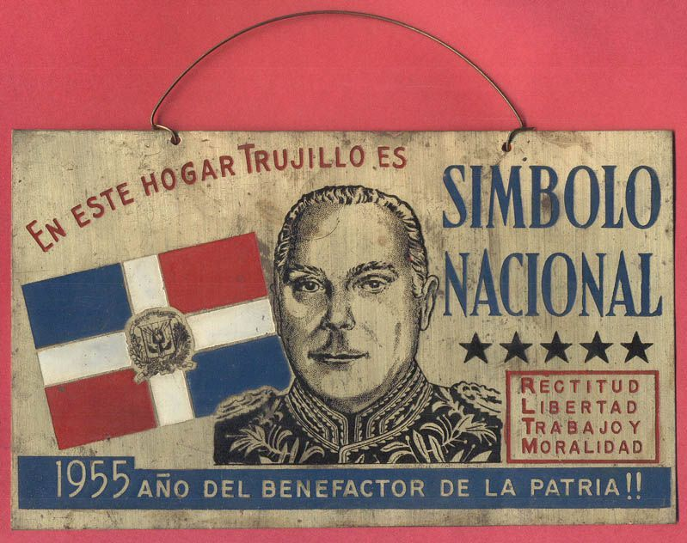
La Dominicanizaciòn de la Frontera
Oct 1937 – 1938
Following the massacre, Trujillo's regime began a process known as "Dominicanization of the border." Dominicans from the interior of the country were incentivized to move to the border region. Places that previously had French and Kréyol names were given Spanish names. This process intended to change the identity of the region from bicultural to monocultural.

Slide 19
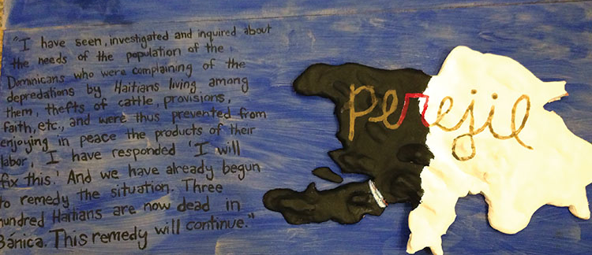
Anti-Haitian State Doctrine
Oct 1937
Though anti-Haitianism was present in Dominican society before the massacre, it became much more prevalent when Trujillo began a public campaign spreading hateful messages against Haitians after the violence began. He described Haitians as "invaders" and "criminals," and created an ideology through which he could justify the massacre and further policies discriminating against Haitians.
Thus, this massacre demonstrates that the 10 Stages of Genocide do not always occur in order. Stage 9: Extermination preceded Stage 4: Dehumanization.

Slide 20
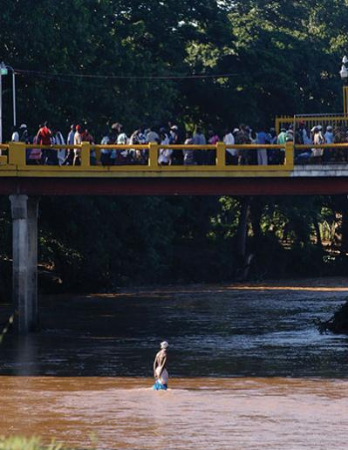
Denial and Coverup
Oct 2–12, 1937
To cover up the role of the Dominican government and military in the massacre, the soldiers used machetes. Trujillo claimed that vigilante citizens and "patriotic Dominican farmers" were responsible for the violence. Additionally, Trujillo restricted the press, not allowing newspapers to cover the violence.
During his rule, Trujillo refused to allow investigations into the Haitian Massacre. It was not until after his assassination in 1961 that researchers could attempt to uncover the truth, at which point no mass graves could be found.

Slide 21
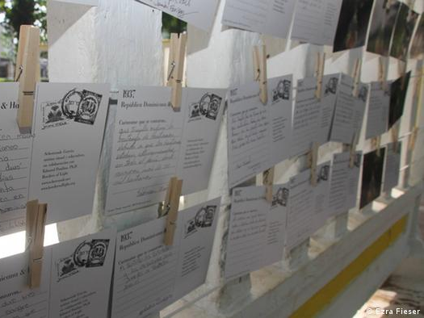
Sham Trials
Nov 1937 to Mar 1938
In response to international backlash for the violence, Trujillo opened an investigation on the matter in November 1937. This investigation and the subsequent trials in March 1938 are part of the Trujillo regime's denial of responsibility. Dozens of Dominicans were convicted after confessing to the murder of 423 Haitians. These men, referred to as "reservistas," were loyal to Trujillo. Despite their convictions, all were set free after a few months.

Slide 22
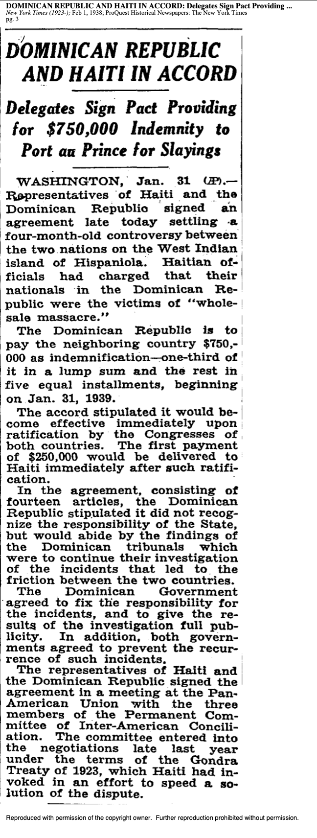
1938 Indemnity Agreement
Jan 31, 1938
Haitian President Sténio Vincent was reluctant to respond to the massacre, and ultimately only acted when faced with severe domestic scrutiny, an attempted coup in December 1937, and pressure from Cuba, Mexico, and the U.S.. When he demanded an investigation and mediation process, Trujillo instead offered to sign an indemnity agreement via the League of Nations in which the Dominican Republic would pay the Haitian government $750,000.
In the agreement, Trujillo took "no responsibility whatsoever," making it virtually impossible to prosecute the government. Instead, he used the opportunity to justify the violence under his false narrative of "illegal immigration by supposedly undesirable Haitians."

Slide 23
Indemnity Payment
1938
As part of the 1938 League of Nations Indemnity Agreement, the Dominican Republic promised to give $750,000 to the Haitian government as compensation to be distributed to survivors and victims' families. This was part of an exchange to end any arbitration on the matter and to defer to convictions within the Dominican justice system.
The Dominican government paid only $525,000 to Haiti, which is worth over 10 million USD today. Most survivors and victims' families never saw any of this money due to corruption within the Haitian government. Beyond this action, the Dominican Republic made no other efforts to preserve the memory or knowledge of this massacre.

Slide 24

Continuation of Violence
1938
Violence against Haitians in the Dominican Republic did not end with the Indemnity Agreement. In the spring of 1938, Trujillo began a new campaign against Haitians living along the southern border. Within a few months, thousands more fled and hundreds were killed, though specific numbers are unknown.
The Dominican government's lack of accountability for the 1937 genocidal massacre legitimized Trujillo's ideology of nationalism and anti-Haitianism. The normalization of the expulsion and exclusion of Haitians continues to this day.

Slide 25
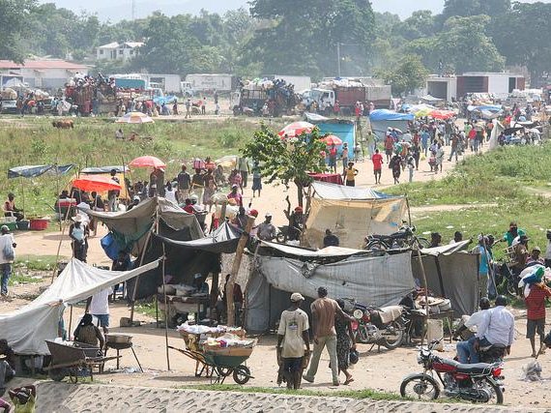
Continued Reliance on Haitian Migrant Workers
1937 – 1990
The Dominican economy relied on Haitian migrant workers due to the importance of the sugar industry in the country. Following the 1937 massacre, the government began forcing Haitian migrants to move to sugar plantations in an effort to keep them contained. This physical and social isolation further erased the mixed cultural history of Dominican-Haitian communities. Forced relocation only became more stringent under Balaguer, who instituted policies requiring Haitian migrants to work on sugar plantations only.
Many of those born on plantations were denied official birth certificates, leaving them vulnerable to deportation. When the Dominican sugar industry collapsed in the 1990s, deportations of Haitian immigrants and Dominicans of Haitian descent increased as they could no longer be isolated by the government.

Slide 26
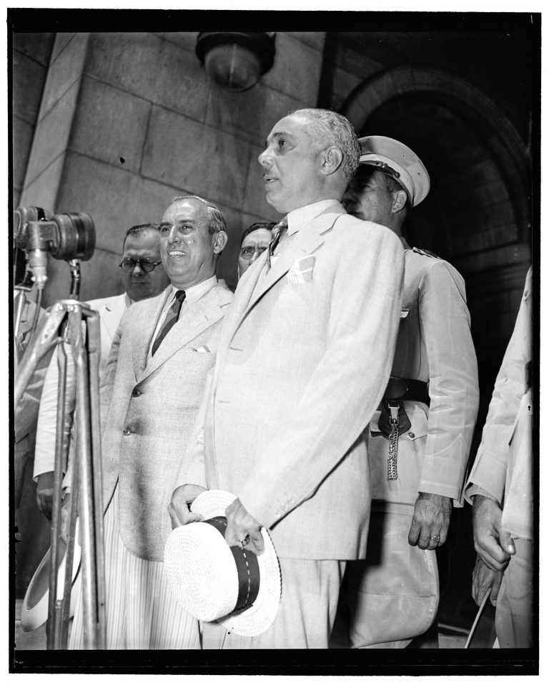
Trujillo Used WWII to Improve Reputation
1939 – 1945
Trujillo's regime received denunciations across the world for the 1937 Haitian Massacre, with U.S. President Roosevelt being among the most vocal.
With the outbreak of WWII in 1939, the U.S. sought to create a unified western hemisphere against the Axis powers. Trujillo saw an opportunity to get back into the good graces of the U.S. and distract from its genocidal massacre. The Dominican Republic even declared war on Germany and Japan in solidarity with the U.S. on December 11, 1941. Though the Dominican Republic did not get involved militarily in the war, the move did help improve its relationship with the U.S.

Slide 27
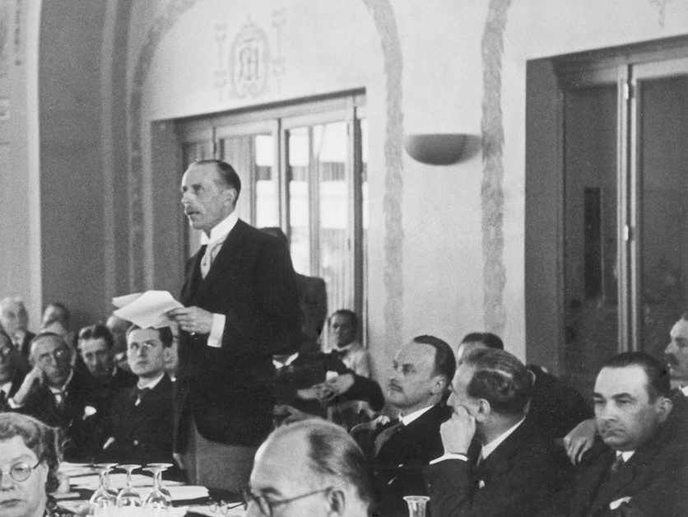
Evian Conference
Jul 6–15, 1938
The Evian Conference brought together 32 countries, including the Dominican Republic, to formulate a response to the Nazi persecution of Jewish people across Europe. The conference was a failure; despite Hitler stating that he would facilitate Jewish emigration, only one country offered to accept refugees – the Dominican Republic. All other countries refused to relax their immigration quotas, even as they expressed sympathy for those who would soon become victims of genocide.
Trujillo agreed to take 100,000 Jewish refugees, although, in the end, only 600 arrived in the Dominican Republic. Some historians believe this generous offer was part of Trujillo's strategy to get back into the good graces of the U.S. and other Western nations.

Slide 28
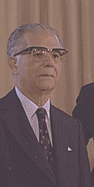
Joaquín Balaguer
1960 – 1996
Joaquín Balaguer held a number of government positions throughout his life. He became president in 1960, though he had little power until after Trujillo's assassination. While he was not always in power throughout his political career, he was very influential.
Balaguer's policies and political writing further institutionalized anti-Haitianism and racism. In 1966, his immigration policies restricted Haitian migrant workers to sugar plantations in an attempt to avoid "racial contamination." Today's citizenship controversy in the Dominican Republic is a direct result of Balaguer's policies.

Slide 29
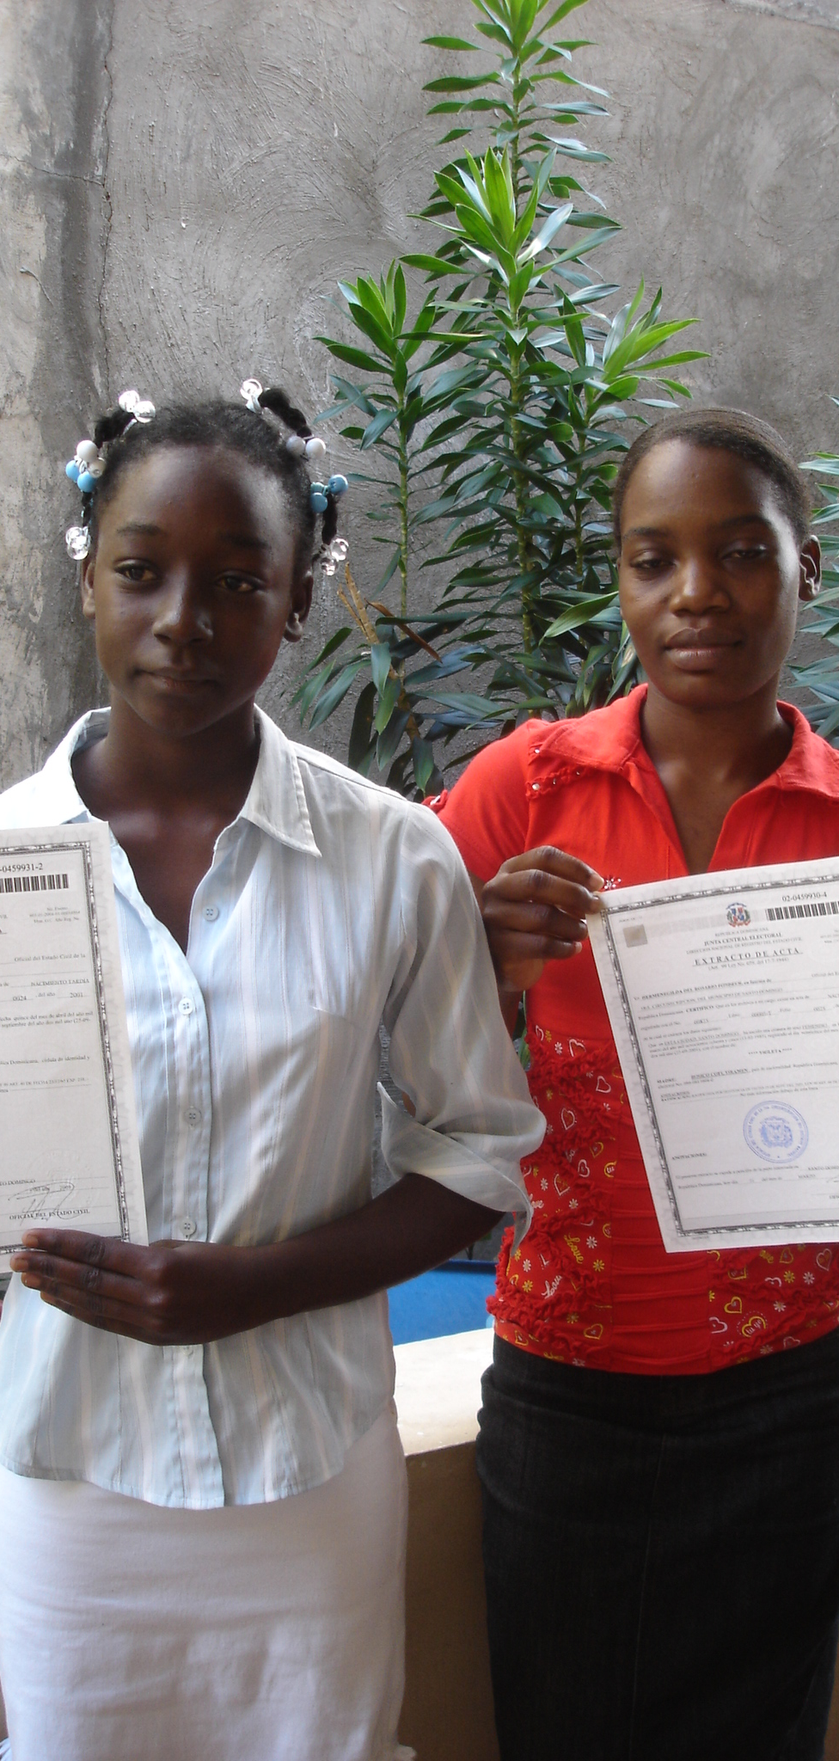
Yean and Bosico v. Dominican Republic
2001 – 2005
In 2005, the Inter-American Court of Human Rights (IACHR) heard the case of Dilicia Yean and Violeta Bosico, two young girls who were denied birth certificates despite being born in the Dominican Republic. Their legal representatives argued that this denial was part of an intentional policy that denied Dominicans of Haitian descent citizenship. While the Dominican Constitution granted birthright citizenship (jus soli), it did not apply to migrants. The Dominican government classified Haitian migrants and their descendants as "permanently 'in transit,'" making them ineligible for citizenship.
Though the girls eventually received their birth certificates, the case continued because the government refused to acknowledge that it had denied their right to a nationality. The IACHR ruled that this was a case of racial discrimination and ordered the government to fulfill its constitutional obligation of jus soli.
The Dominican Republic's Senate rejected the IACHR's finding, and the Supreme Court of Justice upheld its policy. In 2009, the government passed a constitutional amendment to establish citizenship based on the status of a child's parents (jus sanguinis) in direct defiance of the IACHR.

Slide 30
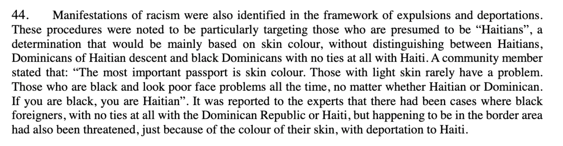
2008 Special Rapporteur and Independent Expert Report
Mar 18, 2008
In 2008, Special Rapporteur Doudou Diène and Independent Expert Gay McDougall published a report on racism and racial discrimination in the Dominican Republic. The pair found that, despite government denials, racism against Black Dominicans, Dominicans of Haitian descent, and Haitians, is rampant in Dominican policies and society. Anti-Haitianism and racial discrimination in immigration policy left even Dominican citizens vulnerable to deportation. Many citizens reported being unable to receive official identity documents, even when they were simply renewing their documents or requesting copies.
Similar to the migrant worker policies post-massacre, immigration was regularly described as an "invasion" despite the reliance on Haitian immigrants for cheap labor.

Slide 31
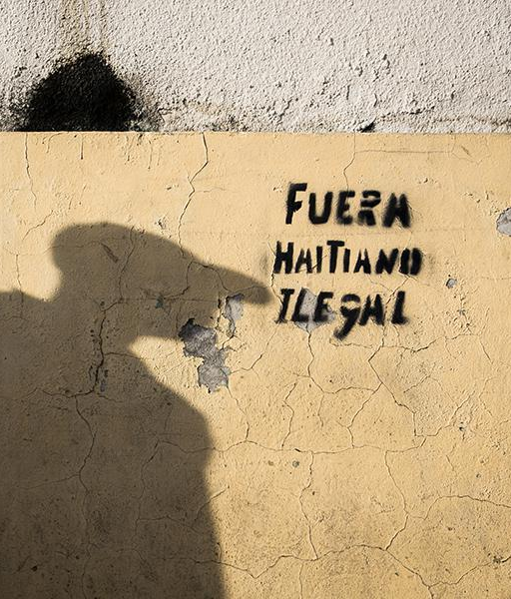
La Sentencia
Sep 23, 2013
The Dominican Republic's Constitutional Court Ruling 168-13, known as La Sentencia, retroactively denied citizenship "to anyone born to undocumented residents" after 1929. This decision threatened to render more than 200,000 Dominican citizens of Haitian descent stateless, stripping them of their rights and homes.
This ruling directly rejects the IACHR ruling in Yean and Bosico v. Dominican Republic. It was clearly based on racial discrimination and anti-Haitianism. La Sentencia violated the Dominican Republic's international human rights obligations.

Slide 32
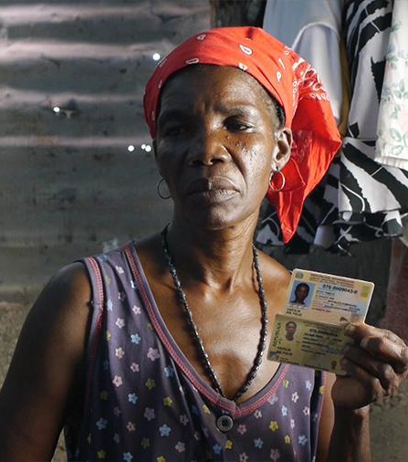
2014 Naturalization Law
May 2014
In response to international criticism for La Sentencia, the Dominican Republic passed Ley de Régimen Especial y Naturalización to soften the denaturalization policy. This law recognizes those who were born in the Dominican Republic from 1929-2007 as citizens but requires those whose births were not formally registered to go through a complicated naturalization process. As seen in Yean and Bosico v. Dominican Republic, many Dominicans of Haitian descent were denied birth registration and other documents due to racial discrimination and anti-Haitianism.
Despite its improvements upon La Sentencia, this new naturalization law still left thousands vulnerable to statelessness.

Slide 33
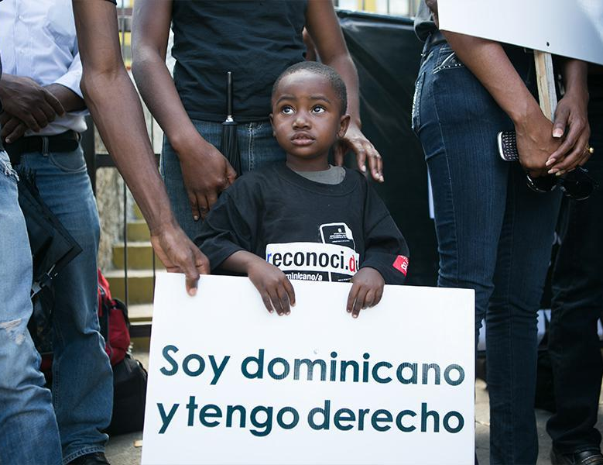
Expelled Dominicans and Haitians v. Dominican Republic
Jul 12, 2012 – Oct 22, 2014
Anti-Haitianism has never been challenged at a national level in the Dominican Republic, further perpetuating discrimination against Dominicans of Haitian descent. A petition was filed with the IACHR when, in 2000, thousands of documented and undocumented Dominicans, as well as foreign nationals with permanent residences in the Dominican Republic, were arbitrarily detained and expelled to Haiti. They were given no time to produce their documents and no due process. Following La Sentencia in 2013, which retroactively stripped thousands of Dominicans of foreign descent of their citizenship, and the 2014 Naturalization Law, the IACHR ruled that the Dominican Republic's citizenship policies breach its commitments to human rights.

Slide 34
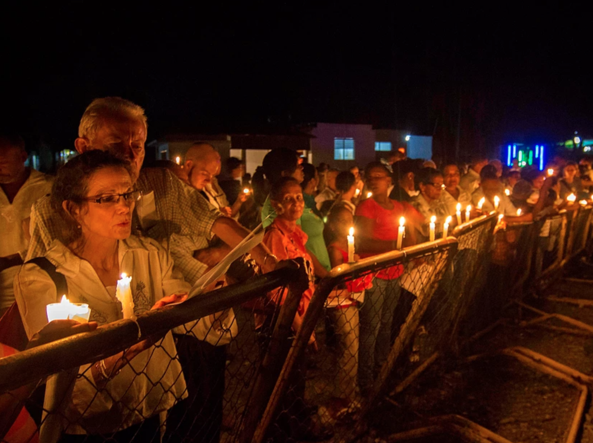
Border of Lights Commemoration
2012 – 2021
The 1937 Haitian Massacre went unrecognized for decades until organizations like Border of Lights helped bring it out of obscurity. Since 2012, Border of Lights has held an annual candlelight vigil along the Dajabòn River from the northern border to the border checkpoint. Border of Lights does community outreach in both the Dominican Republic and Haiti to bring together artists, activists, students, teachers, and parents. The organization also facilitates local efforts to build "cross-border solidarity.”
Border of Lights explains the importance of remembrance by considering the massacre's legacy: "The massacre cemented Haitians into a long-term subversive outsider incompatible with what it means to be Dominicans."

Slide 35
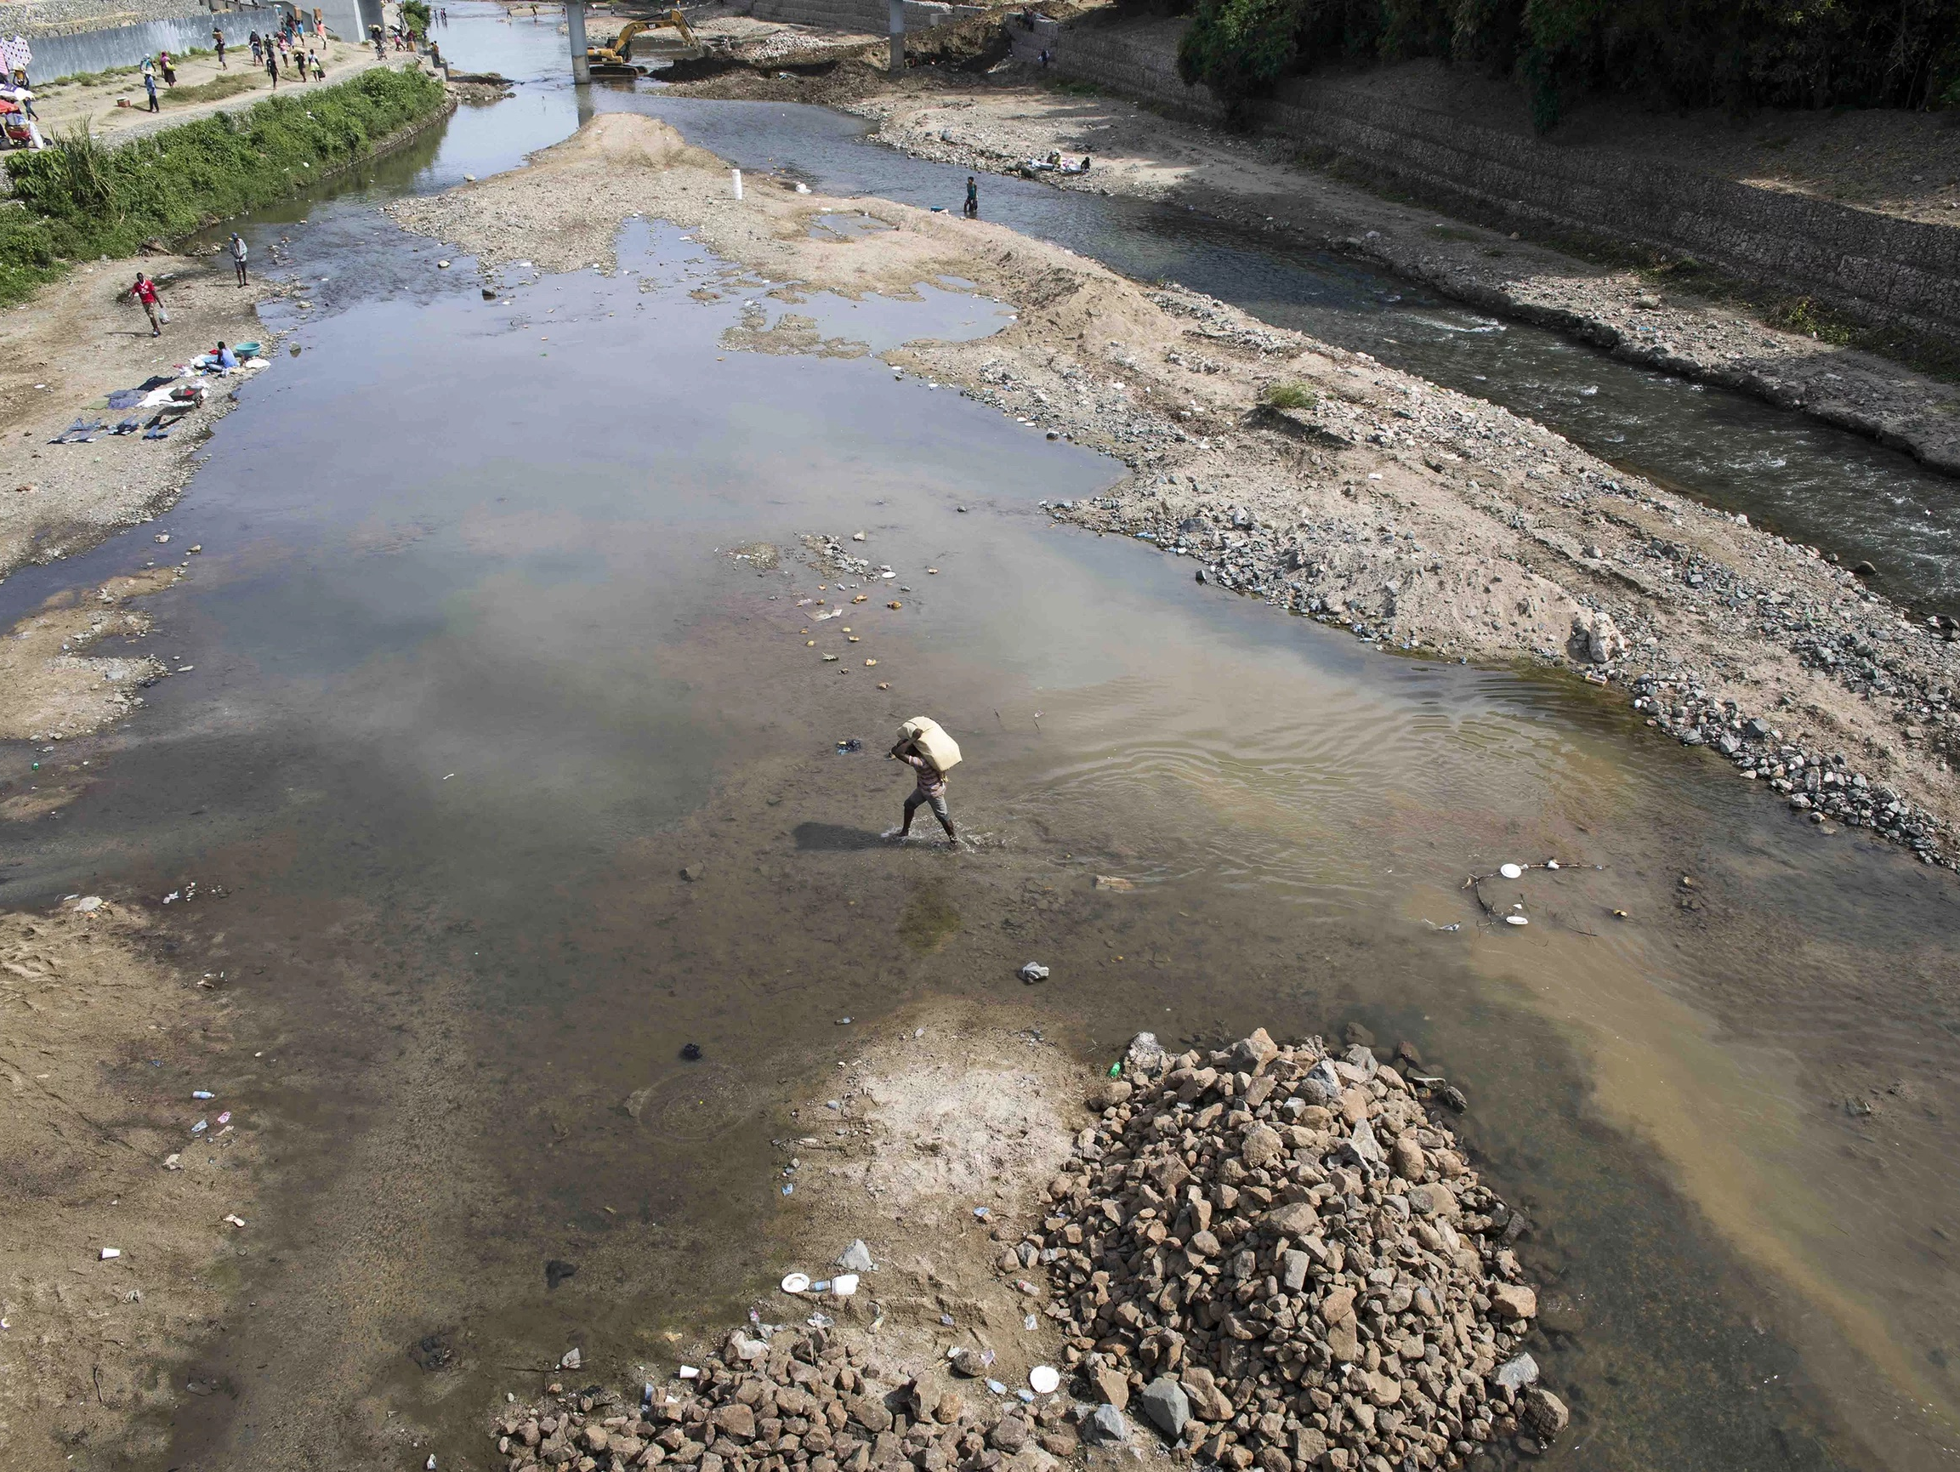
Conclusion
The legacy of the 1937 Haitian Massacre is a source of tension between Haitians and Dominicans. There was never a counter-movement against Trujillo's anti-Haitian ideology. No government officials were ever held responsible for the massacre, and the Dominican government has made few if any efforts to commemorate the victims or preserve the memory of the massacre. Haitians continue to be excluded and deported from the Dominican Republic using the very same hateful ideology propagated after the massacre.
Until the Dominican government accepts responsibility for the genocidal massacres of 1937 and the subsequent history of anti-Haitianism, tensions will not be resolved.

