Slide 1
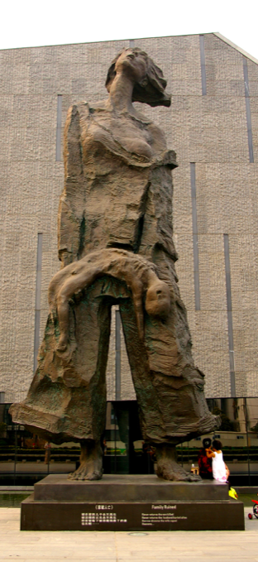
Key Findings
The Nanjing Massacre occurred during a six-week period in December 1937 and January 1938. It was committed by the Japanese military during its conquest of China during the Second Sino-Japanese War.
Despite extensive spoken, written, and photographic memories of the massacre, Japan continues to deny the incident to this day.

Slide 2
The Ten Stages of Genocide
Dr. Gregory Stanton, Founding President of Genocide Watch, uses the Ten Stages of Genocide to describe and explain the genocidal process. The stages are:
1. Classification
2. Symbolization
3. Discrimination
4. Dehumanization
5. Organization
6. Polarization
7. Preparation
8. Persecution
9. Extermination
10. Denial
Genocide Watch recognizes the Nanjing Massacre to be in Stage 10: Denial, due to Japan's attempts to prevent further investigation into Nanjing and to raise doubt of victims and their testimonials.

Slide 3
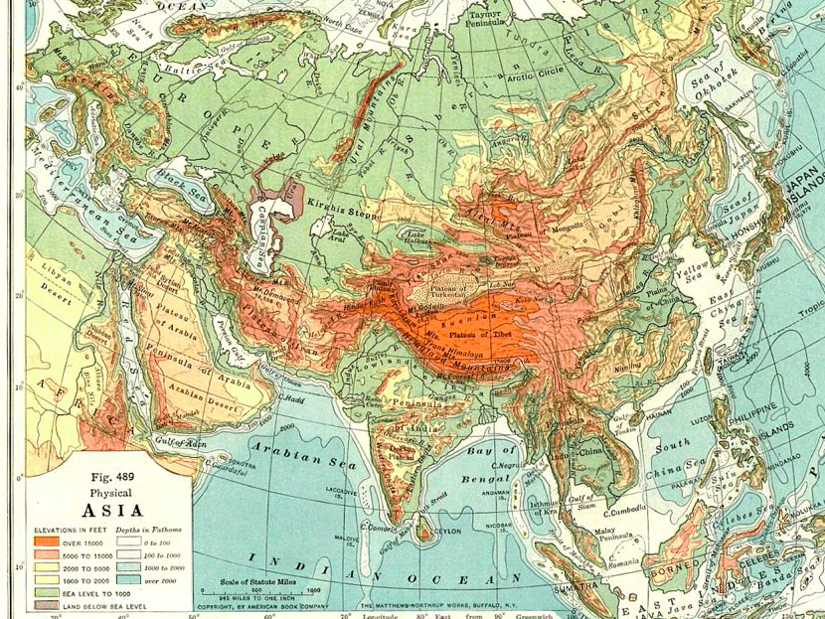
Historical Overview
1894-1895: First Sino-Japanese War. Tensions between China and Japan over influence in Korea break out into war. Japan's army defeats China and takes control of Manchuria and Shandong Province.
1895: The Treaty of Shimonoseki ends the First Sino-Japanese war; China cedes Taiwan, part of Manchuria, and the Pescadores to Japan.
Nanjing: Capital city of Jiangsu province. Located in eastern China, on the Yangtze river.
1928: Chiang Kai-shek makes Nanjing the capital city of China's Nationalist government.

Slide 4
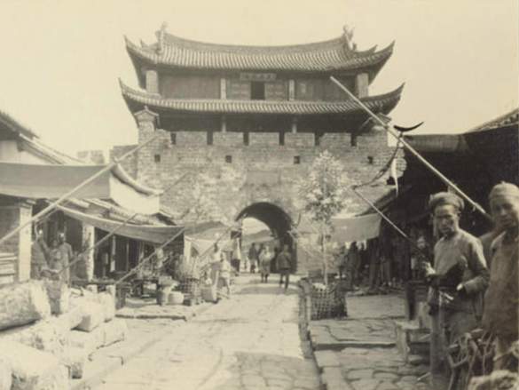
China Country Profile
In the 1920s, China was in the midst of an active civil war. The Communist Party of China and the Nationalist Party clashed in attempts to control the nation. Both parties were responses to China's struggle against Western colonization and influence.
Chiang Kai-shek led the Nationalist party and attempted to revive Chinese traditionalism. His foil was Mao Zedong, the leader of the Chinese Communist Party.

Slide 5
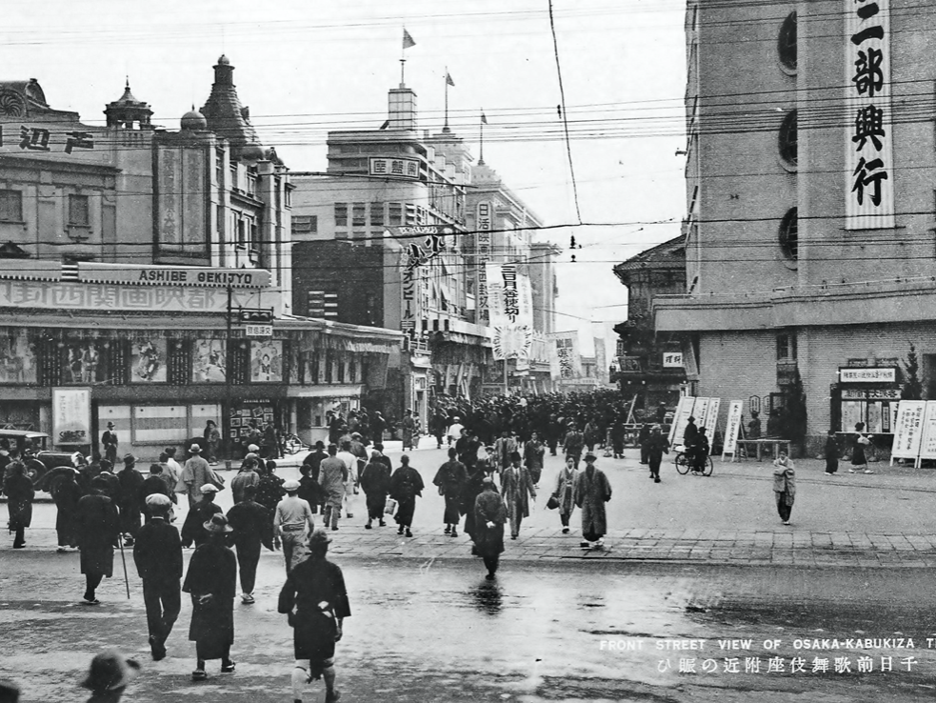
Japan Country Profile
In the 1920s, Japan acted under a policy of Nationalism and reverence for traditionalism. It grew its navy and military in order to achieve dominance in Asia. Territories on the Asian mainland were necessary to provide the island nation with raw supplies for manufacturing its dominance.
During the 1920s and 1930s, Japan had a new acting Prime Minister about every year and a half. Emperor Shōwa served as emperor from 1926-1989, overseeing Japan throughout the Second Sino-Japanese War, World War II, and its post-war recovery.

Slide 6
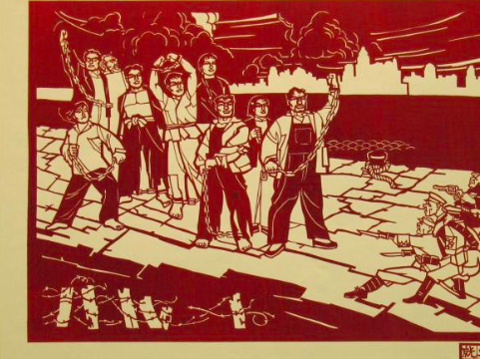
Northern Expedition
June 1926 – Dec 1928
Chinese nationalist leader Chiang Kai-shek led a military expedition from Southern through Northern China. He established a Nationalist regime and began a purge against Communism. His path into Shanghai in 1927 threatened several foreign military bases, including Japan’s.
Until this conquest, Japan had kept a limited fleet in Shanghai. After the 1927 conflict, it established a long-term station and kept a watchful eye on Chiang Kai-shek's movements.

Slide 7
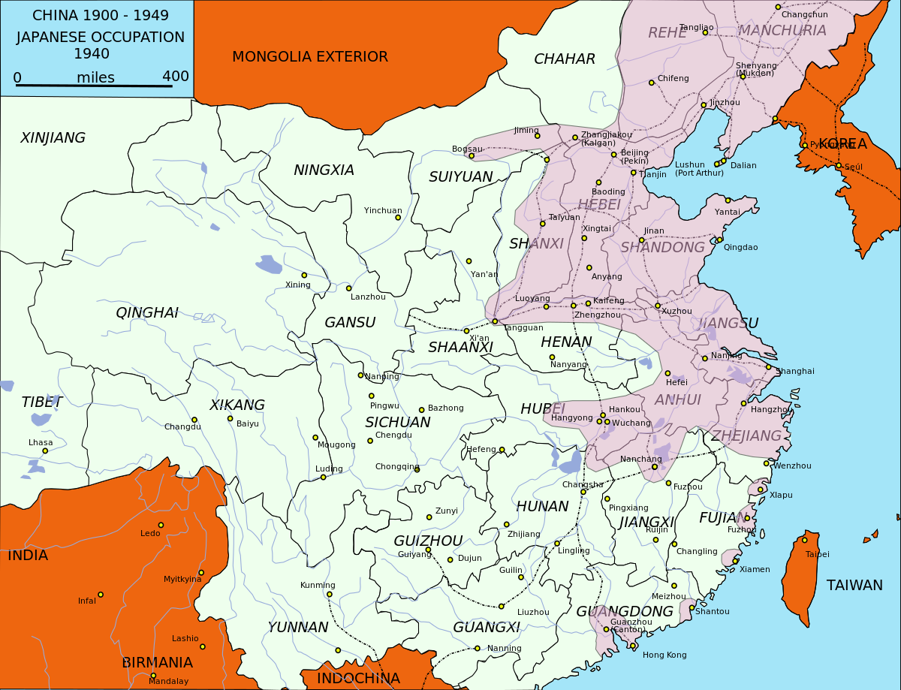
Second Sino-Japanese War
Aug 1931 – Dec 7, 1941
There were multiple reasons for the development of the Second Sino-Japanese war. These included:
1. Remaining tensions between China and Japan from the First Sino-Japanese War (1894-1895)
2. Uncertainty in the face of the financial crisis of the 1930s
3. Japan's fear of the development of Communism
4. Each nation's desire to become Asia's superpower
5. Nationalist propaganda in both China and Japan that relied on racist imagery against one another

Slide 8
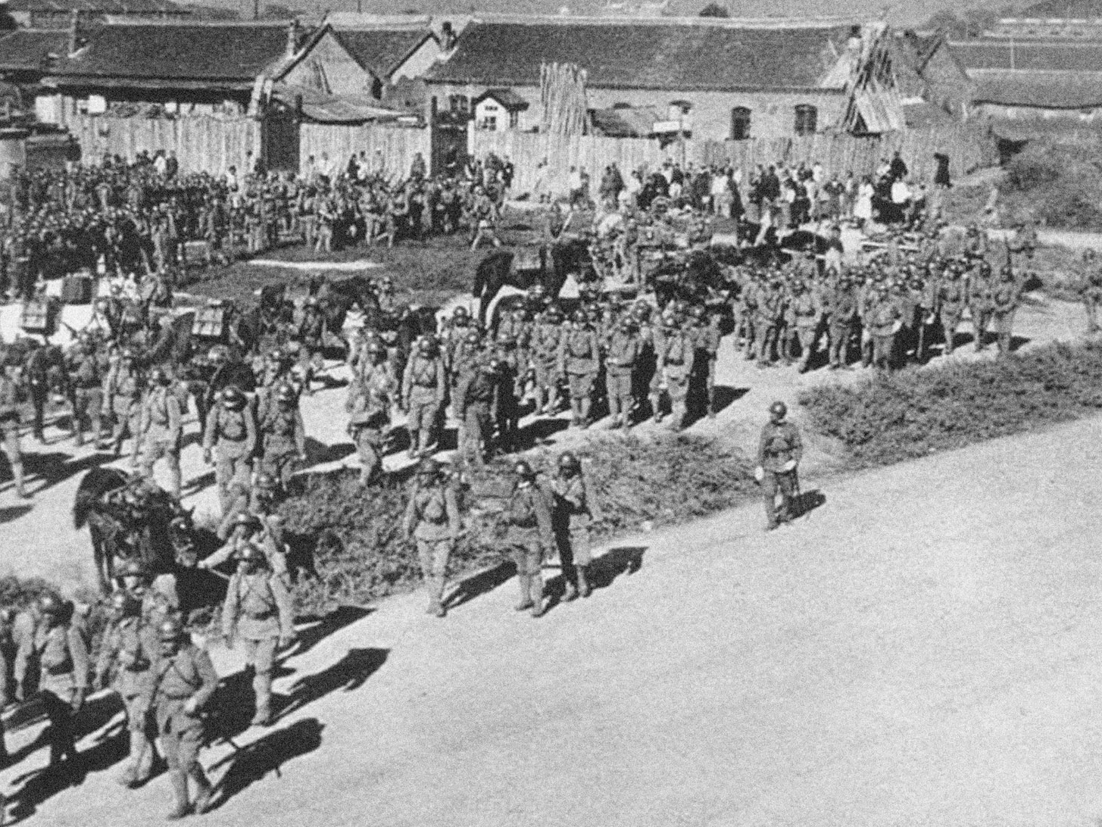
Mukden Incident
Sep 18, 1931
During the late 1920s and early 1930s, China was destabilized by the Northern Expedition and its civil war between Communist and Nationalist parties.
Taking advantage of this, the Japanese military secretly caused an explosion on the South Manchurian Railway. The railway was under the control of Japan at the time. China was blamed for the event, which was called an act of sabotage. It was used as justification for the following Japanese occupation of Manchuria.

Slide 9
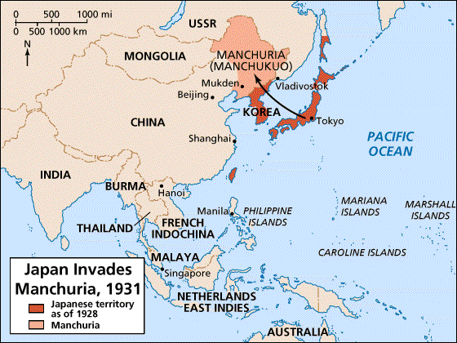
Japanese Invasion of Manchuria
Sep 18, 1931 – Feb 26, 1932
The invasion of Manchuria allowed the Japanese military to seize a strategic foothold between the USSR, Korea, and China's major cities. Occupying Manchuria provided Japan with a source of raw mineral materials for various industries.
The League of Nations condemned the occupation, and Japan withdrew from the League in 1933. The invasion contributed to the international isolation of Japan and is seen as a crucial event on the path to the outbreak of World War II.

Slide 10
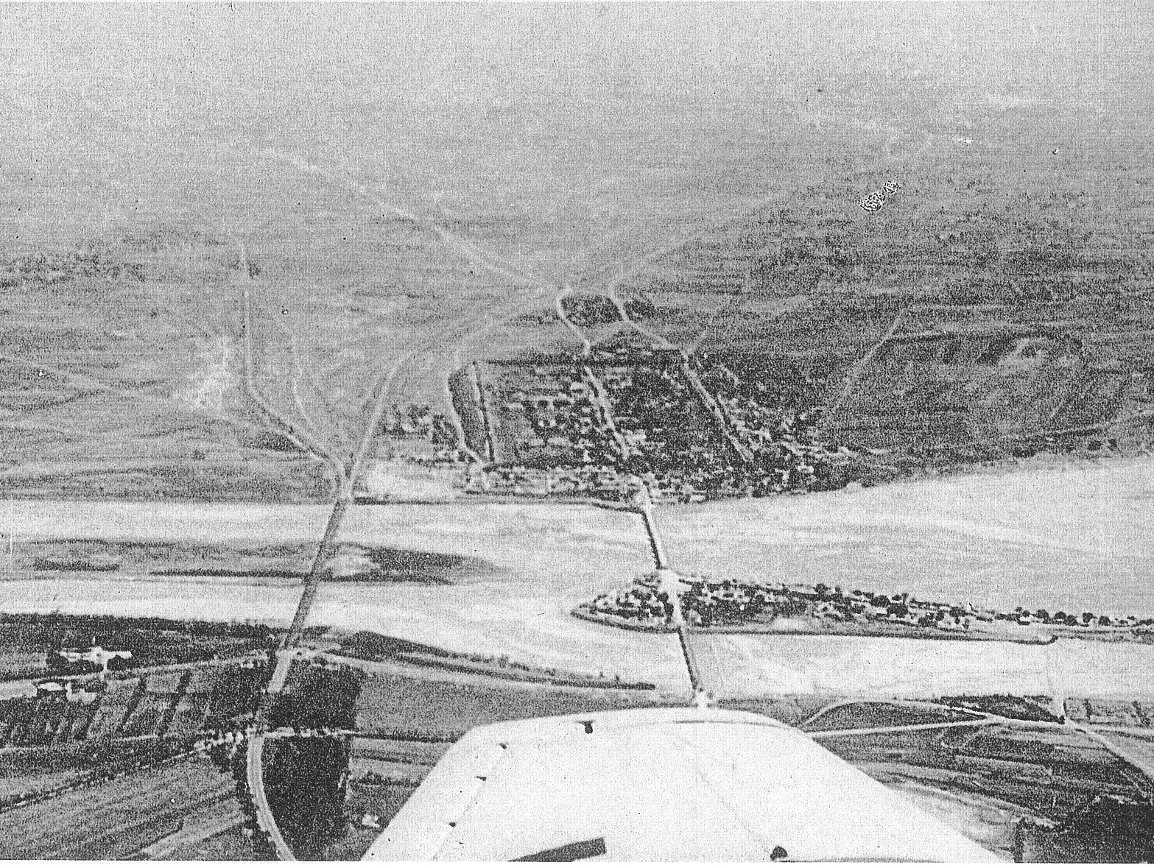
Marco Polo Bridge Incident
July 1937
On July 7, 1937, Chinese troops in Beijing were blamed for the supposed abduction of a missing Japanese soldier. Instead of waiting for a mediated investigation, Japanese troops attacked the Chinese. Further peace negotiations were unsuccessful and Japan occupied the Beijing-Tianjin area by the end of July.
The incident caused the Sino-Japanese conflict to escalate from various skirmishes to full-scale war.

Slide 11
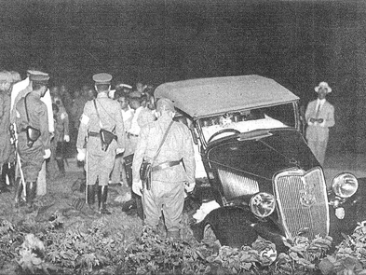
Hongqiao Airfield Incident
Aug 9, 1937
Shanghai had been controlled by Japanese forces since 1932. However, in portions of the city, there existed a Chinese military presence.
On August 9, 1937, a pair of Japanese Navy officers attempted to forcefully enter Hongqiao Airfield. The airfield was controlled by Chinese guards who tried to deny the officers entry. Both Japanese officers and several Chinese servicemen died from the resulting shootout.

Slide 12
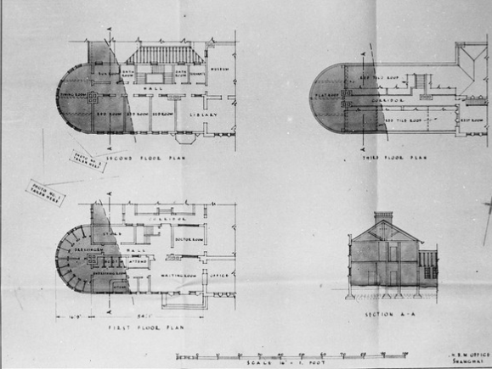
Battle in Shanghai
Aug 13, 1937 – Aug 22, 1937
Peace-keeping following the Hongqiao Airfield Incident proved ineffective and a battle broke out in Shanghai.
Both Japanese and Chinese civilians were casualties of bombs and crossfire. Faced with defeat, Chinese troops retreated to the capital of Nanjing.

Slide 13
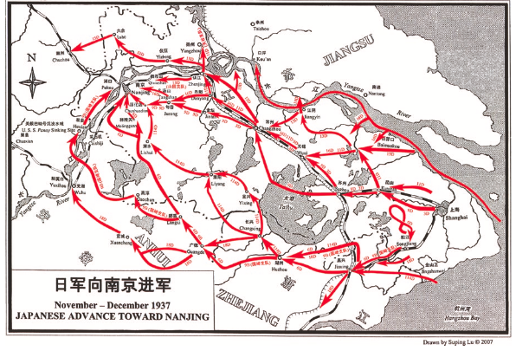
War crimes on the way to Nanjing
Aug 22, 1937 – 1938
Although the Nanjing massacre is generally described as having occurred over the six-week period following the fall of Nanjing, crimes committed by the Japanese army were not limited to that period.
On the path from Shanghai to Nanjing, villages were razed, and killings were indiscriminate of age and gender.

Slide 14
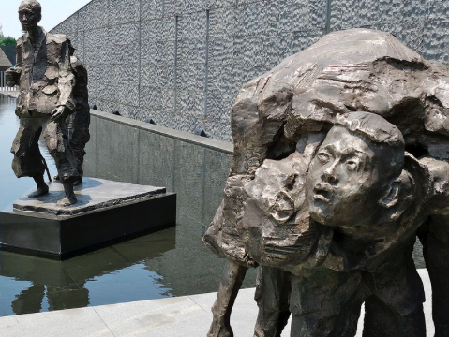
Massacre Contest
Sep 1937
A massacre contest between Toshiaki Mukai and Tsuyoshi Noda, two Japanese Army officers, took place during the Japanese invasion of China. The goal of the contest was to see who could kill 100 people the fastest while using a sword. The two officers were later executed on war crime charges for their actions. The historicity of the event has been contested by Japanese nationalists and historians who seek to invalidate the history of the Nanjing Massacre.

Slide 15
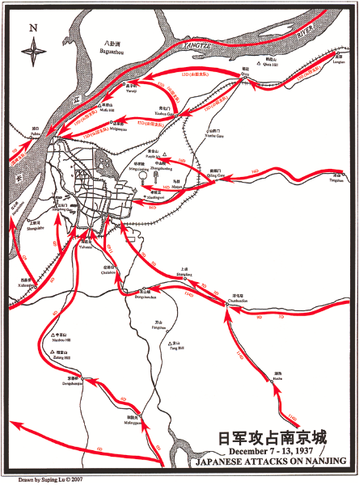
Approaching Nanjing
Nov 1937 – Dec 7, 1938
Three waves of Japanese troops maneuvered to attack Nanjing in late November 1937.
The troops were led by Nakajima Kesago, General Matsui Iwane, and Lieutenant General Yanagawa Heisuke.
On December 7th, General Matsui Iwane grew ill from tuberculosis and was replaced by Prince Asaka Yasuhiko, who operated on a policy of killing captives.
Japan's military, which was much better prepared than China's, took control of and occupied several major ports and cities before attempting to take control of Nanjing. The city quickly surrendered to the Japanese army.

Slide 16
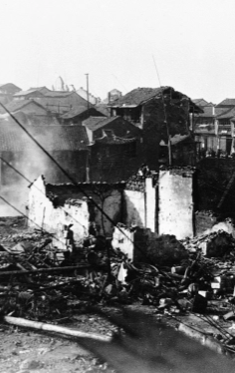
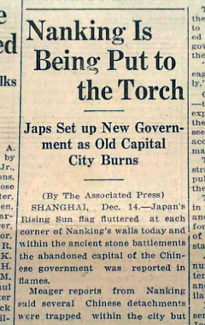
Japan in Nanjing
Dec 1937 – Jan 1938
Japan's military, which was much better prepared than China's, took control of and occupied several major ports and cities before attempting to take control of Nanjing. The city quickly surrendered to the Japanese army.

Slide 17
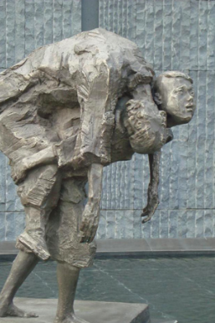
Targeted Groups
Dec 12, 1937 – Jan 1938
1. Soldiers: Soldiers were the first target. Despite outnumbering Japanese troops, Chinese soldiers were vastly under-supplied and surrendered in hopes that the Japanese would spare their lives. Chinese soldiers were dehumanized by their captors, who referred to them as animals, such as ants and sheep.
2. Civilian Men: Chinese civilians, regardless of age, were targeted. Men were feared to be Chinese soldiers in disguise.
3. Women: The women of Nanjing were raped en masse - earning the Massacre of Nanjing the nickname "The Rape of Nanking." It is estimated that between 200,000 and 800,000 women were raped; many were mutilated and killed following their rape. Others were kept as "comfort women," a euphemism for sex slavery.
4. Chinese Muslims: During the Second Sino-Japanese war, the Japanese destroyed 220 mosques and killed countless Hui people by April 1941. During the Rape of Nanking, mosques in Nanjing were found to be filled with dead bodies of Hui Muslims.

Slide 18
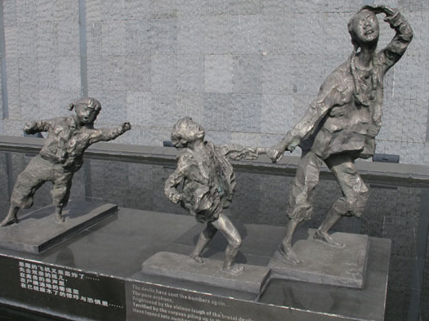
"The Rape of Nanjing"
Dec 13, 1937 – Feb 1938
After Nanjing's official capture, a six-week raid on the city began. This consisted of mass murder, rape, pillaging, and destruction of the city.
Soldiers were hunted down and killed by the thousands. Their bodies were burned or left in mass graves. Entire families, including the elderly and infants, were targeted for execution. Hundreds of thousands of women were raped. Bodies littered the streets for months after the attack. Determined to destroy the city, the Japanese looted and burned at least one-third of Nanjing’s buildings.

Slide 19
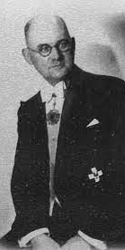
Efforts to Intervene
Dec 14, 1937 – Jan 1938
Some foreigners living in Nanjing attempted to stop the massacre.
Americans Lewis S. C. Smythe and Dr. Robert Wilson recorded the actions of Japanese troops, filed complaints with the Japanese embassy, and provided medical aid in the Nanjing Safety Zone.
German businessman and Nazi Party member John Rabe was called, “the living Buddha of Nanking.” He established the Nanjing Safety Zone, wrote to Adolf Hitler asking Germany to intercede in the conflict, and was willing to put his own life at risk to save Chinese lives.

Slide 20
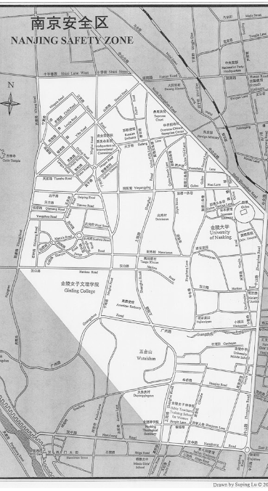
Nanjing Safety Zone
December 7, 1937 – 1938
The International Committee for the Nanking Safety Zone was comprised of a small number of Western businessmen and missionaries. The Committee attempted to set up a zone of neutrality in the city that would provide refuge for Nanking’s citizens.
Though the Japanese initially agreed to respect the Nanjing Safety Zone, ultimately, not even these refugees were safe from the vicious attacks. In January 1938, the Japanese declared that order had been restored in the city and dismantled the safety zone.

Slide 21
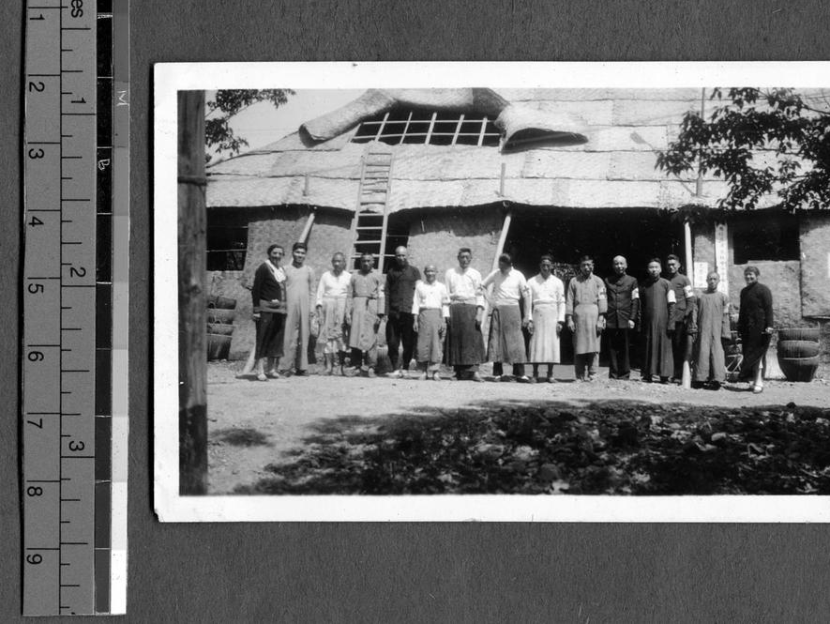
Ginling College Refugee Camp
Dec 24, 1937
Ginling College, a women's college established in Nanjing by Protestant missionaries, transformed its campus into a refugee camp. Under the supervision of Minnie Vautrin, an American educational missionary, thousands of women and children found shelter at the college, with more than 10,000 at the peak of the conflict.

Slide 22
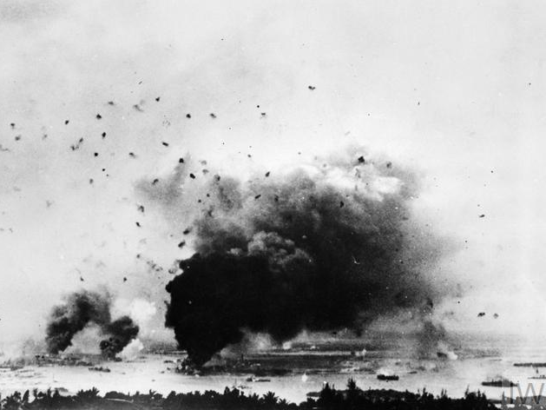
World War II
Dec 7, 1941 – Sep 2, 1945
The Second Sino-Japanese War merged with World War II when Japan attacked the United States naval base at Pearl Harbor on December 7, 1941. Japan made Nanjing their capital in China throughout the war.
The mentality of "take no prisoners" was applied to both further conquests into China and fights in Pacific Ocean regions. Bodies were either buried or burned to hide the number of the dead. Those who were taken as POWs were treated with brutality.

Slide 23
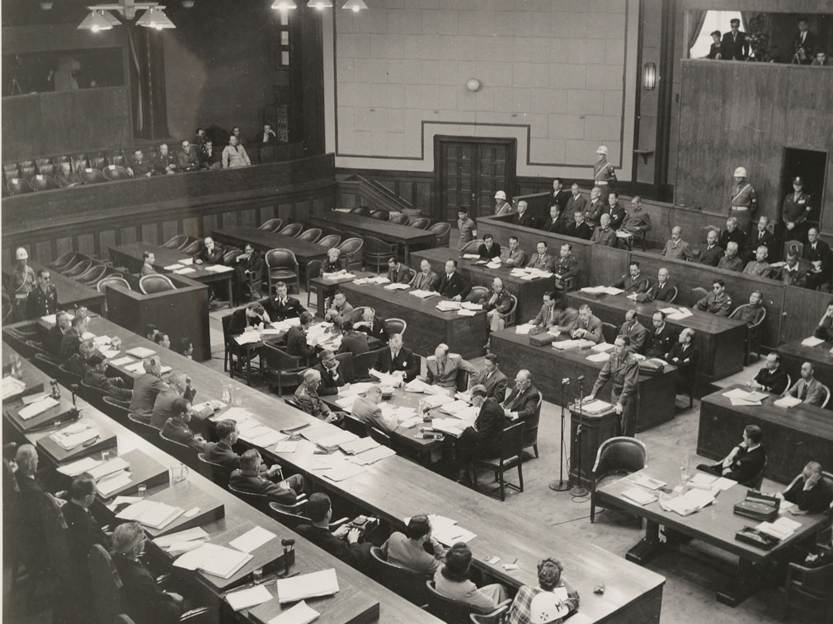
International Military Tribunals for the Far East
May 2, 1946 – Nov 4, 1948
After Japan's surrender, the Allied Powers established the International Military Tribunal for the Far East (IMTFE) to try Japanese military and political leaders for war crimes. The Tokyo War Crimes Trial, which began in May of 1946 and ended in November 1948 prosecuted 28 individuals.
Among those found guilty was Iwane Matsui, the general who oversaw the Nanjing Massacre. The IMTFE sentenced Matsui to death.
A 1945 survey of Nanjing included the opportunity for victims to file atrocity cases. Although victims did not fear Japanese retaliation, some families feared that filing cases of rape would bring indignity to their families. As such, rape case numbers appeared lower than originally reported in 1938.

Slide 24
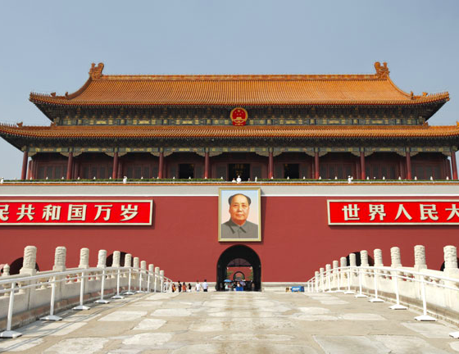
Tiananmen Square Massacre
June 3, 1989
Post-war China was transformed into a Communist state by Mao Zedong. In 1989, pro-democracy protestors gathered in Tiananmen Square and were massacred by Chinese troops.
Historian Iris Chang claims that this event encouraged activists to raise awareness not only for the massacre at Tiananmen Square but also the massacre in Nanjing.

Slide 25
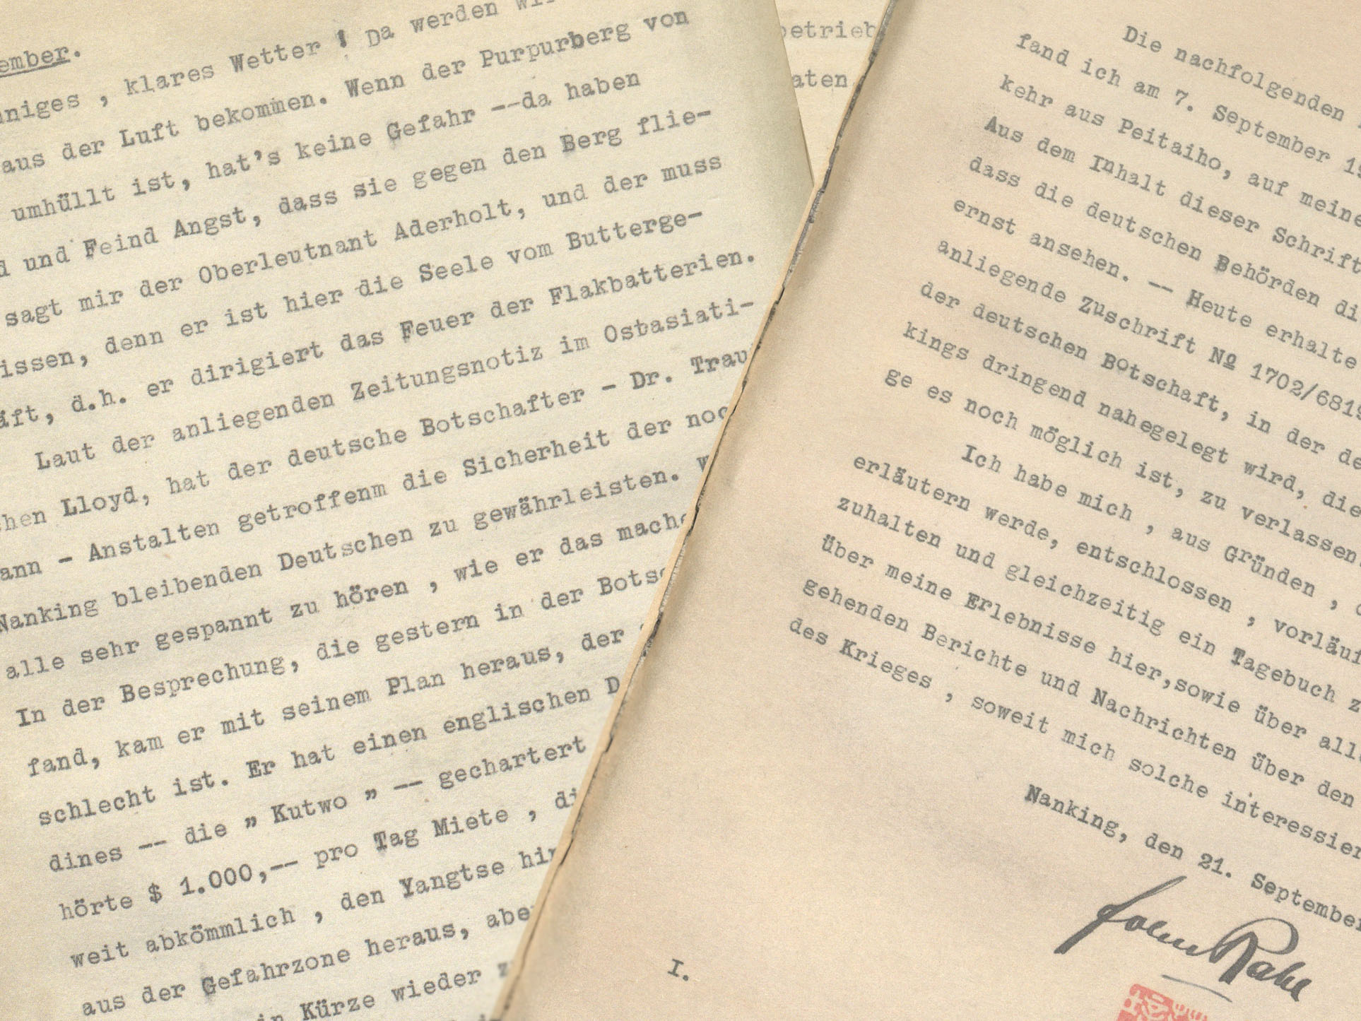
Discovery of John Rabe's Diaries
Dec 1996
Iris Chang discovered the diary of John Rabe, the German businessman and Nazi Party member who assisted in running the Nanjing Safety Zone. His diaries provided evidence for the atrocities in Nanjing, which were systematically denied by Japan.

Slide 26
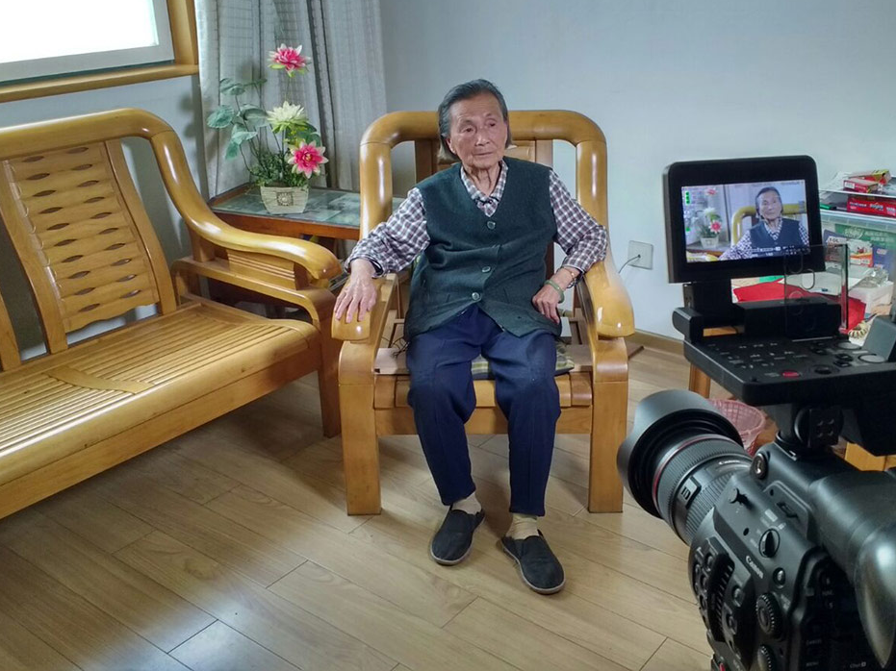
USC Shoah Foundation - Testimony Collection
From 2012-2017, the University of Southern California's Shoah Foundation worked to collect 30 testimonies from survivors of the Nanjing Massacre. These interviews are in Mandarin with English subtitles. The testimonies help combat the denial of genocide in Nanjing.

Slide 27
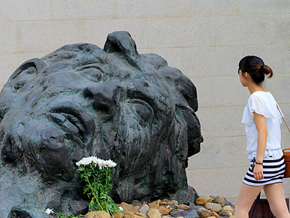
Genocide Denial
Japan has never formally recognized or apologized for the atrocities committed at Nanjing. It has consistently denied the occurrence of the massacre and human rights violations. These denials can be divided into three types: distorted facts and history revisionism, denial of the occurrence of a massacre altogether, and disputing the number of victims.

Slide 28
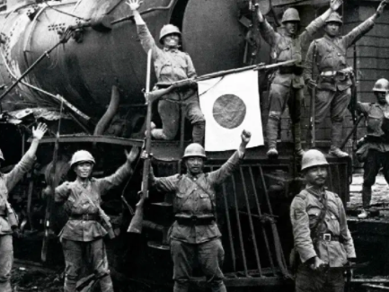
Distortion of Facts
In 1982, the Japanese Ministry of Education headed the campaign to distort and rewrite the events of World War II in history books. Certain words were replaced; Japanese “aggression” in Nanking being replaced by “advancing in and out.”

Slide 29

Outright Denial of Massacre
Perhaps the most outrageous claim was absolute denial of the atrocity. In 1990, Japanese government officials formally denied the Nanjing Massacre by stating that it was a lie. They claim that the event was fabricated by China as a tool for political manipulation.

Slide 30
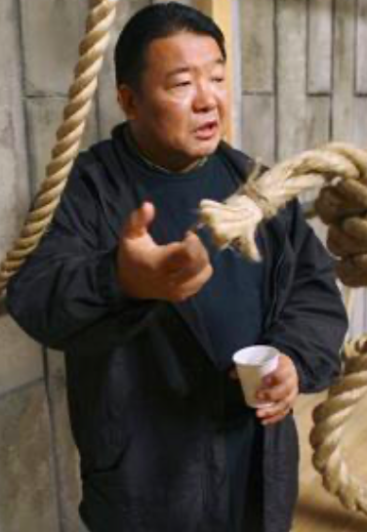
Satoru Mizushima's "The Truth About Nanjing"
Nov 2007
Representative of movements to deny Nanjing was the film "The Truth About Nanjing".
To combat Chinese documentaries produced for the 70th anniversary of the Nanjing Massacre, Japanese filmmaker Satoru Mizushima directed a movie denying the event. It was reported that at a screening, Mizushima stated, "There is one indisputable fact: there was no massacre at Nanjing. We don't want our children to grow up thinking Japan is a barbarian country."

Slide 31
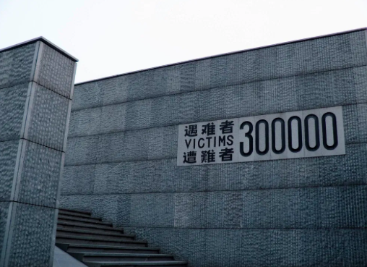
Disputing Number of Victims
Recently the denials of the Nanjing massacre have centered on the question of numbers. In the beginning, the war glorifiers had labeled the massacre as an “illusion” or a fiction, but this view was completely bankrupted by advances in scholarly research. Denialists now contest the number of victims, arguing that because the numbers are small, it was not a massacre. This debate limits the time frame and geographic extent of the events in order to calculate as small a number of victims as possible.

Slide 32
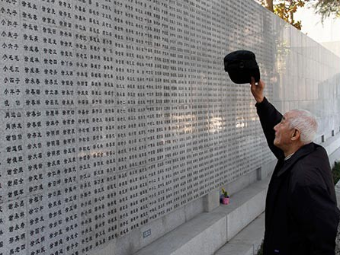
Conclusion
There are no official numbers for the death toll in the Nanjing Massacre, though estimates range from 200,000 to 300,000 people. Soon after the end of the war, Matsui and his lieutenant Tani Hisao were tried and convicted for war crimes by the International Military Tribunal for the Far East and were executed. Anger over the events at Nanjing continues to color Sino-Japanese relations to this day. The true nature of the massacre has been disputed and exploited for propaganda purposes by historical revisionists, apologists, and Japanese nationalists. Some claim the numbers of deaths have been inflated, while others have denied that any massacre occurred.

