Slide 1
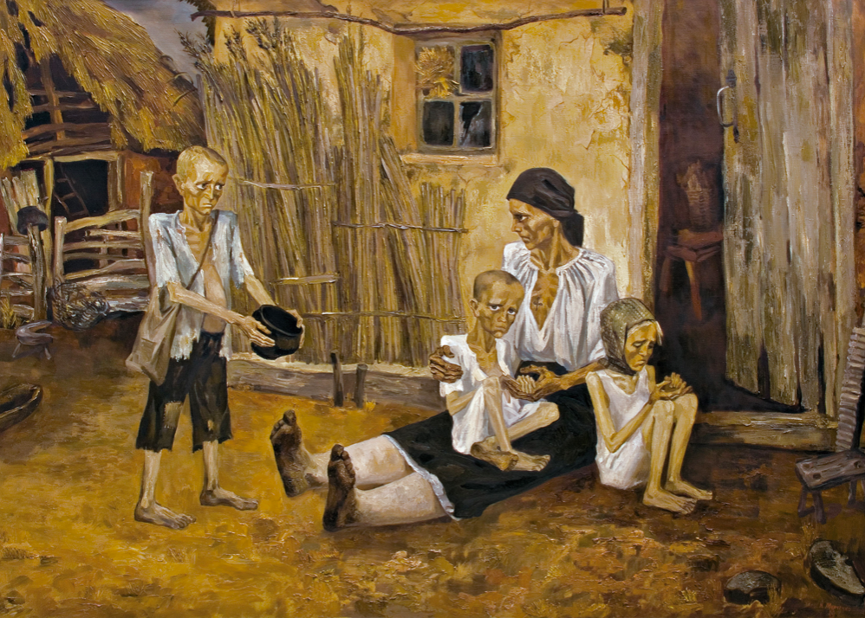
The Holodomor

Slide 2
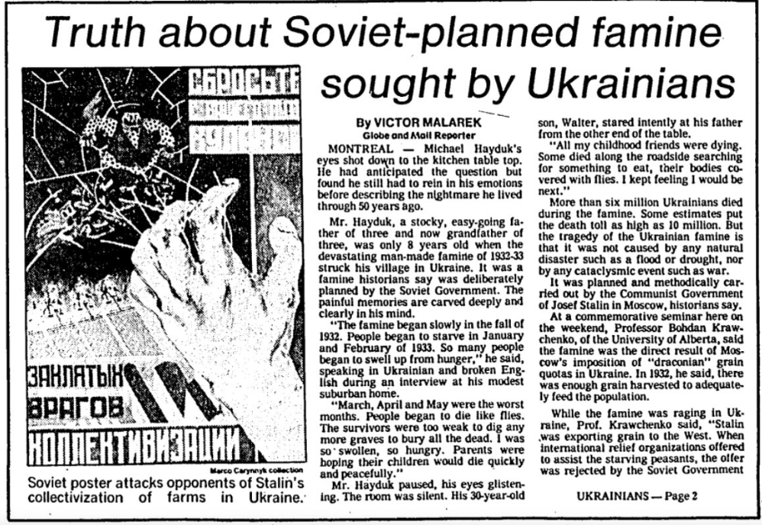
Summary
The Holodomor (loosely translated as "death by starvation") was a famine occurring in Soviet-era Ukraine during 1931-1934. Despite Russia's arguments to the contrary, the famine was man-made by Stalin and his government with the intent of eliminating Ukrainians. Ukraine was seen as a threat to Russia due to its perceived ethnic and cultural difference. Laws encouraged the worsening of the famine, the exile and execution of opposition, and the repossession of Ukrainian land to give to Russian farmers.
The Holodomor is only recognized as a genocide by 17 countries. The global recognition of the event remains the mission of survivors and activists.

Slide 3
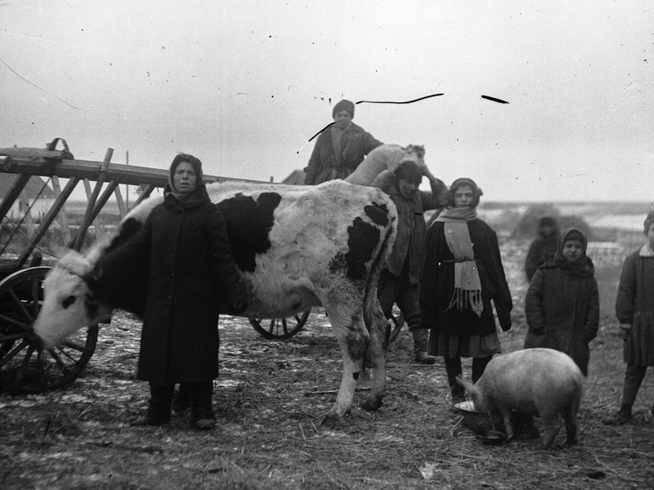
Key Findings
The story of the Holodomor starts with Ukraine's attempt to declare itself independent from Russia in 1918. Communist leaders fought to keep Ukraine's valuable farming land within the USSR. The nation was punished for its push for independence.
Laws targeted academics, the church, and independent farmers before targeting the rest of Ukraine.
Soviet leadership was well aware of the extent of death that occurred as a result of the 1931-1934 famine. Stalin and other top Communist officials made efforts to conceal the sharp decline in population, including repealing the 1937 USSR census.
The Holodomor is recognized as an atrocity symbolic of Stalin's cruelty but remains formally un-recognized as a genocide.

Slide 4
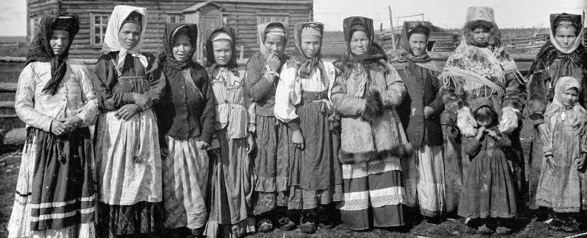
Country Profile: Russia
Pre-World War I, Russia had attempted to make itself a dominant global power with expansion into the Crimea, Ukraine, Belarus, Georgia, the Caucuses, and the Balkans. At the time of World War I, it was a constitutional monarchy state led by Tsar Nicholas II of the Romanov Dynasty and a parliament called the Duma.
Since the early 1800s, Western, liberal ideologies had grown throughout the nation. These ideologies prompted an end to serfdom, but peasant labor continued on large estates. By World War I, Russia's peasant and working industrial classes had begun to campaign for broader improvements to their positions in Russian society.

Slide 5
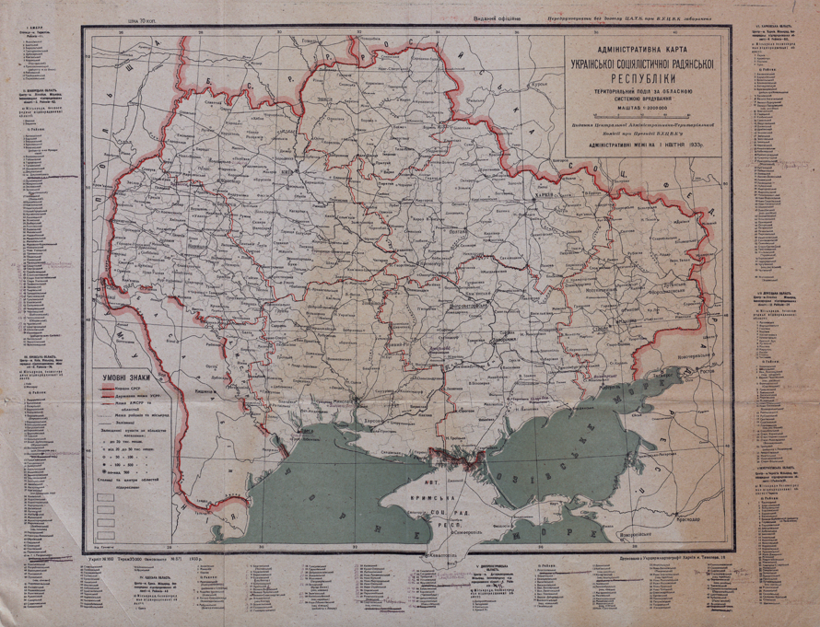
Country Profile: Ukraine
Between 1200-1800, the territory of Ukraine changed hands between wider structures of empire. By the late 1700s, it was formally absorbed as part of the wider Russian Empire. Despite its lack of independence, Ukraine maintained a strong cultural heritage separate from that of its occupiers. This perceived difference set it apart from Russia and its other territories. During the Russian civil war in 1918, Ukraine attempted to declare independence.

Slide 6
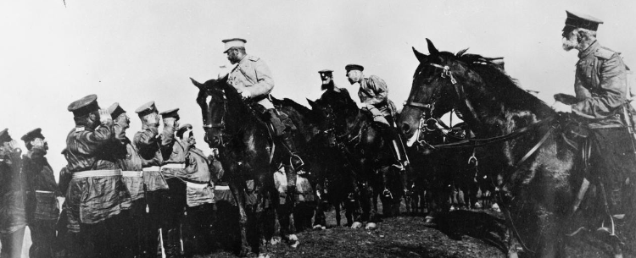
Russia enters WWI
On July 25th, 1914, Russia entered World War I following Austria-Hungary's declaration of war against Russia's ally Serbia. The war was an opportunity for Russian peasants and elites to unify. Instead, the country's internal struggles grew greater.
Russia was governed by the desires of a wealthy elite, despite the fact that peasants constituted the majority of its 150 million citizens.
Russia had little success on the battlefield. Loss of life, food, and security began to anger the working class.

Slide 7
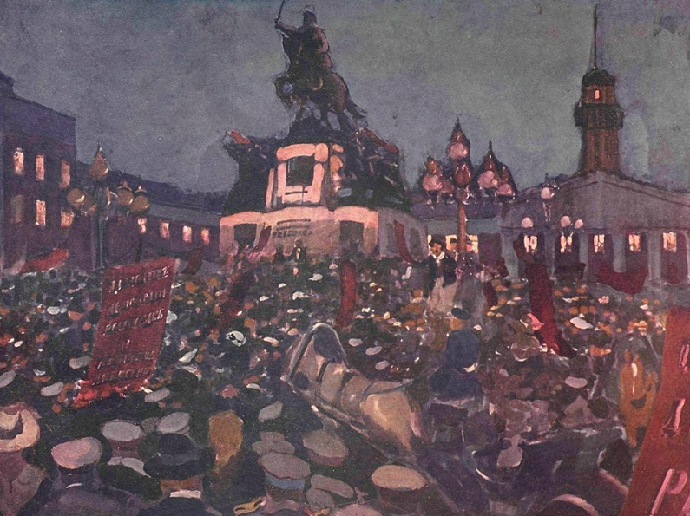
The February Revolution
In an effort to voice their struggles to Tsar Nicholas II, both the military and working-class held various strikes during the period of 1915-1917. On February 22, 1917, metal workers in Petrograd (St. Petersburg) went on strike. Their demands included the abdication of the Tsar and Russia’s withdrawal from World War I.

Slide 8
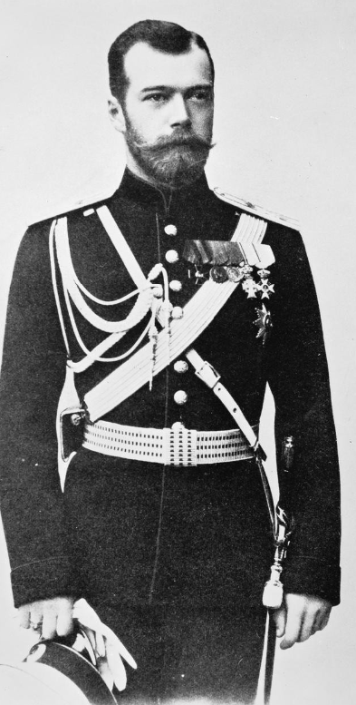
The Abdication of Tsar Nicholas II
Following the February Revolution, Tsar Nicholas II abdicated for both himself and his only son. The title of Tsar went to Nicholas' brother, but he did not accept it, and thus Russia's monarchy came to an end.

Slide 9
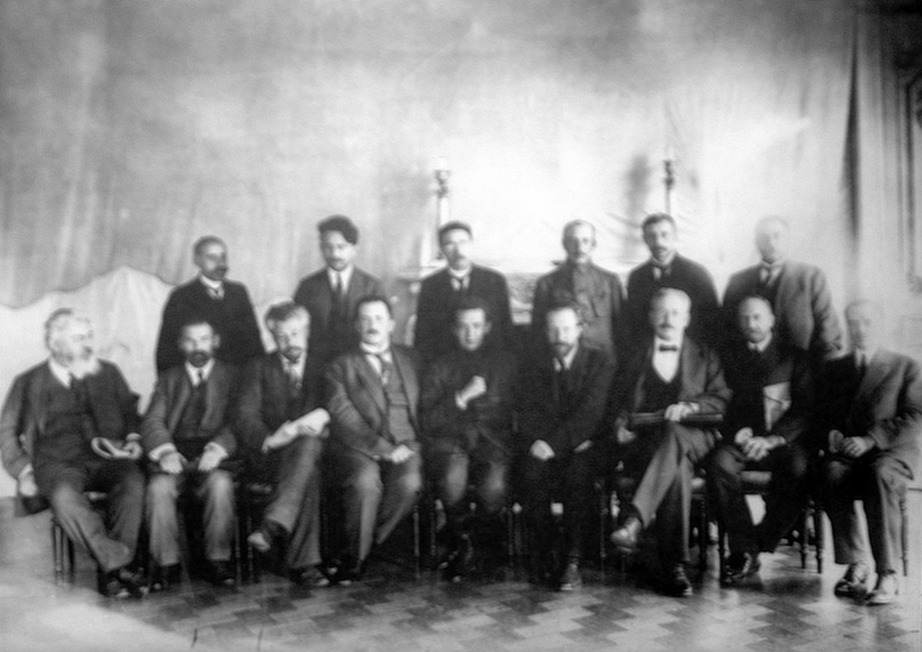
The Provisional Government
In the aftermath of Nicholas' abdication, a temporary Dual-Government was formed. The two political ideologies represented were that of the Russian Provisional Government (Kadets) and the Petrograd Soviets (Bolsheviks).
The Kadets garnered ill will from the working classes for not withdrawing Russia from World War I.

Slide 10
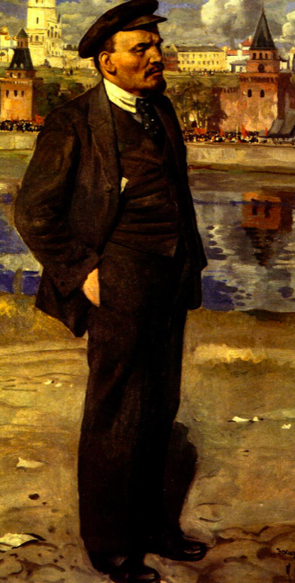
Vladimir Lenin
Vladimir Lenin [1870-1924] was the established leader of the Bolshevik Party and eventually the first leader of the Soviet Union. Lenin was born into the Intelligentsia - a class of academics and artists. During his time in university, he was radicalized and became a self-proclaimed Marxist. He was exiled to Siberia for attempting to spread Marxism.
After leaving Siberia, Lenin lived as an exile in Germany and Switzerland and formed the Bolshevik Party. His writings promoted a revolution and the downfall of Imperial Russia. In April 1917, Lenin returned to Russia and furthered the revolution that had begun in February.

Slide 11
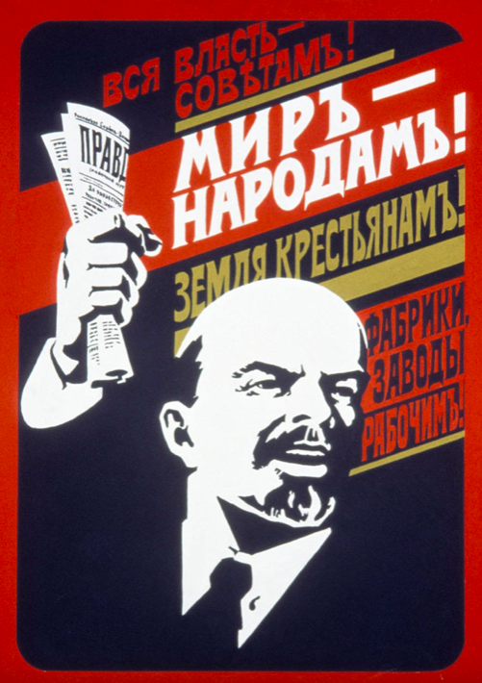
Lenin's April Theses
Lenin's “April Theses” became part of the backbone of Communist literature. The theses were characterized by language that denounced the Provisional Government and called for a stronger Soviet presence. Lenin believed in the concept of “Revolution from Below,” celebrating the claim that capitalist enterprises were to blame for Russia’s plight. Factory workers and peasants found inspiration in Lenin’s appeals.

Slide 12
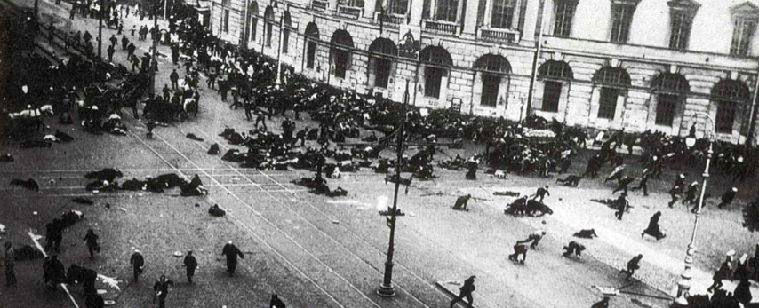
The July Days
The Prime Minister of the dual-government, Alexander Kerensky, denounced the return of Lenin and began to freeze the Bolshevik party out of the government.
Lenin tried to start a revolt against the Provisional Government in July 1917. 4 days of sporadic protest and unrest took place in Petrograd. However, the threat of military interference caused protestors to dissipate, and the "July Days" were a failure. The failed uprising caused Lenin and other Bolshevik party leaders to flee Petrograd.

Slide 13
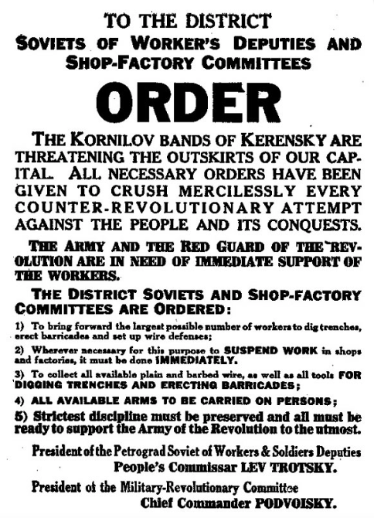
The Kornilov Affair
The scattering of the Bolshevik Party found Russian citizens even more discontent with the Provisional Government's lack of fulfillment of their basic needs. Following his election to the role of Supreme Commander of the military, General Lavr Kornilov sought to further eliminate Bolshevik resistance as well as Kadet moderates.
Kornilov ordered a military march on Petrograd. It was met with Bolshevik aligned-military resistance and blue-collar support who halted train lines carrying Provisional Government troops.
The Bolshevik's victory revitalized party support and dismissed the failures of the July Days.

Slide 14
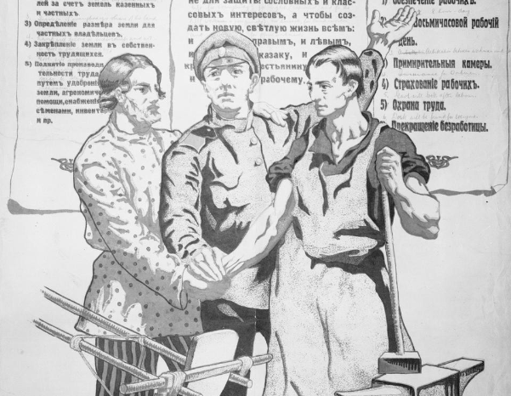
The October Revolution
The October Revolution was a two-day Bolshevik takeover of the Russian government. Overnight, Bolshevik troops gained control of sites throughout Petrograd, including the railway and post office. They stormed the Winter Palace where the Provisional Government was housed, and arrested government leaders, establishing the Communist party as wholly in charge of Russia.

Slide 15
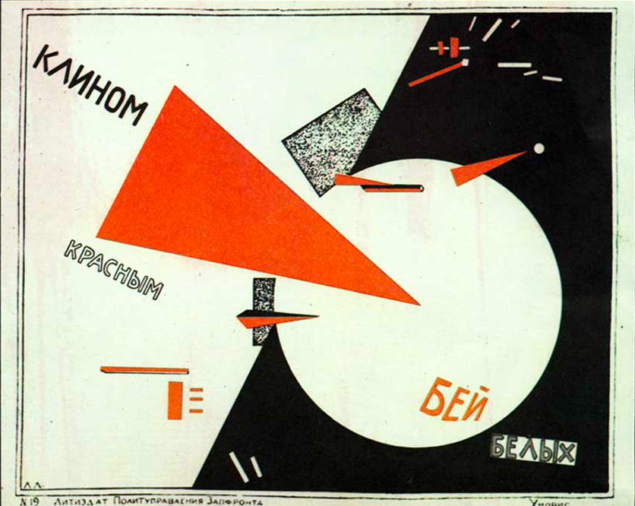
The Civil War
The failure of Bolshevik leaders to create a treaty favorable to Russia as it ended its role in World War I exacerbated the populations who did not support the Communist movement. The resulting civil war was fought by three sides: the Reds (Bolsheviks), the Whites (a mixture of Royalist and Kadet supporters), and the Greens (Nationalist fighters).

Slide 16
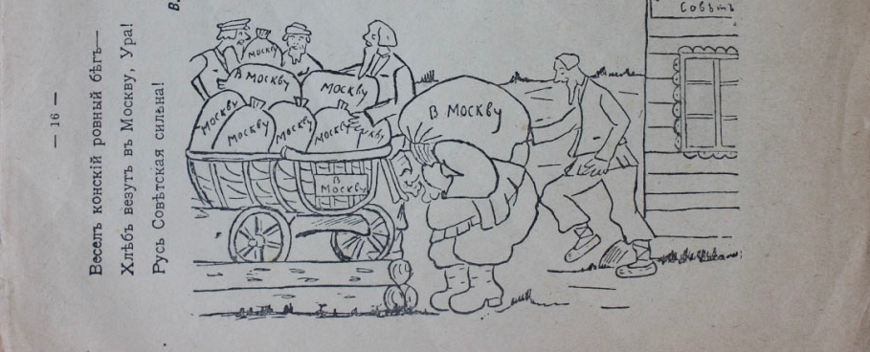
War Communism
During the Civil War, Lenin adopted a stance of full Communism in relation to agriculture and manufactured goods, maintaining his promise for a Socialist economy though perhaps not for a country without war. He nationalized industry - bringing banks, factories, transportation, and distribution of goods under government control. Full Nationalist control was an integral part of Marx’s plan for a Communist nation.
A key part of War Communism was the development of “Prodrazvyorstka,” or grain requisitioning. Russia’s peasants needed to grow and give up their grain, potatoes, and meat. Although the centralization of industries was supposed to grow the power of the Soviets, it only served to heighten dissent.

Slide 17
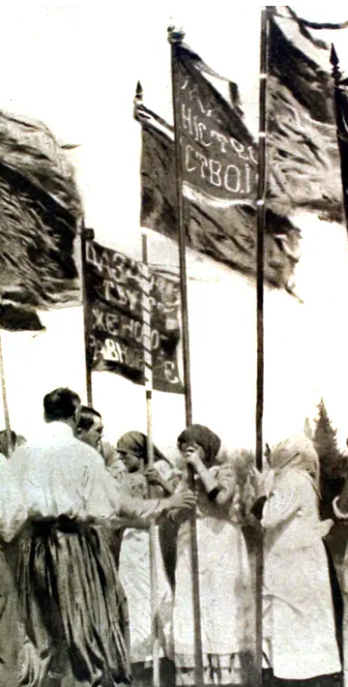
Ukraine Declares Independence
Ukraine announced its independence from Russia in 1918. Bolshevik troops were sent to prevent the nation's freedom. The troops pillaged and murdered in order to weaken the nation and its resolve to be separate.
By 1922, Ukraine was part of the Soviet Union. The nation continued to receive harsh punishments in order to prevent further defiance.

Slide 18
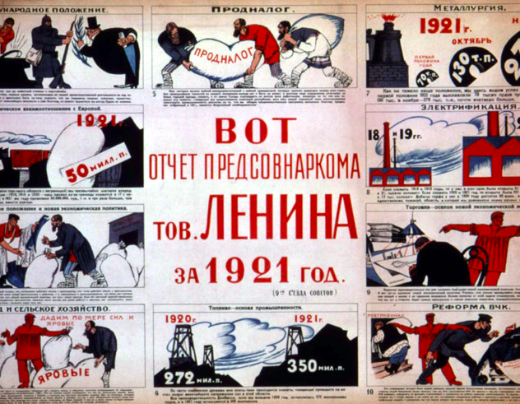
Lenin's "New Economic Policy"
As the Civil War came to a close, Lenin proposed a new set of policies to stabilize Russia’s economy. In March 1921, as a result of the 10th Party Congress, Lenin stopped taking food through outright force and instead instituted taxes, allowing peasants to sell or keep their surplus and once again giving some value to the ruble.
Stalin was one of the opponents to the New Economic Policy, viewing it as un-Marxist. Stalin's policies would reflect those used by Lenin during the Civil War.

Slide 19
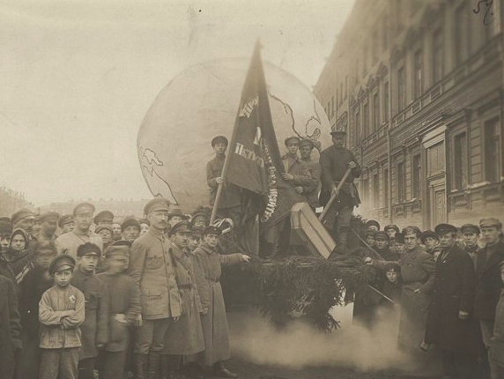
The Formation of the Soviet Union
In December 1922, the "Treaty on the Creation of the Union of Soviet Socialist Republics" was formally signed. The federations represented in the treaty were Russia, Ukraine, Belarus, and the Caucasus.

Slide 20
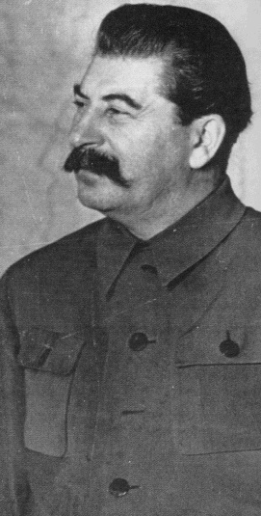
Josef Stalin
Josef Stalin served as General Secretary of the Soviet Union from 1922 until Lenin's death in 1924. Stalin consolidated his power and remained the Union's dictator from 1924 until his death in 1953. He was known for his harsh economic policies, labor camps, and reign of terror.
The intensity of the government that was to come under Stalin can be found in this simple statement from his work "Three Years of Proletarian Dictatorship": “As to our policy towards internal enemies, it remains, and must remain, what it was in all the three periods, that is, a policy of crushing all the enemies of the proletariat. This policy cannot of course be called a policy of "universal freedom"—in the era of the dictatorship of the proletariat there can be no universal freedom.”

Slide 21
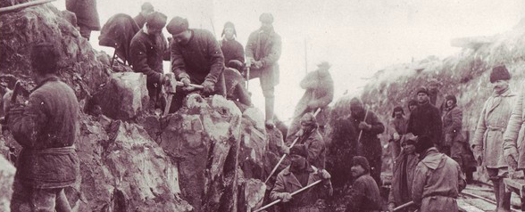
The Cruelty of Stalin
Stalin's dictatorship was full of human rights atrocities. His attempts to be rid of all "internal enemies" led to the establishment of his secret police, the NKVD, extreme farming quotas, and labor camps with harsh conditions. His purges of the Intelligentsia and perceived opposition within the upper echelons of the Communist party have served as a framework for understanding the cruelty under which his government operated.

Slide 22
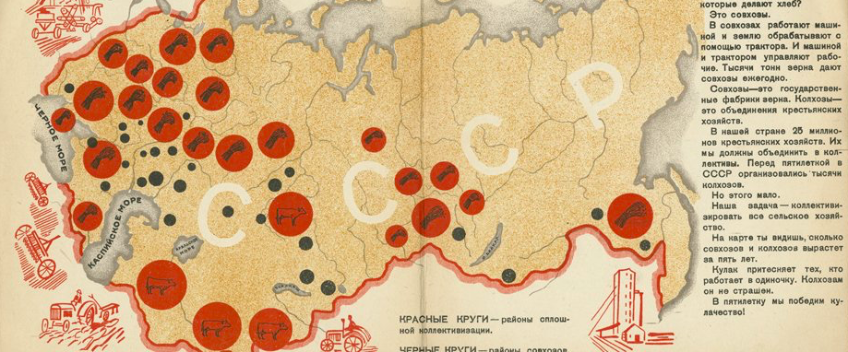
The First "Five Year Plan"
Stalin returned the USSR to the strict Communism executed by Lenin during the Civil War. The first of Stalin's Five-Year Plans covered the years 1928-1932. Extreme goals for industry and expansion were set. These included almost doubling the amount of money created by industry and lowering all costs of production of goods.
The first Five Year Plan relied on the idea of "collectivization" - getting rid of the majority of privately owned farms and factories and creating mass state farms and factories on which Russian peasants would work. Supposedly, collectivized farms were more efficient and made it easier for the government to collect food and distribute it equally - although equality in this distribution was rarely present.

Slide 23
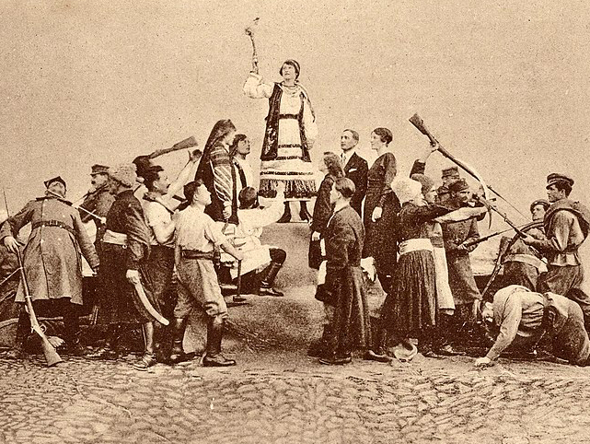
The Creation of an Other
In his essay, 'Soviet Genocide in the Ukraine,' Raphael Lemkin explained the reasoning for the Holodomor. Lemkin writes, "For the Ukrainian is not and has never been, a Russian. His culture, his temperament, his language, his religion — all are different." Ukraine's distinctiveness as a nation threatened the homogeneity required for Communism to work.
In order to protect the Soviet "Union," Lenin and Stalin had to rid Russian territories of both political and cultural "others." It is this reasoning that allows the events of the Holodomor to be understood as not just a famine but as a genocide.

Slide 24
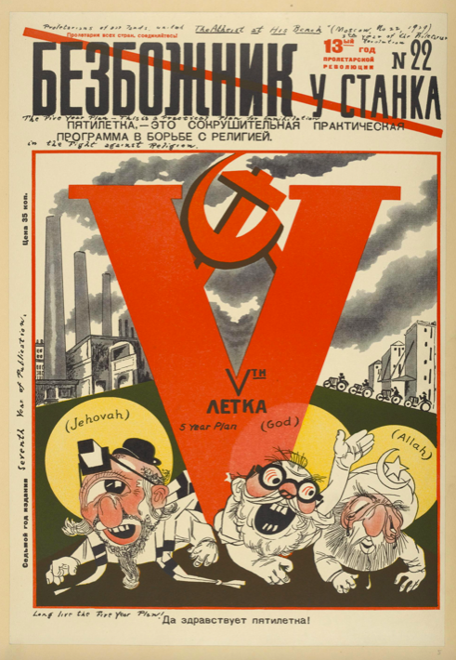
Liquidation of the Ukrainian Orthodox Church
In order to increase productivity as required for the Five-Year Plan, the policy of "Nepreryvka" was introduced. This eliminated Sundays and religious holidays.
Not only was the Russian Orthodox Church brought under the control of Communism, but the Russian Orthodox Church was introduced in Ukraine in order to supplant the Ukrainian Autocephalous Orthodox Church. Members of the Ukrainian clergy and their families were either exiled to Siberia or murdered.

Slide 25
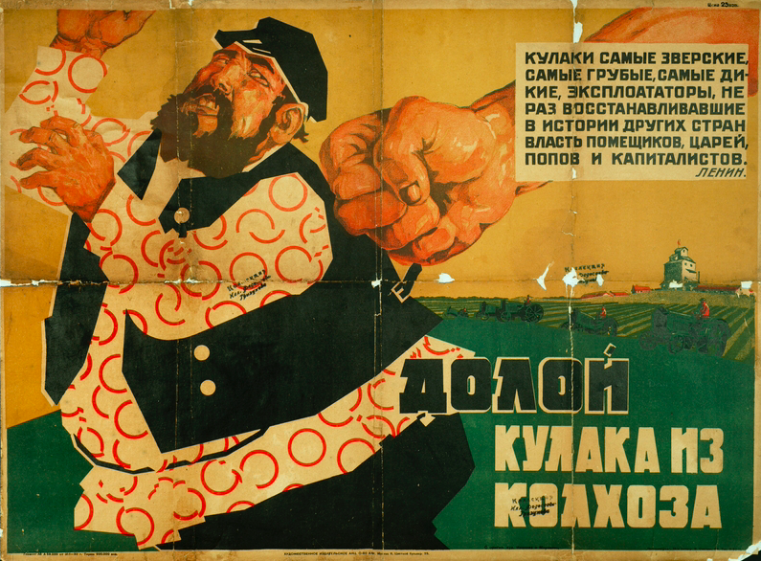
"Dekulakization"
The Five-Year Plans and Collectivization relied on "Dekulakization." The Kulaks were a middle-class group of private farmers. The Kulaks and their independent livelihoods were seen as opposition to the establishment of full Communism. En masse, the Kulaks were "eliminated" by arrest, exile, or execution. Families deemed "kulak" were turned on by neighbors and made social outcasts in society.
A majority of Ukrainian farmers were deemed to be Kulaks and were punished before the famine began in the USSR. A low estimate of 200,000 Ukrainian farmers were displaced as a result of "Dekulakization."

Slide 26
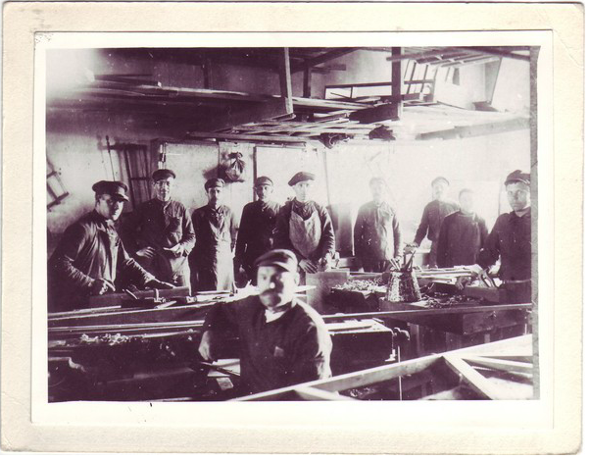
Persecution of the Intelligentsia
The academic classes of the USSR had been targeted since Lenin's rise to power. The Intelligentsia were deported, taken to labor camps, or exterminated. The group represented a threat to the "equality" of Communism, and their presence meant that anti-Communist ideologies had the potential to thrive.

Slide 27
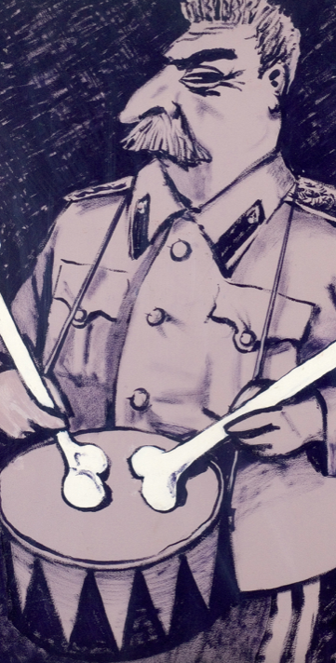
Dizzy with Success
On March 2, 1930, Stalin published an essay in the Soviet newspaper "Pravda" entitled "Dizzy with Success." In it, he made claims that Collectivization had been "overfulfilled" two years into the Five Year Plan. He concluded that the success was due to "voluntary" collective farming. He announced that the nation had embraced Socialism and that the nation's transformation into a fully Soviet State had nearly been achieved. However, he warned that ideologies existed to undermine the Party and that the Soviets would have to stamp them out.
Despite the overfulfillment of the Five Year Plan's grain policies, by the end of 1930, famine began to plague the entirity of the Soviet Union.

Slide 28
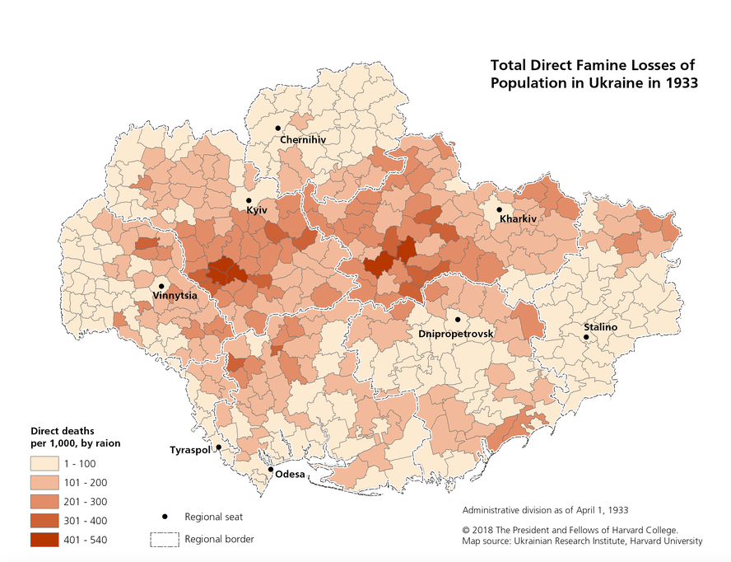
Death by Hunger
Famine from collectivization and "Dekulakization" occurred throughout the USSR. However, only Ukraine experienced a sharp change in population. Starvation in Ukraine was systematic. All food sources - not just grain - were seized or destroyed. Farm tools were also confiscated.

Slide 29
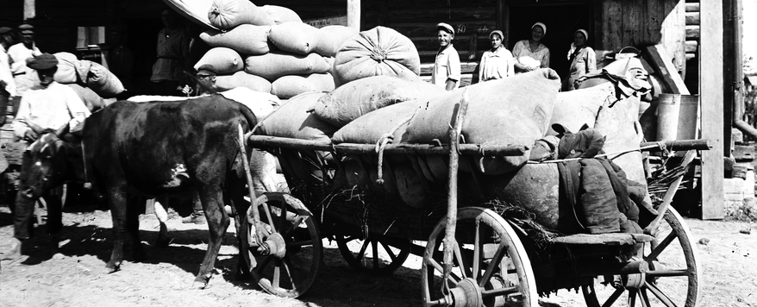
The Law of Five Stalks of Grain
"The Law of Five Spikelets" or "Five Stalks of Grain" helped to legalize the starving that occurred in Ukraine. "The Law of Five Spikelets" gave the government ownership of all grain seized from collective farms. Punishment for stealing just "five stalks of grain" ranged from fines to internment in a labor camp to death.

Slide 30
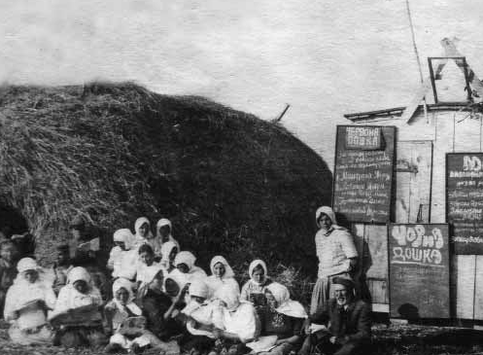
The Blacklist
Families were blacklisted for hiding food or for failing to meet the grain quotas. Villagers learned to not associate with blacklisted farmers for fear that they would also be punished. Some participated in the dispossession of those who were blacklisted and were rewarded for turning on their neighbors.

Slide 31
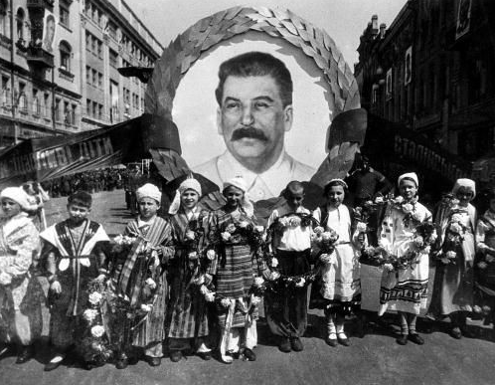
Miseducation
Schoolroom education included Soviet propaganda. Stalin's portrait was given to good students as a reward. Homes were expected to have a "Stalin's corner" for these portraits and other Stalin memorabilia. Children were also taught that their famine was the result of poor harvest and that the real famine was happening elsewhere in the USSR.

Slide 32
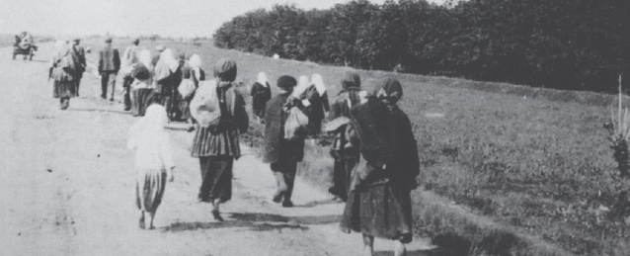
The Closure of Ukraine's Borders
In December 1932, the government introduced passports to deter in-country movement. Less than a month later, Ukraine's borders were sealed to prevent refugees from fleeing the country. Those who crossed the border to look for food were often shot during their attempt to cross back home.

Slide 33
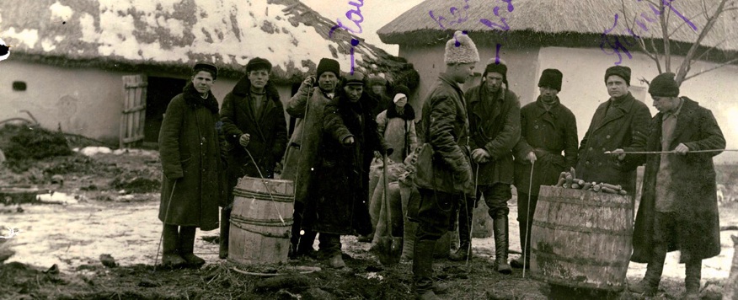
The Soviet Union Replaces Ukraine's Head of Government
In January 1933, the Ukrainian Communist Party began to be punished and purged for the country's "failure" to meet quotas. Pavel Postyshev, a member of Stalin's inner circle, replaced the head of the Party.

Slide 34
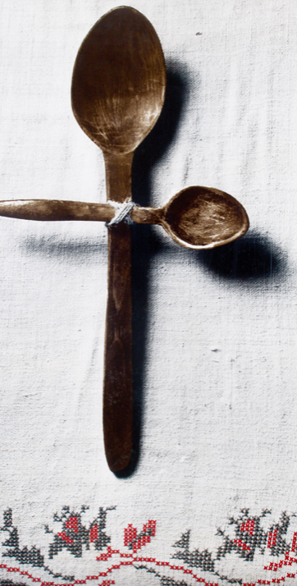
Methods of Resistance
The Ukrainian people attempted to resist the methods of terror being used against them. Statues of Lenin and Stalin were regularly defaced. Food scraps were saved and shared between neighbors. Children made fun of the Communist youth activists deployed in their towns.

Slide 35
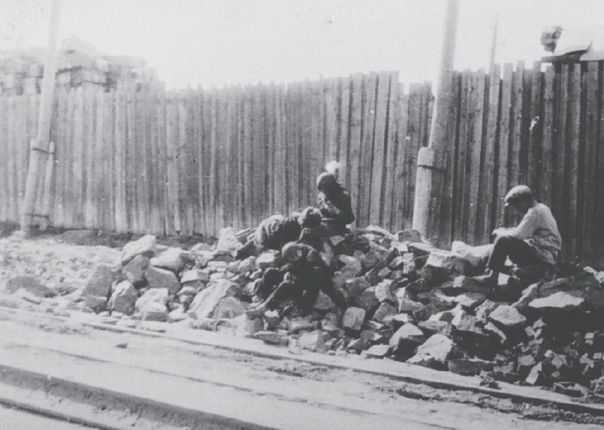
Abandonment of Children
During the famine, children were abandoned in the belief that they would be more likely to survive on their own. At least 18,000 children were abandoned in the town of Kharkiv. Some families took in and fed abandoned children, but many were left on the streets or brought to orphanages.

Slide 36
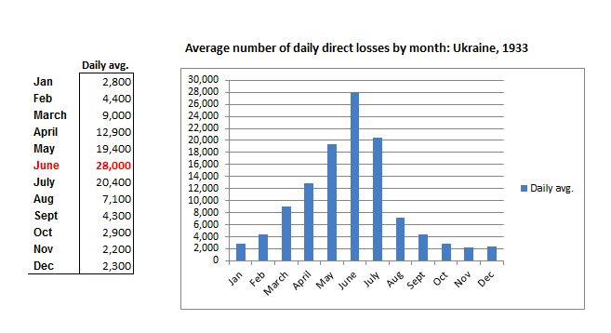
Height of Starvation
As Moscow denied the presence of a famine in Ukraine, close to 28,000 people died of starvation per day. Bodies collected in the streets and were carted away to be interred in shallow mass graves.
Stores of grain were consistently shipped out of Ukraine to Russia. Some food was left rotting in silos near the train stations. Cannibalism was reported by multiple survivors as food continued to remain scarce.

Slide 37
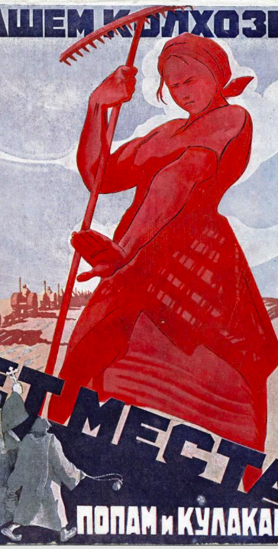
Resettlement of Russian Farmers
Russian and Belorussian farmers were resettled by the All-Union Resettlement Committee into now empty villages to work on collective farms. Between 15,000 to 20,000 families were planned to be transplanted to Ukraine by 1934. In December 1933, the All-Union Resettlement Committee claimed that the task had been successful by 104%.

Slide 38
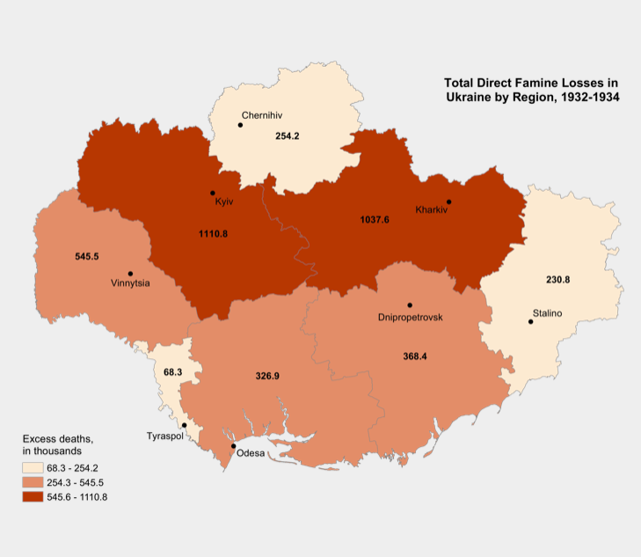
Scale of Death
Low estimates list the victims of the Holodomor at 2-4 million. Other estimates suggest 6-7 million. Regardless of the numbers, the intent for the decimation of Ukrainian life and culture is apparent.

Slide 39
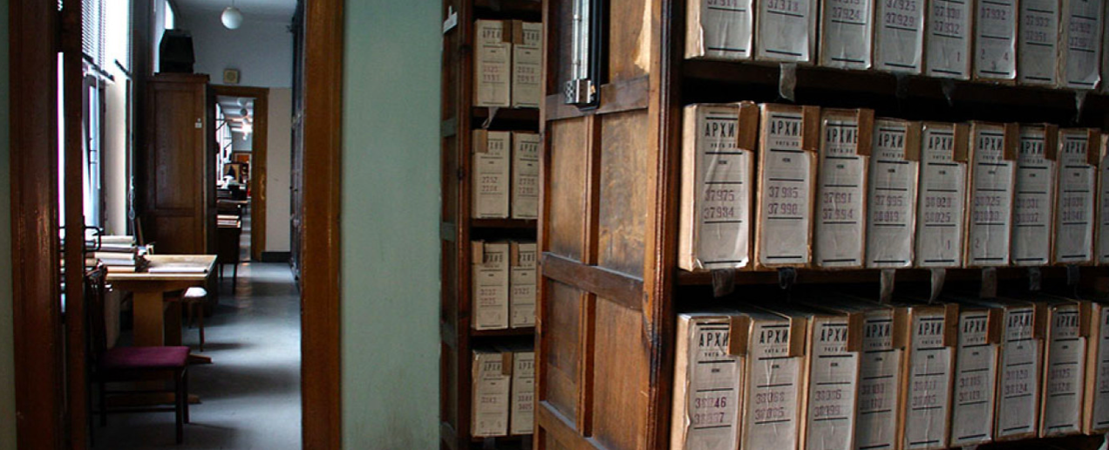
Repeal of the 1937 Census and Further Censorship
The USSR's 1937 census revealed the extent of unnatural death. Non-Ukrainian populations had grown by nearly 6 million, while the Ukrainian population was shown to decrease by nearly 5 million. Stalin ordered the 1937 census repealed and claimed that the census directors tampered with the results.
Propaganda and censorship in newspapers in the USSR and abroad deterred investigation into the famine. Foreign press in Russia were conscious of not angering the country in which they resided.

Slide 40
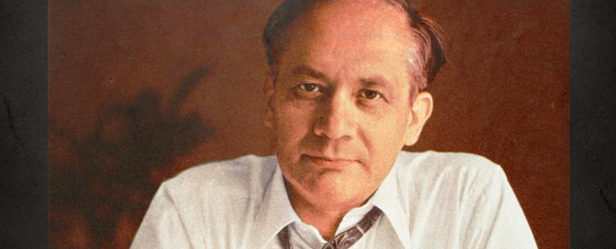
Lemkin's "Soviet Genocide in Ukraine"
Despite the USSR's attempts to hide the extent of the 1931-1933 famine, Western nations were aware that wide-scale, man-made famine had occurred.
Raphael Lemkin, who coined the word "genocide" in 1944, wrote an essay in 1953 which detailed his understanding of the Holodomor as a genocide. "Soviet Genocide in the Ukraine" and other speeches and articles emphasize Lemkin's belief that both cultural and physical genocide occurred in Ukraine at the hand of the Soviet Union. He understood the process as occurring in four steps: the destruction of the Intelligentsia, the destruction of the church, the starvation of the farmers, and the displacement of Ukrainians who dispersed in search of food throughout the USSR.

Slide 41
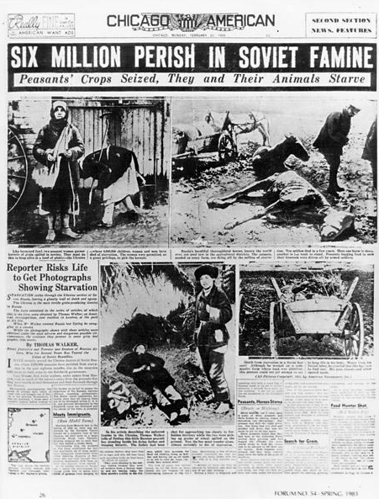
United States Commission, 1988
In 1985, the US government began an investigation into what had occurred during the Ukrainian famine and whether it could be determined genocide. In 1988, the Commission on the Ukraine Famine reported to Congress. They had determined that the famine was man-made. They noted that Stalin was aware that Ukrainians were starving and unable to meet his harsh quotas. They recognized that the American government failed to offer aid despite knowing famine was occurring.
Although they deemed the Holodomor genocide, the US commission and Congress took no further steps to formally recognize it.

Slide 42
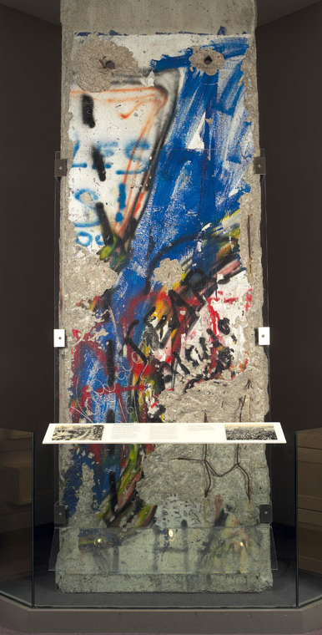
The Collapse of the Soviet Union
The Soviet Union formally dissolved during the period of February 1988 to December 1991. In the 1980s, Soviet leader Mikhail Gorbachev began to restructure the Soviet Union. He idealized the reconstruction with the term "glasnost," meaning openness and transparency. Until Gorbachev's glasnost, conversations in the USSR about the Holodomor were banned.
On December 1, 1991, Ukraine held an Independence Referendum. 92% of voters voted yes to independence. Other countries in the USSR followed suit, forming the Commonwealth of Independent States (CIS) and resulting in the official dissolution of the Soviet Union.

Slide 43
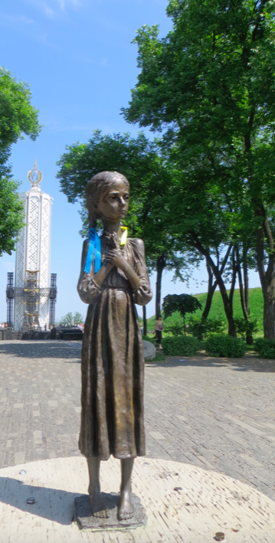
Holodomor Commemoration Efforts
In 2003, the Permanent Representative of the Ukraine and a number of other countries asked the UN to recognize the Holodomor as a genocide. It has yet to be recognized globally as such. 17 nations have independently declared it a genocide, with the US formally doing so in 2018, 30 years after the US Commission on the Ukrainian Famine report.
Several museums are dedicated to telling the story of the Holodomor. Oral history projects have documented survivors' memories, as utilized in this Timestream.
Russia refuses to define the Holodomor as anything other than a famine.

Slide 44
10 Stages of Genocide
Dr. Gregory Stanton, Founding President of Genocide Watch, uses the Ten Stages of Genocide to describe and explain the genocidal process. The stages are:
I. Classification
II. Symbolization
III. Discrimination
IV. Dehumanization
V. Organization
VI. Polarization
VII. Preparation
VIII. Persecution
IX. Extermination
X. Denial
Due to Russia's continued denial of the event as anything but a natural famine and lack of global recognition of the Holodomor as genocide, Genocide Watch recognizes the Holodomor to be in Stage 10: Denial.

Slide 45
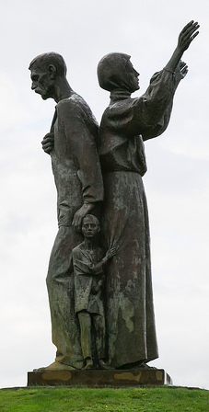
Conclusion
Seen as ethnically and culturally "other" to Russians, the Soviet regime targeted Ukraine. The eradication of the Kulaks, clergy, and Intelligentsia ahead of the 1931-1934 famine eliminated economic and academic opposition to the policies of Stalin's first "Five Year Plan." The Law of Five Spikelets and following decrees criminalized the possession of food, forcing an overworked nation to not have legal access to the fruits of their own labor. The laws legalized exile to a labor camp or execution, furthering the population loss during the famine. The repossession of farmland and the placement of Russian farmers on this land further displaced the Ukrainians who managed to survive the famine.
The cover-up and continued dismissal of the famine as simply symbolic of Stalin's propensity for cruelty diminishes the memory of the event. The recognition of the Holodomor as genocide continues to be a priority for survivors and activists. Despite Russia's denial, the evidence clearly points to the systematic starvation, deportation, and murder of Ukrainians.
The Holodomor was systematic and followed the 10 stages of genocide detailed by Dr. Stanton. The event should be globally understood as genocide.

