Slide 1
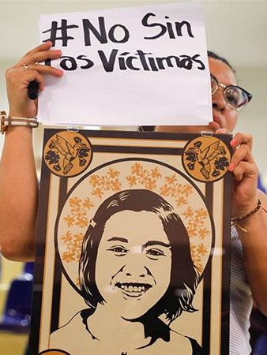
Summary
From 1979-1992, the Salvadoran military and death squads killed more than 75,000 people during the Salvadoran Civil War. Despite the recognition of state responsibility for massacres, including the infamous El Mozote Massacre, perpetrators have yet to be brought to justice.
In 2016, El Salvador's Supreme Court ruled their amnesty laws regarding war criminals to be unconstitutional. However, critics call the new proposed law an "amnesty law in disguise".

Slide 2
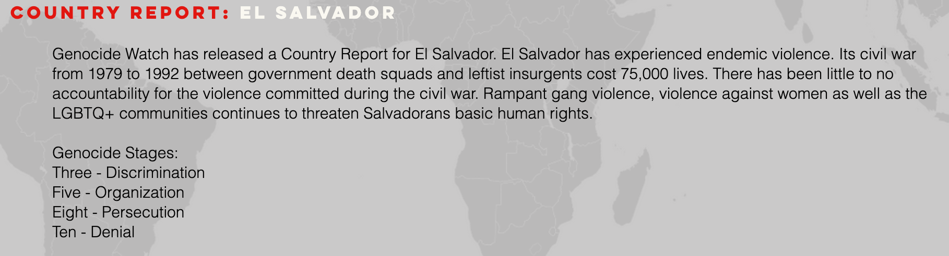
Ten Stages of Genocide
Dr. Gregory Stanton, Founding President of Genocide Watch, uses the Ten Stages of Genocide to describe and explain the genocidal process. The stages are:
1. Classification
2. Symbolization
3. Discrimination
4. Dehumanization
5. Organization
6. Polarization
7. Preparation
8. Persecution
9. Extermination
10. Denial
Because the perpetrators of massacres that occurred throughout the civil war have yet to be brought to justice, Genocide Watch considers El Salvador to be at Stage 10: Denial.

Slide 3
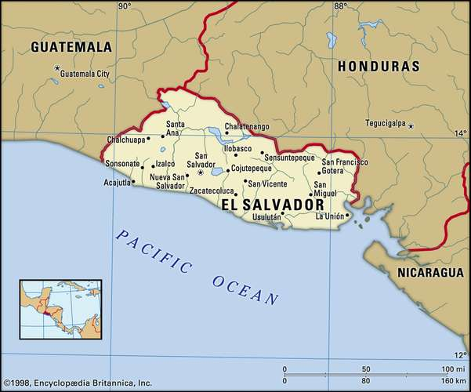
Country Profile
1931 - 1979: Various military governments controlled El Salvador.
1961: A military coup led by the right-wing National Conciliation Party catalyzes El Salvador's civil war.
1961 - 1977: El Salvador's military government commits human rights violations against political dissenters.
1979-1981: Army-backed right-wing death squads kill around 30,000 political dissenters.
1991: FMLN recognized as a political party; government and FMLN sign UN-sponsored peace accord.
1993: Government declares amnesty for those implicated by UN-sponsored commission in human rights atrocities
El Salvador continues to be a divided society marred by the violence of street gangs.

Slide 4
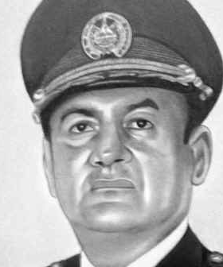
Overthrow of General Carlos Humberto Romero
October 15, 1979
The civil-military group, Junta Revolucionaria de Gobierno (JRG), overthrew General Carlos Humberto Romero in a coup d'état, claiming that they would "restore constitutional order. The JRG announced that a civilian-military junta would take control of the government.
The U.S. government politically and financially supported this coup to prevent the rise of communism.

Slide 5
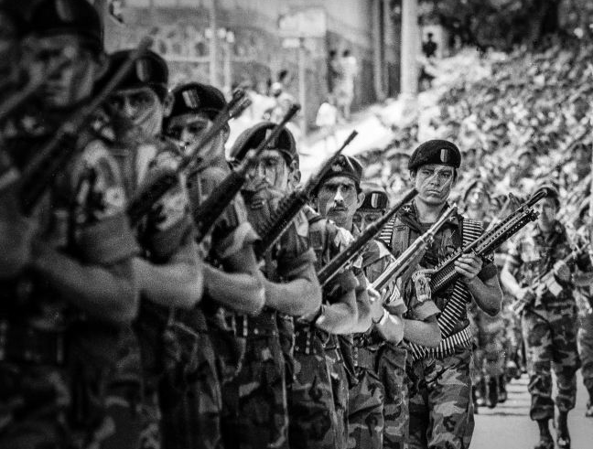
Goals of Junta Revolucionaria de Gobierno (JRG)
The Salvadoran military's main goals were to:
1. Prevent take-over by leftist-led guerrilla movements
2. Prevent uprisings from labor unions, students, and peasants
3. Prevent the spread of communism

Slide 6
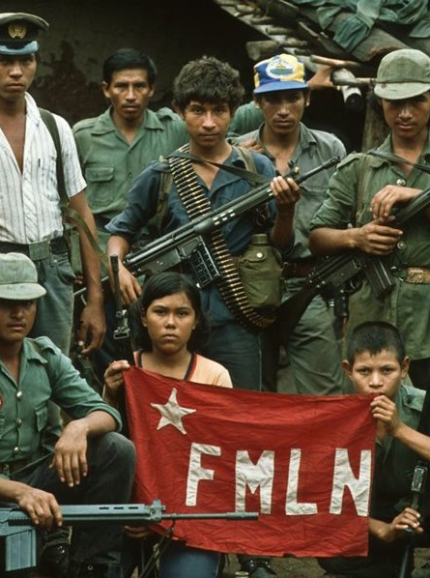
Goals of Insurrection
The guerrilla movement's main goals were:
1. Material gain for campesinos (peasants)
2. Establish political representation
3. Allow economic and social opportunities for campesinos
4. Reduce the wealth gap

Slide 7
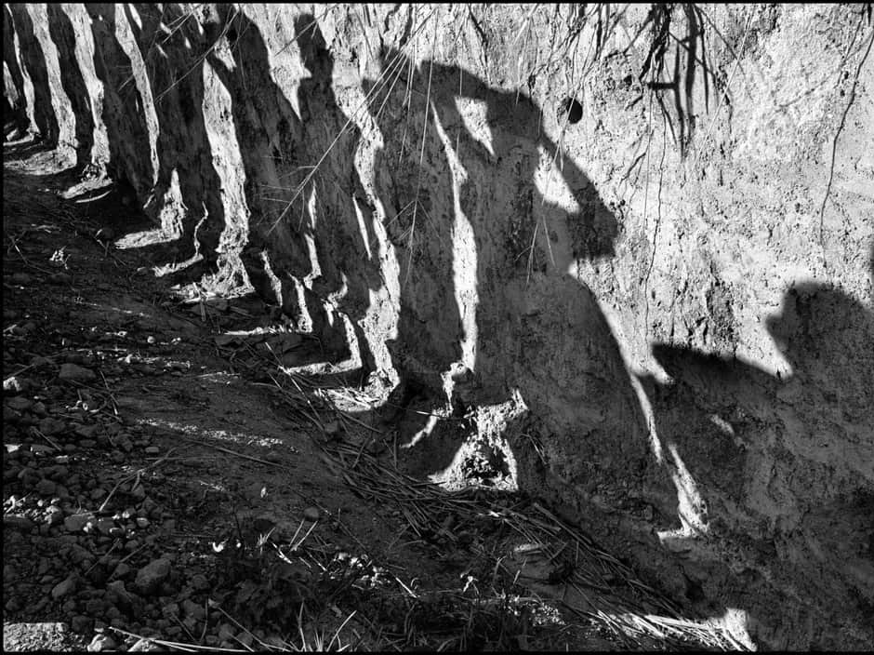
JRG Enact Land Reform Program
November 6, 1979 – February 1980
The JRG restricted landholdings, nationalized the bank and other major industries, scheduled future elections, and disbanded La Organización Democrática Nacionalista (ORDEN), a paramilitary private death squad.
They hoped the land reform act would project a populist image and increase support for the JRG amongst peasants. Instead, this policy further polarized the conflict.

Slide 8
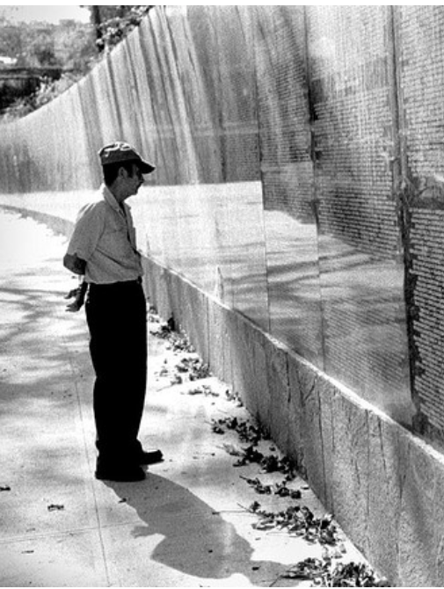
Backlash from Elites and Government Killings
February 1980 — March 1980
Wealthy landowners strongly opposed the land reform and sought to sabotage its efficacy. Government security forces and paramilitary squads hired by elites targeted leaders on cooperatives with assassinations and "disappearances."
The Socorro Jurídico recorded an increase of documented government killings from 234 to 487 in one month.

Slide 9
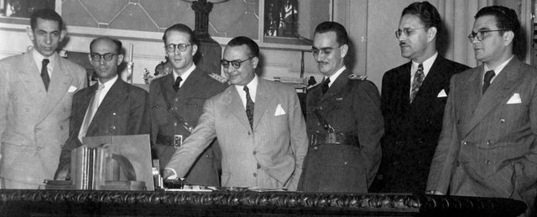
Civilian JRG Members Forced to Resign
January 3, 1980
The military pressured all three civilian members of the junta and 10 of the 11 cabinet ministers resigned. As polarization intensified in this chaos, violence by death squads increased significantly.

Slide 10
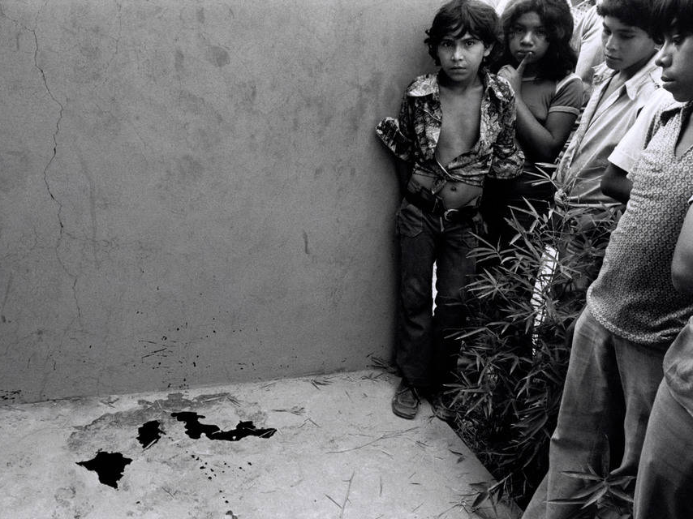
Overview of 1980 Deaths
By the end of 1980, the Salvadoran government and three security branches had killed around 11,895 people. These individuals were mostly peasants, trade unionists, teachers, students, journalists, human rights advocates, priests, and other members of the popular movement.

Slide 11
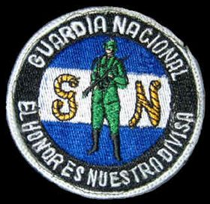
Salvadorian National Guard Attacks Peaceful Protest
January 22, 1980
The National Guard attacked a peaceful demonstration organized by Coordinadora Revolucionaria de Masas (CRM). Between 22 and 50 people were murdered. Hundreds of others were wounded.

Slide 12
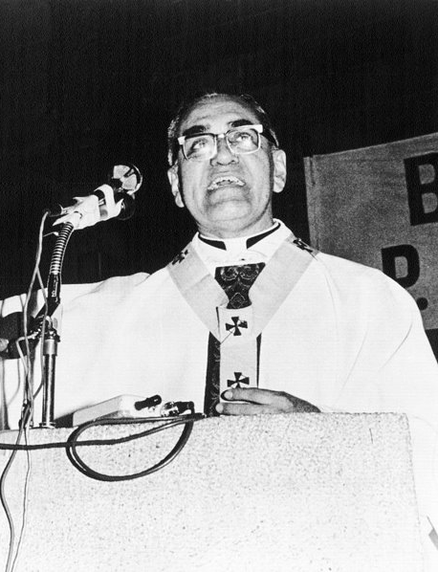
Archbishop Óscar Romero Assassinated
March 24, 1980
Government agents assassinated Archbishop Óscar Romero, a human rights activist, as he conducted mass. As part of his advocacy, Romero publicly pleaded with U.S. President Jimmy Carter to end U.S.-backed military aid to the right-wing Salvadoran regime.
Though the government arrested Major Roberto d'Aubisson, a prominent far-right politician, for the assassination of Romero on May 7th, he was quickly released. The Truth Commission report confirmed d'Aubisson's culpability for Romero's assassination.

Slide 13
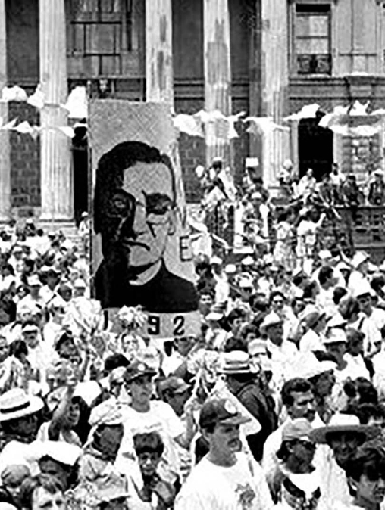
Massacre at Gerardo Barrios Plaza
March 31, 1980
After a bomb detonated at Romero's funeral, state security forces opened fire on the crowd of around 50,000, killing 42 people and wounding 200 others.

Slide 14

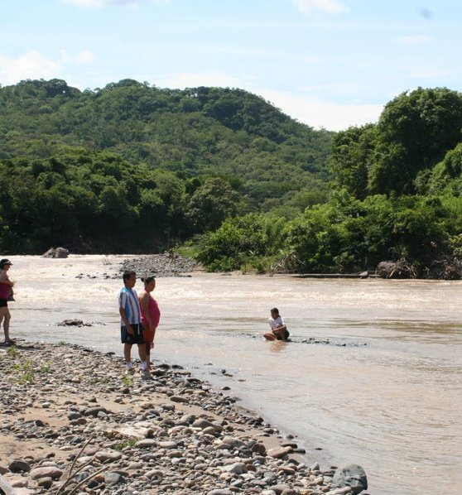
Massacre at the Sumpul River
May 14, 1980
The Salvadoran military forces were present close to the country's border with Honduras as the government believed this area to be a hotbed of guerilla activities.
These National Guard and newly-reorganized ORDEN forces killed at least 300 civilians, including women and children, who were attempting to flee to Honduras via the Sumpul River.

Slide 15

Creation of FMLN
October 10, 1980
Guerrilla activists created the left-wing Farabundo Marti National Liberation Front (FMLN). It was a Marxist-Leninist guerilla supported to varying degrees by Cuba, Nicaragua, and the Soviet Union.

Slide 16
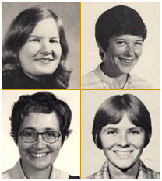
Rape/Murder of U.S. Nuns
December 2, 1980
Four American Catholic nuns, Maura Clarke, Jean Donovan, Ita Ford, and Dorothy Kazel, were raped and murdered by four members of the Salvadoran National Guard. The guardsmen were convicted of murder and sentenced to 30 years imprisonment in 1984. They later claimed that their superiors ordered them to commit the crime.
In response to the murders, American military aid was suspended for six weeks.

Slide 17
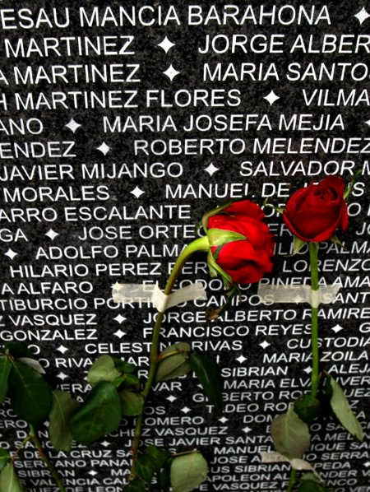
Overview of 1981 Deaths
An Amnesty International report found the Salvadoran government responsible for widespread torture, mutilation, and killing of unarmed civilians. These killings became more strategic over time, including through the use of meatpacking plants to dispose of human remains.
The Socorro Jurídico registered 16,000 individual cases of government-sponsored executions, but many suspect the real number is higher. Many more became internally displaced persons or refugees in neighboring nations.

Slide 18
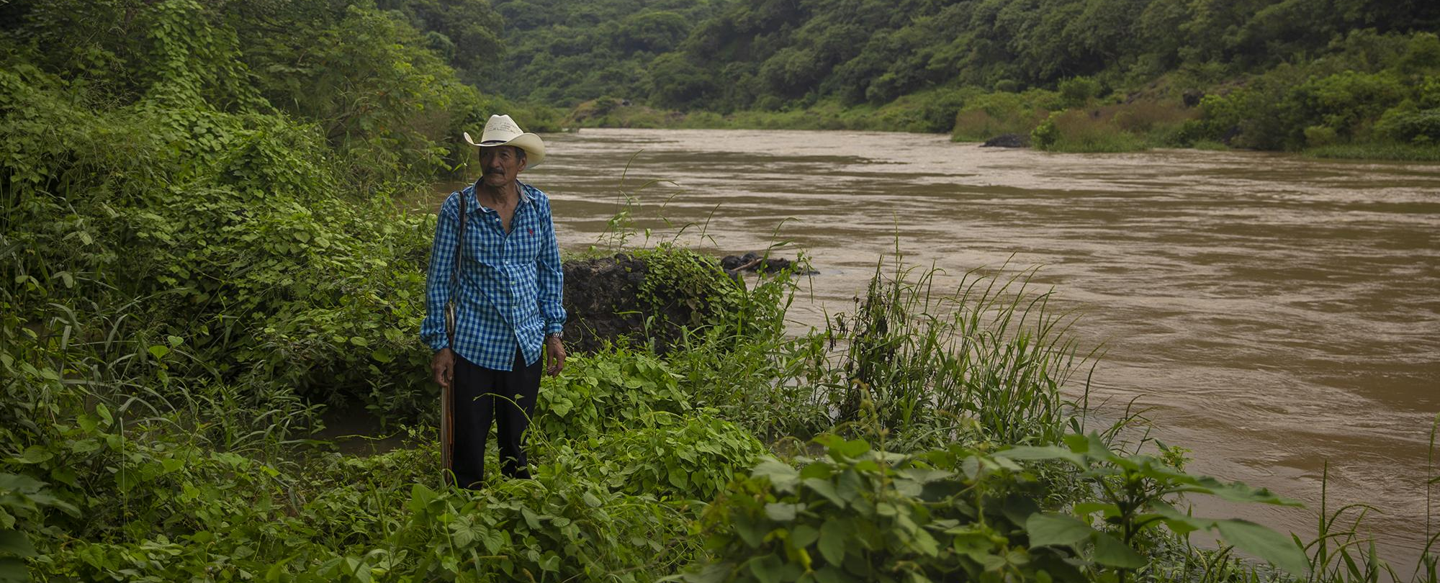
First 'Draining the Sea' Sweep
March 15, 1981 — March 19, 1981
The Salvadoran Army began a counterinsurgency, scorched-earth strategy called Draining the Sea. This strategy was meant to find and eliminate guerilla combatants from the communities that were harboring them.
Beginning in the Cabañas Department in northern El Salvador, they indiscriminately killed left-wing guerrilla members and civilians. Many civilians hid in caves and under trees to evade capture and execution.
On March 18, 4,000-8,000 survivors tried crossing into Honduras via the Rio Lempa. However, the Salvadoran Air Force attacked the citizens with machine-gun fire, killing hundreds. These included 189 civilians who were marked as "disappeared" rather than "murdered."

Slide 19
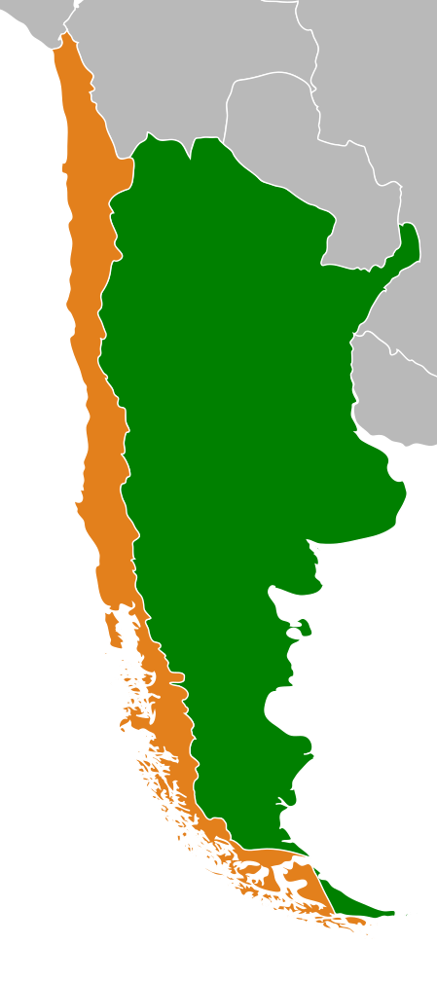
Latin America Nations Support Salvadoran Military
May 1981
Chile's military government provided training and tactical advice to the Salvadoran Armed Forces and was bestowed the Order of José Matías Delgado for their help.
Argentina's military government assisted El Salvador in Operation Charly to repress political dissenters.

Slide 20
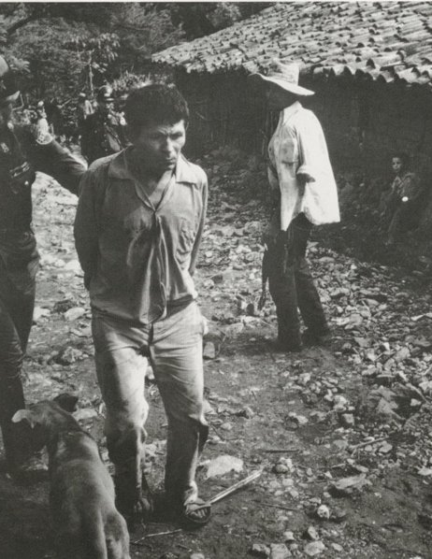
Second 'Draining the Sea' Sweep
November 11, 1981 —
December 1, 1981
The Atlacatl Battalion, an elite anti-guerrilla battalion trained by the U.S., massacred hundreds of civilians in the Cabañas Department.
This sweep was described as a "cleansing" operation, consisting mostly of unarmed civilians.

Slide 21
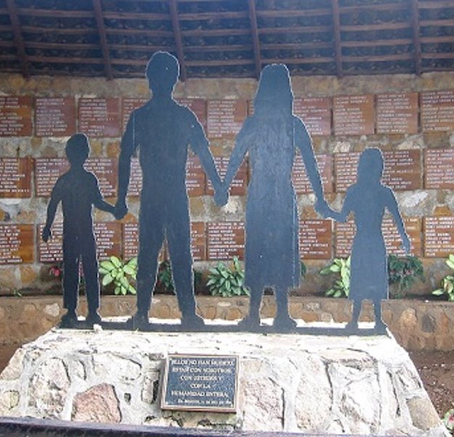
El Mozote Massacre
December 11, 1981
The Atlacatl Battalion massacred from 733 to 1,000 unarmed civilians in El Mozote, a village attacked during a 'Draining the Sea' operation in the Morazán Department. Of those killed, 146 were children.
The battalion was ordered to kill everyone in the village, claiming the adults were collaborating with guerrillas and the children would grow up to be guerrillas.
The U.S. firmly denied its involvement in the massacre until secret cables were declassified in the 1990s.

Slide 22
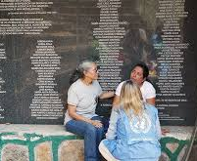
Overview of 1982-1983 Deaths
January 1, 1982 —
December 31, 1983
During 1982 and 1983, government forces killed approximately 8,000 civilians a year. Although the figure is significantly less than the figures reported by human rights groups in 1980 and 1981, targeted executions, as well as indiscriminate killings, remained an integral policy of the army and internal security forces.

Slide 23
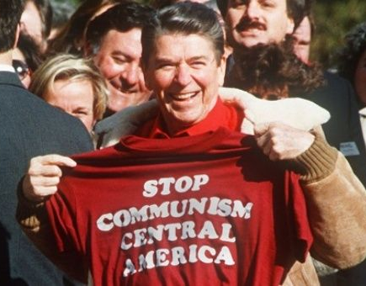
FMLN Calls For Peace Settlement
January 1982
The FMLN began calling for new elections and the formation of a "government of broad participation." However, right-wing paramilitary attacks and subsequent boycotts by the FMLN prevented action on these proposals.
The U.S. continued to support the Salvadoran military and claimed the FMLN wanted to form a Marxist-Leninist dictatorship.

Slide 24
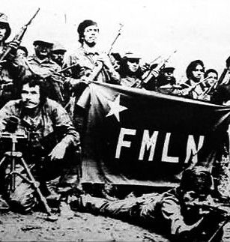
FMLN Lead Sabotage Plan
January 1982 —
September 1982
In the span of nine months, the FMLN committed 782 acts of sabotage against the Salvadoran army. They used explosives and arson to damage both military and economic targets, including U.S. funded property and urban centers.

Slide 25

Interim Government Elections
April 29, 1982
In the first election since 1977, the Nationalist Republican Alliance (Arena) won parliamentary elections, making El Salvador's government officially sponsored by far-right radicals. The elections were filled with fraud and repression of the FMLN.

Slide 26
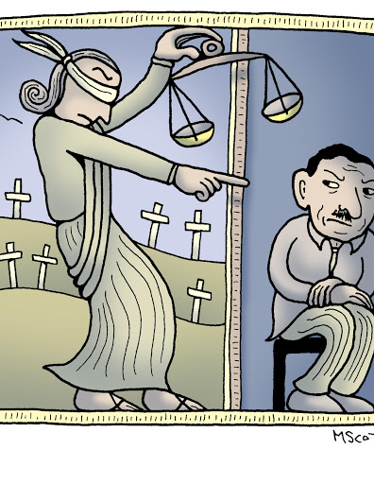
IACHR Reports on Discovered Mass Grave
May 24, 1982
The Inter-American Commission on Human Rights reported the discovery of a clandestine cemetery containing the corpses of 150 disappeared persons near Puerta del Diablo, Panchimalco, approximately twelve kilometers from San Salvador.

Slide 27
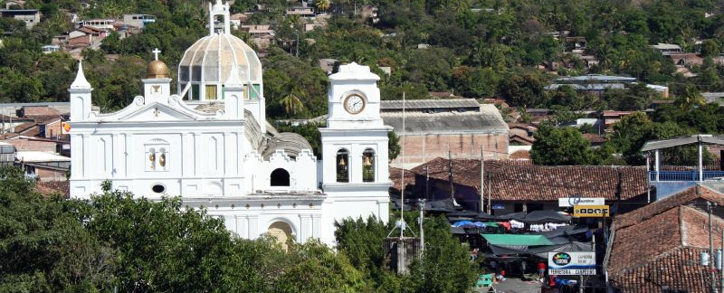
Salvadoran Army
Carries Out "Cleanup"
June 10, 1982
Almost 4,000 Salvadoran troops carried out a "cleanup" operation in the rebel-controlled Chalatenango province, reportedly leading to the massacre of 600 civilians. The three battallions involved in the sweeps were previously trained by the U.S. military and used counterinsurgency tactics recommended by the U.S.

Slide 28
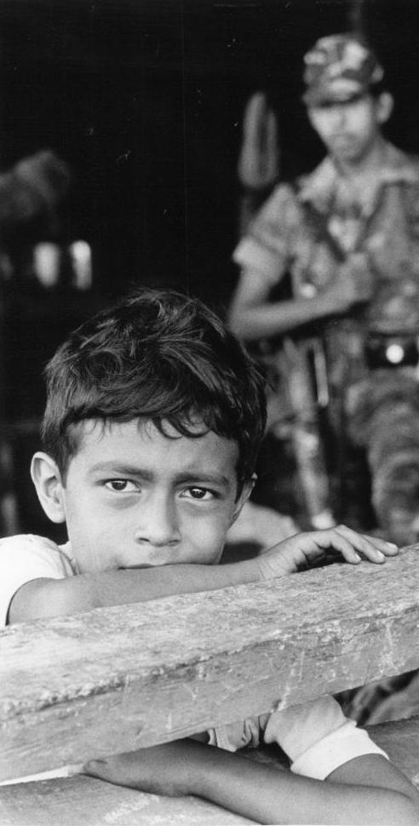
Army Raids San Salvador, 27 Civilians Massacred
June 29, 1982
During house raids in San Salvador meant to discover hiding rebels, the Salvadoran army killed 27 unarmed civilians. Several women were raped before they were murdered. The families of the victims denied the Salvadoran army's claim that those killed in the massacre were FMLN members.
"The operation was a success," said the Salvadoran Defense Ministry communique. "This action was a result of training and professionalization of our officers and soldiers."

Slide 29
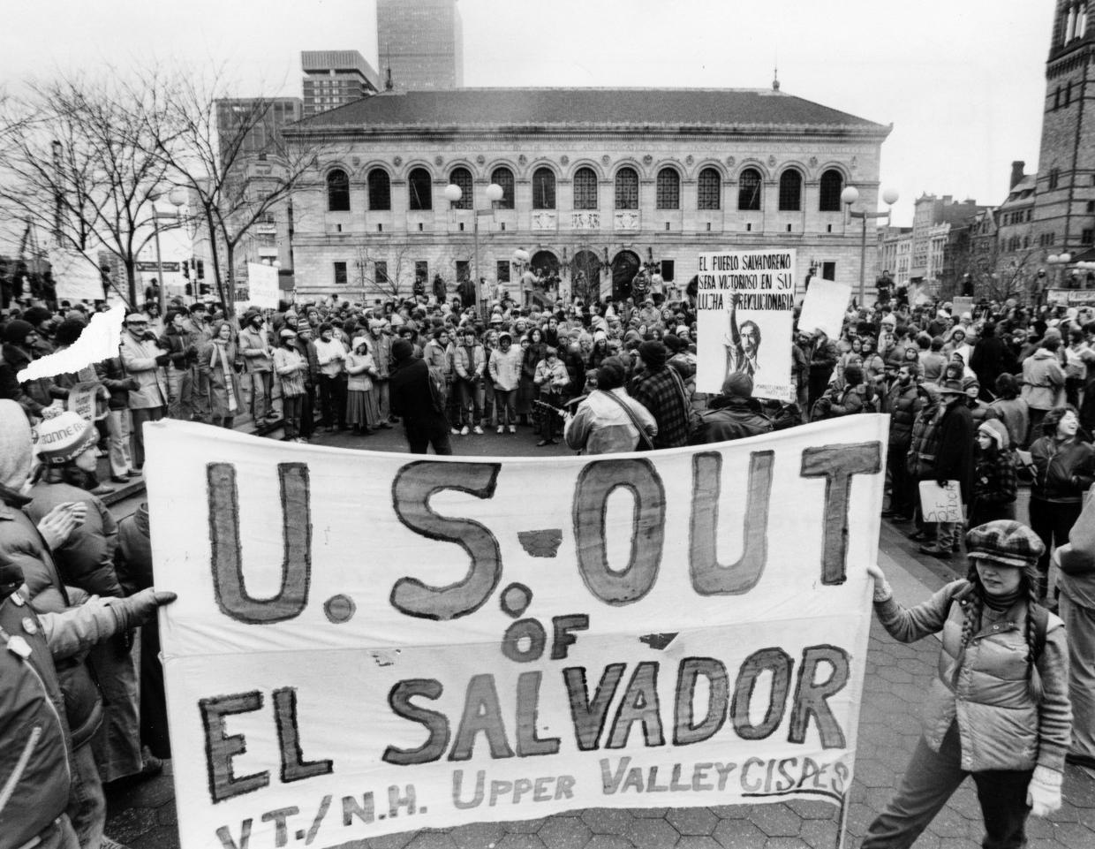
U.S. Threatens to Reduce Aid
1983
In response to growing reports of human rights abuses by the Salvadoran military, Congress restricted direct military aid. President Reagan and Vice President Bush threatened further reductions in military aid should the Salvadoran government and military not reduce the abuses and bring death squad perpetrators to justice.

Slide 30
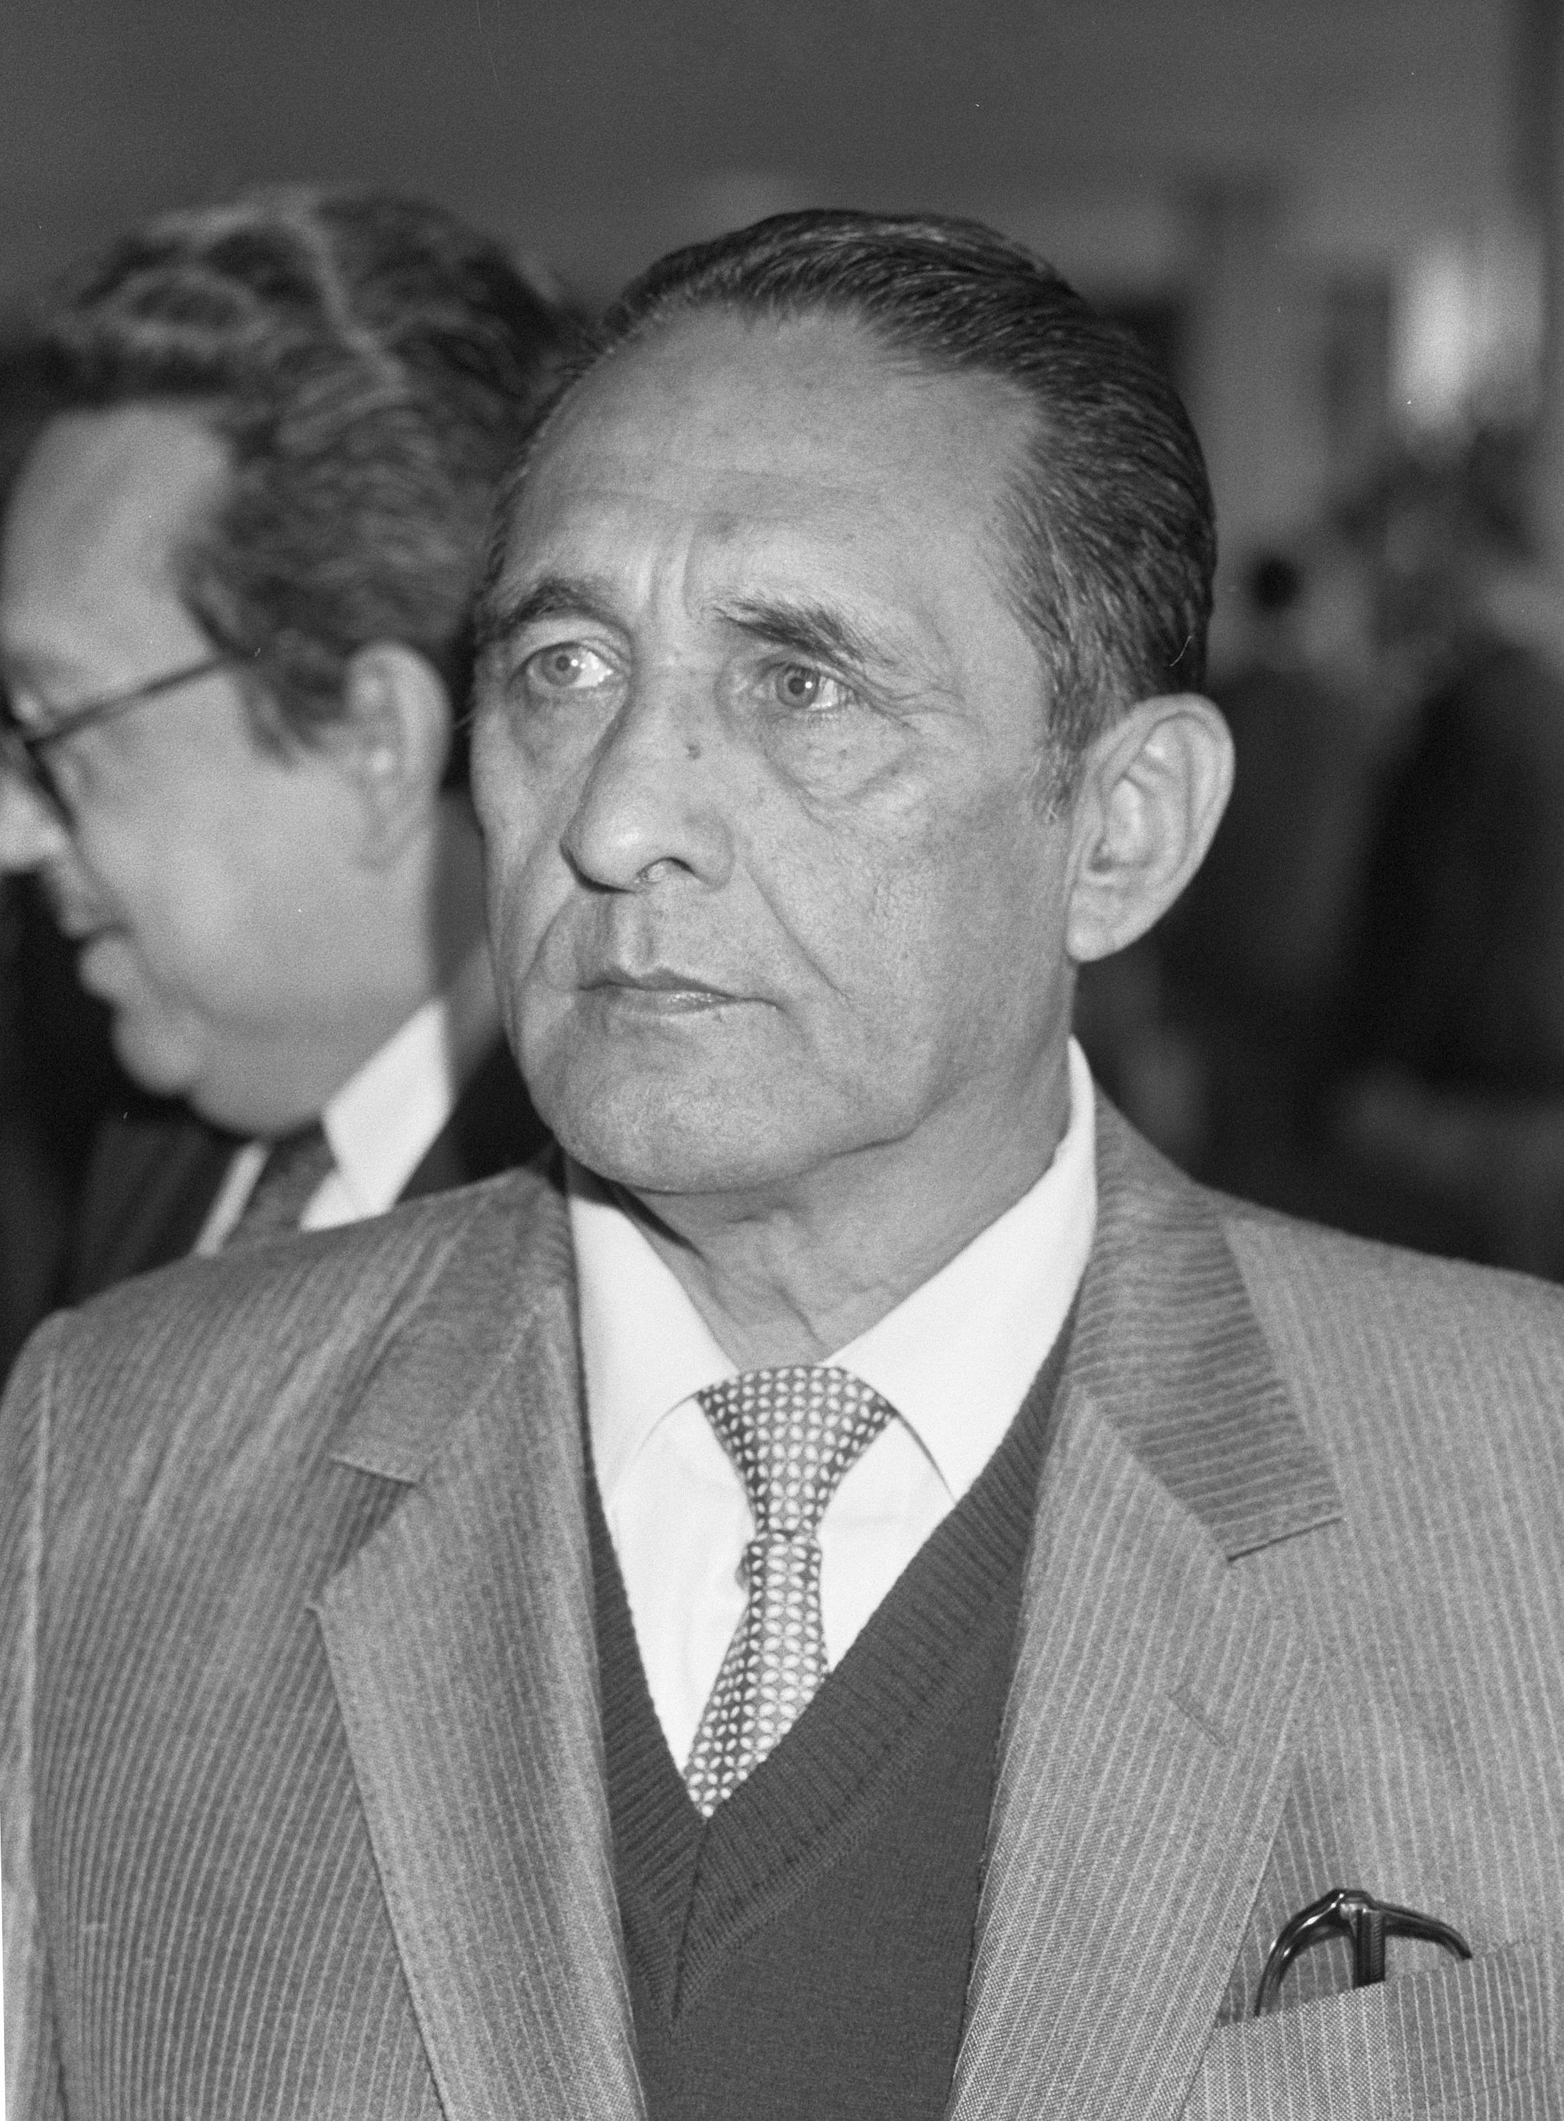
José Napoleón Duarte Elected President
March 25, 1984
Democrat José Napoleón Duarte was officially elected as president of El Salvador. Fearing that the man who killed Archbishop Óscar Romero would be elected, the CIA financed $10 million to rig the election for Duarte's campaign. Following the election, US military support increased, thus allowing the Salvadoran military to more directly confront the FMLN.
Held under military rule, the elections stifled Duarte's associates and inflicted violence on voters.

Slide 31
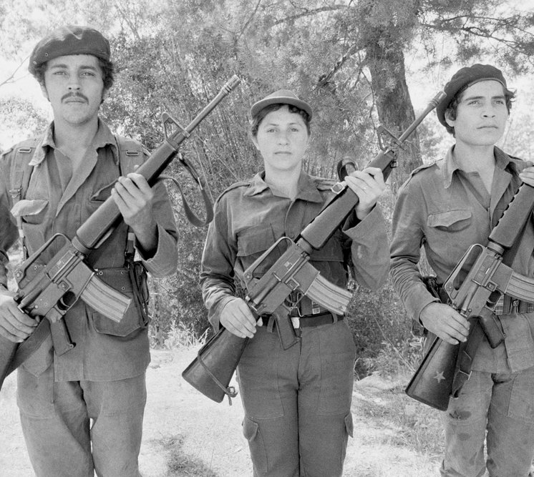
Salvadoran Armed Forces Creates Civic-Action Programs
January 1, 1984 —
December 31, 1985
The Salvadoran Armed Forces created citizen defense committees to defend plantations and businesses. They also led indiscriminate bombings of free-fire zones, killing hundreds of civilians.

Slide 32
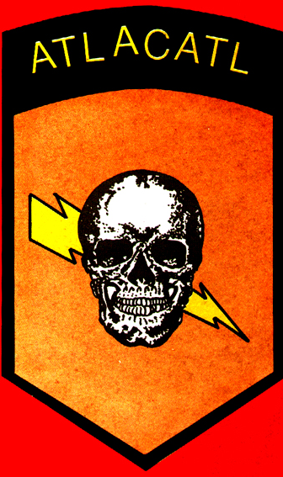
Army Massacres Continue By Atlacatl Battalion
July 1984
Despite Duarte's election, army massacres of civilians continued. In July 1984, the Atlacatl Battalion killed 80 people in Cabanas and 50 people in Chalatenango.
While increased U.S. military aid bolstered the Salvadoran army's efforts, the FMLN shifted tactics to focus on the destruction of economic targets, as well as attacking government officials. The FMLN's tactics shifted once more by the end of 1985 to a more traditionally guerilla-style approach. These shifts significantly impacted civilians, causing displacement and death.

Slide 33
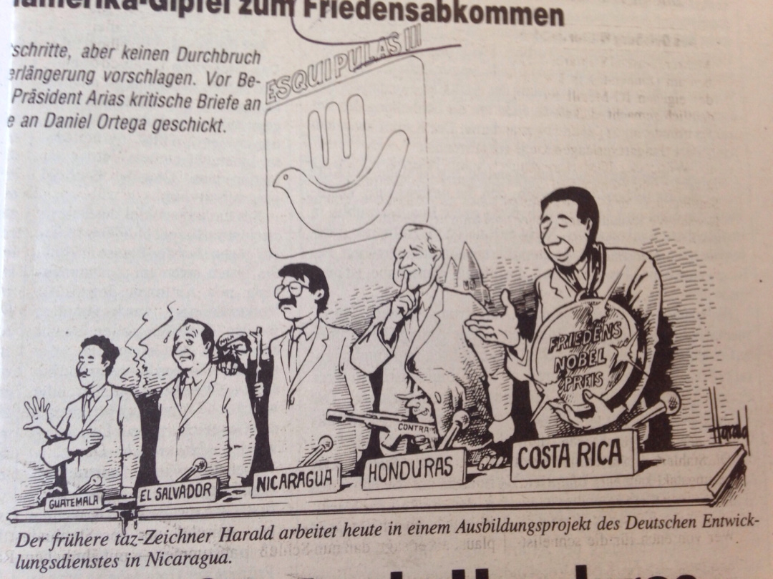
Central American Peace Accords
January 1, 1987
The Esquipulas Peace Agreements, also known as the Central American Peace Accords, served as a regional framework for creating ceasefires and increasing political freedom for Guatemala, El Salvador, Honduras, Nicaragua, and Costa Rica.
As part of subsequent negotiations for a ceasefire, the FMLN demanded that perpetrators of human rights violations be brought to justice. Duarte established an amnesty law for civil war-related crimes, resulting in the release of around 500 political prisoners.

Slide 34
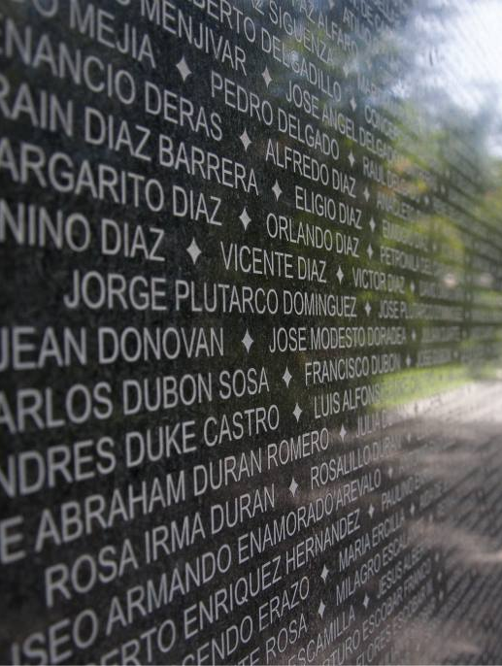
Overview of 1988-1992 Deaths
January 1, 1988 —
December 31, 1992
1988: The FMLN retaliated against right-wing extremists.
1988-1989: Armed forces killed 2,868 people. Despite foreign aid, 75% of the population lived in poverty.
1992: More than one million people have been displaced, and 22,000 complaints of political oppression have been filed.

Slide 35
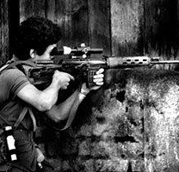
FMLN Launches Major Offensive
November 11, 1989
The FMLN led an operation to unseat President Alfredo Cristiani by assassinating key political figures. This was the first time the capital's wealthy suburbs was the epicenter of the fighting.
The military retaliated with a new wave of repression, killing 2,868 dissenters.

Slide 36
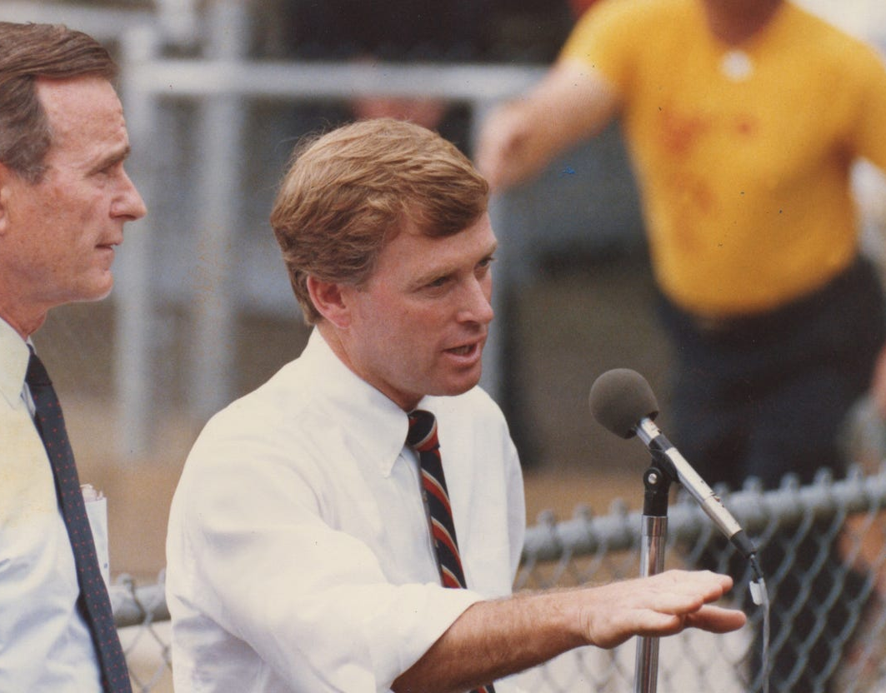
U.S. Government Gives Conflicting Messages
February 1990
U.S. Vice President Dan Quayle publicly condemned the Salvadoran military's human rights abuses and demanded the end of the death squads.
Privately, U.S. advisers said, "Do what you need to do to stop the commies, just don't get caught." They suggested ORDEN stop dumping bodies on the road and instead, "they have an ocean, and they ought to use it."

Slide 37
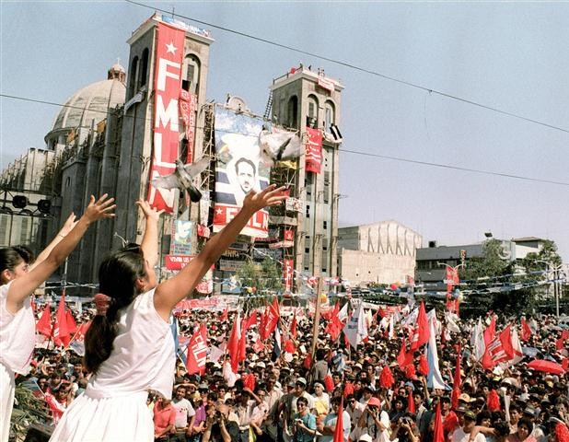
Chapultepec Accords
January 16, 1992
As it became clear that neither side could achieve a clear military victory, in part due to the end of the Cold War greatly reducing outside military aid, the door opened for peace negotiations. The UN-sponsored talks led to the signing of the Chapultepec Peace Accords
The accords initiated military reform, created a citizen-police force, established the FMLN as a political party, and enforced an amnesty law for political dissenters.

Slide 38
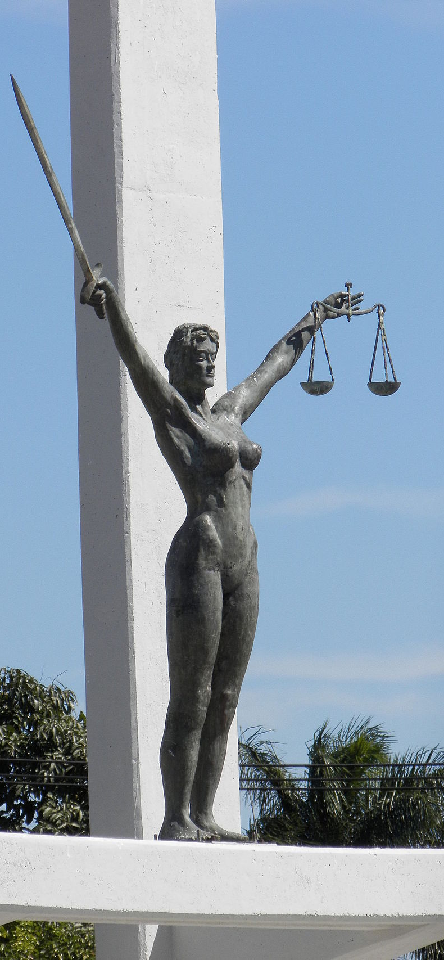
Commission on the Truth for El Salvador
July 1992 – March 1993
The Truth Commission emerged from the peace negotiations in order to bring transparency to the violence of the civil war and to establish recommendations to hold perpetrators accountable. It reported that 85% of "serious acts of violence" were committed by the state. 60% of these acts were extrajudicial killings, 25% were enforced disappearances, and 20% included claims of torture.
Recommendations, particualrly those about accountability and reparations, were largely not implemented by the Salvadoran government.

Slide 39
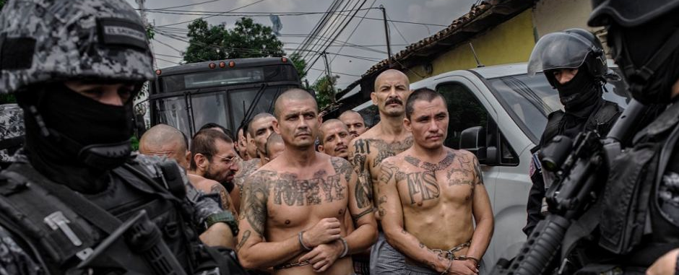
Conclusion
The civil war in El Salvador and the government-sponsored violence surrounding it has had a lasting legacy on the Salvadoran people and society. Despite the fact that 75,000 people were killed during the bloody civil war, there has been no little to no accountability for the perpetrators of massacres, extrajudicial killings, enforced disappearances, and torture.
Today, street-gang culture is prominent in El Salvador, comprising tens of thousands of people who grew up in the shadow of the civil war. These gangs are seen as a perpetuation of the violence of the 1980s.

