Slide 1
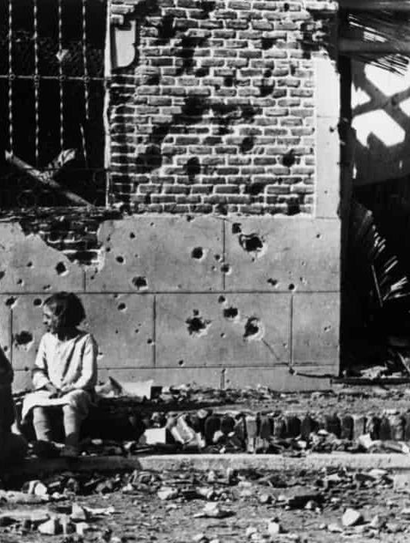
Key Findings
1936-1939: The Nationalists, led by General Franco, pursued a policy of extermination during the civil war, intending to "cleanse" or "purge" Spain of leftist ideologies. They encouraged extrajudicial killings and used the judicial apparatus of military executions to implement this policy.
In total, an estimated 500,000 died in the Civil War, 200,000 of which died by systemic killings or mob violence.
Post-war: General Franco implemented legal reforms to punish those who opposed him during the war, rewriting history in his favor.
By 1940, more than 500,000 were sent to 60 different concentration camps.
1975: After the death of Franco, amnesty was afforded to all those who took part in the war.
Today, Spain has implemented legislative reforms to begin to uncover the truth of the atrocities committed.

Slide 2
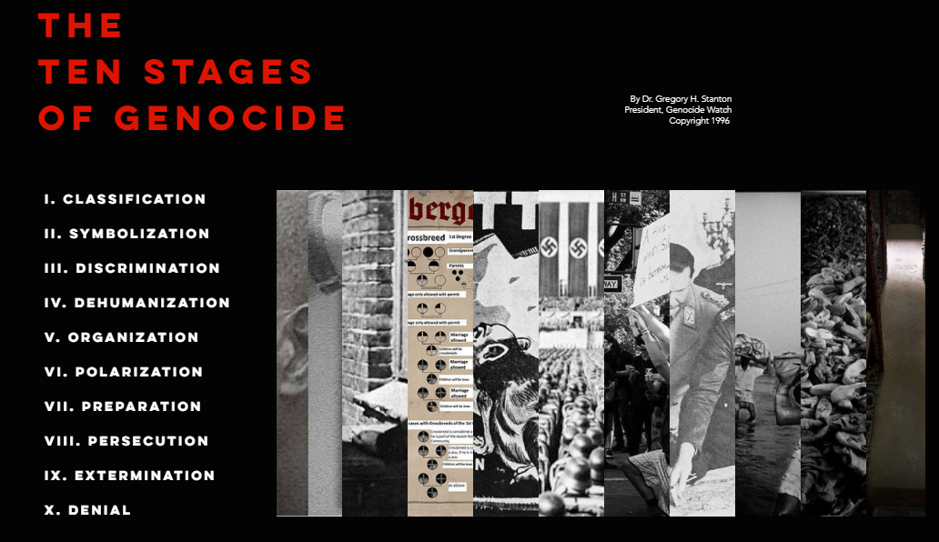
Ten Stages of Genocide
Dr. Gregory Stanton, Founding President of Genocide Watch, is the author of the Ten Stages of Genocide. Many of these were present during the Spanish Civil War and the subsequent Franco Regime.
Classification
Symbolization
Discrimination
Dehumanization
Organization
Polarization
Preparation
Persecution
Extermination
Denial

Slide 3
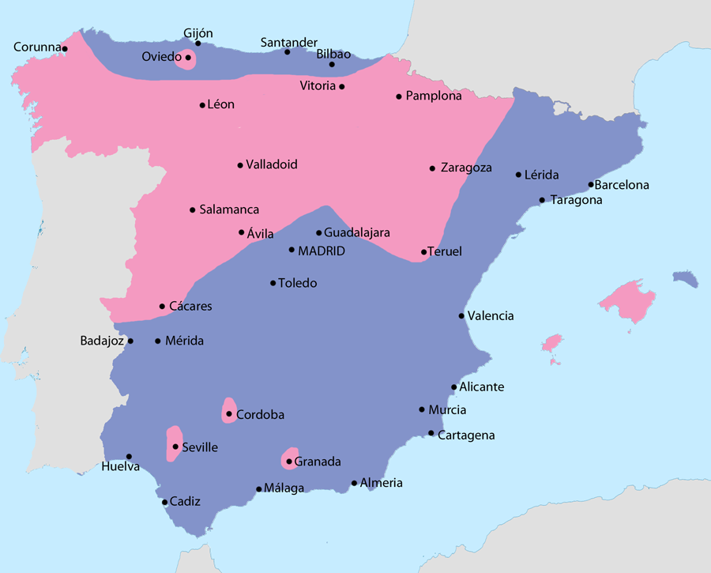
Spanish Civil War: Main Actors
1936
The Spanish Civil War began in 1936 and was fought between the Nationalists (rebels and supporters of the military coup) and the Republicans (supporting the Second Spanish republic).
Nationalists included: The political right - Monarchists, Conservatives, Falangists/Fascists, rebel military members, Catholic Church, landowners, traditionalists.
Republicans included: The political left - Progressives, Socialists, Marxists, Anarchists, trade unions and the working class.

Slide 4
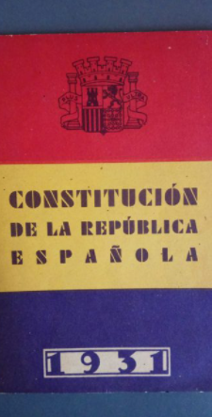
The Second Spanish Republic
April 13, 1931
The fall of the monarchy led to the Second Republic. A reform agenda followed, in areas of land ownership, education, religion, and the army. It is supported by progressive Republicans (a political class consisting of mainly lawyers and teachers) and socialists and trade unions. However, those subjected to reform opposed them, such as members of the military - many of whom were demoted, including Generals Franco and Mola who would later lead the military coup.
Landowners were also mobilized against Republican reforms after the "Ley de Bases" (Agrarian Reform Bill) sought to end large-scale landholding ("latifundismo").
Later during the war these Republican ideas of "reform" and their supporters came to represent social and cultural change that needed to be “cleansed” from the community to rid of the pollution and dangers they caused.

Slide 5
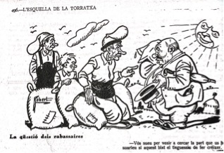
Land reform proposals rejected
June 30, 1931
Initial proposals for land reform were introduced to the Cortes (Spanish legislature) but all were rejected due to lack of agreement by the left (socialists and conservatives).
The left encompassed a broad spectrum of ideologies, making consensus a challenge.
Translation: The rabaissaire question: Peasant: You sweat by coming here to claim your part of the harvest, you would be sweating more if you were to grow it by yourself.

Slide 6
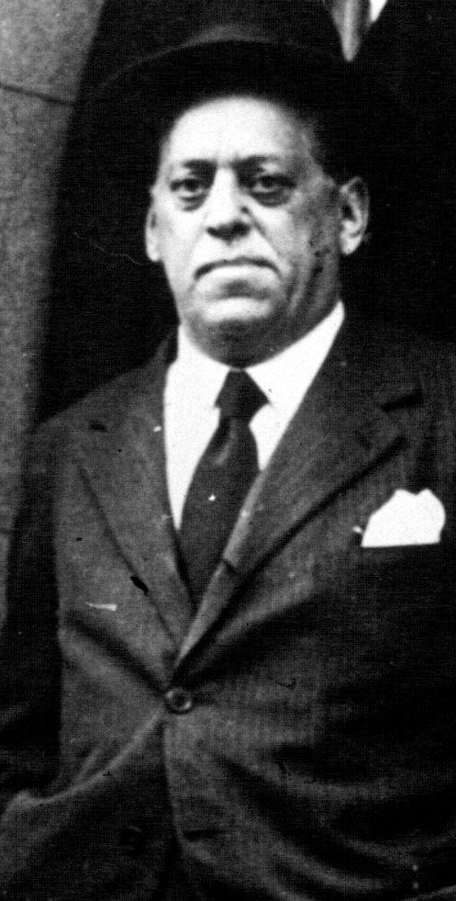
Failed coup attempt
August 9, 1932
General José Sanjurjo became disillusioned with the government and attempted a coup that initially succeeded in taking control of Seville but collapsed within days due to an inability to attract the support of senior military figures. 10 people were killed. General Sanjurjo and 150 others were sentenced to death. General Sanjurjo's sentence was later commuted to life imprisonment.
In 1934, the new government adopted amnesty, freeing those sentenced. Many later played a role in the 1936 coup.

Slide 7
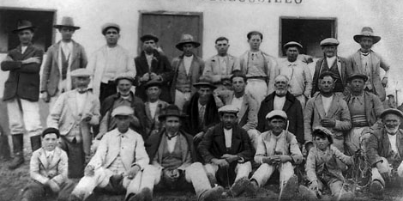
Agrarian Reform Bill passed
September 7, 1932
The "Ley de Bases" (Agrarian Reform Bill) sought to end large-scale landholding ("latifundismo"). This mobilized landowners in opposition to Republican reforms.

Slide 8
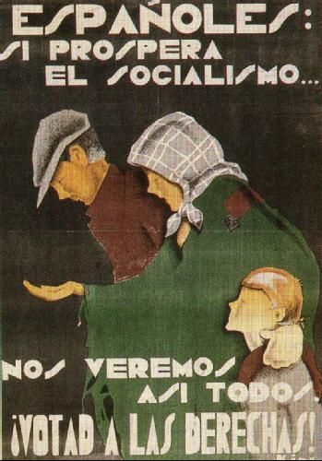
CEDA win elections
November 18, 1933
The right-wing Confederación Española de Derechas Autónomas (CEDA) won the majority of seats in parliament, led by Gil Robles from Acción Popular. The left-wing, middle-class party Lerroux's Radicals won the second most seats and was called upon to form a government rather than CEDA. This illustrated a sharply divided Spain between left and right political ideologies.
Lerroux was unable to form a government without CEDA's support and eventually included four CEDA ministers into his cabinet, causing strikes and calls for a revolution from socialists.

Slide 9
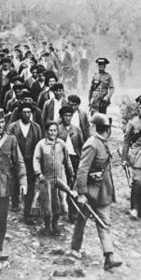
October Revolution
October 4, 1934
Socialists called for a revolution in reaction to the inclusion of CEDA ministers in the cabinet. A country-wide general workers' strike lasted a week in most parts of the country.
Asturias coalfield miners continued to strike for a number of weeks. A failure to see any improvement to their condition radicalized miners there. Destruction of property occurred. In Barcelona, Catalan nationalists led the revolution. Both were violently suppressed by the army.
This "October Revolution" had a polarizing effect. The socialist revolution brought fear of a "Red" rebellion and the army's repression of such revolution brought fears of fascism.

Slide 10
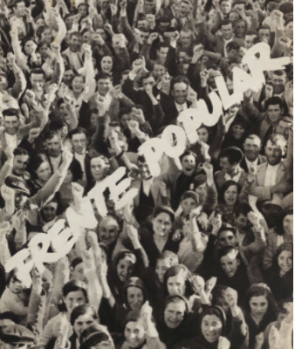
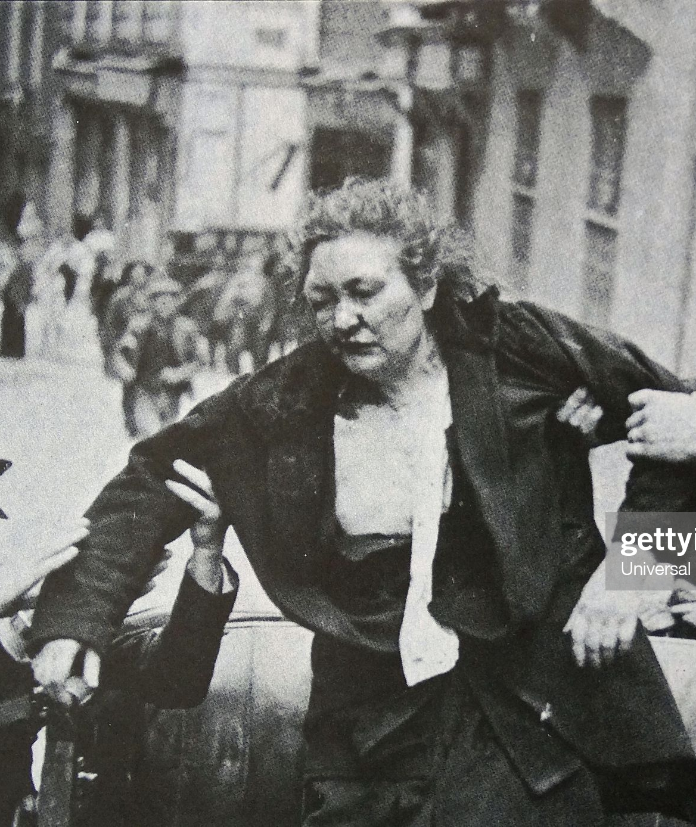
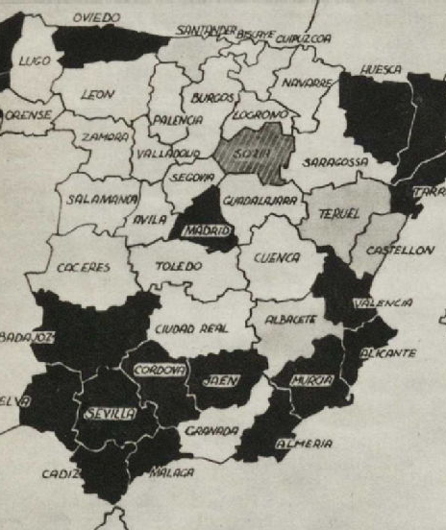
Popular Front win elections
February 15, 1936
The left and the center-left coalition of the Popular Front secured a narrow win amidst violent elections.
During the first four months, hundreds of strikes took place. 170 churches, 69 clubs and 10 newspaper offices were set on fire by arsonists.
The victory of the left brought renewed fears among the military and conservative civilians of a continuation of the reformist agenda.
These were to become the last free elections in Spain until 1977.

Slide 11

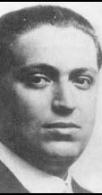
Assasination of Socialist José Castillo Seria
July 11, 1936
Lieutenant of Assault Guards José Castillo Seria, active member of Socialist party, was killed by Falangists in Madrid.
José Calvo Sotelo, right wing political figure and former finance minister under Primo de Rivera, was killed the following day as revenge for José Castillo Seria.

Slide 12
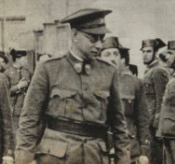
General Mola calls for a military coup
May 24, 1936
General Emilio Mola sent ‘Instrucción reservada no.1', calling for unification of military and political groups behind a military coup.

Slide 13
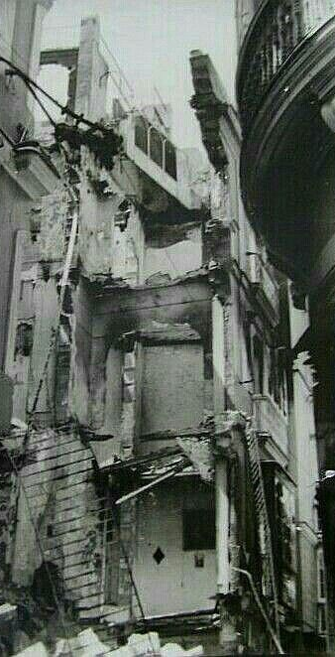
Nationalist Troops Take Cádiz
July 18, 1936
The rebels arrested and shot Mayor Manuel Dela Punta Leal. The Nationalists also detained and executed the provincial assembly that August. The rebels began arresting and looting the homes of Liberals, leftists, unionists, Freemasons. Some of those who were arrested were shot in the street, while others were tortured during their imprisonment.
The Nationalist troops then established the Tribunal of Blood and began to execute 26 prisoners a day. Scholars estimate that more than 1000 were executed in Cadiz at the hands of this tribunal over the course of the war.
At this time, Nationalist General Quiepo de Lano declared martial law in Andalucia, which gave soldiers the go-ahead for extrajudicial killings.

Slide 14
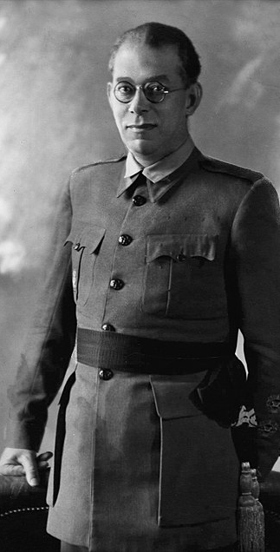
Nationalist Forces Purge the North
July 17, 1936 – April 1939
Within a matter of hours or days from the beginning of the military uprising, Navarre, Álva, 8 provinces of Old Castile, 3 provinces of Leon, 4 provinces of Galicia, two thirds of Zaragoza, and all of Cárceres fell into the hands of Nationalist forces. These areas had been predominantly right wing and Catholic.
In his July 1936 declaration of martial law in Pamplona, Commander of the North, General Emilio Mola Vidal, demonstrated the intent to purge the Northern provinces of Republicans. His directive emphasized the necessity of a period of “exemplary violence” against Popular Front supporters and those that did not actively support the Nationalist military coup. Targets of this purge were trade unionists, member of leftist parties, municipal officials, Republican functionaries, schoolteachers, Freemasons, etc. These killings were passed off as “preventative assassinations.”

Slide 15
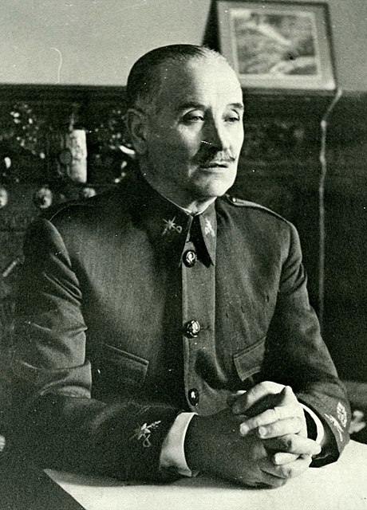
Nationalist Forces Purge the South
July 17, 1936 – April 1939
In July 1936, General Gonzalo Queipo de Llano Sierra of the Nationalist Army of the South led by General Francisco Franco declared martial law in Andalucía and made inciting broadcasts calling the South to be purged of Republicans and for Nationalist soldiers to rape as they take the South. Nationalist propaganda warned of a Communist and anarchist takeover of Spain and played up stories of atrocities committed by these groups targeting those who supported the Nationalist cause.
This propaganda coupled with the declaration of martial law in Southern regions occupied by Nationalist forces gave soldiers a justification for extrajudicial killings of those that did not actively support the Nationalist military uprising.
These extrajudicial killings as well as executions carried out by Nationalist military tribunals were a way for Nationalist forces to carry out “justice.”

Slide 16
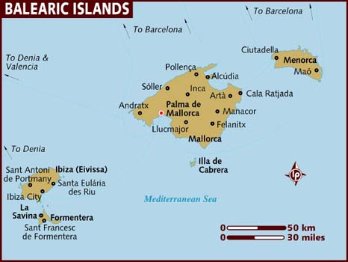
Nationalist Troops Take Balearic Islands
July 1936
In the Balearic Islands, Nationalist troops executed around 2,000 people.

Slide 17
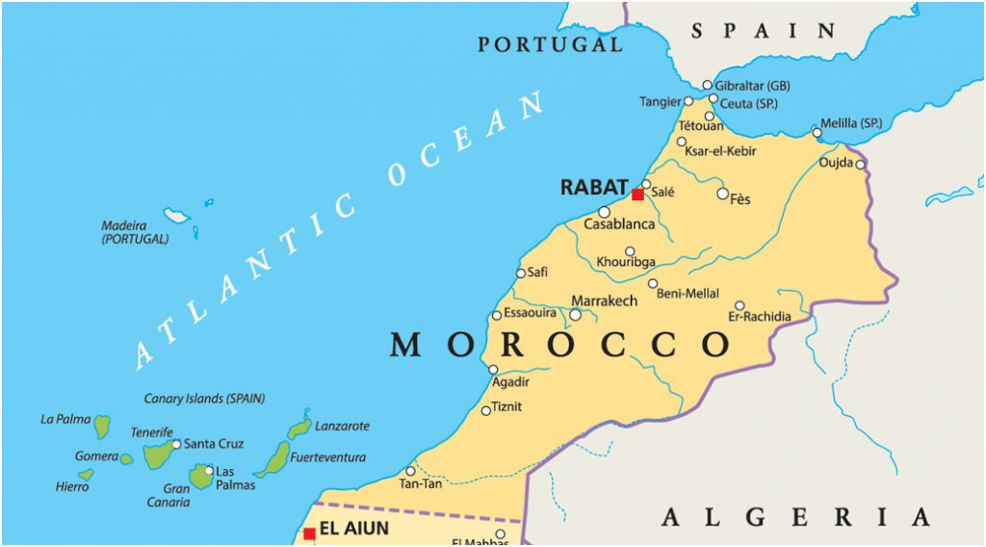
Nationalist Troops Take the Canary Islands
July 1936
In the Canary Islands, it is estimated that Nationalist forces killed around 2,500 people.

Slide 18
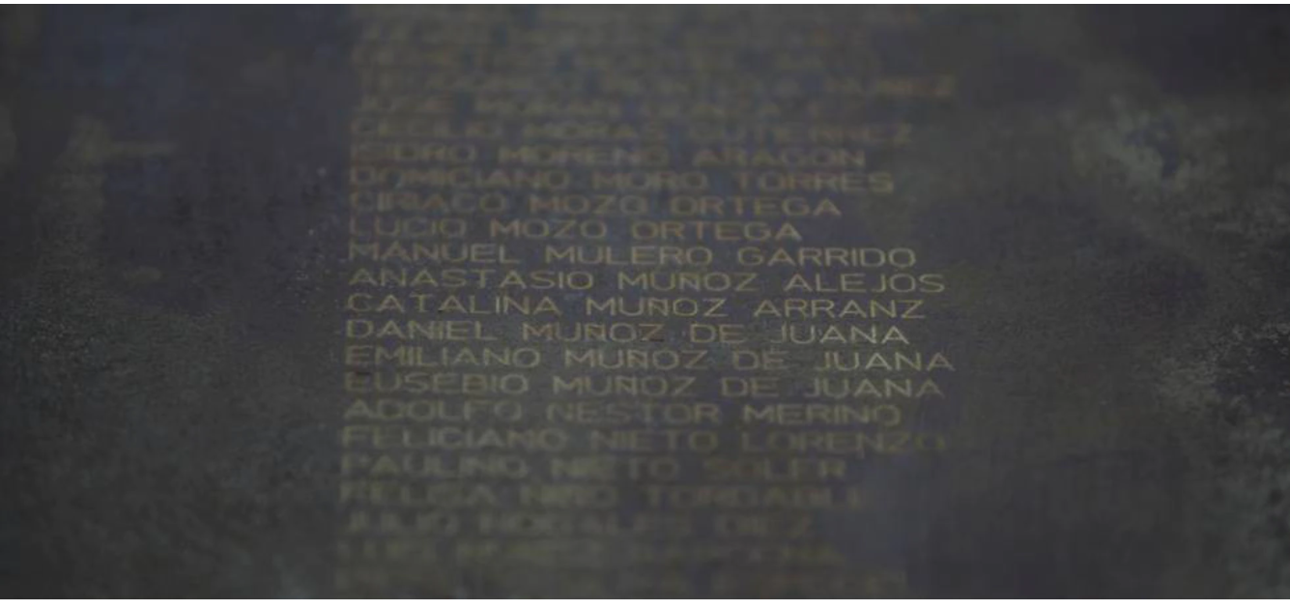
Nationalist Troops Take Palencia
July 1936
In Palencia, Nationalist troops executed 1,500. Throughout the province 1.1 to 3.3% of the population was executed.

Slide 19
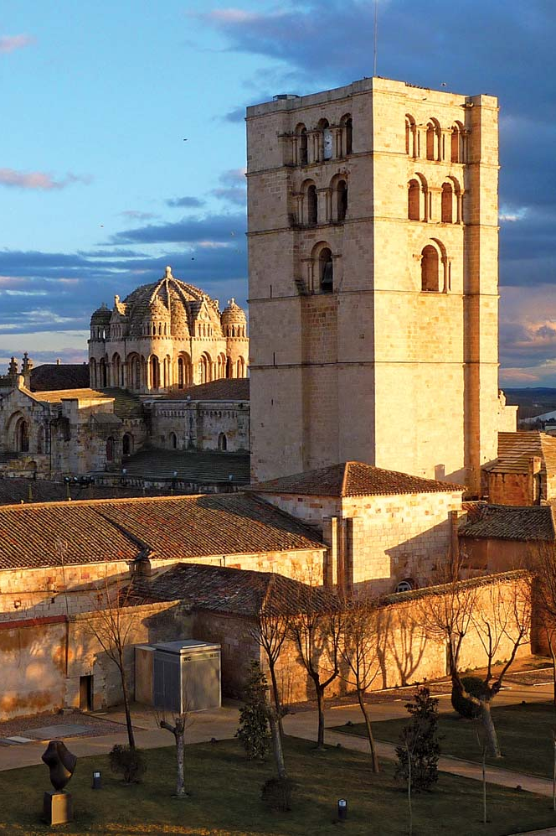
Executions in Zamora
July 16, 1936
In Zamora, the coup succeeded easily, and Nationalist forces began imprisoning, torturing, sexually assaulting, and executing Socialists, trade unionists, and Republican officials and schoolteachers. It is estimated that 1,330 were executed.

Slide 20
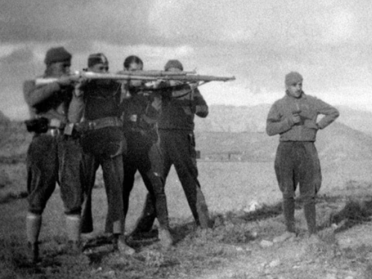
Wartime Military Judicial Apparatus
July 17, 1936 – April 1939
After declaring martial law in occupied areas, Nationalist set up military tribunals to round up, arrest, and try those that did not actively support the Nationalist military uprising such as: Communists, anarchists, leftist politicians, those who had voted for the Popular Front, trade unionists, Freemasons, Republican soldiers, Jews, intellectuals, leftist civil servants, leftist mayors or governors, etc.
These tribunals were essentially show trials, operating on denunciations as proof of guilt with no opportunity for a defense for the accused and the possibility for the accused to be found innocent. Many prisoners underwent intense interrogations where they would be tortured into “confessing” to their “crimes.” Those found guilty usually were executed though other punishments included fines and confiscation of assets. If the accused could not be found or had gone into exile, punishments were also dealt out to spouses or relatives in their stead.

Slide 21
Nationalists Lay Siege to La Macarena
July 19, 1936
Nationalist forces used women and children as shields, laying siege to the city and threatening to shoot anyone displaying any pro Republican slogans

Slide 22
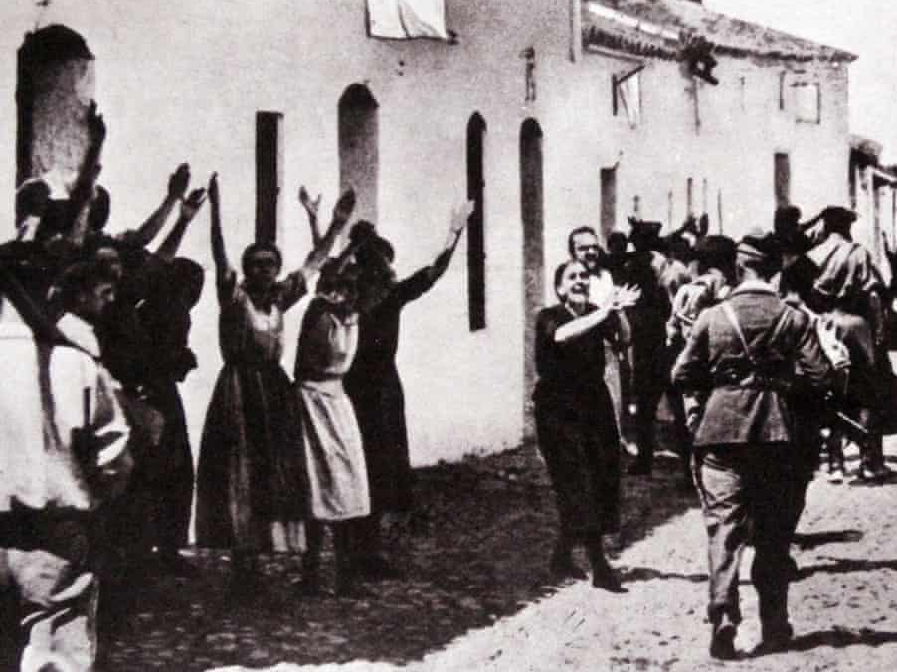
Nationalist Troops Occupy Seville
July 19, 1936
In taking the city, Nationalist troops took 68 Republican prisoners and divide them into 6 groups. Nationalist troops then took these prisoner groups to prominent working-class neighborhoods in Seville and shot them. The bodies of these Republican prisoners were left to terrorize the populations. As Nationalist troops take more villages in the region, Republican prisoners were taken back to Seville to be executed by Nationalist military tribunals.

Slide 23
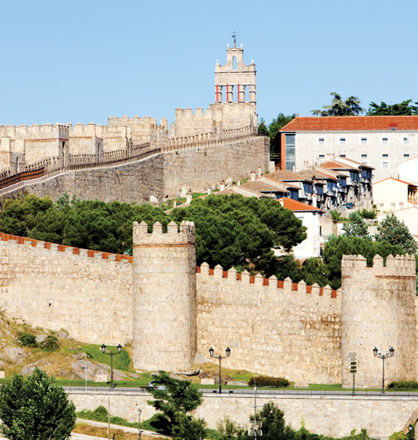
Nationalist Troops Take Ávila
July 19, 1936
After Nationalist troops took the city, Nationalists shot the Civil Governor on August 4th and executed over 600 people across the province

Slide 24
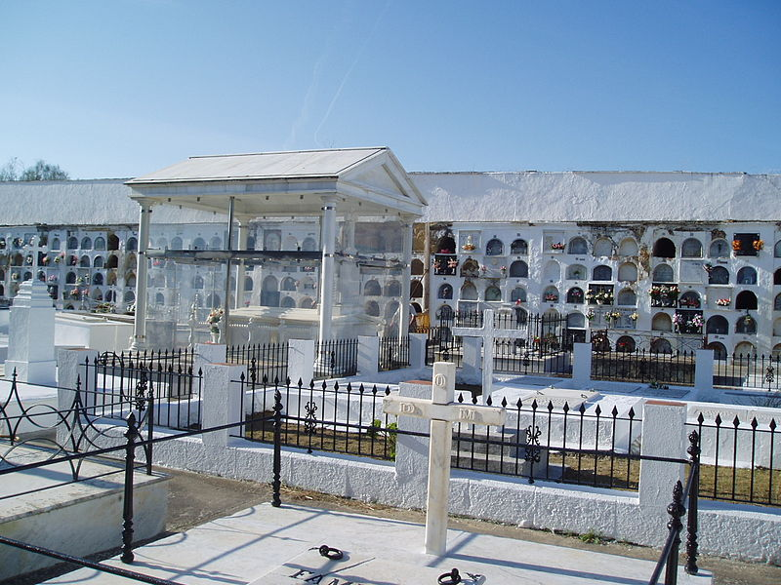
Nationalist Troops Take Arcos de la Frontera
July 19, 1936
After Nationalist troops occupied the city, they shot 86 Republicans.

Slide 25
Nationalist Troops Take Valladolid
July 19, 1936
On July 18th, Nationalist troops arrested 448 leftist men. Historian Paul Preston estimates that around 1000 Republicans, Socialists, and anarcho-syndicalists were arrested from August-September 1936. On July 19th, Nationalist troops arrested and shot the Civil governor and the mayor, and General Saliquet declared martial law. Between July and December 1936, Nationalists tried 1,300 leftists. These “trials” were simply reading the name of the accused, their “crimes,” and their sentence. There was no chance for those accused to make a defense. At least 616 executions were recorded, however, many other killings were carried out by Falangist “dawn patrols” which were more widespread and less public spectacles. Historian, Paul Preston estimates that about 928 people were killed by dawn patrols.

Slide 26
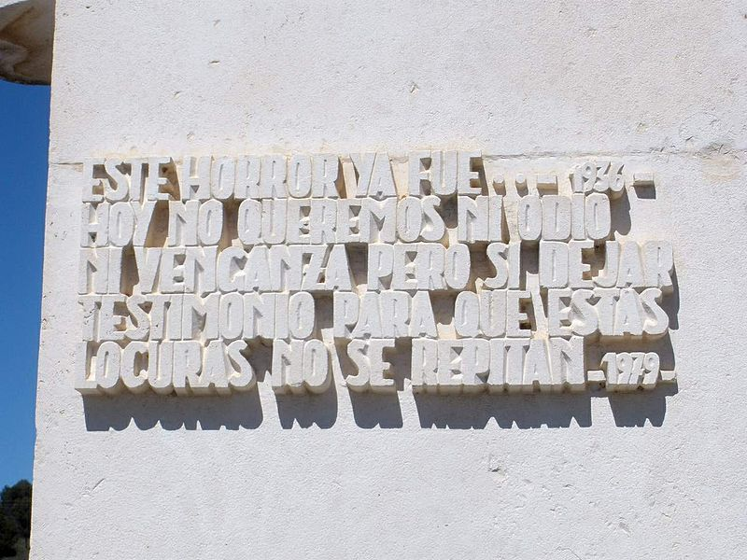
Nationalists Take Logroño
July 19, 1936
On July 19th, Logroño was under control of Nationalist troops. During this occupation, Nationalist troops arrested and executed perceived leftists who were those that did not actively support the Nationalist military uprising. The bulk of the executions of leftists took place over the next 6 months and were extrajudicial.
Around January 1937, military “trials” of leftists begin. To handle the increasing prisoner population, Nationalists converted many buildings into prisons. With the steady stream of leftist executions, the cemetery was full and those killed were then buried in the neighboring town of Lardero.

Slide 27
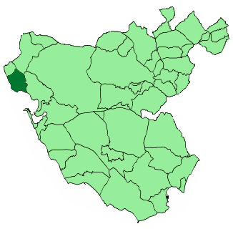
Nationalist Troops take Rota
July 19, 1936
Rebel troops took Rota, Cádiz and shot 60 Republicans.

Slide 28
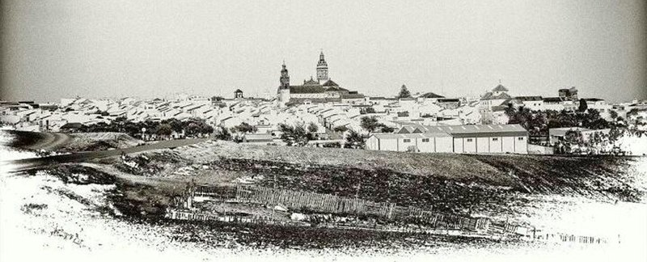
Nationalist Troops Take Fuentes de Andalucia
Jul 19, 1936
After Nationalist troops take the town Fuentes de Andalucía of Seville, these troops rounded up the town's leftists and looted their houses. On July 25th, Nationalists shot the Socialist mayor and three Communist councilors.

Slide 29
Nationalist Troops Take the Region of Galicia
July 20, 1936
By July 20th, Nationalist forces occupied the region of Galicia and began to execute those who did not actively support the Nationalist military uprising. During the first few months of Nationalist occupation there were around 100 executions. Between August 1st and December 1936, there were around 2,500 executions.
Historian Paul Preston estimates that the total number of executions in the province is about 4,560 with about 836 of these being through military tribunal “trials.” In the town of A Coruña, there were around 1,600 executions. In Pontevedra, there were about 1,700. In Lugo, there were 418. Orense saw 569 executions.

Slide 30
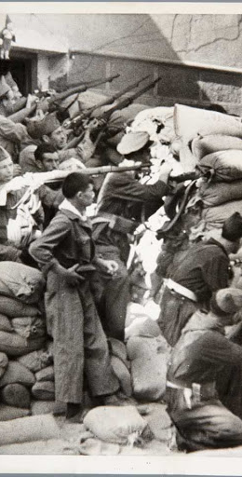
Siege of Alcazar
July 20, 1936 – September 27, 1936
As Republican forces entered Toledo, Nationalist military forces held the Alcazar of Toledo. 1,700 people, including 400 women and children, remained inside the Alcazar. Republican forces requested that women and children be allowed to leave but Nationalists refused. Republicans began daily bombardment and mining the fortress with TNT.
On the 27th of September, the Army of Africa, under Franco, arrived to relive the Nationalist forces. It became an important symbol for Nationalist propaganda.

Slide 31
Nationalist Troops Take Alcalá de Guadaira
July 21, 1936
Nationalist troops took the town Alcalá de Guadaira of Seville. Nationalist troops murdered 137 Republican men and imprisoned and tortured another 350.

Slide 32
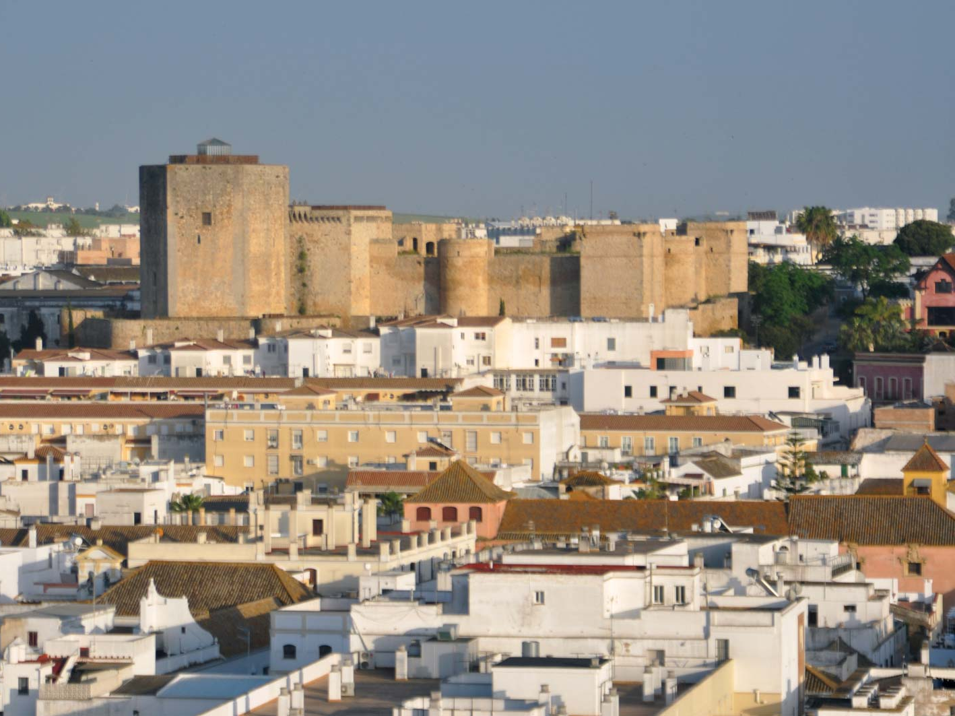
Nationalist Troops Take Sanlúcar de Barrameda
July 21, 1936
After Nationalist forces took the city, Nationalist soldiers shot 80 Republicans. Executions of Republicans at the hands of Nationalist forces continued on August 8th.

Slide 33
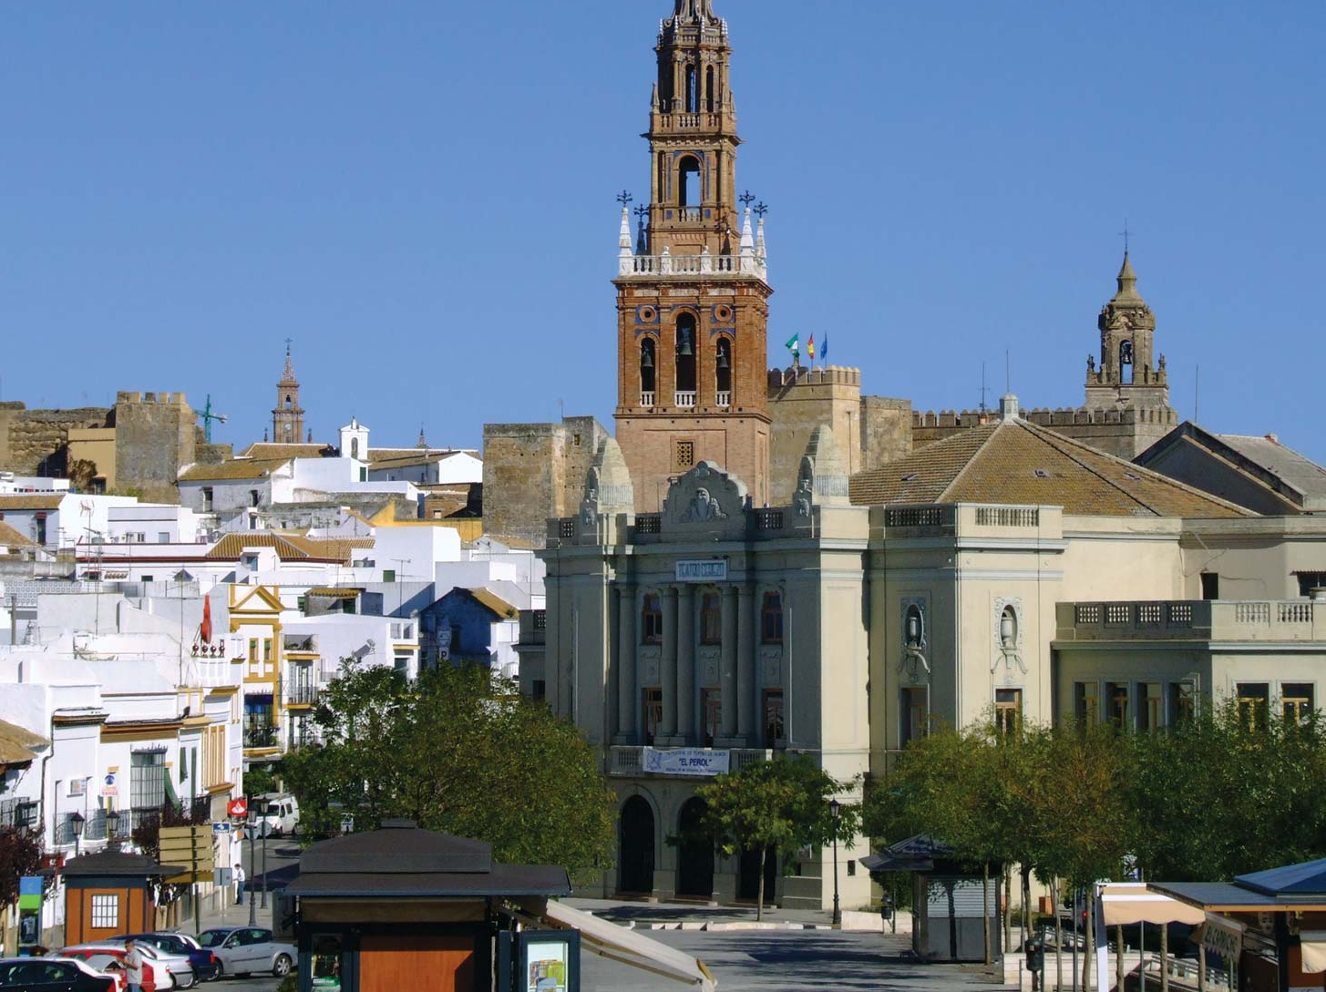
Nationalist Troops take Carmona
July 21, 1936
Nationalist troops took the town Carmona of Seville. Over the next 4 months, Nationalists executed 218 Republicans (men and some women) without trial under the justification of martial law. Nationalists also conscripted large numbers of men into the Nationalist forces.

Slide 34
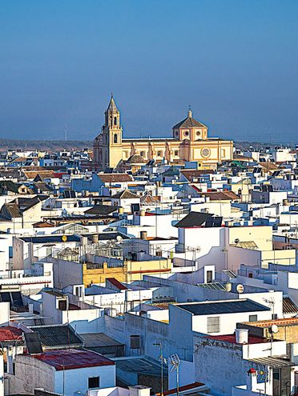
Nationalist Troops Take Arahal
July 21, 1936
After Nationalists troops took Arahal (town outside of Carmona), these troops began to execute those who were not active supporters of the Nationalist military uprising. Accounts of numbers executed vary and it is said that anywhere between 146-1,600 of the town’s inhabitants were executed by Nationalist forces.

Slide 35
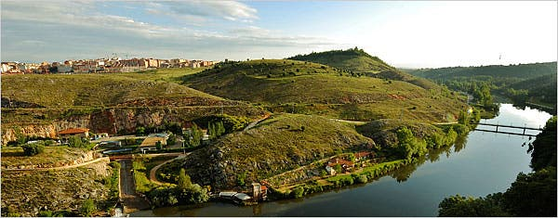
Nationalist Troops Take Soria
July 22, 1936
After taking the city, Nationalist forces executed 300 Republicans.

Slide 36
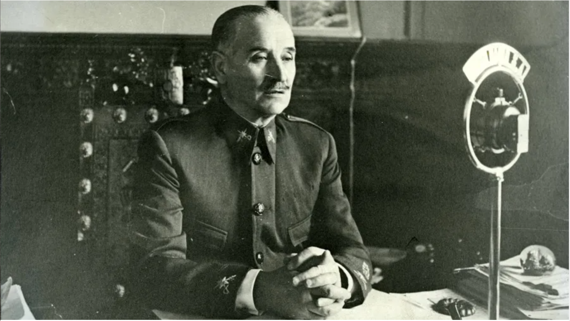
General Quiepo de Llano's Inciting Broadcast
July 23, 1936
During his broadcast, General Quiepo de Llano made an explicit incitement for Nationalist soldiers to rape as they worked their way through the South

Slide 37
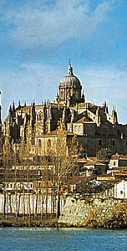
Nationalist Troops Reach Salamanca
July 23, 1936
After the arrival of Nationalist troops, 65 leftists were imprisoned and then in the following week there were more than 400 leftist prisoners. Local Falangists demanded the name of every leftist arrested and then the “sacas” began where prisoners were taken out and shot in the countryside. In the case of Salamanca, lists of leftists had been drawn up in Spring 1936 by local Falangists outlining who was to be eliminated when the military uprising began. The victims of Salamanca were those who opposed the coup, leftist leaders and politicians, union leaders, those who campaigned for the Popular Front.

Slide 38
Establishment of the National Defense Junta
July 24, 1936
The National Defense Junta claimed full state powers and declared themselves a legitimate government while claiming that the Republicans are in military rebellion against the “true” Nationalist government

Slide 39
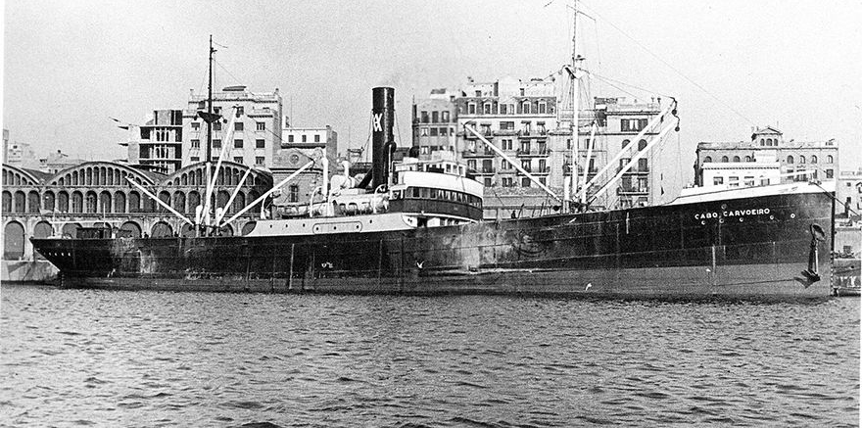
Nationalist Repression of Working Class in Triana and La Macarena
July 25, 1936
Occupying Nationalist forces arrested men of the working-class districts of Triana and La Macarena. Nationalist troops then shot some of these prisoners while others were held on the prison ship Cabo Carvoeiro.

Slide 40
Executions of Leftists in Rociana
July 27, 1936
Occupying Nationalist Troops shot 60 Republicans

Slide 41
Nationalist Troops Arrive in Baena
July 28, 1936
When the Nationalist forces arrive das reinforcement on July 28th, the anarchist guerillas found themselves outgunned and the town fell to the control of Nationalists.
After their victory, Nationalist forces went door to door killing and looting indiscriminately. Those even slightly suspected of opposing the Nationalist cause and supporting the anarchists or the Republic were denounced, rounded up, and shot in the town square. During this time, Nationalists killed 81 hostages, and in the next 2 months, around 700 inhabitants were killed.

Slide 42
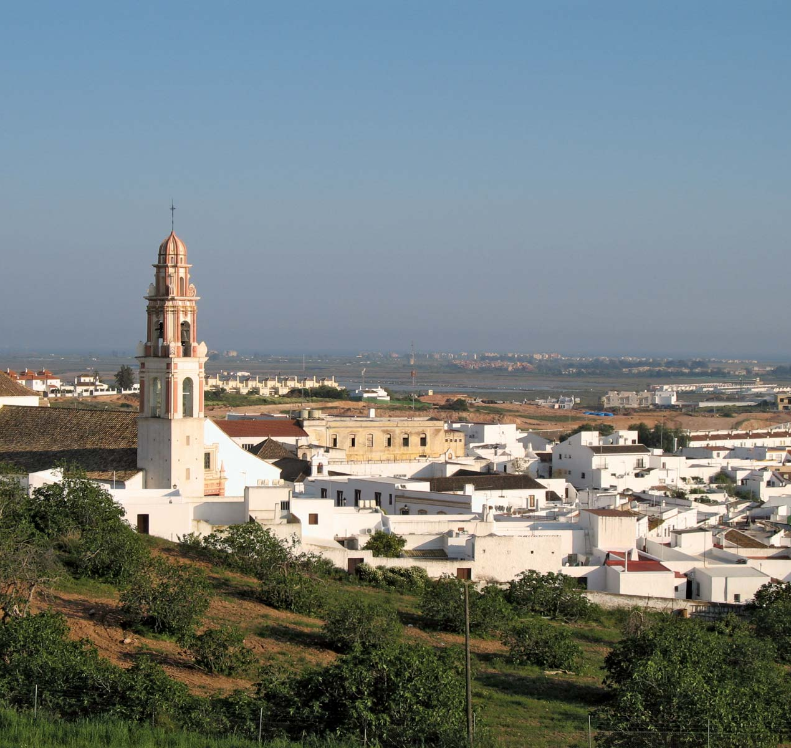
Nationalist Troops Take Huelva
July 29, 1936
After the occupation of Nationalist forces, 400 leftist prisoners were arrested and executed. The city of Huelva became the center for further trials of those in the province who did not actively support the Nationalist military uprising. However, these prisoners were usually murdered in route to Huelva.
In 75 of Huelva’s 78 towns, 6, 019 were executed. Many of these executions were part of the extra-judicial nightly shootings of those who did not stand “trial.”

Slide 43
Nationalist Troops Take Cantillana
July 30, 1936
After Nationalist forces took Cantillana, Nationalist troops imprisoned many townspeople who did not actively support the military uprising. More than 60 were arrested and then transported to Seville to be executed. Over 100 were executed in military trials and 1,000 men (from a town of 9,000) were conscripted to the Nationalist army. To fill in this population gap, women and older men were used by Nationalist forces as slave labor.

Slide 44
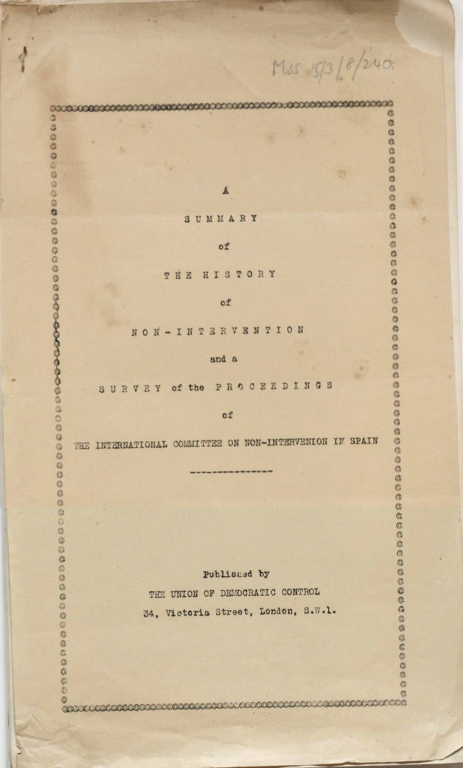
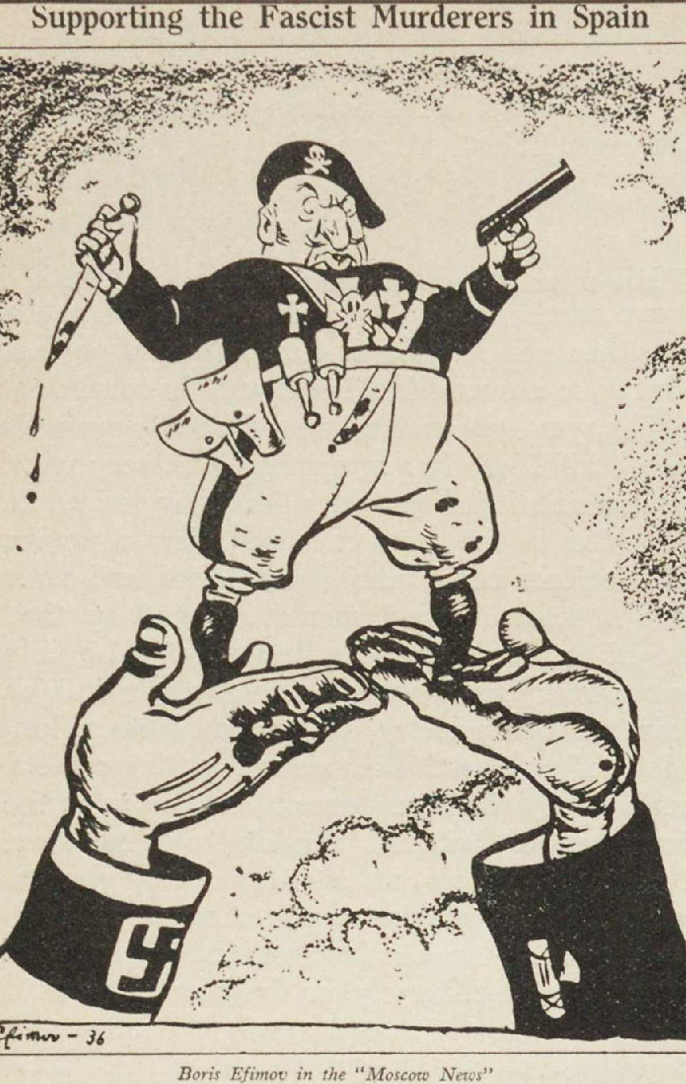
France Calls for Non-Intervention
July 31, 1936
France appealed for Britain and Italy to adopt a non-intervention agreement. France, Britain, Italy, Germany, and the U.S.S.R eventually signed this agreement.
However, Italy and Germany openly violated the agreement by providing military equipment and personnel.
France operated a selective non-intervention policy, sometimes allowing a porous border with Spain. This meant that the Republican side was unable to adequately plan, though it received some assistance from the U.S.S.R.
In October, the first International Brigades arrived in Spain. Over the course of the war, 60,000 foreign volunteers, directed by Communist International, fought on the Republican side.

Slide 45
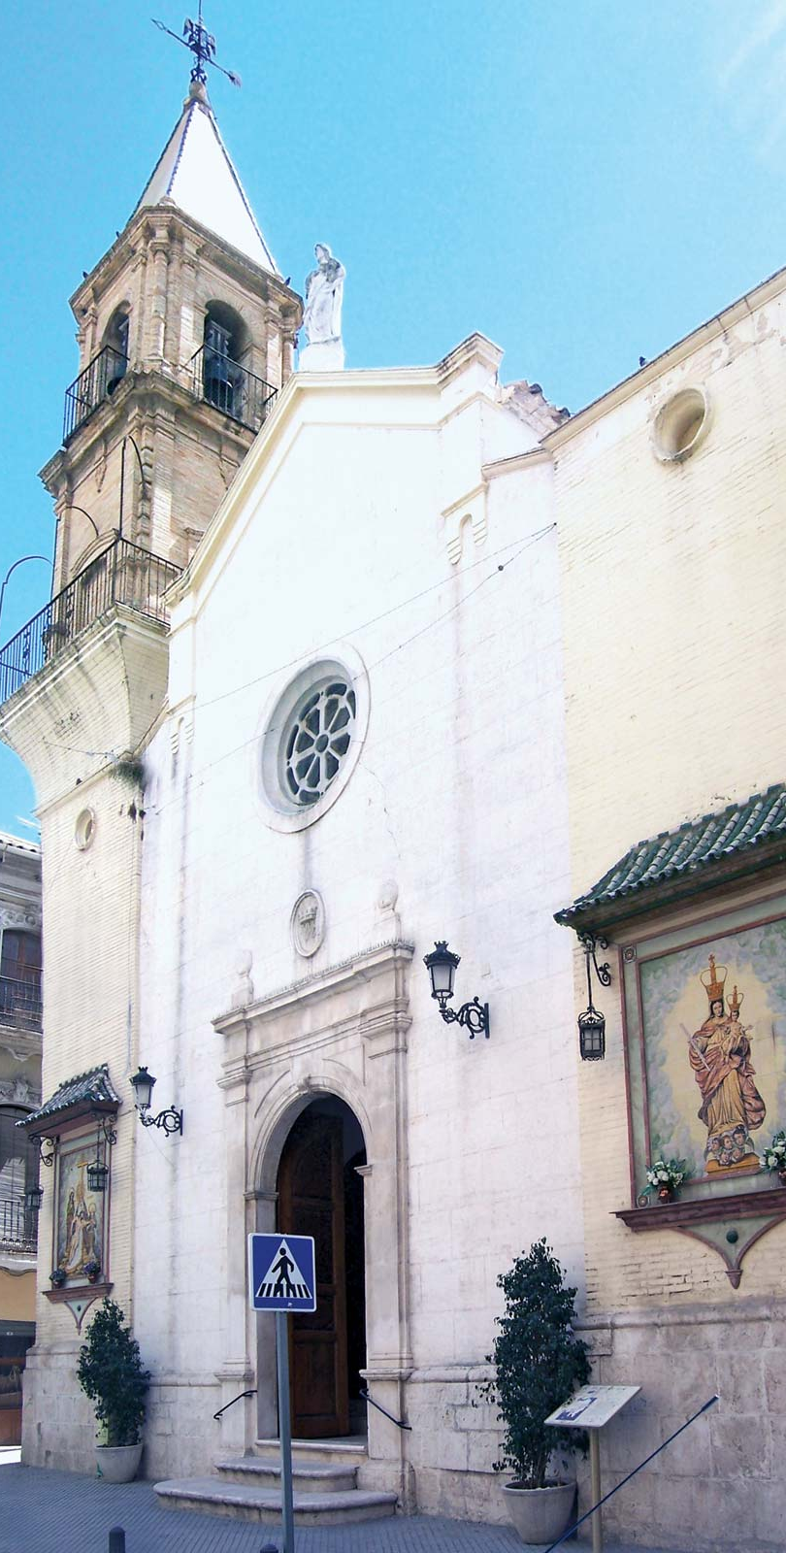
Nationalist Troops Arrive in Puente Genil
August 1, 1936
On August 1st, additional Nationalist troops made their way to Puente Genil and threatened to take 100 lives for every right-wing victim of leftist reprisals. Once Nationalist forces entered the town, Nationalist soldiers began to indiscriminately kill and rape the town's leftist population. Leftist men were taken off the street or pulled from their homes by Nationalist forces who then tortured and shot them. It is said that 500 leftists were killed by Nationalists on the first day of occupation. Over the next few months another 1,000 leftists were executed by Nationalists.

Slide 46
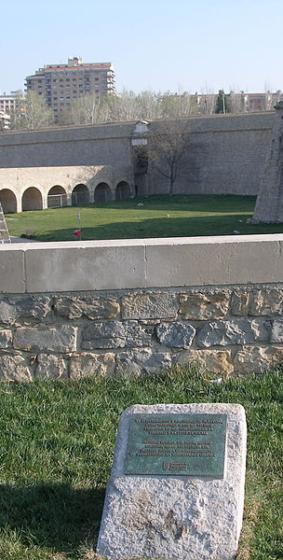
Executions in Pamplona
August 1936
Executions began in Pamplona in front of large crowds. Many of these executions were reprisals committed by zealous Nationalist supporters who also took hostages. Some leftists were kidnapped after dark by the Falangist squad “Black Eagle” and then shot in the outskirts of the city. Historian Paul Preston estimates that around 2,822 men and 35 women were killed in the province and 305 died due to conditions in the prisons.

Slide 47
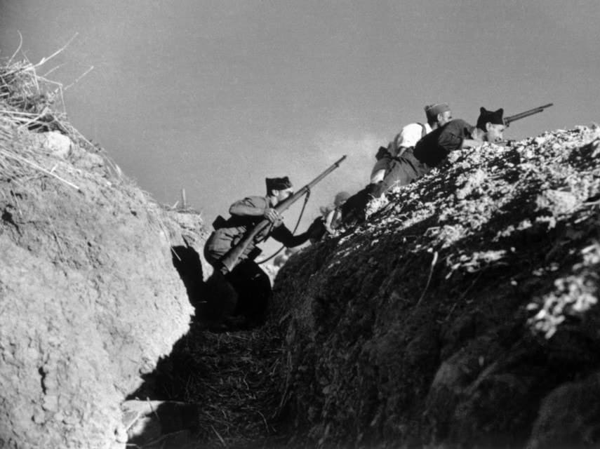
Nationalist Forces Take Córdoba
August 5, 1936
Almost all of Córdoba was in Nationalist hands. Arrests and executions of those who did not actively support the military uprising began based on denunciation lists provided by local landowners and priests. Nationalists arrested 109 and killed the mayor. Others are shot by Nationalist soldiers and left in the street. Historian Paul Preston estimates that 11,500 people are executed by Nationalists in the province of Córdoba between 1936-1945.

Slide 48
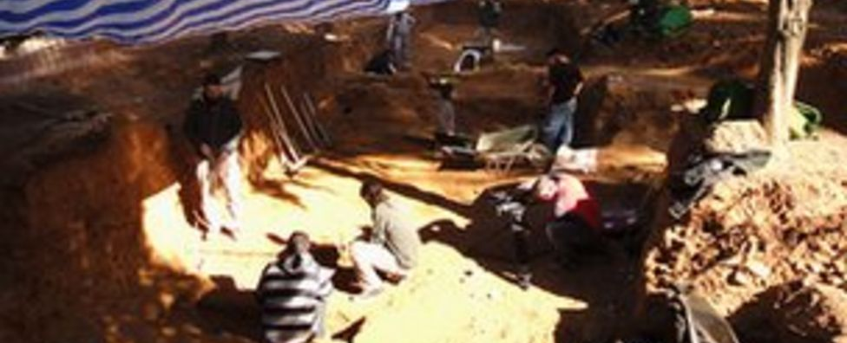
Nationalists Troops Take El Poderoso, Constantina, and Cazalla de la Sierra
August 5, 1936 – August 12, 1936
In Constantina, Nationalist forces carried out reprisals for the atrocities committed by anarchist groups against Nationalist supporters. 300 inhabitants were executed by Nationalists and 3,000 flee the town. Similar reprisals were carried out by Nationalist troops in Cazalla de la Sierra where 76 were tried and executed.

Slide 49
Nationalist Forces Take Lora del Río
August 7, 1936
On August 7th, Nationalist troops arrived and began reprisals against Republican forces. Inhabitants of the town were shot by Nationalists based on denunciations.
Nationalists then tried 300 townspeople without any opportunity for defense. Between 600-1,000 inhabitants of Lora del Río were killed with these Nationalist military tribunals.

Slide 50
Franco promises liberal democracy after war
August 8, 1936
“We started the revolt only after it had become self-evident that the government were playing into the hands of the Communists and extreme Socialists and that there was no justice for others”

Slide 51
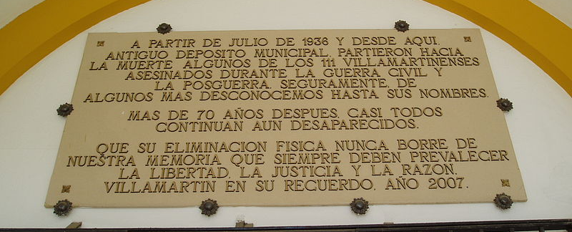
Nationalist Troops Take Villamartín
August 13, 1936
After Nationalist forces take the city, between July 1936 and February 1937, 112 Republicans were shot by Nationalists.

Slide 52
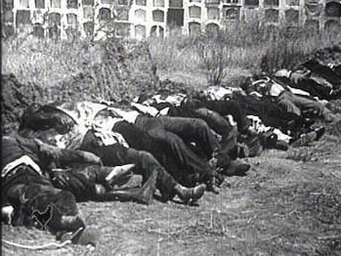
Nationalists Troops Take Badajoz
August 14, 1936
As Nationalist forces led by Colonel Juan Yague took the city, Yague encouraged troops to rape supporters of the Popular Front and became known as “The Butcher of Badajoz.” It is estimated that 2,000-4,000 civilians were massacred, namely by the Moroccan troops.

Slide 53
Nationalist Reprisals in Triana
August 16, 1936
72 Republicans were shot by Nationalists during reprisals in Triana.

Slide 54
Nationalist Troops Take Benambomba
August 18, 1936
After Nationalist forces took the city, 50 leftist prisoners were detained, beaten, and shot by Nationalist soldiers. These soldiers also looted prisoners' houses and sexually abused their spouses.

Slide 55
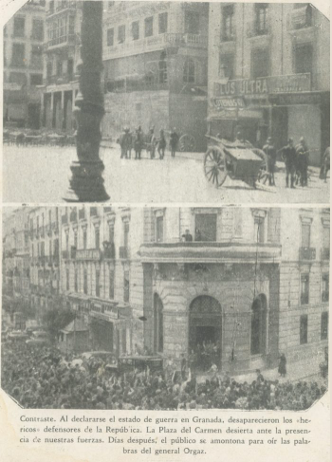
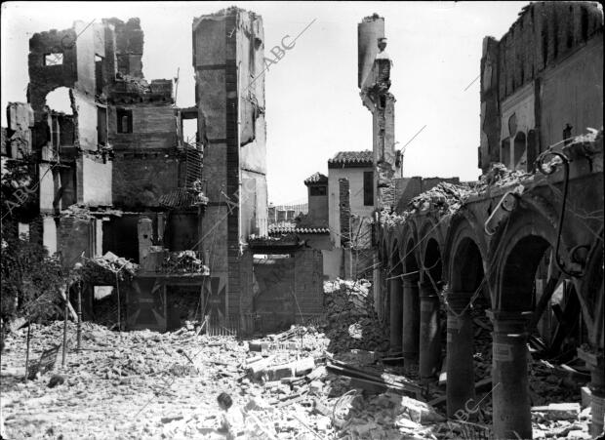
Nationalist Troops Take Granada
August 18, 1936
The center of Republican resistance in Granada, the working-class district of the Albaicin, fell. Doctors, lawyers, writers, artists, schoolteachers, and workers were taken out of their homes at night and shot in the cemetery. The killings were carried out for the most part by locals recruited to the Nationalist cause. One group, the “Black Squad,” was given permission by Nationalist forces to terrorize the town.

Slide 56
Nationalist Troops Take El Campillo
August 28, 1936
After the Nationalist troops took the village, Nationalist soldiers executed 288 inhabitants who did not actively support the uprising. Nationalist soldiers executed another 143 as they fled north to Badajoz.

Slide 57
Nationalist Military Granted Judicial Powers
August 31, 1936
After the declaration of martial law in any territory in Nationalist hands, this decree allowed any military officer to act as a prosecutor, judge, or defender in the trials of those deemed enemies of the Nationalists.

Slide 58
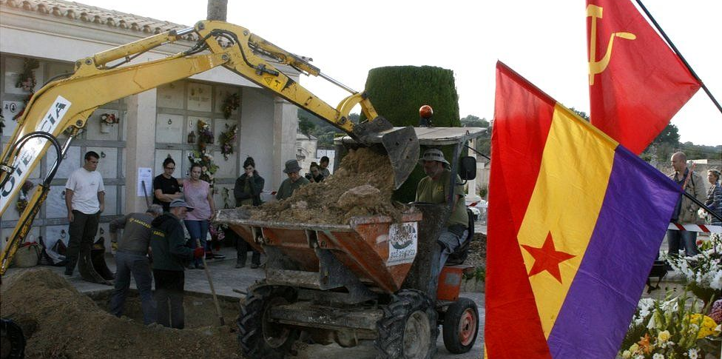
Nationalists Troops Take Mallorca
September 12, 1936
In Mallorca, Nationalist troops executed 1,200.

Slide 59
Outlawing of Parties and Organizations Against the Nationalist Movement
September 13, 1936
The National Defense Junta outlawed all parties, trade unions, and social organizations that supported the Popular Front and opposed the National Movement. The documents and property of these entities were also seized. In additions to political parties and leftist organizations, Freemasons and Jews were also made targets. The decree also ordered the purging of Civil servants, schoolteachers, etc. who supported the Republic and its institutions.

Slide 60
Nationalist Troops Take Alcalá del Valle
September 18, 1936
Nationalist troops arrested 30 inhabitants who did not actively support the uprising. These prisoners were then tortured and shot.

Slide 61
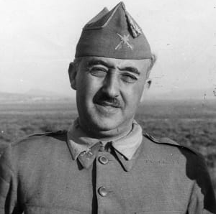
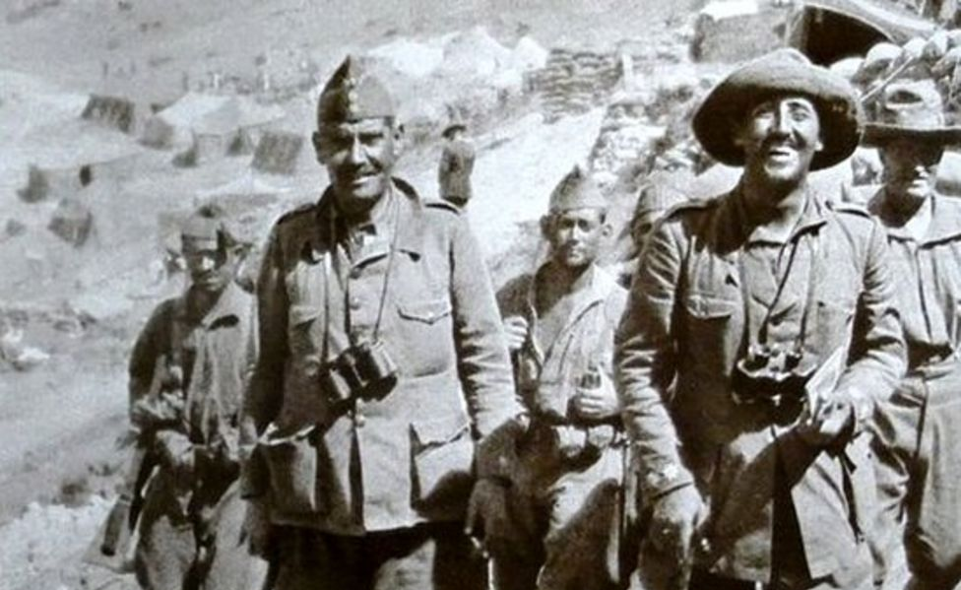
General Franco
October 1, 1936
Franco was officially declared head of the rebel state on October 1st, 1936.
Franco spent 10 and a half years in Spanish North Africa as head of the Spanish Legionnaires, which would later be responsible for massacres during the war. Many of the other "Africanista" army officers played a key role in the Nationalist troops, and as such, they adopted a similar colonial attitude to the landless poor, viewing them as virtual slaves. He later declared that his experience in Africa made the "saving of Spain" possible: "without Africa I cannot explain myself to myself or my comrades in arms."

Slide 62

Repression in Ribera
October 1936
After Nationalist forces took the region, Nationalist troops began a harsh repression of Ribera which had been a stronghold of the Socialist land workers union. In Sartaguda, 84 of its 1,242 inhabitants were killed through extrajudicial executions. It is estimated that 10% of working-class men were killed. In Peralta, 89 of its 3,830 inhabitants were killed.

Slide 63

International Brigades arrive in Spain
October 13, 1936
First International Brigades arrived in Spain. 60,000 foreign volunteers fought on the Republican side over the course of the war directed by the Communist International.

Slide 64
Nationalist Troops Reach Monreal
October 21, 1936
Nationalist forces executed 65 Republican prisoners near Monreal.

Slide 65


Siege of Madrid
Oct 1936 – Mar 1939
The siege of Republican-held Madrid by Nationalist forces began in November 1936 and lasted 28 months.
Nationalists initially made attempts at taking the city but fail after vital arms were sent from the USSR to the Republican troops. This turned into a long war of attrition, with battles on the outskirts of the city, including some of the bloodiest battles of the war. Nationalist troops bombed the city and food shortages occurred throughout the siege.

Slide 66

Prime Minister Primo de Rivera Executed
November 30, 1936

Slide 67
Executions in La Rioja Province
December 1936
Historian Paul Preston estimates that by December 1936 there had been 2,000 executions of Republicans in La Rioja province with the harshest repression in the towns along the River Ebro where the Popular Front got the most votes in the region. In Logroño 595 were executed, Calahorra 504, Harro 309, Alfaro 253, and Arnedo 190.

Slide 68
Attack on Málaga Begins
January 17, 1937
General Queipo de Llano launched an attack on Málaga.

Slide 69
Nationalist Troops Take Málaga
February 8, 1937
After Nationalist and Italian troops occupied the city, for a week, civilians were barred from entering the city proper as Republicans were rounded up by Nationalist forces and shot based on the slightest denunciation.
After the initial roundup and shootings, there were so many prisoners that concentration camps were established at Torremolinos and Alhaurin el Grande. In the following 7 weeks, 3,401 people had been tried by Nationalist military tribunals, and of those, 1574 had been executed. Around 100,000 refugees attempted to flee on the road to Almería, however, with little supplies, around 3,000 died in route.
By the end of 1938, Nationalist forces execute at least 3,027 people.

Slide 70

Concentration Camps for Vizcaya Offense
March 1937
In preparation for an offensive on Vizcaya, Franco ordered the creation concentration camps to handle the potential number of prisoners.
Camps classified prisoners as: suspected “red criminals” (to be sent to military courts), “sympathisers of Nationalists” (to be released) and prisoners of war (to be used as labor).

Slide 71


Bombing of Guernica
April 26, 1937
The city of Guernica was bombed by the German air force (Luftwaffe).
Hundreds of civilians are killed to quell Basque appetite for independence and demoralize civilians. Its brutality inspired a painting by Pablo Picasso.
This event also demonstrated the effectiveness of terror bombing to Nazi commanders.

Slide 72
Identifying Enemies of the Patria
May 29, 1937
Marcelino de Ulibarri Eguílaz was named head of the Delegation of Special Services which was to recover all documentation on enemies of the Patria where it can be classified and archived in an effort to identify and punish these enemies. The Office for the Recovery of Documents was established and eventually merged to become State Delegation for the Recuperation of Documents (DERD).

Slide 73
Nationalist Forces Take Segovia
June 6, 1937
After Nationalist forces took the city, Nationalist supporters looted, tortured, sexually violated, and killed those supporters of the Republic under the loose supervision of the new Nationalist Civil Governor. Nationalist military authorities either turned a blind eye to, provided justification for, or even ordered the murder of those that did not actively support the coup. The military allowed local vigilantes who went around in mobile units to carry out their “dirty work.”
After the initial purging of the city, killings continued on the basis of denunciations. Victims were usually those that were accused of being Republicans, Freemasons, and Marxists. There were no “judicial proceedings” and those that the Nationalists rounded up were taken to the capital and shot in route. Some prisoners were taken by truck and let go, but then were shot in the back by Nationalists as they tried to flee. 217 were executed over the course of the war, 175 died after sentences in military tribunals, 195 died due to the conditions in prison

Slide 74
Franco Takes Control of Concentration Camps
July 1937
The Inspectorate of Prisoner Concentration Camps was established for the duration of the war. This agency took the place of territorial armies and assumed control of the camps. Through this agency, Franco was able to take direct control of the camps.

Slide 75

Amassing Information on Enemies in Salamanca
November 1937
Nationalists created a political information repository from captured Republican documents in Salamanca. This redoubled efforts to amass detailed information on individuals from documents seized from leftist, Freemasonry, anarchist, pacifist, feminists, etc. organizations.

Slide 76


Air Raids on Barcelona
December 1937
Nationalist air raids on Barcelona began. These air bombings were devastating; outside observers found disbelief that Franco was bombing his “own” people. Franco's idea of the purification of Spain led these cities to be seen as sources of “moral pollution.”
From the 16th to the 18th of March, further bombings by Italian planes killed 1,300 and injured 2,000.
After taking the city in January 1939, Nationalist forces declared martial law and began military investigations against Catalonia’s pre-war Civil Guard, which stayed loyal to the Republic. These Civil Guards faced the firing squad for the crime of “military rebellion.”

Slide 77
Collecting Information on Republican Enemies
February 1938
The regime had been collecting information on suspected Republicans, and by this time, information had been collected on over 500,000 Republicans nationally in the form of blacklists.

Slide 78
Consolidating Agencies to Identify Enemies
August 1938
All security services and document agencies were unified under the National Security Service under Lt Cl José Medina. The National Security Service contained the department, Investigation and Security Police, which had the Antimarxism division with subsections for the investigations of Freemasonry, Judaism, and publications. This overarching agency redoubled efforts to sift through captured documents. The files put together by this agency would help carry out the purges under the Special Tribunal in 1940.

Slide 79

Francoist Postwar Rewriting of the History of the Civil War
1939 – 1975
Control over the history of the Spanish Civil War, Republican repression, and crimes committed against Nationalists was a way for the victors to retroactively justify the military uprising and their rule, as well as craft a new Spanish identity under the regime and uplift the martyrs who died for the Nationalist cause. Nationalists interpreted the Spanish history of colonial and religious wars as proof that Spanish identity is defined by struggle. Therefore, the civil war was justified and affirmed the Spanish identity. Nationalists also painted the Civil War as a means to re-Christianize Spain and to eliminate the decadence of the “Red” Republican government. This interpretation reflected the marriage of Nationalism and Catholicism in Francoist ideology.
Schools had indoctrination courses, such as “Formation of the National Spirit” for boys and “Teachings of the Home” for girls. Nationalists established holidays and monuments, such as the Valley of the Fallen, to honor its martyrs. Churches across the country had lists of local martyrs displayed in commemoration.

Slide 80
Redemption of Sentences through Work Program
1939
The Redemption of Sentences through Work program (Redención de Penas por el Trabajo) was established so that convicted prisoners could “redeem” themselves of their crimes through forced labor

Slide 81
Nationalist Occupation of Barcelona
January 26, 1939
After taking the city, Nationalist forces declared martial law and began military investigations against Catalonia’s pre-war Civil Guard who stayed loyal to the Republic. These Civil Guards faced the firing squad for crime of “military rebellion.”

Slide 82
Law of Political Responsibilities
February 9, 1939
This 1939 decree established the Law of Political Responsibilities which targeted all who did not support the military uprising. These cases were handled by the National Tribunal of Political Responsibilities and relied upon denunciations. Punishments for the guilty included execution, imprisonment, fines, and purges of professionals and civil service workers.

Slide 83

The Bellon Commission
February 15, 1939
The Bellon Commission report “Dictamen de la Comisión sobre ilegitimidad de poderes actuantes el 18 de julio de 1936” was released. This commission looked at the illegality of the Republic. This added legitimacy to military tribunals and painted the Republic as illegitimate.

Slide 84

Nationalist Troops Take Madrid
March 29, 1939
After Nationalist forces took the city, there was a concentrated effort to track down “Red criminals” and restore “order.” Nationalist troops arrested suspected Republican supporters. In the first week of Nationalist control, there were around 1,700 arrests. To handle the number of prisoners, concentration camps were created.
On March 31st, Nationalist troops ordered all members of the former Republican army garrison to report to concentration camps established in Carabanchel, El Pardo, Rivas de Jarama, Perales de Tajuna, Tielmes, Chinchon, and the football field of Charmartin and Vallecas. By April 5th, there were around 48,900 prisoners. Through the military judiciary apparatus, Nationalists executed 3,113 over the period of 1939-44.

Slide 85


Franco controls all of Spain
March 1939
Franco won control over all of Spain.
It is estimated that 100,000 executions had taken place by this point.
Franco delivered his New Year speech, placing responsibility for the war on Republicans and declaring that punishment is justified because of the damage they caused. This rationale became the basis for military tribunals punishing the crime of “military rebellion”.

Slide 86

Republican Atrocities
1936
Whilst atrocities on the Nationalist side of the war and subsequently under the Franco regime were numerous, atrocities and killings did occur at the hands of Republicans during the war.
Notably, anti-clerical violence from Republican supporters claimed the lives of 7,000 clergy, priests, monks and nuns were killed, mostly at the beginning of the war. This has been called the "red terror" by historians.
Dr Julius Ruiz published a book (El Terror Rojo) on Republican atrocities in the war, challenging previous conceptions about the nature of these atrocities and arguing that these were organized rather than "uncontrolled" killings that occurred. It is important to recognize that whilst the genocidal campaign committed by the Nationalists under Franco is the main subject of this Timestream, their brutality does not absolve the Republican side from crimes committed during this time as well.

Slide 87

Violence of the Civil War and Franco Regime
1936 – 1975
The overall casualties during the Spanish Civil War is around 500,000 deaths. 200,000 of those deaths are reported to be combat-related with 110,000 being of Republican forces and 90,000 being of Nationalist forces.
The reports of non-combat executions vary. Estimates based on provincial data claim Nationalists executed 110,000-159,000 during the war and the first nine years of the Franco Regime in what is called the "White Terror." Historian Paul Preston puts this number at around 180,000. It is estimated that 43,000-55,000 were also killed during the war behind Republican lines in what is called the "Red Terror."
Additionally, around 5,300 foreign soldiers died while fighting for the Nationalists and 4,900 died fighting for the Republicans. 10,000 Spaniards died during bombing raids which were predominately carried out by German military.

Slide 88
Continuation of Military Tribunals
April 1939
The widespread use of the repressive military judicial apparatus developed during the war continued after the war to persecute the opposing side or those considered against the Nationalist movement.

Slide 89

Francoist Concentration Camps and Forced Labor
1936
During the civil war, nationalist forces established concentration camps to handle the rapidly increasing prisoner population in Nationalist-occupied territories. The camps classified prisoners as suspected “red criminals,” who would be sent to military tribunals, “sympathizers of Nationalists,” who would be released, and prisoners of war, who would be used as slave labor.
In 1937, Nationalists established the Inspectorate of Prisoner Concentration Camps to assume direct control of the camps. In 1939, Nationalists created the Redemption of Sentences through Work Program so prisoners could “redeem” themselves of their crimes through forced labor. The Militarized Penal Colony Service utilized prisoner labor for public works projects. Notable camps include those established in preparation for the Vizcaya offensive, as well as camps in Carabanchel, El Pardo, Rivas de Jarama, Perales de Tajuna, Tielmes, Chinchon, the football field of Charmartin and Vallecas, the bullring and the castles of San Fernando and Santa Barbara in Alicante, and Albatera.
After the end of the war, half a million refugees fled to France, where many ended up in internment camps. After Nazi German forces defeated France, they conscripted Spanish Republicans for forced labor. They also sent 30,000 to Germany, where many ended up in concentration camps.

Slide 90


Concentration Camps Established in Alicante
April 7, 1939
Nationalists established informal concentration camps in Alicante. Nationalists took 15,000 prisoners to the bullring in Alicante and the castles of San Fernando and Santa Barbara. 30,000 were sent to a concentration camp built in Albatera where they would be put to work draining the salt marsh.

Slide 91
The Militarized Penal Colony Service
September 9, 1939
Nationalists set up the Militarized Penal Colony Service to utilize prisoner free labor for public works projects.

Slide 92

Franco's end of year address
Dec 30, 1939
Franco delivered his New Year speech placing responsibility for the war on Republicans and declaring that punishment is justified because of the damage they caused. This rationale became the basis for military tribunals punishing the crime of “military rebellion.”

Slide 93

Postwar Continuation of Judicial Military Apparatus
1939
The widespread use of these repressive military judicial apparatus developed during the war continued after the war to persecute those considered against the Nationalist movement.
By the end of 1940, the Information and Investigation Service of the Falangist security branch had collected the political information on 2,962,853 people. At this time, Franco was informed that military tribunals had already convicted 40,000 people for the act of “rebellion” since April 1939.
By 1943, Madrid military tribunals had given out 25,000 sentences

Slide 94

Legal reforms
January 1940
The 1939 Law of Political Responsibilities targeted all who did not actively support the National movement or military uprising (both coups in 1934 and 1936). These cases (including those carrying over from wartime military tribunals) were handled by the National Tribunal of Political Responsibilities and relied upon denunciations. If one failed to denounce, they too could be subjected to a court-martial. Punishments included execution, imprisonment, and fines. This aided in the purging of professionals and civil service workers.
In 1947, The Law of Banditry and Terrorism (Ley de Bandidaje y Terrorismo) was introduced as a culmination of these legal reforms. Under this law, anyone shouting ‘Viva la República,’ for example, could receive up to 14 years in prison for ‘inciting rebellion.’

Slide 95

The Law for the Repression of Freemasonry and Communism
February 1940
Francoist government equated Freemasonry and Communism with treason and held responsible for the “decadence of Spain...that culminated in the terrible atheist, materialistic, anti-militarist and anti-Spanish campaign.” Communism and Freemasonry were also linked with Judaism to form the idea of the "Jewish-Bolshevik-Masonic" conspiracy. The Franco regime compiled a register of 80,000 Freemasons that are liable for punishment. Sentencing and punishment would be doled out by the Special Tribunal for the Repression of Freemasonry and Communism.

Slide 96

The Causa General
April 26, 1940
The Francoist Attorney General instituted the “General Cause” or Causa General. The Causa General's objective was to provide the “History and the Government” and the “complete story” of the criminality under “Marxist rule.” In other words, the Causa General's objective was to prove the criminality of the Second Republic to legitimize the idea that the Nationalists were right in rising up against the “red” government in self-defense in order to restore law and order.

Slide 97
Postwar Military Tribunal Convictions
May 1940
Franco was informed that military tribunals had already convicted 40,000 people for the act of “rebellion” since April 1939.

Slide 98
Postwar Madrid Military Tribunals
July 1942
At this time, Madrid military tribunals had given out 25,000 sentences.

Slide 99
Postwar Executions
November 1940
By this date there were over 50,000 post-war executions and around 280,000 prisoners.

Slide 100
Collecting Information on Political Enemies
December 1940
By the end of 1940, the Information and Investigation Service of the Falangist security branch had collected the political information on 2,962,853 people.

Slide 101
UN General Assembly Res condemns Franco regime
February 8, 1946
UNGA Res 32(1) condemned the Franco regime.

Slide 102
UN Security Council Res on "The Spanish Question"
April 16, 1946
Continued condemnation of Franco regime due to his support for the Axis powers in WWII:
  “It was established that the question of the Franco regime is not an internal affair of interest to Spain alone but an international problem which concerns all the United Nations”
  “Under the Franco regime Spain continues to be an armed camp”

Slide 103
Martial Law Ends
April 1948
Martial law instituted during the war finally ends in the majority of Spain.

Slide 104
Franco: no real peace for years to come
July 17, 1948
Franco warned Spain that they could expect no real peace for years to come. “The appearance of physical peace should not be mistaken for moral tranquility.

Slide 105

Spain admitted to the UN
December 13, 1955
Spain was admitted to the UN, despite previously condemning the Franco regime due to its relationship with the Axis powers in WWII. Attitudes changed with the Cold War dynamics and Spain's anti-communist stance was looked upon favorably.

Slide 106

Euskadi Ta Askatasuna (ETA) founded
December 31, 1958
Euskadi Ta Askatasuna (ETA) armed separatist group founded, seeking Basque independence.

Slide 107

25th Anniversary of Civil War
July 17, 1961
Franco ruled with less with force and more with “skillful juggling of the power blocs that make up his regime”.
Questions posed in NY Times about the future and sustainability of Franco’s rule. “What mainly preserves General Franco’s grip is his censorship on all fresh ideas. The windows and doors sealed to free thought while monotonously repeating memories of civil war communism, anarchism, pillage and chaos.”

Slide 108
ETA attempts to derail train carrying politicians
July 17, 1961
On the anniversary of the 1936 military coup, ETA attempted to derail a train carrying politicians. Franco's regime responded with road controls, arrests, house searches and the widespread use of torture. This is the first attack of many to come from the ETA throughout the 60s-90s.

Slide 109
Franco decrees Amnesty
November 11, 1966
Franco decreed Amnesty for those convicted of political crimes before and during the war.

Slide 110

Franco approves return of Picasso
October 28, 1969
Franco approved the return of Picasso and to acquire his famous "Guernica" painting depicting the bombing there by Franco's forces during the Civil War.

Slide 111


Social Danger Laws passed
April 7, 1970
Social Danger Laws punished LGBTQ+ people, including confining them to asylums and banishment. This was a continuance of their punishment since the Civil War where about 5,000 people were convicted, sent to camps and subject to electro-therapy. They were viewed as "an illness and danger to society." These punishments were abolished in 1978 after the death of Franco, but victims are still campaigning for reparations.

Slide 112

Francisco Franco Dies
November 20, 1975
Franco died and was succeeded by King Juan Carlos. Spain made the transition from dictatorship to democracy, and withdrew from the Spanish Sahara, ending its colonial empire.
Franco was buried at the Valley of the Fallen, a memorial he claimed to have built for both sides of the war. It houses more than 30,000 dead and was partially built by forced labor of political prisoners.

Slide 113

First Free Elections After the Dictatorship
June 1977
First free elections in four decades were held. Ex-Francoist Adolfo Suárez's Union of the Democratic Center managed a relatively smooth transition to stable democracy.

Slide 114

The Law of Amnesty
October 17, 1977
As part of Spain's transition towards democracy, the government passed the Law of Amnesty or "La Ley de Amnistía" which pardoned all crimes of political intent from the beginning of the Civil War in 1936 up to the ratification of the law in 1977. This law is still active to this day and remains a legal barrier for properly investigating said crimes and honoring the victims’ right to truth.

Slide 115

The Association for the Recuperation of Historical Memory (ARMH) created
September 30, 2000
The Association for the Recuperation of Historical Memory (ARMH) was created to assist in the exhuming of mass graves and address questions of historical memory. Since then, they have carried out a total of 158 exhumations, recovering 1,337 victims. They have information on more than 400 mass graves, many of which still await exhumation.

Slide 116
Human Rights group report highlights plan of extermination
April 13, 2004
Human rights group Nizkor issued a report with other groups questioning the impunity in Spain for crimes under Franco. It highlighted that the regime acted on a plan of extermination.

Slide 117


Law of Historic Memory
December 27, 2007
In 2007, the Spanish government passed the Law of Historic Memory or "La Ley de Memoria Histórica" in order to address the atrocities committed by the Nationalists during the Civil War and the Franco Regime. The law recognizes victims who suffered “convictions, sanctions and any forms of violence” including exile due to their political, ideological, or religious beliefs or their affiliation with certain “political parties, unions, religious or military organizations, minorities, ethnic groups, secret societies, Masonic lodges, and resistance groups.” The law also declares illegitimate the tribunals both during and after the war and orders vestiges to the Franco regime be removed.

Slide 118

Identifying the Remains of Victims
December 27, 2007
The Law of Historic Memory outlines the protocols to exhume mass graves and identify victim remains. The role of the state is to collaborate with public administrations as well as provide subsidies for exhumation efforts. So far, over 2,740 mass graves have been located

Slide 119
Reparations for Victims
December 27, 2007
The Law of Historic Memory outlines reparations for victims. Victims or their descendants are eligible to apply for a declaration of personal recognition and reparation from the Ministry of Justice. This includes pensions for widows and family members of those who died or were injured fighting in the Civil War. This also extends to those who died due to their “political and union actions or opinions” during this time. Those who were imprisoned for three or more years as a result of a conviction from the aforementioned judicial bodies are also eligible for a one-time compensation.

Slide 120

Judge Baltasar Garzón Attempts to Investigate Nationalist Attrocities
2008
In 2008, Judge Baltasar Garzón attempted to assume jurisdiction and launch a judicial investigation into the thousands of alleged forced disappearances from 1936-1952 which he considered crimes against humanity. To claim jurisdiction, Garzón used the argument that the Law of Amnesty is a pre-constitutional act and therefore could be ignored by any judge that deems it unconstitutional.

Slide 121

Supreme Court Decision 101
2012
In 2012, the Spanish Supreme Court upheld the constitutionality of the Law of Amnesty with Decision 101, rejecting Judge Garzón’s authority to investigate said crimes. The Court recognized these forced disappearances as crimes against humanity, however rejected the duty under international law to investigate said disappearances even if those responsible cannot be punished, asserting that these crimes fall under domestic jurisdiction where they are subject to amnesty and Spain’s statute of limitations. Therefore, the Court concluded that the victims’ right to truth is not a judicial, but a private matter better sought through academia.

Slide 122

Franco is exhumed
October 23, 2019
Franco's remains are exhumed and moved from the Valley of the Fallen. The site, meant to commemorate both sides of the war, had become a focal point for Franco supporters who lay flowers at the tomb.
Current President Sánchez of the Spanish Socialist Workers' Party promised to exhume Franco after his election in 2018.

Slide 123

Law of Democratic Memory
September 2020
The bill for the Law of Democratic Memory received initial approval in September 2020, offering improvements for recognizing victims of Nationalist atrocities. Under this law, the Spanish government would create an official registry of victims of the Civil War and the Franco regime. The law will also expressly recognize the role of women and the gendered violence inflicted upon them as victims, as well as the repression of one’s ethnicity (gitanos) or one’s sexuality. The law would open avenues for citizenship for the children of those in exile. This new law would declare null and void the decision of repressive judicial bodies of the Franco regime.
Further, the bill creates the Fiscalia de Sala de Memoria Democrática y Derechos Humanos to investigate Francoist crimes. It also contains provisions to create a DNA bank for victims and their families for reference.

Slide 124

Statue commemorating Spanish Legion
July 21, 2021
Offers to erect a statue in honor of the Spanish Legionnaires have been submitted to the Madrid City Council. This regiment was led by Franco led in North Africa and was responsible for the repression of the Asturias miners in 1934. It was also involved in the Badajoz massacre.
To this day, the far-right Vox party in Spain play their anthem at rallies.

Slide 125

Conclusion
Spain's latest legislative reforms will move it in the right direction, but it continues to face a long road ahead in uncovering the truth that was silenced by Franco's regime in the aftermath of the war. It does remain divided in their perceptions of their past, but by allowing for proper access to information about victims and uncovering of mass graves, they can move away from a state of denial and adequately memorialize the victims of the war and dictatorship.

