Slide 1
Key Findings
July 1983–May 2009
The Sri Lankan Civil War was a 26-year-long conflict that resulted in mass killings of Sri Lankan Tamils by the Sri Lankan army and massacres of Sinhalese civilians by the separatist group Liberation Tigers of Tamil Eelam (LTTE). The Sri Lankan military announced their victory over LTTE in 2009, but victims of the war await justice to date. Hostility between the Sinhalese and Tamil populations remains prevalent.

Slide 2
Ten Stages of Genocide
Dr. Gregory Stanton, Founding President of Genocide Watch, uses the Ten Stages of Genocide to describe and explain the genocidal process. The stages are:
1. Classification 2. Symbolization 3. Discrimination 4. Dehumanization 5. Organization 6. Polarization 7. Preparation 8. Persecution 9. Extermination 10. Denial
Genocide Watch recognizes the Sri Lankan Genocide to be at Stage 10: Denial, due to the government's consistent denial of all allegations of war crimes it committed during the Civil War.

Slide 3
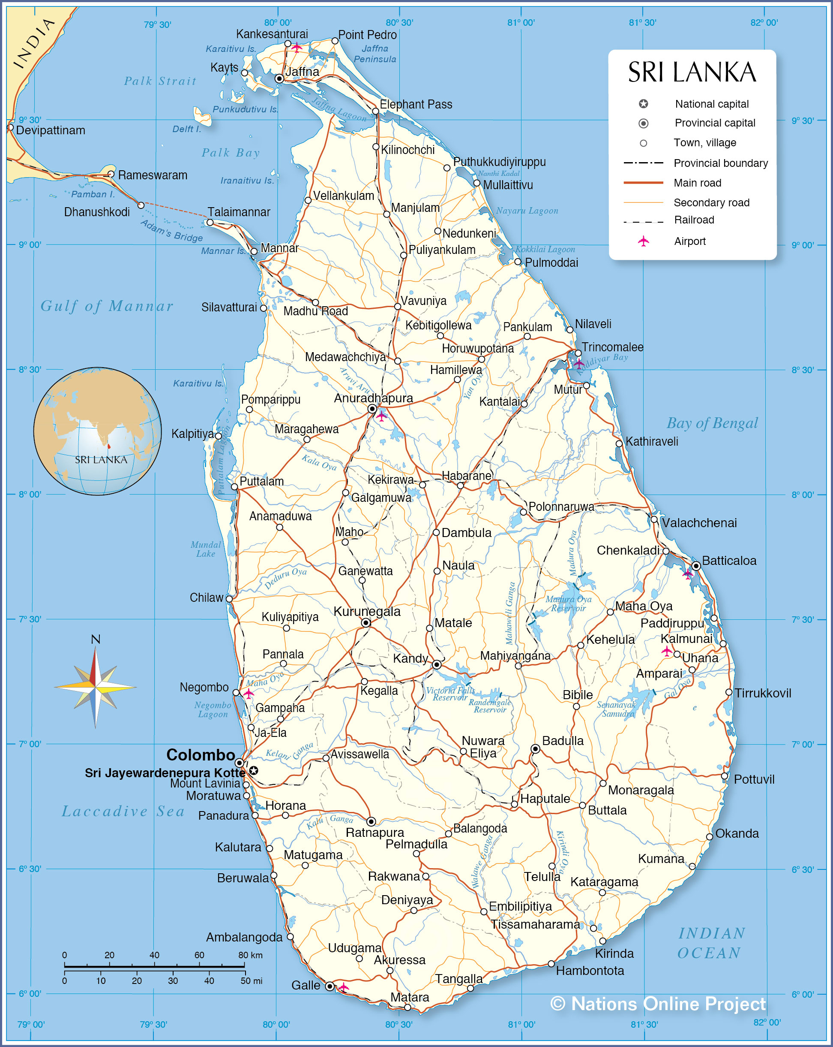
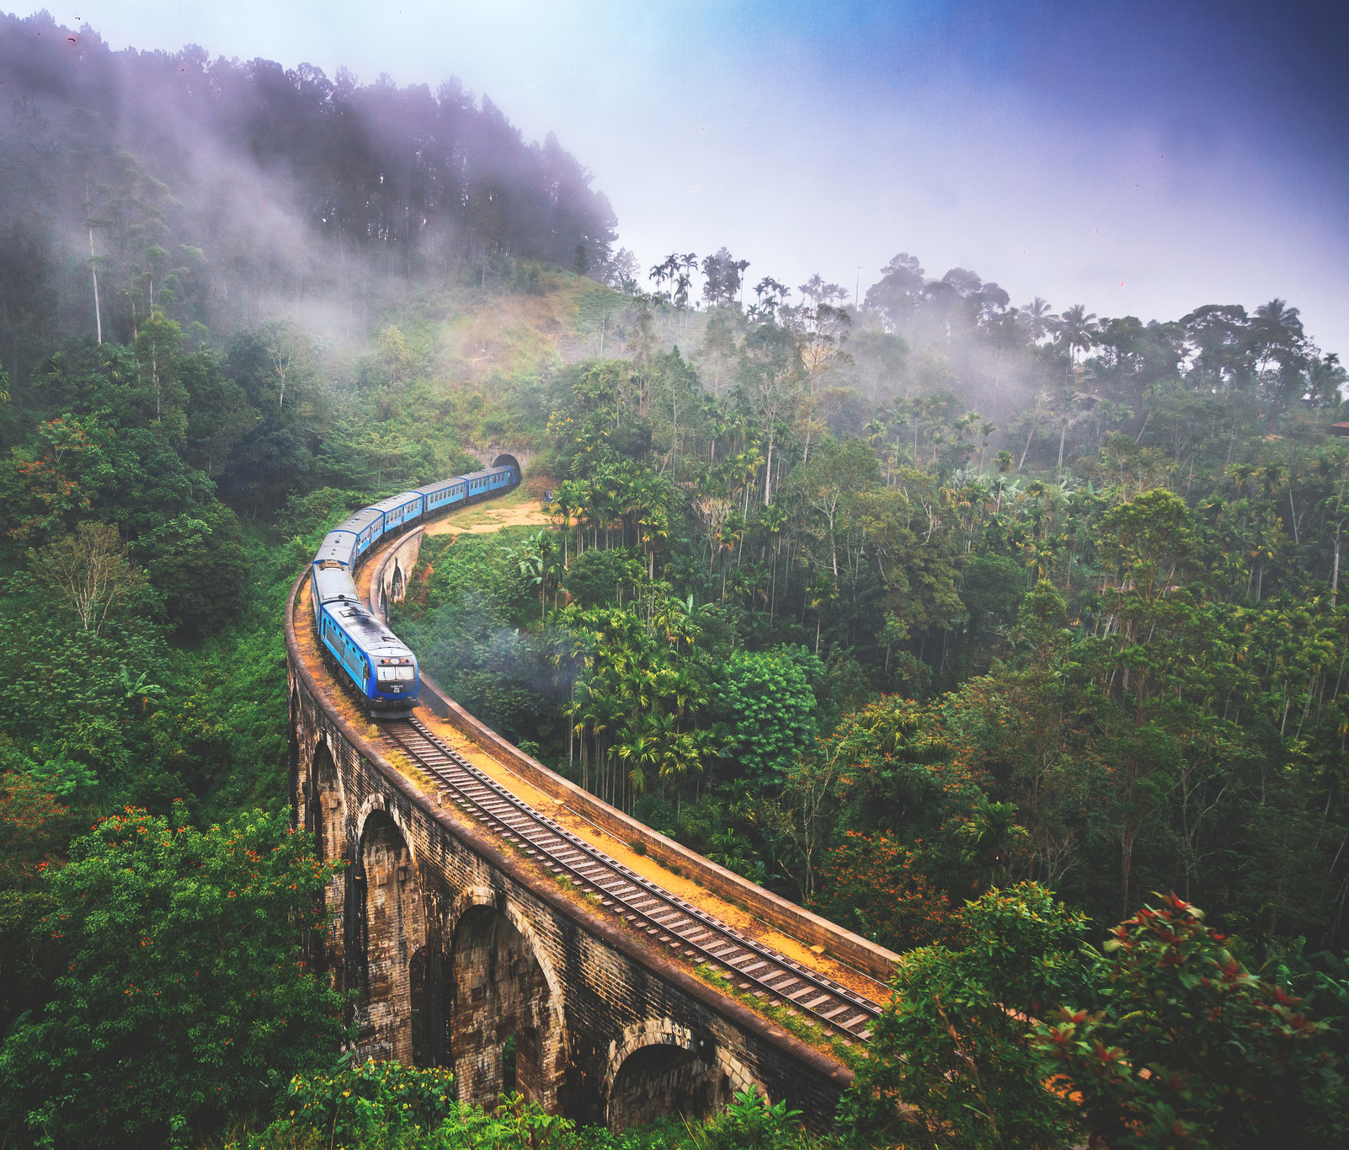
Country Profile
In 1948, Ceylon gained independence from British rule. It was renamed Sri Lanka in 1972. Ethnic groups: Sinhalese 74.9%, Sri Lankan Tamil 11.2%, Sri Lankan Moors 9.2%, Indian Tamil 4.2%, other 0.5% . Religion: Most Sinhalese are Buddhist; most Tamils are Hindu. The Moors are Muslim. Sizable minorities of both Sinhalese and Tamils are Christians. Languages - Sinhala 74%; Tamil 25%; Other 1% The country's post-colonial history has been a story of strife and struggle between the Sinhalese and the Tamils.

Slide 4
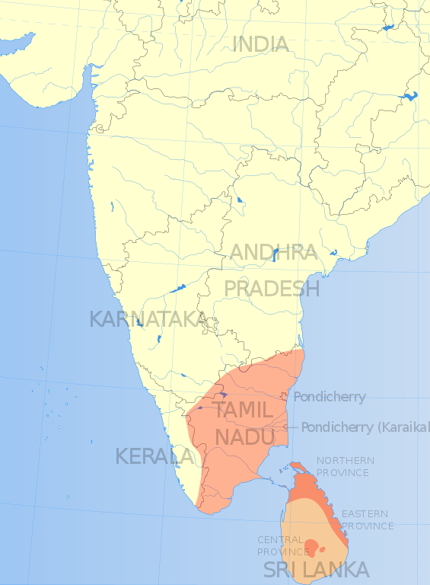
Origin of Tamil-Sinhala Populations
1795
Before the British arrived, Sinhalese people whose forefathers had migrated from India in the 500s BCE dominated the country. Tamil migration to the island took place between the seventh and eleventh centuries CE. The huge cash crop plantations set up by the British led them to bring in almost a million Indian Tamils to work as plantation laborers. These migrants came to be known as hill or plantation Tamils.

Slide 5
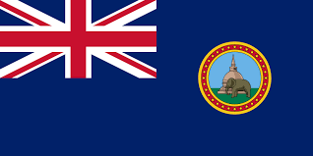
The British Colony of Ceylon
1795 - 1948
Under British control, divide and rule strategies of providing Tamils with better education and employment opportunities increased hostility between the Sinhalese majority and Tamil minority. Post-colonial governments used this as a justification for discriminatory policies against Tamils.

Slide 6
Geographical Composition
1948
The conflict in Sri Lanka also had a regional basis. Tamils’ connection with their geographical location eventually turned into a demand for a separate state. • Tamils of Sri Lankan origin are most dominant in the Northern and Eastern Provinces. • Indian Tamils are found mostly in parts of Central, Uwa, and Sabaragamuwa Provinces. • In nearly all regions of the country, Sinhala Buddhists are the majority.

Slide 7
KEY Leaders
1948
Sinhalese leaders: • Solomon Bandarnaike • J.R. Jaywardane • Ranasinghe Premadasa • Chandrika Kumaratunga • Mahinda Rajapaksa • Gotabaya Rajapaksa Tamil leaders: • Velupillai Chelvanakyam • Velupillai Prabhakaran Indian leaders: • Rajiv Gandhi

Slide 8
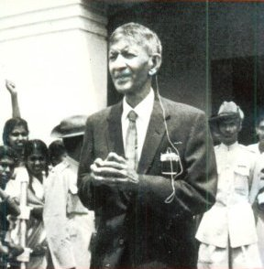
Veluppillai Chelvanakayam
1948 - 1977
Veluppillai Chelvanayakam was the founder and leader of the Illankai Tamil Arasu Kachchi (ITAK), commonly known as The Federal Party, and the Tamil United Liberation Front (TULF). He was one of the key Tamil leaders. He presided over the convention in which the Vaddukoddai Resolution, which called for the "restoration and reconstitution of the free, sovereign, secular, socialist state of Tamil Eelam," was announced.

Slide 9
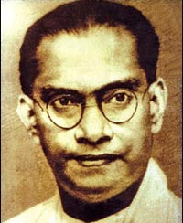
Solomon Bandaranaike
1956 -1959
In 1956, Solomon Bandaranaike and his party, Sri Lanka Freedom Party, came to power. Bandaranaike passed the controversial Sinhala Only Act. He went on to sign a pact with Tamil politician Chelvanakayam to resolve communal tensions. However, he canceled the pact when it was met with opposition. Buddhist monks assassinated Bandaranaike in 1959.

Slide 10
Land Colonization
1948
After independence, the government started a program to settle Sinhalese farmers in the jungles of the Eastern Province. As a consequence, the Sinhalese population in the region rose drastically. In the 1980s, the government extended this colonization scheme into the Northern Province. This policy intended to undermine Tamil nationalist claims on a contiguous north-eastern homeland. It became a major source of tension between Sinhalese and Tamil communities.

Slide 11
Denial of Citizenship to Indian Tamils
1948
The 1948 Ceylon Citizenship Act No. 18 was a controversial law passed by the Ceylon Parliament aimed at snatching the citizenship of Indian Tamils. More than 700,000 Indian Tamils, about 11% of the Sri Lankan population, were denied citizenship and made stateless.

Slide 12
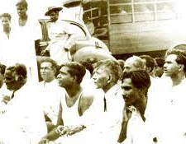
Sinhala Only Act
1956
After independence, English remained the official language. However, in 1956, the Sinhalese government passed the Sinhala Only Official Languages Act, making Sinhalese the national language. The Tamil Federal Party opposed this Sinhala-only policy and organized a peaceful demonstration. Sinhalese mobs disrupted this protest, resulting in a riot that left more than 100 people dead. The Sinhala Only Act is considered one of the major driving forces behind most of the ethnic riots after 1956 and the eventual Civil War.

Slide 13
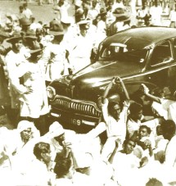
1956 Anti-Tamil Gal Oya Pogrom
1956
The 1956 anti-Tamil Gal Oya violence was the first major pogrom against Sri Lankan Tamils. The violence began in Colombo as Sinhalese mobs attacked the demonstration against the Sinhala Only Act. In Batticaloa, Tamil rioters attacked the Sinhalese and burned down their houses. The peak of the violence was seen in Gal Oya Valley five days after the rioting in Colombo. Sinhalese men commandeered government vehicles and weapons, ultimately massacring around 150 Tamils.

Slide 14
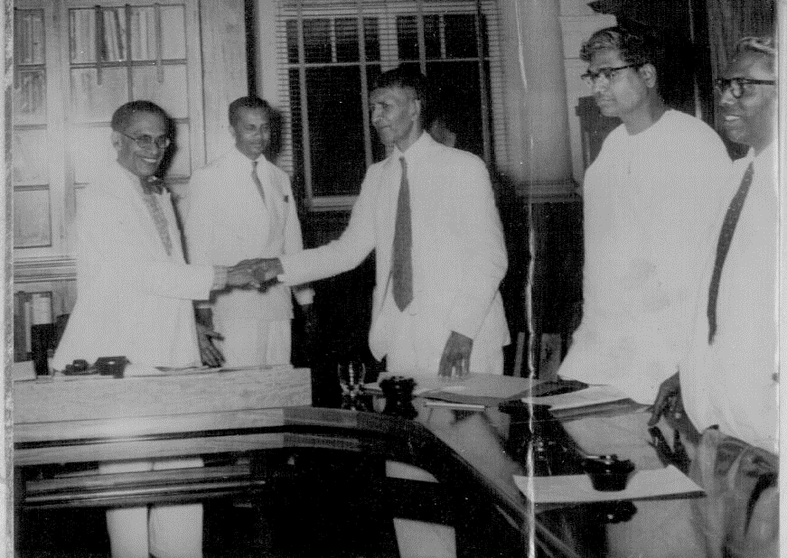
Bandaranaike–Chelvanayakam Pact
1957 -1958
In 1957, Prime Minister SWRD Bandaranaike and Federal Party leader SJV Chelvanayakam signed the Bandaranaike-Chelvanayakam Pact. The pact recognized Tamil as the administrative language in the Northern and Eastern provinces. They intended to resolve the simmering communal tensions between Tamils and Sinhalese. However, Bandaranaike canceled the pact after severe backlash from the Sinhalese community, especially from Buddhist monks and the opposition’s United National Party (UNP) leader JR Jayawardene.

Slide 15
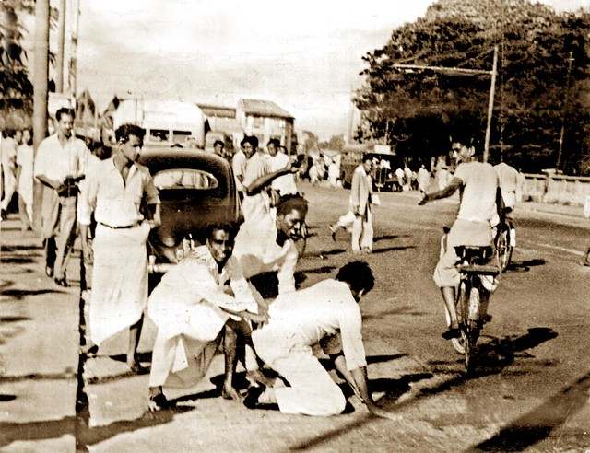
1958 Anti-Tamil Pogroms
1958
In 1958, Sinhala mobs began to attack, rape, and murder Tamils across the island, beginning with an attack on Tamil leaders on their way to the Federal Party convention in Vavuniya. Violence then spread across the whole island. Mobs traversed Colombo, checking whether passers-by could read Sinhala newspapers and killing those who couldn’t. The government declared a state of emergency after five days of brutal violence.

Slide 16
Rise of Tamil Militancy
1970
Sinhalese preferential policies severely curtailed the middle-class Tamil youth, who, during the 1970s and 1980s, found it more difficult to enter university or secure employment. Individuals belonging to this younger generation, often referred to by other Tamils as "the boys" or "podiyan" in the Tamil language, formed many militant organizations. However, the most solid foundation of Tamil militant groups was laid by the ethnic riots, which aimed at wiping off their community and had become common post-independence.

Slide 17
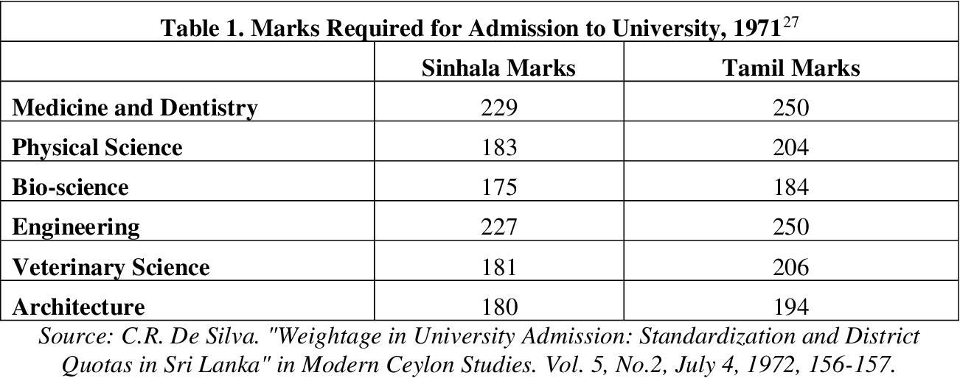
Universities Act - Policy of Standardization
1971
During the 1970s, the government introduced the preferential "policy of standardization" based on geographical criteria. Due to the regional segregation of the country, this policy increased Sinhalese university enrollment exponentially. The policy reduced the proportion of Tamil students at the university level. It is seen as one of the immediate reasons for the rise of Tamil militancy.

Slide 18
Rise of Separatism
1972
Chelvanayakam originally called for federalism to resolve the tensions between the two ethnic groups. However, in 1972, he shifted to a separatist perspective, suggesting that the Tamils in the North and East might demand a separate state due to abrogation of the Bandaranaike-Chelvanayakam Pact and repeated discrimination by the government.

Slide 19
Tamil Eelam
1976
In 1972, all major Tamil parties regrouped under one coalition, the Tamil United Liberation Front (TULF). At their party convention in 1976 in Vaddukoddai, TULF called for a separate state called Tamil Eelam.

Slide 20
Formation of LTTE
1976
In 1976, a number of militant Tamil youths in northern Sri Lanka, led by Velupillai Prabhakaran, formed an organization called the Liberation Tigers of Tamil Eelam (LTTE). Their main aim was to achieve independent statehood through armed struggle. LTTE was the main belligerent against the Sri Lankan army in the Civil War.

Slide 21
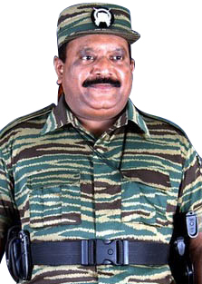
Velupillai Prabhakaran
1976-2009
Velupillai Prabhakaran was the Tamil guerrilla and the founder and leader of the Liberation Tigers of Tamil Eelam.

Slide 22
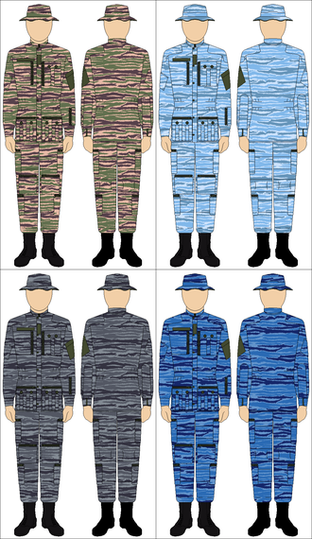
Guerrilla Warfare by LTTE
1976
The LTTE became one of the world's deadliest insurgent groups with unparalleled guerilla techniques. During the 1970s, the organization carried out several guerrilla attacks. LTTE was allegedly the first insurgent organization to use concealed explosive belts and vests. Another popular technique was suicide bombings.

Slide 23
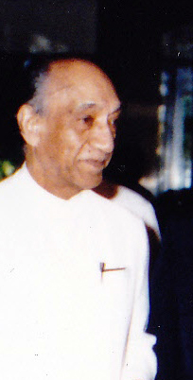
Junius Richard Jayewardane
1977
In 1977, Junius Richard Jayewardene of the United National Party first came to power as Prime Minister before becoming the country's first executive president after six months. A controversial figure, Jayewardene's actions have been recognized as significantly contributing to the beginnings of the Sri Lankan Civil War. Following the 1983 anti-Tamil riots, Jayewardene did not attempt to stop the continuous attacks on the Tamils and blatantly said, "Really if I starve the Tamils out, the Sinhala people will be happy."

Slide 24
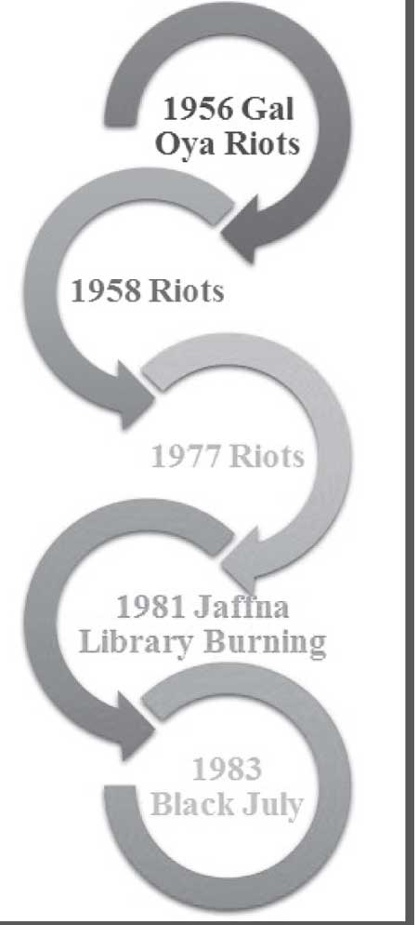
1977 Anti-Tamil Pogrom
1977
The 1977 anti-Tamil pogrom followed that year's general elections in which the Tamil United Liberation Front won the majority of Tamil votes on promises of secession. Sinhalese mobs killed an estimated 300 Tamils. Tamil mobs also attacked Sinhalese people in Tamil-majority areas in retaliation.

Slide 25
1981 Anti-Tamil Pogrom
1981
From June–August 1981, organized Sinhala mobs looted and burned down Tamil shops and houses in Jaffna, Ratnapura, Balangoda, Kahawatte, and Colombo. 25 people died, countless women were raped, and thousands were left homeless. The ruling United National Party allegedly organized the violence.

Slide 26
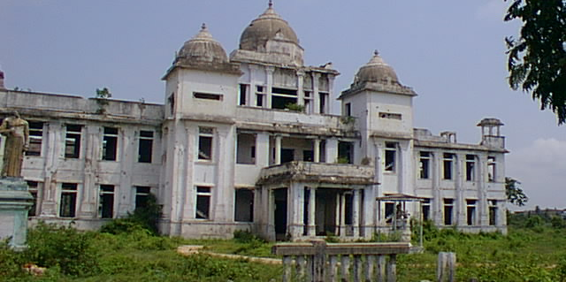
Destruction of Jaffna Library
June 1, 1981
On the night of June 1st, Sinhalese mobs burned down the prestigious Jaffna Public Library, a cultural hub for the Tamil community. Fully armed police officers and paramilitaries took part in the mob. The fire destroyed over 97,000 volumes of books and cultural documents.

Slide 27
Cultural Destruction
1981
In 1981, the state-sponsored militia destroyed 95,000 volumes of books and culturally important texts relating to Tamil culture and history when they burned the Jaffna Public Library to the ground. This arson attack intended to eliminate Tamil cultural and historical heritage. Sinhalese Buddhists also destroyed shrines of Hindu gods worshipped by the Tamils.

Slide 28
Beginning of Black July
July 23, 1983
On July 23, 1983, the LTTE attacked a military vehicle and killed thirteen soldiers. After this, a volatile crowd of Sinhalese men gathered and headed to the streets of Colombo to attack Tamil-run establishments and stores, marking the beginning of Black July.

Slide 29
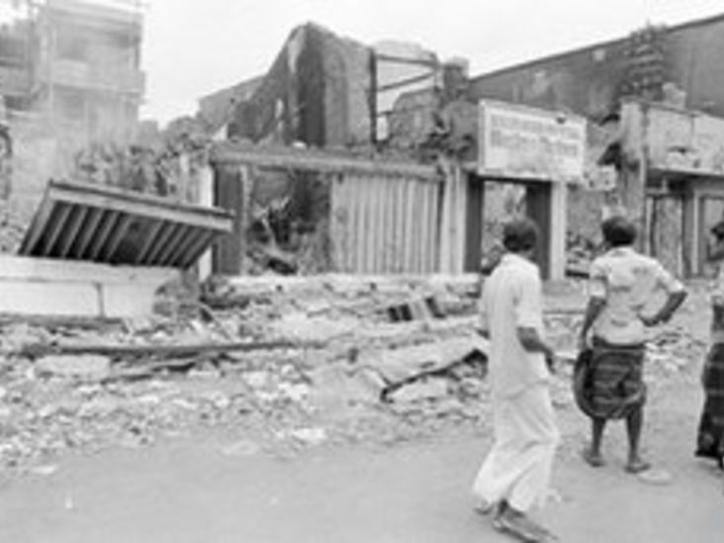
Black July - A Bloody Massacre
July 25, 1983
By the morning of July 25th, the violence in Sri Lanka reached its bloodiest phase. In the following week, Sinhalese mobs attacked and killed Tamils mercilessly. Death toll estimates range between 400 and 3,000. 150,000 Tamils were left homeless. This marked the beginning of the brutal 26-year-long civil war.

Slide 30
Massacres of Black July
July 23, 1983
During Black July, the government provided Sinhalese mobs with weapons and transportation around Colombo to enable anti-Tamil violence. Sinhalese police and security forces either remained mute spectators or joined in on the violence. The war cry of Sinhalese mobs who burned Tamil property translates to: “To save the race and country, give a little petrol and oil." This shows clear intent and a public call to commit genocide.

Slide 31
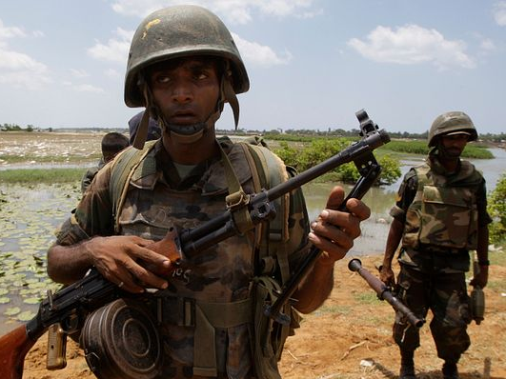
Eelam War I
1983 -1987
The Tamil Tigers declared the "First Eelam War" right after the Black July massacres, aiming to achieve an independent Tamil homeland called Eelam. In the very beginning, Tigers massacred their Tamil opponents to consolidate power over the separatist movement. After this, the Tigers used bombs and landmines against Sinhalese military and civilian targets. The army responded by rounding up, torturing, and disappearing Tamil youths.

Slide 32
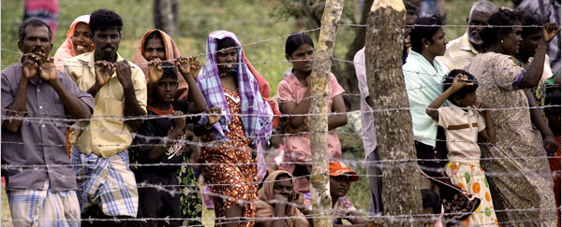
Targeted Groups
1983
Sinhalese mobs and military forces targeted and attacked Tamil citizens throughout the Civil War.
LTTE also targeted Tamils who disagreed with their violent methods and even used innocent Tamil citizens as shields against attacks by the military forces.
LTTE fighters targeted innocent Sinhalese citizens.

Slide 33
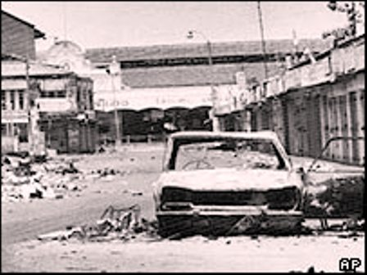
Arson and Burning of Tamils
1983
Sinhalese mobs committed widespread arson during anti-Tamil pogroms, the most of which was the burning of the Jaffna Library. Sri Lankan armed forces burned down Tamil houses, shops, and other property during almost all phases of the Civil War. The army and Sinhalese mobs also burned Tamils alive. They roamed the streets and set alight all Tamil men, women, and children they saw. As the mobs searched for fuel, they chanted, “Rata Jathiya Bera Ganna, Petrol Thel Tikkak Dhenna," which translates to "To save the race and country give a little petrol and oil."

Slide 34
Torture and Psychological Brutality
1983
State-sponsored Sinhalese mobs killed more than 3000 Tamils through beatings, hackings with knives, or burning. Serious mental harm followed for the many Tamil witnesses to these genocidal killings. Tamil men were forced to watch their female relatives be sexually assaulted. The rape of Tamil men and women, apart from being a violent form of abuse, was also a means of inflicting severe psychological trauma.

Slide 35
Sexual Violence
1983
During the war, Sinhalese mobs and state security personnel also carried out numerous acts of sexual violence against women, men, and children in detention centers. Sexual abuse was a tool used to coerce confessions, degrade detainees, and discourage involvement with the LTTE. In refugee camps, women engaged in sexual acts in exchange for assistance, shelter, or food. Women also suffered sexual humiliation, mutilation, rapes, and forced birth control. Tamil men were at an equally high risk of sexual violence; a significant number suffered carnal abuse during and after the war.

Slide 36
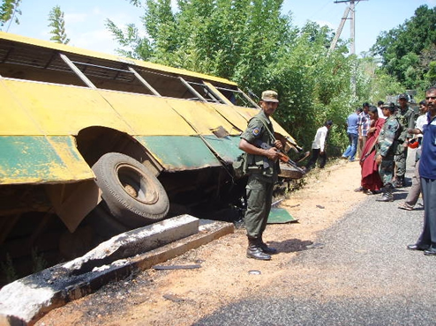
Targeting Sinhalese Civilians
1983
The LTTE gained notoriety for carrying out attacks against innocent Sinhalese civilians. Notable attacks include the Aranthalawa massacre, the Kent and Dollar Farm massacres, the Kattankudy mosque massacre, the Anuradhapura massacre, and the Kebithigollewa massacre.

Slide 37
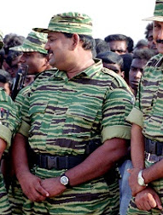
Torturing Prisoners
1983
The LTTE frequently tortured and executed prisoners. In 1990, for example, the LTTE killed 600 unarmed police officers even though they had surrendered. The LTTE also tortured and executed civilian Tamils accused of dissent.

Slide 38
Recruitment of Child Soldiers
1983
LTTE recruited thousands of child soldiers to serve in the war against Sri Lankan Army. Families who tried to resist this forceful recruitment of their sons and daughters faced violence and detention at the hands of the Tigers.

Slide 39
Kent and Dollar Farm Massacres
November 30, 1984
Kent and Dollar are two farming villages in the northern province. On November 30, 1984, LTTE cadres traveled in the night in two buses, armed with weapons. One bus went to the Kent farms, while the other went to the Dollar farms. The LTTE fighters shot and killed guards, women, children, and most of the male members of the families. Some were shut in rooms and blasted with explosives. 62 Sinhalese were killed.

Slide 40
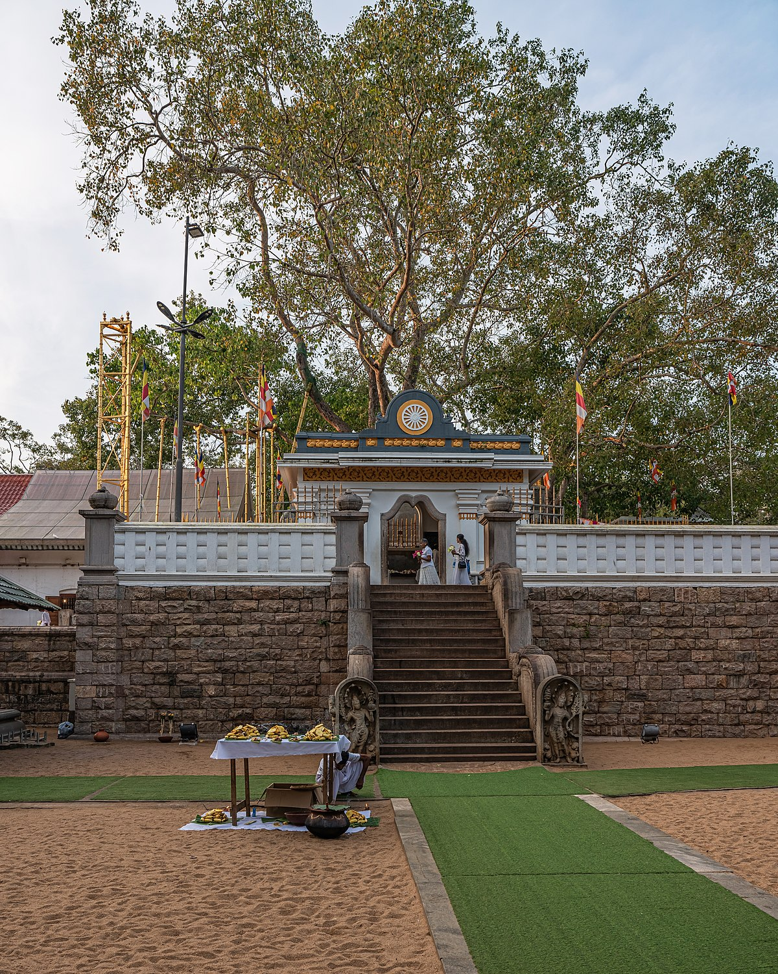
Anuradhapura Massacre
May 14, 1985
The LTTE hijacked a bus on May 14th, 1985 to enter Anuradhapura. There they opened fire indiscriminately, killing and wounding many civilians. They also opened fire on nuns, monks, and civilians at the Sri Maha Bodhi shrine. Altogether, LTTE forces killed 146 Sinhalese men, women, and children in Anuradhapura.

Slide 41
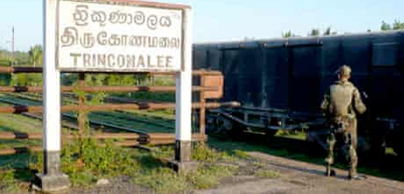
Trincomalee Massacre
1987
The 1987 Eastern Province Anti-Sinhala massacres began spontaneously but became more organized over time, with the LTTE leading the violence. Mobs and military violence killed over 200 Sinhalese. Over 20,000 fled the Eastern Province.

Slide 42
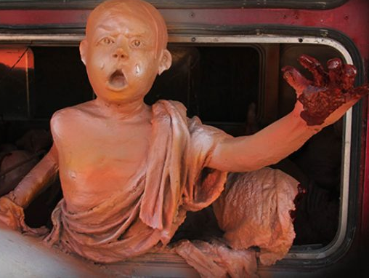
Aranthalawa Massacre
June 2, 1987
LTTE militants killed 33 Buddhist monks, most of whom were young boys, in the Aranthalawa massacre. On June 2nd, 1987, 20 armed LTTE cadres ambushed a bus carrying Buddhist monks and ordered the driver to take the bus into the nearby Aranthalawa jungle. Once they arrived, the LTTE cadres launched their attack, using guns and swords.

Slide 43
Suicide Bombings
1987
The Black Tigers were an important wing of LTTE that carried out suicide attacks. The targets were always military leaders, but the attacks killed civilians as well. LTTE is the only insurgent group to have successfully targeted three world leaders: Rajiv Gandhi and Ranasinghe Premadasa, and Chandrika Kumaratunga, who lost her right eye due to the failed attempt on her life.

Slide 44
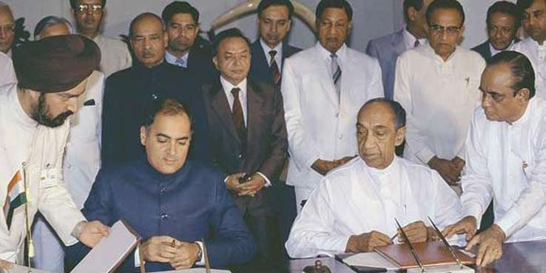
Indo-Sri Lanka Accord
July 29, 1987
Indian Prime Minister Rajiv Gandhi and Sri Lankan President J.R. Jayewardene signed the Indo-Sri Lanka Peace Accord on July 29th, 1987, in an effort to bring the Sri Lankan Civil War to an end. The terms of the accord required Sri Lankan forces to withdraw from the north and the Tamil rebels to subsequently disarm. This accord established the Indian Peace Keeping Force (IPKF) was sent to Sri Lanka.

Slide 45
Indian Peace Keeping Force
1987 - 1990
The Indian Peace Keeping Force (IPKF) was the Indian military contingent responsible for peacekeeping operations during Eelam War I. The IPKF was formed under the mandate of the 1987 Indo-Sri Lankan Accord, which aimed to resolve the conflict between the Liberation Tigers of Tamil Eelam (LTTE) and the Sri Lankan military.

Slide 46
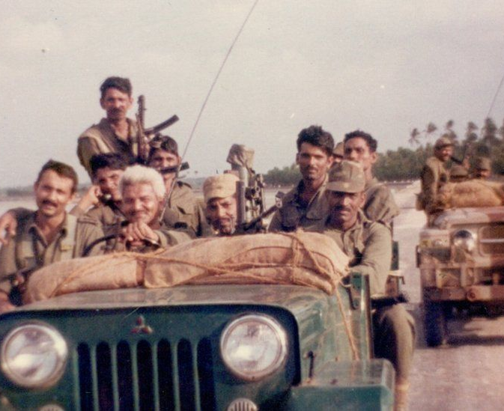
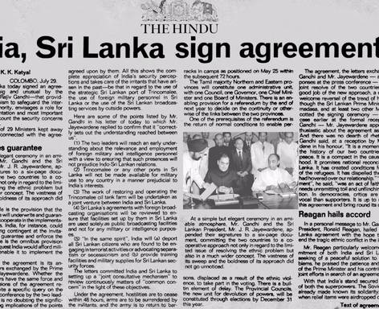
Indian Intervention
1987 – 1990
Adhering to the Indo-Sri Lanka Accord, India sent peacekeeping troops to Sri Lanka to end the war. Instead of quelling the conflict, the IPKF began fighting with the LTTE. Sri Lankan President Ranasinghe Premadasa forced India to withdraw its forces in 1990. In 1991, an LTTE suicide bomber killed the Prime Minister of India, Rajiv Gandhi.

Slide 47
Ranasinghe Premadasa
1989 -1993
Ranasinghe Premadasa was the third President of Sri Lanka. He forced India to withdraw its IPKF forces from the nation. Under his command in 1990, Tamil militants killed some 600 security officers who had surrendered. An LTTE suicide bomber assassinate Premadasa in 1993.

Slide 48
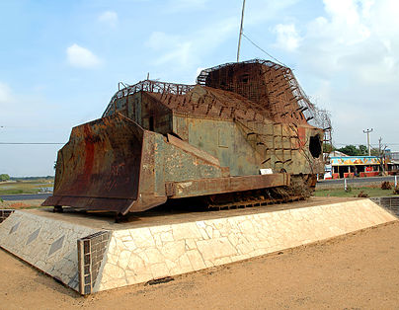
Eelam War II
1990 – 1995
After the Indian Peacekeeping Force withdrew, the Tamil Tigers began the Second Eelam War. On July 11, 1990, Tigers seized some 700 Sinhalese police officers in the Eastern Province. The police surrendered after the Tigers promised no harm would come to them. However, the militants then shot them all dead, one by one. In response, the Sri Lankan Defense Minister announced, "From now on, it is all-out war." The government cut off all shipments of medicine and food to the predominantly Tamil Jaffna peninsula and started dropping aerial bombs. The Tigers massacred hundreds of Sinhalese and Muslim villagers in retaliation.

Slide 49
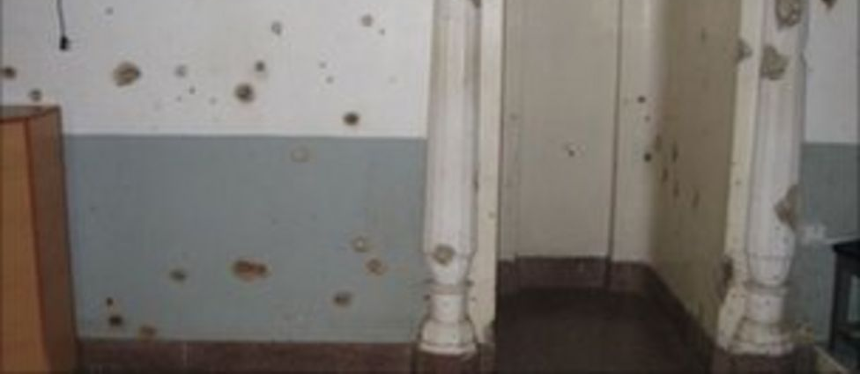
Anti-Muslim Massacres
1990
The LTTE carried out numerous attacks against Muslims in Sri Lanka. The most notable is the Kattankudy Mosque Massacre, wherein 30 armed Tigers raided four mosques in Kattankudy, killing 147 Muslim men and boys on August 3rd, 1990. In 1990, the LTTE also forcibly evicted thousands of Tamil-speaking Muslims from the North and East. This mass expulsion left the entire Muslim population of the region homeless.

Slide 50
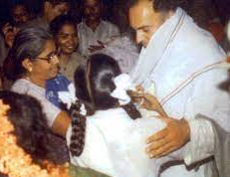
Rajiv Gandhi's Assassination
May 21, 1991
The LTTE planned Rajiv Gandhi's assassination as revenge for his decision to send the Indian Peace Keeping Force (IPKF) and to fight against LTTE members. An LTTE suicide bomber named Dhanu/Thenmozhi Rajarathinam assassinated Rajiv Gandhi on May 21, 1991, in Tamil Nadu, where he had gone to address an election rally.

Slide 51
Chandrika Kumaratunga
1994 – 2005
Chandrika Bandaranaike Kumaratunga, daughter of former Prime Minister S.W.R.D. Bandaranaike, was the President of Sri Lanka from 1994 to 2005. Early in her term, she negotiated a ceasefire with Tamil Tigers in an attempt to end the ongoing civil war. However, the LTTE broke the cease-fire and blew up two Sri Lankan Navy gunboats. After this, Kumaratunga launched several major offensives against LTTE, such as Operation Riviresa, which captured the Jaffna peninsula from the LTTE.

Slide 52
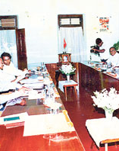
Eelam War III
January 1995–2003
In January 1995, the Tamil Tigers signed a peace agreement with President Chandrika Kumaratunga. However, the Tigers violated the peace accord three months later by blowing up two Sri Lankan naval boats. The government declared a "war for peace" and once again began aerial bombardments of civilian sites and refugee camps on the Jaffna Peninsula. Ground troops also perpetrated numerous massacres against civilians in other Tamil regions. The Tamil Tigers responded by killing more than 1,200 soldiers.

Slide 53
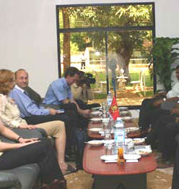
Memorandum of Understanding
2002
In 2002, the Sri Lankan government and the LTTE signed a Memorandum of Understanding mediated by Norway. The two sides compromised with a federal solution rather than the LTTE's demand for an independent state or the government's demand to remain a unitary state.

Slide 54
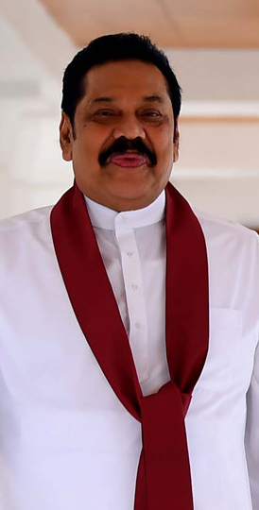
Mahinda Rajapaksa
2005 - 2015
Mahinda Rajapaksa served as president of Sri Lanka from 2005 to 2015, being the leader who finally ended the civil war. When he got elected, the government was already trying to negotiate with the LTTE and sign a ceasefire agreement. However, Rajapaksa announced his intention to completely crush the militant group. In 2009, the Sri Lankan army defeated the Tamil forces for once and all. This resulted in the leader's popularity growing exponentially. However, critics argued that his handling of the war was responsible for deaths of thousands of innocent civilians.

Slide 55
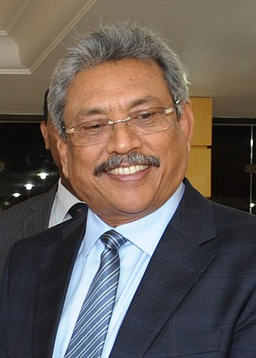
Gotabaya Rajapaksa
2005 - 2021
Gotabaya Rajapaksa was the defense minister during his elder brother Mahinda Rajapaksa's tenure as president from 2005 to 2014. He is one of the key leaders who ended Sri Lanka's civil war with the LTTE.
While the Sinhalese majority hails him as a national hero, families of ethnic Tamils killed or disappeared during the civil war accuse Rajapaksa of war crimes, a charge he vehemently denies. He is currently serving as the president of Sri Lanka.

Slide 56
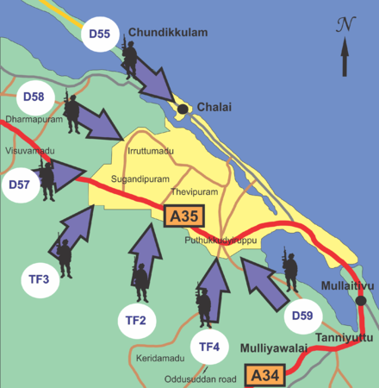
Eelam War IV
2006 - 2009
In 2006, the LTTE ended the Norwegian-brokered ceasefire and initiated Eelam War IV. In response, the Sri Lankan government launched a massive offensive in eastern and northern provinces to permanently defeat the Tigers. The 2007-2009 offensives were extremely violent and dangerous for civilians. A U.N. spokesman described this phase as "a bloodbath." Sensing that victory was out of their grasp, the Tigers began blowing themselves up while the military executed others.

Slide 57
Mullivaikkal Massacre
2009
Tens of thousands of Sri Lankan Tamils were killed in the Mullivaikkal massacre during the closing stages of the war on a tiny strip of land in Mullivaikkal, Mullaitivu. During the end of the war, thousands of Tamils sought refuge in the Sri Lankan government's no-fire zone in Mullivaikkal. The government did not keep its promise and instead heavily shelled the area, hitting hospitals and the U.N. hub. These bombs killed up to 40,000 trapped Tamil civilians.

Slide 58
End of Civil War
On May 16, 2009, the Sri Lankan government declared victory over the Tamil Tigers. The next day, Tamil Tigers also declared that "this battle has reached its bitter end."

Slide 59
Allegations of War Crimes
2009
The Sri Lankan government is accused of committing war crimes, especially in the final phases of the war in 2009. Accusations of shelling hospitals, burning alive Tamil civilians, attacking No Fire Zones, executing prisoners, and preventing food, medicine, and clean water from reaching civilians trapped in the war zone have been leveled against the army. Allegations of war crimes have been made against the rebel Liberation Tigers of Tamil Eelam (Tamil Tigers) as well, including child soldier recruitment, attacks on innocent civilians, and suicide bombings.

Slide 60
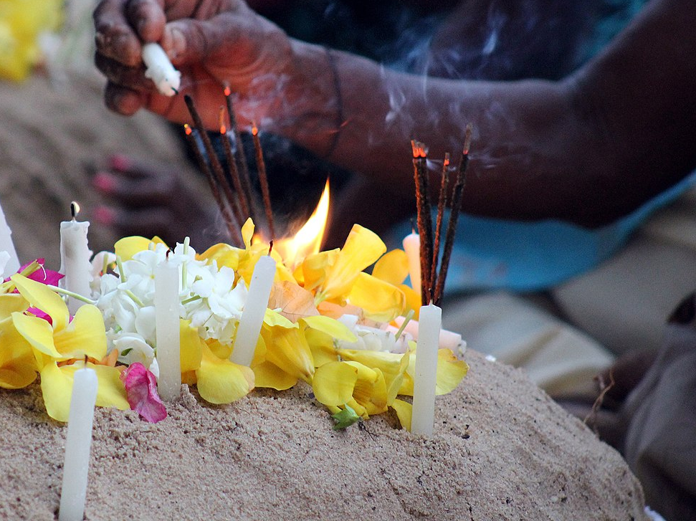
Denial
2009
The Sri Lankan government has consistently denied that they committed crimes against humanity and war crimes that can be classified as acts of genocide, despite compelling video evidence. Leaders continue to lament the loss of Sri Lankan soldiers who died in the war, while family members of thousands of Tamils who were killed or forcibly disappeared await justice. Gotabaya Rajapaksa says that war crimes allegations against him are "baseless."

Slide 61
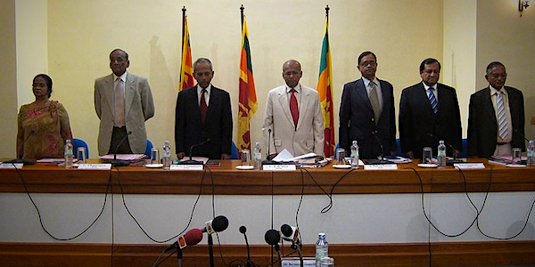
Lessons Learnt and Reconciliation Commission
May 2010
President Rajapaksa set up the Lessons Learnt and Reconciliation Commission (LLRC) in May 2010 to review the civil war period. The commission's report was highly biased, as the government instituted the commission only as a means of avoiding an international inquiry into the government's war crimes.

Slide 62
Sri Lanka's Killing Fields
2011
British TV station Channel 4 broadcasted a documentary film called 'Sri Lanka's Killing Fields' comprising of videos from the final phase of the civil war. The parts filmed by civilians include the shelling of civilian targets, including hospitals, by the Sri Lankan military. The parts filmed by Sri Lankan soldiers show the execution of blindfolded Tamil prisoners and the dead bodies of naked women being dragged onto trucks by soldiers. The Sri Lankan government argued that the documentary is fake and released their own film called 'Lies Agreed Upon,' countering allegations made in 'Sri Lanka's Killing Fields.'

Slide 63
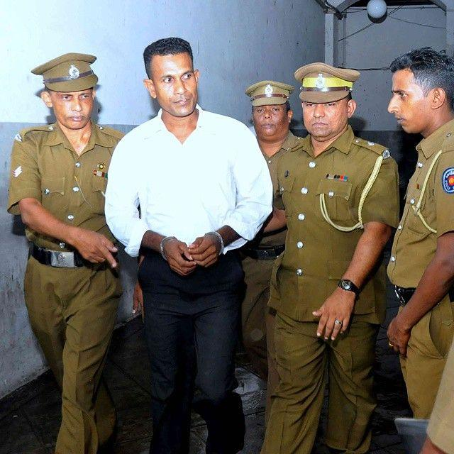
Presidential Pardon of War Criminals
March 2020
President Gotabaya Rajapaksa, an accused war criminal himself, continues to shield and pardon convicted war criminals, such as army sergeant Sunil Ratnayake, who was sentenced to death by the Colombo High Court. The presidential pardon of war instigators has created a grave impunity crisis in Sri Lanka.

Slide 64
Removal of Jaffna War Memorial
January 2021
In January 2021, the Mullivaikal Memorial at Jaffna University, constructed in memory of those who lost their lives in the war, was demolished at the behest of the Sri Lankan government. Many decried its destruction as part of a deliberate plan to erase Tamil history from the island.

Slide 65
UN investigation into Sri Lankan War Crimes
2021
The United Nations has often been accused of ignoring the early signs of genocide in Sri Lanka and being complicit via inaction. The U.N. has pressed for an investigation of war crimes several times, but none have come to fruition. However, in 2021, the U.N. announced that Michelle Bachelet, the High Commissioner for Human Rights, would begin to collect evidence of alleged war crimes during the Sri Lankan Civil War.

Slide 66
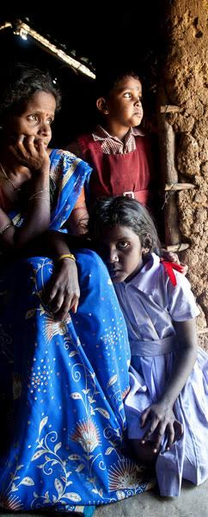
Summary
The Sri Lankan civil war may be over, but it continues to haunt the collective memory of the nation. The Sri Lankan government and army remain the prime accused of war crimes against the Tamil population, while LTTE members face charges of massacring innocent Sinhalese civilians and Tamil opponents. The Sinhalese government must cooperate with the U.N. investigation into charges of war crimes committed by the army and the LTTE. Bringing perpetrators to justice is the first step that the country must take in order to end the decades-old strife. The trauma of a 26-year war will not heal with criminals being punished alone. The government should also start making efforts to bridge the gap between both communities and resolve the hostility through fair and compassionate means.

