Slide 1

The Herero and
Namaqua Genocide
1904-1908

Slide 2
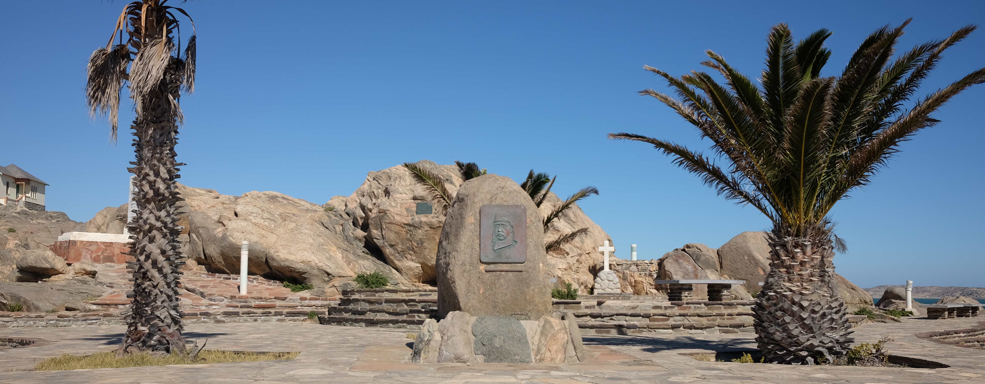
Introduction
In the 19th century, German colonial troops, ‘Schutztruppe,’ arrived in modern-day Namibia and established a German protectorate named ‘German South West Africa.’ Colonial forces faced resistance from the Herero and Nama tribes which culminated in the Herero Rebellion of 1904.
In response, the Commander-in-Chief of the Schutztruppe issued an extermination order. The Schutztruppe carried out indiscriminate violence against the Herero and Nama populations.
An estimated 80,000 Herero and 10,000 Nama people were killed, around 80% and 50% of the populations respectively.

Slide 3
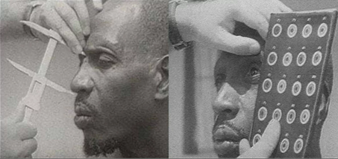
Ten Stages of Genocide
Dr. Gregory Stanton, the Founding President of Genocide Watch, is the author of the Ten Stages of Genocide. These stages are:
i. Classification
ii. Symbolization
iii. Discrimination
iv. Dehumanization
v. Organization
vi. Polarization
vii. Preparation
viii. Persecution
ix. Extermination
x. Denial.
The process is not linear. During the genocide of the Herero and Nama populations, Stage 9: Extermination occurred in two phases: first, indiscriminate killings during the conflict; and second, forced labor and concentration camps. The German government officially denied the occurrence of genocide in Namibia until 2015.

Slide 4
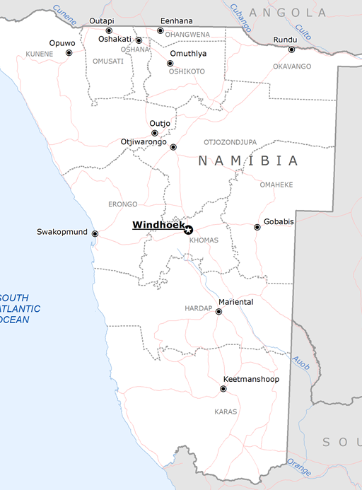
Namibia: Country Profile
1800s - German colonial forces arrived in the territory of modern-day Namibia.
1884 - 'German South West Africa' was established as a German protectorate.
1914 - During WW1, German South West Africa was invaded by South Africa as part of the Allied campaign to seize German colonies.
1920 - South Africa was granted a League of Nations mandate to administer the former German colony. It was renamed South West Africa.
1990 - the country gained independence as Namibia.

Slide 5
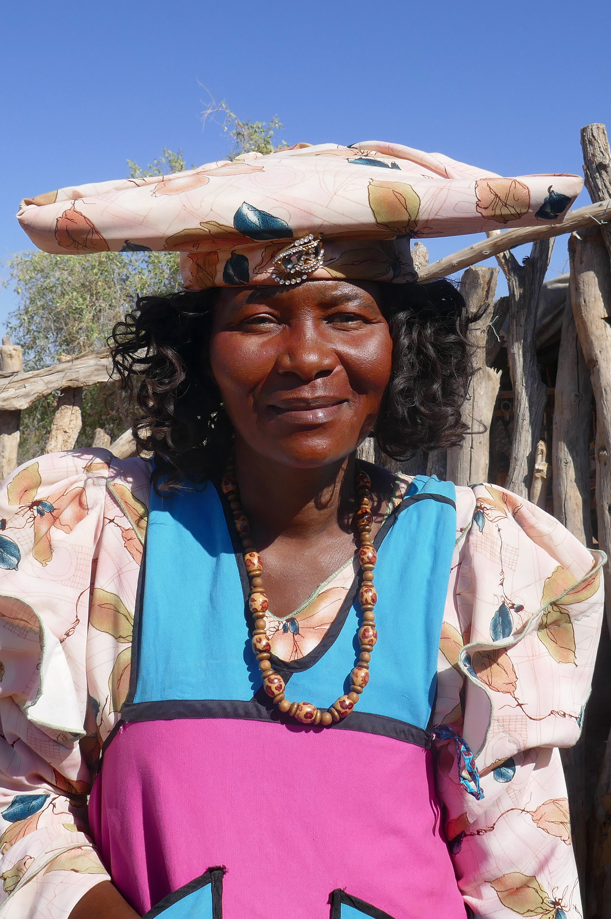
Namibia: Population Demographics
In the 19th century, there were five major ethnic groups in Southwest Africa: the Ovambo, the Herero, the Nama, the Damara, and the San people.
There were an estimated 100,000 Herero and 20,00 Nama in the region. Both groups were semi-nomadic pastoralists, and intertribal warfare over land and cattle was common before the German occupation.
Today, the Herero and Nama are minorities in Namibia and represent 7.5% and 12.5% of the country’s population respectively.
The ruling party in Namibia, the South-West Africa People’s Organization (SWAPO), is dominated by the country’s largest ethnic group, the Ovambo.

Slide 6
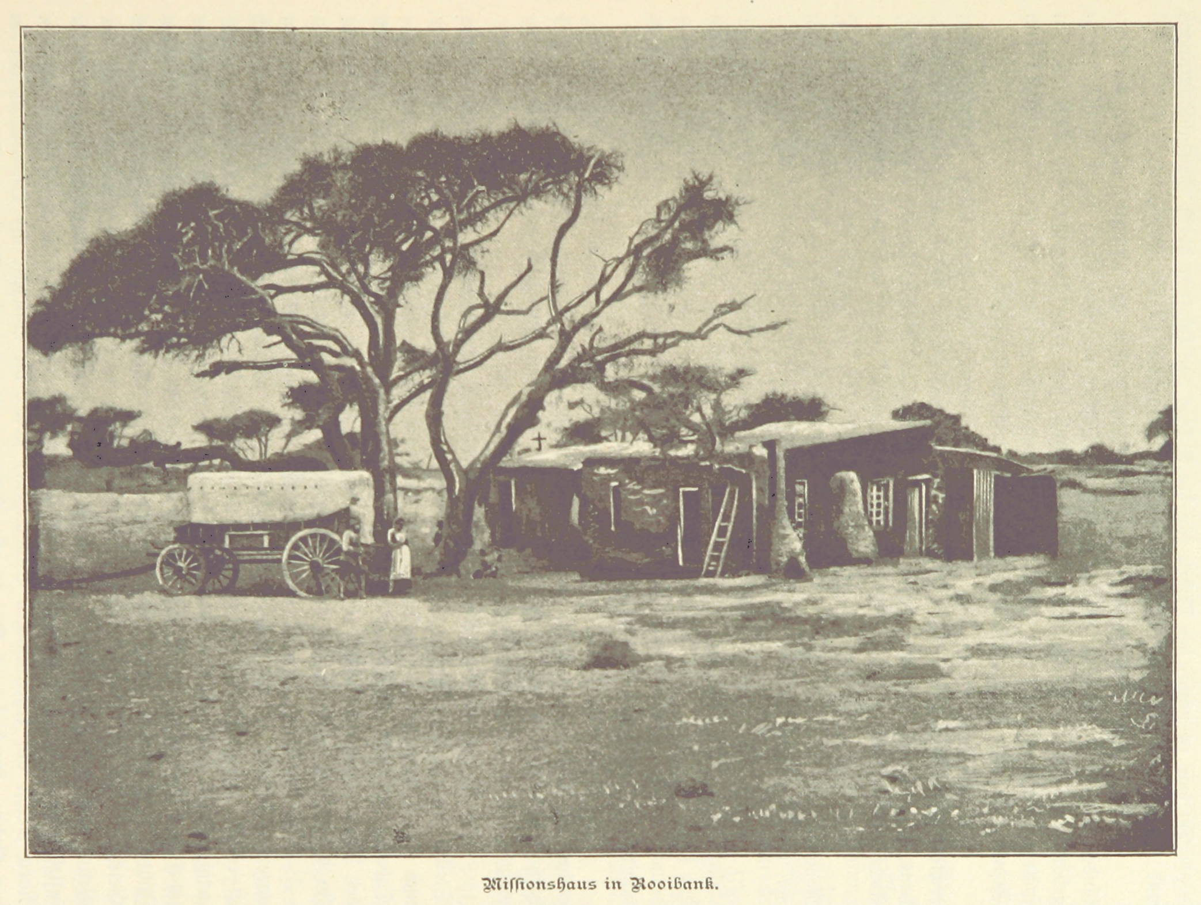
German Missionaries arrive in Southern Africa
1839-1849
German missionaries first arrived in present-day Namibia during the 1840s.
The area was inhabited by several ethnic groups: the San, Damara, Ovambo, Nama, and Herero, with the Nama and Herero being the two dominant tribes.
Southwestern Africa had minimal European contact until the 1860s.

Slide 7
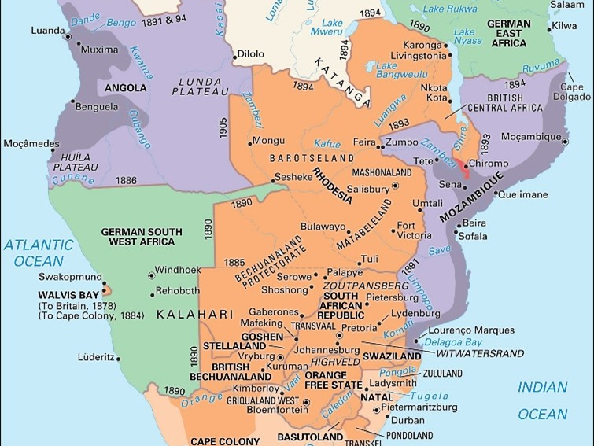
The Scramble For Africa
In the 1800s, European explorers began mapping the interior of the African continent. This led to the discovery of natural resources, which drove competition between European powers for territorial control and new trade routes.
After its unification in 1871, Germany began to seek colonial gains to advance its status as a new European power. To alleviate the growing colonial rivalries, Germany hosted a meeting between European powers to discuss territorial claims on the African continent.
From 1884-1914, European countries seized territory and resources on the African continent at the expense of their existing peoples and states.

Slide 8
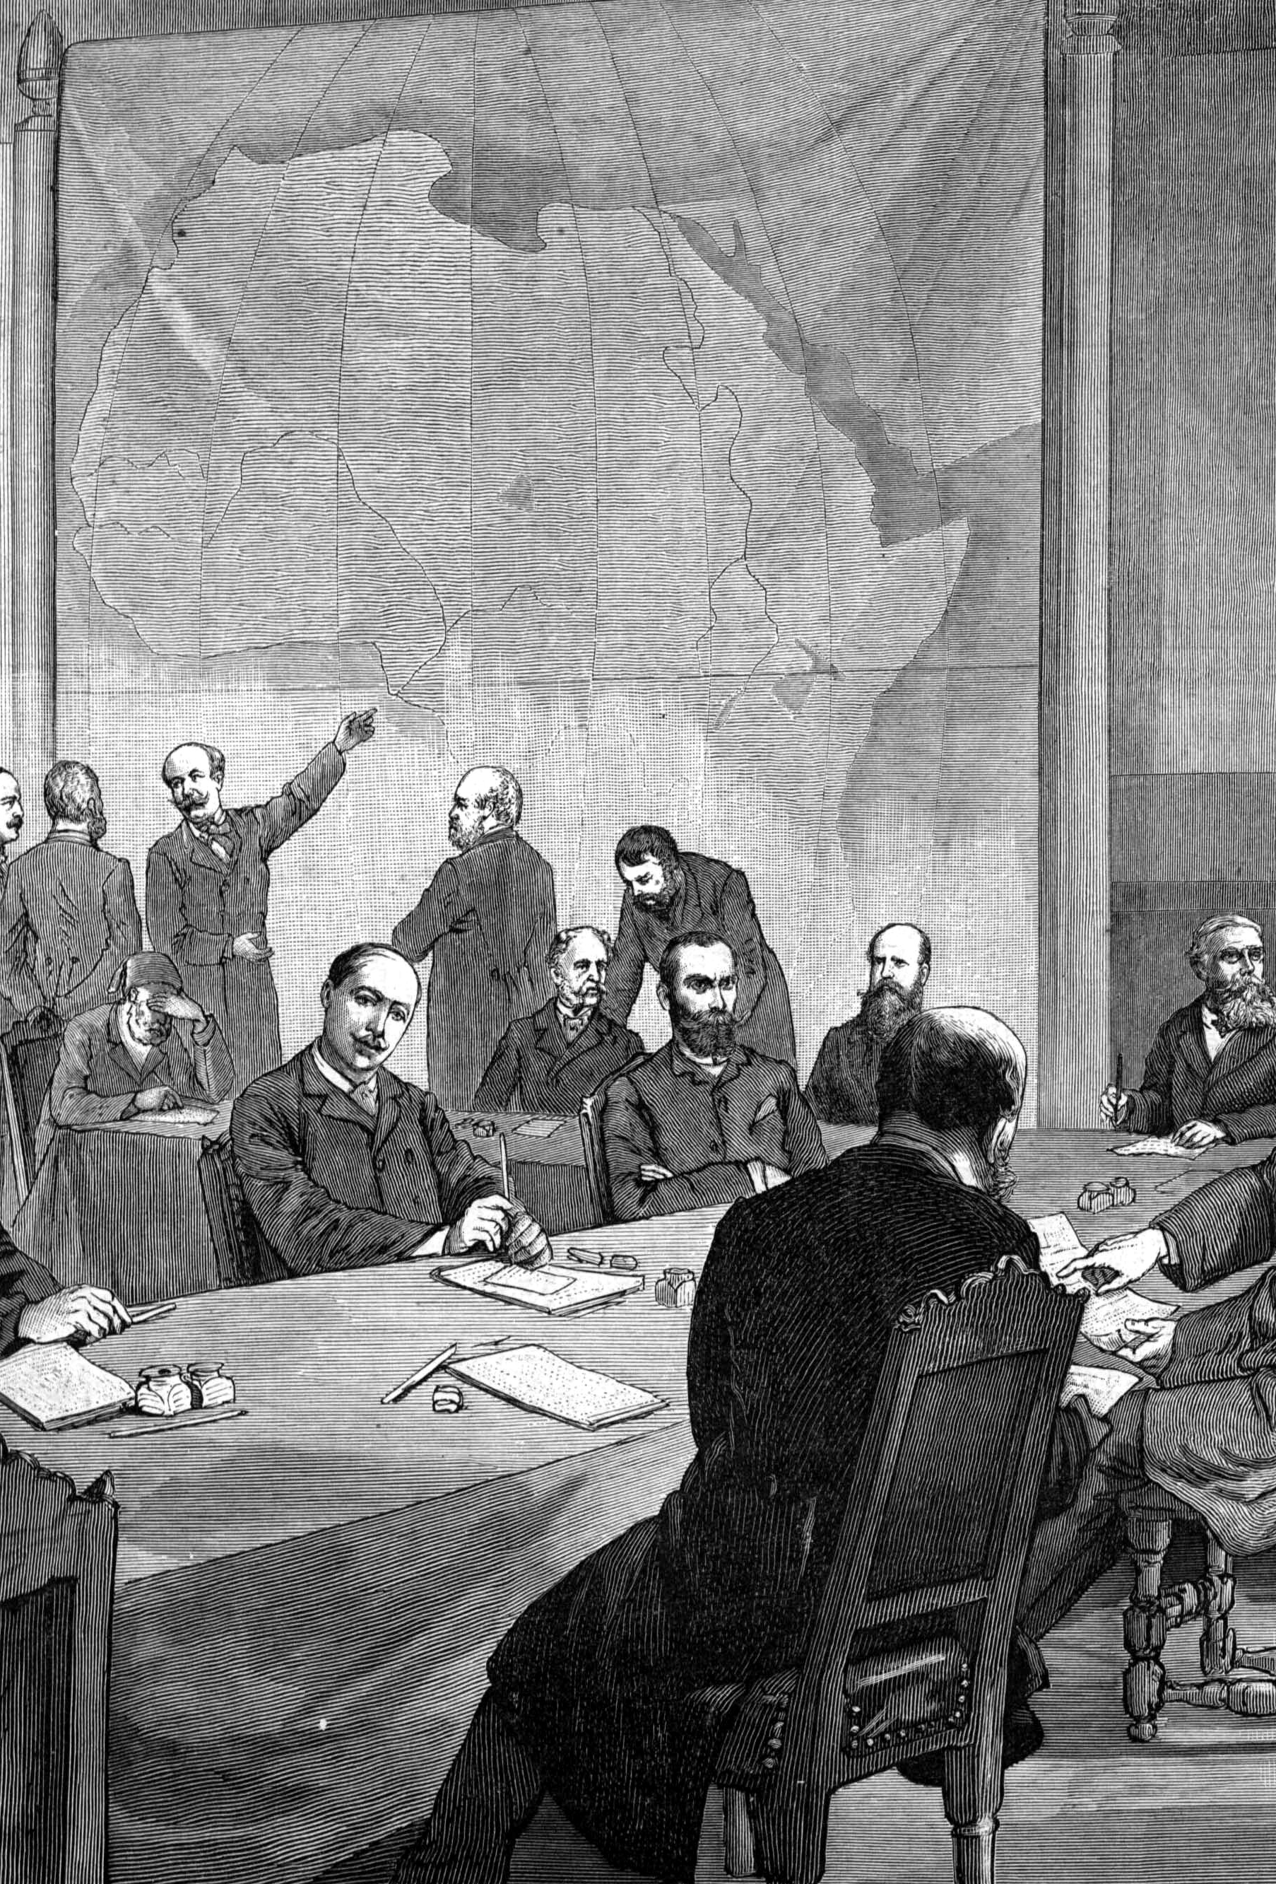
The Berlin Conference
Nov 1884 - Feb 1885
The Scramble for Africa was formalized at the Berlin Conference in 1884.
European powers met in Berlin to negotiate their territorial claims and divided the continent into separate spheres of influence. This was known as the Partition of Africa.
There were no representatives from Africa at the Conference.

Slide 9
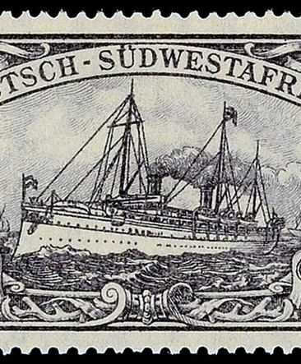
Proclamation of German South West Africa
Jul 1884
After the Berlin Conference, German South West Africa was established as a protectorate of the German Empire.
The territory covered present-day Namibia.

Slide 10
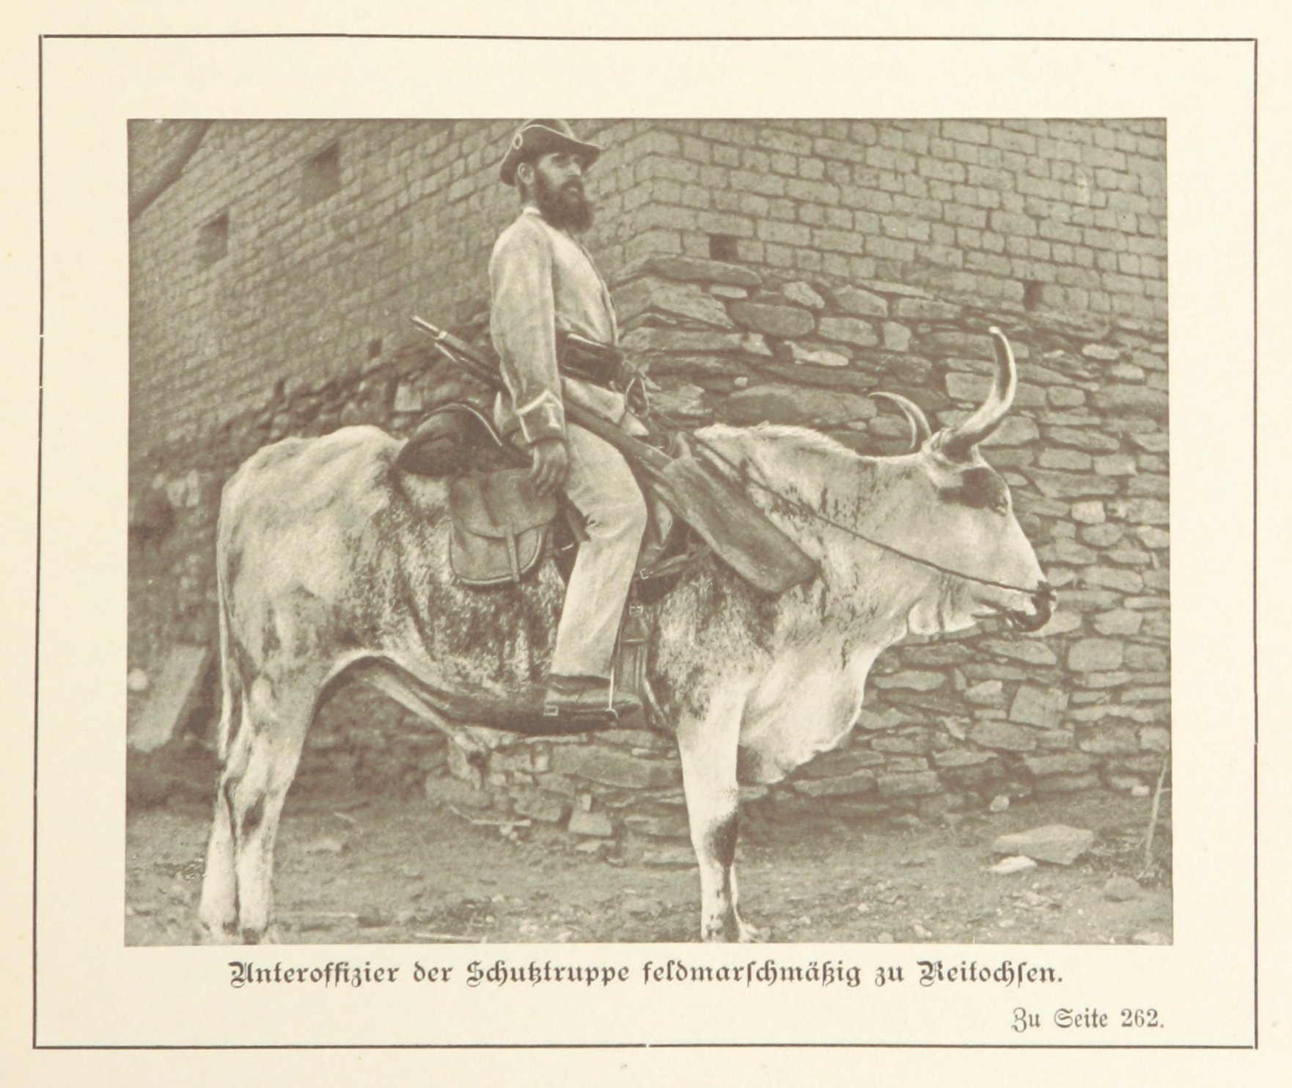
Protection Treaties
1884-1894
The appointed Governor of German South West Africa, Major Theodor Leutwein, negotiated protection treaties with local leaders.
Through these treaties, German farmers stole cattle and confiscated the land inhabited by the Herero and Nama communities.

Slide 11
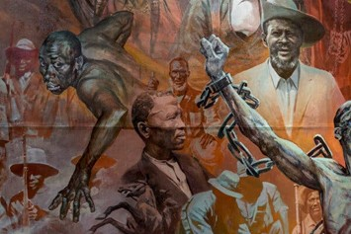
Herero Resistance: 'Small Wars'
1889-1903
Leutwein consolidated German control over the territory through a series of ‘small wars.’
Several Herero chiefs were executed for their ongoing resistance to the German colonial presence.

Slide 12
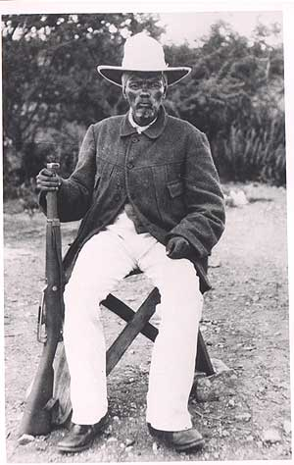
Hornkranz massacre
Apr 12, 1893
Under Chief Hendrik Witbooi, the Nama launched fierce resistance against German rule.
The resistance was violently suppressed by the German administration. German soldiers attacked Witbooi and the village of Hornkranz, shooting indiscriminately and killing 150 people.
Witbooi signed a protection treaty in 1894.

Slide 13
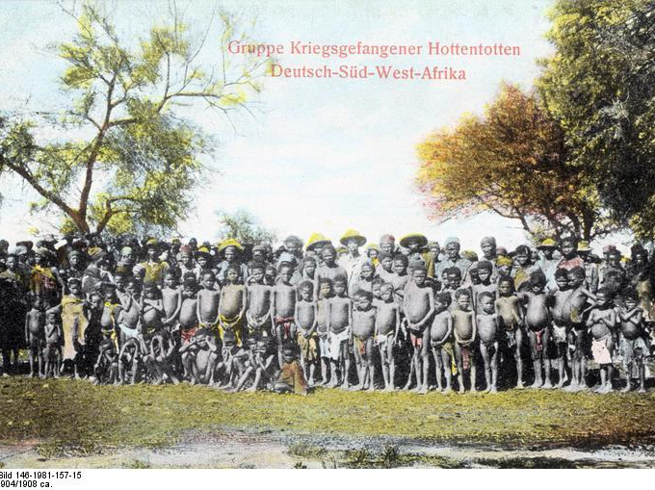
Khauas-Khoi Mbanderu War
1896
In response to ongoing land and cattle dispossession, Herero leader Nicodemus Kavikunua staged an uprising against German forces in Gobabis.
Kavikunua’s forces were annihilated. He was executed in June 1896. Survivors of the uprising were placed into a concentration camp at Windhoek.

Slide 14
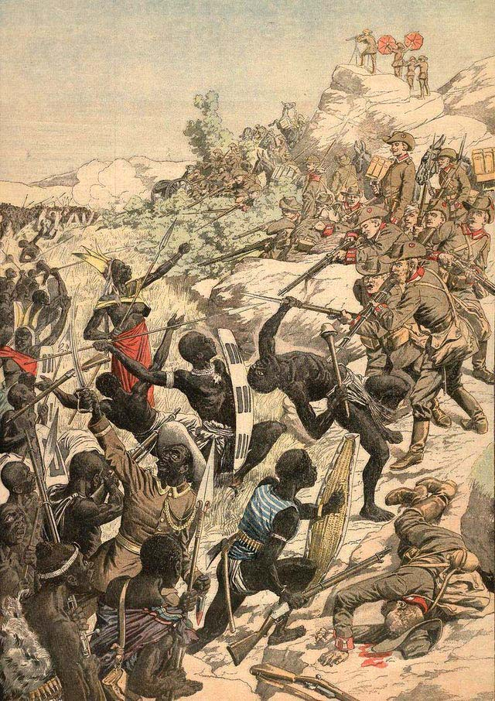
Herero Rebellion
Jan 1904
Led by Chief Samuel Maharero, the Herero staged a major armed rebellion against German rule.
They launched a surprise attack on German farmers near the town of Okahandja, killing 120-150 people.
Significantly, German women, children, and missionaries were not deliberately targeted in the violence.

Slide 15
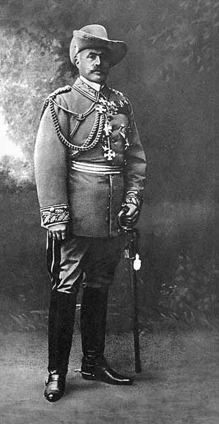
Reinforcement of German forces
May - Jun 1904
Major Theodor Leutwein was dismissed due to growing frustration in Berlin over his failure to suppress the rebellion.
Lieutenant-General Lothar von Trotha was appointed Commander-in-Chief of the Schutztruppe. He arrived in Swakopmund on June 11, 1904.
14,000 troops were sent to strengthen the German presence.

Slide 16
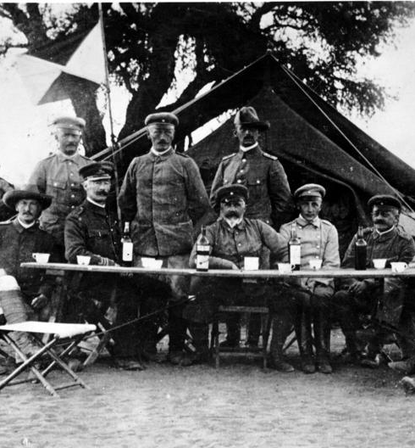
Abandoned Negotiations
Jul - Sep 1904
Around 8,000 Herero gathered at the Plateau of Waterberg to open land rights negotiations with the German forces.
Von Trotha, however, abandoned negotiations with the Herero and adopted encirclement tactics instead.

Slide 17
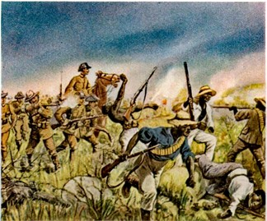
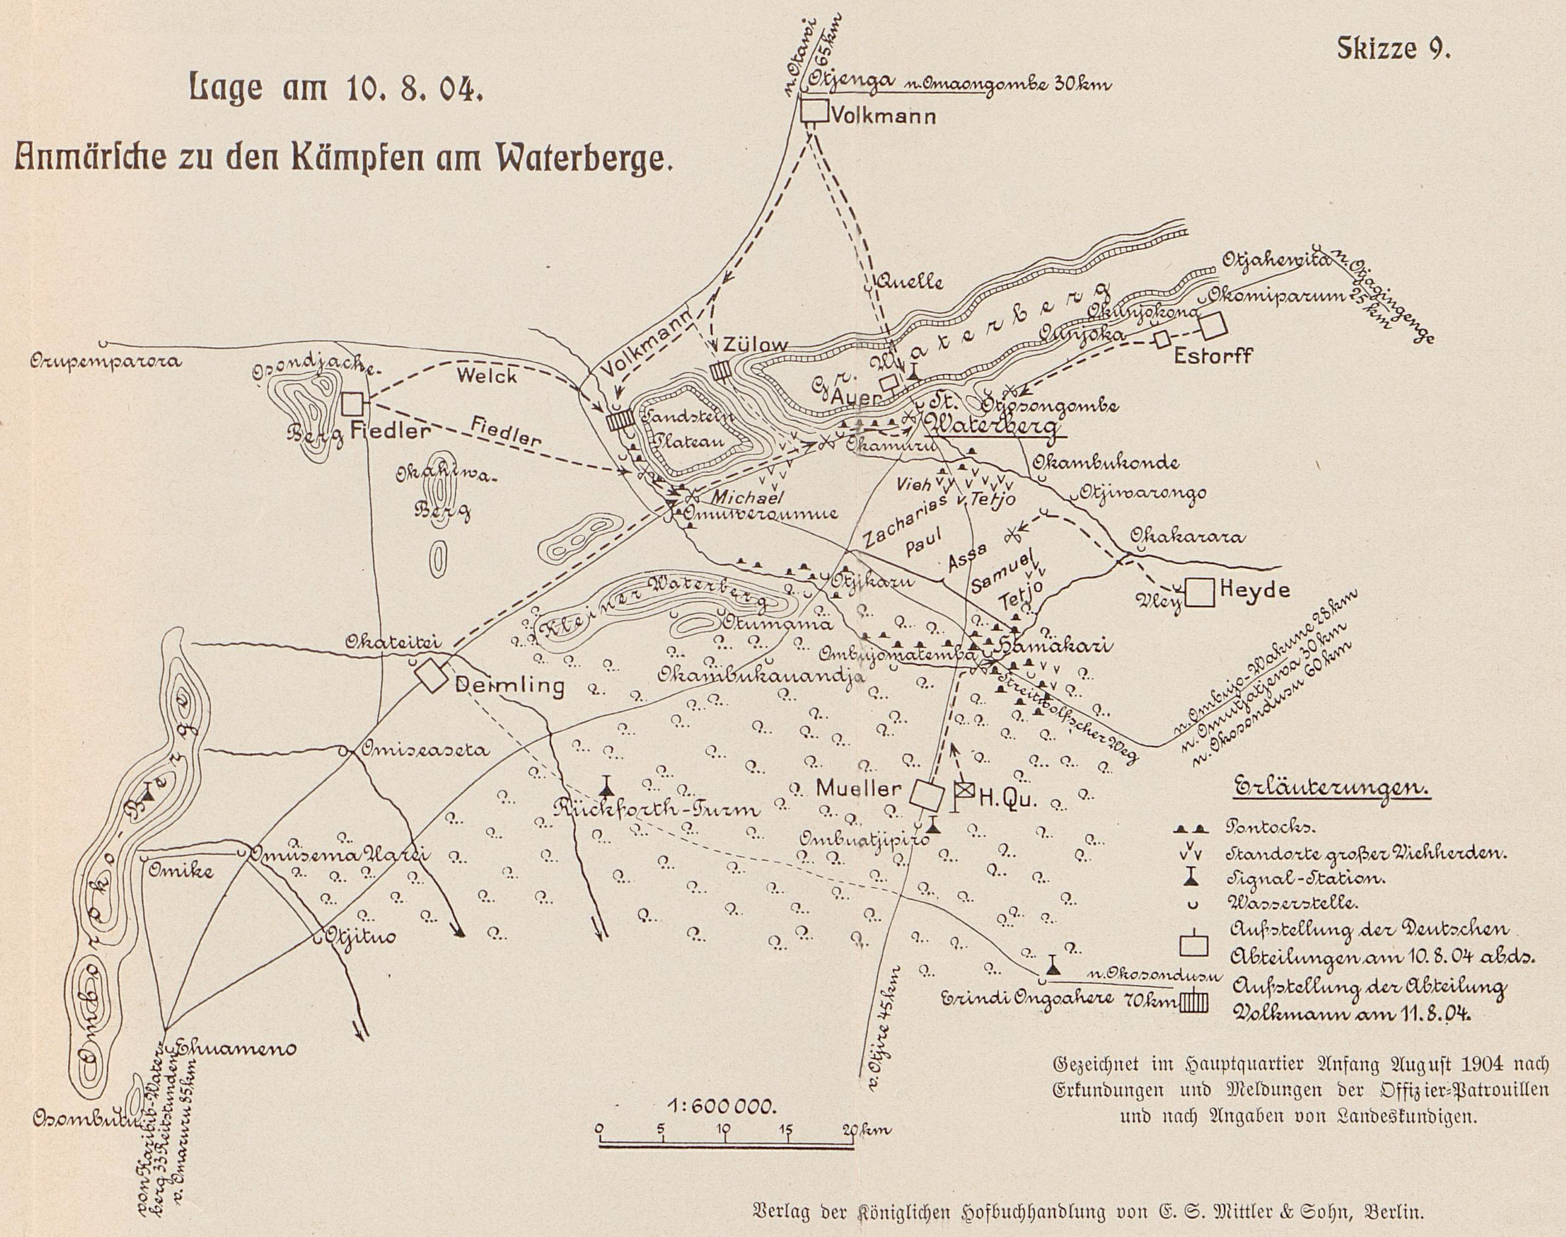
Battle of Waterberg
Aug 11, 1904
German troops clashed with Herero forces at the Waterberg Plateau. Between 3,000-5,000 Herero combatants were killed. The Herero were forced to retreat into the Omaheke desert.
Samuel Maharero led about 1,000 of his followers across the desert to seek asylum in the British Protectorate of Bechuanaland (modern-day Botswana). He remained in exile until his death in 1923.

Slide 18
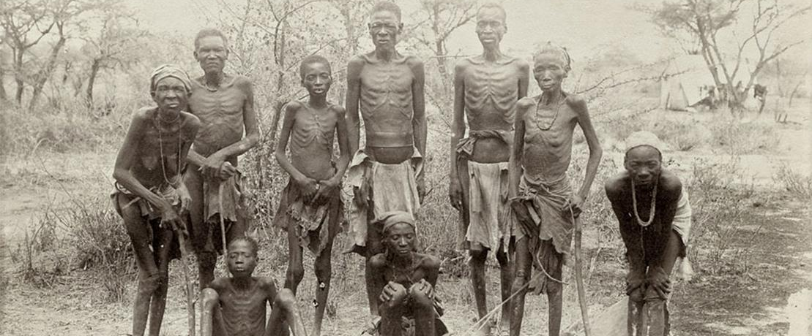
Extermination Order
Oct 02, 1904
General Lothar von Trotha issued an extermination order:
“Within the German borders, every male Herero, armed or unarmed [...] will be shot to death. I will no longer take in women or children but will drive them back to their people or have them fired at. These are my words to the Herero people.”
German forces poisoned wells and constructed a 200-mile-long fence to trap Herero men, women, and children in the desert, where thousands died of thirst and starvation.

Slide 19
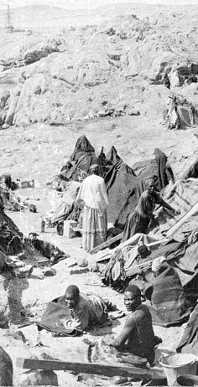
Establishment of Concentration Camps
Nov 1904 - Jan 1908
Due to public outcry in Germany, the government in Berlin overturned von Trotha's brutal campaign of extermination.
Survivors were rounded up and placed in concentration camps, in Lüderitz, Swakopmund, and Windhoek.
Prisoners were subjected to poor hygiene conditions, little access to food, forced labor, and medical experiments.

Slide 20
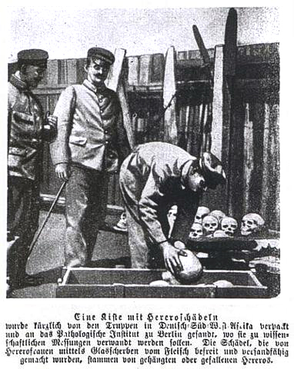
Shark Island
1905-1908
Shark Island, an isolated camp near Lüderitz, was created as an extermination center. Known as ‘Death Island,’ an estimated 80% of Shark Island prisoners died. 8,000 Herero died from disease, exhaustion, and starvation.
Eugenicists, such as Eugen Fischer, performed pseudoscientific racial exams and medical experiments at the camp. Prisoners were injected with smallpox and tuberculosis and were subjected to forced sterilizations.

Slide 21
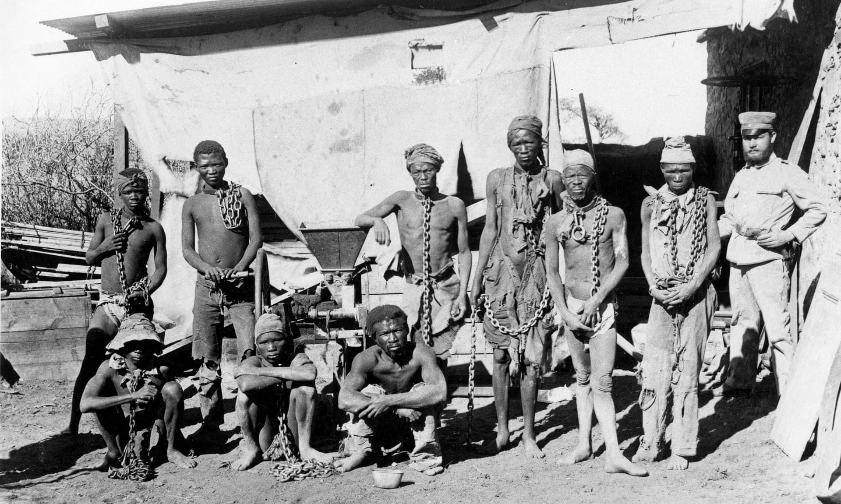
Guerrilla Warfare
1905-1908
Nama communities continued to conduct guerrilla warfare against German rule.
Those who were caught were either executed or placed in concentration camps with the Herero.

Slide 22
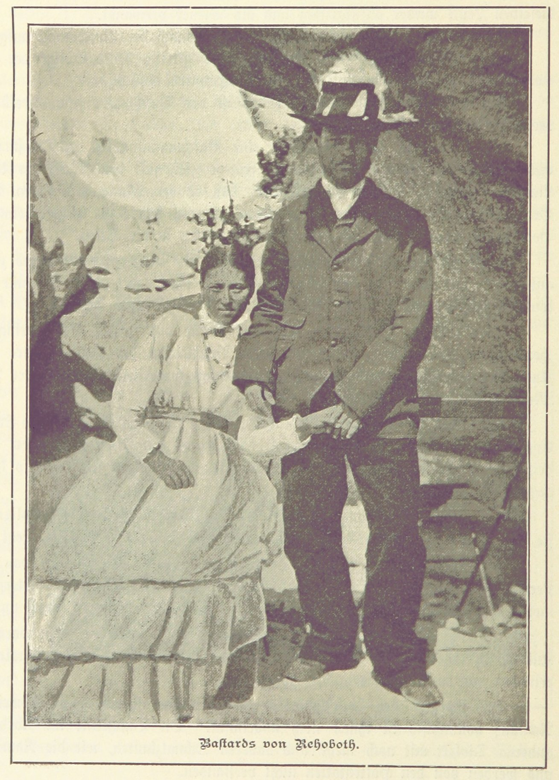
Interracial Marriage Ban
1905
In 1905, a law was passed which forbade interracial marriage in German South West Africa. The law sought to prevent Rassenmischung ‘race-mixing,’ in the colony. New legal definitions for ‘white’ and ‘native’ were developed. People classified as ‘native’ were forced to wear identification badges.
In 1907, the high court in Windhoek nullified existing interracial marriages that predated the 1905 legislation.

Slide 23
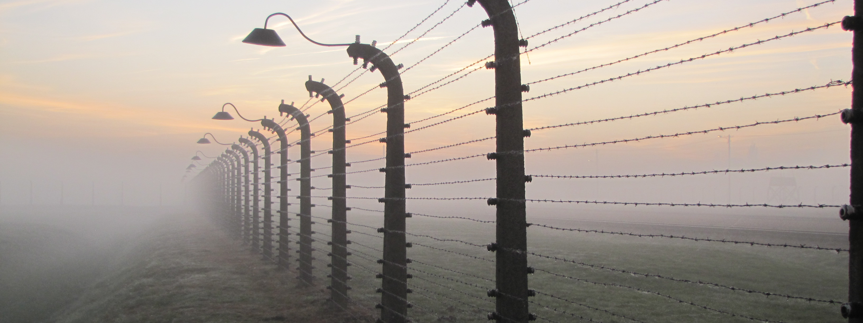
Continuity with the Holocaust
Several elements of the Herero and Nama genocide demonstrate continuity with the Holocaust.
Concentration camps were established in both cases, where prisoners were subjected to forced labor, a starvation diet, and medical experimentation.
At Shark Island, from 1904-1908, research was conducted on corpses by race scientists, including Eugen Fischer. Fischer became the forefather of the Nazi eugenics theory, which drove the state’s genocidal policies against Jews.
Systemic racism was evident in both cases. The laws forbidding interracial marriage in German South West Africa foreshadowed the 1935 Nuremberg Laws in Nazi Germany.

Slide 24
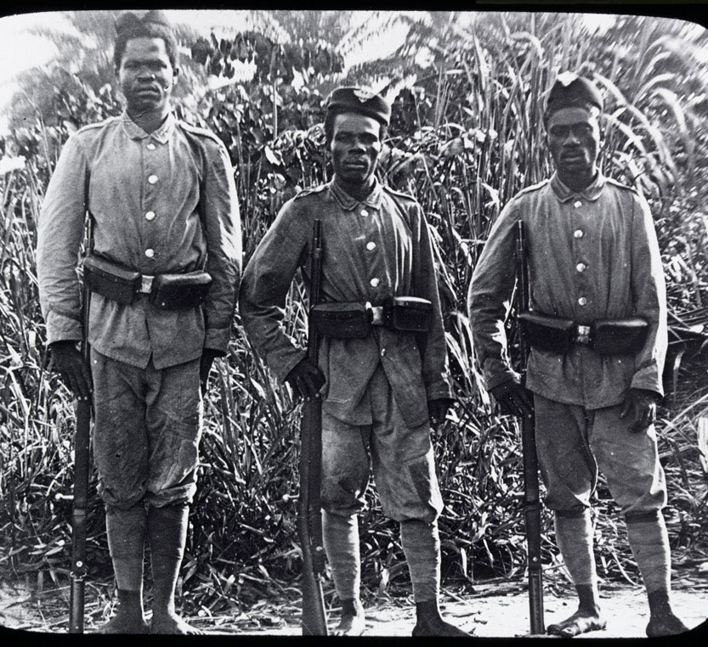
First World War
Aug 01, 1914 - Nov 11, 1918
The outbreak of the First World War occurred on August 1, 1914. The hostilities quickly extended to the African continent.
The Allied powers targeted German colonies to restrict the German navy and disrupt radio transmitters in South West Africa.

Slide 25
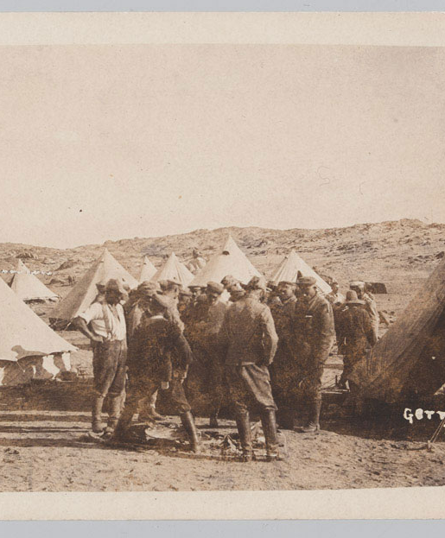
Invasion of South West Africa
Sept 14, 1914 - Jul 09, 1915
German South West Africa was invaded as part of the Allied campaign against German colonies in WWI. The port of Lüderitz was occupied by colonial troops on September 18, 1914.
German forces surrendered on July 9, 1915.
South West Africa was governed by South Africa until it gained independence as Namibia in 1990.

Slide 26

UN Convention on Genocide
Dec 09, 1948
The Convention on the Prevention and Punishment of the Crime of Genocide was unanimously adopted by the United Nations General Assembly on December 9, 1948.
The Convention was effective from January 12, 1951.

Slide 27
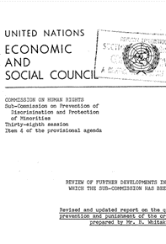
The Whitaker Report
July 02, 1985
Ben Whitaker, the UN Special Rapporteur on Prevention and Punishment of the Crime of Genocide, wrote a report and presented it to the United Nations.
This report officially recognized the German atrocities in South West Africa as genocide.

Slide 28
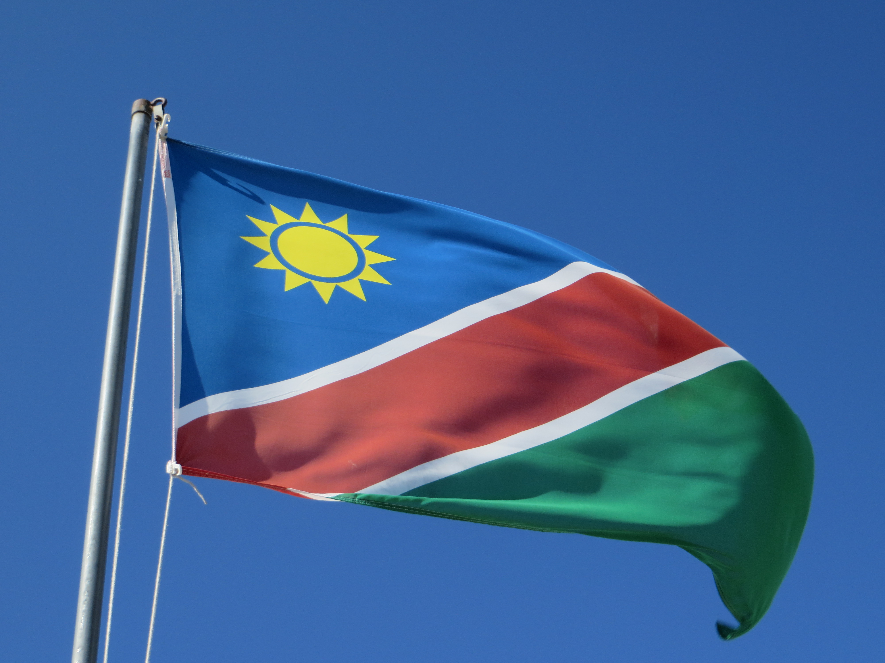
Namibian Independence
Mar 21, 1990
On June 12, 1968, under UN General Assembly Resolution 2372, South West Africa was renamed Namibia.
South Africa ended its occupation of Namibia in 1988. In November 1989, elections were held for a new constitutional assembly.
On March 21, 1990, the Republic of Namibia was officially declared a sovereign state. Sam Nujoma was sworn in as the first President.

Slide 29
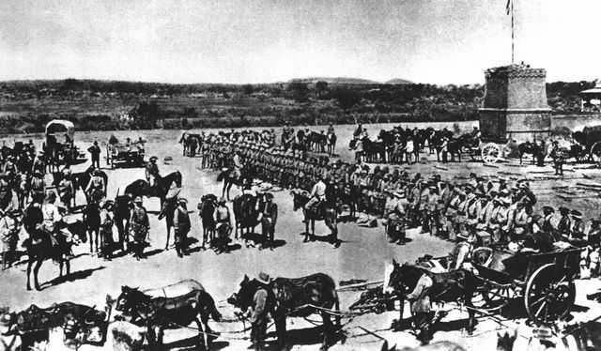

Herero Descendants File Lawsuit
2001-2004
In 2001, Herero descendants filed a $2 billion lawsuit in the USA against the German government and Deutsche Bank for their involvement in the 1904 genocide. They primarily sought compensation to purchase land from white farmers and redistribute it among Herero descendants.
In June 2004, the lawsuit was dismissed for failure to state an actionable claim. It was deemed a political issue rather than a legal one.

Slide 30

100th Anniversary: German Minister Apology
Aug 2004
The German Development Minister, Heidemarie Wieczorek-Zeul, visited Namibia on the 100th anniversary of the Battle of Waterberg.
She issued an apology for the "violence, discrimination, racism and destruction" which led to genocide in Namibia.
This statement was dismissed as a personal opinion by the German government.

Slide 31
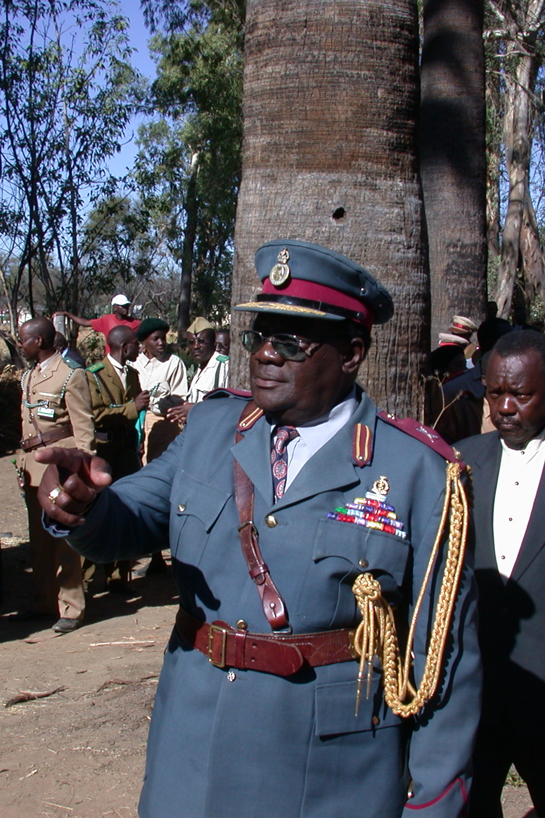
Riruako address to the Namibian National Assembly
Sep - Oct 2006
Kuaima Riruako, the chief of the Herero people, brought a motion to the Namibian National Assembly. He asked for the government to support the Herero claims for recognition and reparations from Germany. The motion was unanimously adopted on October 26, 2006.
The Namibian National Assembly requested a dialogue with the German government to obtain an official apology and reparations.

Slide 32
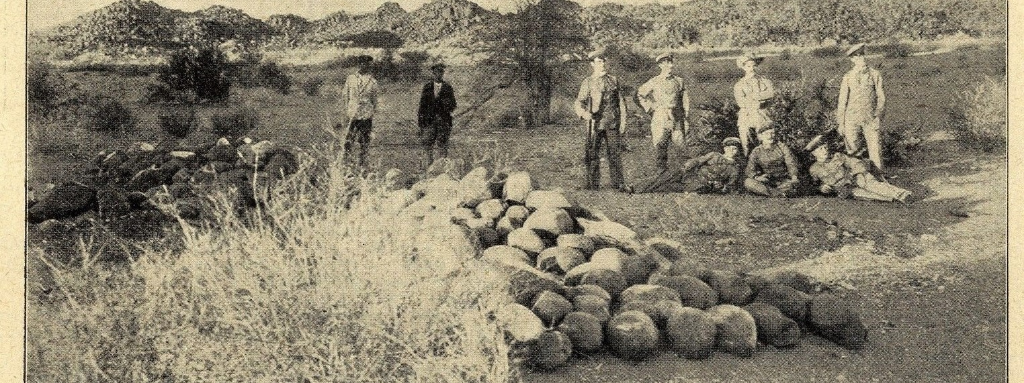
German Foreign Ministry acknowledges genocide
2012-2015
In 2012, the German and Namibian governments appointed special envoys to begin negotiations, to develop a shared understanding of past events. The major representatives of Herero and Nama descendants were excluded from the talks.
On July 10, 2015, the German Foreign Ministry formally acknowledged the events as genocide. Despite this, the German government rejected legal responsibility and opposed the idea of reparations.

Slide 33
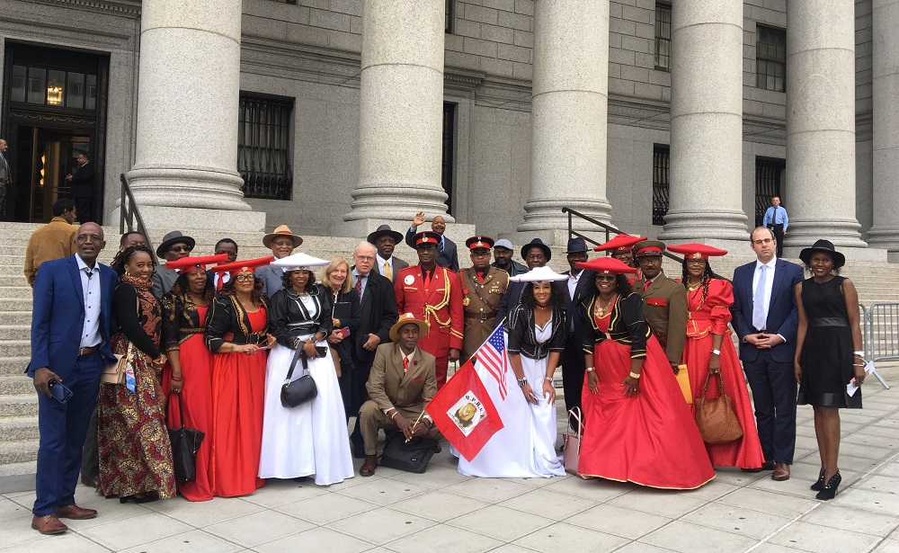
Federal class action lawsuit
Jan 05, 2017 - Jun 07, 2021
On January 5, 2017, descendants of the Herero and Nama people filed a lawsuit against Germany in a New York court, accusing Germany of genocide and expropriation of property. They sought reparations for their losses and demanded inclusion in negotiations between Germany and Namibia regarding how to address the colonial atrocities.
The plaintiffs' arguments built upon the ‘continuity thesis,’ which emphasizes the connection between the colonial atrocities and the Holocaust.
The case was dismissed in March 2019. The plaintiffs appealed and took the case to the Supreme Court in 2021. The case was dismissed once again and closed on June 7, 2021.

Slide 34
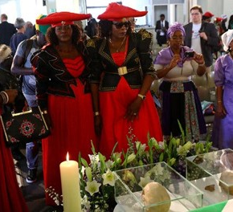
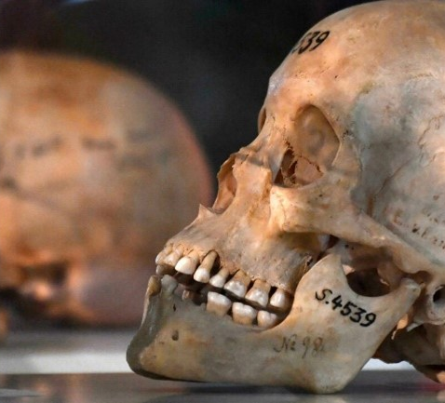
Germany returns victims' remains to Namibia
Aug - Sep 2018
Germany formally returned the human remains of victims of the Herero and Nama genocide. A Namibian government delegation received the skulls at a church service in Berlin.
The skulls were used by race anthropologists to justify their pseudoscientific theories of racial hierarchy.
More than 25 remains were returned.

Slide 35
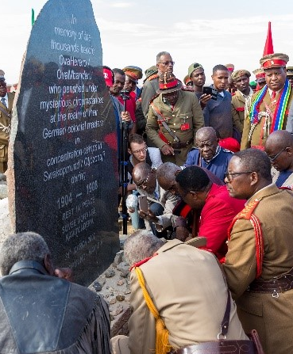
Germany commits $1.34 billion for projects in Namibia
May 2021
The German government described the funds as a ‘gesture of reconciliation’ that do not represent official reparations.
The money will be allocated to different aid programs over a 30-year period.
Projects will focus on rural infrastructure, land reform, water supply, professional training, and establishing a foundation for reconciliation between Germany and Namibia.

Slide 36
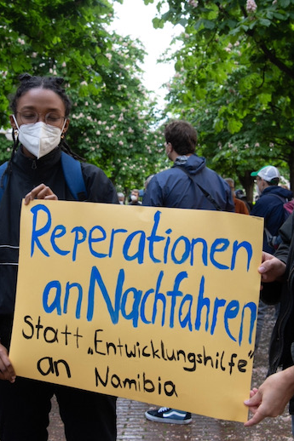
Reparations
Securing recognition and accountability for the Herero and Nama genocide has largely focused on the issue of reparations.
Germany granted Holocaust victims $845 million in reparations on September 10, 1952. A further $125 million was allocated in 1988. In contrast, no reparations have been paid to the descendants of the Herero and Nama peoples.
Although Germany allocated $1.34 billion for development projects in Namibia, the government refuses to refer to these funds as 'reparations'. This has drawn criticism from Herero representatives and scholars alike.
According to the Association of the Ovaherero Genocide in the USA, "Germany takes the position of not issuing reparations…because unlike the victims of the Second World War, we have black skin."

Slide 37
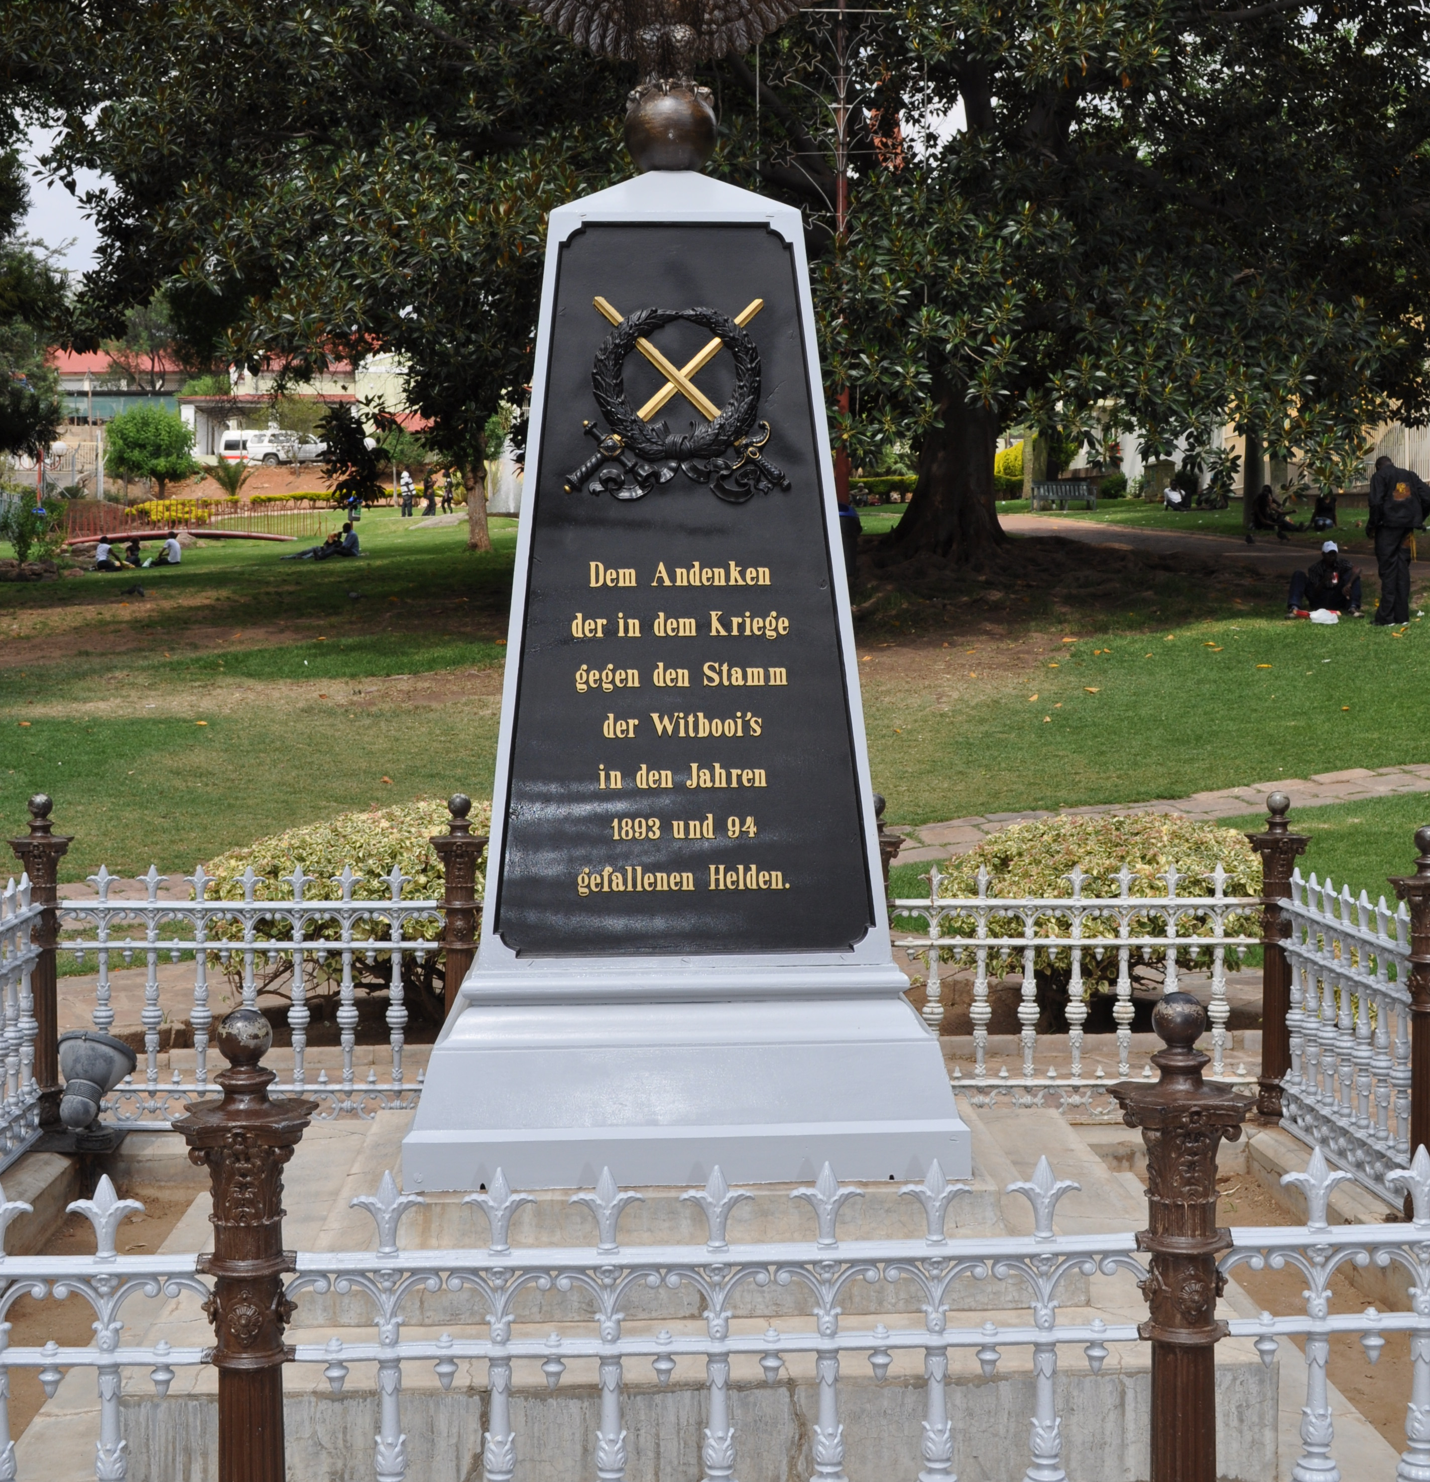
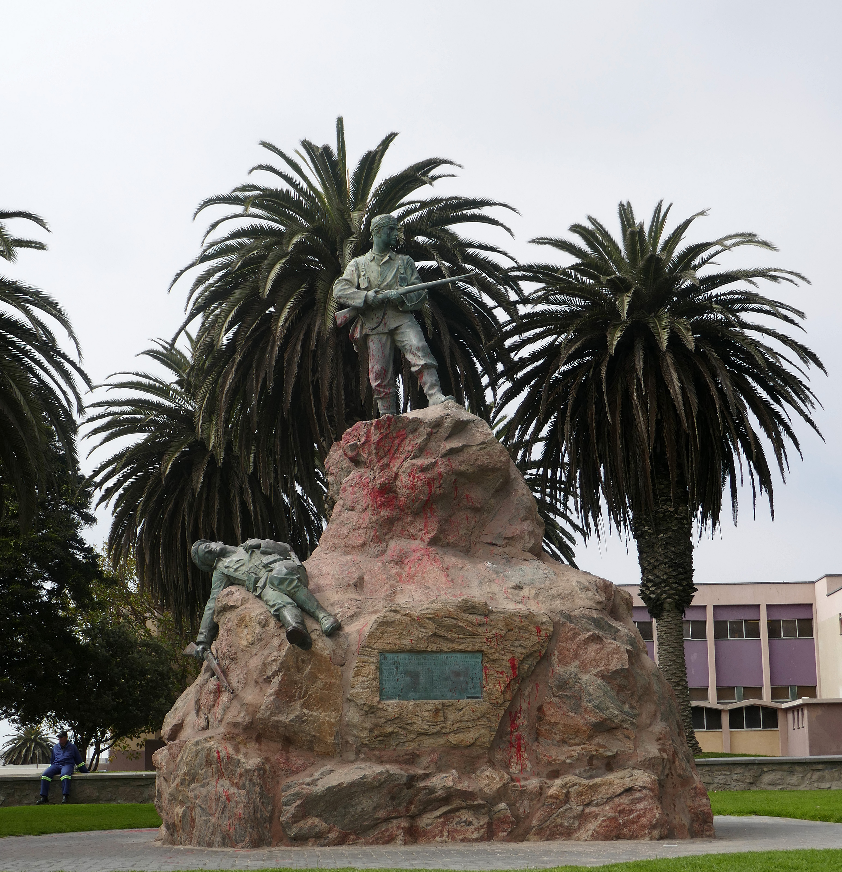
The issue of remembrance
Calls for the German government to acknowledge its responsibility for the Herero and Nama genocide have been met with reticence and, until recently, blatant denial. Historian Jürgen Zimmerer has described this as "colonial amnesia."
This ties in with the wider issue of remembrance, which remains controversial in Namibia to this day. Several Namibian cities still contain colonial-era monuments that commemorate the German soldiers involved in the Herero and Nama genocide. This has fueled heated debates about memorial politics.

Slide 38
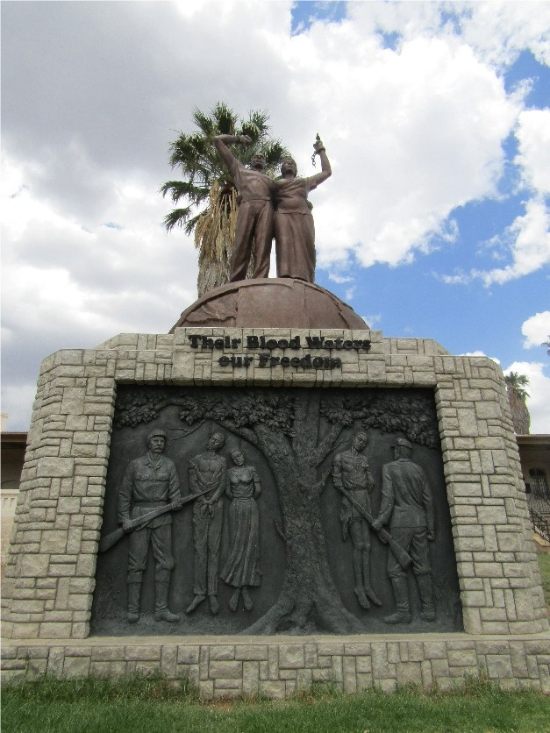
Summary
The colonial atrocities committed in German South West Africa from 1884-1908 represent the first genocide of the 20th century. The effects of the genocide are felt by Herero and Nama descendants in Namibia to this day.
In 2015, the German acknowledgement of these events as genocide marked an important step towards recognition and accountability. The refusal to pay reparations, however, has opened important debates about the limits of international law for securing accountability for colonial-era crimes.

