Slide 1
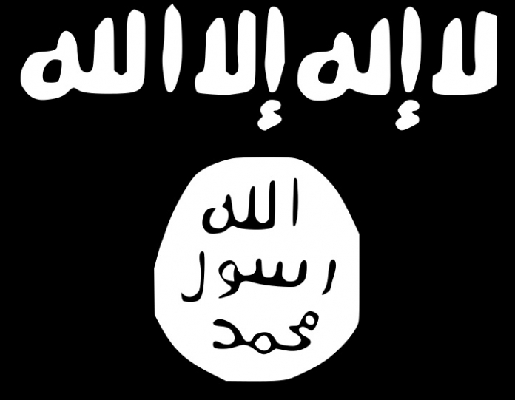
Summary & Key Findings
Since its splintering off from al-Qaeda in the early 2000s, ISIS has committed all stages of the Ten Stages of Genocide.
Genocide Watch, the United Nations, and various other international organizations and states recognized the fact that ISIS committed genocide in Iraq and Syria, most significantly from 2014-2015.
As a significant number of foreign fighters are trying to return to their home countries, many governments are struggling to find ways in which they can bring returning foreign fighters to justice.
Many countries are reluctant to accept foreign fighters back due to previous terrorist attacks conducted by returnees and the risk of the spread of jihadist ideology.
Alongside foreign fighters, ISIS leaders and militants need to be brought to justice as well. There have been several trials in Iraq but the need for an international trial is evident since ISIS has been a global threat.
Islamophobia and the Syrian Refugee Crisis continue to worsen globally regardless of ISIS' defeat.

Slide 2
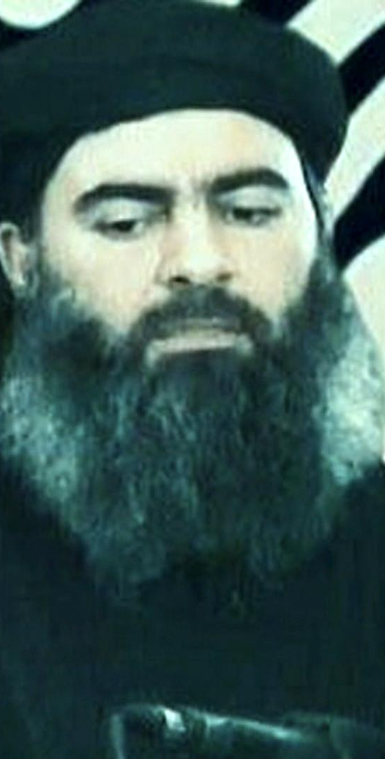
History: The Rise of the Caliphate
1998 – 2017
The roots of what will evolve into ISIS has been established by Abu Musab al Zarqawi back in 1999. With the group's participation in the Iraqi insurgency, many members of the old Ba'ath party and a significant number of foreign fighters joined what soon became al-Qaeda in Iraq.
In 2006, upon merging with other Sunni Islamist groups, AQI became the Islamic State in Iraq (ISI).
Later in 2013, as Syria was toppled with civil war, ISI joined forces with the al-Nusra Front in Syria and became the Islamic State of Iraq and Syria (ISIS).
In 2014, ISIS declared the Caliphate and claimed statehood. No country or organization has ever recognized ISIS as a state.

Slide 3
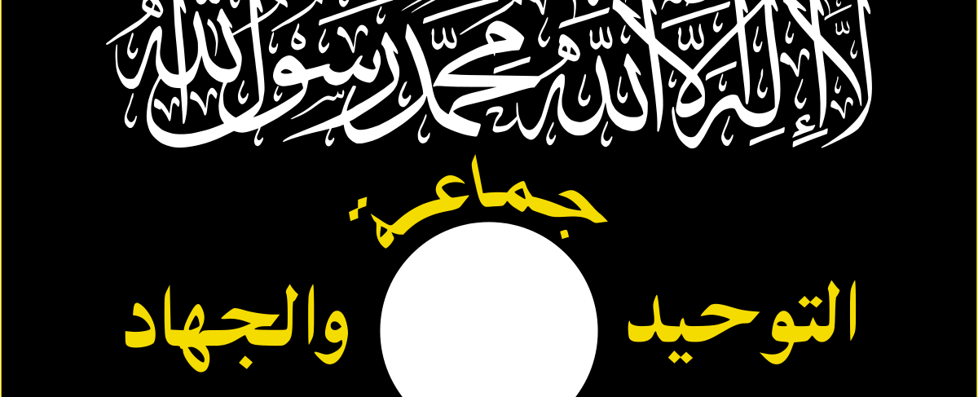
Before ISIS:
Jama'at al-Tawhid wal-Jihad
1998
Abu Musab al Zarqawi established Jama'at al-Tawhid wal-Jihad (JTJ) in Jordan as a militant jihadist group. This group evolved into the terrorist group known as the Islamic State of Iraq and Syria (ISIS) today.
See this link for the interactive timeline on the full history of ISIS. This timeline is the main resource for this section of the timestream.

Slide 4
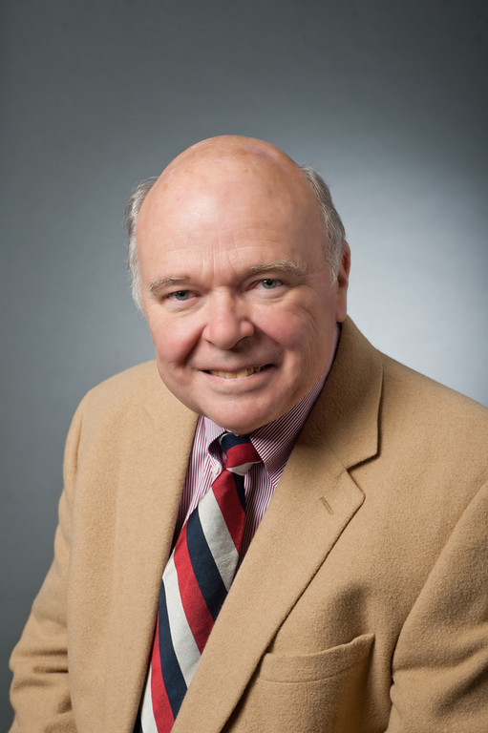
ISIS: Ten Stages of Genocide
Dr. Gregory Stanton, Founding President of Genocide Watch, uses the Ten Stages of Genocide to describe and explain the genocidal process. The stages are:
1. Classification
2. Symbolization
3. Discrimination
4. Dehumanization
5. Organization
6. Polarization
7. Preparation
8. Persecution
​9. Extermination
10. Denial
These stages are not linear and all but the last have been found in the atrocities and genocides committed by ISIS within Syria and Iraq.
The main targeted groups for genocide were Yazidis and Christians who lived in territories invaded by ISIS.
Genocide Watch declared genocide alerts for both Iraq and Syria.

Slide 5
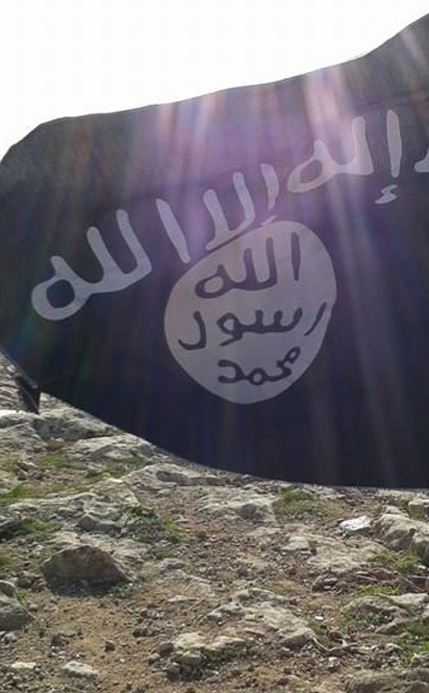
Stage 1: Classification
Takfirism has been the main ideology of the Salafist jihadist doctrine of ISIS. For these extremist Sunni Muslims, other branches of Islam such as Shia and Sufis are blamed for apostasy.
Believers of other religions such as Christians, Hindus, Yazidis, and Jews are also classified as non-believers. And under the ideology of ISIS, they should be converted to the 'true religion' which for them is the Salafist extremist Sunni Islam.

Slide 6
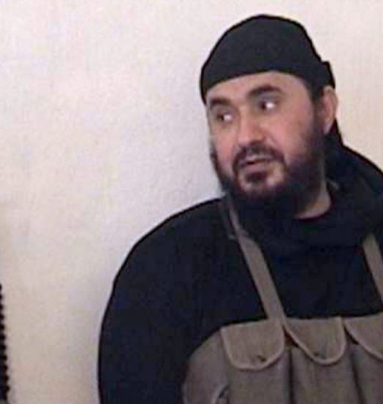
Zarqawi back in Iraq
2001
After 9/11, Zarqawi returned to Iraq to join the Mujahideen fight against the US, where he soon connected with members of al-Qaeda (AQ).

Slide 7
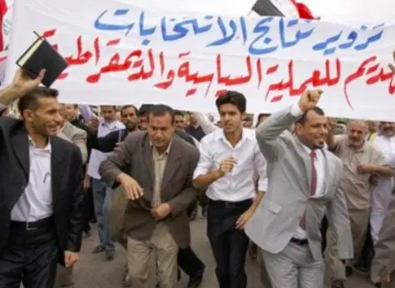
De-Ba'athification & Its Consequences
May 15, 2003
The US invasion of Iraq resulted in the overthrow of Saddam Hussein's government. The process of De-Ba'athification began as members of the Ba'ath party and the remaining members of Hussein's government and military officials were removed from their offices.
After the fall of the Iraqi regime in 2003, the US-led Coalition Provisional Authority (CPA) introduced a sweeping, indiscriminate de-Baathification process intended to rid the country of the Baath party's influence. (Al Jazeera)

Slide 8
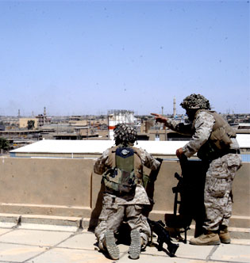
Iraqi Insurgency & AQI
2003
Thousands of military and government officials who were removed from office during De-Ba'athification found interest in joining the Iraqi insurgency, which grew immensely post-De-Ba'athification. As the number of fighters continued to increase, Zarqawi established Al-Qaeda in Iraq (AQI), which would become known as ISIS.

Slide 9
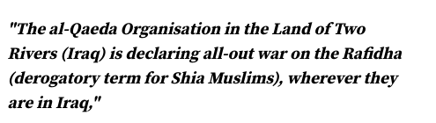
Takfirism
Abu Musab al-Zarqawi was a 'takfiri', which is the word for a Muslim accusing another Muslim of apostasy. Zarqawi hated Shia Muslims and other non-Sunni denominators of Islam accused them of apostasy and condemned them to death. One of his greatest principles was to start a Sunni-Shia Civil War in Iraq.
As tensions between Shia and Sunnis in Iraq increased, many Sunni Muslims acquiesced to AQI or ISIS, even if they considered themselves non-Jihadists. Sunnis thought that doing so would be better than being suppressed by the Shia-dominated Iraqi Security forces or other Shia militia groups.

Slide 10
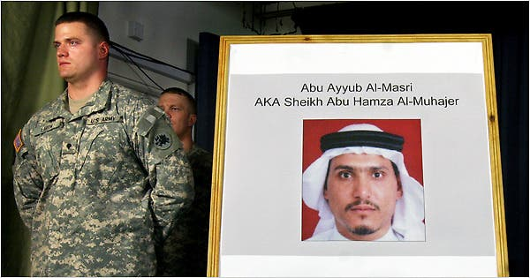

New Leader for ISI
June 6, 2006
When Abu Musab al-Zarqawi was killed during a US airstrike in 2006, Abu Ayyub al-Masri took over the leadership of the group.

Slide 11
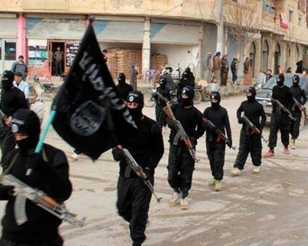
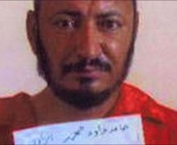
Islamic State in Iraq
Oct. 14, 2006
Abu Musab al-Zarqawi merged al-Qaeda in Iraq (AQI) with other Sunni Jihadist factions to form the Islamic State in Iraq (ISI) before his death in 2006. Al-Masri, who took his place, announced the establishment of ISI on this day. He appointed Abu Omar al-Baghdadi as its leader.

Slide 12
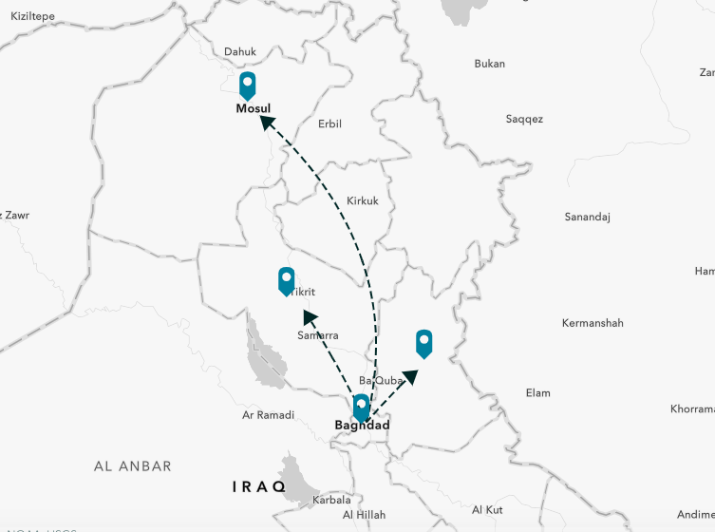
ISIS Movement out of Baghdad
2007
A surge in U.S. troops in Baghdad produced a flood of ISIS militants to Diyala, Salah ad-Din, and Mosul from Baghdad.

Slide 13
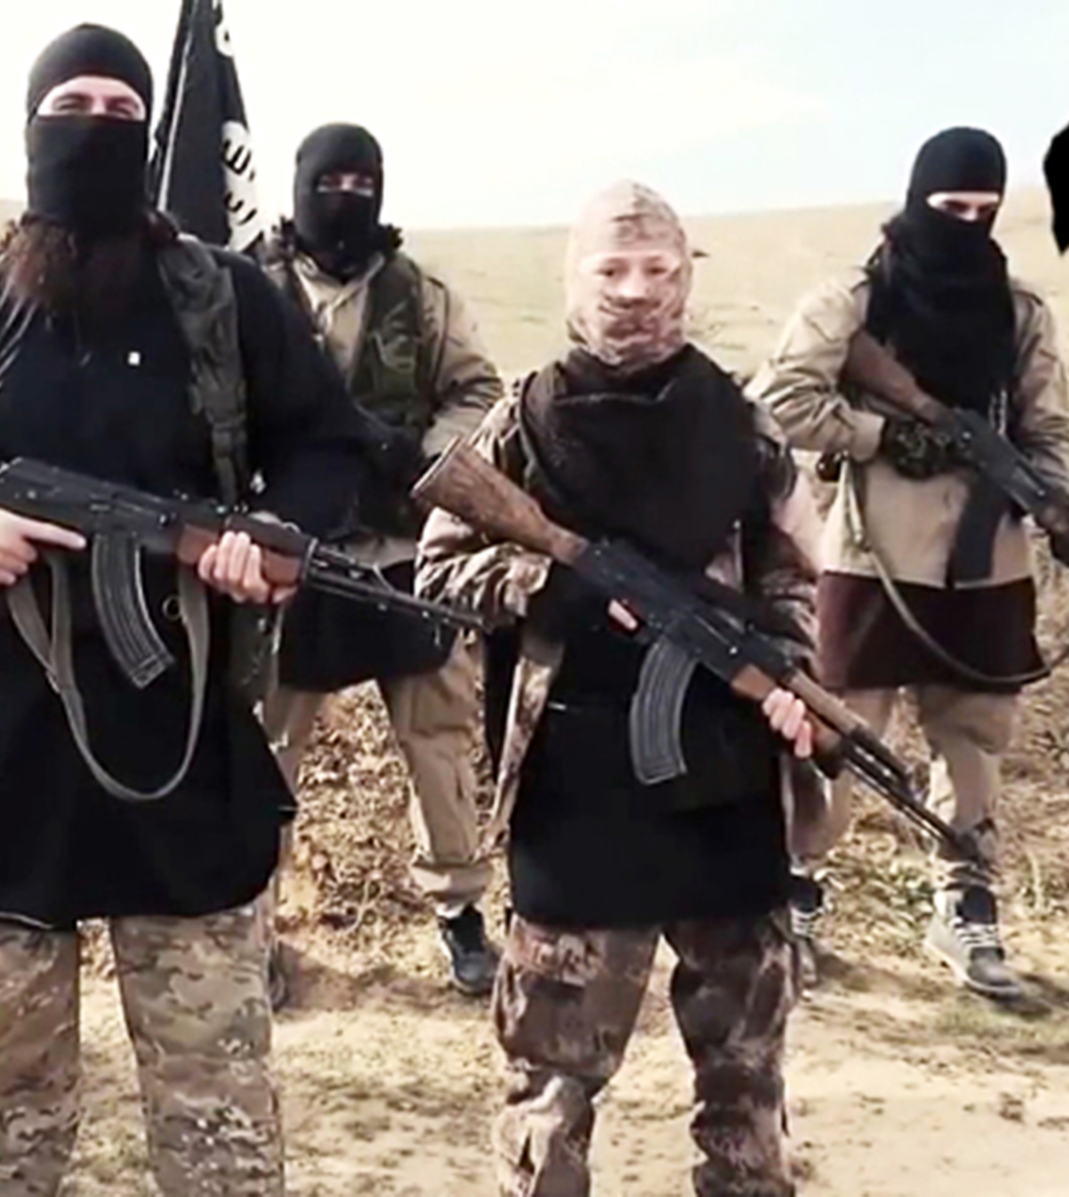
Increase in support for ISI
2008
As the Iraqi government targeted Sunnis and Sunni leaders, there was a huge increase in support for the ISI specifically in Sunni-dominated areas.
ISI officially claimed responsibility for the first suicide attacks in Baghdad that killed hundreds of people.

Slide 14
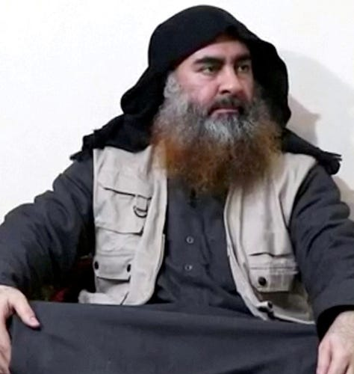
Change in Leadership
April 2010
Abu Omar al-Baghdadi was killed during a US-Iraqi operation. Abu Bakr al-Baghdadi (image to the right) became the new leader of ISI.

Slide 15
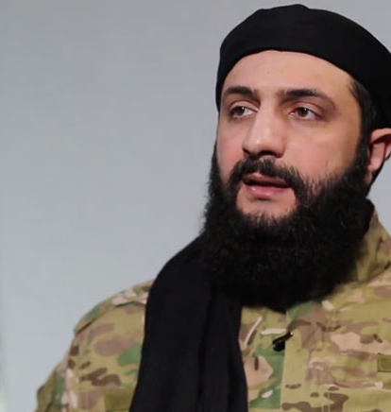
Towards Syria
2010
Abu Bakr al-Baghdadi sent one of his most trusted men, Abu Muhammad al-Julani, to Syria to grow the network in the region.
However, in 2012, he became the new leader of the al-Nusra Front.

Slide 16
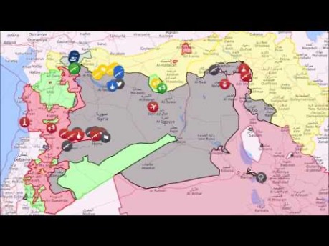
ISIS Territorial Changes Time-lapse
2014-2018
This map time lapse reflects ISIS's territorial changes, as well as military clashes, from 2014-2018.
Courtesy of NY Mapper

Slide 17
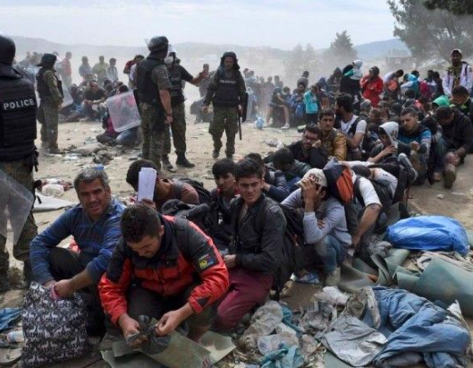
Refugee Crisis
2011-2020
The Syrian refugee crisis has initially started with the outbreak of the Syrian Civil War in 2011. Millions of people fled only in a few years, and soon Syrians became the largest refugee group in the world.
ISIS’s emergence in the region further destroyed the country physically and politically. Furthermore, ISIS has conducted deadly attacks at several refugee camps that hosted Syrians alongside with refugees from neighboring countries.

Slide 18
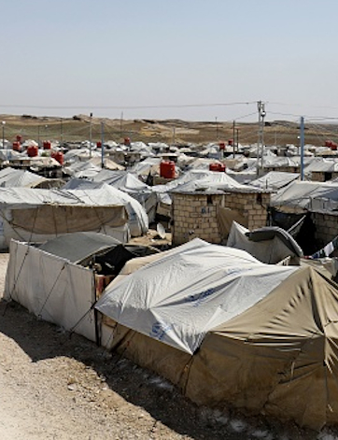
Global interest in the Caliphate
2010-2012
According to the International Centre for Counter-terrorism, ''are individuals that have, for a variety of reasons and with different ideological backgrounds, joined an armed conflict abroad.''
During the early insurgency, the number of foreign fighters was not as significant.
After the declaration of the Caliphate, the numbers rose significantly to the level where foreign fighters outnumbered Syrian jihadists.

Slide 19
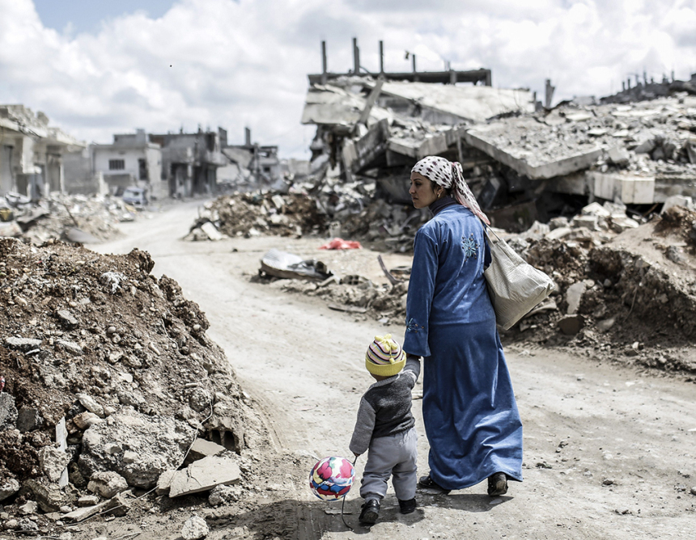
Start of a Humanitarian Emergency
March 2011
In the Syrian town of Daraa, a violent government crackdown began in reaction to public demonstrations in favor of a group of teenagers detained for anti-government graffiti.
Within two months, Turkey opened its first refugee camps to deal with the influx of refugees from the violence.

Slide 20
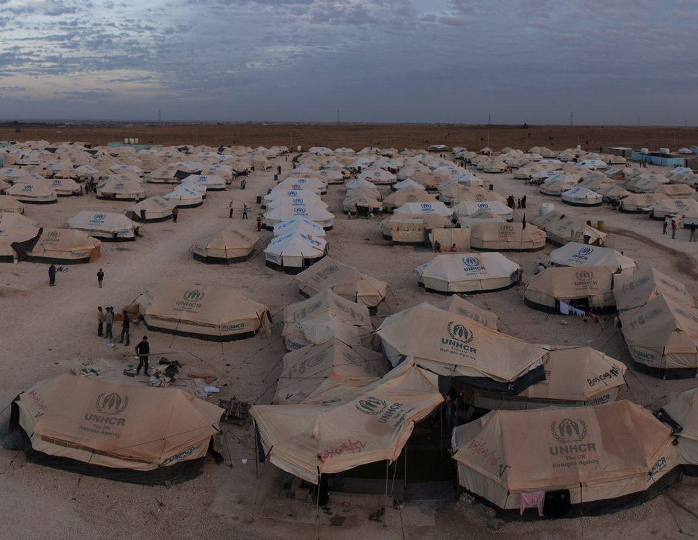
First Camps in Jordan
2011
The first refugee camps opened in Jordan.
The Za’atari refugee camp later became the largest camp, hosting more than 70,000 people.

Slide 21
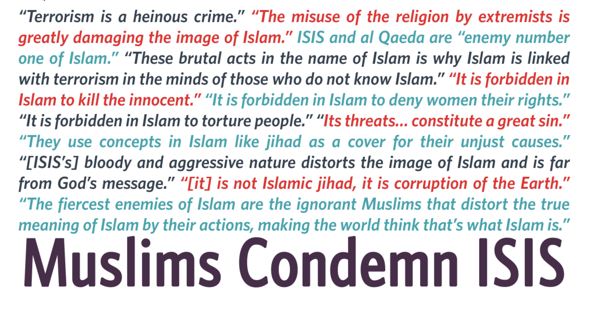
Islamophobia and ISIS
2011-2020
While ISIS themselves have targeted Muslims who do not fit their exclusivist extremist ideology, another issue has been a rise in Islamophobia in recent years.
For example, between 2001 and 2015, the FBI reported 2,545 anti-Muslim incidents in the U.S. In 2015 there was a 67% increase of such crimes compared to 2014.
Muslims around the world have repeatedly denounced ISIS and other organizations like them; yet they continue to suffer attacks. It is vital that while denouncing ISIS, we do not contribute to the anti-Muslim rhetoric that is currently at large.

Slide 22
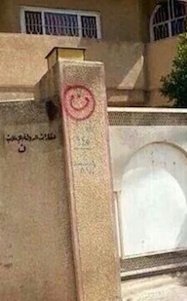
Stage 2: Symbolization
2012
The Black Banner of ISIS is the main symbol of the group.
Islamic sayings such as Allahu Akbar (God is the greatest) have been widely used by ISIS-inspired individuals and groups, especially during terrorist attacks.
Symbols marked on houses of Christians (N = Nazarene) both as a classification and a symbolization of what ISIS considers 'non-believers’.

Slide 23
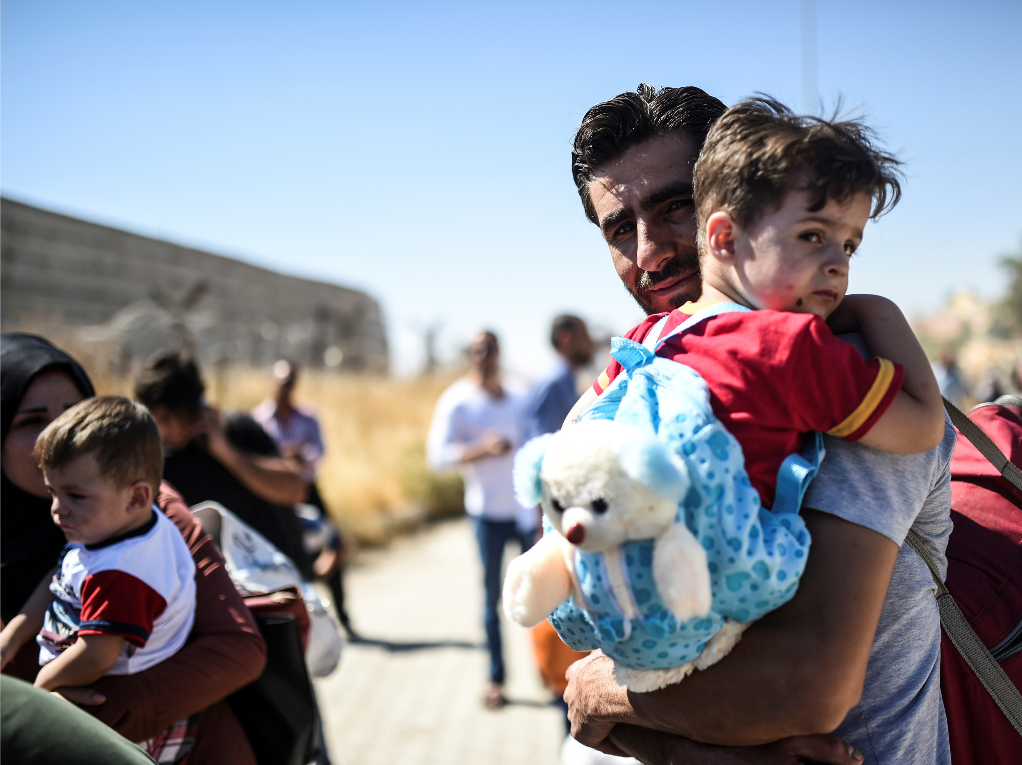
Official number marks 1 million refugees
2012
With the increase of power and territory of the Russia-backed Assad government and the establishment of the Caliphate in Syria, number of people who fled Syria marked 1 million.

Slide 24
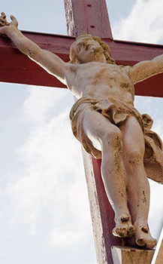
Stage 3: Discrimination
2012
ISIS claims that Islam is the last and only true religion, and it should therefore conquer the world. ISIS believes its followers should have full rights, while believers of other religions should have none.
ISIS falsely claimed that Christians could pay a jizya tax, which would allow them to continue to worship safely. But this was just another way of discriminating against Christians and forcing them to unwillingly support ISIS financially.
Furthermore, this was a way for ISIS leaders to deny accusations of genocide against Christians.

Slide 25
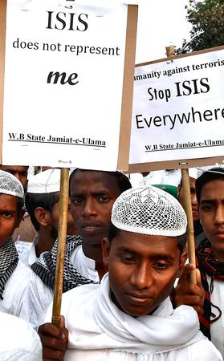
Stage 4: Dehumanization
2012
ISIS claims that believers of all other religions and non-believers are all irreligious (apostates and infidels).
This type of view dehumanizes and disrespects people's personal and religious beliefs and their right to freedom of thought, conscience, and religion.

Slide 26
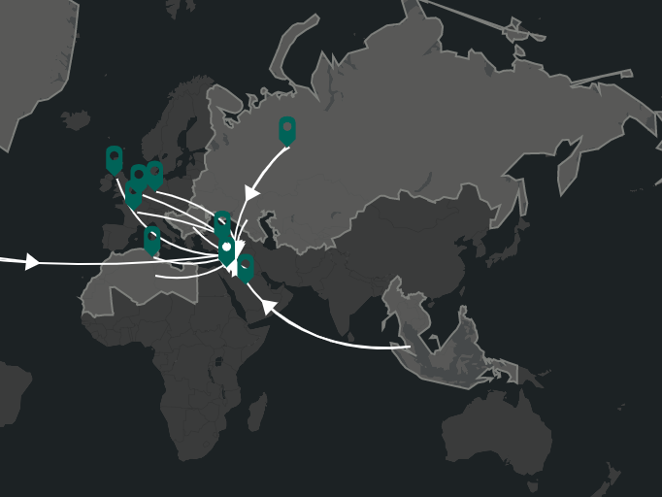
Foreign Fighters
2012-2017
Foreign fighters first started to travel to Syria and Iraq (as an estimate) in 2012 when the foreign fighter numbers officially increased. After 2014, this number outnumbered the local jihadists.
This map shows the interactive map for the estimated number of foreign fighter influx to Iraq and Syria from around the world.

Slide 27
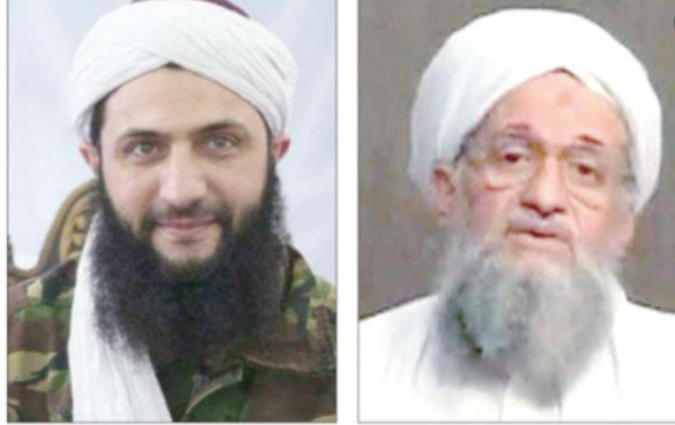
Joining Forces
2013
Al-Baghdadi moved to Syria and claimed that ISI joined forces with the al-Nusra Front in Syria and became the Islamic State in Iraq and Syria (ISIS). Yet, al-Julani rejected the alliance with ISI and stayed loyal to AQ.

Slide 28
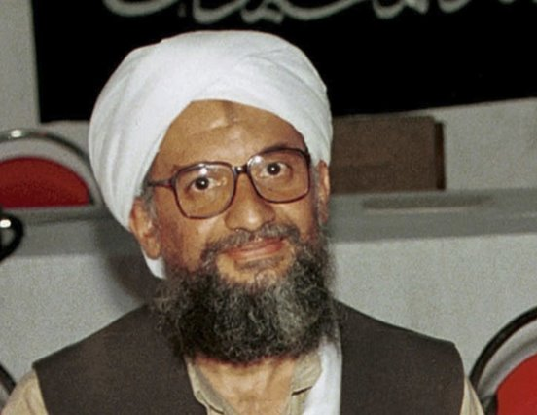
Al-Qaeda cuts ties with ISIS
Feb 2, 2014
Internet statements made on websites commonly used by the terrorist organization al-Qaeda announced the network is formally cutting ties with ISIS.
Reportedly, ISIS had tried to work alongside the Nusra Front, a rival al-Qaeda branch, disobeying orders from Ayman al-Zawahiri, al-Qaeda's leader.

Slide 29
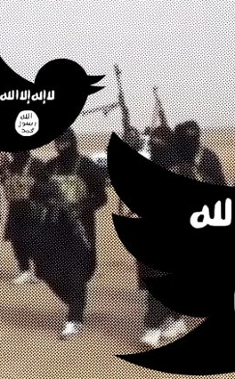
Stage 5: Organization
2014
Recruitment of foreign and local fighters to fight for ISIS both in Syria and Iraq and abroad.
Forced conversion to Islam, more than 30,000 fighters.
Use of women to organize recruitment processes and conduct plans, specifically abroad.
Secret cells in Europe where new members are recruited, attacks are orchestrated, and extremist ideology is spread.
Use of social media propaganda to reach all around the globe.

Slide 30
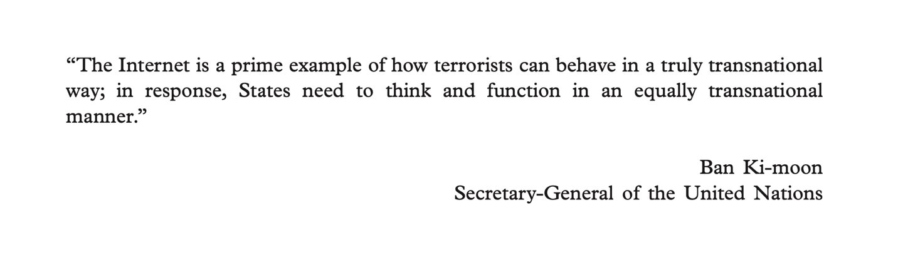
Radicalization and Terror
2014 - Present
ISIS utilizes digital media in an incredibly sophisticated and calculated manner. Their calls for violence build on a wide range of propaganda that targets disillusioned (often young) minds and seeks to lead them to violent action.
Many of the perpetrators behind recent acts of Islamic extremism had viewed ISIS propaganda online before they carried out their attacks.

Slide 31
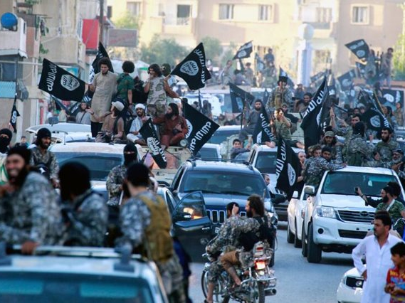
ISIS gains full control of Raqqa
December 2013
This marked the first provincial capital lost by the Syrian regime. Raqqa would become the capital of ISIS's caliphate the following year.

Slide 32
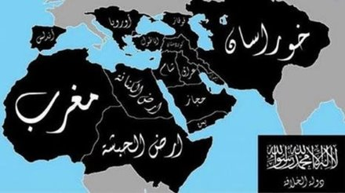
Stage 6: Polarization
2014
ISIS became operational in 18 countries, aiming to unite all Muslims under one single interpretation of Islam, which is driven by extremism & violence.
ISIS also claimed statehood and declared the caliphate, which would expand to several continents. ISIS was never recognized as a state by any official state or organization.

Slide 33
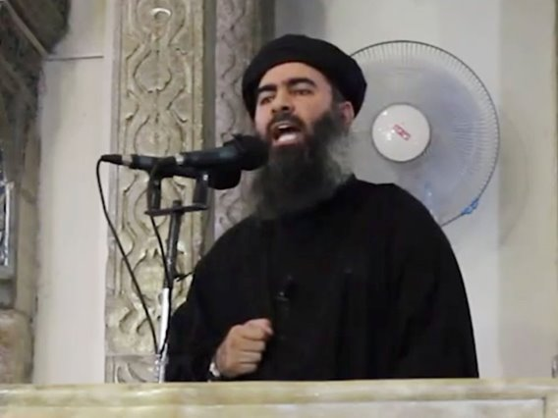
ISIS' 'calls to action'
2014 – 2018
ISIS encouraged their followers to act on their behalf and target civilians, officials, or military personnel in their own nations by any means. Often homemade explosives, vehicles, and knives are used. Other incidents demonstrate greater organization, with coordinated attacks and gunmen involved.
This behavior is part of ISIS' international strategy and is designed to instill fear, create divisiveness, and eradicate those who do not subscribe to ISIS' extremist ideology.

Slide 34
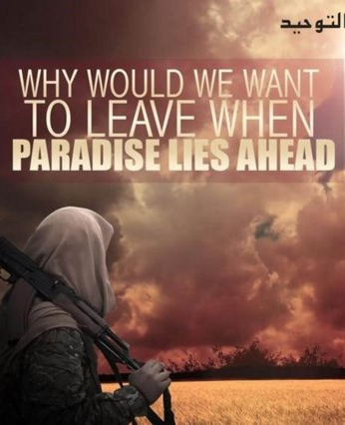
Stage 7: Preparation
2014
ISIS had an annual budget of more than 1 billion U.S. dollars.
Frequent use of social media propaganda and other types of propaganda helped to prepare the genocide committed against the so-called 'infidels'.
As ISIS gained more territory and power, it started to recruit more people by promising them heaven and luxury and praising and supporting fighters to die as martyrs to the Islamic State.

Slide 35
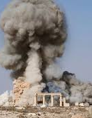
Stage 8: Persecution
Mass Slavery: The capture of thousands of slaves, mostly women (sexual slavery included) and children deprives victims of their basic human rights and forcibly removes them from their homes.
Destruction of Cultural Heritage Sites: This can also be referred to as "cultural genocide", because of the perpetrator's intent to strip a target group of its sense of shared history and solidarity. ISIS often used bulldozers or explosives to destroy cultural heritage sites.
  Several notable destroyed sites include the Temple of Baalshamin in Palmyra (pictured left), Syria, the Christian Mar Elian Monastery near Palmyra, Nineveh, Iraq, and Khorsabad, Iraq (among dozens of others).
Furthermore, several refugee camps were attacked in Syria and Iraq and several concentration camps were established.

Slide 36
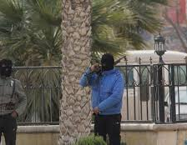
Concentration Camps
2013-2019
The Islamic State's early groups in Iraq and Syria began forcibly transferring people into concentration camps and detention facilities as early as 2013.
Rounding up citizens and transporting them to detention facilities or concentration camps indicates Stage 8 of the Ten Stages of Genocide: Persecution.
ISIS targeted individuals for transport to detention facilities and concentration camps for violating religious law (smoking, drinking alcohol, engaging in extramarital sex). ISIS also targeted media activists, and anyone suspected to not fully support ISIS and its goals.
Reports from these camps and facilities include testimonies citing flogging, various means of torture, interrogation, executions, and sexual violence.

Slide 37
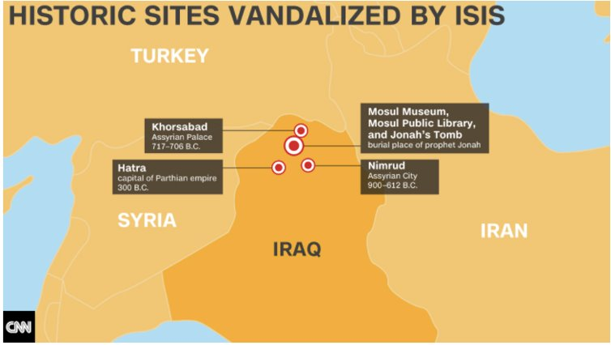
Destruction of Cultural Heritage Sites
2014 – 2019
Destroying sites of important cultural significance indicates Stage 8 of the Ten Stages of Genocide: Persecution. This can also be referred to as "cultural genocide" because of the perpetrator's intent to strip a target group of its sense of shared history and solidarity.
ISIS often used bulldozers or explosives to destroy cultural heritage sites.
Several notable destroyed sites include the Temple of Baalshamin in Palmyra, Syria, the Christian Mar Elian Monastery near Palmyra, Nineveh, Iraq, and Khorsabad, Iraq (among dozens of others).

Slide 38
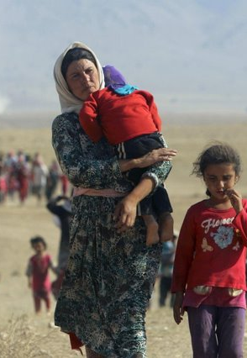
Mass Slavery
2014 - 2019
Capturing and kidnapping individuals indicates Stage 8 in the Ten Stages of Genocide: Persecution.
ISIS kidnapped roughly 6,800 Yazidis during their siege on Mount Sinjar in 2014.
ISIS especially targeted Yazidi women and children, whom they forcibly transferred to larger cities, away from Sinjar. ISIS captives were frequently taken as "war booty," imprisoned, sold at markets, given as gifts to ISIS fighters, and used for sexual slavery.
Thousands of victims are still missing or displaced.

Slide 39
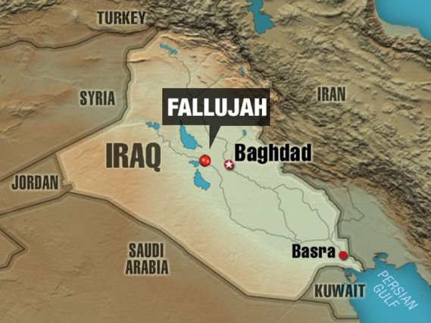
ISIS gains control of Fallujah, Dec. 30th, 2013

Slide 40

Genocide Alert: Christians in Iraq
2014 - 2016
ISIS claims that Islam is the last and truthful religion, and therefore it should conquer the world. Believers of other religions are considered irreligious.
ISIS falsely claimed that Christians could pay a jizya tax which would allow them to continue to worship safely. But this was just another way of discriminating against Christians and making them pay their own lives.
Furthermore, this was a way for ISIS leaders to deny accusations of genocide against Christians.
Symbols marked on houses of Christians (N = Nazarene) both as classification and symbolization of what ISIS considered as 'non-believers.'

Slide 41
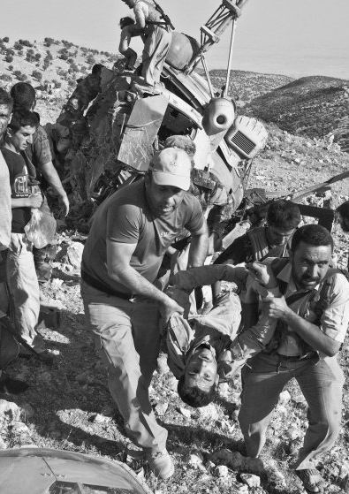
ISIS commits several massacres
2013-2016
Mass killings and summary executions indicate the 9th Stage of Genocide: Extermination.
While this timeline highlights three prominent genocidal massacres – the Mount Sinjar Massacre, Badhoush Prison Massacre, and Camp Speicher Massacre – there are several others that do not appear in the presentation for the sake of brevity, as well as several additional undocumented massacres.
On June 10, 2014, ISIS captured and killed roughly 600 male, mostly Shia inmates from the Badoush Prison outside of Mosul.
The Camp Speicher Massacre in Tikrit, Iraq led to the deaths of over 1,700 Iraqi air cadet recruits on June 12, 2014. Victims were buried in mass graves or dumped into the Tigris River.
In early August of 2014, ISIS descended on the Yazidi population near Mount Sinjar. The United Nations estimates 5,000 Yazidi men died in the massacre, and 7,000 Yazidi women and girls were enslaved and forcibly transferred to locations in Iraq and Syria.
Other massacres perpetrated by ISIS include:
  Qiniyeh, Iraq (August 2014)
  Kocho, or Kuju, Iraq (August 2014)
  Kobani, Syria (June 2015)
  Mosul, Iraq (June 2017)

Slide 42
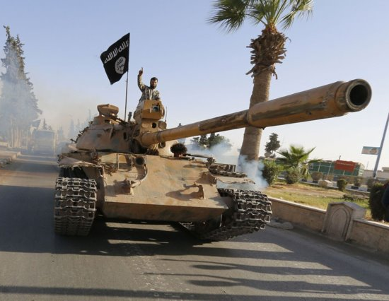
Foreign Fighters on rise
2014 – 2017
With the establishment of ISIS and the announcement of the Caliphate, people from all around the world started to travel to Syria and Iraq to join ISIS.
Women and men were blinded by the promises of a luxurious life under the Islamic State.
A significant number of foreign fighters were recruited online or at the local mosques or religious centers.
By 2015, foreign fighters outnumbered Syrian jihadists.
This interest in joining the jihad steadily increased and the numbers grew significantly until 2017.
However, according to the U.S., the arrival of foreign fighters decreased around 2017, when several governments and military forces declared victory over ISIS in the region.

Slide 43
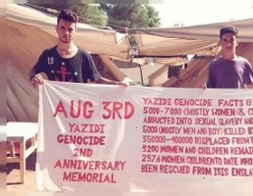
Genocide Alert: The Yazidi Genocide
2014
The United Nations deemed that the Islamic State "may have committed genocide" of the Yazidi population of Sinjar in 2014, with the lead investigator stating that: "It was quite clear the attacks against them were not just spontaneous or happened out of the blue; they were clearly orchestrated.”
When IS captured Sinjar in August 2014, they massacred 4,000 male civilians and mass kidnapped between 5,000-7,000 women to be sold into sexual slavery.
IS clearly publicized and justified the enslavement of Yazidi women in its propaganda magazines following the attack on Sinjar.
When Iraqi Security Forces and Kurdish forces recaptured Sinjar and the surrounding area, several mass graves of Yazidi civilians were discovered.
In 2021, the whereabouts of thousands of Yazidi women are still unknown.

Slide 44
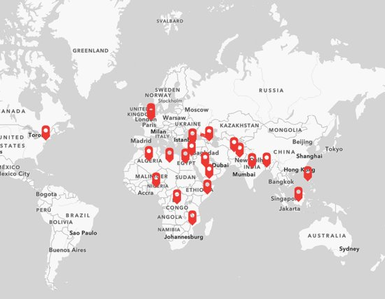
International Responses
2014 – 2020
The rise and expansion of ISIS have received numerous responses from governments and organizations all around the world.
From its emergence to the present day, ISIS-affiliated groups, individuals, and terrorist attacks have been the number one concern of many world governments.
Some countries such as the U.S. and Turkey intervened militarily in Syria and Iraq; some others such as Libya and Egypt fought with the local ISIS-affiliated groups and 'wilayahs' within their national borders.
This map shows more information on several countries' and organizations' responses to ISIS' emergence.

Slide 45
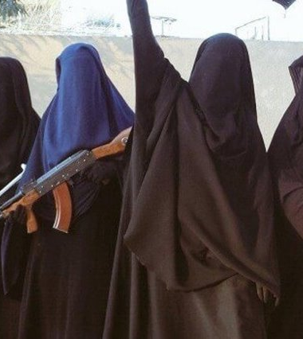
Women in the Islamic State
2014
Within IS territory, women's lives existed heavily in the domestic sphere. Women are expected to support their husbands, and instill their ideology within their children.
Many women, who have been largely been detained in Kurdish-run camps in Syria, also traveled to Iraq and Syria to join ISIS, or have aided in recruiting ISIS militants in their communities in Europe.
The first paper attached contributes to the understanding of women’s roles in the Islamic State. The second research conducted by Genocide Watch contributor Anna Gopsill also explains women's role in ISIS.

Slide 46
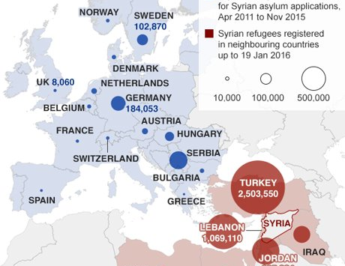
Largest Refugee Group in the World
In 2014, Syrian refugees became the largest refugee group in the world, surpassing 3 million.

Slide 47
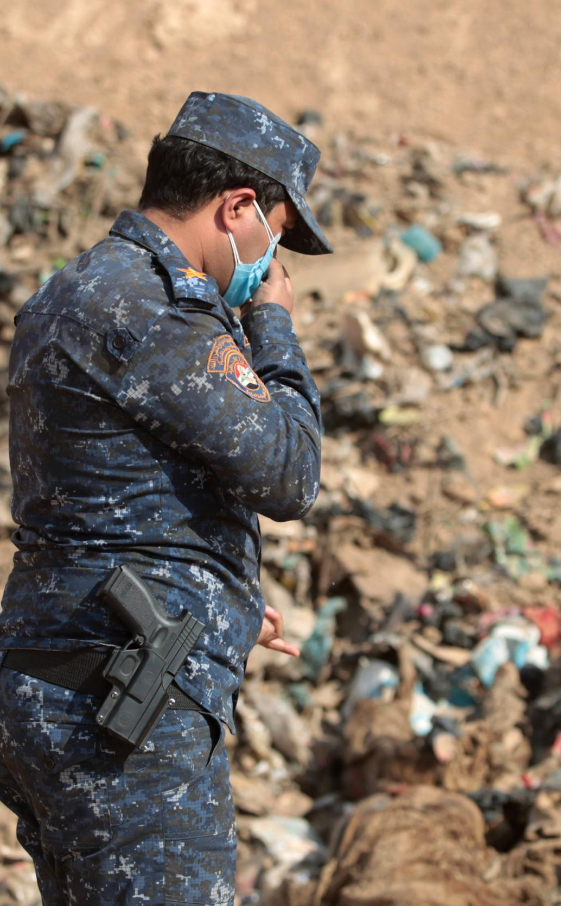
Stage 9: Extermination
2014 – 2019
Mass Killings and Summary Executions: Some massacres perpetrated by ISIS include:
  Camp Speicher (June 2014)
  Badoush Prison Massacre (June 2014)
  Qiniyeh, Iraq (August 2014)
  Mount Sinjar Massacre (August 2014)
  Kocho, or Kuju, Iraq (August 2014)
  Kobani, Syria (June 2015)
  Mosul, Iraq (June 2017)
Beheadings: ISIS frequently filmed hostage beheadings for propaganda directed at the international community, especially Westerners. They often demanded millions of dollars of ransom prior to killing hostages.
Terrorism: ISIS claimed responsibility for huge numbers of terrorist attacks across the world. They claimed to target all those who do not subscribe to their extremist ideology and encouraged followers to carry out attacks using vehicles, knives, guns, and explosives.

Slide 48
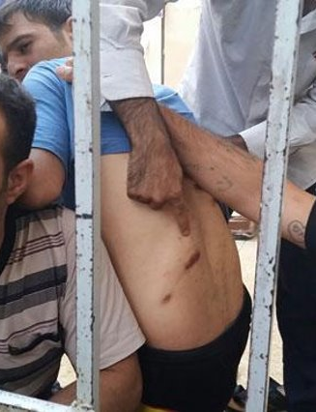
Badoush Prison Massacre
June 10, 2014
ISIS captured and killed roughly 600 male, mostly Shia inmates from the Badoush Prison outside of Mosul.

Slide 49
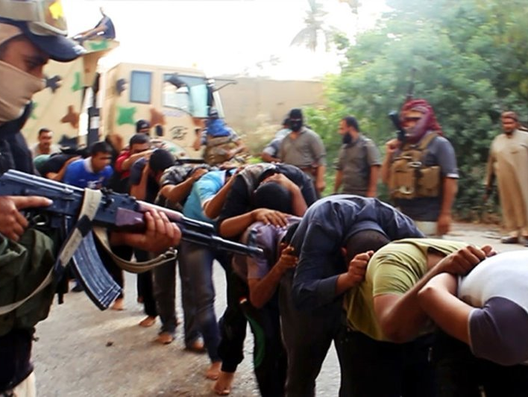
Camp Speicher Massacre
June 12, 2014
The Camp Speicher Massacre in Tikrit, Iraq led to the deaths of over 1,700 Iraqi air cadet recruits. Victims were buried in mass graves or dumped into the Tigris River.

Slide 50

Mount Sinjar Massacre
Aug 8, 2014
The most prominent genocidal massacre was the Sinjar Massacre of the Yazidis in August 2014, which the United Nations recognized as genocide in 2016.
The United Nations estimates 5,000 Yazidi men died in the massacre, and 7,000 Yazidi women and girls were enslaved and forcibly transferred to locations in Iraq and Syria.

Slide 51
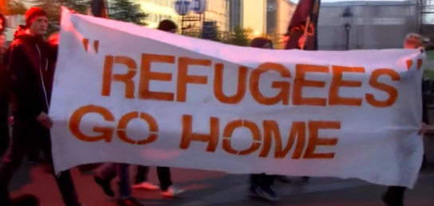
Anti-immigrant stance on rise
2014-2020
The rising numbers of Syrian refugees in Europe raised anti-immigrant stance in politics and even though they had been welcoming at first, many European countries rejected asylum for thousands of Syrians.
With thousands of refugees in the streets, overcrowded camps, rejected asylum, the Syrian Refugee Crisis continues to be one of the worst humanitarian emergencies we have seen in the past few decades.

Slide 52

ISIS and terrorism
2014 - 2020
In recent years, ISIS has carried out huge numbers of terrorist attacks across the world, and thousands have died as a result.
To examine in greater detail ISIS' terrorist activity since 2014, click on the link to our interactive map. A summary of some of ISIS' deadliest terror attacks outside of Iraq and Syria will follow.

Slide 53

The Global Coalition against ISIS
2014 – Present
The Global Coalition Against Daesh/ISIS currently consists of 83 countries across North America, Europe, Africa, Asia and Australaisa. The Coalition was formed in 2014 under U.S. leadership to instigate an international cooperative response to the terrorist organization.
The Coalition has adopted a broad-ranging strategy. In summary, this has involved a combination of offensive military campaigns with more defensive counter-terrorism operations.
Coalition partners have conducted airstrikes, assisted in the training of local forces, provided humanitarian assistance to conflict zones, worked to restrict the flow of foreign fighters to Iraq and Syria, and cut off finances to the region.

Slide 54

ISIS gains control of Mosul
2014
ISIS gained full control of Mosul in northwestern Iraq. ISIS's expansion into the region bordering Iraqi Kurdistan led thousands of Christians and Yazidis to flee.

Slide 55
















Beheading of Hostages
July 2014 to Sep 2017
Beheading hostages indicates Stage 9 of the Ten Stages of Genocide: Extermination.
ISIS frequently filmed hostage beheadings for propaganda directed at the international community, especially Westerners. They often demanded millions of dollars of ransom prior to killing hostages. Below is a non-comprehensive list of ISIS hostage beheadings:
  75 Syrian soldiers (7/25/2014)
  James Foley (8/19/2014)
  Ali al-Sayyed (8/28/2014)
  Steven Sotloff (9/2/2014)
  Abbas Medlej (9/6/2014)
  David Haines (9/14/2014)
  Hervé Gourdel (9/24/2014)
  Alan Henning (10/3/2014)
  Raad al-Azzawi and several others (10/11/2014)
  Peter Kassig, along with more than a dozen
  Syrian soldiers (11/16/2014)
  Jordanian Lt. Muath al-Kaseasbeh (1/3/2015)
  Haruna Yukawa (1/24/2015)
  Hujam Surchi (1/28/2015)
  Kenji Goto, a Japanese journalist (1/31/2015)
  21 Coptic Egyptians (2/15/2015)
  30 Ethiopian and Libyan citizens (4/29/2015)
  Tomislav Salopek (8/12/2015)
  Khaled al-Assad (8/18/2015)
  Mohsen Hojaji (8/10/2017)

Slide 56

ISIS gains control of Tikrit
June 11, 2014
ISIS took control of Tikrit but lost most of it the next day after Iran sent in forces to combat ISIS in Iraq.

Slide 57
Iran starts flying drones over Iraq
June 12, 2014
According to British and American sources, Iran started flying drones over Iraq. Iranian soldiers were in Iraq fighting ISIS as early as July. By August 2014, the campaign was officially targeting ISIS in Iraq.

Slide 58
Iraq formally asks U.S. to conduct airstrikes
June 18, 2014
Amidst ISIS' territorial gains in the country, the Iraqi government formally asked the United States to conduct airstrikes in Iraq.
"We have a request from the Iraqi government for air power," confirmed senior U.S. military commander General Martin Dempsey in front of U.S. senators.

Slide 59


ISIS declares its Caliphate
June 29, 2014
ISIS declared its caliphate from Aleppo (Syria) to Diyala (Iraq). Raqqa is its nominal capital, and Abu Kajr al-Baghdadi became the caliph.
The declaration of the Caliphate signaled ISIS's goal to attain statehood and therein become a state actor. Territorial goals expanded far beyond the declared Caliphate's territories in 2014, though those goals never manifested.

Slide 60
ISIS seizes important border crossing between Deir Ezzor (Syria) and Iraq
July 21, 2014
In addition to seizing this border crossing, ISIS seized three additional Iraqi towns

Slide 61

ISIS conquers Kurdish towns
Aug 2, 2014 - Aug 4, 2014
ISIS seized the two Kurdish towns of Sinjar and Zumar, which forced thousands more Yazidis to flee

Slide 62

ISIS' presence in Northern Syria results in refugees to flee into nearby Turkey
Sep 19, 2014
As ISIS advanced on the Syrian border town of Kobani, thousands of refugees fled to Turkey.

Slide 63
U.S. airstrikes against ISIS officially begin
Sep 22, 2014
The U.S. began airstrikes against ISIS targets in September 2014; by October 7-8, 2014, these began to escalate as ISIS gained territory around Kobani in Syria. On Oct 15, 2014, the Pentagon named the campaign in Iraq and Syria, 'Operation Inherent Resolve'.
The American-led intervention also involved a coalition of many foreign militaries like the UK, France, Saudi Arabia, and Germany.

Slide 64

UNSC adopts Resolution 2178
Sep. 24, 2014
U.N. Security Council Resolution 2178 called all countries to tackle the foreign terrorist fighters (FTFs) threat, including to prevent the entrance or transit of suspected FTFs and to prosecute FTFs upon their return.

Slide 65

Deadly Journeys
October 2014
More and more refugees risk deadly sea journeys in boats through the Mediterranean Sea to reach Europe.

Slide 66
Global Coalition to intervene in the Syrian conflict begins
By December 3, 2016, over 60 countries were enlisted in a many-sided strategic plan to destroy ISIS named the Global Coalition to Counter the Islamic State of Iraq and the Levant.
There are five strands to the Coalition's strategy:
  Providing military support to our partners;
  Impeding the flow of foreign fighters;
  Stopping financing and funding;
  Addressing humanitarian crises in the region;
  Exposing the true nature of ISIS.

Slide 67

Recognition as terrorist organization
In 2015, United Nations Security Council (UNSC) Resolution 2253 declared ISIS as a terrorist organization as an extension to the previous list that included al-Qaeda and Taliban.

Slide 68

Summary of terrorist attacks - 2015
In 2015, ISIS inspired and orchestrated multiple terrorist attacks across the world. Here is a summary of some of the deadliest incidents:
Egypt, Turkey, Yemen, and Libya were all hit particularly hard with multiple high-casualty attacks. France and America were also subjected to sophisticated and organized terrorist violence.
On March 20th, Yemen's capital, Sana’a, suffered one of the year’s deadliest attacks when two mosques were bombed, killing 137 people.
In Ankara in Turkey, two bombs were detonated at a peace rally on October 10th, killing 97 people.
A Russian passenger plane was bombed down after leaving the Sharm el-Sheikh airport on October 30th, killing 224 people.
Six coordinated attacks across Paris on November 13th killed over 130 people.

Slide 69

ISIS Territory Overview: 2015
ISIS territorial holdings at the group's peak.

Slide 70

The Case of Shamima Begum
Feb 17, 2015 to Feb 19, 2019
In 2015, a British citizen named Shamima Begum was recruited by ISIS. Begum, aged 15, joined two other teenagers on a flight from London to Istanbul. They are believed to have then travelled to Syria. Begum is the only known survivor of the three girls and currently resides in a refugee camp in Northern Syria.
Since requesting to return to the UK in 2019, Begum has had her citizenship revoked. Begum's case has sparked debate over the rights of governments to make individuals stateless, and questions about the failure to protect vulnerable children from radicalization. In interviews, Begum maintains that she is not a terrorist. The British government has been criticized for the controversial revocation of citizenship to prevent the return of British nationals involved with ISIS.

Slide 71
ISIS loses Tikrit
Mar 31, 2015
After four months of fighting, coalition-backed Kurdish forces liberated the Iraqi town of Tikrit.

Slide 72

ISIS seizes Palestinian Refugee Camp in Damascus
Apr 5, 2015
ISIS seized the Palestinian refugee camp of Yarmouk in Damascus, where more than 18,000 people reside.

Slide 73

ISIS gains control of Palmyra
May 2015
ISIS gained control of the Syrian city of Palmyra. ISIS fighters destroyed much of this ancient heritage site during their control of the city. Pictured is the destroyed Arch of Triumph in Palmyra.

Slide 74

ISIS gains control of Ramadi
May 17, 2015

Slide 75

ISIS gains control of Sirte
May 21, 2015
ISIS took full control of Sirte, Libya.

Slide 76
ISIS loses control of Tal Abyad
June 17, 2015
Kurdish fighters expelled ISIS from Tal Abyad, located on the Syrian-Turkish border.

Slide 77

2015 marks 4 million Syrian refugees worldwide
July 2015
U.N. official figures show that the number of Syrian refugees has marked 4 million by summer 2015.

Slide 78


European countries start to take anti-immigrant stance towards Syrian refugees
June 2015
Several countries in Europe took anti-humanist strategies to combat the arrival of migrants. Hungary, for example, added fencing and barbed wire along its border to deter migrants.

Slide 79

Support for the refugee crisis in Europe
July 2015
Angela Merkel announced an open border policy for Syrian refugees and said ‘’Wir schaffen das.’’ (We’ll manage it).

Slide 80

OPCW & UN report shows use of chemical weapons
Aug 21, 2015
A report from the United Nations and the Organization for the Prohibition of Chemical Weapons’ Joint Investigative Mechanism (JIM) says ISIS was responsible for the use of sulfur mustard, also known as mustard gas, in the Syrian town of Marea in Aug 2015. In another instance that year, samples revealed ISIS used mustard gas against Kurdish forces in Iraq.
Alongside ISIS, the U.N. accused the Assad regime and the Syrian Arab Armed Forces of using chemical weapons on their own people, exemplifying the assault civilians face on all sides of this conflict.

Slide 81

ISIS is committing genocide
August 2015
Genocide Watch founding chairman Dr. Stanton published a brief on ISIS' atrocities in Iraq and Syria. The alert, directed to the Dutch government, briefly explains how and why the actions of ISIS amount to genocide and the need for establishing an international domestic tribunal for fair prosecution of the offenders.

Slide 82

Refugees Welcome
August 2015
The ‘Refugees Welcome’ slogan became a symbol for solidarity movements within Europe as a result of the shocking image of a 2-year-old Syrian toddler Aylan Kurdi washed up on a Turkish beach. He and his family were attempting to reach Greece by boat.

Slide 83

Russia begins airstrikes in Syria
Sep 30, 2015
Russia began airstrikes in Syria, claiming to have the permission of the Syrian government. There was international skepticism, particularly from the U.S., that they were targeting civilians and Western-backed rebel groups. Thousands of bombing raids targeted the Free Syrian Army and the al-Nusra Front.

Slide 84

U.S. announces special operations forces to be sent to Iraq and Syria
Oct 30 – Dec 2, 2015
U.S. Defense Secretary Ashton Carter announced that U.S. special operations forces would be sent to Iraq to support Iraqi and Kurdish fighters and to launch operations against ISIS.
This followed the White House announcement on October 30, 2015, that revealed 50 special operations troops would be sent to Syria to help advise and coordinate local ground forces against ISIS.

Slide 85

End of the Schengen Visa?
Oct 2015
The E.U.’s Schengen border system allows for easy travel between countries without required passport checks. However, a number of countries instituted border controls in response to the influx of refugees and migrants across the continent.

Slide 86

ISIS loses northern Sinjar region
Nov 13, 2015
Iraqi Kurds recaptured the northern Sinjar region, which ISIS had controlled since August 2014.

Slide 87
France ramps up airstrikes in Syria
Nov 14, 2015
In direct response to a series of coordinated terrorist attacks in Paris on November 13, 2015, that killed over 130 people, the French government requested support from the EU for their airstrikes against ISIS in Iraq and Syria.
On Nov 14, 2015, ISIS claimed the attacks on the French capital were a response to Opération Chammel, the French military campaign which began in Iraq in September 2014 and Syria in September 2015.

Slide 88

ISIS loses Ramadi
December 2015
After seven months of occupation, the loss of this city proved to be a pivotal slowing moment for ISIS's trajectory.

Slide 89

How many fighters joined ISIS?
2015 – 2018
According to the Soufan Group, around 30,000 people, including women and children, who would normally not engage in the conflict traveled to Syria and Iraq to join ISIS in 2016. This number has increased since 2012 and started to decrease after the end of 2016.
This map captures the estimated numbers of foreign fighters' influx to Syria and Iraq from all around the world. Click on the hyperlink to access the map and click on the points to learn more.

Slide 90

Summary of terrorist attacks - 2016
In 2016, ISIS surpassed Boko Haram as the deadliest terrorist group in the world, according to the Global Terrorism Index.
Here is a summary of some of the deadliest attacks around the world:
The U.S. suffered a terrible attack on the 12th of June when a gay nightclub in Orlando, Florida was targeted, and 49 people were killed.
Turkey's Ataturk International Airport in Istanbul was subject to three suicide bombings on June 28th. Over 40 people were killed.
On July 14th (Bastille Day), crowds of celebrators in Nice, France were hit with a truck. 84 people lost their lives.
Yemen suffered multiple attacks this year, several in Aden and more in Mukalla. Army camps and a police academy were attacked along with civilians. Dozens were killed overall.

Slide 91

ISIS Territory Overview: 2016
By 2016, ISIS territory began to shrink after the group's peak holdings in 2015.

Slide 92

EU-Turkey Deal
Feb 2016
The EU and Turkey deal signed a deal consisting of the lawful return of every person arriving irregularly to the Greek islands to Turkey. In exchange, EU member states would take one Syrian refugee from Turkey for every Syrian returned from the islands. Furthermore, the EU pledged a total of 6 billion euros of European funds to Turkey.

Slide 93

The Balkan Route
Feb 2016
The main refugee route that goes through Macedonia, Serbia, and Hungary, called the Balkan Route, was officially closed. Thousands of migrants remained trapped in Greece.

Slide 94

ISIS gains al-Rai
Apr 11, 2016
ISIS recaptured the Syrian town of Al-Rai, which is on the Turkish border.

Slide 95
ISIS loses Hit
Apr 11, 2016
Iraqi forces took back Hit, which ISIS had controlled since October 2014.

Slide 96
ISIS loses ar-Rutbah
May 19, 2016
This two-day battle paved the way for Iraqi forces to begin their attempt to take back Fallujah.

Slide 97
Russia circulates rumor of joint airstrikes with the U.S.
May 20, 2016
In roughly mid-2016, the Russian Defense Minister Sergei Shoigu proposed 'joint-action' between the U.S.-led coalition and Russian forces against terrorist groups (al-Nusra Front) in the Syrian conflict.
However, this coordination of airstrikes never materialized; U.S. State Department spokesman John Kirby quickly responded that no such plans existed.

Slide 98

ISIS loses Fallujah
June 26, 2016
ISIS controlled Fallujah for 2.5 years before Iraqi forces captured it.

Slide 99
ISIS' Calls for International Attacks
July 31, 2016
One of the first YouTube videos uploaded by ISIS shows a masked man calling for the members and supporters of ISIS to carry out attacks in Russia, saying, “Listen, Putin, we will come to Russia and will kill you at your homes ... Oh Brothers, carry out jihad and kill and fight them.''
This general message of warning and attempt to instill fear is echoed across ISIS' digital platforms across recent years.

Slide 100

A U.S. airstrike in Syria kills al-Adnani
Aug 30, 2016
ISIS declared Abu Mohammad al-Adnani, one of its leading members, was killed in a U.S. airstrike in Syria in the Aleppo Province. This was confirmed by an official statement from the U.S. Defense Department on Sept 12, 2016.

Slide 101

ISIS loses Dabiq
October 2016
ISIS had planned a final, apocalyptic battle in Dabiq, making this territorial loss symbolically significant.

Slide 102

ISIS Territory Overview: 2016
By 2016, ISIS territory began to shrink after the group's peak holdings in 2015.

Slide 103

ISIS media output in decline
Oct 10, 2016
U.S. terrorism researchers at West Point announced that ISIS’s media output dropped from 700 items in Aug 2015 to under 200 items in August 2016.
This decline continued into 2017 under mounting military pressure. However, even diminished ISIS propaganda continued to be a formidable tool in the coming years.

Slide 104

ISIS loses Christian region of Qaraqosh
Oct 22, 2016
Iraqi forces took back Qaraqosh, which ISIS controlled since 2014. Iraqi Christians began to return en masse in April 2017.

Slide 105

UN states ISIS are using thousands of civilians in Mosul as 'human shields'
Oct 28, 2016
The UN released information stating that ISIS was surrounded by tens of thousands of men, women, and children in Mosul. They were using this to their advantage to prevent Iraqi troops from advancing.
Civilian deaths in the conflict were incredibly high as they suffered assaults on every side from ISIS, the Assad regime and often indiscriminate international airstrikes.

Slide 106
Iraqi counterterrorism recaptures Mosul Television Station
Nov 1, 2016
The Iraqi counterterrorism service captured the Mosul Television station from ISIS in Iraq. This marked the first building retaken from ISIS since the campaign to retake Mosul began.

Slide 107
Al Baghdadi addresses international affiliates
Nov 3, 2016
ISIS leader al-Baghdadi made his first statement in almost a year, addressing “soldiers of the Islamic State,” specifically citing Algeria, Tunisia, Libya, and other countries where ISIS established so-called 'provinces'. Referring to them as the “pillars of the caliphate,” he stressed that they were essential for ISIS’ survival.

Slide 108

Losses in the Mediterranean
Nov 2016
The number of losses in the Mediterranean Sea passed 5,000.

Slide 109

ISIS instructs followers to stop using WhatsApp and Telegram
Dec 2016
ISIS instructed its members and followers to stop using apps like WhatsApp and Telegram, as it suspected that the U.S.-led coalition was using the apps to track and assassinate leaders in the group.
Online propaganda is a crucial strand of ISIS' strategic thinking, but this revealed one of the ways counterterrorism efforts forced them to reassess their usage of digital media platforms.

Slide 110

ISIS loses Sirte
Dec 6, 2016
After a 6-month assault, Libyan fighters announced that they finally defeated ISIS, which had occupied Sirte and used it as a coastal stronghold since 2014. American planes supported a coalition of militias to combat the brutal ISIS regime in the city.

Slide 111

ISIS retakes Palmyra
Dec 11, 2016
ISIS took back control of Palmyra from the Syrian government.

Slide 112

Senior ISIS commander al-Kuwati killed in U.S. airstrike
Dec 26, 2016
One of ISIS' most senior commanders, Abu Jandal al-Kuwaiti, was killed in a U.S. airstrike in Syria. Al Kuwati was also a member of the war committee for ISIS, and a recruiter and propagandist.
Some sources record his death as the 26th, others as the 29th.

Slide 113
Russia, China and Pakistan warn ISIS is growing in Afghanistan
Dec 27, 2016
Russia, China, and Pakistan warned against the growing threat and influence of ISIS in Afghanistan after a third consultation meeting in Moscow to discuss the situation. ISIS announced the formation of its Khorasan province branch in 2015, which included Afghanistan and Pakistan.
Afghanistan became the target of increasing numbers of suicide bombers and other terrorist attacks in the coming years.

Slide 114
ISIS calls for more attacks in Europe
Dec 28, 2016
ISIS called for more terrorist attacks in Europe as the international community continued military advances on ISIS in Syria and Iraq. They also urged Muslims to stay away from Christian holidays and festivals.

Slide 115

Number of Foreign Fighter Deaths
2016 – 2020
According to the Syrian Observatory
for Human Rights, at least 65,726 foreign fighters (almost entirely jihadists) were killed in Syria from 2012 to May 2020.
A further 10,045 foreign fighters were killed while fighting for the Assad regime.

Slide 116

Return of the Foreign Fighters
2016 – 2020
Many foreign fighters have fled the Caliphate upon the difficult conditions of the war zone, uninhabitable environments, traumatic experiences, and survival needs.
Most of these returning foreign fighters have been stuck in their home countries' embassies or refugee camps in the neighboring states, waiting to be granted to go back.
Each year, hundreds of returnees are stripped of their citizenship due to reasons such as treason, membership in a terrorist organization, etc.
Even though official numbers are unknown, this map shows some of the countries which are currently dealing with legal and safety issues with foreign fighters who wish to return.

Slide 117

The threat posed by the returning Foreign Fighters
2016 – 2020
This map shows the terrorist attacks conducted by returning foreign fighters, ISIS recruited foreigners, ISIS-affiliated groups or persons, ISIS-inspired attacks. Most of these attacks have been highly deadly and the attacks have further increased the terrorist activity around the world.
In Western and Northern Africa and Southeast Asia, ISIS subgroups were established. Similarly, hubs in Belgium, Germany, and France are believed to be formed.

Slide 118

The Downfall of ISIS
2017 – 2020
Around 2017, ISIS suffered from serious territorial losses and casualties. The downfall of the Caliphate began.
In 2019, the longest-serving Caliph Al-Baghdadi was killed in a U.S. operation,. Many actors and governments, such as Iraq, Libya, and the Syrian Democratic Forces (SDF), declared victory over ISIS.

Slide 119

Summary of terrorist attacks - 2017
In 2017, ISIS lost its hold on Raqqa and its online output lowered, however, attacks continued around the world.
Here is a summary of some of the deadliest that took place:
Afghanistan, particularly Kabul, was hit by multiple high-casualty attacks.
The Reina nightclub in Turkey was attacked in the early hours of the New Year on January 1st. 39 people were killed.
On February 16th, a suicide bomber killed over 90 people at the Shrine of Lal Shahbaz Qalandar in Sehwan, Pakistan.
On May 22nd, a suicide bomber attacked the entryway of the Manchester Arena after a concert, killing 22 people and injuring over 100.
Egypt's Sinai peninsula saw multiple gunmen attack the al Rawda mosque and kill over 300 people in one of the year's deadliest incidents.

Slide 120

ISIS Territory Overview: 2017
By December 2017, ISIS's caliphate was reduced to 5% of its original size. The two major losses for ISIS were Mosul and Raqqa.

Slide 121
ISIS threatens Egyptian military, releasing a kill list
Jan 2017
At the end of January 2017 (official date unknown), ISIS threatened the Egyptian military by releasing photographs, names, and addresses for ranks of the military and police services and instructing its followers to target these individuals.
This was part of its campaign to extend their attacks beyond the Sinai peninsula.

Slide 122

5 Million mark
Feb 2017
More than 5 million people have fled Syria. According to UNICEF, 910 children were killed in Syria in 2017 at this point.

Slide 123

ISIS' Deputy Leader al Jumaili killed in an airstrike
Apr 1, 2017
A spokesperson for the Iraqi intelligence services announced that ISIS deputy leader Ayad al-Jumaili and two other commanders had been killed in an airstrike by the Iraqi air force. The U.S.-led coalition said it was unable to verify the information.

Slide 124

Abdul Hasib is killed by a joint Afghan-U.S. operation
Apr 26, 2017
Abdul Hasib Logari, head of ISIS' branch in Afghanistan, was killed in a joint Afghan-U.S. Special Forces operation in the Nangarhar province, Afghanistan.
His death was confirmed by US officials on May 8, 2017.

Slide 125

ISIS attacks another refugee camp
May 2, 2017
According to the Syrian Observatory for Human Rights, ISIS attacked the Rajm al Salibi checkpoint and refugee camp in Syria near the border with Iraq. At least 38 people were killed.

Slide 126
ISIS developing own social media platform
May 4, 2017
In early May, Europol (the European Union's police agency) Director Rob Wainwright warned that ISIS was developing its own social media platform. Reportedly, this was a plan to avoid security suppression of its propaganda and communications on mainstream apps.

Slide 127

ISIS attacks the Rukban Refugee Camp
May 15, 2017
ISIS claimed responsibility for two car bombs that killed at least six people near the Rukban refugee camp along the Syria-Jordan border.

Slide 128

President Rodrigo Duterte says the Marawi rebellion was "purely ISIS"
May 23 – Oct 23, 2017
The President of the Philippines, Rodrigo Duterte, stated that the Marawi City rebellion was "purely ISIS". The rebellion took place on the southern Minandao Island between Islamic State-affiliate Abu Sayyaf and the government.
Duterte had long warned of ISIS’s arrival in the Philippines. The conflict lasted 5 months overall, beginning May 23rd and ending October 23rd, and caused massive displacement (around 1 million people)
The U.S. began providing technical assistance to support the Philippines.

Slide 129

ISIS gains some control of Marawi
June 12, 2017
ISIS affiliates controlled roughly 20% of Marawi City, Philippines. The military chief in Jakarta announced that ISIS had a presence in almost all Indonesian provinces.

Slide 130

End of Caliphate?
June 28, 2017
Iraqi troops captured the Great al-Nuri Mosque in Mosul, where al-Baghdadi declared the caliphate back in 2014, after an eight-month campaign. Iraqi Prime Minister Haider al-Abadi declared the end of the ISIS caliphate.

Slide 131
ISIS withdraws from Aleppo
June 30, 2017
ISIS’ withdrawal was prompted by the SDF taking the Ithriya-Rasafa road in Aleppo.

Slide 132

Iraqi victory over ISIS
July 8, 2017
Iraqi Prime Minister Haider al Abadi declared victory over ISIS in Mosul.

Slide 133

Za'atari Refugee Camp becomes the first job center for Syrian refugees
Aug 2017
UNCHR and partners opened the first job center in the Za’atari refugee camp in Jordan. This followed the introduction of a new working permit for Syrian refugees to work in Jordan.

Slide 134

Estimates of 2,000 ISIS fighters still in Raqqa
Aug 4, 2017
Brett McGurk, the U.S. special envoy for the coalition against ISIS, said about 2,000 ISIS fighters were still in Raqqa and continued to use civilians as human shields against the advancing U.S. forces.

Slide 135
ISIS remains deadliest militant organization in 2016
Aug 21, 2017
ISIS remained the world’s deadliest militant organization in 2016 despite losing fighters and territory, according to a report from the University of Maryland.
ISIS carried out more than 1,400 attacks and killed more than 7,000 people, a 20 percent increase from 2015.

Slide 136

Hezbollah seizes most of ISIS's territory on Syria/Lebanon border
Aug 24, 2017
The Syrian army and Hezbollah announced a joint assault on ISIS territory on the NE border with Syria. Hezbollah and the Syrian army targeted ISIS from the Syrian side, while the Lebanese army targeted the caliphate from the Lebanese side.

Slide 137

EU sees drastic rise in anti-immigrant stance
Sep 2017
Right-wing anti-immigrant parties were on the rise in the EU, with Alternative for Germany (AfD) entering the German parliament with strong anti-immigrant rhetoric.

Slide 138

ISIS loses Deir Ezzor
Sep 5 – Nov 4, 2017
Deir Ezzor was one of ISIS's last major strongholds.
The Syrian government declared victory over Deir Ezzor on November 3, 2017.

Slide 139
ISIS releases audio message of Baghdadi after long silence
Sept 29, 2017
ISIS released a new audio message from leader Baghdadi. This was the first message from him in 11 months.
His death was reported numerous times by international powers such as Russia and Iran, casting doubt on their claims to have killed him in airstrikes.

Slide 140

ISIS loses Hawija
Oct 5, 2017
This signaled ISIS's loss of its final major urban stronghold.

Slide 141
ISIS gains control of 12 Syrian villages near Hama
Oct 9, 2017
Syrian forces cleared ISIS from this region several days before they retook 12 Syrian villages, signaling a possible territorial comeback.

Slide 142

ISIS loses Raqqa
Oct 17-20, 2017
After months of fighting, the U.S.-backed alliance of Syrian Kurdish and Arab forces recaptured Raqqa. They declared victory on October 20th.

Slide 143

SDF victory over ISIS
Oct 19, 2017
US-backed Syrian Democratic Forces (SDF) which had been fighting against ISIS and Assad's regime in Syria, declared victory over ISIS in Raqqa. By losing Raqqa, ISIS lost its former capital.

Slide 144
U.S. President Trump announces end of caliphate in sight
Oct 21, 2017
U.S. President Donald Trump made a statement saying, ”the defeat of ISIS in Raqqa represents a critical breakthrough in our worldwide campaign to defeat ISIS and its wicked ideology.“
While Trump optimistically claimed, "the end of the ISIS caliphate is in sight," his key advisors remained wary of the threat of militants and the strength of the Assad regime.

Slide 145

Trial for the Battle of Mosul
Nov 1, 2017
A U.N. human rights report said Iraq was not capable of trying atrocities committed by the Islamic State during the battle for Mosul.
According to the report, at least 2,521 civilians were killed, including 741 executions, as a result of ISIS attacks. It suggested Iraq should find alternative routes, such as the International Criminal Court (ICC).

Slide 146
UN report announces ISIS faction in Somalia growing
Nov 8, 2017
An ISIS faction in northern Somalia grew from a few dozen to 200 members over the last year, according to a U.N. report.
Security officials feared it could become a safe-haven and organization point for ISIS fighters fleeing from Iraq and Syria.

Slide 147

The U.S. and Russia issue joint statement to work together
Nov 11, 2017
U.S. President Donald Trump and Russian President Vladimir Putin issued a joint statement in which both countries agree to continue cooperative efforts against the Islamic State until it is defeated.

Slide 148

ISIS loses Rawa
Nov 17, 2017
This was the last remaining town in Iraq under ISIS control. Iraqi Prime Minister Haider al-Abadi declared victory over ISIS on December 9th.

Slide 149

Shift in Migrant Routes
Dec 2017
The western Mediterranean route saw a threefold increase in arrivals in 2017.

Slide 150

Bringing (Foreign) Terrorist Fighters to Justice
There have been two main ideas on how to bring FTFs to justice:
1- Prosecution by Iraqi and Syrian national courts:
There are two main concerns with this approach. Firstly, Syria is still a war-torn country that is home to many perpetrators of genocide, war crimes, etc. The ongoing conflict in Syria prevents the possibility of holding safe and fair trials, essential features of justice and accountability.
Secondly, the use of the death penalty in Iraq, condemned by most countries as a violation of human rights, poses problems.
2- Prosecution by Foreign National Courts:
Unless crimes have been committed by their own citizens, few European countries have become involved in bringing other perpetrators in Iraq and Syria to justice.
The focus has predominantly been on terrorism-related charges, creating a void in accountability for other international crimes (genocide, crimes against humanity, and war crimes).

Slide 151

ISIS Territory Overview: 2018
By 2018, ISIS lost most of its territorial holdings that it held at the group’s peak.

Slide 152

Summary of terrorist attacks - 2018
In 2018, Asian nations were hit hard by ISIS terror attacks. Afghanistan and Pakistan.
Here is a summary of some of the year's deadliest incidents:
On January 15th, Baghdad, Iraq saw 38 people die and 90 injured in a suicide bombing at Tarayan Square.
A bombing at a voter registration center in Kabul, Afghanistan on April 22nd killed 69 people. Another attack in July at Kabul International airport killed 23, and in August in Gardez, two attackers killed 39 people.
Ahead of the Pakistani general election, attackers targeted rallies. On July 13th in Mastung, 149 people were killed in a blast.

Slide 153

U.S. troops remain in Syria to counter Iran and Assad
Jan 17, 2018
U.S. troops remained in Syria to counter Iran and Bashar al Assad’s presence in the country. Airstrikes continued.
U.S. Secretary of State Rex Tillerson announced that “ISIS has one foot in the grave, and by maintaining an American military presence in Syria until the full and complete defeat of ISIS is achieved, it will soon have two.”

Slide 154
U.S. government and foreign experts announces ISIS still has 10,000 loyalists
Jan 22, 2018
An announcement from the U.S. government and a team of foreign experts warned that ISIS still had as many as 10,000 loyalists in Iraq and Syria.
Despite announcements from Iraqi and Syrian governments that ISIS had been defeated, the conflict was not truly over; hotbeds of extremism still held powerful potential.

Slide 155

Overcrowded camps of the EU
Jan 2018
Thousands of migrants remained stranded in the overcrowded camps on the Greek islands. Amnesty International called the conditions ‘’an open wound’’ for European human rights.

Slide 156

Europol says some ISIS propaganda has been removed successfully
Apr 27, 2018
Europol announced the U.S., Canada, and some European countries took down the Islamic State's propaganda, including its affiliated Amaq News Agency, in a coordinated operation.

Slide 157

Family Reunification
Apr 2018
Germany announced family reunification legislation. 1000 family members could come to Germany from Syria.

Slide 158

Crowded streets of Bosnia
May 2018
Bosnia saw a drastic increase in migrant arrivals, with refugees settling in the streets.

Slide 159

How to bring ISIS to justice: An Alternative
July 6, 2018
A founding conference for the establishment of an international tribunal to bring ISIS to justice was held.
This event marked the beginning of a crucial process in ending impunity and allowing for justice and reconciliation both in Iraq and internationally. Decisions made here had a direct impact on local and international policy on how to bring ISIS to justice.

Slide 160

ISIS and Taliban clash in Jowzjan Province
July 12 – Aug 2, 2018
The Taliban and ISIS battled in Jowzjan Province, northern Afghanistan for several weeks until ISIS's defeat and loss of most of Jowzjan.

Slide 161
ISIS releases audio of Baghdadi downplaying recent territorial losses
Aug 23, 2018
ISIS released an audio recording, supposedly from leader al Baghdadi, who downplayed the importance of the group’s recent territorial losses, saying: “For the Mujahideen [holy warriors] the scale of victory or defeat is not dependent on a city or town being stolen.”
ISIS' propaganda, though diminished from its peak output, still held international influence, continually reaching followers and reinforcing images of strength within the caliphate.

Slide 162
ISIS regains territory in eastern Syria
Oct 24, 2018
ISIS regains territory along the Syria-Iraq border.

Slide 163

ISIS loses Hajin
Dec 14, 2018
Syrian Democratic Forces took back Hajin. This left ISIS with only a few villages along the Euphrates River.

Slide 164

U.S. President Trump announces ISIS defeated
Dec 19, 2018
U.S. President Donald Trump declared that ISIS had been defeated and announced his intention to withdraw all 2,000 U.S. troops supporting the Syrian Democratic Forces in Syria.
His decision was widely criticized as too rapid by international powers who warned ISIS' 'defeat’ was not so concrete.
In reality, the SDF continued its work in Syria with some U.S. support.

Slide 165

Summary of terrorist attacks - 2019
Although rapidly losing territory in Iraq and Syria in 2019, ISIS continued to claim responsibility for terrorist attacks across the globe. Its propaganda demonstrated its desire to assert its own strength through terror as its geographical power diminished.
Here is a summary of some of the year's deadliest incidents:
In Jolo in the Philippines, two bombs exploded at two Catholic Cathedrals, killing 20 people and injuring 120 others on January 27th.
On April 21st in Colombo, Sri Lanka, 267 people were killed by three coordinated attacks on churches and hotels during Easter celebrations.
Afghanistan continued to suffer high-casualty attacks as 92 people, predominantly Shia Hazara civilians, were killed at a wedding on August 17th in Kabul.

Slide 166

U.S. announces troops will remain in Syria
Feb 22, 2019
The U.S. announced that a small contingent of 200 U.S. troops would remain in Syria to prevent the resurgence of ISIS, reversing Trump’s initial signal that all U.S. forces would withdraw from the country following the apparent 'defeat' of ISIS. The previous December, 2,000 U.S. troops had been withdrawn. Trump was criticized for this decision by international governments concerned with such rapid withdrawal.

Slide 167

ISIS Territory Overview: 2019
By March 2019, ISIS had lost its caliphate and control of almost all the group's territory.

Slide 168

U.S. remain concerned about ISIS resurgence
Mar 7, 2019
General Joseph Votel, outgoing commander of U.S. Central Command, warned Congress that ISIS made a “calculated decision to preserve the safety of their families and preservation of their capabilities by taking their chances in camps for internally displaced persons, and going to ground in remote areas and waiting for the right time to resurge.”
There remain serious concerns about a resurgence of ISIS power, despite its loss of territorial strongholds.

Slide 169

SDF leader announces final ISIS pocket in Syria reclaimed
Mar 23, 2019
The SDF announced ISIS was completely defeated territorially in Syria after losing the Battle of Baghuz Fawqani. “We announce today the destruction of the so-called Islamic State organization and the end of its ground control in its last pocket in Baghouz,” - SDF Commander Mazloum Kobani.

Slide 170

ISIS loses Baghouz, formally ending caliphate's territorial claims
Mar 23, 2019
The fall of Baghouz signaled the formal end to the caliphate's claim to any territory. At this point, ISIS fighters surrendered en masse.

Slide 171

British Foreign Secretary warns ISIS is not yet defeated
Mar 25, 2019
British foreign secretary Jeremy Hunt wrote an article for the Sunday Times newspaper outlining Britain’s warning that efforts to distinguish ISIS’ extremism must go far beyond territorial gain.
Hunt made three main points, declaring the internet as much of a 'battlefield' as Syria and Iraq; emphasizing the importance of international powers pulling their weight in a forceful coalition; and warning that even without territory ISIS' extremism remains a formidable power and shouldn't be underestimated.

Slide 172

Repatriation of German Foreign Fighters
Apr. 17, 2019
The question of how to deal with foreign terrorist fighters has been a major issue of concern for many European countries.
For example, the ICCT has reported on the growing pressure facing the German government regarding the repatriation of German citizens and dual citizens who have left the country and joined the global jihadi movement.
Statistics from The German Federal Domestic Intelligence Service estimated in 2019 that over 1050 Germans had travelled to Syria and Iraq to join terrorist organizations. Of this number, 200 have died and over 42 are detained by authorities in Syria, Iraq and elsewhere.
Germany has received 350 returned FTF's and have initiated a new legislative proposal to deal with the issue of repatriation: 'statutory forfeiture of citizenship' for individuals who have joined terrorist operations abroad, are over the age of 18, and hold a second nationality.

Slide 173

Video of Al Baghdadi released claiming Sri Lankan attacks were revenge for Baghuz Fawqani
Apr 29, 2019
Al-Baghdadi remerged online in a video claiming the Easter terrorist attacks in Sri Lanka were revenge for the military loss at Baghuz.
He also claimed, that while losing territory, ISIS affiliates continued carrying out dozens of attacks in foreign countries, demonstrating the supposed 'strength' of the caliphate beyond mere territorial holds.

Slide 174

Turkish Offensive at the Northern Syrian border starts
Sep 2019
U.S. troops withdrew from Northern Syria.
Turkey entered Aleppo, Northern Syria.
The Turkish-Syrian border is no longer safe for refugees to flee due to ongoing violence between Turkish and Kurdish forces.

Slide 175

Turkish President Erdogan announces plans to invade Syria
Oct 5, 2019
Turkish President Recep Tayyip Erdogan said his forces were preparing to invade northern Syria. U.S. troops had just been withdrawn from the border region. President Trump stated he did not support Erdogan's decision.
By October 9th, reporters revealed Turkey launched a ground offensive. This decision was internationally condemned, with the European Union urging Turkey to end the offensive.

Slide 176

U.S. announces withdrawal of troops from Northern Syria
Oct 7, 2019
The U.S. formally announced the withdrawal of its troops from Northern Syria, in the face of Turkey's incursion in the region. The decision effectively ceded control of this region to the Syrian government and Russian forces and was criticized by international powers as dangerous.

Slide 177

Al Baghdadi killed in U.S. raid
Oct 26 - 27, 2019
ISIS' leader, al Baghdadi, died during a U.S. raid in northern Syria. After multiple rumors of his death in various military attacks, the senior-most member of the group was officially confirmed dead by ISIS on October 31st.
The Pentagon later announced his death had little impact on ISIS' power and operations.

Slide 178
New Leadership
Oct 31, 2019
Ibrahim al-Hashimi al-Qurashi was declared the new leader of the Caliphate.

Slide 179

Children in the Refugee Crisis
Dec 2019
According to UNICEF, more than 500,000 children have been displaced and 77 children killed or injured as a result of the intense violence in northwest Syria since December 2019. Furthermore, 900,000 people have been uprooted from their homes.

Slide 180

Stage 10: Denial
Leaders and militants of ISIS claim that the jizya tax indeed allowed Christians to safely practice their religions in the claimed territories, even though it was proven that this is not true.
ISIS militants, leaders, or fighters have not denied any of the attacks they conducted against any civilian or group.
ISIS openly publicized its atrocities in order to terrorize people.

Slide 181

Syrian Refugee Crisis in Figures
The start of the Syrian Civil War in 2011 has led to one of the most catastrophic refugee crises in history.
According to the U.N., there are around 6.6 million Syrian refugees worldwide, 13.4 million Syrians in need of humanitarian aid, and 6.7 million Syrian are now considered internally displaced people (IDP).
Linked here is an interactive map that shows more about the Syrian refugee crisis from its beginning until today.

Slide 182

Turkey opens its Western borders
Jan 2020
Turkish president Erdogan opened western borders as a result of not seeing the support he was seeking for his offensive in Northern Syria. Many refugees fled to bordering Bulgaria and Greece. Most refugees are stranded in the no-mans-land in between the countries’ borders and the Greek border patrol uses tear gas to hold the refugees back from entering Greece.

Slide 183

9th Anniversary
March 15th, 2020 marks the 9th anniversary of the start of the Syrian Civil War, and thus the resulting refugee crisis.

Slide 184

The Potential Danger of Returning Foreign Fighters
February 2017
In February 2017, two German residents were arrested in Turkey in connection to an alleged terrorist
attack plot, which was foiled by German intelligence.
This plot, among others, highlights the potential danger of transnational coordination of ISIS attacks.

Slide 185

U.S. Repatriates Last of its ISIS Suspects
Sep 30, 2020
The U.S. Justice Department announced it repatriated and charged the last of the U.S. citizens who had been detained by Syrian forces and stand of supporting ISIS.

Slide 186

Current Updates
There has been a strong initiative to bring foreign fighters and the ISIS militants and leaders to justice.
The atrocities of ISIS both in Iraq and Syria, and abroad amount to serious crimes against humanity, war crimes, and genocide.
The international community believes that Iraq and Syria's national courts are not capable of bringing them to fair justice due to the use of the death penalty, and ongoing civil war, respectively.
In 2017, the Founding Conference on the topic was held in the Hague. The conference declared that ISIS members that have been active in Iraq - including Kurdistan- should also be judged by an international mechanism.

