Slide 1
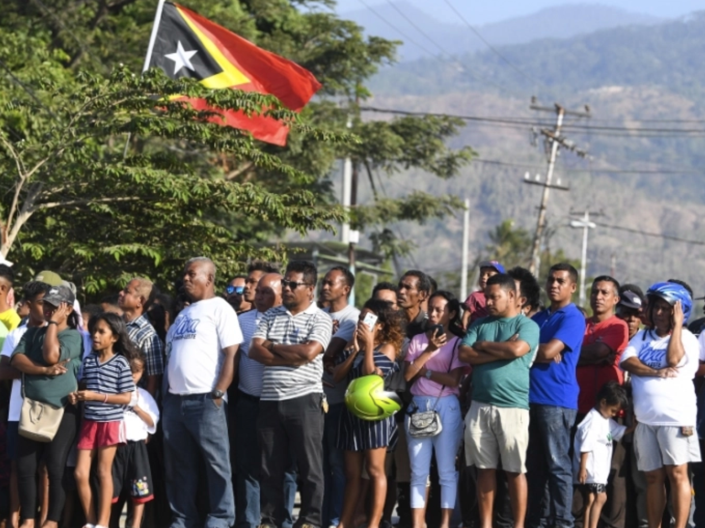
Key Findings
Timor-Leste, formerly East Timor, was invaded and occupied by Indonesia from 1975-1999. During this time, one-fifth of the population died due to fighting, massacres, and forced starvation. Violence committed by the Indonesian military and anti-independence militias erupted again in 1999 before and after a referendum to decide the status of East Timor. Up to 2,600 died, up to 25% of the population fled their homes, and much of the country's infrastructure was destroyed. Though courts and truth commissions were established, no higher-level Indonesian officials were ever brought to justice.

Slide 2
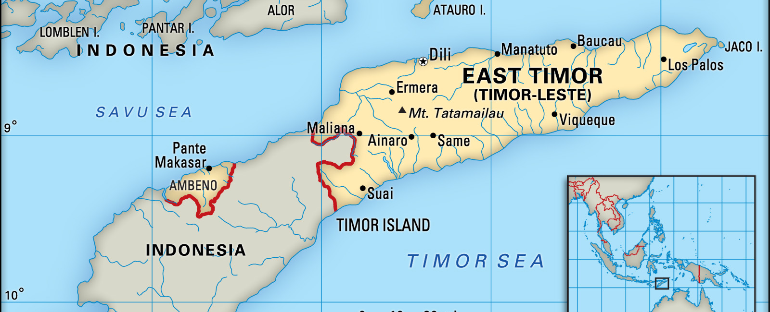
Country Profile
1749: Timor split following battle between the Portuguese and Dutch. Portuguese take the eastern half.
1942: Japanese invade, fighting battles with Australian troops. Up to 60,00 East Timorese are killed. Japan in control until 1945.
1975: After a brief civil war, Fretilin (Revolutionary Front for an Independent East Timor) declares East Timor independent.
1975: Indonesia invades, using its fight against communism as a pretext. It annexes territory as its 27th province, a move not recognized by the U.N.
1998: Indonesian President Suharto resigns. Replaced by Bacharuddin Jusuf
1999: Result of the referendum shows 78% of voters favored independence. Violence erupts as anti-independence militia helped by the Indonesian military resume campaign of terror, leaving up to 1,000 dead. Australian-led peacekeeping force arrives, gradually restores order. Indonesian parliament recognizes the outcome of the referendum.
2002: Truth and reconciliation commission opens to try and heal wounds of past.

Slide 3

Ten Stages of Genocide
Dr. Gregory Stanton, Founding President of Genocide Watch, uses the Ten Stages of Genocide to describe and explain the genocidal process. The stages are:
1. Classification
2. Symbolization
3. Discrimination
4. Dehumanization
5. Organization
6. Polarization
7. Preparation
8. Persecution
9. Extermination
10. Denial
East Timor reached all 10 stages of genocide during and after the Indonesian occupation.

Slide 4
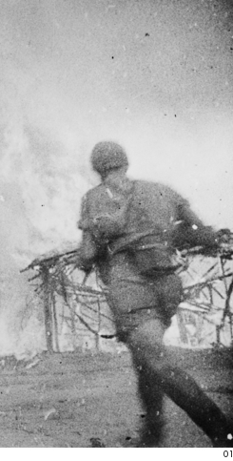
Japanese Occupation during WWII
Feb 1942 to Dec 31, 1945
Despite Portugal's neutrality in World War II, Australia and the Netherlands sent troops to East Timor ten days after the Pearl Harbor attacks. Japan still bombed and invaded Dili in February 1942. The Allies began a bombing campaign that mostly destroyed important infrastructure and killed East Timorese civilians. By December 1942, Australian troops evacuated.
The Allies continued to bomb East Timor during the Japanese occupation, resulting in the destruction of 90% of the country's buildings. An estimated 45,000-70,000 East Timorese, or 10-15% of the pre-war population, were killed during the occupation.

Slide 5
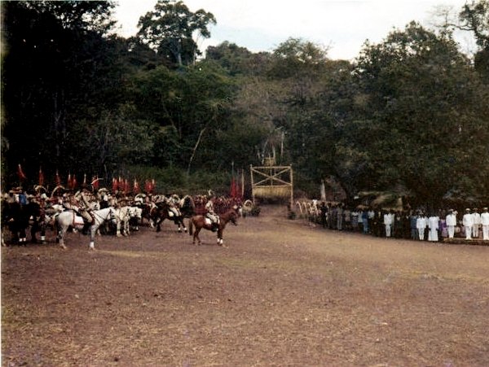
Decolonization
1974
East Timorese civilians were first able to form political parties following the Carnation Revolution in April 1974, which overthrew Portuguese Prime Minister Marcelo Caetano. Portugal officially began the process of decolonization in 1975.
Ahead of elections, the two biggest political parties, the Revolutionary Front for an Independent East Timor (Fretilin) and the Timorese Democratic Union (UDT), formed a
short-lived coalition. The break-up of the coalition resulted in a brief civil war and ultimately Indonesia's invasion and occupation.

Slide 6


Civil War Between Fretilin and UDT
Aug 1975 to Nov 28, 1975
The Indonesian government saw the Fretilin-UDT alliance as a threat to its ambitions of having sovereignty over East Timor. Its intelligence services worked to undermine the alliance. They told UDT leaders that Indonesia would not accept an East Timorese government that included Fretilin leaders and that Indonesia would invade if UDT didn't unilaterally take control of the country.
On August 11, 1975, UDT leaders began their coup by seizing weapons from the police. Fretilin responded quickly by rallying East Timorese soldiers to form the Armed Forces for the Liberation of East Timor (FALANTIL). Fretilin controlled most of East Timor by mid-September and declared independence on November 28, 1975, effectively ending the civil war.
Approximately 1,500-3,000 people died and 10,000 fled to West Timor during the civil war. Many of those who fled were taken hostage by the Indonesian military.

Slide 7
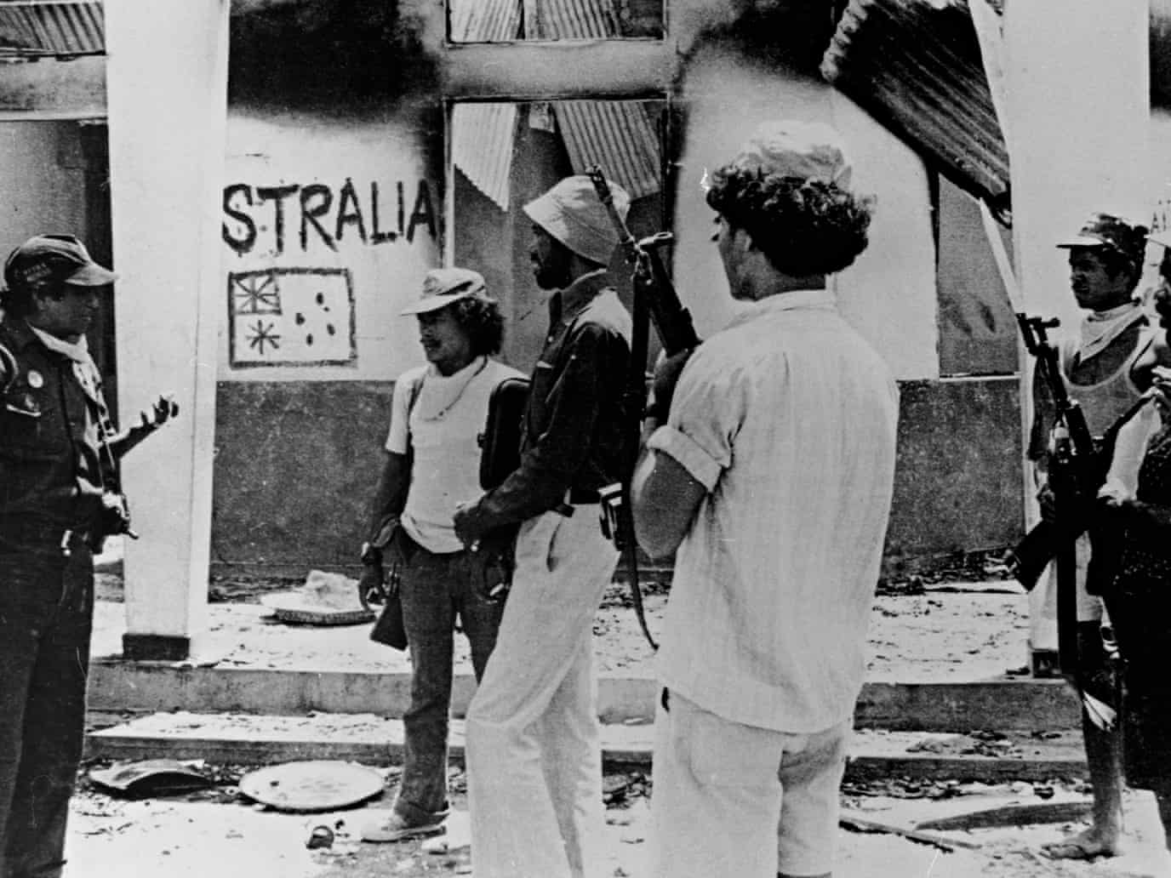
Balibo Five Murdered
Oct 6, 1975
Five Australian journalists, Greg Shackleton, Malcolm Rennie, Brian Peters, Gary Cunningham, and Tony Stewart were executed by Indonesian soldiers in Balibo, East Timor. They were attempting to report on the beginning of Indonesia's invasion of East Timor, which the Indonesian government was denying at the time. On December 8th, another journalist, Roger East, was executed by Indonesian soldiers while investigating the deaths of the 'Balibo Five.’
Indonesia denied responsibility for the murders, claiming they were accidentally killed in crossfire. Though Australia eventually opened a war crimes investigation, the killers were never brought to justice.

Slide 8
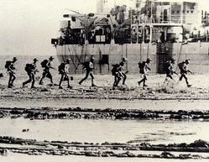
Indonesian Invasion
Dec 7, 1975
The Indonesian military began attacks on East Timor from its border with West Timor in late September 1975. As these attacks intensified, Fretilin requested a peacekeeping force from the U.N. in late November, but the request was not met. Indonesia's General Suharto had the support of U.S. President Gerald Ford with his claim that Fretilin was a communist party and that the region would destabilize if Fretilin formed a government.
Indonesia launched a full-scale invasion in December 1975 and attacked Dili with 20 warships, 13 aircraft, and 10,000 soldiers. At least 2,000 people were killed in the first days of the invasion. Fretilin leaders and their families were targeted for execution. Others faced indiscriminate killing, rape, torture, and public executions.

Slide 9

U.N. General Assembly Resolution on Timor
Dec 12, 1975
The U.N. General Assembly passed a resolution that strongly deplored the "military intervention of the armed forces of Indonesia in Portuguese Timor" and called upon "the government of Indonesia to desist from further violation of the territorial integrity of Portuguese Timor and to withdraw without delay its armed forces from the territory in order to enable the people of the territory freely to exercise their right to self-determination and independence."
While the Security Council unanimously adopted this resolution on December 22, the U.N. and international community took no action to support East Timor.

Slide 10
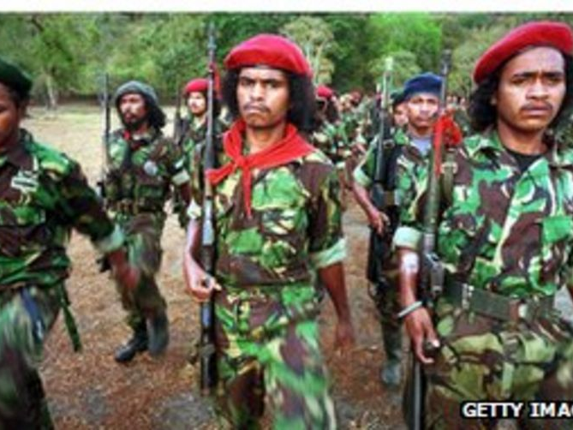
Summary of Resistance in 1976
By the end of 1967, Indonesia controlled Dili, East Timor's capital. In fact, Indonesia declared East Timor to be its 27th province in July.
The majority of the East Timorese population fled into the mountains. They organized their own farming, education, and health care programs. Fretilin formed an armed wing, Falintil. which conducted guerilla-style resistance to Indonesian occupation.

Slide 11
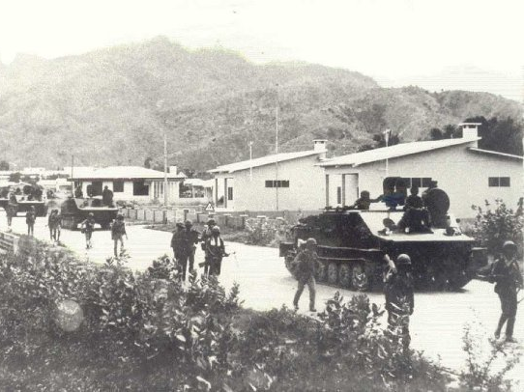
Summary of Resistance in 1977-1979
In the first years of Indonesia's occupation, 100,000 East Timorese civilians died. Many were killed directly by the military, while others died by famine caused by the systematic destruction of livestock and food supplies.
After building up troops and acquiring military equipment from the United States and the United Kingdom, Indonesia launched an intensified military offensive in September 1977 to takedown Fretilin strongholds. In late 1978, Indonesia defeated the last Fretilin base at Mount Matebian. In March 1979, the intensified military offensive was ended. Indonesian announced that its military had "pacified" East Timor.
Though Fretilin/Falintil continued to conduct guerilla-style resistance throughout Indonesia's occupation, a number of leaders were captured or killed, 80% of its soldiers were killed, and 90% of its equipment was confiscated or destroyed.

Slide 12
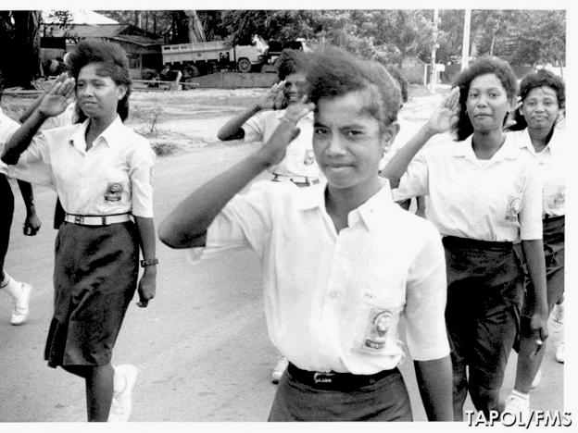
Summary of Resistance in the 1980s
Despite the disproportionate strength of Indonesia's military, Falantil continued to operate as a mobile guerilla throughout the 1980s. With this new style of combat, a pattern emerged in which Falantil would attack Indonesian military targets and the Indonesian army would respond by indiscriminately attacking both combatants and non-combatants. Another strategy used by the Indonesian army was the "fence of legs" tactic in 1981, in which a human chain made up of conscripted civilians marched across the island in an attempt to push resistance militants out of hiding.
Though conditions improved in general in the 1980s, especially due to reduced violence and the delivery of humanitarian aid, Indonesian officials benefited more than the locals. The East Timorese suffered from high unemployment and deteriorating culture.
In May 1993, Indonesia and the East Timorese resistance negotiated a brief ceasefire for the visit of the Australian Defense Minister. Following the visit, which resulted in a report that reflected positively about the Indonesian government's actions, Indonesia unilaterally broke the ceasefire as part of 'Operation Clean-Sweep. The Kraras Massacre, in which over 200 people were executed, was part of this operation.
The imbalance of military strength led some to begin focusing on international diplomacy as a means of resistance.

Slide 13
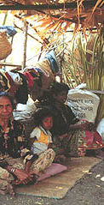
Refugee Camps
Dec 1975 to Jan 1, 2003
In 1978, 372,900 East Timorese, or 60% of the population, were held in 150 internment camps run by the Indonesian military. They were given very little land to cultivate, which created devastating famines in 1978-1980, 1981-1982, 1984, and 1987. The Truth Commission report concluded that the Indonesian military deliberately starved those in the camps.
Following the referendum, more than 249,000 refugees who fled the violence in East Timor were forced into camps in West Timor controlled by pro-Indonesian militias. Most were women, children, and the elderly. Militiamen often came into the camps to seek out supporters of the independence movement. Some refugees were disappeared or killed, while others were forced to join the militias. Because of the harsh conditions, many likened these refugee camps to concentration camps.
Militias continued to exercise control over these camps for two years after the independence referendum, challenging repatriation efforts. By September 2002, 220,000 East Timorese had returned home. On January 1, 2003, East Timorese were no longer considered refugees.

Slide 14
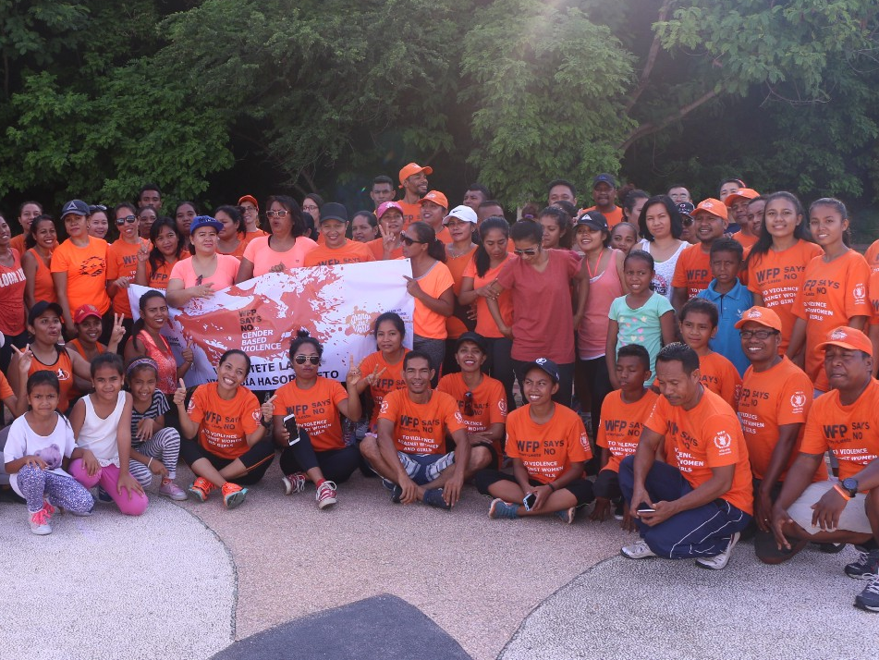
Gender-Based Violence
The Indonesian army and pro-Indonesia militias systematically raped women and forced them into sexual slavery. Some collaborated "'to abduct women or share them like chattel, or in some cases forcibly taking women across the border into West Timor where the women were raped daily and made to perform household chores.'' Some mass rapes coincided with massacres, particularly in April, May, and September 1999. Many women chose to remain silent even after the referendum violence ended due to the stigma associated with victims of sexual violence in East Timor.
In the 1980s, Indonesia began implementing a "family planning" policy in East Timor which entailed widespread sterilization of women, such as through the Depo-Provera shot. The systematic sterilization continued into the 1990s.

Slide 15
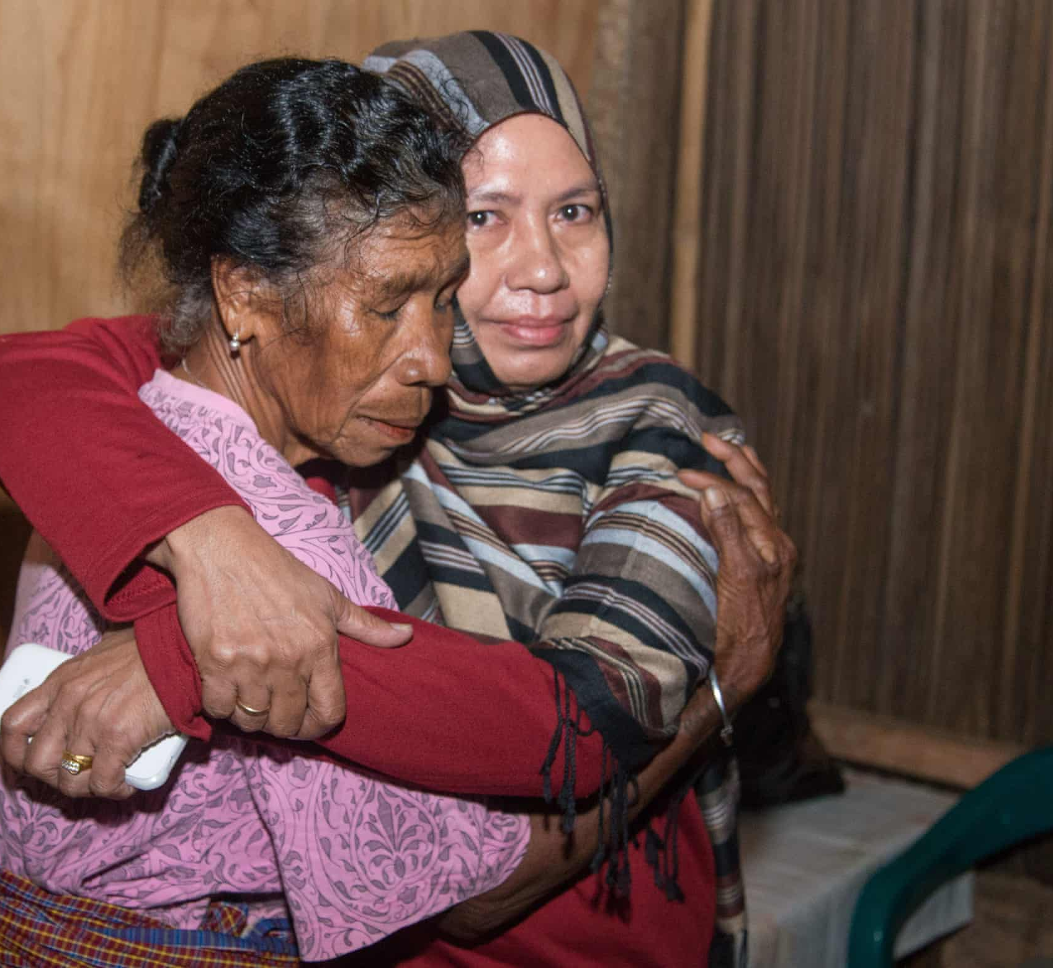
East Timorese Children Abducted
According to East Timor's truth commission, 4,000 children were abducted by Indonesian soldiers during Indonesia's occupation. It is believed that the true number of abducted children is higher, as thousands likely didn't survive.
Children were first taken to serve as guides and to transport supplies. Later in the occupation, children were abducted as part of a state-sponsored mission to "educate and civilize." Though some were fully adopted into Indonesian families and treated well, others faced physical and sexual abuse.

Slide 16
U.N. Resolution for East Timor Independence
Nov 24, 1981
The U.N. General Assembly passed a resolution advocating for East Timorese independence. U.N. talks between Indonesia and Portugal began the following year to attempt to resolve East Timor's status, but not much was accomplished. East Timor remained a low priority in the international community until the 1990s

Slide 17
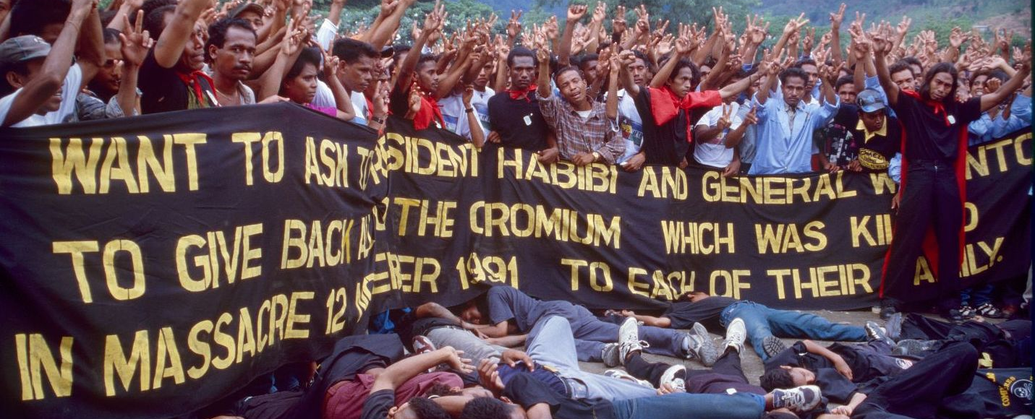
Santa Cruz Cemetery Massacre
Nov 12, 1991
A funeral for a young separatist at Santa Cruz cemetery in Dili brought together 3,500 protestors. Members of the Indonesian army were filmed firing into the crowd, which prompted international outrage and the US to freeze military assistance to Indonesia. This forced General Suharto established a commission of inquiry into the massacre. However, the commission only reported a death toll of 50, while human rights organizations listed 271 dead, 382 wounded, and 250 missing.

Slide 18
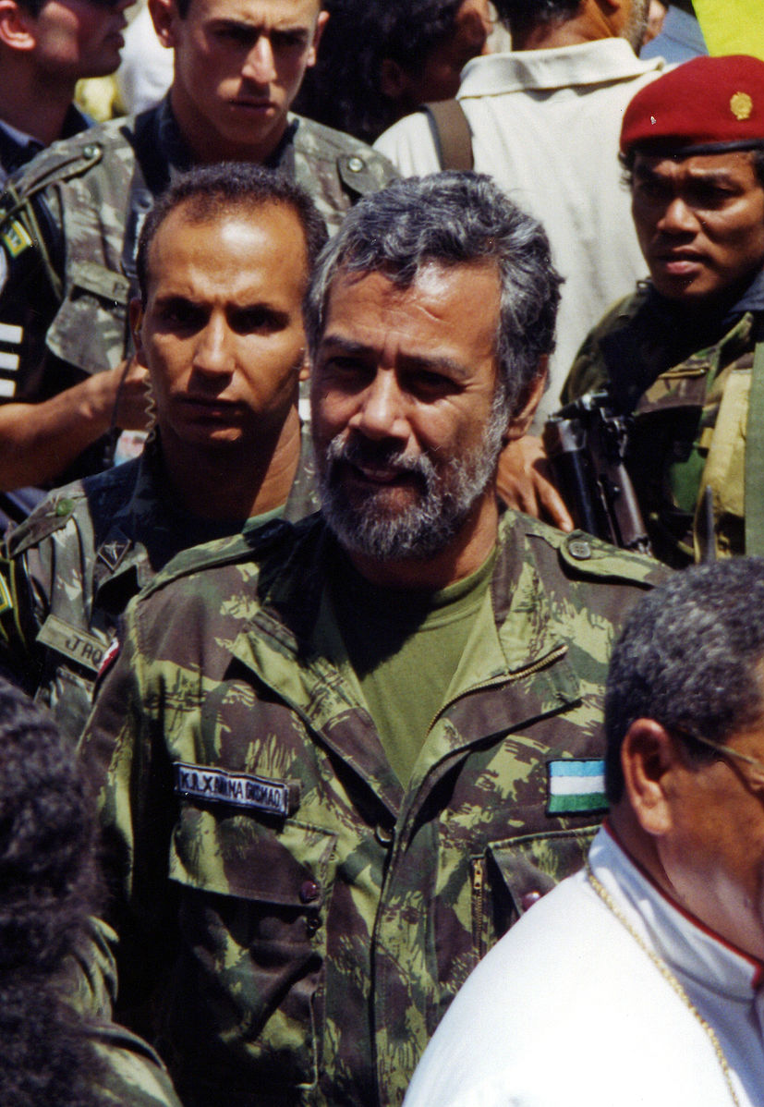
Xanana Gusmão Captured
Nov 20, 1992 to Feb 1999
Xanana Gusmão, leader of Falintil, was captured by the Indonesian military. He was sentenced to life in prison for plotting against the Indonesian government and for illegal possession of firearms, though the sentence was later reduced to 20 years. He managed to continue to provide leadership to the resistance while in prison. Gusmão was released to house arrest as part of a settlement in March 1999.

Slide 19
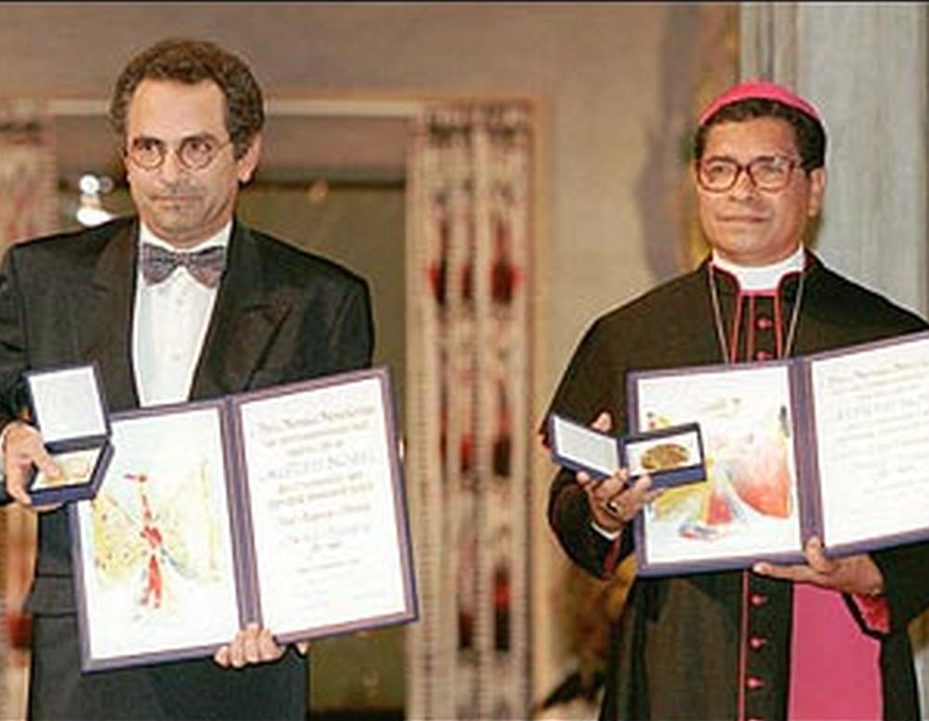
Bishop Belo and Jose Ramos-Horta win Nobel Price
1996
Bishop Carlos Ximenes Belo and Jose Ramos-Horta won the Nobel Peace Prize for their work in calling international attention to Indonesia's actions in East Timor. The Nobel Committee explicitly derided the Indonesian government's occupation of East Timor.

Slide 20
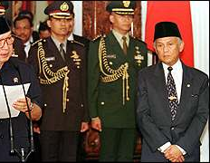
President Suharto resigns
May 21, 1998
Following domestic and international pressure due to political and economic crises, Indonesian President Suharto resigned. Vice President B.J. Habibie was sworn in as president.

Slide 21
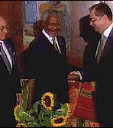
Indonesia and Portugal Discuss East Timor Autonomy
Aug 4, 1998 to Aug 5, 1998
Indonesia and Portugal resumed talks about the status of East Timor and came to a breakthrough preliminary agreement. This was the first time both countries recognized the need for the participation of East Timorese representatives in these discussions. Indonesia also pulled some troops out of East Timor following the talk.

Slide 22
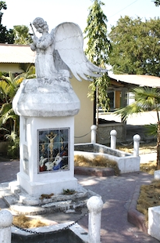
Liquiçá Church Massacre
Apr 6, 1999
Paramilitary troops attacked a church in Liquiçá where 2,000 civilians had taken refuge following several days of violence in the pro-independence town. At least 100 civilians were killed, though police only reported 5 dead.
Priests, nuns, and other church workers were often the subjects of violence because the Indonesian government presumed that they were pro-independence.

Slide 23
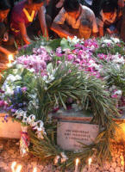
Carrascalão's House Massacre
Apr 17, 1999
The home of Manuel Carrascalão, a prominent leader of the independence movement, was attacked by pro-Indonesian militias, killing at least 19 people. Carrascalão was sheltering around 150 refugees in his home at the time.
The massacre was preceded by a massive rally of militiamen, which was also attended by several senior government officials. Eurico Guterres, leader of the Aitarak militia, directly incited violence in his speech: "I command all pro-integration militia to conduct a cleansing of all those who have betrayed integration. Capture and kill them, if you need.”
Following the rally, militias went on a rampage through Dili, culminating in the massacre at Manuel Carrascalão's home. TNI soldiers are also believed to have participated.

Slide 24
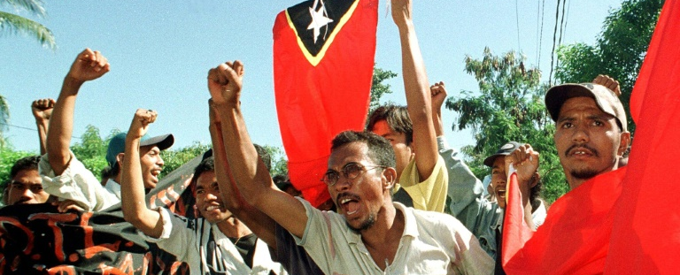
May 1999 Agreement
May 5, 1999
Talks between Portugal and Indonesia stalled for two decades due to disagreement over holding a referendum to decide the status of East Timor. With the resignation of Indonesian President Suharto in May 1998, this changed as President BJ Habibie was more willing to negotiate.
On May 5, Portugal and Indonesia signed an agreement to hold a referendum to allow East Timorese to decide whether they preferred to have special autonomy within Indonesia or to become fully independent. The U.N. agreed to facilitate and monitor the referendum.

Slide 25
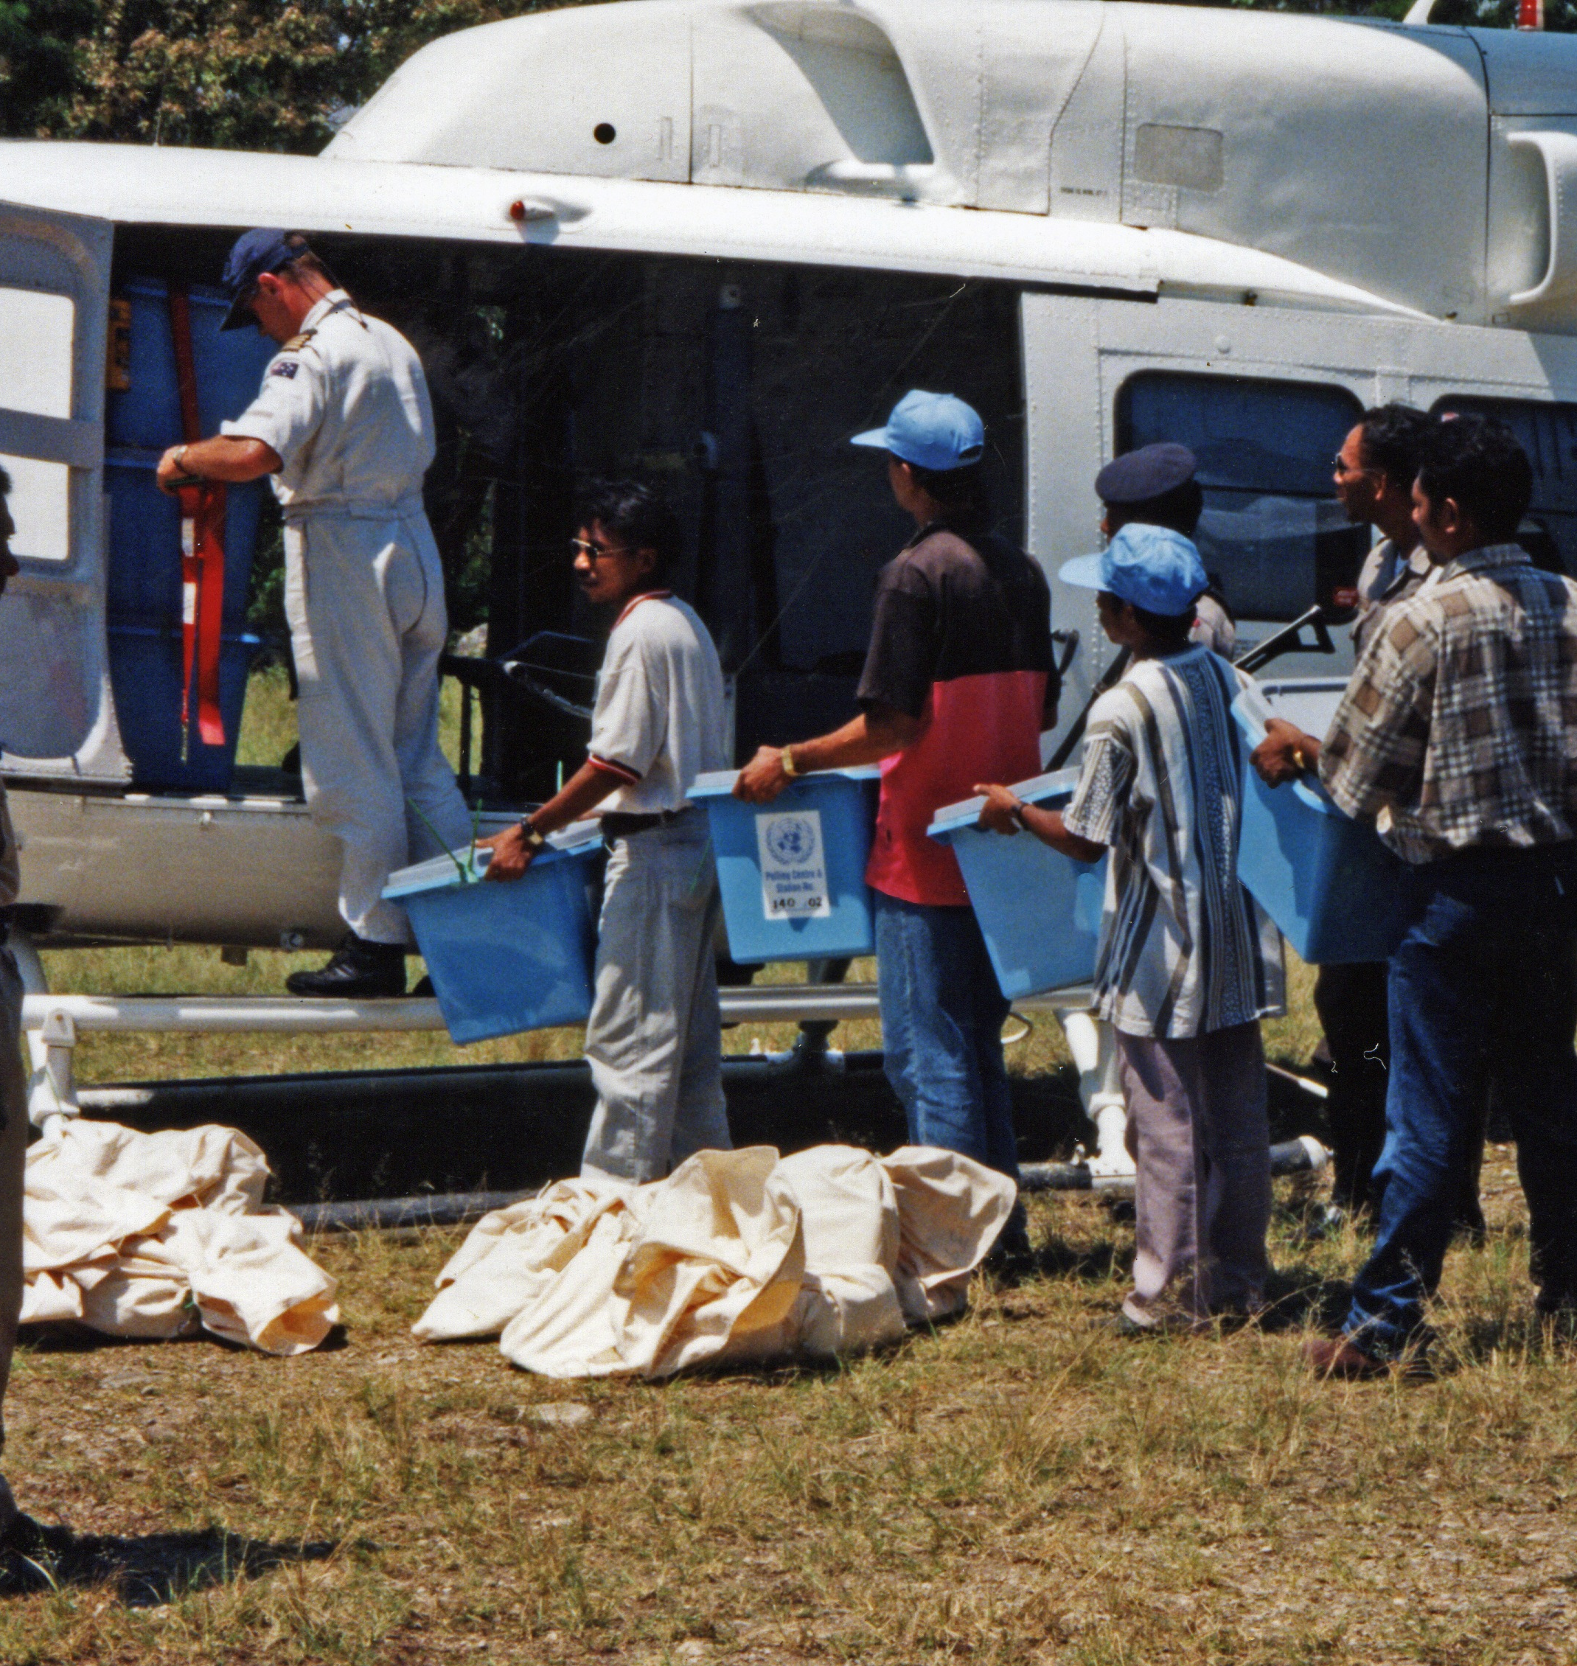
UNAMET
Jun 11, 1999 to Nov 30, 1999
The United Nations Mission in East Timor was established as a political mission to administer the referendum to decide the status of East Timor. Its responsibilities included registering eligible voters, monitoring security conditions to ensure voters and staff were protected with the assistance of Indonesian authorities, running the election sites, and verifying the outcome. UNAMET staff and offices were threatened and attacked by militias before and after the election.

Slide 26
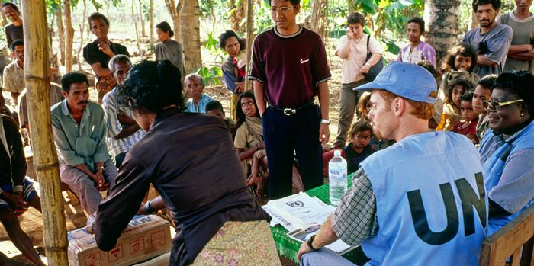
Referendum for Independence
Aug 30, 1999 to Sep 4, 1999
The United Nations oversaw a referendum for East Timorese independence. An impressive 98% of the population turned out, and 78.5% voted for independence. This triggered a massive wave of violence by Indonesian-backed militias.

Slide 27
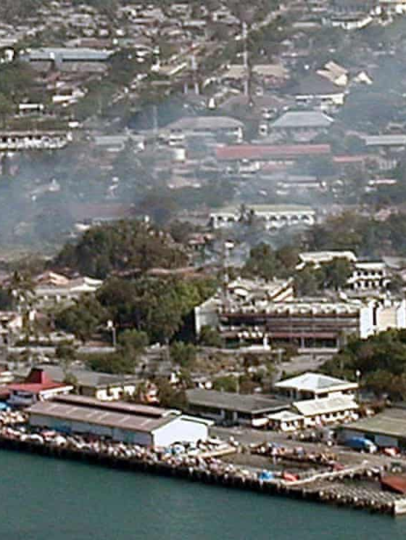
Violence Following Referendum
Sep 1, 1999 to Oct 1999
Even before the results of the referendum were announced on September 4th, the Indonesian army and Indonesian-backed militias began conducting summary executions and destroying public buildings, as well as the archives that held the evidence of the abuses inflicted by Indonesia. This systematically planned violence displaced 300,000 East Timorese to West Timor and internally displaced hundreds of thousands of others to the mountains. More than 1400 people were killed during this outbreak of violence.
By September 10th, President bill Clinton called out the Indonesian government's complicity in the violence. On September 12th, Indonesian President Habibie agreed to allow an international peacekeeping force. INTERFET arrived in East Timor on September 20th and secured the country by the end of October.

Slide 28
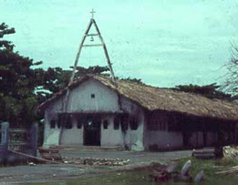
Suai Church Massacre
Sep 6, 1999
A Pro-Indonesian militia attacked a group of pro-independence civilians with machetes, assault rifles, and hand grenades. They raped dozens of women and killed more than 100 people.
When investigators from the Australian army arrived, they found that most victims' bodies had been hidden or burned by the militia.

Slide 29
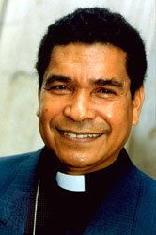
Attack on Bishop Belo's house
Sep 6, 1999
5,000 internally displaced persons (IDPs) were seeking shelter in the home of Bishop Belo, a prominent pro-independence activist, in Dili when militiamen and Indonesian soldiers attacked. They forced the IDPs out at gunpoint. At least 39 people were killed and the whereabouts of the others was unknown.
The militiamen also burned down Bishop Belo's house. The bishop fled to Australia immediately following the attack.

Slide 30
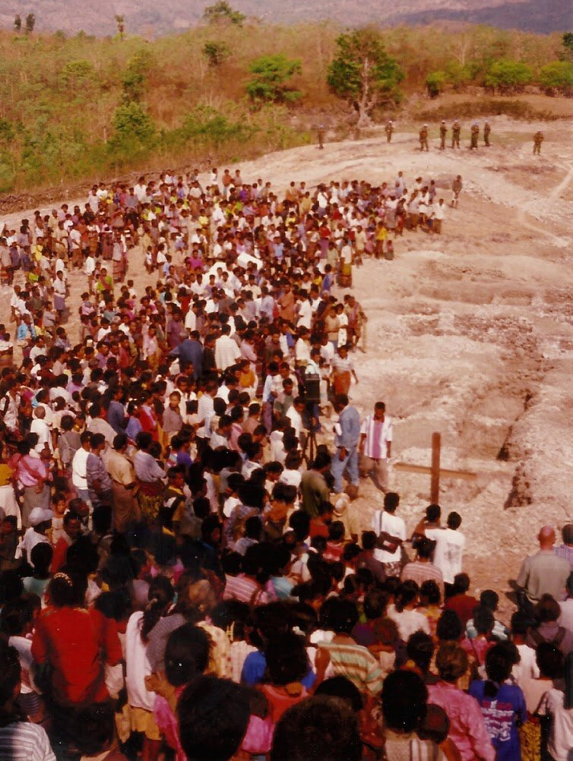
Passabe Massacre
Sep 9, 1999
In one of the worst post-referendum massacres, pro-Indonesian militias murdered around 75 men for allegedly being pro-independence.

Slide 31
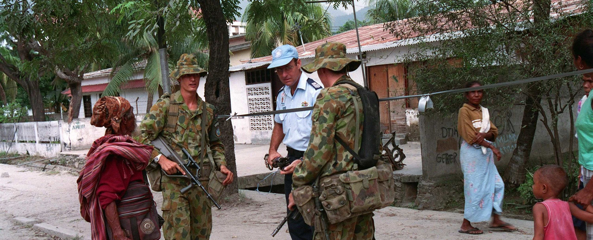
INTERFET Arrival in Dili
Sep 20, 1999 to Feb 28, 2000
The Australian-led International Force East Timor (INTERFET) arrived in Dili after being approved by Indonesian President Habibie on October 12th. INTERFET secured the country by early October. Extensive damage was done to vital infrastructure, as well as tows and villages. As much as 80% of the country's buildings were destroyed.
At the end of February 2000, INTERFET passed control of military operations onto UNTAET.

Slide 32
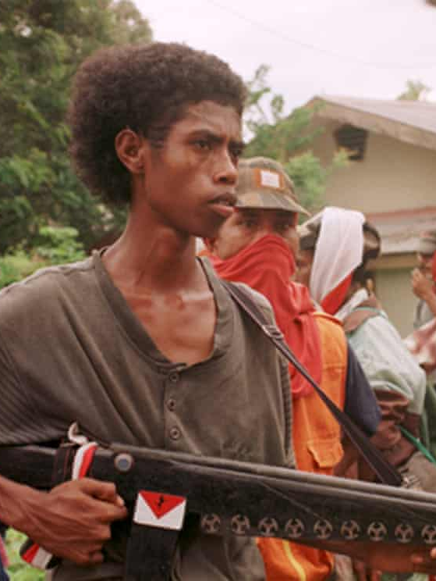
US Complicity
From 1975-1999, the US provided 90% of Indonesia's military equipment. The US even doubled its military aid following Indonesia's invasion and occupation of East Timor. The US wasn't inclined to intervene in the illegal occupation because Indonesia claimed it was fighting the spread of communism. Though the US froze military assistance to Indonesia after the Santa Cruz Cemetery Massacre, US special forces continued to train Indonesian soldiers.
Declassified documents revealed that the US knew early on about plans between the Indonesian military and pro-Indonesian militias to commit mass violence to combat the independence movement. Despite this knowledge, the US didn't fully suspend its military relationship with Indonesia until September 9, 1999.
This complicity led many pro-independence activists to wonder why the US and other countries who were complicit in the atrocities committed by Indonesia were taking prominent roles in monitoring and administering the referendum.

Slide 33
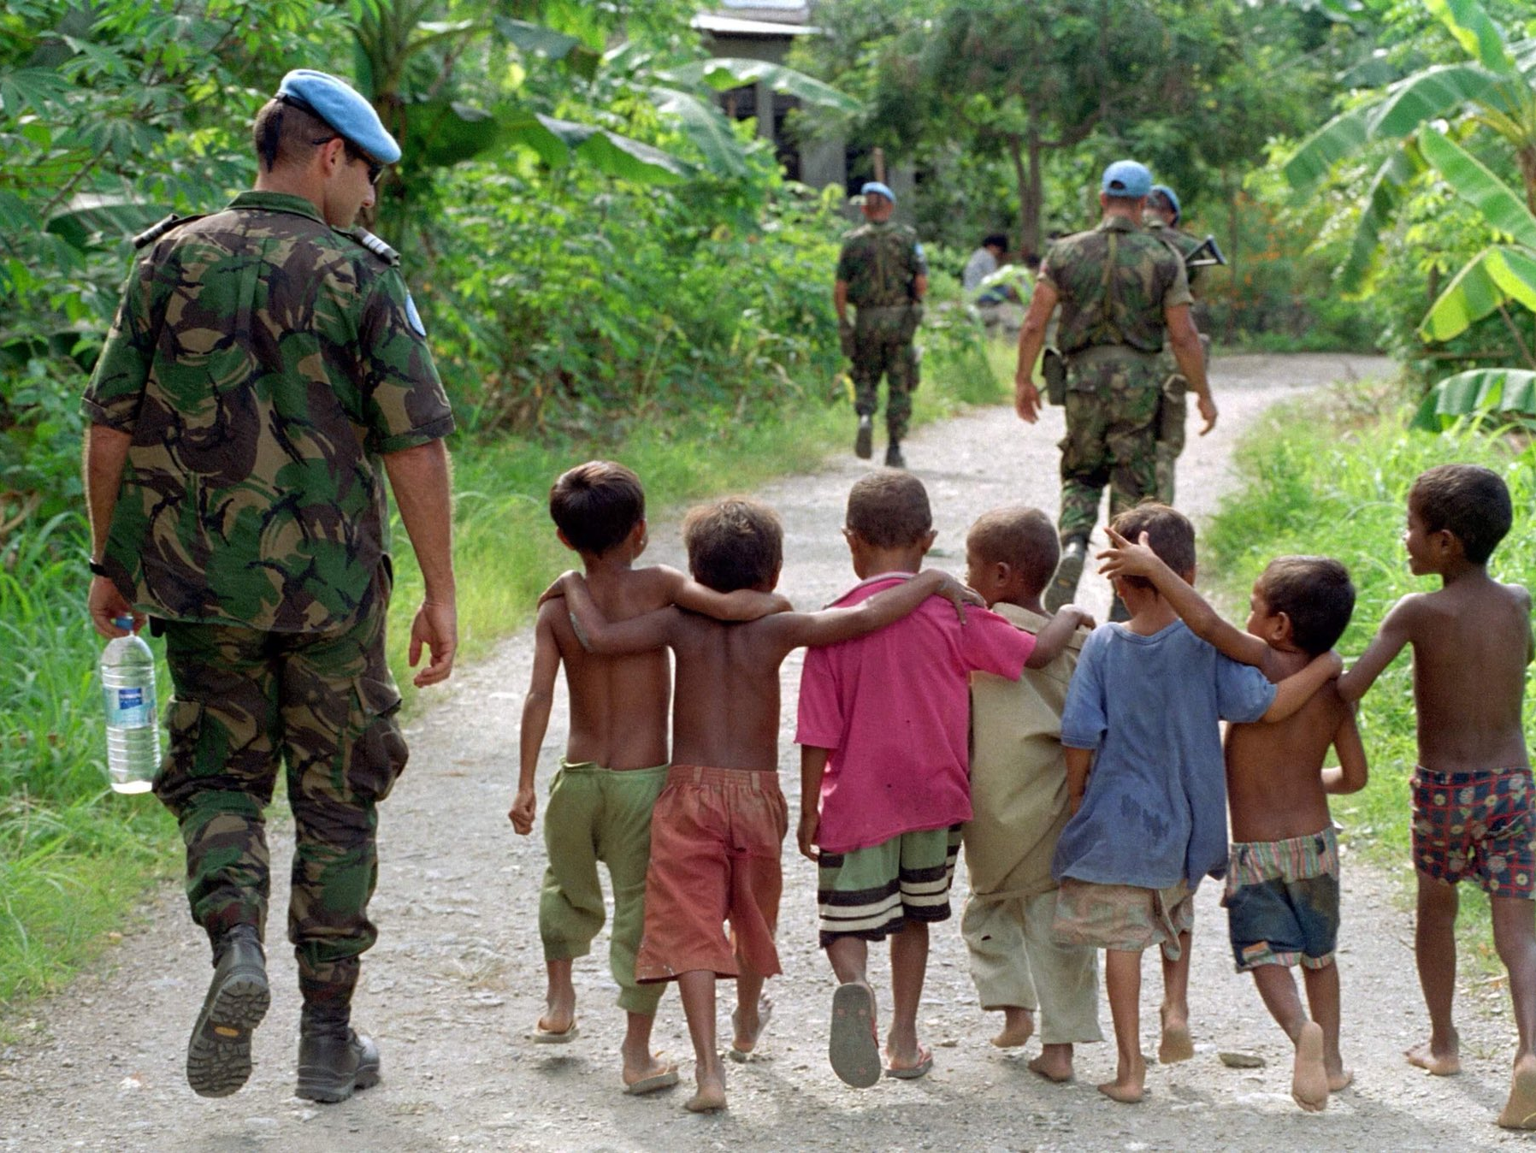
UNTAET
Oct 25, 1999 to May 20, 2002
The United Nations Transitional Administration in East Timor was a peacekeeping operation meant to facilitate East Timor's transition to independence. Its mission included three components: (1) governance and public administration; (2) humanitarian assistance and emergency rehabilitation; and (3) military security. In order to accomplish these goals, the National Consultative Council (NCC), made up of eleven East Timorese representatives and four UNTAET representatives, was created to consult on several policy needs, including but not limited to creating a legal system, re-establishing a judiciary, implementing an official currency, and creating a national budget.
The UNTAET mandate ended following the first successful elections in 2002 in which Xanana Gusmão was elected president.

Slide 34
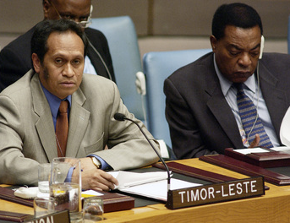
UNMISET
May 17, 2002 to May 20, 2005
The United Nations Mission of Support in East Timor supported the political stability of the newly independent East Timorese government. Over time, it gradually handed executive control of security efforts over to the East Timorese government.

Slide 35
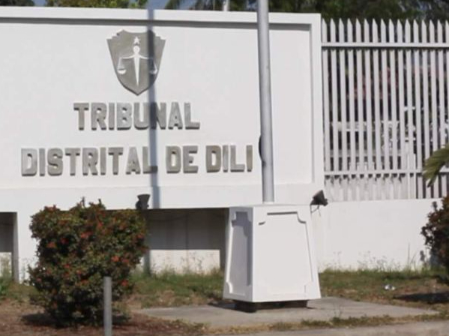
Special Panels
2000 to 2005
The Special Panels for Serious Crimes were created by the UNTAET in order to investigate and prosecute the following crimes that were committed in East Timor by/against East Timorese citizens: genocide, war crimes, crimes against humanity, murder, sexual offenses, and torture. Though the panels issued nearly 400 indictments, it only held only 55 trials for a total of 84 individuals because Indonesia refused to cooperate with investigators and to extradite those indicted.
The panels faced significant challenges, especially due to its lack of funding.

Slide 36

CAVR
2000 to 2005
The Commission for Reception, Truth, and Reconciliation was created under UNTAET with the mandate "to establish the truth about the human rights violations which occurred in Timor-Leste" between April 1974-October 1999.
The report found that the human rights violations suffered by the East Timorese included violation of their rights to self-determination, unlawful killings, forced disappearances, forced displacement, famine, detention, torture, violations of the laws of war, political trials, sexual violations, violations of the rights of the child, and violations of economic and social rights. It also found the Indonesian government and military to be responsible for most of the East Timorese deaths during its occupation.

Slide 37
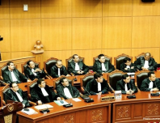
Ad Hoc Court of East Timor
Aug 2001 to May 2004
Unwilling to cooperate with an international tribunal, Indonesia established an Ad Hoc Court to bring to justice the perpetrators of the violence in 1999. Its jurisdiction was limited to crimes committed by Indonesian citizens from April-September 1999 in only three of East Timor's thirteen districts.
Of the twelve trials that took place, ten ended in acquittals despite the strong evidence against them. The only two individuals convicted were East Timorese.
The Ad Hoc Court was highly scrutinized for a number of failures. In general, it seemed unwilling to go after high-ranking Indonesian officials. The limited scope of the court made it difficult to convict on crimes against humanity due to the need for evidence of a widespread or systematic attack. Witnesses also faced threats and intimidation without adequate protection.

Slide 38

CTF
2005 to 2008
Indonesia–Timor Leste Commission of Truth and Friendship was tasked with finding the "conclusive truth" about who was responsible for the outbreak of violence in 1999 in East Timor. It was highly criticized by the international community due to its focus on amnesty and its flawed public hearings, among other issues. The UN refused to participate entirely.
Despite its flaws, the CTF did have important findings, including that the crimes committed by the Indonesian military, police, and civilian officials were the result of established policies and practices rather than an abnormality.

Slide 39
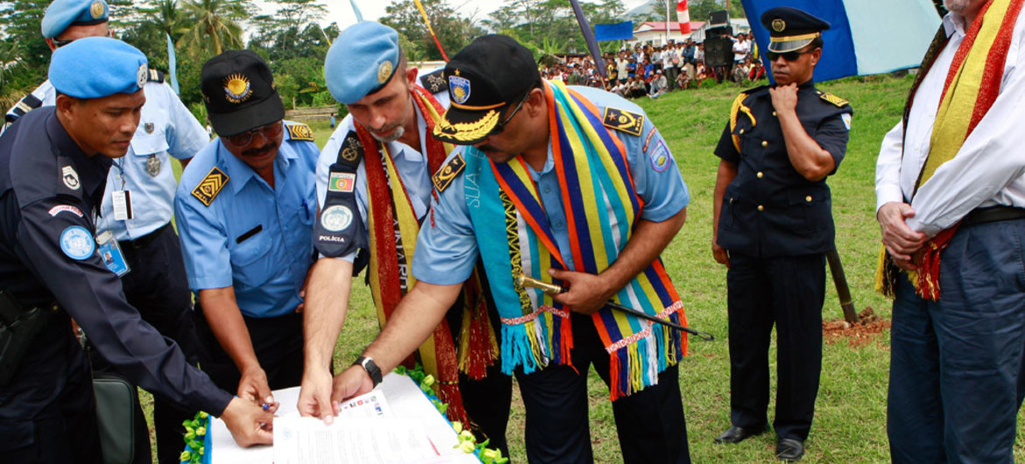
End of Peacekeeping Missions
Dec 31, 2012
The United Nations began the withdrawal of its peacekeeping forces in October 2012. The 2012 elections were peaceful, but some were concerned about the sustainability of East Timor's economy and institutions. U.N. peacekeepers fully pulled out of East Timor on December 31.

Slide 40
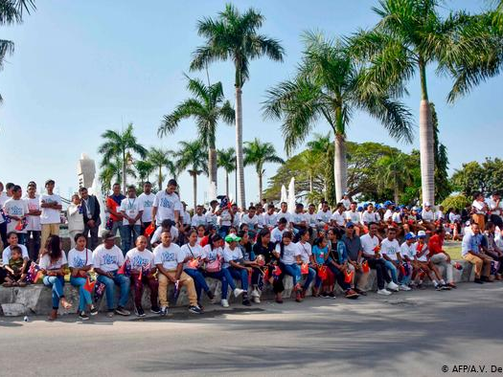
Conclusion
East Timor has continued to experience periodic violence and instability in the post-independence era, which has sometimes required intervention by the UN. Despite clear and strong evidence of crimes against humanity and acts of genocide against the East Timorese, many of the perpetrators have yet to be brought to justice. This is especially true of high-ranking Indonesian military leaders, many of whom still hold influential positions. The Indonesian government continues to resist cooperating with investigations and prosecutions.

